Slide 1

Aleksandra Romanowski, 8721181
Anushka D’souza, 8527542
Christopher Schofield, 8720798
Isabelle St-Jean, 8641570
Martin Zhao, 8615411
AdMarketing

Slide 2

Success isn’t about how much MONEY you make, it’s about the DIFFERENCE you make in people’s lives
~Michelle Obama

Slide 3

Agenda
Problem
Implications
Alternatives
Recommendation
Implementation
Notes:
https://www.google.ca/search?biw=1600&bih=764&tbm=isch&sa=1&q=agenda&oq=agenda&gs_l=img.3...17528.1875268.0.1876514.0.0.0.0.0.0.0.0..0.0....0...1c.1.64.img..0.0.0.RxgaxktviOk#imgrc=kY-RZ2pQHyp0kM%3A

Slide 4
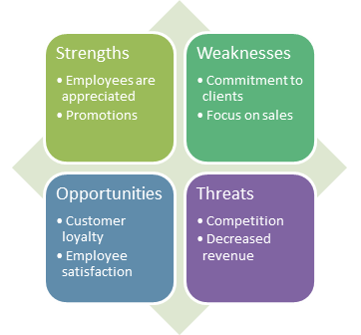
Analysis

Slide 5

Satellite Problems
Customer dissatisfaction
Loss of revenue
Loss of value behind informal meetings

Slide 6

Primary Problem
Through the current performance appraisal system, AdMarketing is placing too much focus on sales rather than customer service

Slide 7

Implications on Organization
Gaining a poor public image
Repelling potential investors
Other companies gaining competitive advantage

Slide 8

Implications on Personnel
Limiting potential employees
Informal meetings seen as unimportant
Negligence of CSR

Slide 9

Alternatives
Graphic Rating Scale
Behaviourally anchored rating scale
Critical incidence technique
360 degree feedback

Slide 10

Graphic Rating Scale
Vital traits are rated from 1-5
A total score
Overall employee performance

Slide 11

Behaviourally Anchored Rating Scale
Assigns numerical rankings to different employee behaviours to determine the effectiveness of each

Slide 12

Critical Incidence Technique
A performance appraisal method that keeps a record of one’s effective and ineffective behavior.

Slide 13
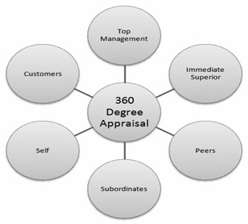
360 Degree Feedback
Uses Feedback from
→ Managers
→ Peers
→ Subordinates
→ Customers

Slide 14

Recommended solution
360 Degree Feedback
Addresses issues
Accurate qualitative analysis
Widely successful

Slide 15

Pros and cons
Pros
Market Customer service
Increased knowledge
Friendlier
Eliminates bias
Performance improvements
Cons
Can be complex
Time Consuming
Costly
Reliability of some respondents

Slide 16

Compared to alternatives
More qualitative
Constructive
More feedback than from one person
Precise and reliable

Slide 17

How it solves the problem?
Qualitative performance appraisal
Better customer service
Increased revenue

Slide 18

Implementation
Immediate Term
Short Term
Long Term

Slide 19
Success isn’t about how much MONEY you make, it’s about the DIFFERENCE you make in people’s lives
~Michelle Obama

Slide 20
Aleksandra Romanowski, 8721181
Anushka D’souza, 8527542
Christopher Schofield, 8720798,
Isabelle St-Jean, 8641570
Martin Zhao, 8615411
AdMarketing

Slide 21
Photos
http://www.ikkinkshof.nl/sites/default/files/styles/large/public/360.png?itok=mRrtLMgW
http://www.topendsports.com/head2head/athletes/golf/woods.htm
http://www.javatpoint.com/marketinghr/hr/images/360DegreePerformanceAppraisal.jpg
http://anythingurban.typepad.com/.a/6a011278db110528a40115706048c4970c-pi
https://www.google.ca/search?biw=1600&bih=764&tbm=isch&sa=1&q=agenda&oq=agenda&gs_l=img.3...17528.1875268.0.1876514.0.0.0.0.0.0.0.0..0.0....0...1c.1.64.img..0.0.0.RxgaxktviOk#imgrc=kY-RZ2pQHyp0kM%3A
http://www.videoexcellence.com/b2b-video-marketing-formats-drive-sales/
http://images.clipartpanda.com/satellite-clipart-satellite-clipart-1.jpg
http://static1.squarespace.com/static/5230b4bae4b0bb2fd2e8a288/t/5258ca0be4b0daa056cedad9/1381550604058/Core_Comp-2.png
http://www.topmba.com/mba-programs/one-year-mbas-online-mbas-and-beyond-alternatives-two-year-programs
http://www.employee-performance.com/blog/the-traditional-rating-scale-needs-improvement/
https://www.roberthalf.com.sg/sites/roberthalf.com.sg/files/styles/blog_image/public/employee-performance-appraisal.jpg?itok=T5YUbZrs
http://www.menaitech.com/wp-content/uploads/2016/03/performance-appraisal-system-in-dubai.jpg
http://www.custominsight.com/images/360-superman.png
http://eastonpersonnel.com/yahoo_site_admin/assets/images/group.8094152_std.jpg

