Slide 1
ADM 1300 Section C
Introduction to Business Management Fall 2016
Monday September 12, 2016

Slide 2
The Internal Organization and Management

Slide 3

Stairway Model (HRM)
Success and Sustainability
Organizational Results
HRM Results: Employee Attitudes and Behaviors'
HR Policies
HR Programs
HR Practices

Slide 4
The Management Process
Management is the process of planning, organizing, leading, and controlling the use of resources to accomplish performance goals
All managers are responsible for the four functions
The functions are carried on continually

Slide 5
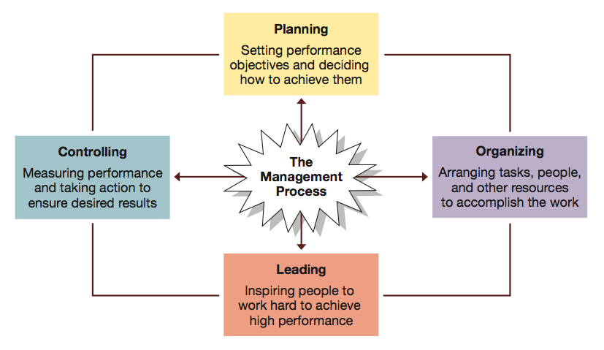
Four Functions of Management Figure 1.10: p. 26

Slide 6
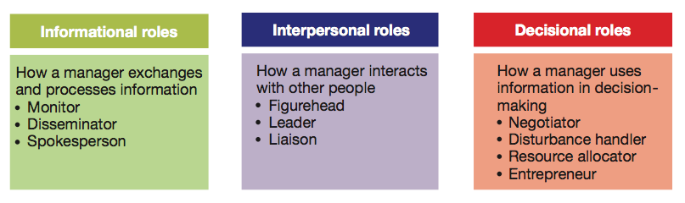
Henry Mintzberg Figure 1.11: p. 29
  Informational: Giving, receiving, and analyzing of information.
  Interpersonal: Interactions with persons inside and outside the work unit.
  Decisional: Using information to make decisions in order to solve problems or address opportunities.

Slide 7
Managerial Agendas
John Kotter studied the behaviour patterns of successful general managers and identified the following categories of behaviour:
  Agenda setting
  Agenda Implementation (Networking and Social Capital)

Slide 8
Agenda Setting
What they wanted to accomplish for the organization
Almost always informal and unwritten and concerned with people issues

Slide 9
Networking
Formal and informal networks of key people inside and outside of the organization
Provided mangers with information and established cooperative relationships relevant to their agendas

Slide 10
Agenda Implementation
Managers:
Use networks to implement their agendas
Employ a wide range of influence tactics
Sustain a high degree of informal interaction and concern with people issues necessary to achieve the goals and successful implementation of their agendas

Slide 11
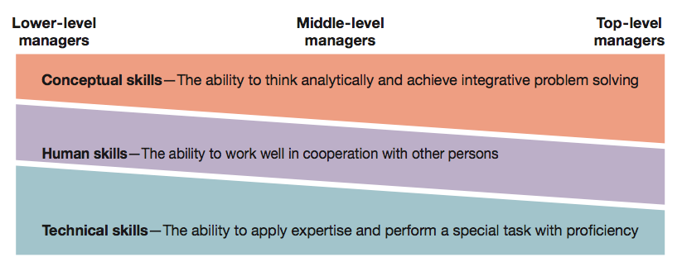
Robert Katz’s Managerial Skills Figure 1.12: p. 30
  The ability to translate knowledge into action that results in desired performance.
  Technical: Applying a special proficiency or expertise to perform particular tasks.
  Human/Interpersonal: Working well in cooperation with others.
  Emotional Intelligence: Managing self and relationships effectively
  Conceptual: Thinking critically and analytically to solve complex problems.

Slide 12
Daniel Pink: Competencies
“High Concept” and “High Touch”
Communication: Sharing ideas and findings
Teamwork: Working effectively
Self-Management: Evaluating and modifying actions

Slide 13
Daniel Pink: More Competencies
Leadership: Influencing and supporting others
Critical Thinking: Gathering and analyzing information
Professionalism: Impression management and career advancement

Slide 14
Managerial Minds
Experienced managers use intuition to guide many of their actions:
  Sensing that a problem exists
  Performing well-learned mental tasks rapidly
  Synthesizing isolated pieces of information and data
  Double checking and performing more formal or mechanical analyses

Slide 15
Managerial Minds
Good intuition is problem identification and problem solving based on a long history of systematic education and experience.

Slide 16
Management: Past to Present

Slide 17

Management: Past to Present
Management: Getting the “right” things done through other people
How has the way we do this, as managers, evolved over time?
“Management thought” started over 100 years ago, and has evolved rather quickly

Slide 18
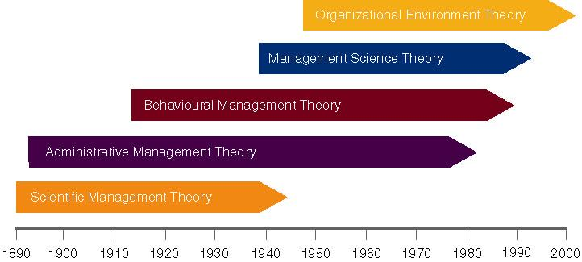
Evolution of Management Theory

Slide 19
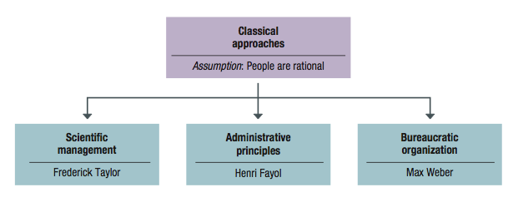
Classical Management Figure 2.1: p. 45

Slide 20
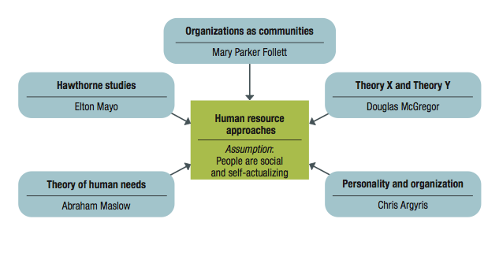
Behavioural Management Figure 2.3: p. 49

