Slide 1
ADM 1300 Section C
Introduction to Business Management Fall 2016
Wednesday September 07, 2016

Slide 2
Business
Business: All profit-seeking activities and enterprises that provide goods and services necessary to an economic system
Profits: Rewards for businesspeople who take the risks involved to offer goods (products) and services

Slide 3
Organizations
  A collection of people working together to achieve a common purpose
  Organizations provide useful goods and/or services that return value to society and satisfy customer needs

Slide 4

Products and Services
Products
PEOPLE
POSSESSIONS
Services Targeting People
Services Targeting Tangibles
Possessions
TANGIBLE ACTIONS
eg: airlines, health, hotels, restaurants, hairdressers, gyms
eg: repair, cleaning, landscaping, retail
Services Targeting Intangibles For People
Services Targeting Intangibles
Possessions
(Information)
INTANGIBLE ACTIONS
eg: radio, consulting,
training, psychotherapy
eg: accounting, banking,
insurance, lawyers

Slide 5
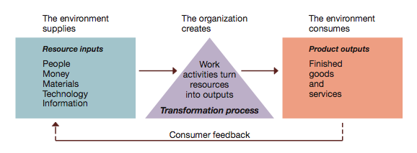
Organizations As Open Systems Figure 1.2: p.13

Slide 6
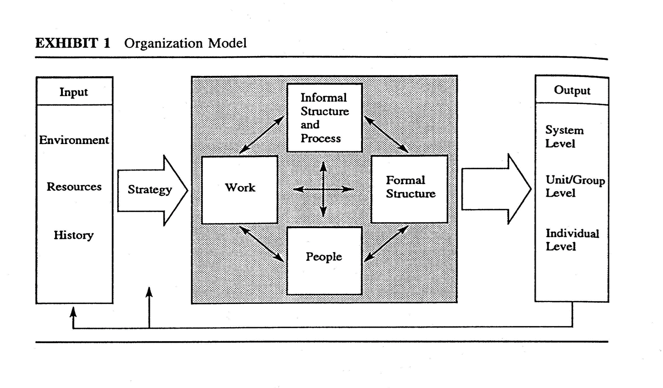
Open Systems View

Slide 7
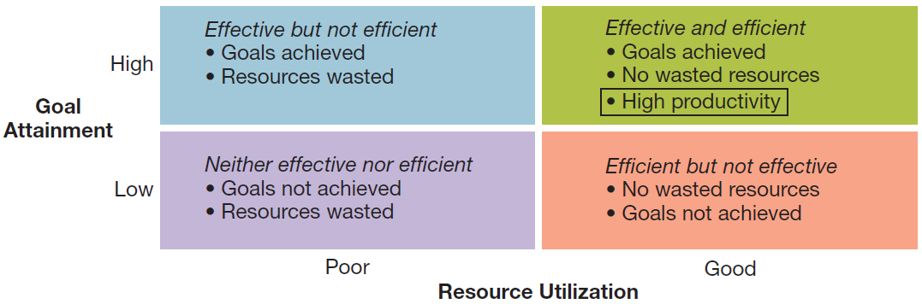
Productivity and Performance Figure 1.3: p. 13

Slide 8
Organizational Environment
  Economic: Health of the Economy
  Legal-political: Norms, Customs, Social Values
  Socio-cultural: Philosophy/Objectives of the Government
  Technological: Development and Availability
  Natural environment: Nature and Conditions of Environment

Slide 9
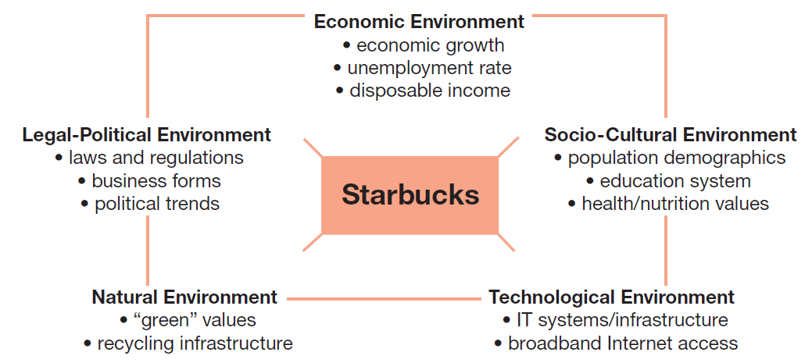
Organizational Environment Figure 1.4: p. 15

Slide 10
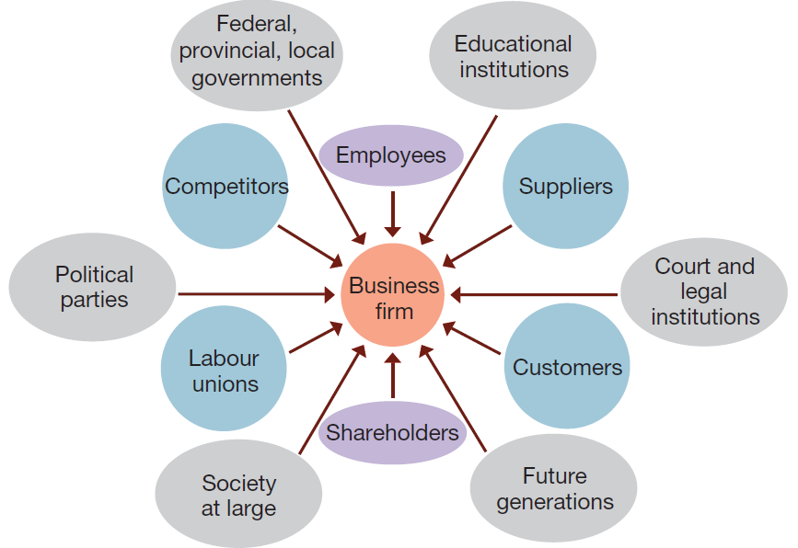
Task Environment Figure 1.5: p.18

Slide 11
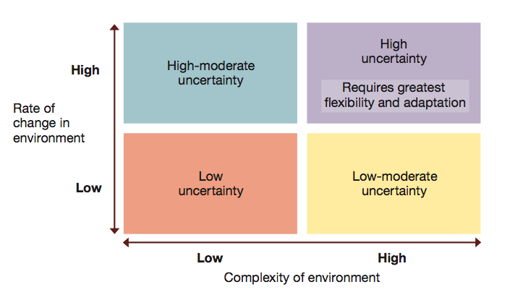
Environment Uncertainty Figure 1.6: p. 21

Slide 12
Management
Defined as the art and science of getting things accomplished through others in organizations

Slide 13
Management
Different roles of management
First level – mobilization
Second (middle) – coordination
Third level - strategic

Slide 14
Put Another Way…
  Top managers — responsible for the performance of the organization as a whole or for one of its larger parts
  Middle managers — in charge of relatively large departments or divisions
  Team leaders or supervisors — in charge of a small work group of non-managerial workers

Slide 15
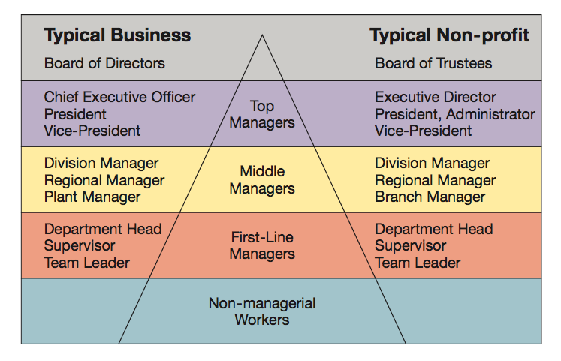
Management Levels Figure 1.8: p. 23

Slide 16
Managers in the New Workplace
The organization as an upside-down pyramid
Reflects the changing nature of work today
A manager’s job is to support workers’ efforts
Whole organization is devoted to serving the customer

