Slide 1
Independent assignment now posted
Microbes “up for adoption” (you must choose from this list)
Pyrolobus fumarii
Leptospira interrogans
Nipah virus
Bacillus thetaiotaomicron
Questions relating to your organism worth ~10% of individual component of final exam

Slide 2
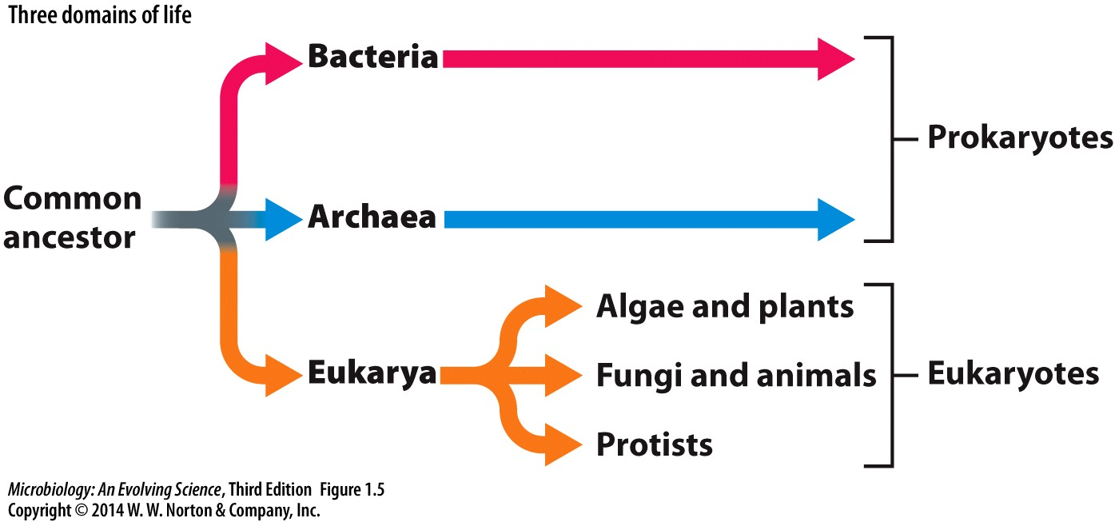
What is the importance of the microbes?
→ Ch. 1
protozoa
Defined by everything it is not
>3 billion years ago
Isotopic and microfossil evidence suggests life first arose on earth > 3 billion years ago
- bacteria may have existed ~3.6 BY ago, followed closely by archaea
- existed, adapted, and changed environments a billion years before eukarya
- algae and plants have photosynthesis in common

Slide 3
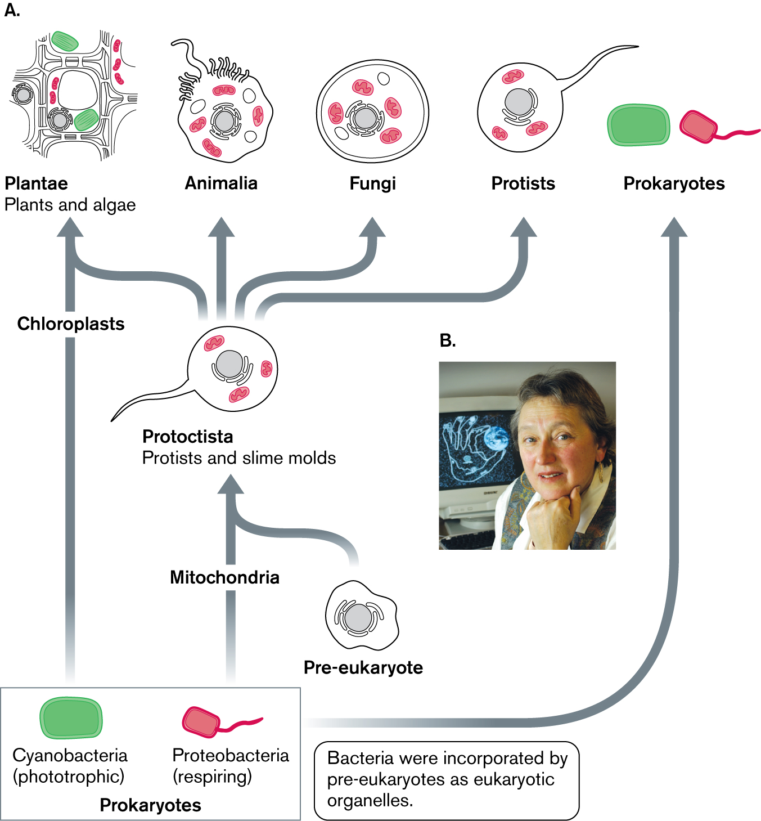
The microbes shaped Earth’s history
Oxygenic photosynthesis, the cyanobacteria & “the Great Oxygenation Event”
Lynn Margulis & the endosymbiont theory
Evolved photosynthetic bacteria, consumed CO2, waste is oxygen. Proposes the modern day chloroplast evolved from and endosymbiotic relationship between cyanobacteria living in a host cell (produced an aerobic environment from anaerobic
All cells contain mitochondria, not chloroplast- suggest it came first
- Oxygen photosynthesis first arose in the bacteria (the cyanobacterial ancestor) (“the blue green algae”) and gave rise to an aerobic atmosphere (“the Great Oxygenation Event”)
The evolution of the eukaryotes occurred > 1BY after the bacteria and archaea and likely required both
Produces an explosion of complex life forms
Evidence suggest it was a particular type of archaea
Fig. 1.27

Slide 4
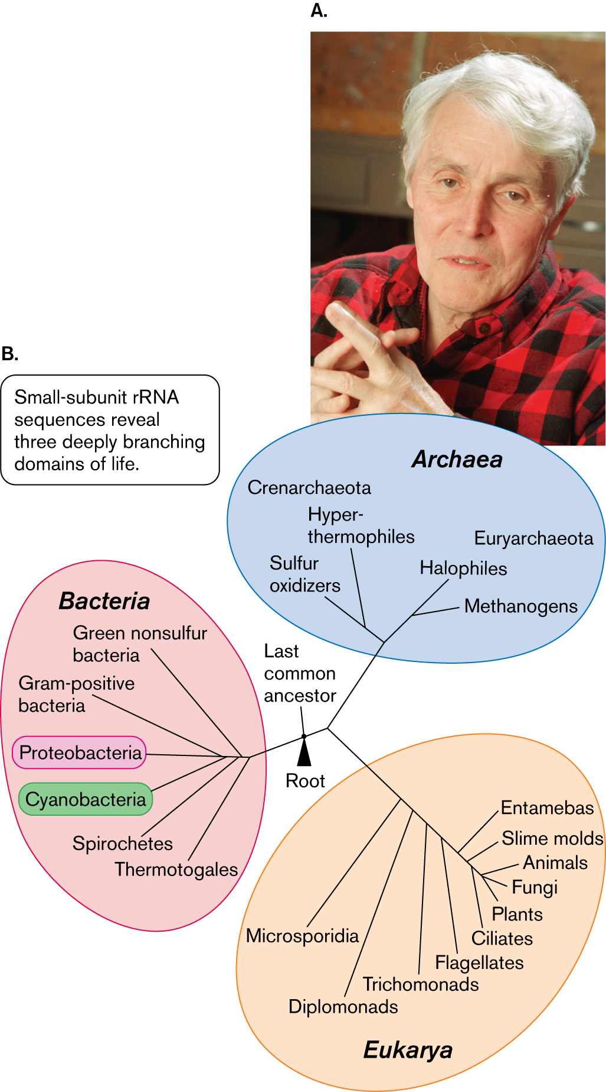
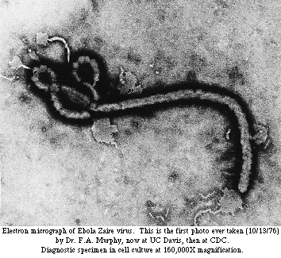
The Universal Tree of Life & the microbes
Carl Woese, molecular phylogeny & the Universal Tree of Life
Major source of natural occurring methane and are an ancestor of the host bacteria
ToL based on rRNA
Use it as a molecular measure of age and relatedness
Revised tree of life and discovered archaea
Proto and cyanobacteria produce their own ribosomes
www-micro.msb.le.ac.uk
The viruses are microbes too
All but the animals and plants are microbial
Metagenomics & the uncultured majority…

Slide 5
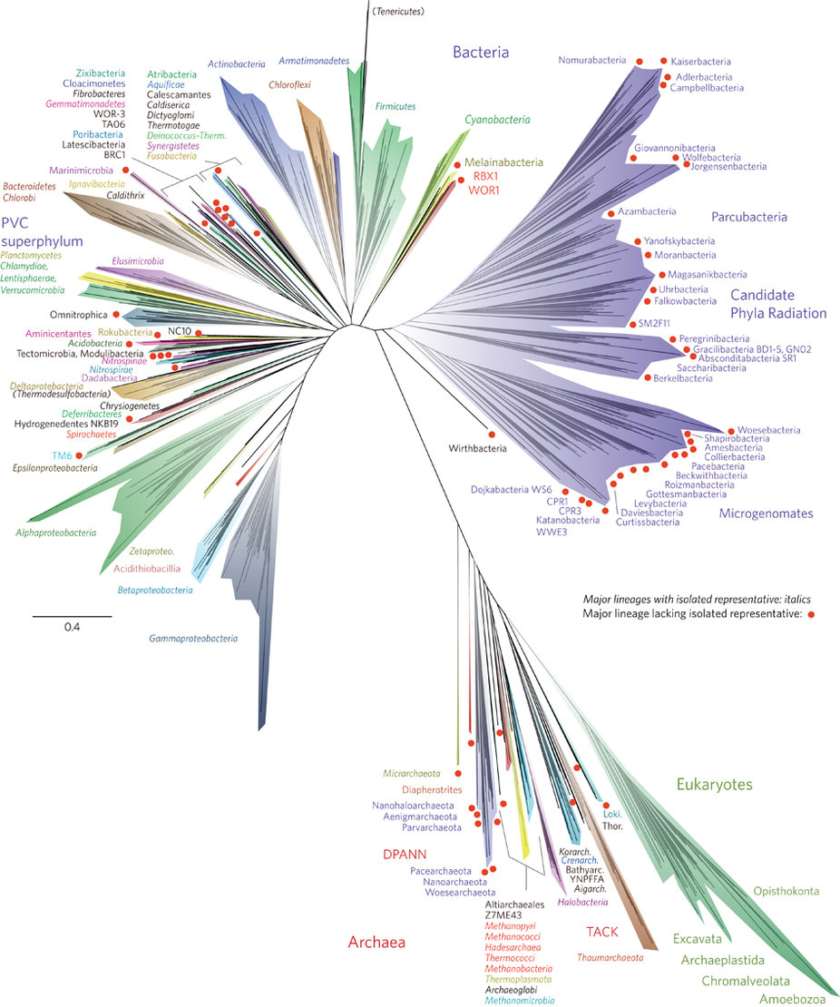
“A new view of the tree of life”
Carl Woese, the father of molecular phylogeny, revolutionized the way we identify and classify life on earth
99% of microbes have yet to be isolated
Identified and characterized through metagenomics
Hug et al., 2016.
Notes:
Most recent tree of life
ar

Slide 6
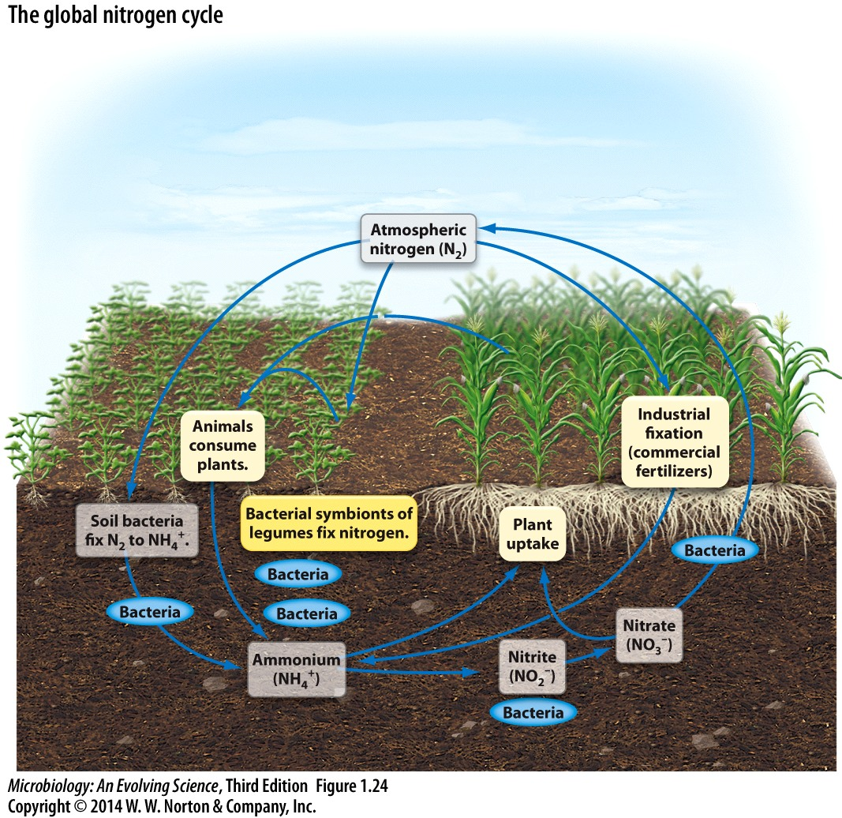
Earth’s ecology is dependent on the microbes
they are critical to biogeochemical cycling
Fig. 1.24
Nitrogen fixation: N2 -> NH4+ -> amino acids
Oxidation and reductions of inorganics:
Inorganics, lithotrophy & anaerobic respiration
& archaea
The microbes are the “biological infrastructure” of the planet
Notes:
Nitrogen is found in a.a, DNA, RNA

Slide 7
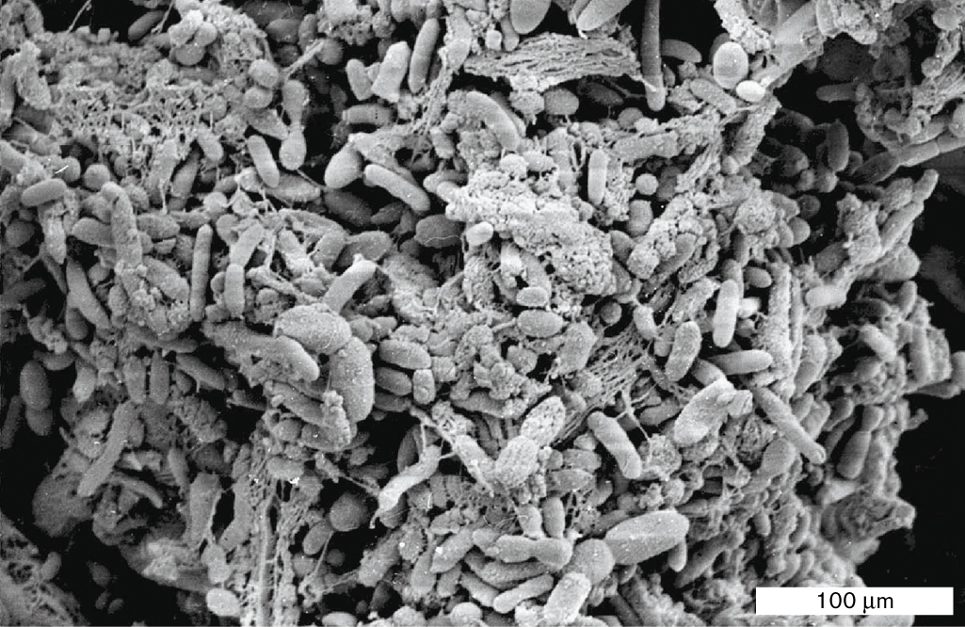
endosymbionts of animals
A minority of microbes are human pathogens
endosymbionts of the human GI tract:
Microbial biofilm on partially-digested food particle
Fig. 1.26
Human microbiome sequencing project
http://hmpdacc.org/

Slide 8
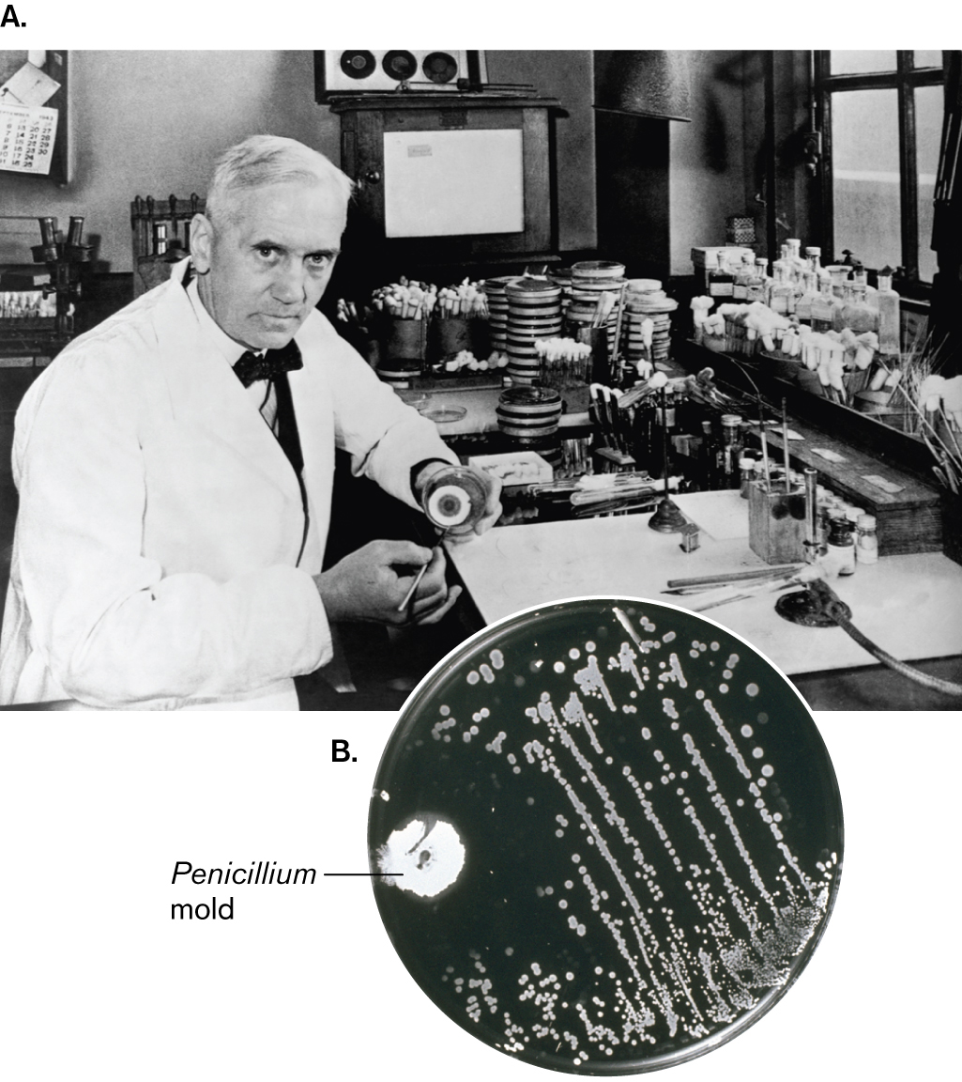
Biotechnological applications -
Production of antibiotics
Sir Alexander Fleming
Fig. 1.21

Slide 9
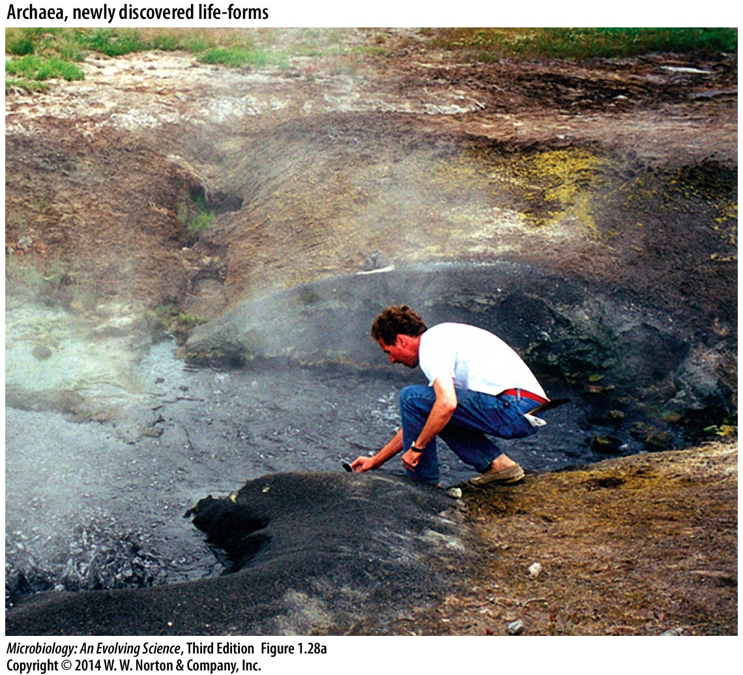
Extremophilic bacteria and archaea have biotechnological applications
Fig. 1.28
Extremophilic bacterium Thermus aquaticus

