Slide 1
CHM 1321
Refresher
Nathan Yutronkie
University of Ottawa
Sept. 27, 2016

Slide 2
CHM 1321 Review
Basic Tools Used in Organic Chemistry
Acid/Base Reactions
Bronsted Acid/Base
» Structure and Bonding
» Nucleophiles and electrophiles
» Steric interactions
» Electronegativity
Lewis Acid/Base
π-Bonds as Electrophiles
π-Bonds as Nucleophiles
Acidic Conditions
Basic Conditions

Slide 3
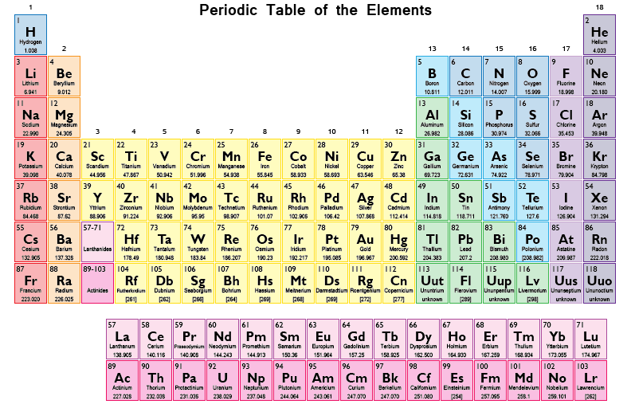
Understand the Trends of Periodic Table
Increasing Electronegativity
Increasing Electronegativity
Why is this important?
» Covalent vs. Ionic.
» Reactivity
» Bonding

Slide 4
Drawing Lewis Structures
e.g. CF₃COOH
» Draw the molecule using clues from the formula and the octet rule (Second row elements always have
at most 8 valence electrons
» Count the number of valence electrons
C x 2 x 4 e = 8
F x 3 x 7 e = 21
O x 2 x 6 e = 12
H x 1 x 1 e = 1
Charge = 0
Total e = 42 e
7 Bonds Used = 14 e
28 electrons unaccounted for
» Attach the remaining valence electrons

Slide 5
Drawing Lewis Structures
e.g. CF₃COOH
» Calculate formal charge on atoms (FC = Valence electrons – Bonds – Lone electrons)
-1
+1
Carbon does not have a full octet
» Combine adjacent charges to form the most predominant structure (i.e. Resonance)

Slide 6
Why Does Hybridization Occur?
2s + 2p + 2p +2p
2p_{x}
2p_{y}
2p_{z}
Energy
Hybridize
2sp³
2sp³
2sp³
2sp³
2s
Core Electrons
1s
» Do not participate in bonding
1s
C
C_{sp3}
Atomic Number = 6
» Carbon has 6 total electrons
Group Number = 14
» Carbon has 4 valence electrons

Slide 7
Why Does Hybridization Occur?
For simplicity…
Valence Electrons
» All electrons in sp³ orbitals
will be involved in σ bonding or
be non-bonding lone electrons
» This depends on the atom and the number of electrons that fills these orbitals
=
sp³ hybridized atomic orbital
109.5°
2sp³
2sp³
2sp³
2sp³
C
Electron Repulsion
» Angle with the least
electronic repulsion
» Most stable configuration
» This is why sp³ atoms have
atetrahedral geometry
1s
C_{sp3}

Slide 8
Why Does Hybridization Occur?
2s + 2p + 2p
2p_{x}
2p_{y}
2p_{z}
2p
Energy
Hybridize
2sp²
2sp²
2sp²
2s
Core Electrons
1s
» Do not participate in bonding
1s
B
B_{sp2}
Atomic Number = 5
» Oxygen has 5 total electrons
Group Number = 13
» Carbon has 3 valence electrons

Slide 9
Why Does Hybridization Occur?
For simplicity…
Valence Electrons
» All electrons in sp² orbitals
will be involved in σ bonding or
be non-bonding lone electrons
» All electrons in p orbitals will be in involved with π bonding or be non-bonding lone electrons
» This depends on the atom and the number of electrons that fills these orbitals
=
sp² hybridized atomic orbital
2p
120°
2sp²
2sp²
2sp²
B
Electron Repulsion
» Angle with the least
electronic repulsion
» Most stable configuration
» This is why sp² atoms have
a trigonal planar geometry
1s
B_{sp2}

Slide 10
Why Does Hybridization Occur?
2s + 2p
2p_{x}
2p_{y}
2p_{z}
Energy
Hybridize
2p
2p
2sp
2sp
2s
Core Electrons
1s
» Do not participate in bonding
1s
N
N_{sp}
Atomic Number = 7
» Carbon has 7 total electrons
Group Number = 15
» Carbon has 5 valence electrons

Slide 11
Why Does Hybridization Occur?
For simplicity…
Valence Electrons
» All electrons in sp orbitals
will be involved in σ bonding or
be non-bonding lone electrons
» All electrons in p orbitals will be in involved with π bonding or be non-bonding lone electrons
» This depends on the atom and the number of electrons that fills these orbitals
=
sp hybridized atomic orbital
180°
2p
2p
2sp
2sp
N
Electron Repulsion
» Angle with the least
electronic repulsion
» Most stable configuration
» This is why sp atoms have
a linear geometry
1s
N_{sp}

Slide 12
Acid Base Chemistry
Bronsted Acid/Base Reactions
» Transferring of protons
» Acid = Donating (Giving up) proton
» Base = Accepting (Receiving) proton
Base
Acid
Conjugate
Acid
Conjugate
Acid
Lewis Acid/Base Reactions
» Transferring of electrons
» Acid = Accepting (Receiving) electrons
» Base = Donating (Giving up) electrons
Acid
Base

Slide 13
Bronsted Acid Base Chemistry
Bronsted Acid/Base Reactions
» Reactions are reversible; however, the equilibrium will favour the more stable chemical species
» Most stable chemical species = The weakest acid or base
» The strongest acid (most acidic, most reactive, less stable, higher energy) will result in the weakest (less basic, least reactive, most stable, lowest energy) conjugate base
Base
Acid
Conjugate
Acid
Conjugate
Base
Conjugate
Base
Conjugate
Acid
Acid
Base

Slide 14
Predicting The Equilibrium
Predicting The Equilibrium via pKa Values
» The lower the pKa value, the more acidic that proton is…… therefore, it will push the equilibrium to the other side (Strongest acid results in the weakest base)
http://evans.rc.fas.harvard.edu/pdf/evans_pKa_table.pdf
Predicting The Equilibrium via Stability of Conjugate Base
» The side with the most stable products (weakest base) will be favoured in the equilibrium
» Compare bases using the following factors: Electronegativity, Size of Ion, Hybridization, Inductive Effects, and Resonance

Slide 15
Predicting The Equilibrium via pKa Values
Bronsted Acid/Base Reactions
pKa = ~0
pKa = ~7
Base
Acid
Conjugate
Acid
Conjugate
Base
» This problem is specifically showing you which proton is being transferred
» By knowing where the proton is being transferred, you must first determine which
chemical species is acting as the acid and which is acting as the base
» Once the acids are determined, assign the pKa value to the proton in both acids
» The lower the pKa value, the more acidic that proton is…… therefore, it will push the equilibrium to the other side (Strongest acid results in the weakest base)

Slide 16
Predicting The Equilibrium via Conjugate Base
Bronsted Acid/Base Reactions
Base
Acid
Conjugate
Acid
Conjugate
Base
Analysis:
» The highlighted lone pair on imidazole (Base) resides on a less electronegative atom
compared to trifluoroacetate (Conjugate Base)
» Nitrogen is less electronegative compared to oxygen
» Lone pair on the oxygen of trifluoroacetate is resonance stabilized with the adjacent
carbonyl, whereas the lone pair on the nitrogen of imidazole is not (Lone pair is in an sp²
orbital, cannot delocalize in the π-framework
» Therefore, the side with the weakest base (trifluoroacetate) will favour the equilibrium

Slide 17
» Keep in mind, most reactions you’ve seen in this courses incorporates acid/base chemistry. Therefore, you must recognize if an acid/base reaction can occur. If you think it can occur, draw out the reaction and use these methods to determine whether or not that reaction can occur.
» If the reaction can occur, this reaction will happen immediately, as acid/base reactions happen fast

Slide 18
Ketones/Aldehydes as Electrophiles
General Mechanism Under Basic Conditions
» Groups attached to the
carbonyl are hydrogens, alkyl or aryl
» Nucleophile must be strong
to attack carbonyl
Nucleophilic Addition to Carbonyls with Carbanion/Hydride Nucleophiles
» Grignard Addition
» Organo-Lithium Addition
» Cyanohydrin Reactions
» Reduction of Carbonyls

Slide 19
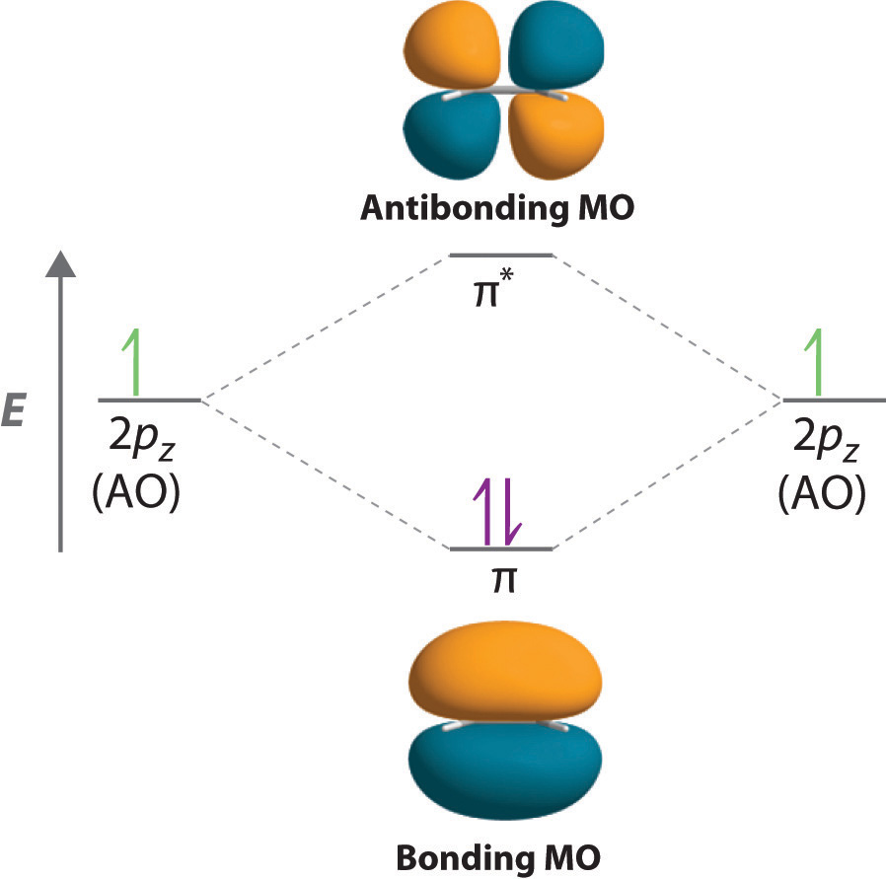
π-Bonds as Electrophiles

Slide 20
Carbonyls as Electrophiles
σ*
» Lowest Unoccupied
Molecular Orbital (LUMO)
π*
2p
Energy
2p
2sp²
2sp²
2sp²
» These electrons
are used in the σ
bonding with H’s
2sp²
2sp²
2sp²
2sp²
2sp²
π
» Highest Ooccupied
Molecular Orbital (HOMO)
» Lone pairs in sp² orbitals
» Non-bonding orbitals,
therefore no change in
energy
σ
C_{sp2}
C=O
O_{sp2}

Slide 21
C-C Double Bonds as Nucleophiles
General Mechanism of Electrophilic Aromatic Substitutions
» Benzene stable molecule due to aromaticity
» Requires super electrophiles to react with
» Five Key Substituion Reactions
» Nitration
» Sulfonation
» Halogenation
» Friedal-Craft Alkylation
» Friedal-Craft Acylation
» Hucklel’s Rules for Aromaticity
» Planar, cyclic molecule
» All atoms on the ring have p-orbitials
and participate in delocalization
» (4n + 2) pi electrons
Aromatic Manipulations

Slide 22
C-C Double Bonds as Nucleophiles
General Mechanism For Disubstituted Benzene Products

Slide 23
C-C Double Bonds as Nucleophiles
Addition of One Substituent on Olefins
Addition of Two Substituent on Olefins

Slide 24
Ketones/Aldehydes as Electrophiles
Tetrahedral Intermediate
» The tetrahedral intermediate cannot collapse on itself
» Carbon-carbon and carbon-hydrogen bonds are strong and not easy to break.
» Protonate the oxyanion to make alcohols
» Keep in mind, nucleophiles can also act as bases
π
*** On Exam, Use Real Example Of H+ ***

Slide 25
Ketones/Aldehydes as Electrophiles
General Mechanism Under Acidic Conditions
» HOMO of carbonyl (lone pairs) react with acid, making it a better electrophile
» Used to protect aldehydes, ketones and even alcohols
δ⁺
δ⁺
» Acetal Formation
Aldehyde
Ketone
Hemi-Acetal
Acetal
» Intamolecular reactions happen faster
than intermolecular reactions…
therefore, the blue route will occur

Slide 26
Principle of Microscopic Reversibility

Slide 27
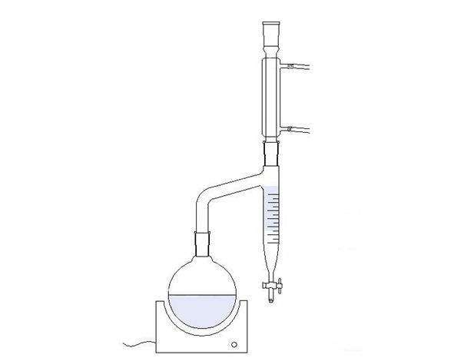
Le Chatelier’s Principle
1 : 2 : 1 : 1
» Le Chatelier’s Principle: Equilibrium will favour the side with the highest entropy
» Equilibrium favours reagents (3 molecules to 2 molecules)
Solutions
» Remove water from the products via Dean Stark or
use of drying agents such as MgSO₄
» Start with a diol
1 : 1 : 1 : 1
» Start with a diol and acetal
1 : 1 : 1 : 2

Slide 28
Substitution and Elimination Reactions
General S_{N}2 Mechanism
General E2 Mechanism
δ⁺
δ⁺
General S_{N}1 and E1 Mechanism
S_{N}1 Product
δ⁺
» Both reactions go through the
same intermediate (carbocation)
E1 Product

Slide 29
Criteria For Substitution and Elimination Rxns
 | S_{N}2 | E2 | S_{N}1/E1
Leaving Group | Weak Base
Alpha Carbon | Me, 1°, 2° | 1°, 2°, 3° | 3°. Resonance Stabilized Carbocation
Nucleophile | Strong | N/A | Weak, usually solvent
Base | N/A | Strong | Weak, usually solvent
Solvent | Polar, Aprotic (Best) |  | Polar, Protic
If the nucleophile is also a strong base, use the alpha carbon to decide what the major product is:
» 1° = S_{N}2 major product
» 2° = E2 major product
» 3° = E2 only

Slide 30
S_{N}2 Reactions
» Nucleophile and leaving group must be antiperiplanar to each other in order to generate product
» Tail of the antibonding orbital is pointing in opposite direction of LG
» If the alpha centre is chiral, this will cause an inversion in stereochemistry
» In the cases of chair conformations, leaving group must be axial for an S_{N}2 reaction to occur
» When a LG is equatorial, the tail of the antibonding orbital is pointing inside the ring, making it non-accessible for a nucleophile.
» Ring must change conformations in order to occur

Slide 31
Converting Alcohols into Good Leaving Groups
Method 1: Protonation of Alcohols with Strong Acid
» Alcohols are not typically good leaving groups, mainly due to the strength of the C-O bond
» By protonating the oxygen, a formal charge of 1+ is placed on the atom, making it electron deficient
» If oxygen is electron deficient, it will pull electron density from its surrounding (i.e. alpha carbon), thus
weakening the C-O bond
» The partial positive charge on the alpha carbon increases significantly, attracting nucleophiles
» REMEMBER….. pKa of protonated alcohol is around ##. Thus, when using strong bases/nucleophiles in
S_{N}2 or E2 reactions, deprotonation can occur before substitution or elimination.
Method 2: Converting Alcohols into Sulfonate Esters
» Alcohol reacts with sulfonyl chloride (Ms-Cl, Ts-Cl, Tf-Cl) followed by deprotonation with a base
» Works great when not using strong basic conditions
Note: LP’s removed for simplicity. Draw in on final exam!

Slide 32
Regioselectivity of E2 Reactions
Zaitsev’s Product
Hoffman’s Product

Slide 33
Additional Questions
Provide the structure of sodium cyanoborohydride, along with the geometry and
hybridization of the boron atom
Remove Box For Answer
sp³ - Tetrahedral
Determine the equilibrium of the following acid/base reaction
Remove Box For Answer

Slide 34
Additional Questions
True or False. The second step in a general S_{N}1 reaction can be considered a
Lewis Acid/Base reaction
Remove Box For Answer
True

Slide 35
Aromatic Substitution Questions
» Fill in the major product for each reaction
Remove Box For Answer
Remove Box For Answer
Remove Box For Answer
Remove Box For Answer
Remove Box For Answer

Slide 36
Aromatic Substitution Questions
» Synthesize the following functionalized aromatic systems starting from benzene
Remove Box For Answer

Slide 37
Carbonyl Chemistry Questions
» Which carbonyl is more proned for a nucleophilic attack?
Remove Box For Answer

Slide 38
Substitution/Elimination Questions
Remove Box For Answer
Remove Box For Answer

Slide 39
Additional Questions
Fill in the mechanism
» Provide the arrows required to complete the follow mechanisms
Remove Box For Answer
Remove Box For Answer
Remove Box For Answer
Remove Box For Answer

