Slide 1
ADM3346
Midterm Review
2016 Fall

Slide 2
Key points
Cost concepts and cost flows (Ch1, 2)
Cost function, high-low & regression analysis (Ch10)
Job costing (Ch4)
Overhead costs allocation: traditional / ABC (ABM) (Ch4, 5)
Process costing (Ch17,18)
CVP (Ch3)
Decision making (Ch11)

Slide 3
Classifying Costs
Classifications | Applications | Cost Terms
Relevance | Decision-making | Relevant vs. irrelevant cost
Behaviour | Cost estimation | Fixed vs. variable cost
Traceability | Cost assignment | Direct vs indirect cost
Function | Cost determination | Product vs period cost
Controllability | Performance evaluation | Controllable vs. uncontrollable cost

Slide 4
Raw Materials
Finished Goods
We use FG to Calculate COGS
DM usage
BI
Costs of goods sold
BI
Purchase
IDM usage
Costs of finished products
Factory Payroll
WIP
DL usage
BI
Wages paid
DM
Costs of finished products
IDL usage
DL
Cost of Goods Sold
MOH
Costs of products sold
MOH
Indirect costs incurred
Allocations
We use WIP to calculate COGM

Slide 5
High-Low Method
Calculate variable cost per unit of activity
Calculate Total Fixed Costs

Slide 6
High-Low Method
Summarize in a linear equation

Slide 7
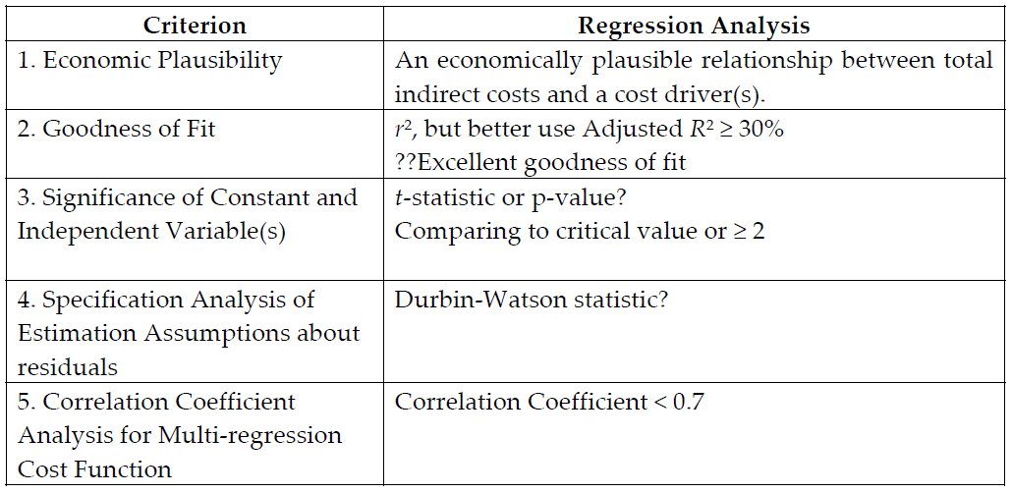
Regression Analysis

Slide 8
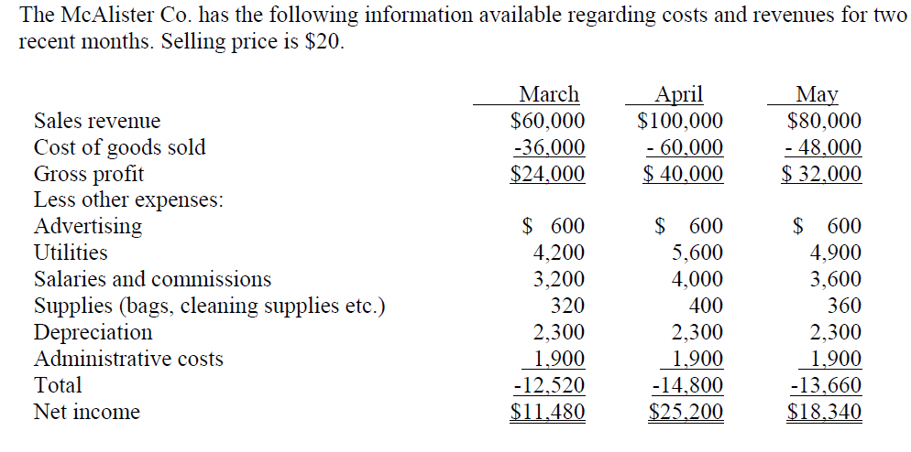
Question 1

Slide 9
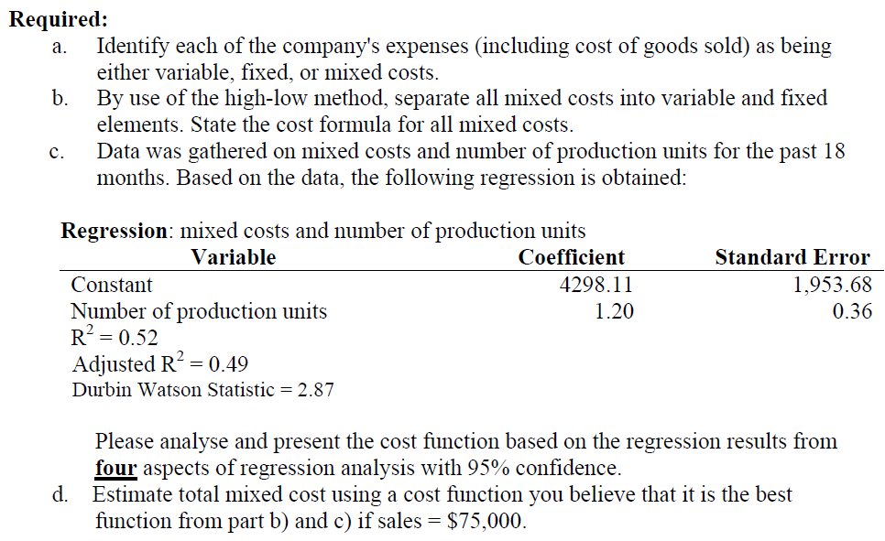

Slide 10
Decision Making
Outsourcing - Make or Buy
Special offer
Equipment replacement decision
  Analyze relevant and irrelevant costs
Production mix - constrained resources
  Choose the product that produces the highest contribution margin per unit of the constraining factor

Slide 11
Job Costing
Calculating costs of each job or unit costs of a job
  tracing direct costs (DM, DL)
  allocating indirect costs
Two indirect cost allocation methods
  Traditional method (normal or actual costing using one allocation base)
  ABC method using multiple allocation bases for different cost activities
Cross-subsidization

Slide 12
Correcting for Over / Under allocations of Indirect Costs
Adjusted Allocation Rate Approach
  Allocations are recalculated with the actual allocation rate (usually too costly)
**Proration Approach
  The over (or under) applied difference is allocated between cost of goods sold, work-in-process, and finished goods based on their relative proportions
**Write-Off Approach
  The difference is simply written off to cost of goods sold (simple and cost effective)

Slide 13
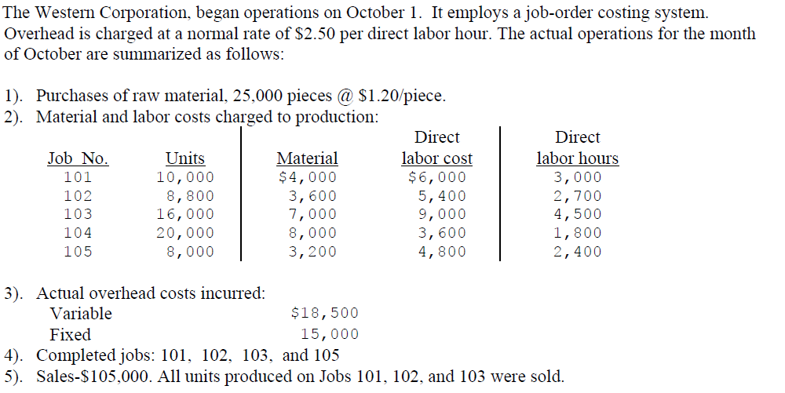
Question 2

Slide 14
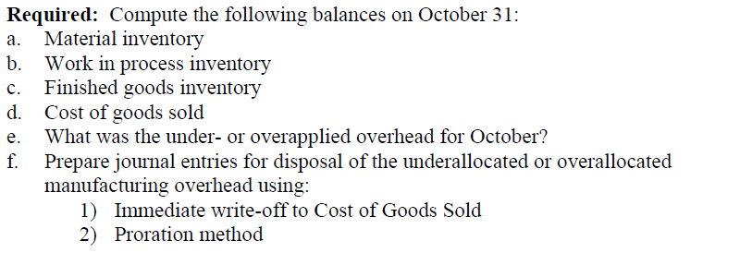

Slide 15
Process Costing
PETCAT
WA and FIFO
  DM are assumed to be applied at discrete points in the production process (e.g. at the beginning of the production process)
  CC are added evenly along the production process
  TI is another cost classification, different from DM and CC

Slide 16
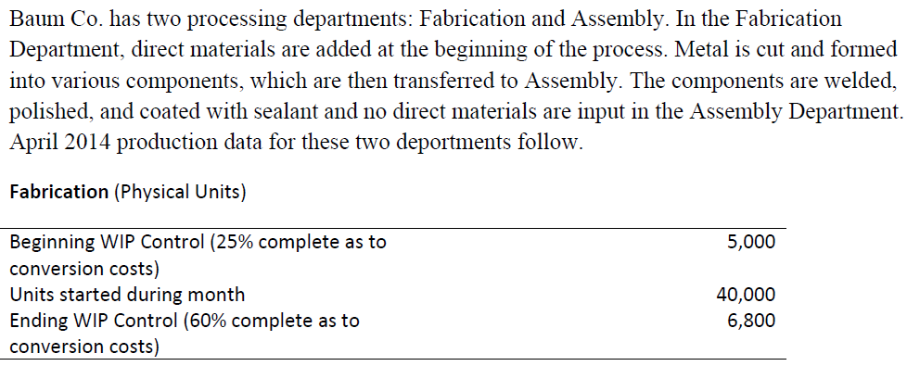
Question 3

Slide 17
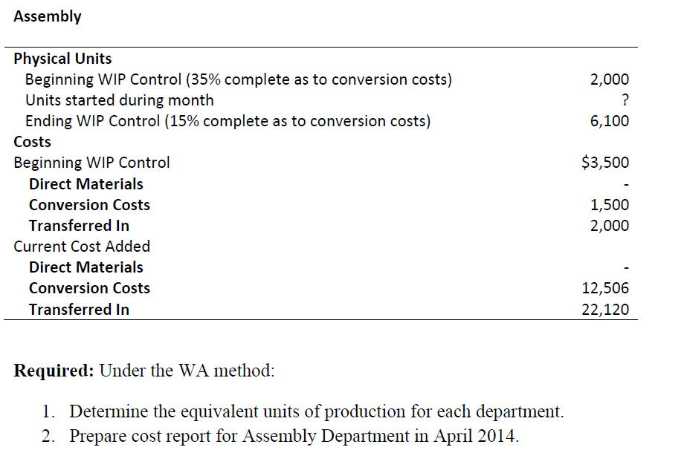

Slide 18
Spoilage, Rework and Scrap
Job costing and spoilage
  Normal spoilage:
  attribute to a specific job or all jobs
  Abnormal spoilage:
  record as loss of abnormal spoilage
Process costing and spoilage
including EU of spoilage
Rework account for

Slide 19
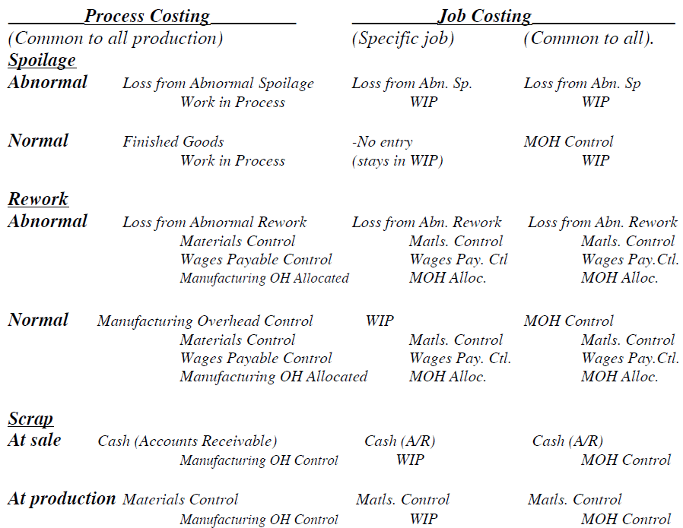
Summary of Journal Entries

Slide 20
Spoilage, Rework and Scrap
Concept of EU
PETCAT steps for preparing cost report
esp.

