Slide 1
Health and the Health Care System
NSG2113

Slide 2
Objectives
Discuss definitions of health
Discuss historical changes in Canada related to health care approaches

Slide 3
Canadian Health Care System
Evolved out of necessity
  Disease, population changes, & hard times
1947 Tommy Douglas (The father of medicare) introduced a public insurance plan
By 1961 all prov. & territories had prov. & fed funded in patient hospital care.
By 1972 out of hospital care was included and modern medicare was born

Slide 4
5 Principles of the CHA (Health Canada, 2008)
Public Administration
Comprehensiveness
Universality
Portability
Accessibility

Slide 5
Health care settings
Institutional sector
Community sector
Hospitals
Long-term care facilities
Psychiatric facilities
Rehabilitations centres
Complex continuing care
Public Health
Physicians offices/Family Health Teams
Community Health Centres
Assisted living facilities
Home Care
Community and Voluntary agencies
Others…

Slide 6
Levels of care
Health Promotion – improve and maintain health status
Disease and Injury Prevention – screening, immunizations, environmental changes
Diagnosis and Treatment – focus on individual
Rehabilitation – restoring individual to fullest functioning level possible
Supportive Care – chronic or progressive illnesses

Slide 7
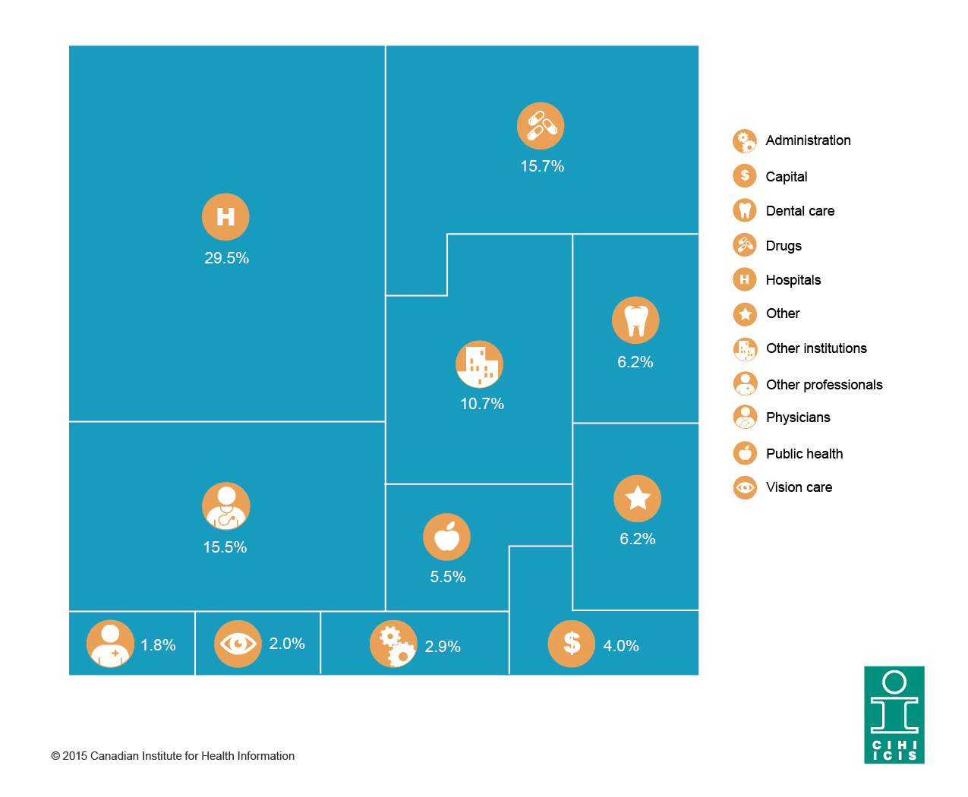
Where are Canada’s health care dollars going?
More than 60% of total health care dollars are being spent on hospitals, drugs and physician services

Slide 8
Show me the Money
It is estimated that health spending in Canada reached $211 billion in 2013, or approximately 11.2% of GDP, the majority of which goes to hospitals (30%), drugs (16%) and physicians (15%) (Canadian Institute for Health Information, 2013). As of 2013, physician compensation is the fastest-growing category of health spending and is expected to reach $31.4 billion (3.6% growth) (Canadian Institute for Health Information, 2013). In comparison, spending on hospitals is expected to grow by 2.6% in 2013 and spending on drugs is expected to grow by 2.4% (Canadian Institute for Health Information, 2013).

Slide 9
What determines health?
ACTIVITY ONE:
Break into groups of 5 or 6
Select a Health Case Scenario
One student reads the card aloud
Individually decide if they feel the person described is healthy or unhealthy and provide a rationale
Discuss as a group and come to consensus
Write down a list of reasons why your group feels the individual is healthy or unhealthy
Share with the class: Does class agree or disagree

Slide 10
WHO (1946)
The World Health Organization (WHO) defined health in its broader sense in 1946 as "a state of complete physical, mental, and social well-being and not merely the absence of disease or infirmity."

Slide 11
ACTIVITY ONE CONTINUED
How do you define health?

Slide 12
WHO (1984)
The WHO (1984) continued to broaden the definition of health to “the extent to which an individual or group, on the one to realize aspirations and satisfy needs, and on the other hand, to change or cope with the environment. Health is therefore seen as a resource for everyday life, not the object of living, it is a positive concept emphasizing social, personal as well as physical capacities”

Slide 13
ACTIVITY ONE CONTINUED
What makes an individual healthy?
What makes a community healthy?

Slide 14
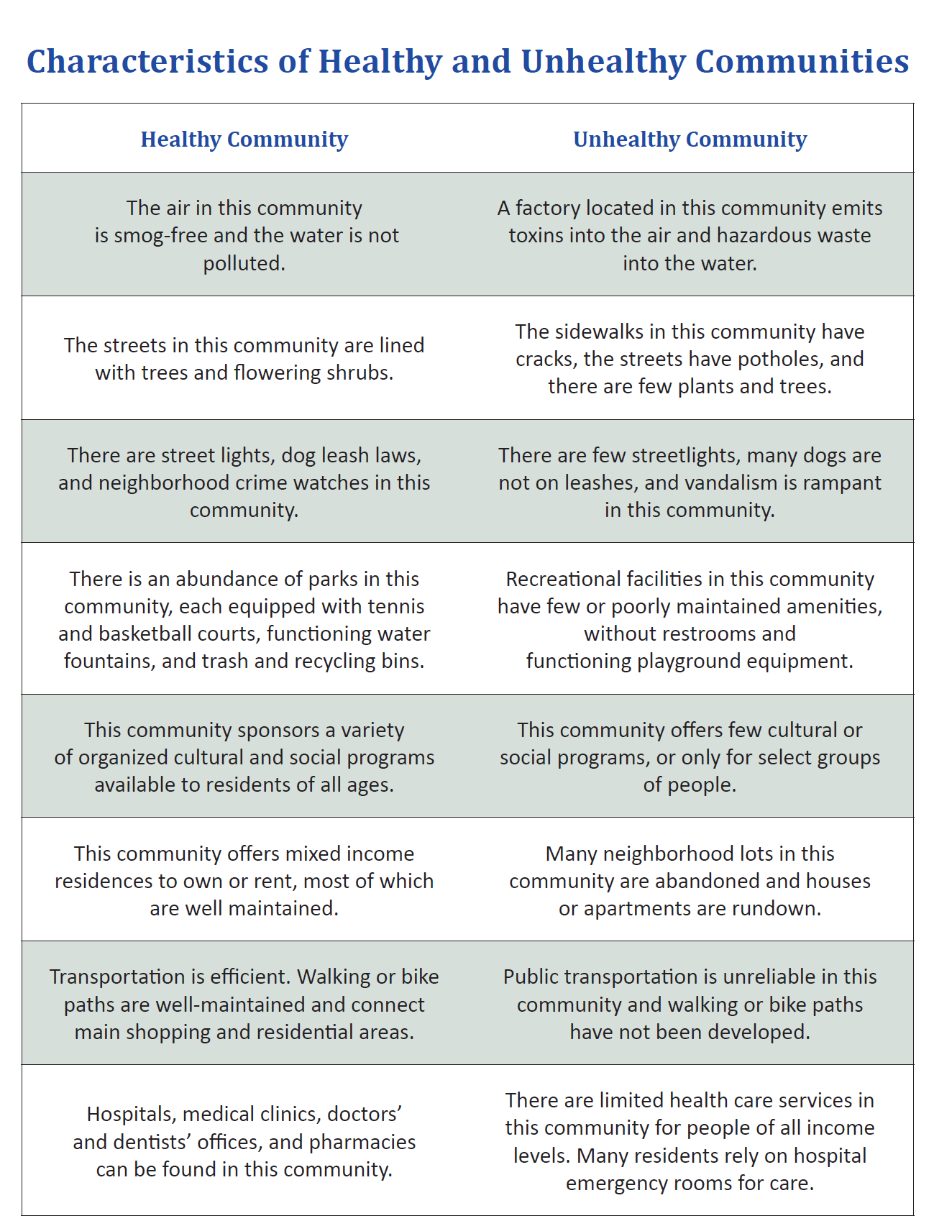

Slide 15
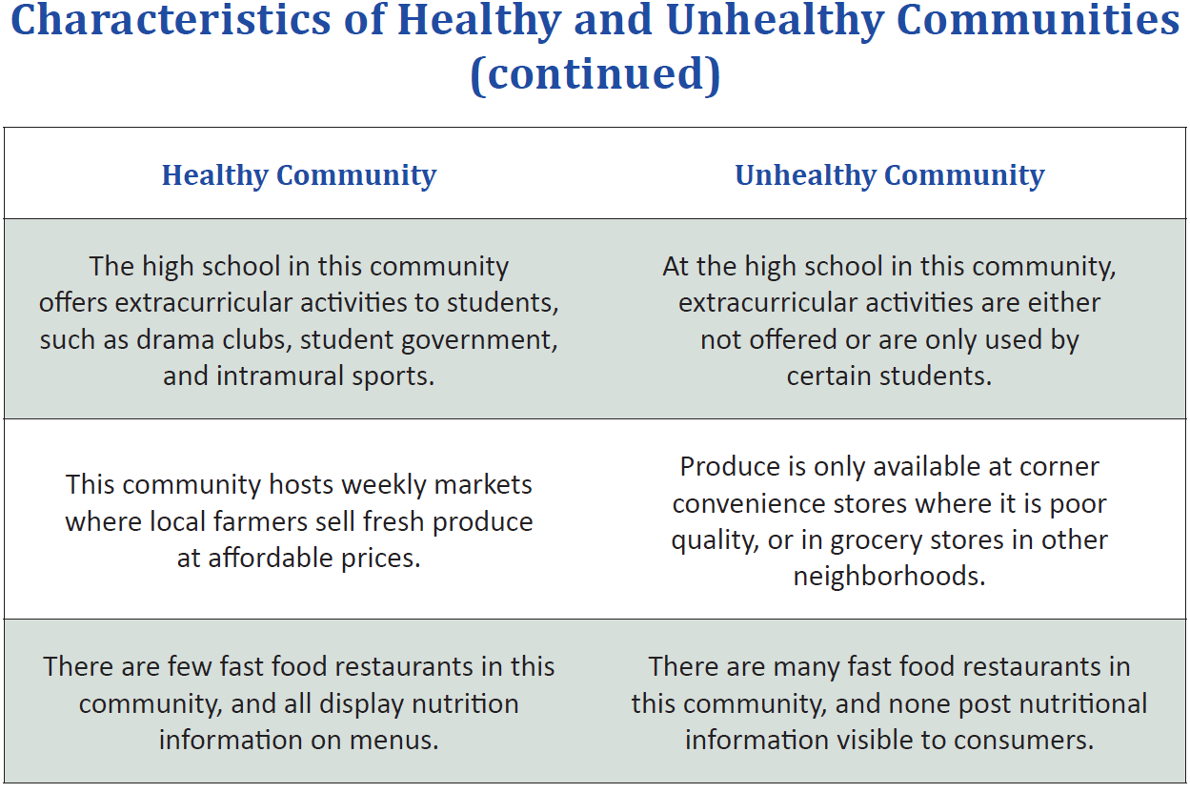

Slide 16
ACTIVITY ONE CONTINUED
Re-examine your lists of reasons for determining if the young person in the scenario is healthy or unhealthy
Distinguish between individual factors and community factors (circle individual factors and place a square around community factors)
Discuss with large group

Slide 17
ACTIVITY ONE CONTINUED
How does the unequal distribution of resources (goods/services/people) and policies affect the health of individuals in different ways (community based factors)
What do the terms health equity and health disparities mean?

Slide 18
ACTIVITY ONE CONTNUED
Health Equity: all people have the opportunity to attain their full health potential
Health Disparity: a difference in health due to social or economic disadvantage

Slide 19
ACTIVITY TWO
Let’s think upstream
1. Read the upstream story card in your groups

Slide 20
Upstream Causes
The root causes of health and disease outcomes-social, economic or political factors that affect health as much as or more than genetics, individual behaviour lifestyle choices.

Slide 21
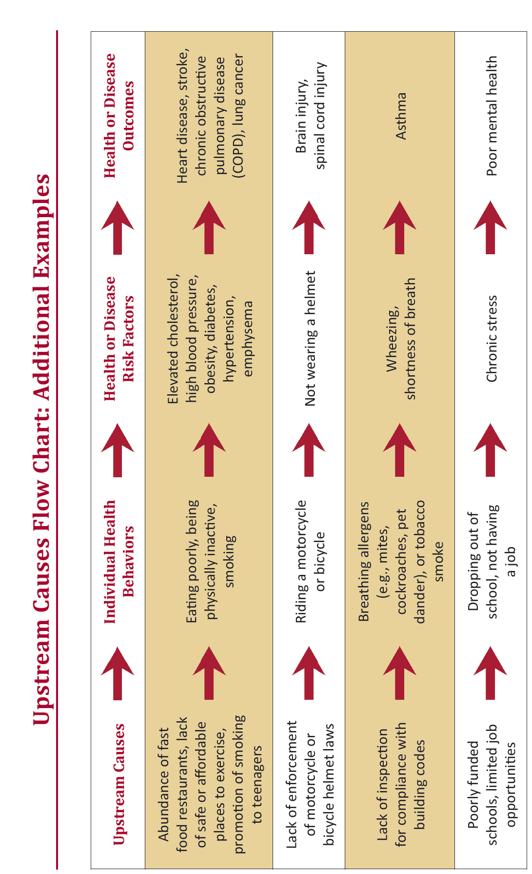

Slide 22
ACTIVITY TWO CONTINUED
Fill in the Upstream Causes Flowchart from the Upstream causes story

Slide 23
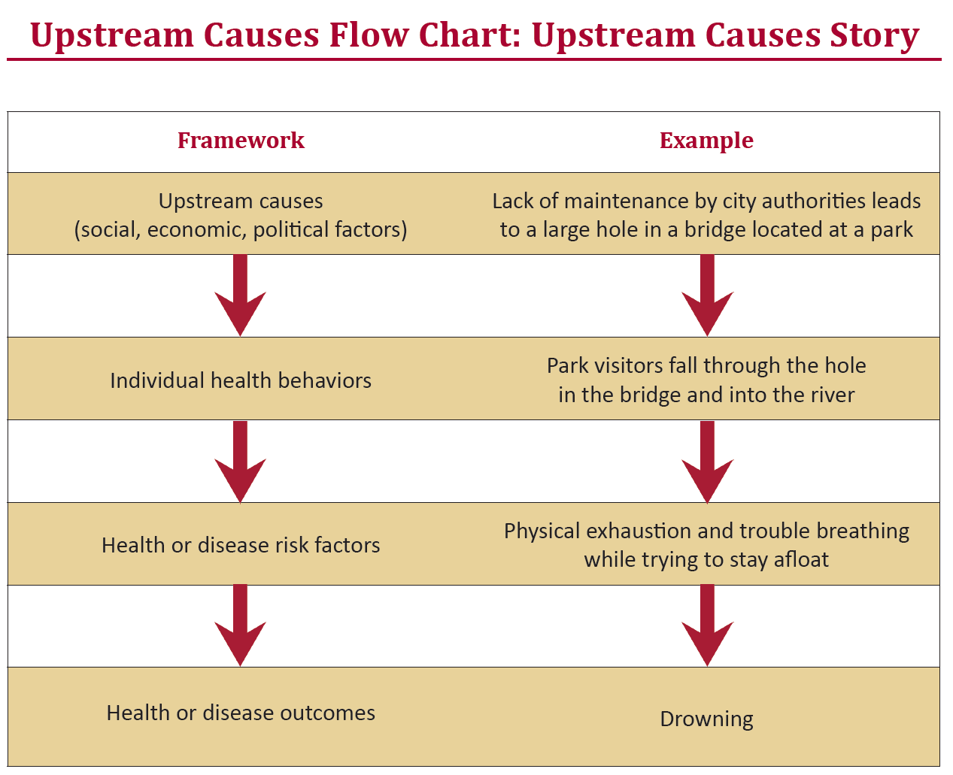

Slide 24
Summary
What is health?
It is more than the absence of disease
Health is broad
It looks at the person holistically in terms of individual health behaviours, genetics, biology, community, politics and economics
Social determinants of health-upstream thinking
    Reference for Activities and Materials: (Stanford Prevention Research Centre, 2012)

Slide 25
Medical Model
Dominant Model of the 20th Century in Western cultures-body is a machine that needs to be fixed
Focus on treatment of disease
Disease as an objective state pathology
detected by medical science
Illness care approach
Led to building of hospitals, access for illness care-lots of money spent on illness care
Someone with a disability or chronic disease is sick

Slide 26
Emergence of a More Holistic Approach
Introduced aspects of well-being, not just absence of illness and disease
Health is seen as positive concept
Well-being is subjective and contrasted with objective medical model
Criticized because well-being is difficult to measure

Slide 27
Behavioural Approach
1970’s
Illness system not working compared to the amount of money being spent
Focus on environment, reduction of self imposed risks, greater knowledge of human biology
Emergence of Health Promotion to decrease behavioral risk factors (smoking, lack of exercise)

Slide 28
Led to Wellness Models
Actualization and stability dimensions
Health as Stability-maintenance of physical, functional and social norms-person can adapt and maintain balance
Health as Actualization-related to human potential-maximizing the human experience
Even if a person has a physical disease or is nearing death, they can be healthy

Slide 29
Socioenvironmental Approach-1980’s
Behavioural approach-impacted well educated, employed, higher income Canadians-individuals being blamed for poor health
Need more focus on the environment and social contexts ex. Workplace safety, air pollution

Slide 30
Ottawa Charter for Health Promotion
Building on WHO definitions
Need prerequisites for health
Peace, shelter, education, food, income, stable ecosystem, sustainable resources, social justice and equity
Society also responsible for health not just the individual

Slide 31
Social Determinants of Health
http://www.youtube.com/watch?v=GMw_7AWEg4A
http://www.thecanadianfacts.org/The_Canadian_Facts.pdf

Slide 32
Social Determinants of Health
“The primary factors that shape the health of Canadians are not medical treatments or lifestyle choices but rather the living conditions they experience. These conditions have come to be known as the social determinants of health.”

Slide 33
Key Determinants
Income & social status
Social support networks
Education and Literacy
Employment & working conditions
Safe & clean physical environments
Biology and genetic makeup
Personal health practices& coping skills
Early child development
Health services
Gender
Culture
Social environments

Slide 34
Income and Social Status
Health researchers have demonstrated a clear link between income and socio-economic status and health outcomes, such that longevity and state of health rise with position on the income scales.
– Andrew Jackson, 2009

Slide 35
Social Support Networks
Relationships with family, friends, formal and informal groups
Help during crisis or times of stability
Impacts stress and coping

Slide 36
Education and Literacy
Canada as a whole performs well on national and international assessments, but disparities exist among populations and regions that do not seem to be diminishing with time.
– Charles Ungerleider, Tracey Burns, and Fernando Cartwright, 2009

Slide 37
Employment and Working Conditions
Workers are not only more uncertain about the likelihood that they will be retained in their current job, they are also uncertain about whether they will be able to find another job that meets their needs.
– Emile Tompa, Michael Polanyi, and Janice Foley, 2009

Slide 38
Physical Environments
It would hardly seem necessary to argue the case that housing—and homelessness in particular—are health issues, yet surprisingly few Canadian studies have considered it as such.
– Toba Bryant, 2009

Slide 39
Biological and Genetic Endowment
Genetics and age

Slide 40
Individual Health Practices and Coping Skills
Physical Activity (Inactivity)
Poor Nutrition
Tobacco Use 23 1/2 hours
www.youtube.com/watch?v=aUaInS6HIGo

Slide 41
Healthy Child Development
There is strong evidence that early childhood experiences influence coping skills, resistance to health problems and overall health and well-being for the rest of one’s life.
– Federal/Provincial/Territorial Advisory
Committee on Population Health, 1996

Slide 42
Social Environments
Includes the broader community in social networks
Absence of violence, and discrimination

Slide 43
Health Services
The health sector has been relatively slow in grasping the connections among human rights, social injustice, and how everyday life unfolds for patients.
– Elizabeth McGibbon, 2009

Slide 44
Gender
Gender matters in health and care. The point may seem obvious, but it has only recently been acknowledged in health policy and research.
– Pat Armstrong, 2009

Slide 45
Culture
Cultural and Ethnic factors impact health
Interactions with the health care system
Language barriers, changes to access
http://www.youtube.com/watch?v=piS2o_SQO50

Slide 46
Who are Patients?
1963
First, in general, the consumer is not well informed about health and medical care, certainly much less well informed than are physicians. Many, if not most, medical encounters are initiated, at least in part, for the explicit purpose of obtaining health information. It appears that people in their roles as medical care consumers have no well-formed preferences. If people had the necessary amount of information to make themselves fully informed, patients would have “as good or nearly as good understanding of the utility of the product as the producer” Prior to treatment, consumers may be faced with choices that have important consequences for either life or death or good quality of life versus a life of disability without having sufficient time or emotional stamina for making adequate decisions.

Slide 47
2016…..?
In the Cochrane Collaboration, the term health consumer applies to anyone who uses, is affected by or is entitled or compelled to use a health-related service. A health consumer is anyone who is concerned with making wise health-care decisions whether he or she is a patient, family member or caregiver.

Slide 48
Trends for Patient Engagement
Since health promotion models (Achieving health for all) included the involvement of patients and public in health activities there has been a movement for consumers being more involved in health and decision making

Slide 49
Other Trends which Impacted (are currently impacting) Patient Engagement
Informed Consent (1970’s)
Technology (medical advances, genetics, internet)
Advertising/Media
Patient Advocacy
Notes:
Bringing diseases out of the closet

Slide 50
Patient Engagement
Key to transforming the health care system
Improved quality
Innovation

Slide 51
Patients
Want:
Improved Service
More Personalized Service
Greater Access to health care records

Slide 52
Patients Like Me
http://www.patientslikeme.com
Canadian Patient Safety Institute
http://www.patientsafetyinstitute.ca/English/Pages/default.aspx
Patient’s Association Canada
http://patientsassociation.ca/

Slide 53
References
Arnold, E. & Boggs, K.U. (2011) Interpersonal relationships: professional communication skills for nurses, ^{th} ed.: St. Louis, Elsevier. Chapter 1.
Deloitte Centre for Health Care Solutions (2009). Treating patients as consumers. 2009 health care consumer survey report, Toronto
Mikkonen, J. & Raphel, D (2010). Social Determinants of Health: The Canadian Facts. Toronto: York University
Potter, P. & Perry, P. (2010). Canadian Fundamentals of Nursing, 4rd ed. revised: Toronto, Mosby. Chapter 1
Shea, B. et al. (2005). Consumer Driven Health Care: Building Partnerships in Research, Health Expectations, 8, 352-359
Snowdon, A. et al (2011). Transforming Canadian Healthcare through Consumer Engagement. The Key to Quality and System Innovation. London: Ivey for Centre of Health Leadership and Management
Sloan, F. A. (2001). Arrow’s concept of the health care consumer. Journal of Health, Politics, Policy and Law, 26 (5), 899-911

