Slide 1
Lecture 7: Leadership and Communication
Text Reference:
Chapter 11

Slide 2
The nature of leadership
Leadership.
  The process of inspiring others to work hard to accomplish important tasks.
Contemporary leadership challenges:
  Shorter time frames for accomplishing things.
  Expectations for success on the first attempt.
  Complex, ambiguous, and multidimensional problems.
  Taking a long-term view while meeting short-term demands.
Management 3e - Chapter 11
2

Slide 3
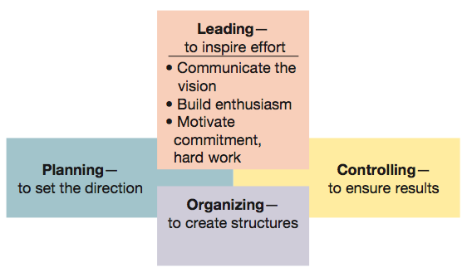
Figure 11.1 Leading viewed in relationship to the other management functions.
Management 3e - Chapter 11
3

Slide 4
The nature of leadership
Power
  Ability to get someone else to do something you want done or make things happen the way you want.
Power should be used to influence and control others for the common good rather seeking to exercise control for personal satisfaction.
Two sources of managerial power:
  Position power.
  Personal power.
Management 3e - Chapter 11
4

Slide 5
The nature of leadership
Position power
  Based on a manager’s official status in the organization’s hierarchy of authority.
Sources of position power:
  Reward power
    Capability to offer something of value.
  Coercive power
    Capability to punish or withhold positive outcomes.
  Legitimate power
    Organizational position or status confers the right to control those in subordinate positions.
Management 3e - Chapter 11
5

Slide 6
The nature of leadership
Personal power.
  Based on the unique personal qualities that a person brings to the leadership situation.
Sources of personal power:
  Expert power
    Capacity to influence others because of one’s knowledge and skills.
  Referent power
    Capacity to influence others because they admire you and want to identify positively with you.
Management 3e - Chapter 11
6

Slide 7
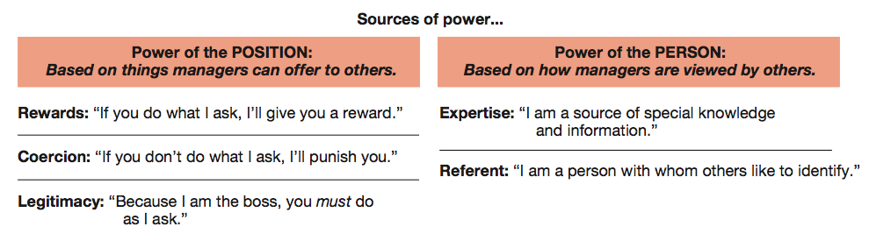
Figure 11.2 Sources of position power and personal power used by managers.
Management 3e - Chapter 11
7

Slide 8
Leadership traits and behaviours
Traits that are important for leadership success:
  Drive
  Self-confidence
  Creativity
  Cognitive ability
  Job-relevant knowledge
  Motivation
  Flexibility
  Honesty and integrity
Management 3e - Chapter 11
8

Slide 9
Leadership traits and behaviours
Leadership behaviour
  Leadership behaviour theories focus on how leaders behave when working with followers.
  Leadership styles are recurring patterns of behaviours exhibited by leaders.
  Basic dimensions of leadership behaviours:
    Concern for the task to be accomplished.
    Concern for the people doing the work.
Management 3e - Chapter 11
9

Slide 10
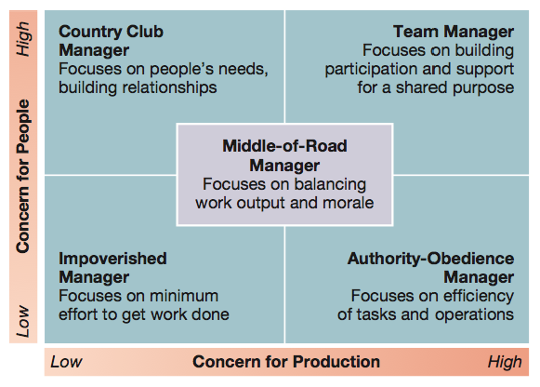
Figure 11.3 Managerial styles in Blake and Mouton’s Leadership Grid.
Management 3e - Chapter 11
10

Slide 11
Leadership traits and behaviours
Classic leadership styles:
  Autocratic style.
    Emphasizes task over people, keeps authority and information within the leader’s tight control, and acts in a unilateral command-and-control fashion.
  Human relations style
    Emphasizes people over work
  Laissez-faire style.
    Shows little concern for task, lets the group make decisions, and acts with a “do the best you can and don’t bother me” attitude.
  Democratic style.
    Committed to task and people, getting things done while sharing information, encouraging participation in decision making, and helping people develop skills and competencies.
Management 3e - Chapter 11
11

Slide 12
Contingency approaches to leadership
Hersey-Blanchard situational leadership model.
  Leaders adjust their styles depending on the readiness of their followers to perform in a given situation.
    Readiness — how able, willing and confident followers are in performing tasks.
Management 3e - Chapter 11
12

Slide 13
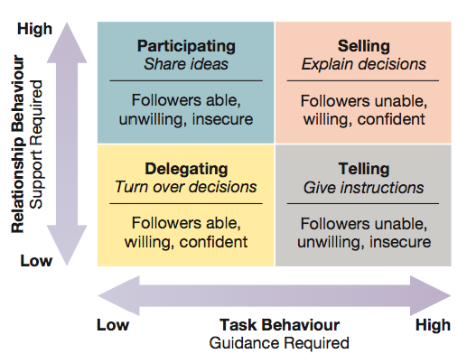
Figure 11.6 Leadership implications of the Hersey-Blanchard situational leadership model.
Management 3e - Chapter 11
13

Slide 14
Contingency approaches to leadership
Hersey-Blanchard leadership styles:
  Delegating.
    Low-task, low-relationship style.
    Works best in high readiness-situations
  Participating.
    Low-task, high-relationship style.
    Works best in low- to moderate-readiness situations.
Management 3e - Chapter 11
14

Slide 15
Contingency approaches to leadership
Hersey-Blanchard leadership styles:
  Selling.
    High-task, high-relationship style.
    Work best in moderate- to high-readiness situations.
  Telling.
    High-task, low-relationship style.
    Work best in low-readiness situations.
Management 3e - Chapter 11
15

Slide 16
Contingency approaches to leadership
House’s path-goal leadership theory.
  Effective leadership deals with the paths through which followers can achieve goals.
  Leadership styles for dealing with path-goal relationships:
    Directive leadership.
    Supportive leadership.
    Achievement-oriented leadership.
    Participative leadership.
Management 3e - Chapter 11
16

Slide 17
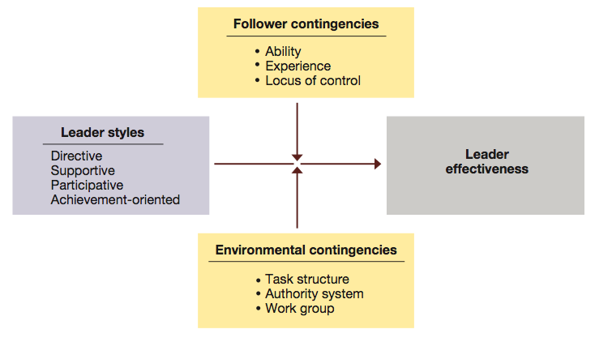
Figure 11.7 Contingency relationships in the path-goal leadership theory.
Management 3e - Chapter 11
17

Slide 18
Contingency approaches to leadership
House’s leadership styles:
  Directive leadership.
    Communicate expectations.
    Give directions.
    Schedule work.
    Maintain performance standards.
    Clarify leader’s role.
  Supportive leadership.
    Make work pleasant.
    Treat group members as equals.
    Be friendly and approachable.
    Show concern for subordinates’ well-being.
Management 3e - Chapter 11
18

Slide 19
Contingency approaches to leadership
House’s leadership styles:
  Achievement-oriented leadership.
    Set challenging goals.
    Expect high performance levels.
    Emphasize continuous improvement.
    Display confidence in meeting high standards.
  Participative leadership.
    Involve subordinates in decision making.
    Consult with subordinates.
    Ask for subordinates’ suggestions.
    Use subordinates’ suggestions.
Management 3e - Chapter 11
19

Slide 20
Communication

Slide 21
Communication – What is it?
Communication is the ability to share ideas and feelings
Communication … is a two-way process by which information is exchanged between individuals, including and behaviour, verbal or nonverbal that is perceived by another
Communication is a two-way process in which the communicators try to achieve a shared meaning

Slide 22
Characteristics of Communication
No direct mind-to-mind contact, so we must share feelings and experiences through a physical process
Only inference is possible, so we never know for sure
Communication is a dynamic process – no obvious beginning and end, and a means through which we bring definition to the world around us
Communication is interactive, a reciprocal process
Communication is inevitable
Communication permits the transmission of knowledge between persons, and also between generations
Communication is symbolic, expressing things, processes, ideas
Communication does not mean understanding

Slide 23
Characteristics of Communication
Communication has consequences
Communication is self-reflective, rooted in our ability to think about ourselves and to reflect on our past, present and future
The brain is an open system – we can learn and we never stop learning
Communication is contextual – time, place, and prescriptive regarding the type of behaviour preferred or prohibited

Slide 24
Importance of Communication to Management
Management is getting things done through other people
Everything a manager does involves communication (managers spend 75% of their time on communicating)
For the manager, communication facilitates control, motivation, the expression of emotions and the transfer of information/meaning

Slide 25
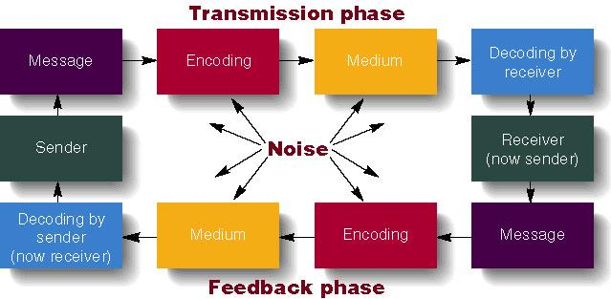
The Communication Process

Slide 26
The Communication Process
  Communication consists of two phases:
    1. Transmission phase: information is shared by 2 or more people.
    2. Feedback phase: a common understanding is assured.
  Starts with the Sender who wants to share information.
    Sender must decide on a message to share
    Sender also puts the message into symbols or language, a process called encoding (constructing the message).
  Noise: anything harming the communication process (distractions that interfere with the message).

Slide 27
The Communication Process
  Messages are transmitted over a medium to a receiver.
    Medium: pathway the message is transmitted on (phone, letter).
    Receiver: person getting the message.
  Receiver next decodes the message.
    Decoding allows the receiver to understand the message (interpreting the message).
    This is a critical point, can lead to misunderstanding.
  Feedback is started by receiver and states that the message is understood or that it must be re-sent.

Slide 28
Communication Issues
  Encoding of messages can be done verbally or non-verbally
    Verbal: spoken or written communication.
    Nonverbal: facial gestures, body language, dress.
  Sender and receiver communicate based on their perception.
    Subjective perception can lead to biases and stereotypes that hurt communication.
    Effective Managers avoid communicating based on a pre-set belief.

Slide 29
Nonverbal Communications
In a normal two-way conversation, verbal components carry less than 35 percent of the social meaning of the situation
We believe nonverbal messages over verbal messages when the two contradict each other
Nonverbal communication is often the foundation for our first impressions

Slide 30
Nonverbal Communications –
What is it?
Communication in any form other than words that can produce shared meaning and elicit a response
Embraces the intentionality and ‘unintentionality’ of messages during the encoding and decoding stages

Slide 31
Verbal vs. Nonverbal communication
Verbal Communication
Based on culturally agreed upon set of symbols
usually deliberate
Learned later in life
Come in an orderly sequential way
Has a definite ending point
Nonverbal Communication
Based on culturally agreed upon set of symbols
Often governed biologically/involuntarily
Learned earlier in life
Do not come in an orderly sequential way, but simultaneously from a multiple of channels
Continuous process, never ending

Slide 32
Categories of Nonverbal Communication
Time
Space
Material Possessions
Silence
Kinesics
Facial Expression
Posture
Gestures
Eye Contact
Touch
Dress
Paralanguage
Smell

Slide 33
The Communication Process (con’d):
Categories of Nonverbal Communication
Chronemics
Proxemics
Paralanguage
Material Possessions
Chromatics
Smell
Oculesics
Haptics
Kinesics

Slide 34

Directions of Communications Within Organizations
Downward communication
  Goals, objectives, directions, decisions, and feedback
Upward Communication
  Information, suggestions, questions, problems
Lateral Communication
  Information exchange – formal and informal – that assist or affect coordination

Slide 35
Informal Communication Channels – aka the grapevine
Tend to operate more often in the lateral than in the vertical direction
Information flows extremely fast
Carry work-related as well as non work-related information

Slide 36

Barriers to Effective Communication
Interpersonal Barriers
  Selective perception
  Frames of reference
  Individual differences
  Emotions
  Language
  Nonverbal cues

Slide 37
Barriers to Effective Communication
Organizational Barriers
  The hierarchical structure
  Differences between levels of authority

Slide 38
Barriers to Effective Communication
Cultural Barriers
  Culture cannot exist without communication and human communication occurs within a cultural context
    Ethnocentrism
    Stereotyping
    Cultural distance

