Slide 1
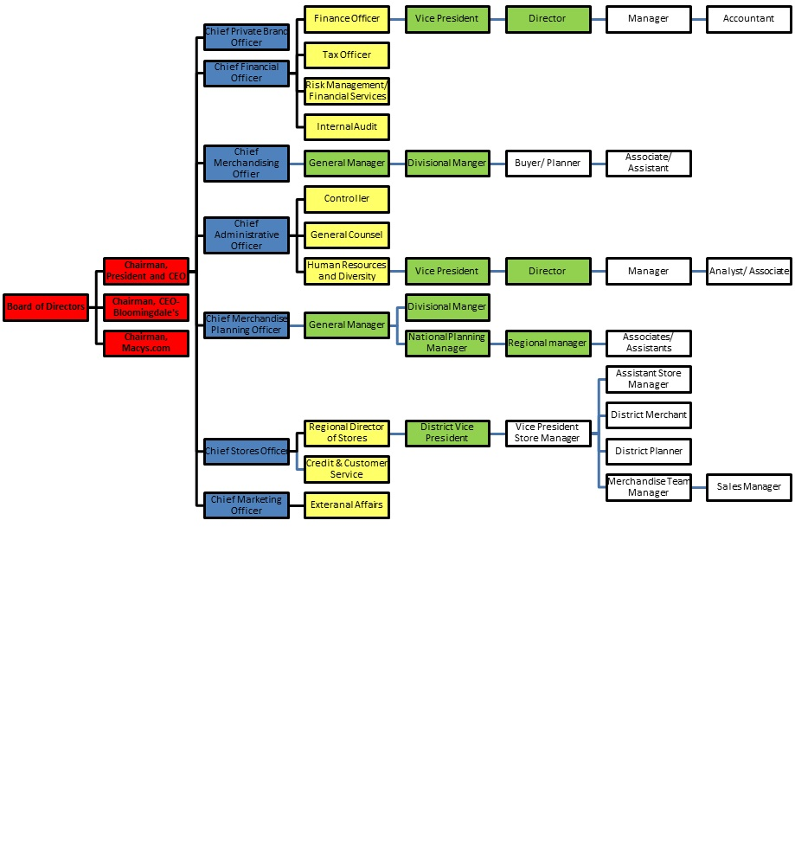
ADM1300
Lecture 6
Organization Structure and Design
Organization Culture
Text Reference: Chapter 8

Slide 2
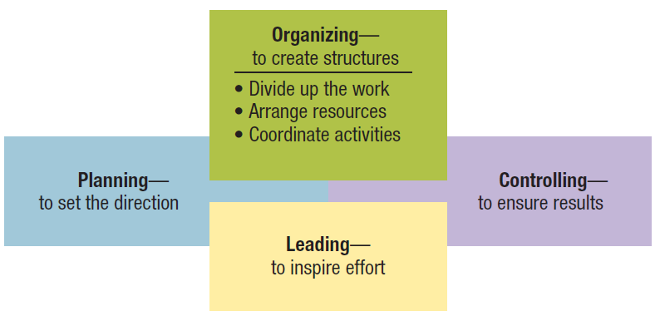
Figure 8.1 Organizing viewed in relationship with the other management functions.
Management 3e - Chapter 8
5

Slide 3
Organizing as a Management Function
Organizing and organization structure
  Organizing
    The process of arranging people and other resources to work together to accomplish a goal.
  Organization structure
    The system of tasks, workflows, reporting relationships, and communication channels that link together diverse individuals and groups.
Management 3e - Chapter 8
4

Slide 4
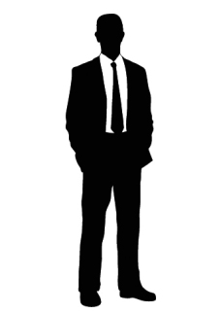
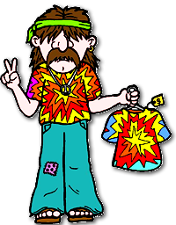
Organizational Structure:
Formal or Informal

Slide 5
Organizing as a Management Function
Formal structures
  The structure of the organization in its official state.
  An organization chart is a diagram describing reporting relationships and the formal arrangement of work positions within an organization.
  An organization chart identifies the following aspects of formal structure:
    The division of work.
    Supervisory relationships.
    Communication channels.
    Major subunits.
    Levels of management.
Management 3e - Chapter 8
6

Slide 6
Organizing as a Management Function
Informal structures
  A “shadow” organization made up of the unofficial, but often critical, working relationships between organization members.
  Potential advantages of informal structures:
    Helping people accomplish their work.
    Overcoming limits of formal structure.
    Gaining access to interpersonal networks.
    Informal learning.
Management 3e - Chapter 8
7

Slide 7
Organizing as a Management Function
Informal structures (cont.)
  Potential disadvantages of informal structures:
    May work against best interests of entire organization.
    Susceptibility to rumor.
    May carry inaccurate information.
    May breed resistance to change.
    Diversion of work efforts from important objectives.
    Feeling of alienation by outsiders.
Management 3e - Chapter 8
8

Slide 8
Traditional Organization Structures
Departmentalization
Traditional Structures
Grouping positions and teams so as to enhance coordination
This has resulted in three major types of traditional organization structures →
Functional
Divisional
Matrix
Management 3e - Chapter 8
9

Slide 9
Traditional Organization Structures
Functional structures
  People with similar skills and performing similar tasks are grouped together into formal work units.
  Members work in their functional areas of expertise.
  Are not limited to businesses.
  Work well for small organizations producing few products or services.
Management 3e - Chapter 8
9

Slide 10
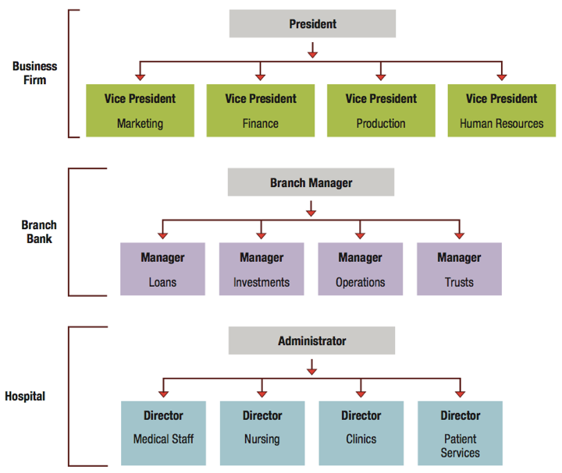
Figure 8.3 Functional structures in a business, branch bank, and community hospital.
Management 3e - Chapter 8
10

Slide 11
Traditional Organization Structures
Divisional structures
  Group together people who work on the same product or process, serve similar customers, and/or are located in the same area or geographical region.
  Common in complex organizations.
  Avoid problems associated with functional structures.
Management 3e - Chapter 8
13

Slide 12
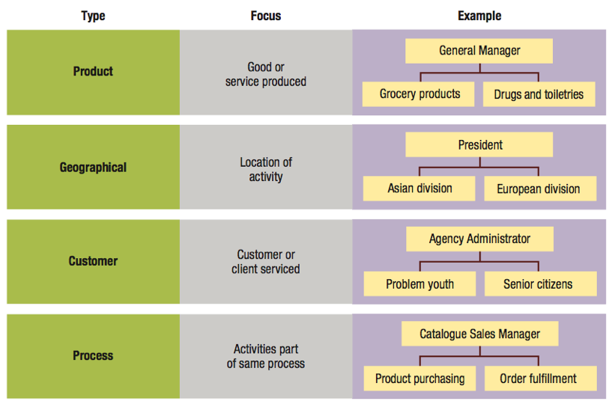
Figure 8.4 Divisional structures based on product, geography, customer, and process.
Management 3e - Chapter 8
14

Slide 13
Traditional Organization Structures
Types of divisional structures and how they group job and activities:
  Product structures focus on a single product or service.
  Geographical structures focus on the same location or geographical region.
  Customer structures focus on the same customers or clients.
  Process structures focus on the same processes.
Management 3e - Chapter 8
15

Slide 14
Traditional Organization Structures
Matrix structure
  Combines functional and divisional structures to gain advantages and minimize disadvantages of each.
  Used in:
    Manufacturing
    Service industries
    Professional fields
    Non-profit sector
    Multi-national corporations
Management 3e - Chapter 8
18

Slide 15
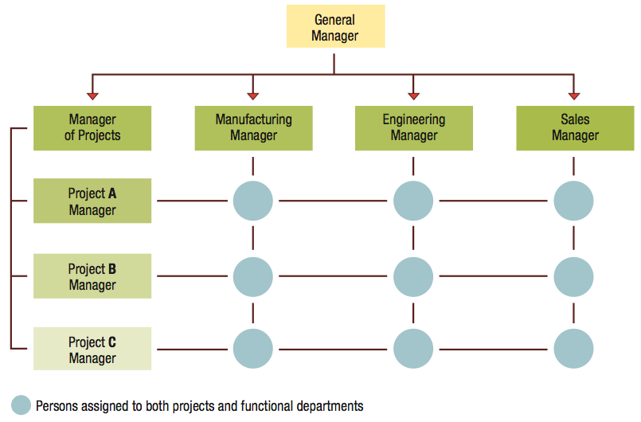
Figure 8.5 Matrix structure in a small multi-project business firm.
Management 3e - Chapter 8
19

Slide 16
Organizing and Organization Structures
Traditional Organization Structures
  Functional
  Divisional
  Matrix
Horizontal Organization Structures
  Team Structures
  Network Structures
  Boundaryless Structures

Slide 17
Horizontal Organization Structures
Team structures
  Extensively use permanent and temporary teams to solve problems, complete special projects, and accomplish day-to-day tasks.
  Often use cross-functional teams composed of members from different functional departments.
  Project teams are convened for a specific task or project and disbanded once completed.
Management 3e - Chapter 8
22

Slide 18
Horizontal Organization Structures
Network structures
  A central core that is linked through networks of relationships with outside contractors and suppliers of essential services.
  Own only core components and use strategic alliances or outsourcing to provide other components.
Management 3e - Chapter 8
26

Slide 19
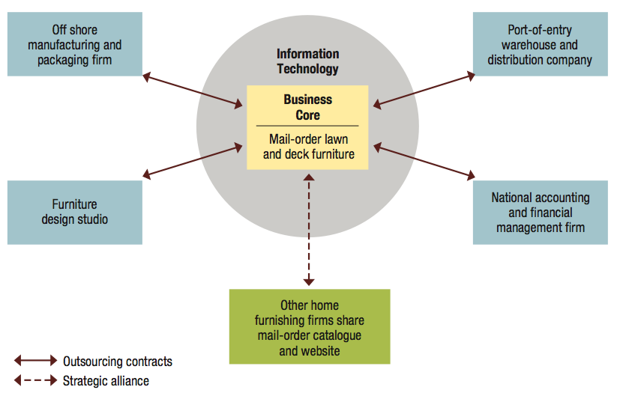
Figure 8.7 A network structure for a Web-based retail business.
Management 3e - Chapter 8
27

Slide 20
Horizontal Organization Structures
Potential advantages of network structures:
  Firms can operate with fewer full-time employees and less complex internal systems.
  Reduced overhead costs and increased operating efficiency.
  Permits operations across great distances.
Management 3e - Chapter 8
28

Slide 21
Horizontal Organization Structures
Potential disadvantages of network structures:
  Control and coordination problems may arise from network complexity.
  Potential loss of control over outsourced activities.
  Potential lack of loyalty among infrequently used contractors.
  Excessively aggressive outsourcing can be dangerous.
Management 3e - Chapter 8
29

Slide 22
Horizontal Organization Structures
Boundaryless organizations
  Eliminate internal boundaries among subsystems and external boundaries with the external environment.
  A combination of team and network structures, with the addition of “temporariness.”
  Key requirements:
    Absence of hierarchy.
    Empowerment of team members.
    Technology utilization.
    Acceptance of impermanence.
Management 3e - Chapter 8
30

Slide 23
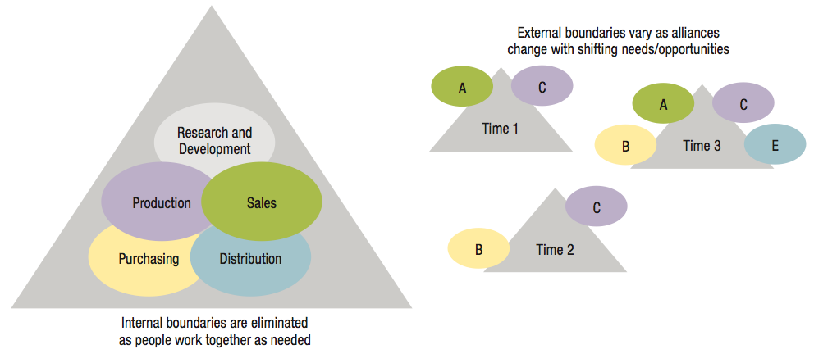
Figure 8.8 The boundaryless organization eliminates internal and external barriers.
Management 3e - Chapter 8
32

Slide 24
Horizontal Organization Structures
Boundaryless organizations (cont.)
  Encourage creativity, quality, timeliness, flexibility, and efficiency.
  Knowledge sharing is both a goal and essential component.
  Virtual organization.
    A special form of boundaryless organization.
    Operates in a shifting network of external alliances that are engaged as needed, using IT and the Internet.
Management 3e - Chapter 8
31

Slide 25
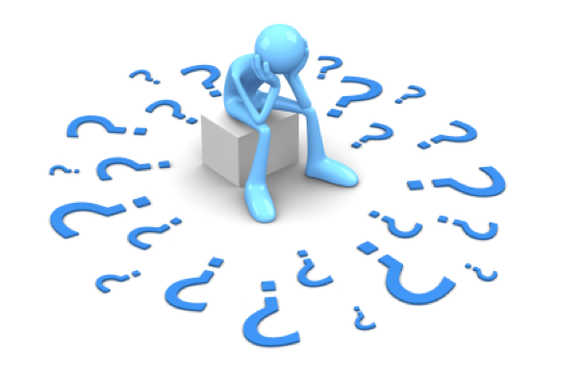
Horizontal Organization Structures
What is the difference between a network structure and a boundaryless structure?

Slide 26
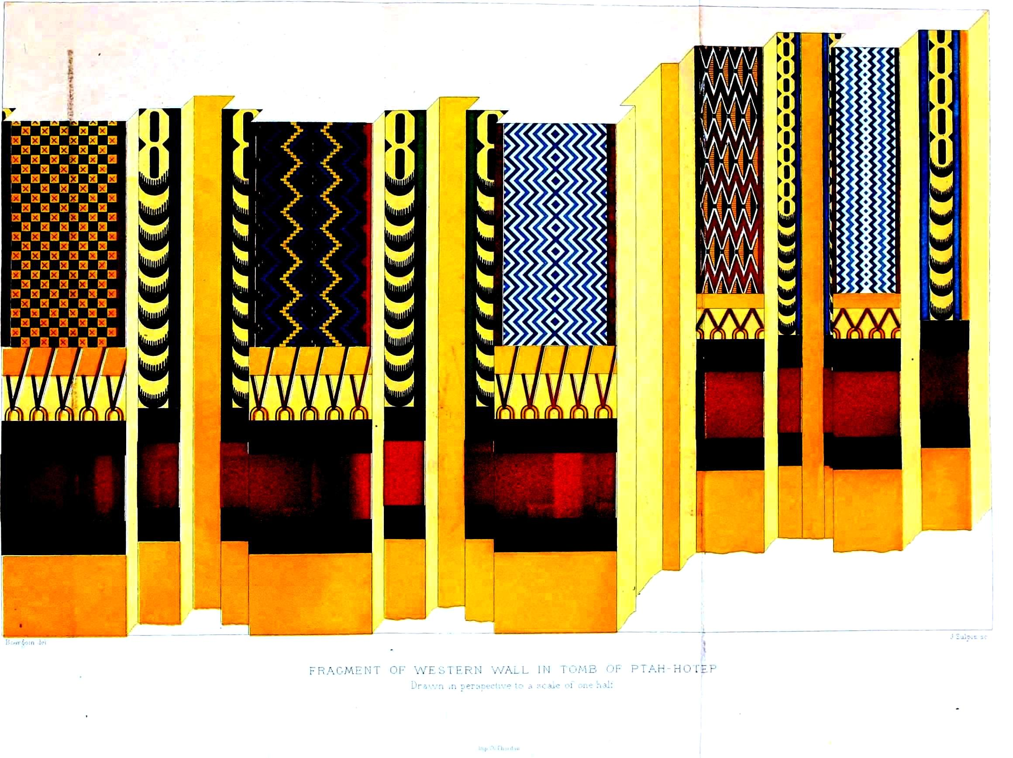
Organizational Design

Slide 27
Organizational Designs
Organizational design
  Choosing and implementing structures that best arrange resources to serve the organization’s mission and objectives.
  Mechanistic or Organic
Management 3e - Chapter 8
33

Slide 28
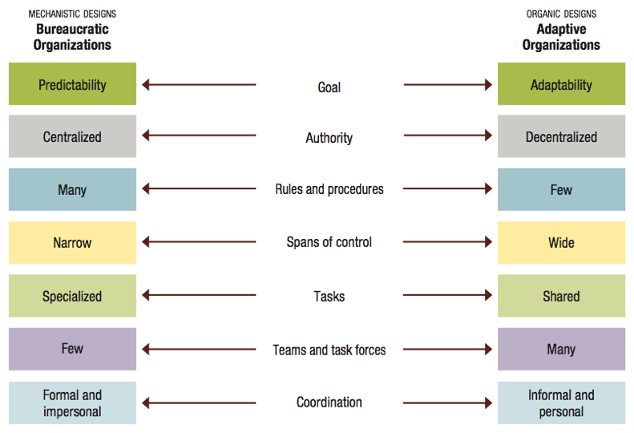
Figure 8.9 A continuum of organizational design alternatives: from bureaucratic to adaptive organizations.
Management 3e - Chapter 8
37

Slide 29
Organizational Designs
Contemporary organizing trends include:
  Fewer levels of management
    Shorter chains of command.
    Less unity of command.
  Wider spans of control.
  More delegation and empowerment.
  Decentralization with centralization.
  Reduced use of staff.
Management 3e - Chapter 8
44

Slide 30
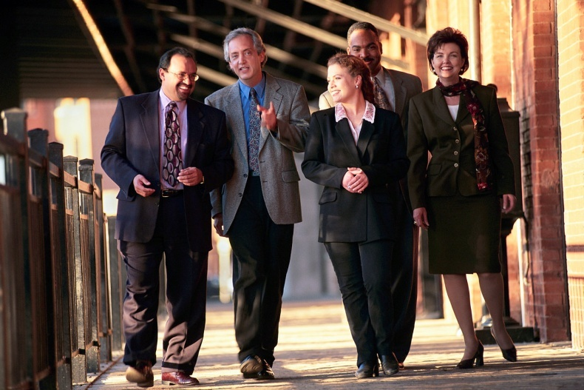
Organizational Culture

Slide 31
Organizational Culture....
Something unique that exemplifies and differentiates the organization

Slide 32
Organizational Culture – What is it?
The system of shared actions, values, and beliefs that develops within an organization and guides the behaviour of its members (Edgar Schein, “Organizational Culture,” American Psychologist, Vol.45 (1990), pp.109-119.)
The values shared by associates and managers in an organization (Hitt, Miller, and Colella: Organizational Behaviour, 3rd Edition, Wiley, 2011)
A system of shared meaning, held by organizational members, that distinguishes the organization from other organizations (Langton, Robbins & Judge)

Slide 33
Organizational Culture – Common Features
Distinction between one organization and another
A sense of identity for organizational members
A commitment to something larger than self interest
A standard recognized and honoured willingly by employees
The driving force behind the successful operation of the organization

Slide 34

Levels of Organizational Culture (Schermerhorn, Hunt, Osborn, Currie: Organizational Behaviour, Danadian Edition, Wiley, 2005)
Observable Culture
(the way we do things around here)
Shared Values
(that link people together)
Common Assumptions
(the taken-for-granted truths that members share as a result of their joint experience)

Slide 35
Levels of Organizational Culture(Schermerhorn, Hunt, Osborn, Currie: Organizational Behaviour, Danadian Edition, Wiley, 2005)
Observable Culture
(the way we do things around here)
Stories
Rites
Rituals
Symbols

Slide 36
Levels of Organizational Culture (Schermerhorn, Hunt, Osborn, Currie: Organizational Behaviour, Danadian Edition, Wiley, 2005)
Shared Values
(that link people together)
What the organization stands for
Greater concern for individuals
A belief in ritual and ceremony
Clearly understood expectations

Slide 37
Levels of Organizational Culture (Schermerhorn, Hunt, Osborn, Currie: Organizational Behaviour, Danadian Edition, Wiley, 2005)
Common Assumptions
(the taken-for-granted truths that members share as a result of their joint experience)
“we are different”
“we are better”
“we are talented”
“we are competent”
“we are innovators”
“we are the best there is”

Slide 38
Teaching the Culture to Employees
Four Factors
  Values of the founder
    Have a substantial influence on the values, norms and standards of behaviour that develop over time within the organization
  Socialization
    Process by which newcomers learn an organization’s values and norms and acquire the work behaviours necessary to perform jobs effectively

Slide 39
Teaching the Culture to Employees
Four Factors
  Stories and language
    Stories about organizational heroes and villains provide clues about values and norms
  Ceremonies and Rites
    Rite of passage (how one enters, advances within, or leaves the organization)
    Rite of integration (build and reinforce common bonds among organizational members)
    Rite of enhancement (let organizations publicly recognize and reward employees’ contributions and thereby strengthen their commitment to organizational values)

Slide 40
Organizational Rites
TYPE OF RITE EXAMPLE OF RITE PURPOSE OF RITE
Rite of passage Induction and basic training Learn and internalize
norms and values
Rite of integration Office Christmas party Build common norms
and values
Rite of enhancement Presentation of annual Motivate commitment
award to norms and values

Slide 41
Organizational Culture and Change
Five Mechanisms that alert employees to what management finds important in the culture:
  Attention – what is criticized, praised
  Reactions to crises – conveys core values
  Role modeling – walk the talk
  Allocation of rewards – signal how one succeeds in the organization
  Criteria for selection and dismissal – who gets recruited; who gets dismissed

Slide 42
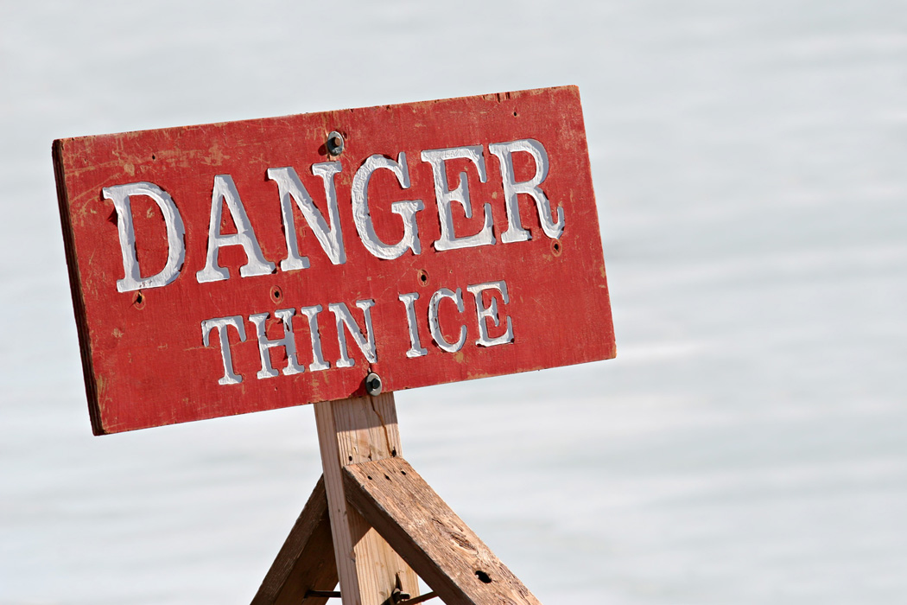
Liabilities of Organizational Culture
Barrier to change
Barrier to diversity
Barrier to mergers and acquisitions

