Slide 1
Lecture 2
  Management Learning: Past to Present (aka: Management Theory)
Management 3e - Chapter 2
4

Slide 2

From whence we came…
Management = getting the right things done through other people
How has the way we do this, as managers, evolved over time?
“Management thought” started over 100 years ago, and has evolved rather quickly

Slide 3
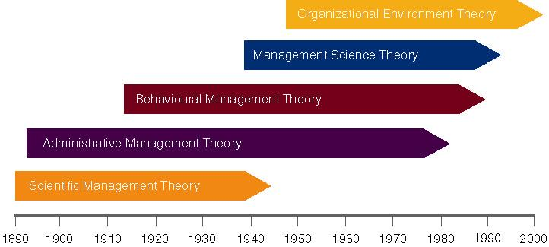
Evolution of Management Theory

Slide 4
Classical Management Approaches
Classical approaches to management include:
  Scientific management
  Administrative principles
  Bureaucratic organization
Management 3e - Chapter 2
4

Slide 5
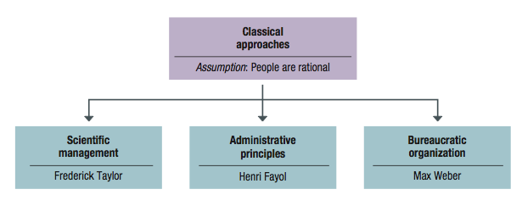
Figure 2.1 Major branches in the classical approach to management.
Classical Management Approaches
Management 3e - Chapter 2
5

Slide 6
In the beginning
Scientific Management

Slide 7
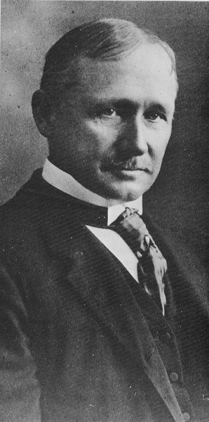
Scientific Management –
Frederick Taylor
Defined scientific management
  The systematic study of the relationships between people and tasks to redesign the work for higher efficiency.
Taylor sought to reduce the time a worker spent on each task by optimizing the way the task was done.

Slide 8
Taylor’s Principles
Principles to increase efficiency:
  For every job develop a science that includes:
    Rules of motion
    Standardized work implements
    Proper working conditions
  Carefully select workers with the right abilities to perform the job
  Train workers to do the job and give them proper incentives to cooperate with the job science
  Support workers by carefully planning their work
  Study & Codify –> Select & Train –> Reward

Slide 9
Problems of Scientific Management
Managers often implemented only the increased output side of Taylor’s plan.
  They did not allow workers to share in increased output.
  Specialized jobs became very boring, dull.
  Workers ended up distrusting Scientific Management.
Workers could purposely “under-perform”
Management responded with increased use of machines.

Slide 10
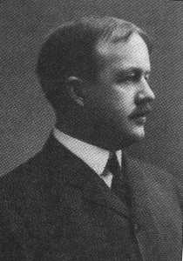
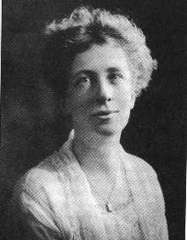
Scientific Management –
Frank and Lillian Gilbreth
Frank and Lillian Gilbreth refined Taylor’s methods.
  Made many improvements to time and motion studies.
Time and motion studies:
  1. Break down each action into components.
  2. Find better ways to perform it.
  3. Reorganize each action to be more efficient.
Gilbreths also studied fatigue problems, lighting, heating and other worker issues.

Slide 11
The Gilbreths vs. Taylor
Gilbreths’ studies were more focused on how a task was done, and how to best eliminate unneeded, fatiguing steps in any process
Gilbreths’ form of scientific management had a more developed view of the worker and his/her interests vs. Taylor’s predominant view of the worker as driven solely by pay
Gilbreths used photography as a means to study human motion in completing tasks (micro motion films)

Slide 12
Classical Management Approaches
Practical lessons from scientific management
  Make results-based compensation a performance incentive
  Carefully design jobs with efficient work methods
  Carefully select workers with the abilities to do these jobs
  Train workers to perform jobs to the best of their abilities
  Train supervisors to support workers so they can perform jobs to the best of their abilities
Management 3e - Chapter 2
8

Slide 13
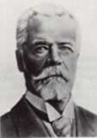
Administrative Management –
Henri Fayol
Fayol postulated that all administrative activities could be divided into 6 groups:
  Technical operations (production/manufacturing)
  Commercial operations (purchases, sales)
  Financial operations (finding & controlling capital)
  Security operations (protecting property & persons)
  Accounting operations (stock-taking, costing)]
  Administrative Operations or managerial activities:
    “foresight, organizing, commanding, coordinating, controlling”

Slide 14
Fayol’s Principles
Fayol also developed a set of 14 principles:
  1. Division of Labour: allows for job specialization.
    Fayol noted firms can have too much specialization leading to poor quality and worker involvement.
  2. Authority and Responsibility: Fayol included both formal and informal authority resulting from special expertise.
  3. Unity of Command: Employees should have only one boss.
  4. Line of Authority: a clear chain from top to bottom of the firm.
  5. Centralization: the degree to which authority rests at the very top.

Slide 15
Fayol’s Principles
  6. Unity of Direction: One plan of action to guide the organization.
  7. Equity: Treat all employees fairly in justice and respect.
  8. Order: Each employee is put where they have the most value.
  9. Initiative: Encourage innovation.
  10. Discipline: obedient, applied, respectful employees needed.

Slide 16
Fayol’s Principles
  11. Remuneration of Personnel: The payment system contributes to success.
  12. Stability of Tenure: Long-term employment is important.
  13. General interest over individual interest: The organization takes precedence over the individual.
  14. Esprit de corps: Share enthusiasm or devotion to the organization.

Slide 17
Classical Management Approaches
Bureaucratic organization (Max Weber)
  Bureaucracy
    An ideal, intentionally rational, and very efficient form of organization.
    Based on principles of logic, order, and legitimate authority.
Management 3e - Chapter 2
12

Slide 18
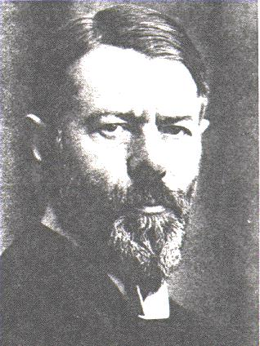
Administrative Management –
Max Weber
Max Weber developed the concept of bureaucracy.
  A formal system of organization and administration to ensure effectiveness and efficiency.
  Developed five principles of bureaucracy

Slide 19
Bureaucratic Principles
A manager’s formal
authority derives
from his/her position
People should occupy
Positions because of
Performance, not
Social connections
5 Principles of
Bureaucracy
The authority, responsibility
of each position relative
to every other position
should be made clear
Positions should be
arranged hierarchically
Managers must create a
well defined system of rules
standard operating
procedures, and norms

Slide 20
Key Points of Bureaucracy
  Authority is the power to hold people accountable for their actions.
  Positions in the firm should be held based on performance not social contacts.
  Position duties are clearly identified. People should know what is expected of them.
  Lines of authority should be clearly identified. Workers know who reports to who.
  Rules, Standard Operating Procedures (SOPs), & Norms used to determine how the firm operates.
    Sometimes, these lead to “red-tape” and other problems.

Slide 21
Behavioural Management Approaches
Behavioural Management - human resource approaches include:
  Follett’s notion of organizations as communities
  Hawthorne studies
  Maslow’s theory of human needs
  McGregor’s Theory X and Theory Y
  Argyris’s theory of adult personality
Management 3e - Chapter 2
14

Slide 22
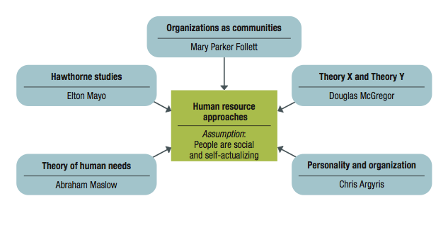
Figure 2.2 Foundations in the behavioural or human resource approaches to management
Behavioural Management Approaches
Management 3e - Chapter 2
15

Slide 23
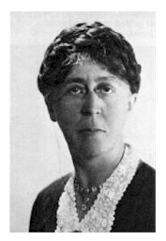
Behavioural Management Theory –
Mary Parker Follett
Mary Parker Follett:
Suggested workers help in analyzing their jobs for improvements.
The worker knows the best way to improve the job.
If workers have the knowledge of the task, then they should control the task.

Slide 24
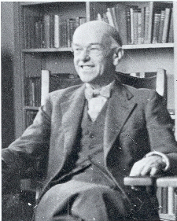
Elton Mayo – The Hawthorne Studies
Occurred at the Hawthorne Plant of the Western Electric Company in Cicero, Illinois
Initially examined the physical and environmental influences of the workplace (brightness of lights, humidity) and later examined the psychological aspects (breaks, group pressure, working hours, managerial leadership)

Slide 25
The Hawthorne Studies
Four General Conclusions:
  The aptitudes of individuals are imperfect predictors of job performance
  The informal organization affects productivity
  Work-group norms affect productivity
  The workplace is a social system

Slide 26
Behavioural Management Approaches
Maslow’s theory of human needs
  A need is a physiological or psychological deficiency a person feels compelled to satisfy.
  Need levels:
    Physiological
    Safety
    Social
    Esteem
    Self-actualization
Management 3e - Chapter 2
21

Slide 27
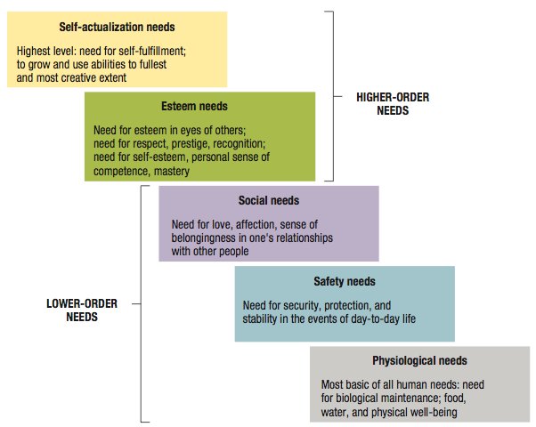
Figure 2.4 Maslow’s hierarchy of human needs.
Behavioural Management Approaches
Management 3e - Chapter 2
22

Slide 28
Behavioural Management Approaches
Maslow’s theory of human needs
  Deficit principle
    A satisfied need is not a motivator of behaviour.
  Progression principle
    A need becomes a motivator once the preceding lower-level need is satisfied.
  Both principles cease to operate at self-actualization level.
Management 3e - Chapter 2
23

Slide 29
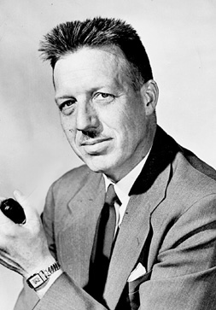
Douglas McGregor
Douglas McGregor proposed the two different sets of worker assumptions.
  Theory X: Assumes the average worker is lazy, dislikes work and will do as little as possible.
    Managers must closely supervise and control through reward and punishment.
  Theory Y: Assumes workers are not lazy, want to do a good job and the job itself will determine if the worker likes the work.
    Managers should allow the worker great latitude, and create an organization to stimulate the worker.

Slide 30
Modern Management Foundations
Foundations for continuing developments in management
  Quantitative analysis and tools
  Systems view of organizations
  Contingency thinking
  Commitment to quality
  Learning organizations
  Evidence-based management
Management 3e - Chapter 2
27

Slide 31

Questions?

