Slide 1
HSS 2381
Quantitative Methods in Health Sciences I
Kerry-Anne Hogan RN PhD
Wednesday Sept 7, 2016
Thursday Sept 8, 2016
Tuesday Sept 15, 2016

Slide 2
What is Research?
Research is what we do when we have a question or a problem we want to resolve
We may already think we know the answer to our question already
We may think the answer is obvious, common sense even
But until we have subjected our problem to rigorous scientific scrutiny, our 'knowledge' remains little more than guesswork or at best, intuition.

Slide 3
What is research about?
Answering important and interesting questions
Not just data collection
Research questions are about what you WANT TO KNOW
Not about WHAT YOU WANT TO DO

Slide 4
Classical scientific method
Observation of some phenomenon
  Maybe systematic, occasional or accidental
Some idea of an explanation (hypothesis)
  Induction, conjecture, intuition, guesswork
  Usually informed by related work
Testing of the hypothesis
  Test and revision cycle

Slide 5
Quantitative vs Qualitative
Quantitative research
  systematically observe changes in the phenomena of interest while manipulating what are believed to be causal influences
  Measured in terms of numbers
  eg height, weight , size
Qualitative research
  may be more concerned with the individual’s personal experiences of the problem under study
  Do not imply a numerical ordering
  Aka categorical variables
  Eg religion

Slide 6
Quantitative Research:
Systematic scientific investigation of data and their relationships.

Slide 7
Overview of Quantitative Research
The objective of quantitative research is to develop and employ mathematical models, theories and hypotheses pertaining to natural phenomena.
Measuring is key in quantitative research because it shows the relationship between data and observation.

Slide 8
Research Hypotheses for Quantitative Research
Educated guess or presumption based on literature
States the nature of the relationship between two or more variables
Predicts the research outcome
Research study designed to test the relationship described in the hypothesis

Slide 9
Quantitative
Research Hypotheses
Directional hypothesis
  Precise statement indicating the nature and direction of the relationship/difference between variables
Nondirectional hypothesis
  States only that relationship/difference will occur

Slide 10
Assessing Hypotheses
Simply stated?
Single sentence?
At least two variables?
Variables clearly stated?
Is the relationship/difference precisely stated?
Testable?

Slide 11
Null Hypotheses
Implicit complementary statement to the research hypothesis
States no relationship/difference exists between variables
Statistical test performed on the null
Assumed to be true until support for the research hypothesis is demonstrated

Slide 12
Types of Variables
Variable
  Element that is identified in the hypothesis or research question
  Property or characteristic of people or things that varies in quality or magnitude
  Must have two or more levels
  Must be identified as independent or dependent

Slide 13
Independent Variables
Manipulation or variation of this variable is the cause of change in other variables
Technically, independent variable is the term reserved for experimental studies
  Also called antecedent variable, experimental variable, treatment variable, causal variable, predictor variable
Notes:
In general, the number of levels of an independent variable is the number of experimental conditions

Slide 14
Dependent Variables
The variable of primary interest
Research question/hypothesis describes, explains, or predicts changes in it
The variable that is influenced or changed by the independent variable
  In non-experimental research, also called criterion variable, outcome variable

Slide 15
Relationship Between Independent and Dependent Variables
Cannot specify independent variables without specifying dependent variables
Number of independent and dependent variables depends on the nature and complexity of the study
The number and type of variables dictates which statistical test will be used

Slide 16
The Levels of Measurement
Nominal
Ordinal
Interval
Ratio
Notes:
For dependent variable

Slide 17
Nominal Measurement
The values “name” the attribute uniquely (classification).
The value does not imply any ordering of the cases, for example, jersey numbers in football and dates in a calendar.
Notes:
Simply names or categories
Eg gender, fav color

Slide 18
Nominal continued
Nominal: These variables consist of categories that are non-ordered. For example, race or ethnicity is one variable used to classify people.
  A simple categorical variable is binary or dichotomous (1/0 or yes/no). For example, are students happy to be here or not?

Slide 19
Ordinal
Ordinal: These variables are also categorical, but we can say that some categories are higher than others. For example, income tax brackets, social class, levels of education etc.
  However, we cannot measure the distance between categories, only which is higher or lower.
  Hence, we cannot say that someone is twice as educated as someone else.
  Can also be used as a dependent variable.

Slide 20
Ordinal Measurement
When attributes can be rank-ordered…
Distances between attributes do not have any meaning, for example, code Educational Attainment as
  0=less than H.S.
  1=some H.S.
  2=H.S. degree
  3=some college
  4=college degree
  5=post college
Is the distance from 0 to 1 the same as 3 to 4?

Slide 21
Interval
Interval: Variables of this type are called scalar or index variables in the sense they provide a scale or index that allows us to measure between levels. We can not only measure which is higher or lower, but how much so.
  Distance is measured between points on a scale with even units.
  Good example is temperature based on Fahrenheit or Celsius.
Notes:
Numerical scales which intervals have the same interpretation throughout
- No true zero point → 0 degrees doesn’t mean that absence of temp

Slide 22
Interval Measurement
When distance between attributes has meaning, for example, temperature (in Fahrenheit) -- distance from 30-40 is same as distance from 70-80
Note that ratios don’t make any sense -- 80 degrees is not twice as hot as 40 degrees (although the attribute values are).
Notes:
Because they no no true point o→ where zero doesn’t mean theres an absent in temperature etc

Slide 23
Ratio
Ratio: Similar to interval level variables in that it can measure the distance between two points, but can do so in absolute terms.
  Ratio measures have a true zero, unlike interval measures.
  For example, one can say that someone is twice as rich as someone else based on the value of their assets since to have no money is based on a starting point of zero.
Notes:
Most informative scale
It is an interval scales w additional property that 0 position indicates the absence of the quantity being measured
Eg amt of money

Slide 24
Ratio
Has an absolute zero that is meaningful
Can construct a meaningful ratio (fraction), for example, number of clients in past six months
It is meaningful to say that “...we had twice as many clients in this period as we did in the previous six months.

Slide 25
Measurement Hierarchy
RATIO
STRONGEST
INTERVAL
ORDINAL
NOMINAL
WEAKEST

Slide 26
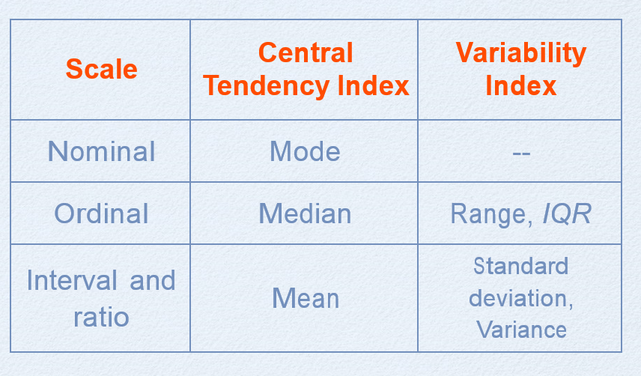
Descriptive Statistics
Discrete variable | Descriptive variable | Cumulative freq | - Bar graph (discrete variable)- do not touch - Pie chart
Discrete variable
Continuous variable |  |  | Histogram (continuous variable) Polygons
Notes:
Normal distribution plays an impt role in inferential stat
Shape of distribution: modality (uni, bi, multi), skewness (pos n neg) [symmetry], kurtosis (leptokurtic, mesokurtic & palytokurtic)
Both central tendency and variability can be expressed by indexes that are descriptive statistics
Many inferential statistics are based on the mean
Classic descriptive statistics include mean, min, max, standard deviation, median, skew, kurtosis. Inferential statistics are a function of the sample data that assists you to draw an inference regarding an hypothesis about a population parameter.
A hypothesis must include 2 variables
Hypothesis (simple [variable vs variable] & complex [2 or more variable vs 2 or more variable])

