Slide 1
1
Introduction to Materials Management

Slide 2
Wealth
What is it?
Where does it come from?
Adding value
  Designing the process
  Managing the process

Slide 3
Wealth
Natural resources
Transformation
Conversion
Managing the process
Services

Slide 4
Operating Environment
Government
  Regulations
  Safety
Economy
  Affects demand
  Shortages and surpluses
Competition is now global
  Reduced costs of transportation
  Communications, reduced costs, and increased speed

Slide 5
Operating Environment (continued)
Customers demand
  Lower prices
  Improved quality
  Reduced lead time
  Improved pre-sale and after-sale service
  Product and volume flexibility
Quality
  Exceeds customer expectations

Slide 6
Order Winners and Qualifiers
Order Qualifiers
  Customer requirements for price, quality, delivery, etc.
  A company must meet or exceed minimum level to qualify for order
Order Winners
  Characteristics that persuade customers to select a product/service from a qualifying company
  “Today’s order winners are
  tomorrow’s order qualifiers”

Slide 7
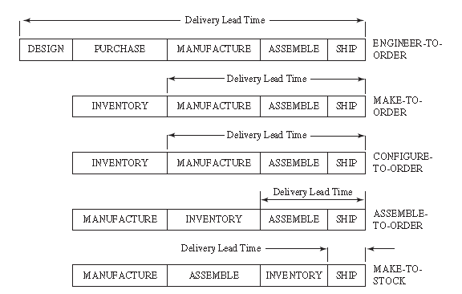
Manufacturing Strategy
Figure 1.1 Manufacturing strategy and lead time

Slide 8
Engineer-to-Order
Manufacturer does not start until the order is received
Custom designs
Unique products
Long lead time
Inventory purchased after order is received

Slide 9
Make-to-Order
Manufacturer does not start until the order is received
Often uses standard components
Little design time
Lead time is reduced
Inventory held as raw materials

Slide 10
Configure-to-Order
Customer allowed to configure product based on features and options
May be an entirely new configuration
Since features and options often available, no significant design time required
  Typically implies shorter delivery time
Similar characteristics to Make-to-Order

Slide 11
Assemble-to-Order
Manufacturer inventories standard components
No design time required
Assembly only required
Shorter lead time
Inventory held as standard components

Slide 12
Make-to-Stock
Manufacturer produces the goods in anticipation of customer demand
Little or no customer involvement with design
Shortest lead time
Inventory held as finished goods

Slide 13
Postponement
Shift differentiation in product as close to customer as possible
Reduced number of different items in the supply chain
  Implies lower supply chain inventory
  Implies faster delivery

Slide 14
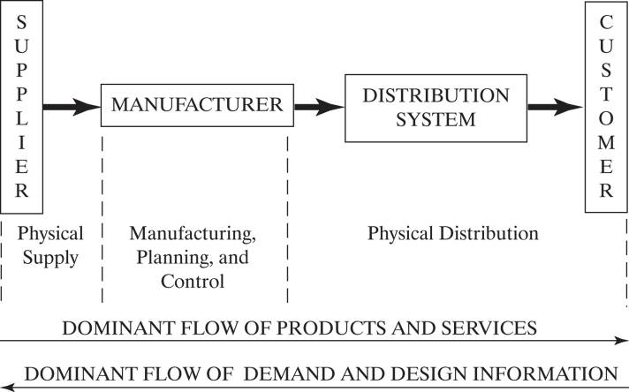
The Supply Chain Concept
Figure 1.2 Supply-production-distribution system

Slide 15
The Supply Chain Concept
Includes all activities and processes to supply a product or service to the customer
Links many companies
Has a number of supplier/customer relationships
May contain intermediaries such as
  Wholesalers
  Warehouses
  Retailers
Flow of products, services, information and cash

Slide 16
Historical Perspective
In the past there were well defined and rigid boundaries between organizations
JIT viewed suppliers as partners
  Mutual analysis for cost reduction
  Mutual product design
  Greatly reduced inventory
  Improved communications (internet, EDI)

Slide 17
Growth of Supply Chain Concept
Integrated systems (ERP) and the sharing of information
Global competition and supply
Flexible designs - reduced product life cycles
JIT approach to inter-organizational relations
Subcontracting or outsourcing work

Slide 18
Current Supply Chain Concept
Manage the flow of materials
Share information through the internet
Transfer funds electronically
Reverse logistics
  Recover
  Recycle
  Reuse

Slide 19
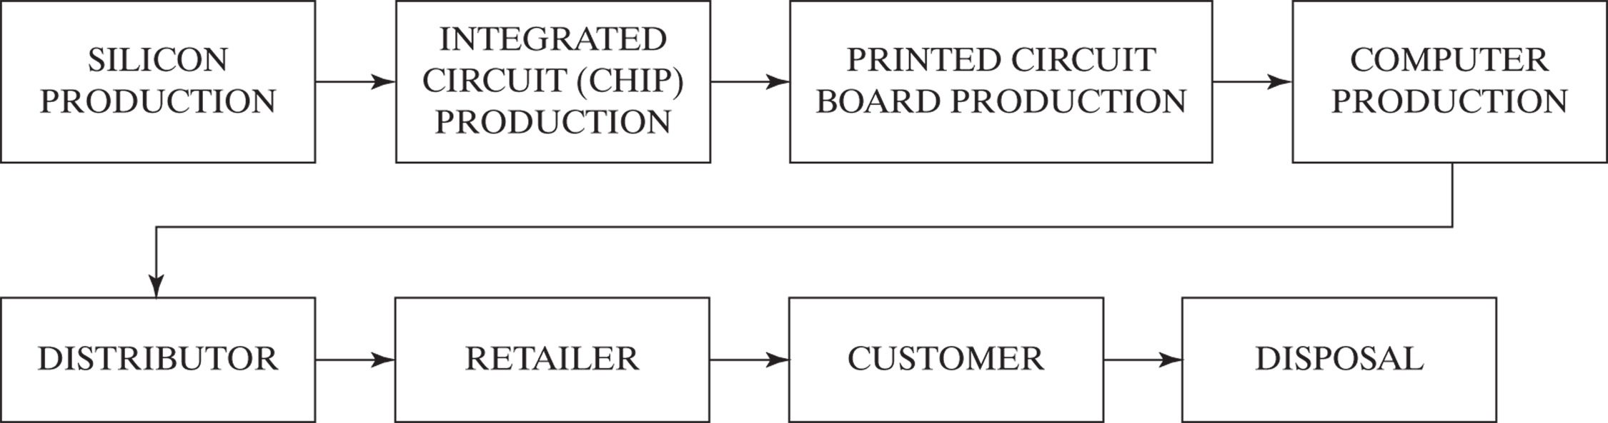
Supply Chain Organization

Slide 20
Supply Chain Metrics
Metric = a verifiable measure
Used to
  Communicate expectations
  Identify problems
  Direct action
  Motivate people
Must be timely

Slide 21
Challenges
1. Customers are rarely satisfied
2. Supply chains are large
3. Product life cycles are getting shorter
4. Lots of data
5. Narrow profit margins
6. Increasing number of alternatives

Slide 22
Metrics
Performance measures
  Quantified and objective
  Contain two parameters
    e.g. Orders per day, Sales per person
Performance standards
  Sets the goals
  Establishes controls
    Performance standards set the goal
    Performance measure say how close you came

Slide 23
Metrics
Strategy
Customer
Focus
Standard
Strategic
Metrics
Operational
Figure 1.4 Metrics context

Slide 24
Metrics Program
1. Establish company goals and objectives
2. Define performance
3. State the measurement
4. Set performance standards
5. Educate the participant
6. Apply consistently

Slide 25
Conflicts in Traditional Systems
Company main objectives to provide
  1. Best customer service
  2. Lowest production costs
  3. Lowest inventory investment
  4. Lowest distribution costs

Slide 26
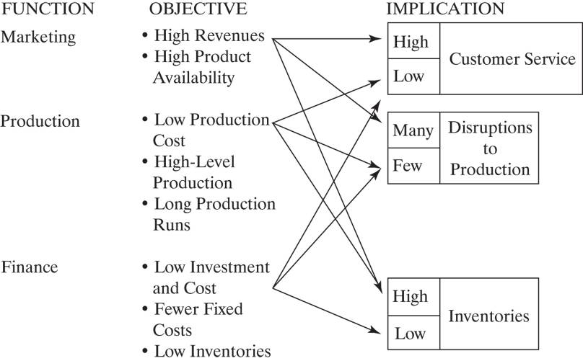
Conflicts in Traditional Systems

Slide 27
Conflicts in Traditional Systems
Marketing Production Finance
Objective: High Revenue Low Cost Cash Flow
Implications:
Customer Service High Low Low
Production
Disruptions Many Few Few
Inventories High High Low

Slide 28
Materials Management
Planning and controlling the flow of materials
Objectives
  Maximize the use of the firm’s resources
  Provide the required level of customer service

Slide 29
Materials Management and Profits
Direct labor
Direct material
  Varies with volume sold
Overhead
  Does not vary with volume sold

Slide 30
Materials Management and Profits (continued)
Dollars % of Sales
Sales Revenue $1,000,000 100
Cost of Goods Sold
  Direct Material $500,000 50
  Direct Labor $200,000 20
  Overhead $200,000 20
Total Cost of Goods Sold $900,000 90
Gross Profit $100,000 10

Slide 31
Materials Management and Profits (continued)
Reduce Materials by 12% and Labor by 5%
Dollars % of Sales
Sales Revenue $1,000,000 100
Cost of Goods Sold
  Direct Material $440,000 44
  Direct Labor $200,000 20
  Overhead $200,000 20
Total Cost of Goods Sold $840,000 84
Gross Profit $160,000 16
Profit has increased 60%

Slide 32
Materials Management and Profits (continued)
To get the same result (+ 60% profit) through Sales
Dollars % of Sales
Sales Revenue $1,200,000 100
Cost of Goods Sold
  Direct Material $600,000 50
  Direct Labor $240,000 20
  Overhead $200,000 20
Total Cost of Goods Sold $1,040,000 87
Gross Profit $160,000 13
Sales must increase by 20%

Slide 33
Manufacturing
Planning and Control
Planning and controlling the flow of materials the manufacturing process through
  Production planning
  Implementation and control
  Inventory management

Slide 34
Materials Management is a Balancing Act
Priority
The Demand
For Products
Capacity
The Ability to
Produce
Products
Trade-offs
Between
Cost of
Providing
The Service
Customer
Service

Slide 35
Production Planning
To meet the demands of the marketplace
Establish priorities
Ensure capacity
Activities
  Forecasting
  Master planning
  Materials requirements planning
  Capacity planning

Slide 36
Implementation and Control
Putting into action and achieving the plans
  Made by production planning
Production activity control
  Shop floor control
Purchasing

Slide 37
Inventory Management
To support production (raw materials) or as a result of production (finished goods)
Provide a buffer against the differences in demand rates and production rates
How much is enough?

Slide 38
Inputs to the Manufacturing Planning and Control System
1. Product description
2. Process specifications
3. Time needed
4. Available facilities
5. Quantity required

Slide 39
Product Description
Engineering Drawings
  Specifications
Bill of Material
  Components used to make the product
  Sub-assemblies at stages of production

Slide 40
Process Specifications
Recorded on a Route Sheet
Describe how the product is made
  Operations required to make the product
  Sequence of operations
  Equipment and accessories required
  Standard time to perform each operation

Slide 41
Time Needed to Perform Operations
Expressed as Standard Time
  An average operator, working at a normal pace
Obtained from the Routing master

Slide 42
Available Facilities
What equipment is available
What labor is available
Obtained from the Work Center master

Slide 43
Quantities Required
Information from
  Forecasts
  Customer Orders
  Production Planning
Expressed in the Shop Order

Slide 44
Physical Supply / Distribution
All the activities involved in moving goods
  From the supplier to the beginning of the production process
  From the end of the process to the customer
Transportation ● Distribution Inventory
Warehousing ● Packaging
Material Handling ● Order Entry

Slide 45
Supply Chain
Customer Service
Cost
Transportation
Inventory

Slide 46
Chapter 1 Summary
Manufacturing creates wealth
Must make the best use of
  Labor, materials and capital
Need to plan the flow of materials
  Into, through and out of production
Three elements in a material flow system
  Supply
  Manufacturing
  Distribution

Slide 47
Chapter 1 Summary (continued)
Need to balance
  Customer service with the cost of supplying the service
There are three basic ways to organize manufacturing processes
  Flow, intermittent and project
  Determined by the
    Item
    Production rate
    Range of products

Slide 48
Chapter 1 Summary (continued)
Each manufacturing system requires the planning of materials
Need the right material at the right place at the right time
Metrics will help with control and meeting the goals of the company

