Slide 1
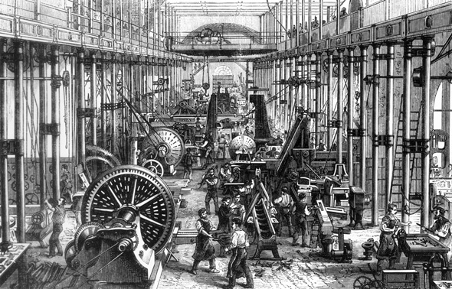
Average urban workers 1868, Cotton spinning machine room: Chemnitz

Slide 2
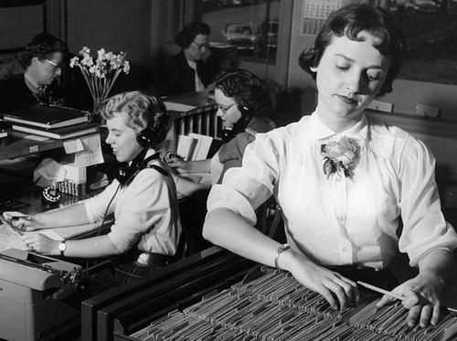
Average Urban workers, Milwaukee: 1950
Notes:
Jump 100 years and the averge urban worker was an office worker

Slide 3
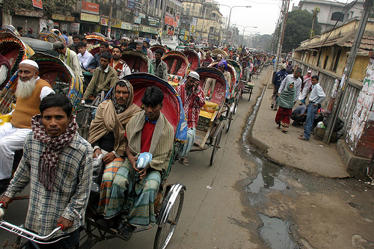
Average urban worker, Dhaka, 2014
Notes:
Mostly labours, squaters, slums, no wet infrastructure, migrating to city from countryside due to less oppertunities

Slide 4
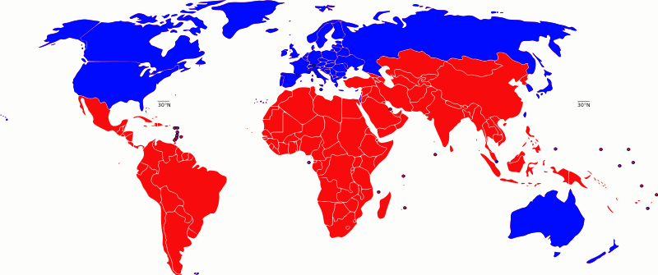
North – South divide
Notes:
Rural existance: No jobs, oppertunities to grow
North is blue
South is red (Usally 3rd world countries, category to follow the first world war after the second world war)
Neutral Countries: Switzerland(Not so much nowadays), India, Africa
Post Colonial: 140 countries in red were all colonized at some point in time
THE CORE: North countries
THE PERIFERY: South Countries

Slide 5
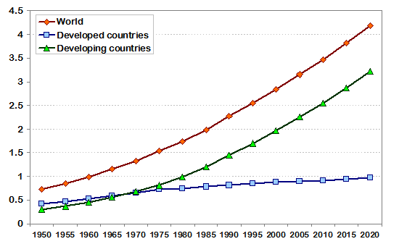
World Urban Population, 1950-2020
Notes:
Theatres of Accumulation = Cities (population)
Cities: Are much like a language, complicated, intraquit, never the exact same
THE WORLD POPULATION: Is growing at a high rate in the global south: Lifting every other urban population up
Whereas the global north: Urban population is steadily increasing

Slide 6
20th century world urban population
220 million
2000 2800 million

Slide 7
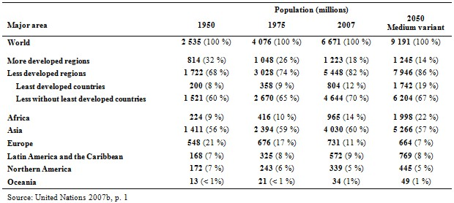
World population growth by region: 1950-2050
Notes:
Urban population increasing a lot higher in the global south, not so much in north.

Slide 8
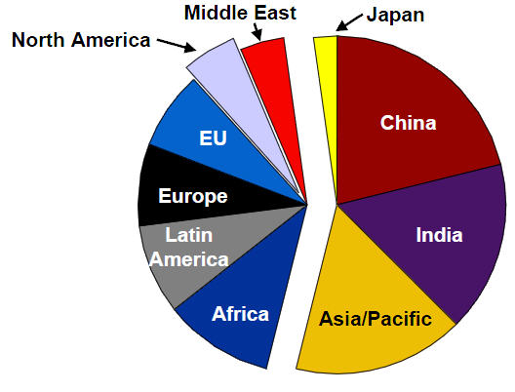
Distribution of World Population 2011
Notes:
53% of the world today lives Urban. Projected to rise to 60% in 2050

Slide 9
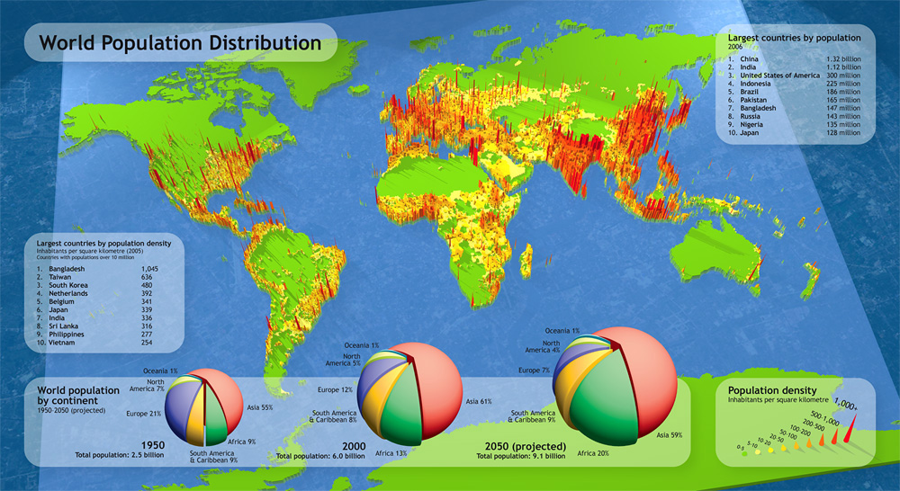

Slide 10
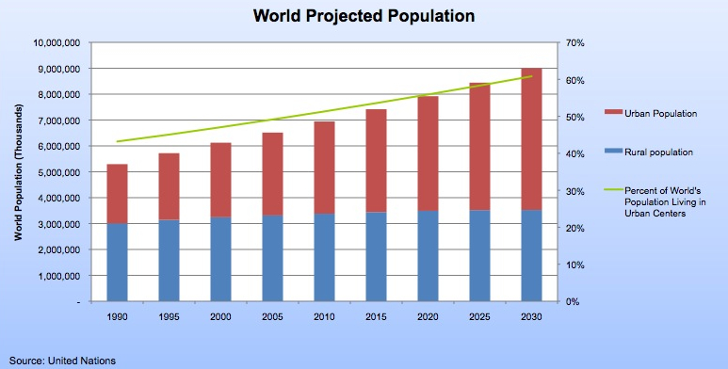
Notes:
Where does the city end? Urban population woll double in Africa and Asia.
Do we add delta, richmond, surrey apart of Vancouver?

Slide 11
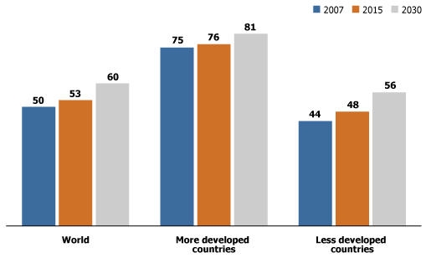
Percent Urban: 2007,2015,2030

Slide 12
Asia and Africa: urban population doubles
1.7 billion
2030 3.5 billion
Notes:
Alarming!

Slide 13
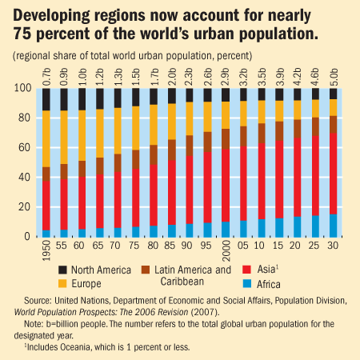

Slide 14
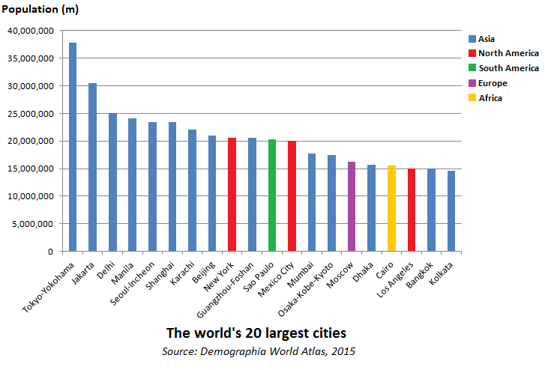

Slide 15
1st wave – North America and Europe
1750 – 1950
10% - 52%
15m – 423m
2nd wave – Third World
1950 – 2030
18% - 56%
309m – 3900m
Notes:
Second wave: We are growing much faster –climate change

Slide 16
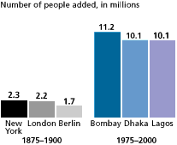
Notes:
What happens when you cant farm anymore due to climate change? No rain? Move to the city and start corporate farming (contracting work out)

Slide 17
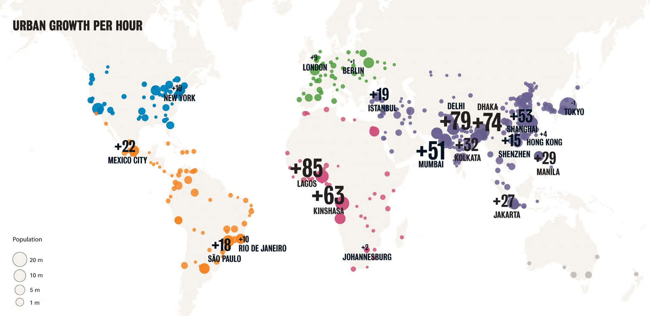

Slide 18
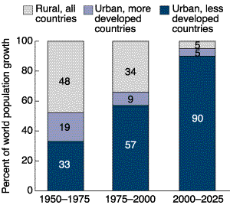
Share of World Population Growth Urban and Rural Areas LDCs and MDCs 1950 to 2025
Over the next quarter century, increases in urbanization will be almost entirely attributable to sub-Saharan Africa and Asia

Slide 19
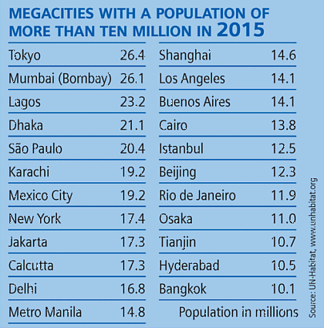

Slide 20
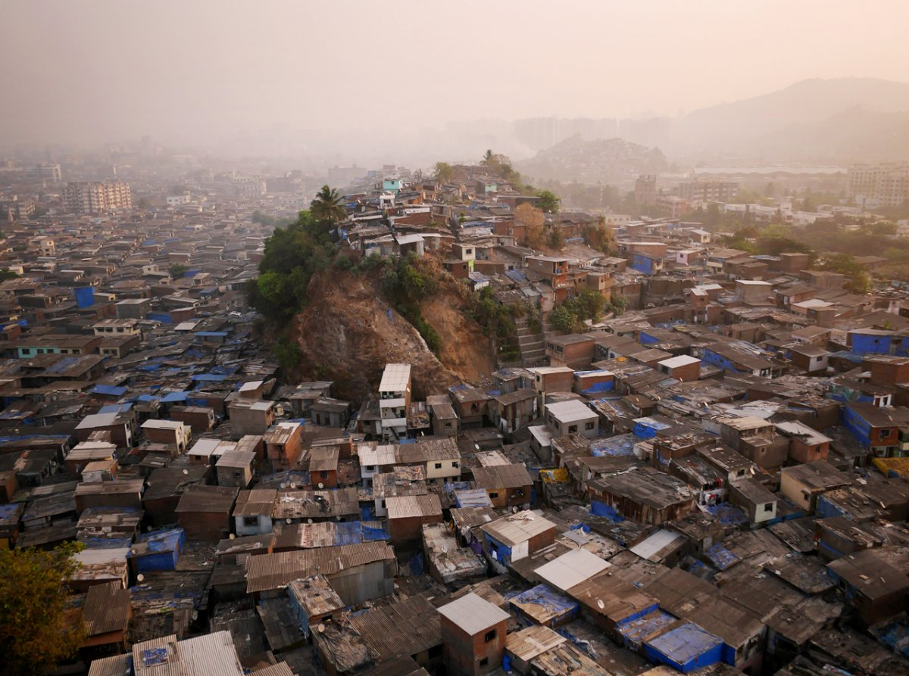
Megacity Mumbai
Notes:
Mega city= 10 million people or more

Slide 21
Urban Growth is Speeding Up
Time required to reach 2 million population:
Rome, Italy 2000 years
Vienna, Austria 400 years
Vancouver, B.C. 115 years
Shenzhen, China 20 years

Slide 22
II Origins and theories
Notes:
Urbaninduction: More people leads to more services, never ending cycle

Slide 23
Origins and Theories
Modernization
International Political Economy
    Colonialism, mercantilism
    Economic disparity
    Urban Bias
Convergence and Divergence
Conservation and Dissolution
Theory of Rural Mobility
Theory of Resistance
Notes:
Slums are low cost living: Provide entery point to urban areas
In india slums have low commutes, where as china doesn’t have slums and long commuting
Slums are shock absorbers

Slide 24
Modernization Theory
Neo-classical
Transition: preindustrial to industrial
Capitalist markets
Cultural changes occur
Primary – secondary – (tertiary)
Notes:
Modernization: Neoclasical, less developed countries are eveloping, transition: pre industry to industrial –all encompassing capitalist markets
Creation of capitalist market
Markets open up and cultural change occurs
Traditional values are compramised/ eroded, replaced by new western values
More industry=More manufacturing
Only looks at one region, doesn’t consider connections.
Doesn’t account for history

Slide 25
Modernization Theory
Dualistic structure: a modern , developed, westernized sector co-existing with a traditional ‘underdeveloped’ sector.
Hierarchical diffusion: Over time modernization will diffuse to most of the country.

Slide 26
Modernization Theory
Disparities – push factor
Urban primacy
Some LDC: +ve evidence
Others (Africa): theory unproven
Primary – secondary – (tertiary)
Notes:
Economic poverty in traditional sector trigger urban primacy often 1 city that attracts migrants
Mass internal migration
Some LCD are following some are not

Slide 27
International Political Economy
Inadequacies of ‘modernization’
Colonialism/ mercantilism
    colonial power build the bulk of the city
    built to ‘serve’
    conduits of extraction
Notes:
Europe took raw material from these countries
Most cities result of Europe colonizing
Colonial enerprise was economic gain

Slide 28
International Political Economy
Mercantilist model:
James Vance (1970)
Metropole
Port – bridges interior of colony with colonizer
Sugar from Barbados : from plantation to kitchen
Notes:
Metropole: Looks at stages of colonized and colonizer
Stage 1: Exploration, the hunt for knowledge
Stage 2: Creation of settlement pockets: small communities along rivers to base resource extraction
Stage 3: Expansion : Area broadens in size and numbers
Stage 4: Complete urban model
Port: EG: Barbados population follows the esablihment of colonial ports. Bridgetown was created to transport sugar from interior of island to Kitchens of Europe. The profits flowed out of Barbados, all about port.

Slide 29
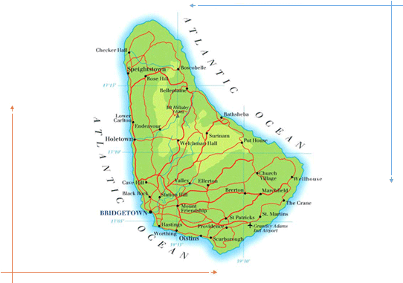
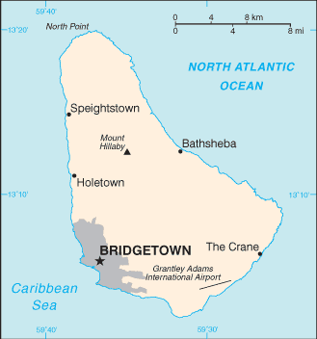
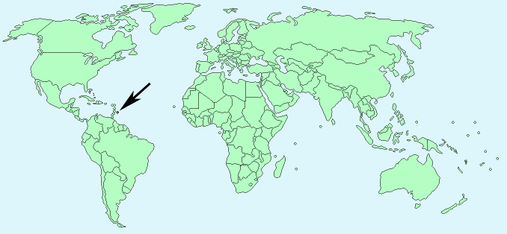
Barbados: population follows the establishment of colonial ports
Notes:
Colonial cities locked migrants out

Slide 30
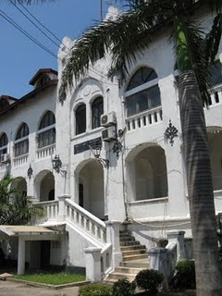
Former colonial administrative building, Dar es Salaam
Notes:
Purpose of these settlements is to expedite resource extraction only when industry occurs is there growth

Slide 31
International Political Economy
2. Economic Disparity
    neocolonialism
    continued dependence
    commodity export economy (cee)
Notes:
Dependence on former colonial dependence
Satellite (Third world) has only raw material to export, needs to import everything up
STAPLES are a dead end alley

Slide 32
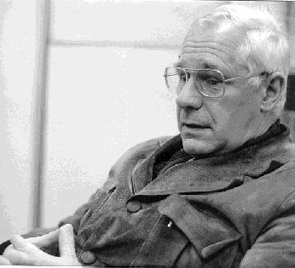
Dependency theorist Andre Gunder Frank
“the development of underdevelopment”
Notes:
CEE triggers instability, no control over demand on price
World super feminist theory: Core, semi periphery, periphery
Had staples, and manufacturing, more diversified economy when it shifts, often explotion of labour and gender discrimination.

Slide 33
International Political Economy
3. Urban Bias
    Industry drives urbanization
    Favouritism and preference
    Ecuador: binary system
    More pronounced in LDCs
    Hard to measure
Notes:
There is no industrial urbanization, well recognized that cities in the global south remain relatively small. Attempted to industrialize: Large scale industrial growth. Urban Bias: When capital spending is spent on the primate city (rural communities are neglected). Why cities, almost everywhere in the global south, the primate cities are better educated, and developed with govt. funding.
Urban Bias: Does exist in England: London has Urban Bias
Urban Bias: Primate city in the country that receives more attention than other rural areas
However the Global South: Urban bias is a huge concern here, because there is a huge difference between urban and rural.

Slide 34
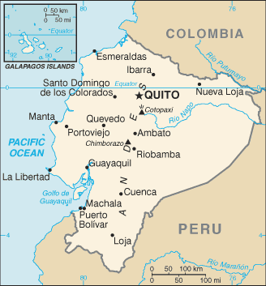
Ecuador
Notes:
EG: Equador: Export Banana’s so the port was very important to export. The second city rises (Quito, lies right on the equator) due to oil all of the sudden booms! Urban bias is then split between the two cities. What is happening to the rest of the Country of Equador? 90% of the housing in rural areas had no electricity or sewage.
Machela Aquaculture: Shrimp farming.
Port of Machala: Left wing politics, port is heavily funded

Slide 35
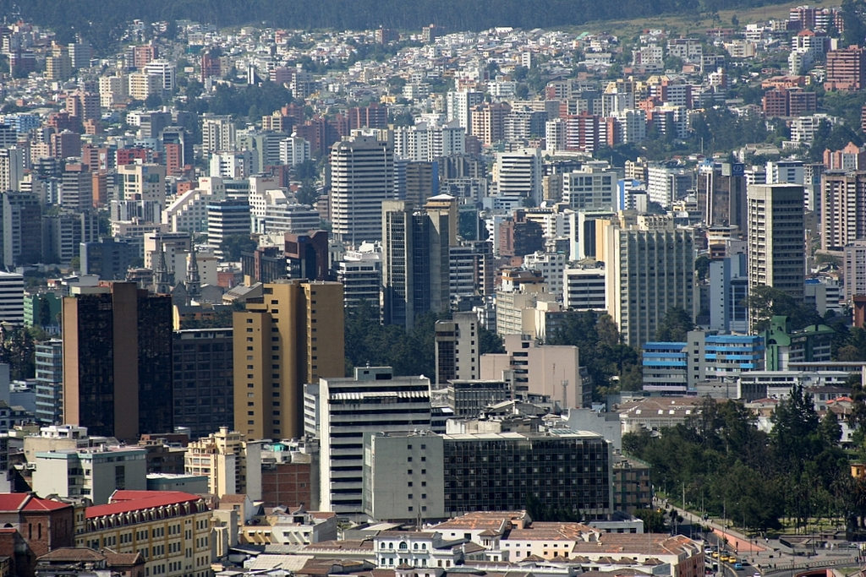
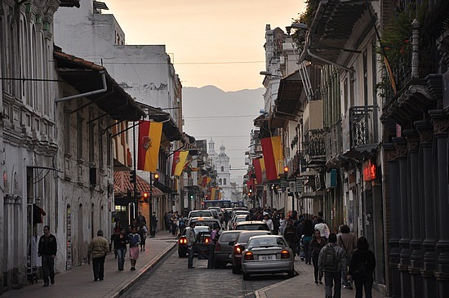
Quito
Cuenca
Notes:
Quito was very much urbanized due to urban bias, however Cuenca gets neglected. No electricity or sewage. Cuenca: Equador’s retiring capital (people from the west). Machela: Most banana’s come from here.
Top soil: In rural area (precious resource), when govt. subsidise agriculture (to lower food for the people in the city) the rural farmers are hurt by this

Slide 36
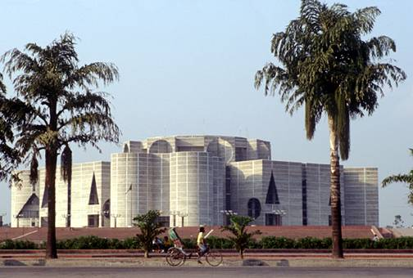
Dhaka: Jatiyo Sangshad Bhaban (National Assembly)
Urban bias?
Notes:
Parlament building in Dhaka: In Bangladesh, 85% of population in Bangladesh live in Rural area, no schools, health clinic.

Slide 37
Convergence and Divergence
Two contradictory developments
Growing heterogeneity is evident
Growing convergence too
Reflection of the uneven pattern of capitalism
Primate cities are most impacted
Secondary cities - less
Notes:
In cities: 2 contradictory developments:
1)Growing Heterogeneity (Many different functions that cities take on, eg: changhai and ladner)
Globalization: does not impact all places equally
2)Growing Convergence: Things are starting to look the same (eg: hotels, malls, political elite values, lifestyle, etc.)

Slide 38
Convergence and Divergence
Creates an elite ruling class with international values
Dual role of primate city
    Gathering
    Diffusing

Slide 39
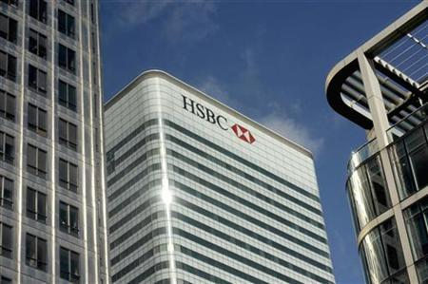
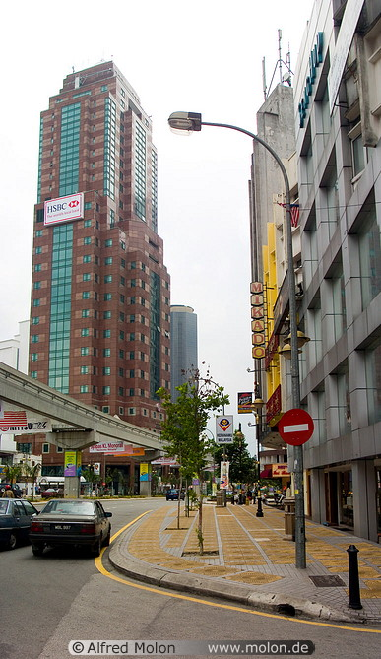
Convergence
HSBC building: Canary Wharf London
HSBC building: Kuala Lumpur, Malaysia
Notes:
Convergence: Largest HSBC in Malaysia,

Slide 40
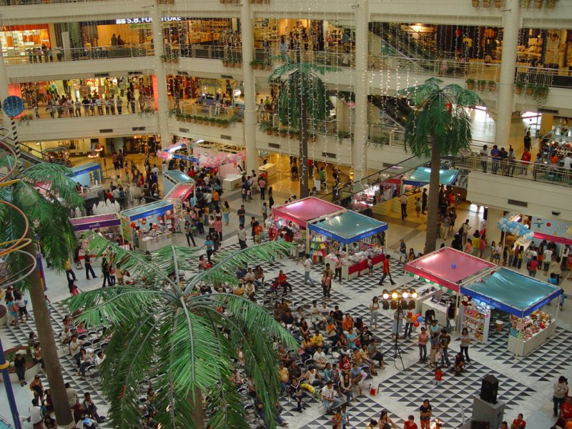
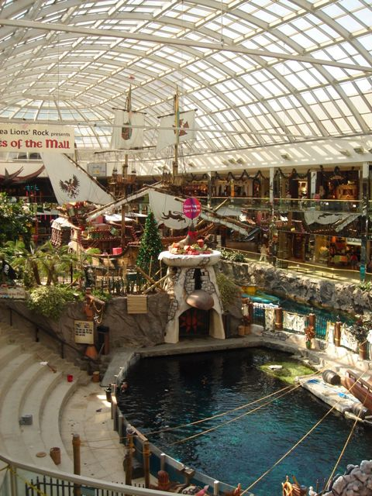
Convergence
Seacon Square: Bangkok; West Edmonton Mall
Notes:
Malls look identical

Slide 41
Conservation and Dissolution
An unequal relationship between modern capitalist sector and traditional sector
Capitalist sector: ability to expand, accumulate and invest
Capitalist sector chooses to conserve traditional sector
    unprofitable
    generation of surplus labour
    less need for social welfare
Notes:
Capitalism: The relationship between modern capitalism and traditional economics
Very significant traitional sector: A cities economy that is characterizsed by informal sector, family business → True dualistic (Underdeveloped sector) sector → Capitalist international sector has many tools (technology, $$, etc capacity to expand/grow)
Dissolution: To make it go away, point is there seems to be a tollerance of conservation. Non-capitalist stuctures (EG: family buisness) would dissapear.
London, berlin: you don’t see much trading on the street, not that seen as global south.
Capitalism could easily squash the traditional sector: Not worth the effort (why ruin it if its not a threat)
1)Not a threat (Un profitable)
2) Generates surplus labour (Large amount of labour) → Huge quantities of labour, is a good thing for capitalism (Capitalism loves cheap labour). *Race to the bottom
3) Less need for social welfare: Jobs are not lost, streets are calm, poor but employed (Splitting hairs: 3 people doing one persons job)
“we are modernizing the economy”: The perfect opportunity to get rid of street economy (Widen roads and thin sidewalks)
Dissolving transportation: Small sector (privatized) get rid of it and make a large train system.
Paul thurow: “the great railway bazzar”
Example: Beall (street sweepers)

Slide 42
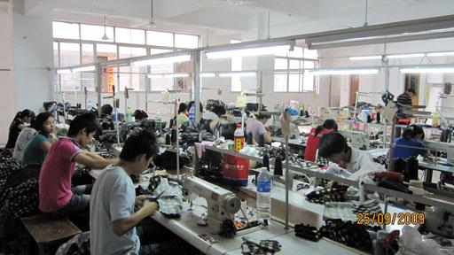
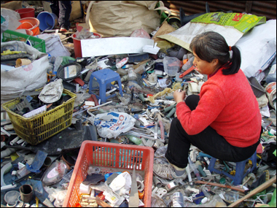
Conservation:
Modern capitalist sector, Shenzhen
traditional sector, Beijing
Notes:
Conservation: Modern vs Traditional sector read last slide notes

Slide 43
Theory of Rural Mobility
Conventional Economic
Unequal distribution of factors of production
Urban – rural gap is wide
Economic rationality prevails
Best understood by examining condition of rural masses
Notes:
Conventional Economic Approach: More capital/land/labour/resourses in some places, and less in others
People will move, if they feel they can get a job and make more money, they will move (economic rationality)
Rural→ Urban migration: No jobs, move to urban
Cities are powerful, enhance economic circumstances
Rural mobility: People who move to the city do better than rural (study shows).
China: Became a country in 1949 and the leader was mao → Reduce rural-urban inequality (preach it) He elivated the status of peasants.
1949: not even one person should die of hunger (turned villages into work units) –collective (goats,etc)
Great Leap forward: Mao promised (USSR) 1957 china will leap ahead of UK (Worst policy lead to 40 million people starving to death/killed in 3 years)

Slide 44
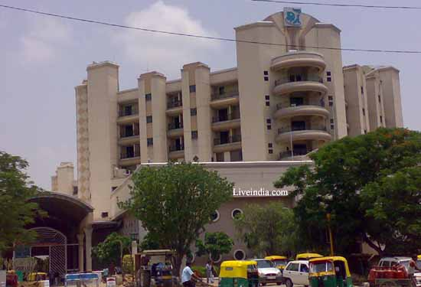
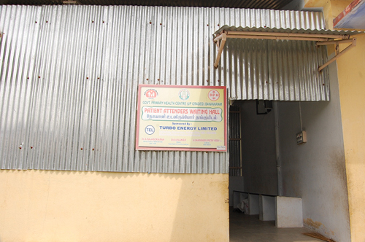
Hospital and research centre, Delhi and rural health clinic , Banavaram, Tamil Nadu

Slide 45
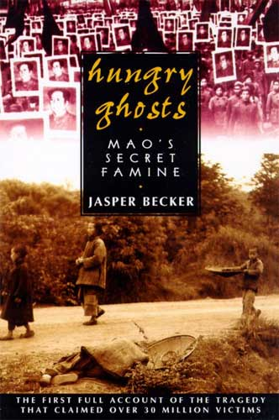
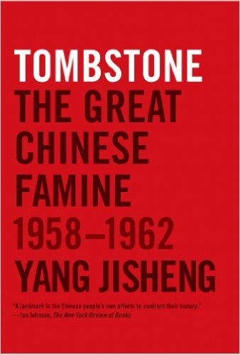
Great Leap Forward: Famine in China
Notes:
Great Leap forward: Mao promised (USSR) 1957 china will leap ahead of UK (Worst policy lead to 40 million people starving to death/killed in 3 years)
Ratio: 6-1 (urban to rural)
Cultural revolution (10 years): book tombstone read and see what happened Mao dies, replacement (Dang) undoes everything.
No matter how high they rise people out of poverty, ratio is still 7-1 (rural mobility: no matter what you do you cannot close that gap,)
Thailand: Transportation is huge, sealed roads all the way to the village, nothing changes still, gap never changes

Slide 46
Theory of Resistance
Common but misguided
Controlling rural to urban migration flow is ineffective
Free flow of migrants is beneficial to migrant, city, state
Skeldon (1997)
Notes:
Every country had schemes to lock people In the rural areas (eg: better educate) never works
Colonize the farm land
Regulate urban land use (Squatting or slum dwellings: the government should make it illegal)
Evicting squaters: cause of urban poverty
The urban poor: Is not always migrants, many slum dwellers are not all poor, Rural and urban are very separate.
Too much fluidity (cant stop them)
Doug Sanders: Arrival city→ When you see all these poor people in the slums it is not a shock,
Mike Davis misses this: A slum always is there (don’t look at the poverty, but don’t look at the present look at the future)
If you block arrival city functions (from rural areas into the slums) you deny people the opportunity for people to rise out of poverty.
If it looks poor but the slum is a transition, (No romance in rural areas) their kids will hopefully be better off.
Skeldon: The role of women→ women often migrate more frequently then men, their lives are better then men (data shows this).
The poor are not a drain: food carts, labour intensive work, etc: they all contribute to the city

Slide 47
III Urban Development in a National Context
Notes:
Read Chapter 4&5
Mark Mongomery (Health issues in countries)
Jan neigment study of space and (Mumbai Slums)

Slide 48
Introduction
Centre-Periphery model
Primacy
Secondary Cities
New Cities
Notes:
Urbanization and national development: What role does the city have on the Country?
Urban Structure = Development of Country (Economic spillover, trickle down)
Cities convey an impact on the country (Role of Bangkok in Thailand)
Can a country develop without their city?
New cities: Built deliberately by the state

Slide 49
Centre – Periphery model
Friedmann (1966)
Evolution of spatial system for national integration
Stage 1 – scattered
2 - strong centre
3 - reduction of inequality
4 - integrated urban network
Notes:
Core- Periphery model: Useful model John Friedman→ Regional welfare desparity model
Regional inequality (spatial and economic model) Newly colonized economy
4 Stages:
1)Scattered: Un exploited region (pre colonial), no cities, no market traditional economy (agriculture).
No heirarchy
2)Strong Centre: Regional desparity increases (Resources flow to the more productive core) Core (center) vs Periphery (Declining)
3) Reduction of inequality: Basically rising political figure, maturing economically, response from national core is lets share welth, investment in periphery which reduced inequality (Balance in the economy) Provincial economies, poverty is in decline.
4) Integrated urban network: Cities talk to each other, national integration, efficiency, max amount of economic growth, regional competition in healthy. Less inequality. Series of regional development stages.
Model is not real, it is an aproximation

Slide 50
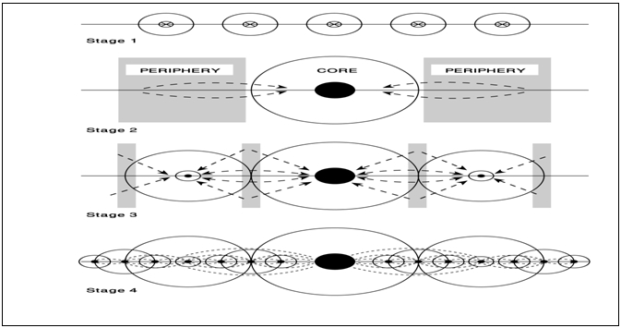
Centre – Periphery model : A sequence of stages in spatial development

Slide 51
Analysis of Centre- Periphery model
Rural realities
Underplays role of foreign influence
Apolitical
False assumptions about development
Notes:
4 critiques, of the model:
1)Rural realities: Model assumes the way French expierenced Canada (Eg: a big empty land, blank slab) Indiginous people? Friedman’s model does not fit so well with Canada and Australia.
2) Foreign influence: Underplays this which neglects the periphery, Industrial was owned by foreign multinationals. (HBC saw periphery as resources not anything more)
Operates only in Nations best interest, but they are somewhat foreign
3)Apolitical: He ignores govt intervene. Not much concern, urban bias.
4)False assumptions about development: Eventually countries following the model will become developed, its linear, not real, does not work for everyone!

Slide 52
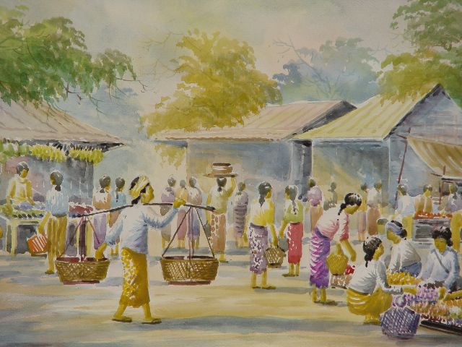
A day at the market – rural Burma
Notes:
Everything was already set up, British did not set up economy

Slide 53
Primacy
One-third of all urban dwellers in cities with 1 million +
Intense urbanization focuses on a single city
More than just demographic
Primacy is slowing
More common in LDC
+ve or -ve ?
Notes:
People concentrate in big cities.
Many third world countries have a primate city: If the city is twice as large as the second largest city, then it is a primate city!
So Many primate cities: EG: Lagos (15-20 million people, Nigeria Kano is 5 million people)
Primate city defininition: If the city is twice as large as the second largest city, then it is a primate city!
Third World: urban primacy and urban bias connection
Seoul Korea: 2005-2015 has flat lined, used to be a primate city. (5% per year growth before)
Problems with Primate city: High lad cost, pollution, housing crisis, etc.
Growth Pole Theory: Challenge Primacy, govt. would invest in an industrial activity far away from the city, spatial strategy (Usually negative outcomes). EG: Chang Mai (try to make a big city, did not create help in Bangkok) Creates uneven development

Slide 54
Secondary Cities
At least 50% of total population
Increasing share
Opportunities and challenges
Multiple roles
At a crossroads
Notes:
Smaller cities are less in the news, but people still live here and a lot more ppl migrating.
Modest growth, but we can expect high growth in the future.
Secondary cities: Absorbing migrants (Comfort), a whole bunch of tier two cities are trying to attract more people. More room, but a lot more problems.
Under served, homeless, slums in small cities, transportation is poor, etc.
Urban poor in smaller cities: Worse poverty (Healthcare sucks)
Politically removed from capital city, makes it hard for the city to get attention for resources.
Secondary cities: Relieve population stress on the primate city (and reduces congestion)
Secondary city has a better spinoff from modern.
These cities are called to do the heavy lifting (100 thousand or more)
“Largest 600 cities today”: Have 60% of the worlds GDP today. Projects ahead to 2025 → Will still have 60% of the world GDP but it is a different list then the ones today!
Center of gravity: a third of the first world cities will fall of the list will be replaced by cities in the global south
Rural-Urban Migration: Quickest in India → Indian cities will need a trillion of american dollars for infrastructure to keep it going
Rise of the middle cities is crazy and cool to see
China’s secondary cities: If china is 60% urban, 700 million people living in the city (most urban city in the world)

Slide 55
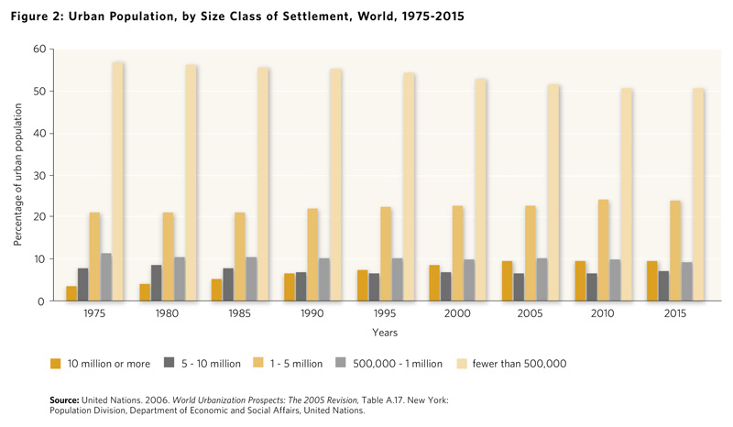
Notes:
Medellin Columbia: The worst city in the world for crime: Worst poverty in Latin America, Murder capital in the world.
“How cities make us sick” youtube video: City has invested in Escalators to integrate transport and community.

Slide 56
New Cities
Dramatic and direct spatial deconcentration
Variety of spatial functions
Results are mixed
Notes:
Dramatic form of gloablisation: building a city from scratch (not organically created, like most cities)
Used to help accommodate to population growth
Canada: Instant towns (Eg. Kitimat built in the 50’s for industry)
To build/move a capital city
Symbolic, state showing that we can capture a hinterland

Slide 57
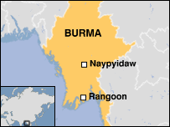
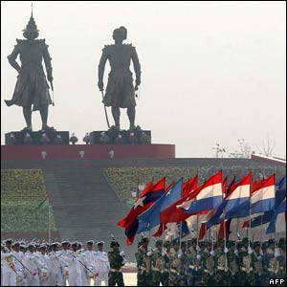
Burma’s strange new capital
Notes:
British new town movement: To relieve congestion in London
MIT and Harvard: urban studies
India: Navi Mumbai and now new Mumbai is being built now
Swiss French: Chandegar (1953), big city, it has it own government (capital of 2 states) (union territory)
Ex. New city: capital city of Brazil → Brazilia (built in the 50’s, build a capital inland), Move things inland, new capital, symbolic act of inland decenteralization
Canbra: Is inland in Australia (capital city)
Nigeria: Capital city is Lagos but now Ibooja (Very large, not as big as Lagos, Symbolic, inland, economic tension in Lagos so they chose other)
Tanzania

Slide 58
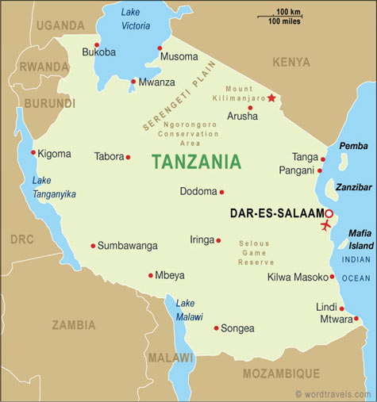
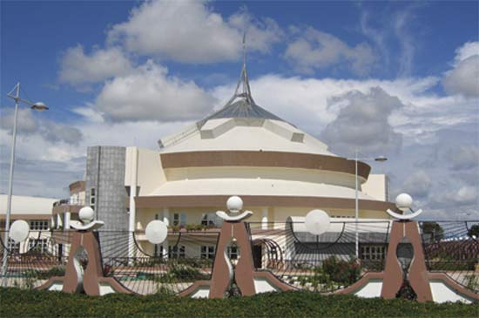
Tanzania’s capital is now Dodoma
Notes:
30 years and they have not moved everything yet
Berma’s new capital (isolated, malaria infested jungle) –No go zone
Ordos China: the new Ordos was empty, video, all new apartments sold but no one is living there.
Keep capital going to grow GDP (expansion of capital), govt adds to infrastructure
Paul Romer→ Charter City: Large unhabited land, in a third world city, Canadian urban planners invited in to come build this new city (rules) Hondoros has a piece of land set aside for Charter city
Hong Kong: Opium war, drug lords, inspiration of the charter city

Slide 59
IV Urban Development in a Global Context
Notes:
Next class: Chapter 6, Dickins de Giron Article (Available on his website)
Steven Graham: Cities as battle space

Slide 60
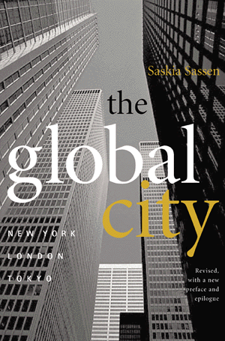
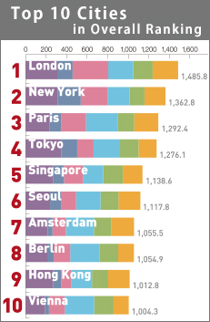
Notes:
Global cities: first world cities, Top 3,4 (London, New York, Paris)
Focuses on NA and european cities

Slide 61
Hall (1966)
“disproportionate part of the world’s most important business is conducted in world cities”
Notes:
Patrick Ghetties: World cities (used the work world cities 101 years ago for the first time)
Hall: world cities are major centers of …

Slide 62
World Cities Characteristics
Political power
Seats of national or international government
Concentration of corporate power
TNC headquarters
Trade
Finance
Transportation/ communication.....

Slide 63
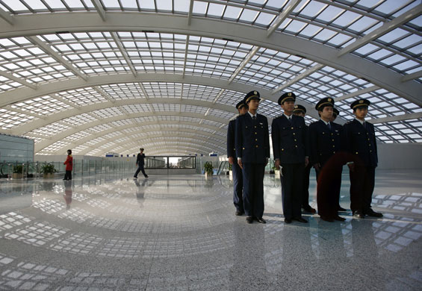
World Cities Characteristics (2)
port
airport
Science / technology
University / R&D
Arts
Beijing’s new airport terminal 3 – largest building in the world
Notes:
Research and Development
1966: Hall since he wrote this, so many revisions, global/world cities many different atriles, decision makings of the world,
100 different cities: How globally engaged they are, article by Kearney
5 dimensions:
Buineness (speed, TNC, HQ, capital markets)
Human Capital (education, creative class)
Info Exchange (media, role of media, freedom of the press)
Cultural expeirences of the city (arts, resuraunts)
Political engagement (embassy, consulates, etc)
The number one city 64.7 is the most global city in the world new york, then london, then paris,
Cities in the global south: Hong Kong is number 5, Singapore, Shanghai, Buenas aries 20
Mumbai: 41st position, 57: New Delhi, Banglahore (64) India is going up.
Social globalization: Huge gap between rich and the poor, Kearney fails to mention this
Importance of the history: Progress, where has the city come from?
Top city in Africa: Joansberge,
Addis: Capital of Ethiopia

Slide 64
Recent World city literature
Globalization
Decision-making
Creative class
Social polarization
Sassen : historic specificity
Notes:
World cities beyond the core

Slide 65
World cities beyond the core
Rich city in poor country
Resources: much more limited
Infrastructure: rudimentary
Population pyramid: bottom heavy (younger population)

Slide 66
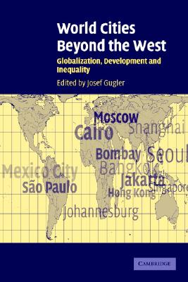
Gugler (2004)
Shanghai Seoul
Cairo Bangkok
Moscow Mexico City
Hong Kong Singapore
Jakarta Sao Paulo
Mumbai Johannesburg
Notes:
Gugler: 10 years old, 12 cities, important characteristics of the cities,

Slide 67
Other findings:
Corporate command functions
Stock market capitalization
International flights
Media ideology
Political context
Demographic situation
Non-formal political actors
Three big conclusions (Gugler 2004)
Extraordinary diversity
Rich/poor : big gap
Power of the state
Notes:
Three big conclusions from the book:
1: cities are so diverse, crazy histories, jaw dropping, political and economical diversity
2:Inequality, common between cities(when you are poor, you are poor)
3: State has the power to change, but no change is occuring, the state is moving back (neoliberalism), but it still has the power.
The state has its finger over everything (role of state to provide healthcare and corporate economic decions)
Other:
a)HQ of large corps
b) 9/12 cities exceeded 100 billion on stock market capital
c)INTL fight: How connected the cities are with airports and so many flights (Aerospace in china: James fowler “China airborne” → Book)
d)
e)Political context: stable vs regime changes (City of Bangkok is falling)
f)Diverse
G) Advantage of these world cities: high profile, despite politics, non formal political actors can act, those who lack power can play a huge role in these cities (gain presence in this type of situation), cities are spotlighted, hybrid bases where people can generate (new forms of power for the city) → How sweatshops in the global south (isolation does not occur in cities)

Slide 68
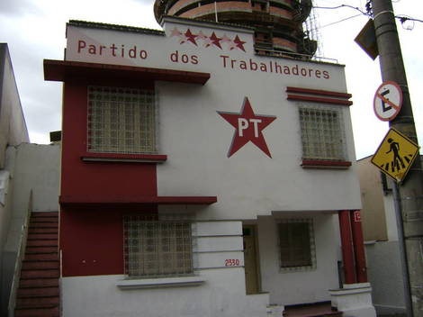
Worker’s Party Headquarters in Belo Horizonte (Brazil)
Notes:
Digital technology and social media: in Bangkok, protest against the state, state doesn’t know (texting and twitter) state is taken by surprise
5 cities in the global south that have taken a mark
1)Sao Palo (Brazil)
2)Singapore (Asia)
3)Mumbia
4)Manila
5)Brazil
#1) Sao Palo: contemporary Brazil, ranked 44 in Kearney list, significant In Brazil.
40% of Brazil’s GDP
Population is huge (20 million → Double mega)
One of the largest cities of the world
Early capitalist in Sao Palo: Laizze Faire→ Working conditions were exploiting the slavery workers, 1922 Brazil has the communist party of Brazil (same year of communist party of China), Unions, 1929 depression, Sao palo got hit hard, big gap (no industry)
1956: Start of Sao Palo autoindustry
Companies came there to manufacture
Over a million indirect jobs to do with cars in Sao Palo
Labour rotation: Massive layoffs and immediate rehirings (move the workers around to keep wages low) move workers
Brazil: military rule 20 years (1986) strikes cannot happen, workers were opressed, labour was silenced
Secret meetings, secret workers meeting. The picture

Slide 69
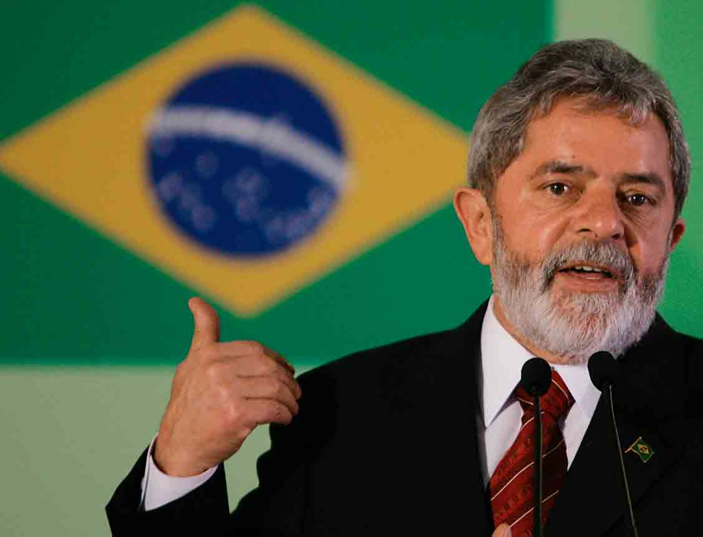
Luiz Inácio Lula da Silva
Notes:
Underground Labour Leader (Autoworkers came to work, all stand at machines and not work and protest) → moevement was called arms crossed in machines stop movement (spread to all factories) Negotiations came in, finally big change happened.
Brazil is quite well known for having good labour movements (workers party)
Lula: Union leader ruled (socialist) Brazil
Sao Palo: global exporter of ideas (Democratisation of workers writes)
Sao Palo contribution: People will say lets follow their footsteps

Slide 70
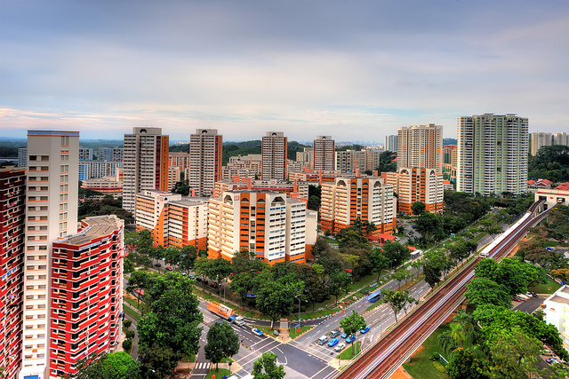
Singapore: clean, tidy – housing for everyone
Notes:
#2) Singapore: tiny little city state, independence in 1965, no one would think Singapore would be what it is today (Asian metropolist), Number 9 on the Kearny list, transformation is crazy.

Slide 71

Minister Mentor Lee Kuan Yew
Notes:
Lee Kuan Yew: Poverty after the Japanese and British, Lee Kuan Yew is clean and safe, nanny state (Used to be a slum but moved up)
Special economic zones: Liberalization
City of efficientcy, tidy, high standard of living,
Minister Mentor Lee: His son now is in power.
The many times, he challenged third world country stigma

Slide 72

Notes:
Mumbai: Bollywood (Global)
Soft Power: is a great power, influence and agency, through Bollywood (exporting the culture) –Dance, music, love triangle, colors,
Huge everywhere
#1 films in other countries: Africa, Europe, Asia,

Slide 73

\]E
Notes:
People power of Manila: Revolutions, mass protest, inspiration for non violent regime trends, in result fall of berlin wall,
To end the Marcos regime (ended peacfully)
People protest fueled by opposition to Marcos’s Regime (3rd world capitalist)
Marcos and his family stripped wealth out of the country, try to overthrow him, Benino Akino (Manila Akino airport), left wing solutions, people supported him, Marcos arrested him, Exiled him, but he came back 1983 and killed when he returned
Marcos: did the killing, people in Manila grabbed Akino’s wife to be the symbol and stood up, the people assisted her.
Marcos 1986 left Manila (to Honalulu)
After her term she resigned,
The ruling miliatry dictatorship failed to see the rapid growth of the population of Manila (more poverty), Catholic, population increased, unlivable, Manila became the fastest city due to rural urban migration (1950-1983 population timed by 4)
Manila slum: Tando (pag pag) → Mid 80’s informal communities, forming in Manila, secret meetings (politically active cells), Marcos needed to go, Poverty that brought them together got these people to the streets and came in peace with the mission and got what they wanted
The public space: Public places are where democracy feels at home (public events happen here),
Manila: public square is important (public event), technologies quick connections are not as affective as gatherings of lots of people,
City Square: the original social media (Roman empire: Gathering place)

Slide 74

Curitiba: an urban lesson to be learned
Notes:
Curitiba (city in Parana, Brazil)
Brazillian urbanization: you think of Flavella’s. but in Curitiba it is different (lots of diversity and migration euopeans)
1964: Mayor proposed (Jamie Learner: architect later became the mayor) He implemented a plan of urban sprawl, closing streets, cars were everything, Learner is saying there are too many cars, close the streets to cars. Very high pedestrian rate, use transit
BRT: bus rapid transit (Curitiba: Sao Palo (traffic is so bad)) Bus system is awesome
Boarding tubes: the swiss envy
Curitiba BRT is very efficient
Less use of cars, lowest emmisions, Curitiba has the best public transit, many awards for urban planning (well planned)
Green city (a lot of park space)
#1 recycling city
Crime has fallen, better then the rest of Brazil

Slide 75

In Curitiba ‘BUS RAPID TRANSIT’ is not an oxymoron
Notes:
This is Curitiba (RBT and tubes work well)

Slide 76

Jaime Lerner
Notes:
Ted talk: Sustainability song, the use of RBT
Curitiba Model Criticisms: much of the infrastrucutre was inteplated during the dictatorship
A lot of people were not talked to, who’s land are they taking over
A good city: Is like a magnet (Curitiba is becoming a place for poor people to go to, growing gap between rich and the poor, findge of the city is becoming slumish, gated communities.
A lot of the poor people: where the people are living are suseptable to urban flooding

Slide 77
V The Urban Form: Density, sprawl and the use of Space
Notes:
Spatial topic, introduction:
Space taken up by urban location: the amount of space cities take up a lot of space, no room for the people which creates sprawl
Paul Romer: 2.8% of the worlds land value is taken up by cities, there is so much more space, why is 50% of people living here?
Urban sites: critical, why is a city located where it is, city is built near a coast, rich biodiversity, when a city expands, we loose this biodiversity and coastal environments
How aditional land is incorporated: when a city expands spatially, there are issues (rural people loosing their land, human rights issues, creative destruction, taking away agriculture land no place to grow the food, coastal pollution, loss of habitat

Slide 78
Density, sprawl and land use
Average densities are declining
Sprawl: 1. residential suburbanization
2. peri-urbanization
Notes:
Modern patter of city growth: average densities are declining
I think we know this, as suburbanization reaches out, density decreases.
Transportation: continues to improve so cities can use more land per person
In 3rd world cities: they are really going to double, triple their land, also in 1st world they go on forever because suburbanization (huge car infrastructure, pheonix)
2 parts split into

Slide 79
Residential suburbanization
N.A. – after WWII
Regulatory regimes
Automobile: cause and consequence
Suburban ideal diffuses to rest of the world
L. American – cities are vertical not horizontal
China’s short march
Notes:
Suburbs: Modern trend, been around for a while, after ww2 suburban growth was the american way of life, returning to nature, being closer to nature (important for higher quality of life), suburban developments built outside with connection of freeways
The state: made sure that suburbia made money (subsidize the construction)
The automobile was front and center, daily commuting was a consequence
Pattern of subruban settlement: changed the way people shop, consume, big homes, how suburbs changed America, shopping malls, parking lots,
Suburbs today: have become complete with its own CBD (central buisness district), becomes its own
Suburbs in Canada: we should try to end because of demographics (we don’t have the baby boom with lots of kids), today small families,
Reverse now a days: Vancouver (ethnoburbs) the white upper class is in the CBD
Rise and cost of oil, and climate change, people don’t feel comfortable spending 45 mins in a polluting car.
American dream only really works in North America
Europe: cities are compact, suburbs didn’t work there, ethnic segregation.
In third world countries: the culture of automobile ownership is completely different story there then america, it is restrictive, 3rd world cities suburbia relies on public transportation,
Latin America: No real suburbs, they build highrises
3rd world suburbanization: Peri-urbanization make a bit more sense
Chinas short march: next week we will talk about it

Slide 80
2. Peri- urbanization
Form of sprawl
Administrative grey zone
Worst consequences of urban growth
Mix of activity
Speculative bubble
Pushes urban frontier further outwards
Notes:
Works better in 3rd world cities→ More peri-urban then suburban
Peri means around or circling
Blurring and transition zone
Form of sprwal, further than suburbia
Lacks clear regualation (no land use rules)
Pollution, rapid social change, environmental exploitation, in Peri-urban
Varriety of economic and social industry (homes)
Field by land speculation (land increases)
Speculators hold onto land around the city and wait for it to increase in value
Speculating, leads to further peri-urbanization because you are pushing the poor further and further out, go beyond and beyond
Global south: advances in trasportation, communications, the outlining area is more accesable
“Mike davis writes: the more you move out to the peri-urban areas the thicker the fog gets (result you have slums there now, refugees, etc.)
A lot of crime here, stupendiously dangerous,
Form of sprawl: grey zone (a little urban, residential and industrial, a lot of poverty, environmental issues, a lot of cities sit here)

Slide 81

Outer city industrial estate: Bangkok’s fringe
Notes:
Bangkok: Industrial activity

Slide 82

Outer city Longhouse Kuala Lumpur
Notes:
Longhouse: is a shack in the outter city area

Slide 83
More on peri - urbanization
City centre is full and expensive
Spill over is inevitable
Land and labor are cheaper
Ribbon/corridor development
Rural residents work in non-agriculture
Environmental degradation
Golf and shrimp
Notes:
Spill over is inevitable (land and labour is cheaper out there)
Win win (they have room and labour/work)
Population density in peri-urban then in the west (cheaper than the city) win win for industry
Along river, traintrack, highways : Corridor development
Rural people live on a farm but work in a factory
Golf courses: were taking over the peri-urbanization areas (approach the farm areas and stole the water) Had money to drill deeper in the Aquafer (farmers were driven off the land)
Toxic chemicals on the golf courses (chemical fertilizers) Would be banned in Canada, but used and applied liberally in china and Asia, when the rain comes the water takes the chems into the drinking water (serious problem) (Local elite and tourists only can golf 3%)
Exploitation of women on golf course (in Thialand) young 18-20 women as caddies (no golf cart, you hire a caddie based on sexual relations) –”19th hole”
Shrimp: aquaculture (farmed shrimp) took up lots of land near manila, so much land was taken over. Significant cash crop, Saturated with chems and pesticides. Health hazard

Slide 84

Desakota: made in UBC term
Terry McGee
Notes:
Desakota (mike davis talks about it in ch 1)
Desakota: Peri-urban region (between rural and urban) Its indonesian (blending of town and city) encompases more than just peri urban
Rural urban (people who work in a factory live on a village) interlinked lives
Desakota area: well served (transport) Diverse economy, occupy and radiate out from a village
Housing, people are migrating there (many cities there is not urban areas, there is migration to Desakota) *Rural to Desakota migration (because the city is too full, or expensive)
Now there are slums in the Desakota
McGee: Fluidity (rural areas are anchored to the location) but a desacoda is fluid with transport, not agriculture and agricultural households (one person is working in the rice field, one person works in the city (due to good transportation –busses, roads, etc) and one works in a facatory in the desacoda.
Population density is very high due to: good agricultural land, good transport, work, cheap land, labour force insitue (set up a factory and don’t look far, your workers are right there)
Zoning for farming, industry, residential, golf courses, no one knows where the cut off is, it all merges together
Wet patties: growing rice, this is where Desakota is formed (wet patties= high population density, low education)
Unique landscape

Slide 85

Outer city Shrimp farm: Thailand
Notes:
Chapter 1: The ambebic model (ameba)
They capture their food and move on: highway, linkages, take off, becomes a Desakota (cinepod is the new part of the city)
EMR: Extended Metropolitian Region → city and countryside becomes blurred, small towns and farming communities on the edge of the cities expierence changes in labour, practices, etc.
Villagers go to the city, but here the industry comes to the village (changes the layout)
Bun Chun: 60 years ago seemed very far from Bangkok, Peri-urbanists expand, not Bun Chung has become a peri-urban area (industrial suburb)
After the shrimp are shipped oout, the stangment water left over poses a huge problem ( destroys land and smells bad)

Slide 86

Outer city golf courses: Bangkok
Notes:
Number of golfcourse in the desakota area (40+)

Slide 87
VI The Urban Labour Market
Notes:
First wave urbanization: industrial revolution –lots of labour needed, people migrated and fueled the industrialization
Developed countries:
Second wave: 1950-now Urban pop increase is 10X higher, labour struggles in this situation

Slide 88
LDC world differs from 19thc. west
LDC today can not absorb urban labour force (some exceptions)
Debt crisis, recessions, inflation, automation - prevent higher employment and dignified wages
Conditions of the labour market
    Open unemployment
    Underemployment
    misemployment
Notes:
Make sure people find jobs, there are cases but overall so many countries in the global south are dealing with a labour glut (Inflation) people cant find decent jobs, wages are not high enough, big push of rural urban migration, debt crisis (IMF restructuring) neolibealism, inflation, privatization
Retreat of the state
**Wage Puzzle: how do people get by with a low wage

Slide 89
Unemployment
Data hard to obtain
Reliability of the data is questionable
Definition of ‘employment’ ?
Some notes on employment:
Unemployed are not always ‘desperate’
kin
village
part time work
Some are ‘desperate’ and ‘destitute’
Notes:
This Is tricky, info is problematic, data is hard to get, estimates, a lot of seasonal workers, moving from village to city so it is had to get
Census data
What is employment? Is it restrictiive
Who is employeed? What if your not looking for work, or a senior, or part time work
Unemployment: Does not always lead to slums (their uncle will help us)
People go back to the village for work
Or the poorest

Slide 90
2. Underemployment
Underutilization of labour
‘idle’; fluctuations
3 types – activity ebbs
labour glut
‘obligated’ labour
3. Misemployment
Begging
Hangers-on
Notes:
Defined as underutillization of labour (when labour is part time) → I am eager to work, but I only have 2 days of work (I am under employed)
People who cant hold down a job due to health
India: The milllions of young men who sit on plastic seats (security guards) underpaid, watch economic others pass by them, their job is to sit there, they cant get rich working as one
There are a lot of angry young ppl wondering where they will find jobs or their kids
Polulation growth of youth, economic active years, no way to find jobs
Last election in India: urgent demand for jobs
Ant tribe in china: They work in retail with university degrees
Underemployment: Labour surpless, over supply, street vendors, all selling the same tshirt (you only need 1 or 2 but everyone does it)
Hidden underemployment: refers to the obligated (keep them hired but really not needed, eg uncle tellls you to work for their company)
China SOE (State owned enterprise) Big industrial big owned factory: Chinese capitalisms, dinasors, hire so many people, hire many
India: big companies are legally not able to release workers even iff they don’t need them (you have to apply to let go of workers)

Slide 91
Notes:
Miss employment: Begging
Hang on
Productive vs unproductive (people are working but not actually adding to society)
EG: enterouge of the rich

Slide 92

Informal Sector
jobs in the economy that are unregulated by the institutions of society
Fruit market, Chennai
Notes:
People who cant get a job in the formal sector, get work in informal sector (economy that is unregulated)
Independent, do it yourself, untaxed, garbage, shoe shiners, mechanics, bike repairs, etc.

Slide 93
Informal Sector
Potter and Lloyd (1998) The City in the Developing World:
Large portion of the economy
Legal and illegal
Merits and faults
Encompasses wealth and poverty
Productivity and ineffeciency
Exploitation and liberation
Notes:
Sex trade,
Africa: 80% or more in the informal sector
Family enteprise, labour intensive, discouraged by the state, profit margin is slim,
Slang phrase: Debrougher: someone who is resourceful
Informal: System D (Flea markets vs free market) HUGE SYSTEM D SECTOR

Slide 94
Informal Sector
Ease of entry
Family enterprise
Small scale
Bottom of pyramid
Labour intensive
Unregulated and unregistered
Discouraged by state (attitudes changing)
Tiny margin of profit
Usually untaxable
unsafe
Notes:
Hawkers are stugling with fines, health and hygine concerned, roads are being widen, less side walk space to sell products

Slide 95
Gender dimension of the informal sector
Two global facts :
men tend to be over-represented in the top segment and women tend to be over-represented in the bottom segment.
formal employers have the highest earnings; homeworkers have the lowest; and informal workers in the middle
The net result is a significant gender gap in earnings within the informal economy, with women earning less on average than men.
Notes:
Women are usually higher in informal sector (wage gap)

Slide 96

Notes:
Case study: Jakarta Indonesia

Slide 97

Pseudo-Urbanization in Djakarta
Urban Involution
Notes:
Pseudo-Urbanization: functional infrastructure lacks, shortages of jobs, education, transport, resources, housing, etc (population is growing too much)
Informal Setcor
Urban Involution (MENSIONED IN DAVIS): Jakarta is the biggest city in the world, desakota has expanded,
Rural development could not keep people there in Java, ppl move to the city
Large informal sector (people who move from rural to urban work in informal economy)
Low income, little jobs, etc.
Why is it that there is no revolutionary change? No pathway out of poverty, why isnt there a breaking point? Why don’t the people say enough is enough.
The people do it for the kids, the grandchildren.
In Jakarta Urban Involution: People rely on kin, but informal economy is so elastic people feel there is always a job. More people that come in creates more jobs.
The sponge can absorb a lot just like the informal economy = is Urban Involution
People who work in the informal economy → they all work together, proffit is narrow but it does the job
Desakota and the urban involution are by terry mcgee
Urban Involution:
Bangkok: shift change 5000 people shift change every 8 hours, 40 minuite market opens at Cgate (to sell to the people getting off work)

Slide 98
Parastatals
Overstaffed
Underemployed
’ghosts’
Targeted by SAP/ IMF
Notes:
Parastatal: Government policies (mostly africa) Not to let people go (govt employing far more people than they need)
Rules the economy (ghost workers) Parastatal is the reason people are employeed

Slide 99

Sweatshop labour
Marginalization theory
Conditions
Building the stereotype to rationalize preference
Disorganic development
Notes:
Expansion, thialand was a cheap investment to set up factories (FDI) only wanted women workers
Chasing cheap female workers (investment from america)
Everything from cars to clothers (mostly female)

Slide 100

Workers make clothes at a garment factory in Dhaka. Bangladesh's exports dominated by the sale of low-cost garments to mass-market retailers like Wal-Mart.
Notes:
Femanization of mass production (cheap labour)
Labour is so deregulated (workers rights very few) –Special economic zones (women workers)
Naoimi clien: exploit women without anyone knowing about it (behind high walls and barbed fences)
Young worker women, that took orders, small hands, do textile work easy, hard working, quiet, did not talk back.
No unions, minor case study: Bangladesh, may 2013 (rana plaza building collapsed) 8 story factory, RNG (ready made garments) Structural integrity

Slide 101

On May 10, 1993, the worst factory fire in history took place at the Kader Industrial toy factory on the outskirts of the Thai capital of Bangkok. Officially 188 workers, most of them young women from impoverished rural families, died in the blaze. Another 469 were injured; many seriously and permanently, after they were forced to leap from second, third and fourth floors of the buildings to avoid being burnt to death.
Notes:
RNG in Bangladesh: These workers live a horrible life, these workers come n young, exploited, no free time, work long hours, no stepping stones, no upward mobility, work ard and have little not sleep (problems with health)
Not safe, working conditions, Kader produces hasbro toys
Bottom line is money. Women are still exploited, race to the bottom,

Slide 102

Walmart ‘Supercentre’ opens in South Surrey, B.C. On July 30, 2008
Notes:
Resistance: workers do there own thing (blue mondays everyone calls in sick), huge mass protest.

