Slide 1
Donated blood that has been stored for more than three weeks may be deficient in nitric oxide (NO). Why is that a concern?
ANP1105B

Slide 2
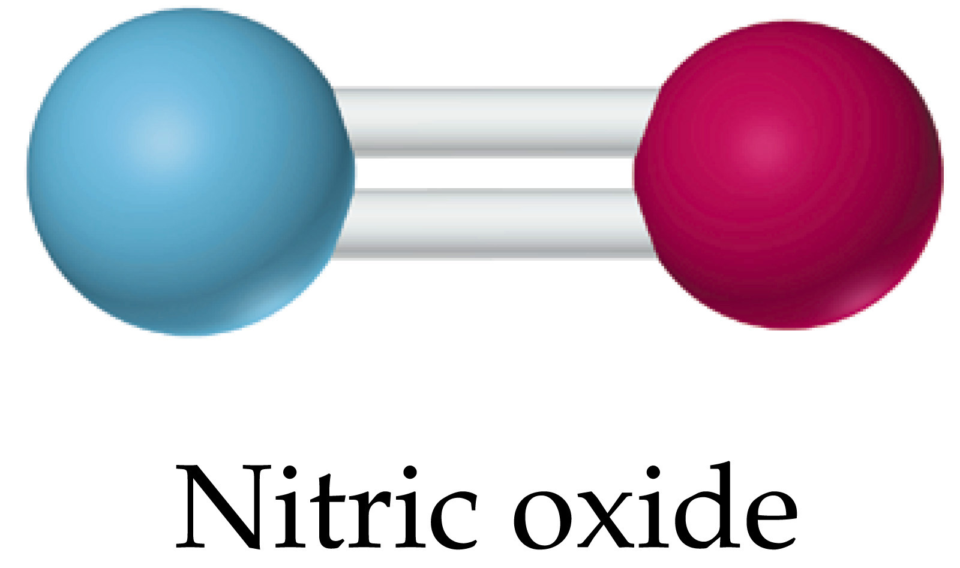
What is Nitric Oxide?
A small gas made of a nitrogen atom and an oxygen atom (N=O).
Produced by every tissue and organ in the body
    Specifically in the endothelial layer of arteries
1998: discovered to be the major signaling molecule in the cardiovascular system
Nitric oxide carries messages within the cardiovascular system at a microscopic cellular level

Slide 3
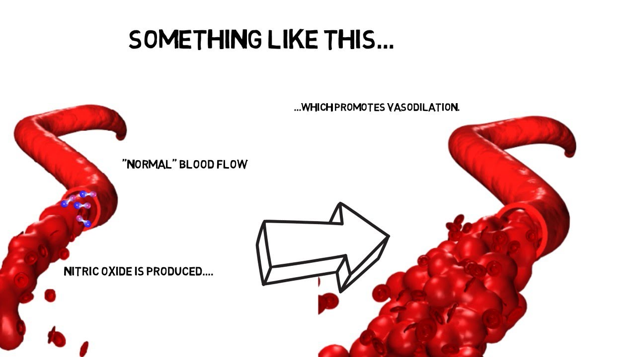
Main Functions:
The main function of NO is to signal arteries to relax
  This allows for an increase in blood flow
  Therefore, NO regulates blood pressure
Lowers blood pressure
Responsible for healthy blood circulations
Nutrient exchange:
  More blood flow allows for more oxygen and nutrient flow which can diffuse through along the way
Lung: relaxation of bronchi, therefore an increase in air flow
Digestive tract: Promotes peristalsis

Slide 4
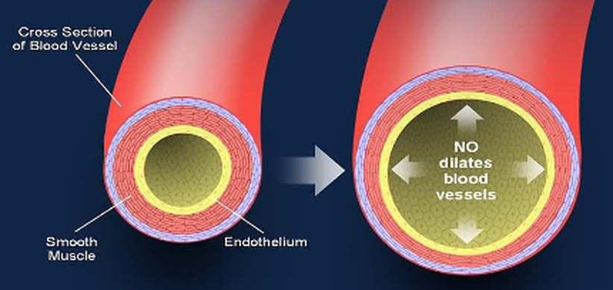
Effects of NO deficiency
Impaired blood vessel function:
  With the absence of NO in the blood, arteries will not relax and allow more blood flow
Hypertension
Impaired blood circulation
  Deficient oxygen delivery
Cardiovascular disease
Chronic kidney disease
This would not happen.

Slide 5

Symptoms of NO deficiency
Fatigue
Low energy levels
Poor memory and concentration
High blood pressure
Less stamina and endurance

Slide 6

Treatments
Supplements:
  Taking supplements of NO such as Neo40, NOx, BeetElite
Eating more beets and dark green leaves
  More nitrate rich foods
Lose weight
  Less areas in the body that will be deficient in NO
Exercise
Reserve flesh blood for those patients at most risk
  Decrease chance of them receiving NO deficient blood
Additive: Nitrite
  Nitrite is a reservoir of nitric oxide. By adding nitrite to blood, we can increase the amount of NO in the blood.

Slide 7
To Conclude…
To avoid patients receiving blood with deficient nitric oxide levels, a critical component for the successful functioning of the cardiovascular system, blood should not be stored for longer than 3 weeks.
To reduce this: Red blood cells are now stored in a solution with glucose, anticoagulant and acidity buffering properties
References
Abeyakirthi, Sharnika, Dr. "Nitric Oxide." DermNet NZ. DermNet NZ, 1 Feb. 2015. Web. 04 Dec. 2015.
Volpe, Arturo M., Dr. "Could Nitric Oxide Deficiency Be the Cause of Your Health Challenges." Natural Health Solutions. Dr. Arturo M. Volpe, 19 Apr. 2011. Web. 04 Dec. 2015
"What Is Nitric Oxide? | Austin Family Medicine." Austin Family Medicine. Wet Media Design, 2014. Web. 04 Dec. 2015.

