Slide 2
CHAPTER 1:
ThE CANADIAN FINANCIAL REPORTING ENVIRONMENT

Slide 3
The Canadian Financial Reporting Environment
After studying this chapter, you should be able to:
Explain how accounting makes it possible to use scarce resources more efficiently.
Explain the meaning of “stakeholder” and identify key stakeholders in financial reporting, explaining what is at stake for each one.
Identify the objective of financial reporting.
Explain how information asymmetry and bias interfere with the objective of financial reporting.
Explain the need for accounting standards and identify the major entities that influence the standard setting and financial reporting.
Explain the meaning of generally accepted accounting principles (GAAP) and the significance of professional judgement in applying GAAP.
Discuss some of the challenges and opportunities for accounting.

Slide 4
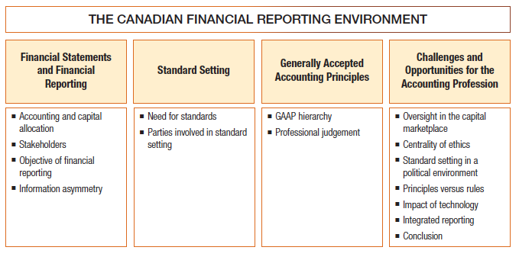
The Canadian Financial Reporting Environment

Slide 5
Characteristics of Accounting
Accounting identifies, measures, and communicates financial information to various users (decision makers)
Accounting has two broad classifications:
  Financial accounting
  Managerial accounting
Accounting theory and practice have evolved and will continue to evolve to meet changing demands and influences
Notes:
LO1

Slide 6
Characteristics of Accounting
Identification, measurement, and communication of financial information about;
Economic entities to;
Interested persons.
Notes:
L01

Slide 7
Financial Reporting
Financial accounting results in preparation of financial reports about business activities
Financial reporting is used by both internal and external users
External users include such decision makers as investors, creditors, unions, and government agencies
Managerial accounting is used by management (internal users only)
Notes:
L01

Slide 8
Financial Statements and Other Means of Financial Reporting
Major financial statements include:
    Statement of Financial Position
    Income Statement
    Cash Flow Statement
    Statement of Changes in Equity
    + Note Disclosures
Notes:
L01

Slide 9
Financial Reporting
Other forms of financial reporting include:
    President’s letter
    Prospectuses
    Government reporting
    News releases
    Management forecasts
Notes:
L01

Slide 10
Accounting and Capital Allocation
Financial reporting aids users in the allocation of scarce resources (capital)
Notes:
L01

Slide 11
Accounting and Capital Allocation
The accounting profession has the responsibility of measuring a company’s performance accurately, fairly, and on a timely basis
These measurements enable investors and creditors to compare the income and assets employed by companies
Investors can then assess the relative risks and returns associated with companies

Slide 12
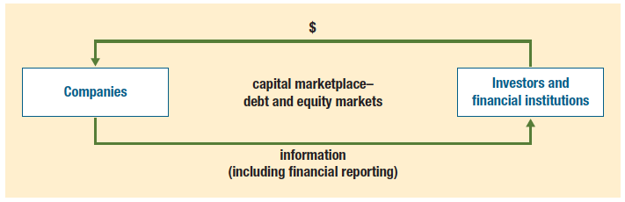
Capital Allocation Process
Notes:
L01

Slide 13
Accounting and Capital Allocation
In Canada, the primary exchange mechanisms for allocating resources are:
  Debt and equity markets (e.g. TSX)
  Financial institutions (e.g. banks)
Notes:
L01

Slide 14
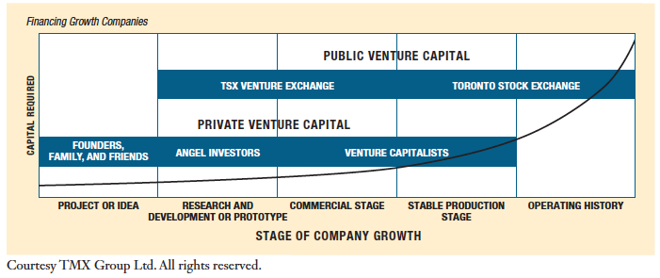
Sources of Capital
Notes:
L01

Slide 15
Accounting and Capital Allocation
An effective process of capital allocation is critical to a healthy economy
Unreliable and irrelevant information leads to poor capital allocation
Credit rating agencies use accounting to rate companies’ financial stability
This gives investors and creditors additional independent information
Notes:
L01

Slide 16
Stakeholders in Financial Reporting
Stakeholders: parties who have something at risk (stake) in the financial reporting environment
Key stakeholders include traditional users of financial information
Notes:
L02

Slide 17
Stakeholders in Financial Reporting
Broader definition of users is: anyone who prepares, relies on, reviews, audits, or monitors financial information
Includes both internal and external parties
Key stakeholders include:
  investors, creditors, auditors, employees, regulators, analysts, management, standard setters, and others
Notes:
L02

Slide 18
Stakeholders in Financial Accounting
Investors and creditors rely on the financial statements to make decisions
Standard setters set Generally Accepted Accounting Principles (GAAP) to provide direction for accounting
Notes:
L02

Slide 19
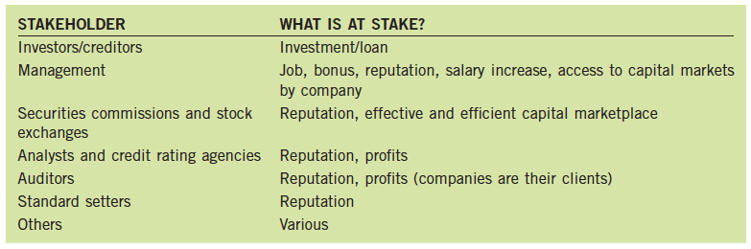
What is at Stake for Each Stakeholder
Notes:
L02

Slide 20
Objective of Financial Reporting
The overall objective of financial reporting is to provide information that is decision-useful.
Financial statements should provide information about:
  the entity’s economic resources and claims to those resources, and
  2. changes in those resources and claims
Resource allocation decisions are assumed to include assessment of management stewardship (i.e. management role in maximizing shareholder value)
General-purpose financial statements are prepared for a wide variety of stakeholders
Notes:
L03

Slide 21
Information Asymmetry
Ideally, all stakeholders should have equal access to all relevant information (i.e. symmetry of access to information)
Managers have access to more information than other stakeholders (i.e. information asymmetry)
Some reasons for information asymmetry
  Capital markets are not fully efficient
  Human behaviour sometimes motivated by maximizing self-interest at the cost of others
Notes:
L04

Slide 22
Information Asymmetry Problems
Two types of information asymmetry problems:
  Adverse selection: knowing that there is an information asymmetry, capital markets may attract wrong kinds of companies
  Moral Hazard: knowing that there is information asymmetry, individuals may act in their own best interest at the expense of others (e.g. management bias)
Some of the possible motivations for management bias include the following:
  Evaluation of management performance
  Compensation structures
  Access to capital markets and meeting analyst expectations
  Meeting contractual obligations
Notes:
L04

Slide 23
The Need to Develop Standards
Accounting standards help reduce information asymmetry problems in financial reporting
Standards are not rules, regulations, or laws they are recommendations
Standards are intended to be generally accepted and universally practised
Notes:
L05

Slide 24
The Standard Setting Process in Canada – Parties Involved
Canadian Accounting Standards Board (AcSB)
  Primarily responsible for setting GAAP for Canadian private enterprises (ASPE), not-for-profit entities, and pension plans
  Two underlying premises for development of standards
    Be responsive to the needs and viewpoints of the entire economic community
    Operate in full public view through due process
Notes:
L05

Slide 25
The Standard Setting Process in Canada – Parties Involved
International Accounting Standards Board (IASB)
  Major international standard setting body
  Mission “to develop, in the public interest, a single set of high quality, understandable and international reporting standards (IFRSs) for general purpose financial statements”
  IFRS must be used by public companies in Canada
  Private enterprises have an option of using IFRS
Notes:
L05

Slide 26
The Standard Setting Process in Canada — Parties Involved
Financial Accounting Standards Board (FASB) and the Securities and Exchange Commission (SEC)
  FASB is the major standard setting body in the U.S.
  SEC has the final authority over accounting standards in the U.S
Provincial Securities Commission
(e.g. Ontario Securities Commission)
  To oversee and monitor capital marketplace
  Ensure strict adherence to securities law/legislation
Notes:
L05

Slide 27
Generally Accepted Accounting Principles (GAAP)
Under ASPE, GAAP consists of :
  Primary sources
    CPA Canada Handbook Sections 1400 to 3870
    Accounting guidelines
  Other sources
    Background documents and implementation guidance issued by AcSB
    Pronouncements in other jurisdictions
    Research studies, accounting textbooks, journals, etc.
  Must be consistent with primary sources and in accordance with the conceptual framework (i.e. CPA Canada Handbook Section 1000)
Notes:
L06

Slide 28
Generally Accepted Accounting Principles (GAAP)
Under IFRS, GAAP includes:
  IFRS
  International Accounting Standards (IAS)
  Interpretations (IFRIC or SIC)
  If above sources do not specifically apply, other sources may be considered:
    Pronouncements of other standard-setting bodies
    Other accounting literature
    Accepted industry practices
Notes:
L06

Slide 29
Professional Judgement
There cannot be a rule for every situation
Standards in Canada are based primarily on principles rather than specific rules
Therefore, must use professional judgement
The United States currently uses a rules-based approach
Notes:
L07

Slide 30
Sarbanes-Oxley Act (SOX)
The Sarbanes-Oxley Act (SOX) was enacted in 2002 (in the United States)
Some of the legislation’s key provisions:
  Public Company Accounting Oversight Board (PCAOB)
  Independence rules
  Bonus/profit forfeiture
  CEO/CFO certification
  Management report on effectiveness of internal controls over financial reporting
  Independent audit committees
  Codes of ethics
Notes:
L07

Slide 31
Canadian Response
The Canadian Public Accountability Board (CPAB)
Additional rules issued by Canadian Securities Administrators (CSA) including:
  Management responsibility for appropriateness and fairness of financial statements
  Independent audit committees
  Increased disclosures
Notes:
L07

Slide 32
Centrality of Ethics
Ethical dilemmas are common in accounting and other areas of business
It is not always easy to do the right thing or make the right decision
Ethical decisions often go beyond applying GAAP or rules of the profession
Notes:
L07

Slide 33
Challenges and Opportunities for the Accounting Profession
Standard setting in a political environment
  Political action can have a significant impact on accounting standards
Principles versus rules
  Principle-based standards (like ASPE and IFRS) are more dependent on professional judgment
Notes:
L07

Slide 34
Challenges and Opportunities for the Accounting Profession
Impact of technology
  Increased ability to produce and access timely information
  New ways of communicating financial information (e.g. XBRL)
Integrated reporting
  Reporting to extend beyond financial information and include broader business reporting (e.g. governance and compensation, as well as sustainability reporting)
Notes:
L07

