Slide 1
Chapter 10
Intelligence and Schooling

Slide 2
The Psychometric Approach
Psychometric approach to intelligence:
  Focuses on the use of standardized tests to identify individual differences among people
  IQ tests yield ordered differences among people
    Results in an evaluative dimension in which person A is less or more intelligent than person B
  IQ tests are pragmatically oriented
    Determine the type of education a student should receive

Slide 3
The Nature of IQ Tests
Binet approach:
  Developed in 1905 by Alfred Binet and T. Simon
  Purpose was to measure individual differences in intellectual ability
Wechsler scales:
  Include Verbal Comprehension, Perceptual Reasoning, Working Memory, and Processing Speed
K-ABC:
  Grounded in information processing conceptions of intelligence
  Examines broad cognitive abilities.
More recent entries include group tests of intelligence and infant tests

Slide 4
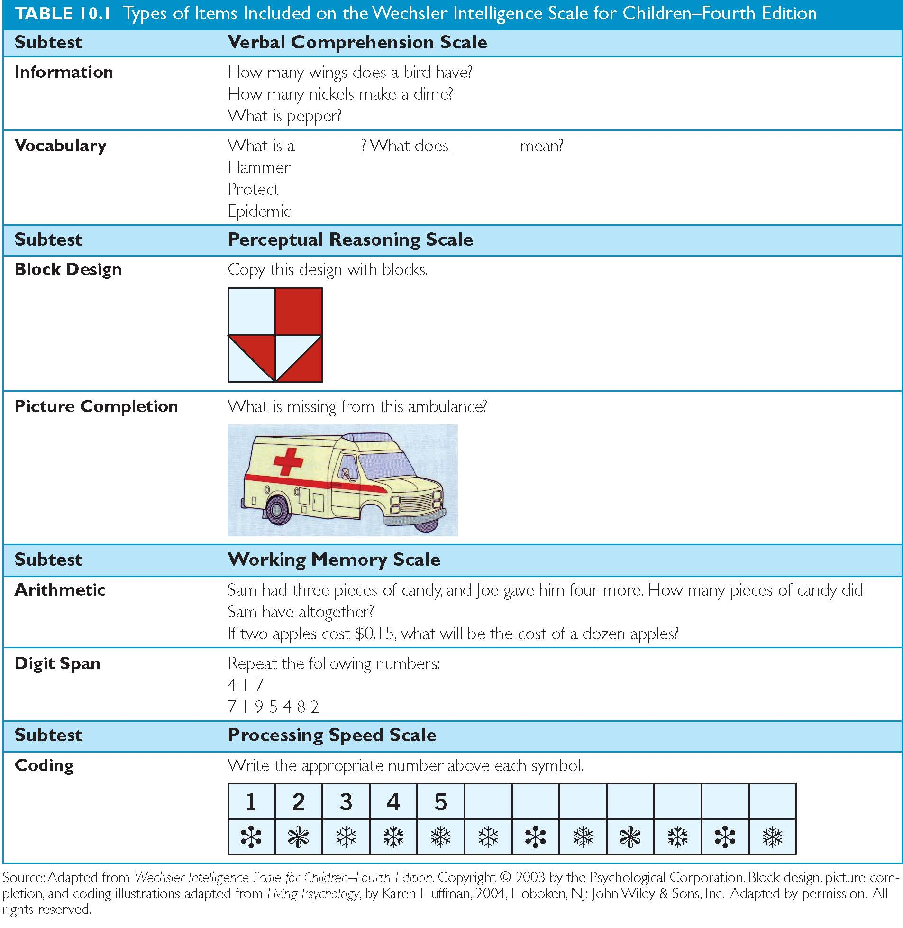
Wechsler Intelligence Test Items

Slide 5
WISC
100 (50th) Average
Average range: 25th – 75th

Slide 6
Validity
Does it measure what it claims to measure?
Criterion validity (correlation)
  Academic achievement
  Occupational status
  Job performance

Slide 7
Evaluating Intelligence Tests
Characteristics of a good psychometric test include :
  Reliability:
    Asks whether the test gives repeatable scores (consistency of measurement)
  Validity:
    Asks whether the test measures the intended domain
    Criterion validity determines whether IQ can predict a criterion such as school performance
    IQ scores correlate 0.5 to 0.6 with school performance

Slide 8
Organization of Intelligence
What is the underlying structure of intelligence?
  Number and organization of factors
  Spearman’s two-factor theory:
    General intelligence (“g”): part of all forms of intellect
    Specific intelligence (“s”): special abilities
  Thurstone:
    Seven primary abilities
    Verbal comprehension, verbal fluency, number, spatial visualization, memory, reasoning, and perceptual speed
  Hierarchical model of intelligence

Slide 9
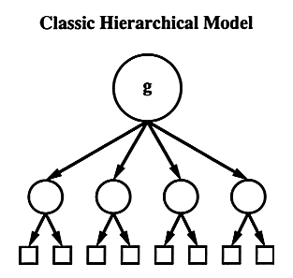

Slide 10
Stability of IQ
Infant intelligence tests do not predict later IQ
  Some research findings suggest infant response to novelty is associated with later IQ scores
IQ scores become stable across childhood through to adulthood
Family studies and twin studies suggest that IQ is, in part, genetic

Slide 11
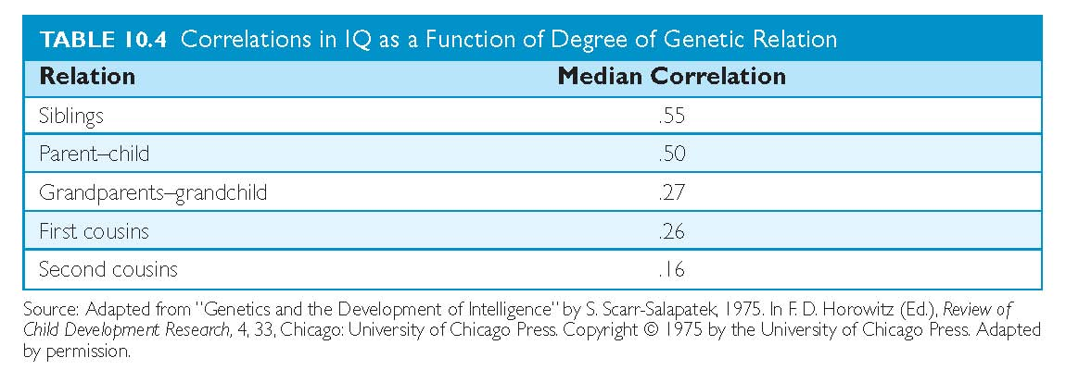
Origins of Individual Differences
Family studies

Slide 12
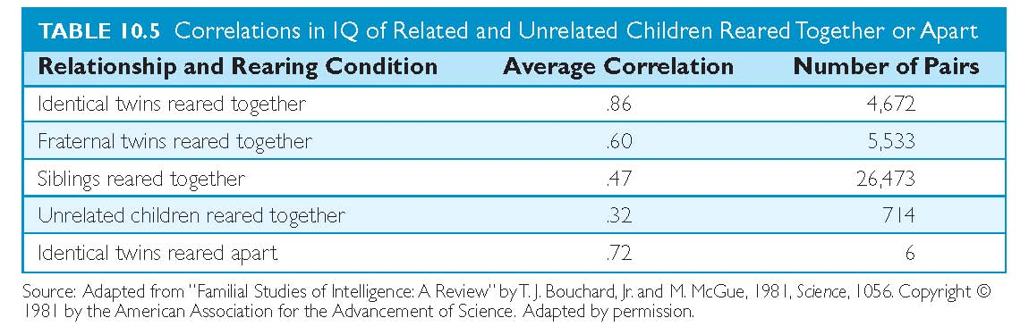
Origins of Individual Differences
Twin studies

Slide 13
Research with the HOME
Family experiences and values can alter intelligence
Home Observation for Measurement of the Environment (HOME):
  Scores correlated with IQ scores
Cross-cultural research suggests that family environment contributes to mathematics achievement in children

Slide 14
Ethnicity, Environment, and IQ Scores
Ethnic differences in IQ have been consistently found
Within a group, variations exist
Environmental differences such as socio-economical, cultural and experiential differences must be considered
Motivational factors such as stereotype threat can affect performance (e.g., women and math)

Slide 15
Early Intervention Programs
Project Head Start
Better Beginnings, Better Futures
Aboriginal Head Start
Effects
  Immediate effects greater than long-term effects
  School performance impacted greater than general IQ

Slide 16
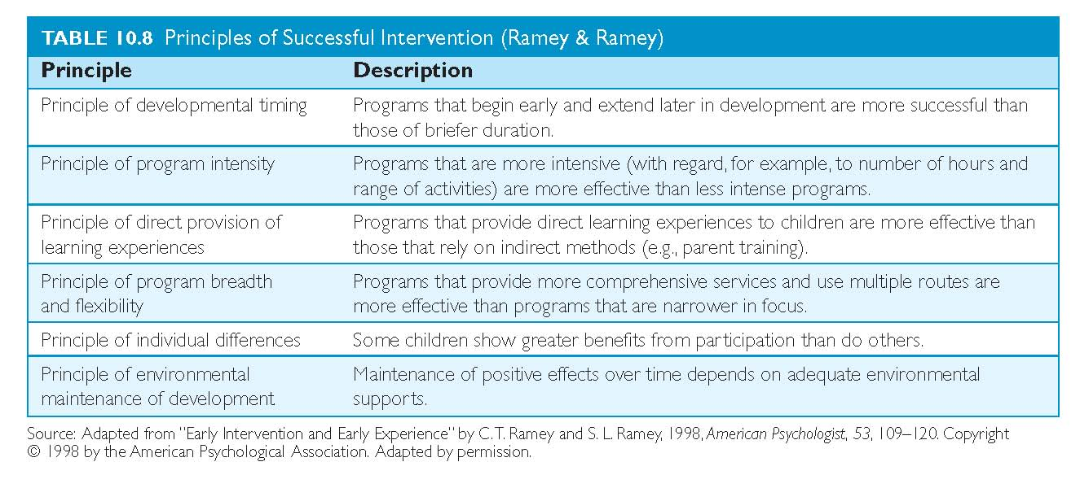
Principles of Successful Intervention

Slide 17
Schooling: Variations and Effects
Cross-cultural studies suggest that schooling can affect children’s cognitive development
Amount and quality of schooling can alter intelligence
Stage-environment fit and cultural compatibility can impact intellectual development

Slide 18
Alternatives Conceptions of Intelligence
Evolutionary approaches:
  Focus on environment of evolutionary adaptiveness this environment produces
  Biologically primary abilities:
    Abilities that have evolved by natural selection to solve recurring problems
  Biologically secondary abilities:
    Non-evolved abilities that appear in specific cultural contexts

Slide 19
Alternatives Conceptions of Intelligence
Vygotsky emphasized that children have two levels of development:
  Actual or current versus that of potential development
  Vygotsky emphasized that adult assistance can enhance intellectual performance by closing the zone of proximal development (the gap between actual and potential development)
    This is the focus of dynamic testing

Slide 20
Alternatives Conceptions of Intelligence
Gardner’s Theory of Multiple Intelligences:
  Suggests that certain forms of intelligence (e.g. musical) are not tapped by current IQ tests
Creativity and giftedness are often not captured through conventional IQ tests
Creativity involves the convergence of divergent thinking, personality, and motivation

