Slide 1
ADM1300
Lecture1
Text References:
Chapter 1— Introducing Management
Management 3e- Chapter 1
2
Notes:
WELCOME!!
LET’S START WITH A VERY SIMPLE QUESTION→

Slide 2
A simple question...
What is management?

Slide 3
Organizations
Organization
  A collection of people working together to achieve a common purpose.
  Organizations provide useful goods and/or services that return value to society and satisfy customer needs.
Management 3e- Chapter 1

Slide 4
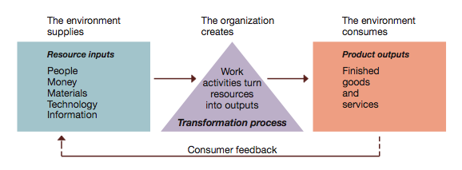
Figure 1.2 Organizations as open systems.
Organizations
Management 3e- Chapter 1
15

Slide 5
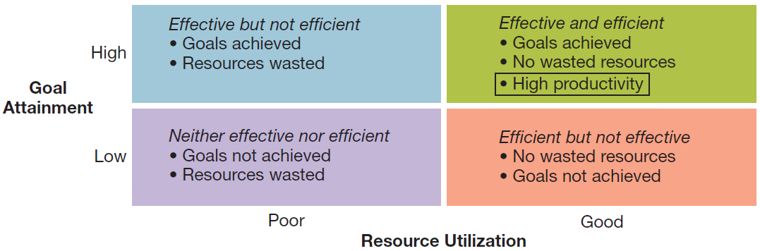
Figure 1.3 Productivity and the dimensions of organizational performance.
Organizations
Management 3e- Chapter 1
18

Slide 6
Organizational Environment
The general environment — all of the background conditions in the external environment of the organization including:
  Economic – health of the economy
  Legal-political – norms, customs, social values
  Socio-cultural – philosophy/objectives of political party running the government
  Technological – development and availability of technology
  Natural environment – nature and conditions of environment
Management 3e- Chapter 1
20

Slide 7
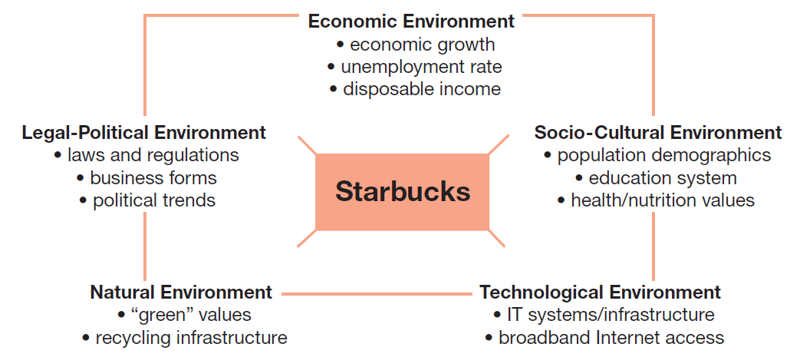
Figure 1.4 Sample general environment conditions faced by firms like Starbucks
Organizational Environment
Management 3e- Chapter 1
21

Slide 8
Organizational Environment
The specific (task) environment: actual organizations, groups, and persons with whom an organization interacts and conducts business.
Includes important stakeholders such as:
  Customers
  Suppliers
  Competitors
  Regulators
  Investors/owners
Value creation is creating value for and satisfying the needs of constituencies
Management 3e- Chapter 1
22

Slide 9
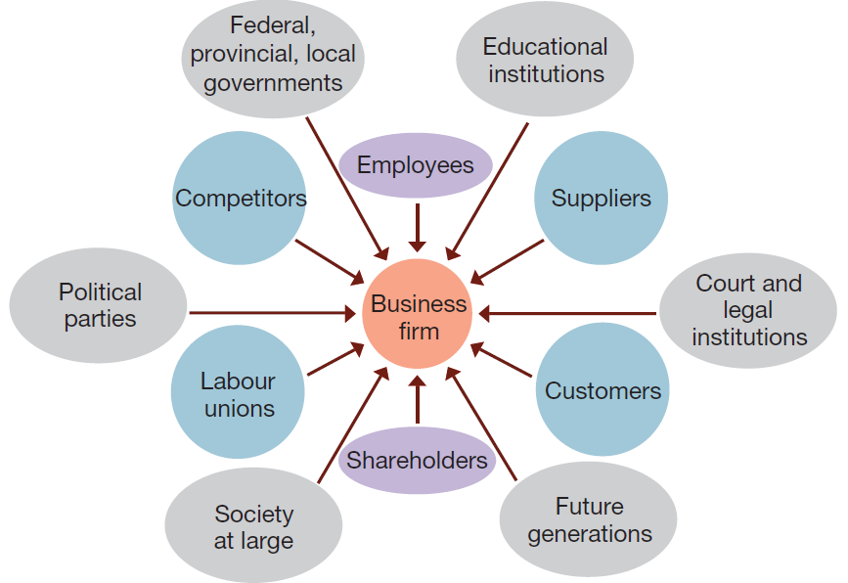
Figure 1.5 Multiple stakeholders in the specific or task environment of a typical business firm
Organizational Environment
Management 3e- Chapter 1
23

Slide 10
Organizational Environment
Environmental uncertainty: a lack of complete information regarding what exists and what developments may occur in the external environment.
Two dimensions of environmental uncertainty:
  Degree of complexity
  Rate of change
Management 3e- Chapter 1
26

Slide 11
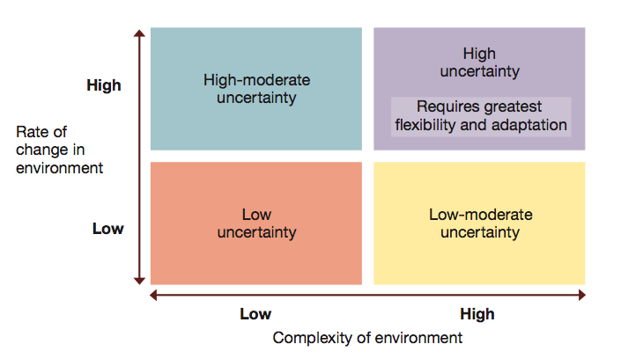
Figure 1.6 Dimensions of uncertainty
Organizational Environment
Management 3e- Chapter 1
27

Slide 12
Managers in the New Workplace
Levels of management
  Top managers — responsible for performance of an organization as a whole or for one of its larger parts.
  Middle managers — in charge of relatively large departments or divisions.
  Team leaders or supervisors — in charge of a small work group of non-managerial workers.
Management 3e- Chapter 1
31

Slide 13
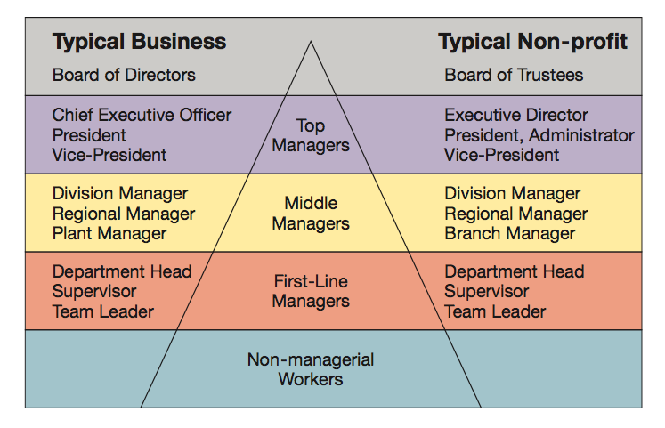
Figure 1.8 Management levels in a typical business and non-profit organizations
Managers in the New Workplace
Management 3e- Chapter 1
32

Slide 14
The Management Process
Managers achieve high performance for their organizations by best utilizing its human and material resources.
Management is the process of planning, organizing, leading, and controlling the use of resources to accomplish performance goals.
All managers are responsible for the four functions.
The functions are carried on continually.
Management 3e- Chapter 1
40

Slide 15
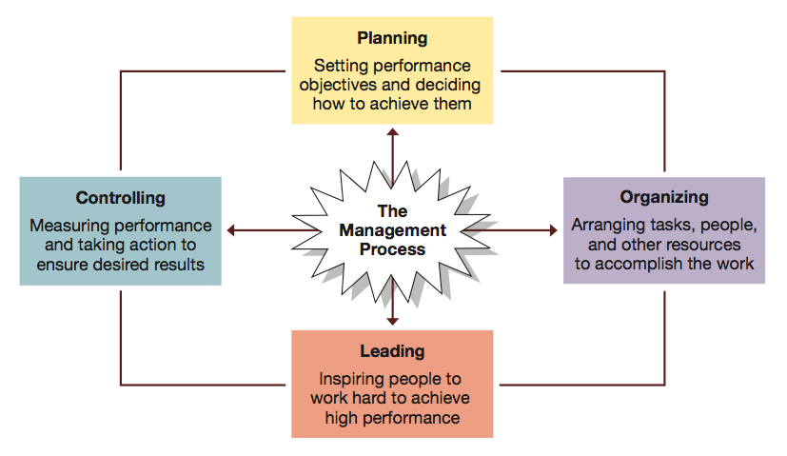
Figure 1.10 Four functions of management.
The Management Process
Management 3e- Chapter 1
41

Slide 16
The Management Process
Functions of management …
  Planning
    The process of setting objectives and determining what actions should be taken to accomplish them.
  Organizing
    The process of assigning tasks, allocating resources, and arranging the coordinated activities of individuals and groups to implement plans.
Management 3e- Chapter 1
42

Slide 17
The Management Process
Functions of management …
  Leading
    The process of arousing people’s enthusiasm to work hard and direct their efforts to fulfill plans and accomplish objectives.
  Controlling
    The process of measuring work performance, comparing results to objectives, and taking corrective action as needed.
Management 3e- Chapter 1
43

Slide 18
The Management Process
Managerial activities and roles
  Informational roles
    Involve giving, receiving, and analyzing of information.
  Interpersonal roles
    Involve interactions with persons inside and outside the work unit.
  Decisional roles
    Involve using information to make decisions in order to solve problems or address opportunities.
Management 3e- Chapter 1
44

Slide 19
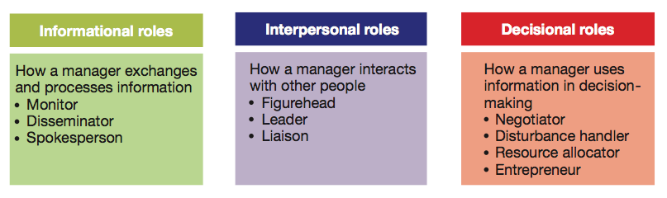
Figure 1.11 Mintzberg’s 10 Managerial Roles.
The Management Process
Management 3e- Chapter 1
45

Slide 20
The Management Process
Essential managerial skills
  Skill — the ability to translate knowledge into action that results in desired performance.
  Technical skill — the ability to apply a special proficiency or expertise to perform particular tasks.
  Human or interpersonal skill — the ability to work well in cooperation with others.
    Emotional intelligence is the ability to manage ourselves and relationships effectively
  Conceptual skill — the ability to think critically and analytically to solve complex problems.
Management 3e- Chapter 1
49

Slide 21
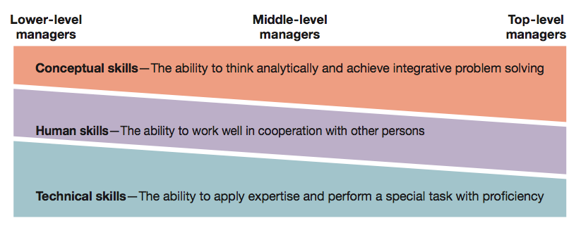
Figure 1.12 Katz’s Essential Managerial Skills.
The Management Process
Management 3e- Chapter 1
50

Slide 22
About this course…..
An introductory course on business management
Formal lectures, discussions, videos, case studies
Considerable in-class discussion
Considerable material to be covered in a relatively short period of time

Slide 23
About this course…..
Program Learning Goals:
  LG1 – Understand, Apply and Integrate Core Management Disciplines
  LG3 – Demonstrate Leadership, Interpersonal and Communication Skills
  LG5 – Unlocking the Value of Globalization

Slide 24
About my expectations
It is expected that:
  You will regularly attend all lectures
  You will come to the lectures fully prepared: in other words you will read all the text material to be discussed in the lectures BEFORE the lecture
  You will fully participate fully in class discussions and in-class group discussions
It is also expected that you will not hesitate to contact me for any reason relating to your educational experience in this course:
  By e-mail: Delcorde@Telfer.uottawa.ca
  In person: DMS 1111D (by appointment)
  By telephone: (613) 562-5800 ext. 4890 (email preferred)

Slide 25
About email…
I WILL:
  Respond to all legitimate e-mail queries that seek a further clarification of the material covered or those relating to serious administrative-type issues
  Respond to all “emergency” e-mails
  Try to respond in a timely manner – usually within 24 hours
I WILL NOT:
  Provide assignment, examination, term or final grades by e-mail
  Reiterate any dates or announcements provided in class
  Answer e-mail questions relating to course material that has been covered in class: the calibre of the question will tell whether the questioner has been in class – in other words I will not re-teach the course on e-mail
  Bring graded assignments more than ONCE to class

Slide 26
About how you will be taught
The lectures will highlight the main points of the reading – you must do the necessary reading in advance!
  Most (but not all) lecture slides will be based on the text readings.
  Frequently the slides will contain information from sources other than the text book
  You are responsible for all material presented in class, the entire content of the assigned chapters of the text book (whether explicitly addressed in the lecture slides or not), as well as the general themes of any videos or the general content of any guest lecturers
Case analyses and videos will apply the theoretical concepts to “real” situations

Slide 27
About what you will need to study…..
The course outline available on Blackboard Learn
The mandatory text book that accompanies this course: Schermerhorn & Wright: Management 3rd Canadian Edition, Wiley, 2014. Available from the university book store (in hardcopy and loose leaf).

Slide 28
Course Requirements and how you will be evaluated
Mid-Term (25%)
Individual Project (20%)
Discussion Group (DGD) Participation (20%) [refer to course syllabus]
Final Examination (35%)
*weekly attendance at the lecture and the DGD is mandatory (no exceptions)

Slide 29
Course Requirements and How You Will be Evaluated
You absolutely must carefully read the course outline posted on Blackboard
  Everything is well explained
  Deliverables and due dates are clearly noted

Slide 30
Blackboard Learn – Step by Step Access Instructions

Slide 31
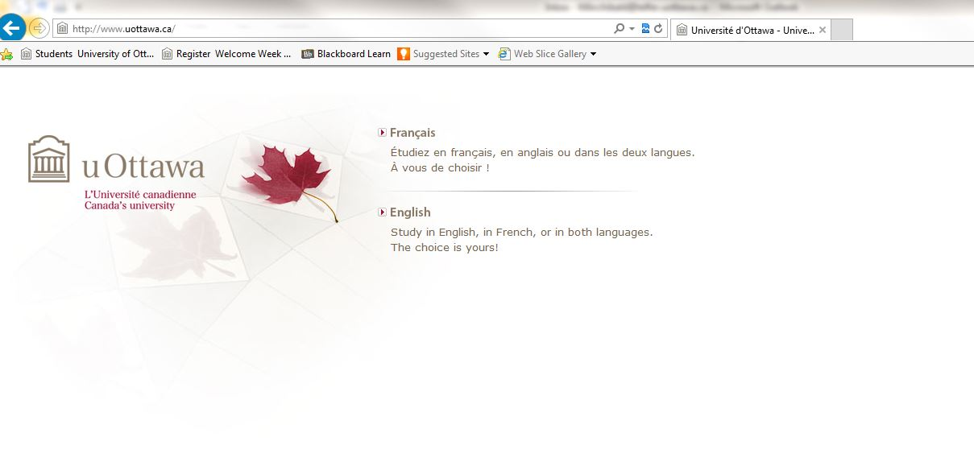
Go to www.uottawa.ca

Slide 32
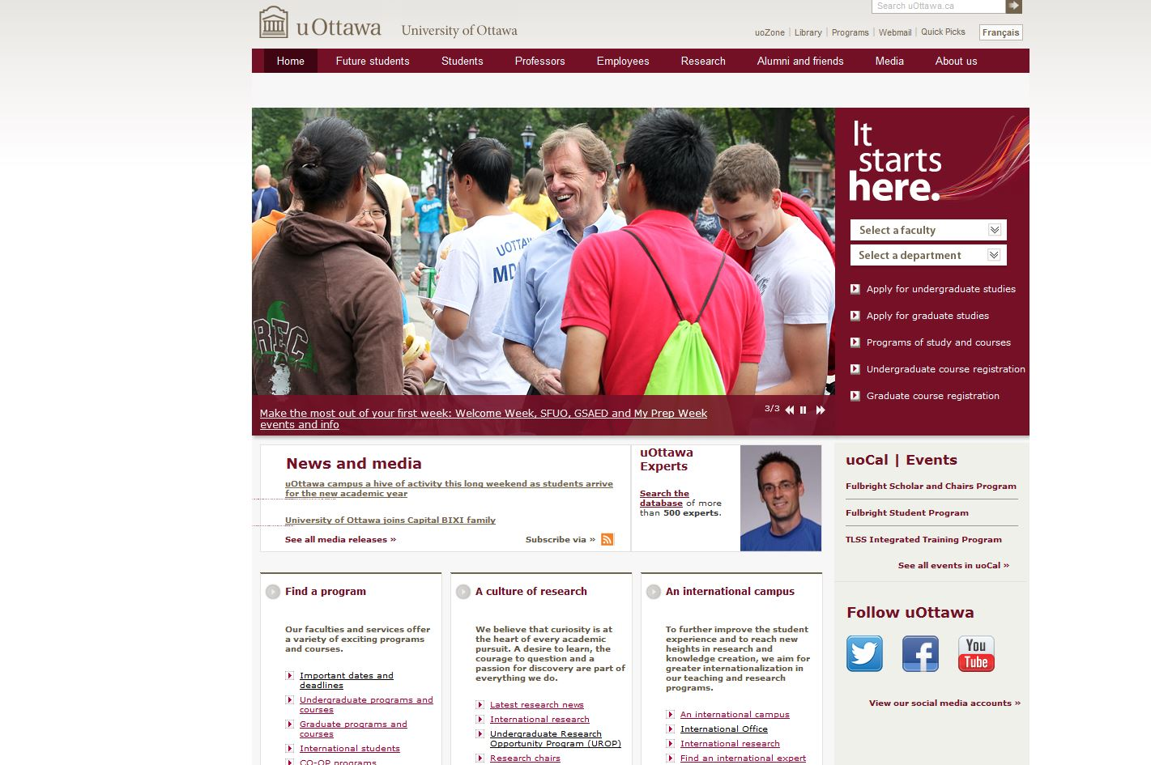
Go under the ‘Students’ directory

Slide 33
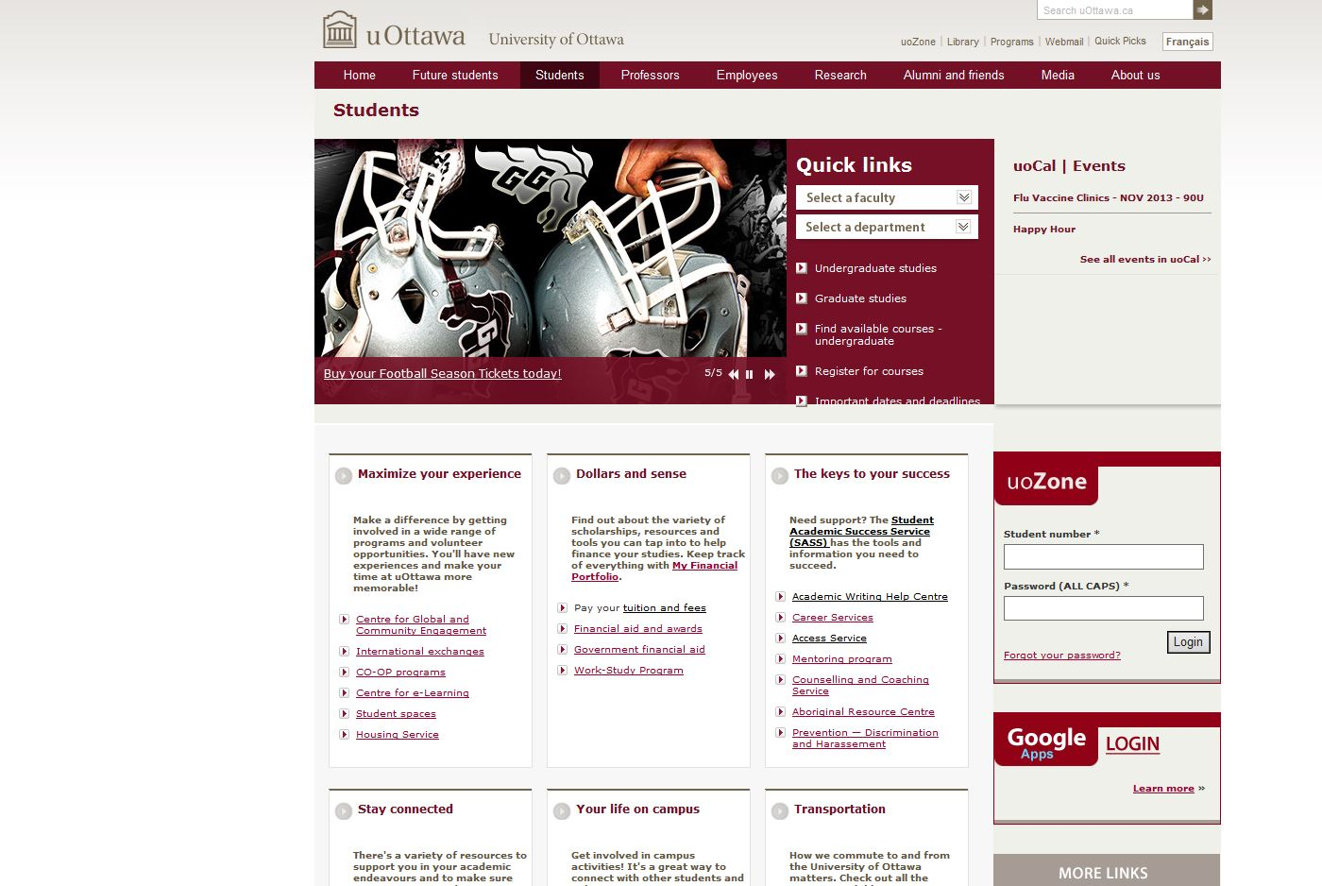
Look for the UoZone on Right Side
Log In

Slide 34
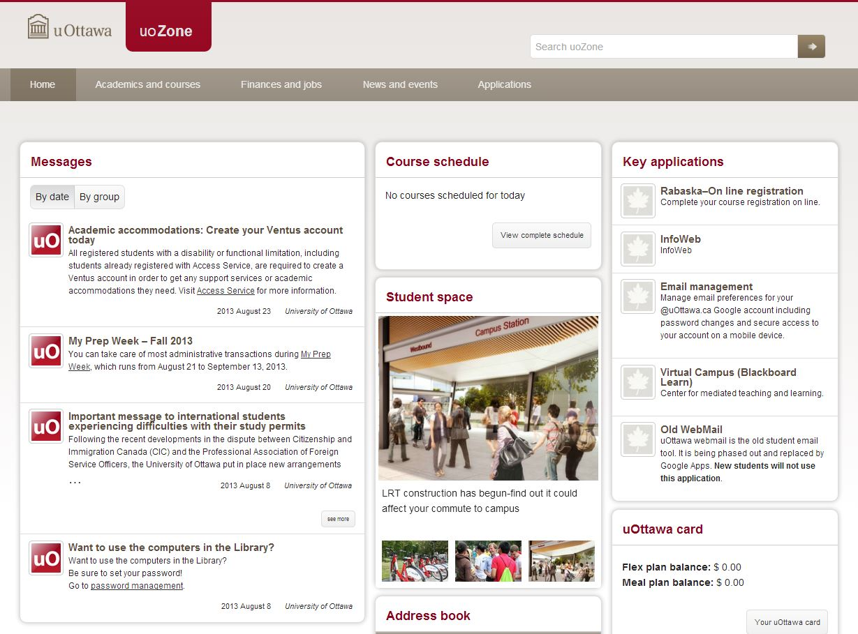
This is UoZone (lots of important information) – look for BB Learn

Slide 35
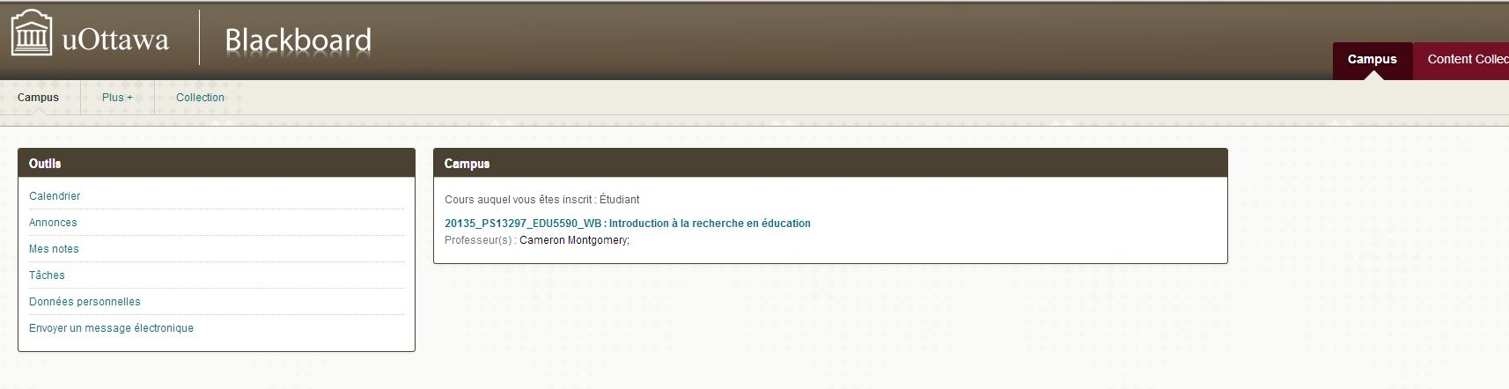
Blackboard Learn

Slide 36

Questions?

