Slide 1
ANP1105C Review Sept 30
TOPIC #2.2: PHYSIOLOGY OF THE NEURON 392 - 418
2.2.1 Identify the different regions of the neuron and associate each region with the functions of reception, propagation and transmission of nerve impulses (pp. 392-395)
2.2.2. Explain the phenomena (diffusion of ions, types of ion channels) that are responsible for the electrical activity of neurons (resting membrane potential, action potential) (pp. 398-401)
2.2.3 Describe the factors that influence propagation of the action potential along an axon (pp. 402-408)
2.2.4 Explain the mechanisms of synaptic transmission (synapse, post-synaptic potentials, synaptic integration (pp. 409-418)

Slide 2
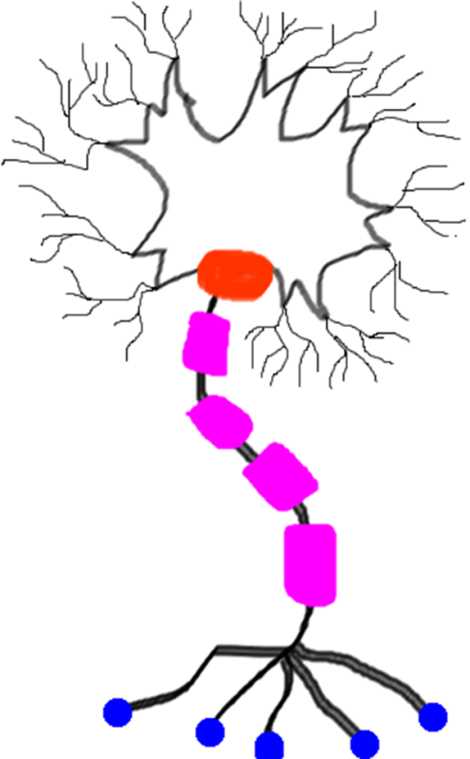
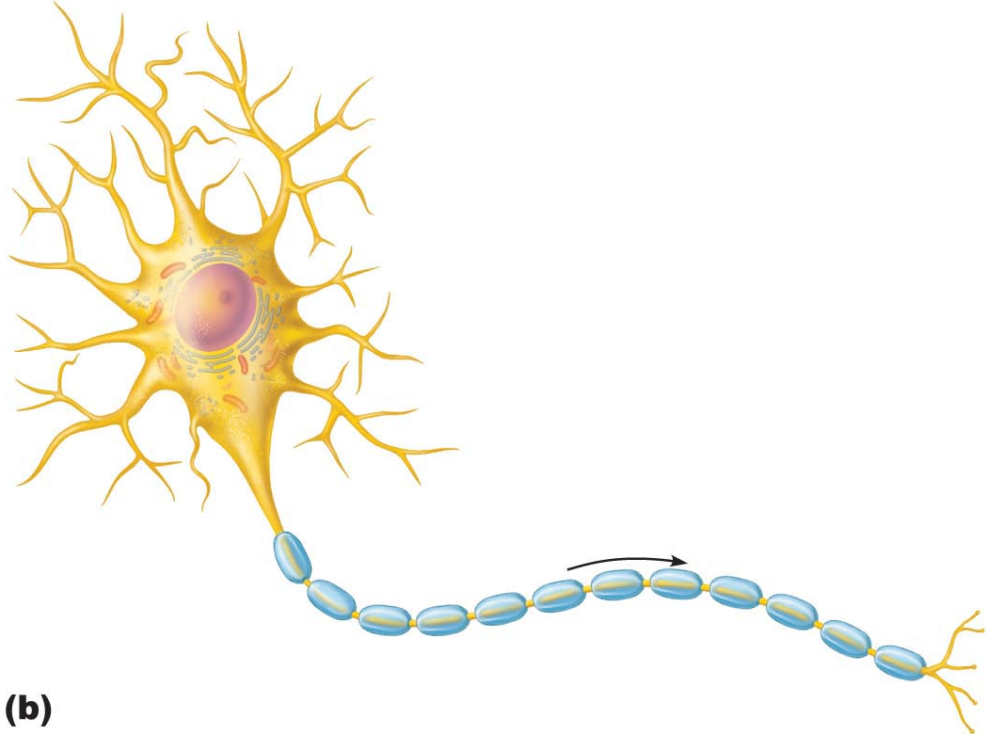

A. Neuron Cell Body
• large, spherical nucleus + granular cytoplasm ➢ biosynthetic centre
• extensive RER + ribosome clusters (Nissl bodies); also elaborate Golgi & lots of mitochondria Why??
• CNS/ PNS as a whole: What is a nucleus? What is a ganglion?
B. Neuron Processe
Dendrites
Axons
axonal terminals
2 more terms:
tract: bundle of nerve processes in CNS
nerve: bundle of nerve processes in PNS
1. Receptive region
2. Conducting region
3. Secretory region
Fig. 11.4
J. Carnegie, Uof O

Slide 3
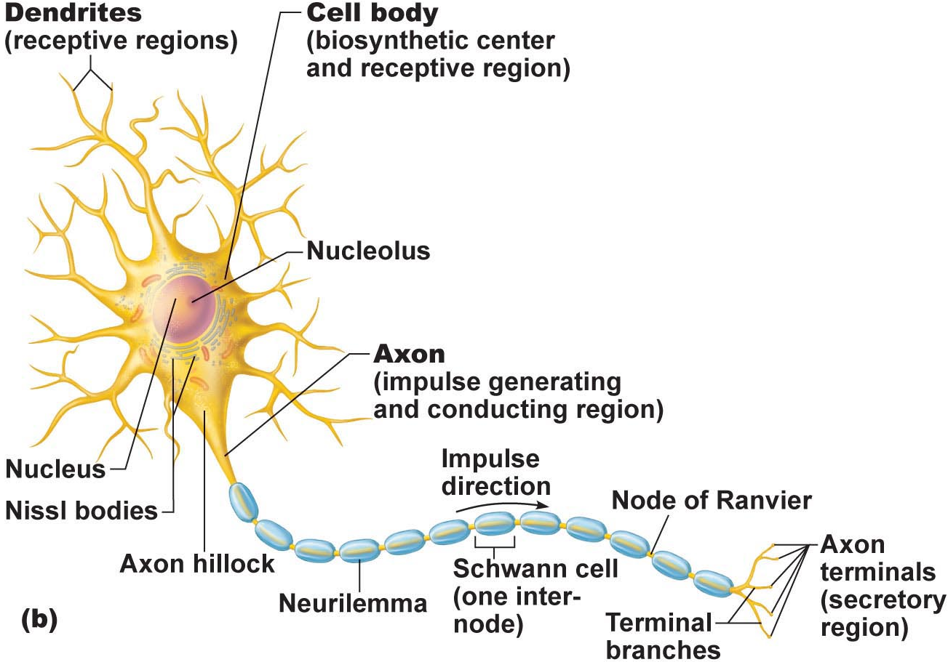
B1. Dendrites: (receptive region)
• short, tapering, branched extensions; usually hundreds/cell body
• enormous SA for reception from other neurons
• conduct impulses toward cell body
• short distance, graded potentials
J. Carnegie, Uof O
B2. Axon
• arises from axon hillock; variable length (can be > 1 metre)
• rate of conduction increases with axon diameter
• usu. 1 axon/neuron; branches at end (~10,000 telodendria) which end in axonal terminals

Slide 4

4.1.5 indicate the effect of axon diameter on neuron conduction velocity
4.1.6 distinguish between anterograde and retrograde transport
B2. Axons (cont.):
Neurotransmitters convey information from one axon to the next
Axon has same organelles as cell body, but no Nissl bodies; axons quickly degenerate if cut
Elaborate cytoskeleton in axon to move material to & fro:
anterograde (eg: mitos, cytoskeleton, membrane parts, NTs)
retrograde (eg: organelles to be degraded/recycled)
Conduction velocities depend on:
(i) axon diameter
(ii) myelin sheath
J. Carnegie, Uof O

Slide 5
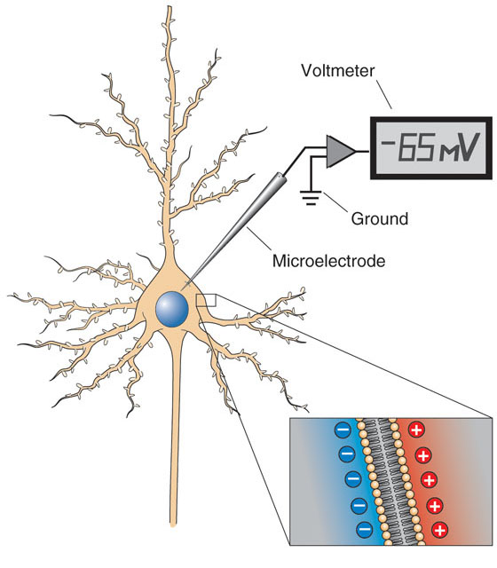
2.2.2.1 describe the resting membrane potential (RMP) of an excitable cell in terms of the differential permeability of the cell membrane to Na⁺ and K⁺; indicate which ion is found primarily inside cells and which is found primarily in the ECF
A. Creation of Resting Membrane Potential (RMP)
What do we mean when we say that neurons are excitable cells??
Some Fundamental Principles of Electricity:
voltage: electrical potential energy due to separation (PM) of oppositely-charged particles (ions) (-70 mV for many neurons)
resting membrane potential: all cells polarized; RMP cell-type-dependent (neg)
J. Carnegie, UofO
http://www.bioon.com/book/biology/whole/image/3/3-11.tif.jpg

Slide 6
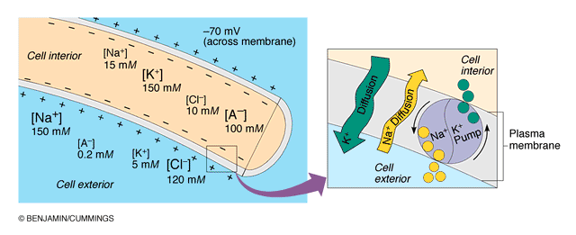
2.2.2.2. describe the Na+/K+ ATPase in terms of its role in maintaining the RMP of a neuron
NEGATIVE because INSIDE of cell negative compared to OUTSIDE
negativity only at level of membrane
RMP due to differential permeability of membrane to Na⁺ and K⁺ ions
Which ion primarily inside cells??
Which ion primarily outside cells??
3. At rest: membrane somewhat permeable to K⁺ but only very slightly permeable to Na⁺; so what happens??? What is the net result???
Fig. 11.8b (7th edition)

Slide 7
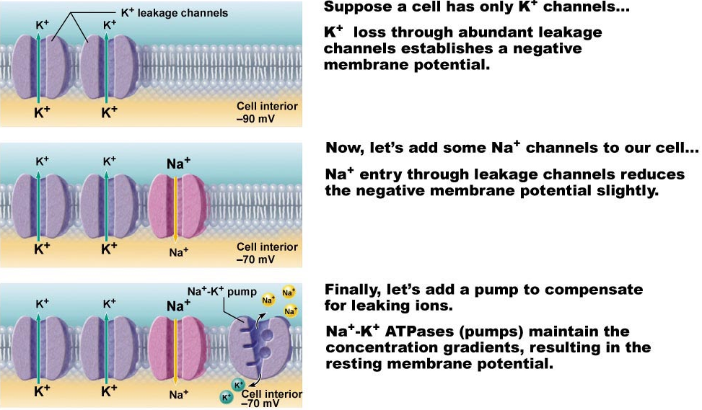
2.2.2.3 define electrochemical gradient; see also pages 79-82
We have:
1. Differential resting membrane permeabilities to Na⁺ & K⁺
2. Also, Na⁺/K⁺ pump moves 3 Na⁺ OUT for every 2 K⁺ IN
Fig. 11.8

Slide 8
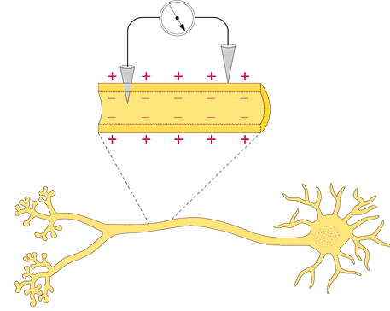
B. Measurement of Resting Membrane Potential (RMP)
RMP for a neuron is -40 to -90 mV (how is this measured???)
Fig. 11.7

Slide 9
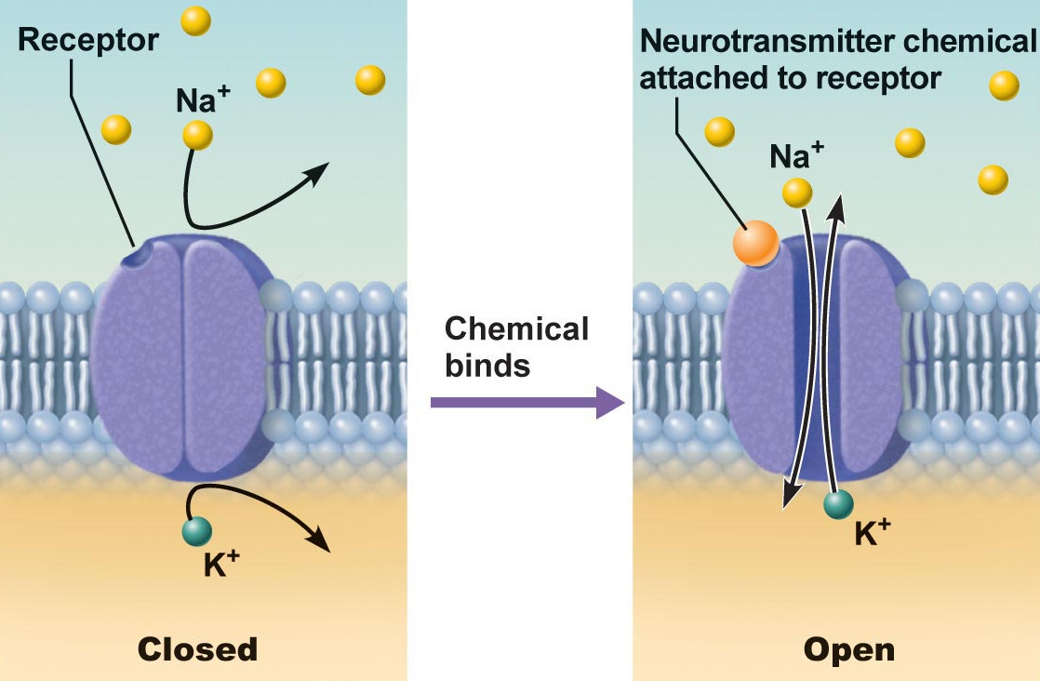
2.2.2.4 distinguish between passive (leakage) and active (gated) channels; list & describe the functioning of the 2 types of gated channels
Channels in plasma membranes:
1. Passive or leakage channels: always open
2. Active or gated channels: signal required to open/close
a) chemically-gated (neurotransmitter/hormone)
b) voltage-gated (change in membrane potential)
channels ion-specific: channels open ➔ ions move in response to electrochemical gradients
Fig. 11.6a
J. Carnegie, Uof O

Slide 10
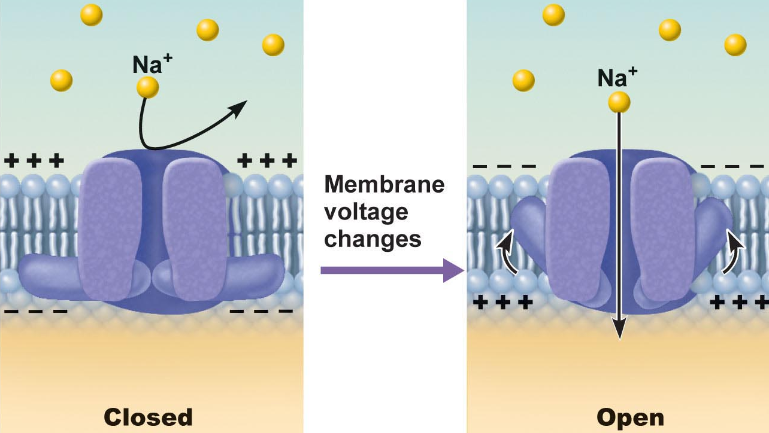
Fig. 11.6b
Fig. 11.6b
● neurons & muscle cells communicate by changing membrane potentials
● 2 types of signals:
graded potentials:……………………………………
action potentials:………………….…………………
J. Carnegie, UofO

Slide 11
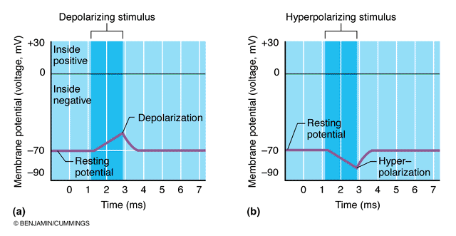
2.2.2.5 distinguish between depolarization and hyperpolarization
Fig. 11.9
remember that depolarization increases the probability of producing nerve impulses; hyperpolarization decreases this probability

Slide 12
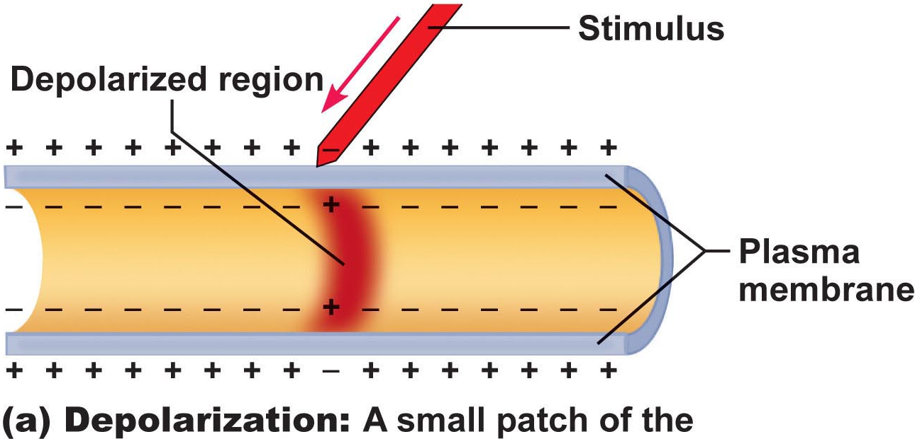
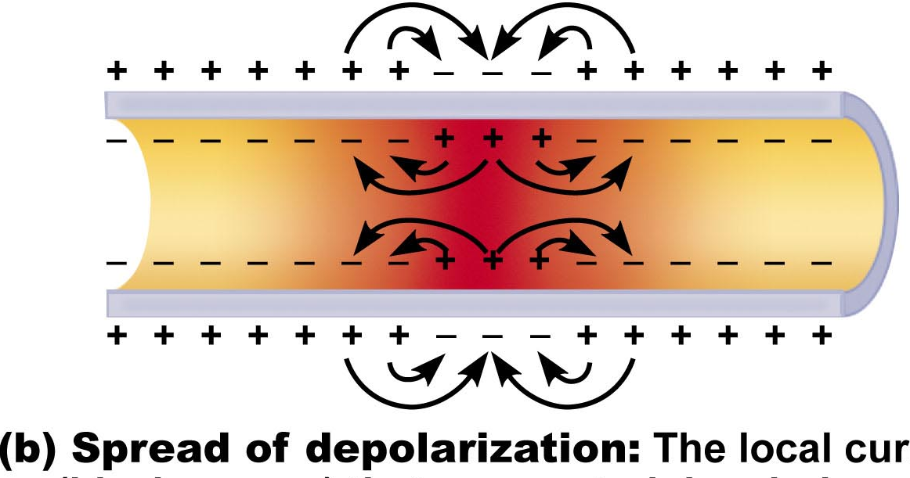
Graded Potentials
short-lived depolarizations or hyperpolarizations
current decreases with distance traveled
graded because magnitude determined by strength of stimulus
Initial stimulus depolarizes or hyperpolarizes local area of membrane
↓
decremental movement of ions on either side of membrane propagates signal for short distance
Fig. 11.10a
Generator potential
Postsynaptic potential
Fig. 11.10b

Slide 13
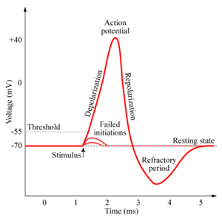
2.2.2.6 describe and graph a typical action potential, illustrating the 3 consecutive, overlapping changes in membrane permeability to specific ions; define: threshold, hyperpolarization undershoot, absolute refractory period, relative refractory period
Definition: a brief reversal of membrane potential; total amplitude = ~100 mV (from -70 to +30 mV)
• cells with excitable membranes (neurons, muscle cells) can generate action potentials; in neurons, only axons can generate action potentials
APs do not decrease in amplitude with distance travelled!!
• voltage-gated channels on axons open & close in response to local currents (graded potentials)
http://www.chm.bris.ac.uk/webprojects2006/Cowlishaw/mech%20synaptic%20transmission.htm
J. Carnegie, UofO

Slide 14
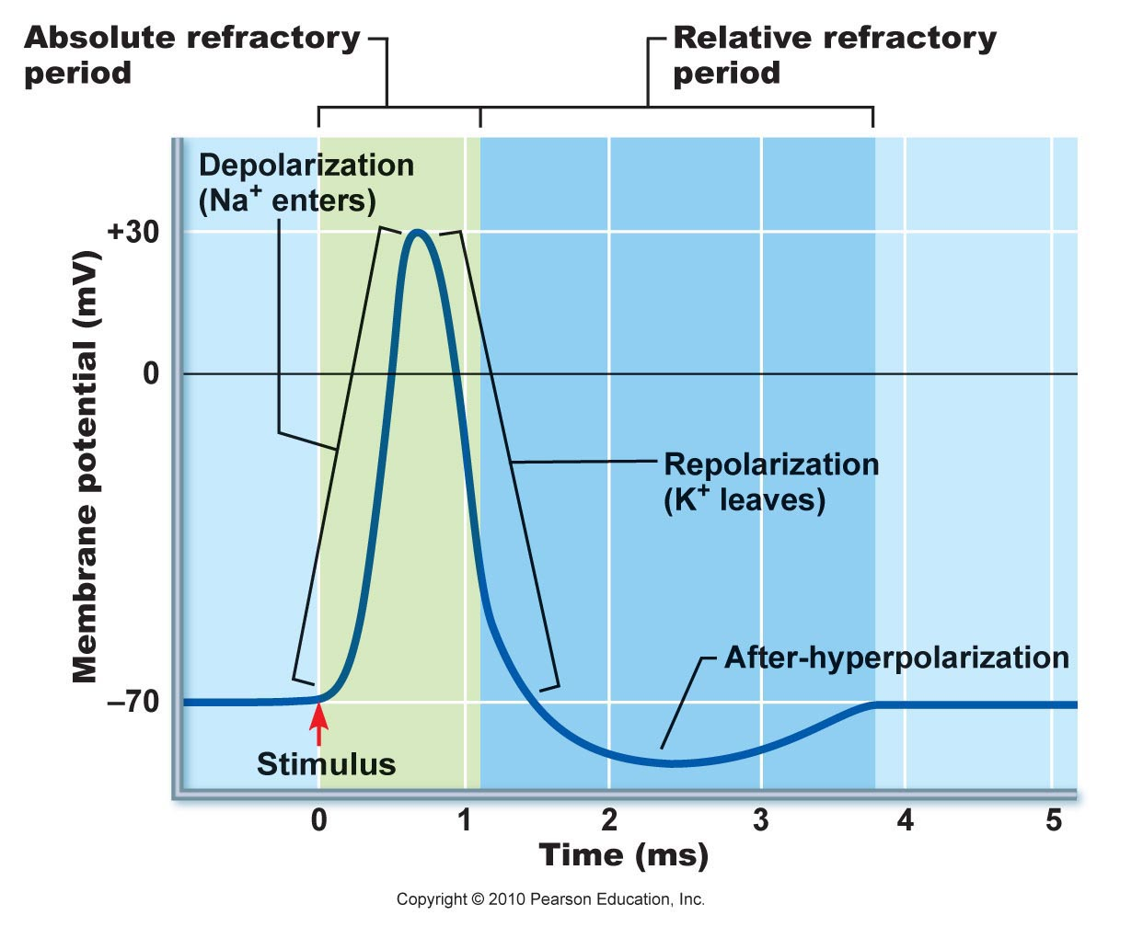
Generation of an Action Potential
transient increase in Na⁺ permeability
restoration of Na⁺ impermeability
transient increase in K⁺ permeability
(i) Increase in Na⁺ permeability
resting state: voltage-gated Na⁺ & K⁺ channels closed; normal leakage
local depolarization: voltage-gated Na⁺ channels open (fast activation gates)
What does threshold (-55 to -50 mV) mean? Why is AP then self-sustaining?
What is the spike of an AP? Concept of positive feedback
Fig. 11.14
Depolarizing Phase:
Both Na⁺ gates must be open for entry; closure of either gate stops Na⁺ entry
J. Carnegie, Uof O

Slide 15
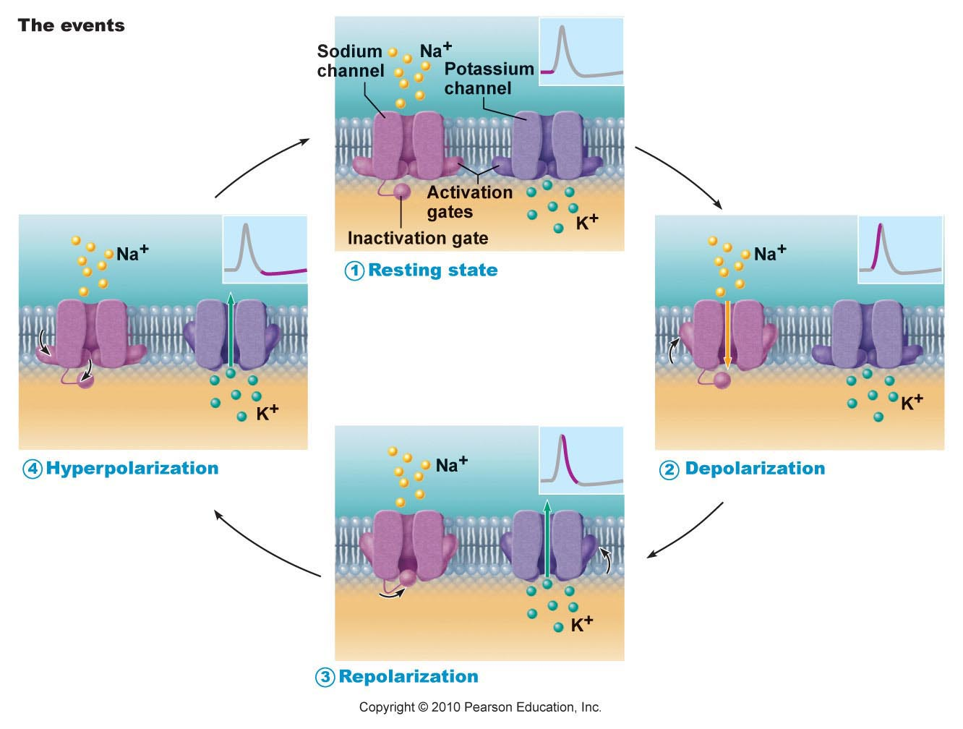
Fig. 11.11

Slide 16
(ii) Decrease in Na⁺ permeability
as membrane potential passes 0 mV, inside positivity resists further Na⁺ entry
Na⁺ gates begin to close; turning point in spike
cell will now begin to repolarize
Repolarizing phase:
(iii) Increase in K⁺ permeability
K⁺ leaves cell along electrochemical gradient & repolarizes cell
also slow gates: so slow that do not close quickly enough →
after-hyperpolarization
Na⁺/K⁺ pumps quickly restore ion gradients across membrane
J. Carnegie, Uof O

Slide 17
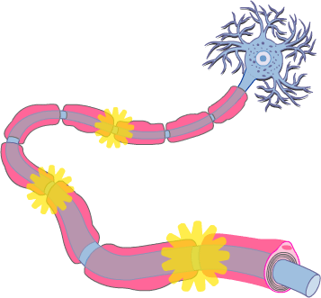
2.2.3.1 justify the unidirectional propagation of an AP and the description of an AP as an “all-or-none” event; indicate how stimulus intensity is coded in action potential production
Propagation of an Action Potential
• AP must traverse length of neuron to signal next neuron
• propagation rather than conduction of an AP - Why??
• unidirectional - Why?? What do we mean when we say that an area of a neuron is refractory to further stimulation? What does this mean about the Na⁺ channels??
J. Carnegie, UofO
http://www.getbodysmart.com/ap/nervoussystem/neurophysiology/actionpotentials/menu/menu.html

Slide 18
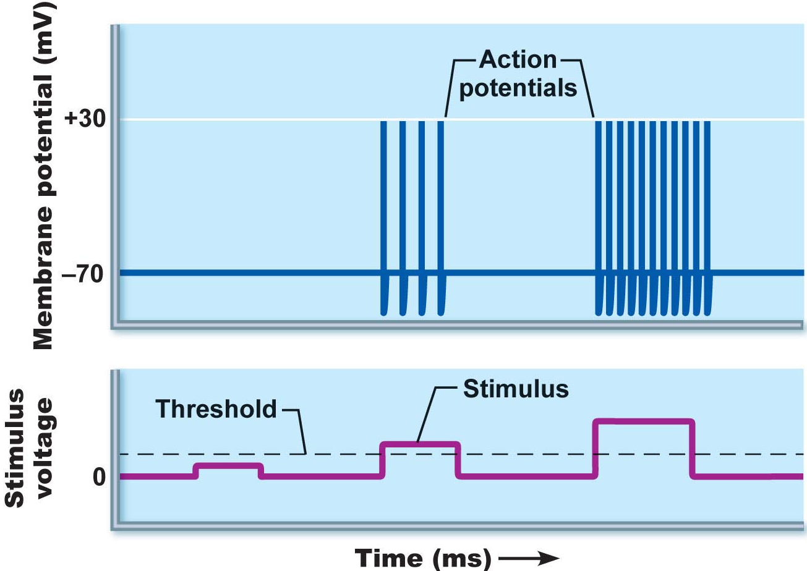
Threshold and All-or-None Phenomenon
outward K⁺ current = inward Na⁺ current (~20 mV of depolarization)
can go either way!!
local depolarizations (graded) must sum to reach threshold or no AP
Why do we say that an AP is an all-or-none event?
NB: APs are all the same size: stimulus intensity is indicated by AP frequency
Fig. 11.13

Slide 19
Absolute & Relative Refractory Periods
Absolute RP: Na⁺ gates open & second depolarization impossible
Relative RP: Na⁺ gates closed but K⁺ gates open; can only be stimulated by a very strong stimulus (greater than threshold); a means of increasing frequency when incoming stimulus is strong
Fig. 11.14

Slide 20
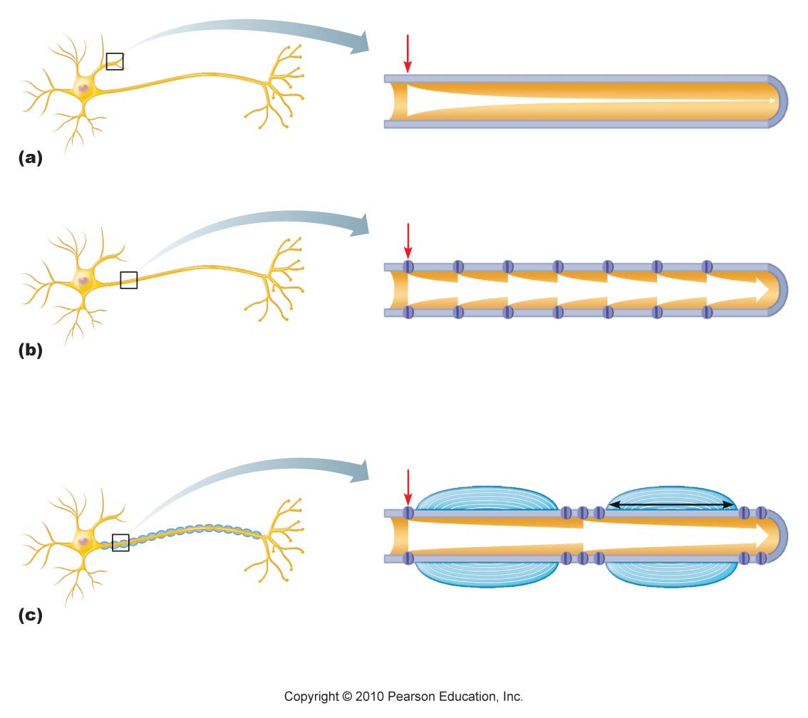
2.2.3.2 describe the production of myelin sheathes around peripheral neurons and indicate their role in AP propagation; define: Schwann cell, node of Ranvier, saltatory conduction, oligodendrocytes, multiple sclerosis as a disease affecting the myelin sheath
Myelin Sheath:
• white, lipid-protein; insulates/protects peripheral nerves
• increases (up to 150 X) rate of impulse propagation
• Schwann cells: membranes <25% protein (minimal channels ➢ Why?)
Node of Ranvier? saltatory conduction? Are dendrites myelinated?
Fig. 11.15. Myelin sheath speeds up impulse propagation

Slide 21
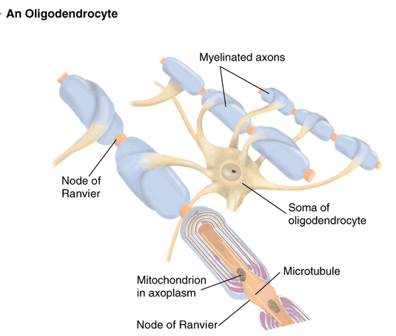
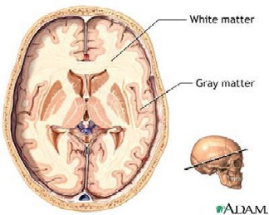
myelinated nerves also in CNS: oligodendrocytes; white vs gray matter
http://homepage.psy.utexas.edu/homepage/class/Psy332/Salinas/Cells/Cells.html
http://reinventioninc.blogspot.com/2005_01_01_reinventioninc_archive.html

Slide 22

A Clinical Note
Multiple Sclerosis:
persistent inflammatory response in which myelin sheaths gradually destroyed (autoimmune? persistent virus?)
cycles of relapse and remission: flare-ups and then some healing and myelin regeneration; axons develop more Na⁺ channels in demyelinated areas
blindness (optic nerve), muscle weakness, clumsiness, urinary incontinence
ultimately myelin destruction is permanent and axons “drop out” or degenerate
Therapy:
(1) reduce inflammatory destruction
(2) manage symptoms
(3) promote repair of damaged myelin
J. Carnegie, UofO

Slide 23
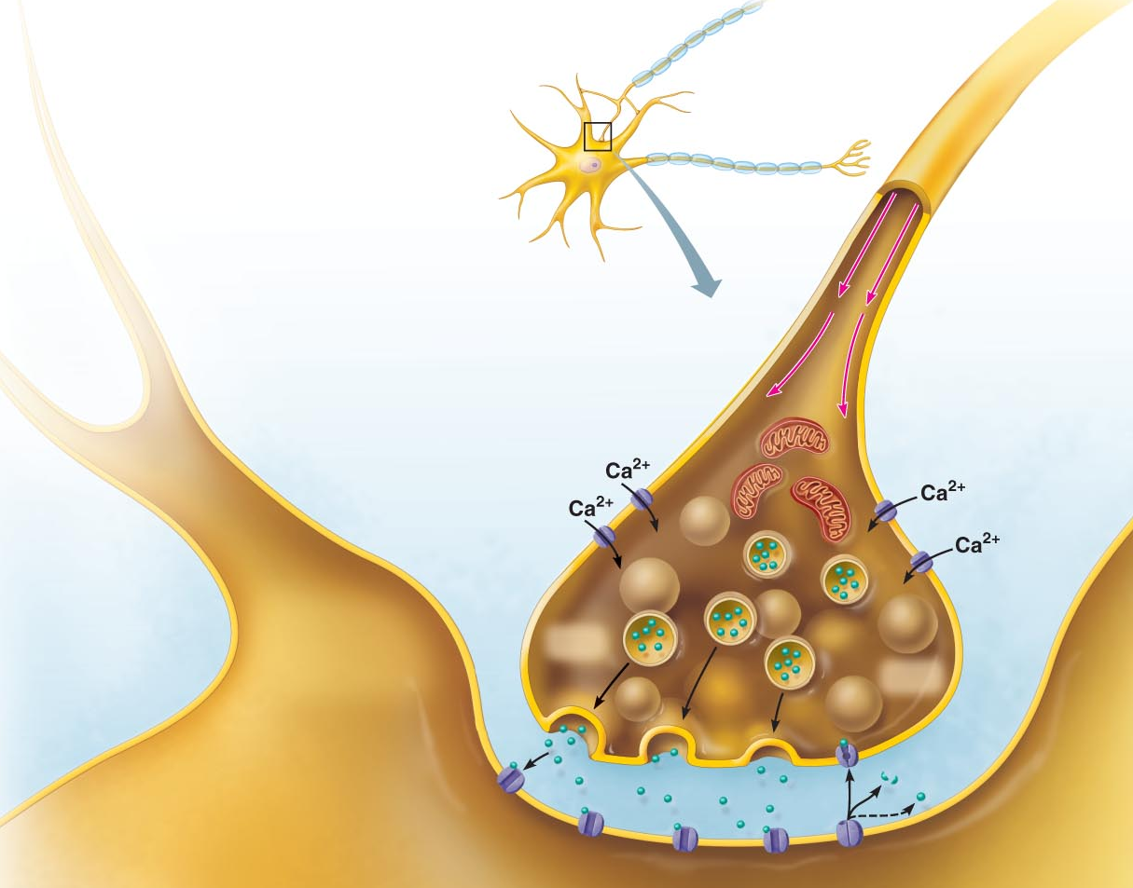
2.2.4 Explain the mechanisms of synaptic transmission (synapse, post-synaptic potentials, synaptic integration)
2.2.4.1 differentiate between electrical and chemical synapses in terms of relative frequencies, distributions, mechanism, speed and properties of inter-neuron communication
Fig. 11.18 (7th edition)
THE SYNAPSE
junction between 2 neurons or neuron + effector
presynaptic vs postsynaptic neuron (most neurons are both)
2 types of synapses: electrical and chemical

Slide 24
A. Electrical Synapses
much less common; like gap junctions
direct current flow - protein channels
rapid transmission (electrically-coupled)
neurons can be synchronized
primarily embryonic, also eye movement; in non-nervous tissue, found in cardiac & smooth muscle where can synchronize contractions
Chemical Synapses
release and binding of neurotransmitters
“Neurotransmitters . . .function to open or close ion channels that influence membrane permeability and, consequently, membrane potential.” (Marieb, /98)
2 parts: (i) axonal terminal:
(ii) receptor region:
What events occur in the synaptic cleft (fluid-filled space of 30-50 nm)?
Why is synaptic transmission unidirectional?

Slide 25
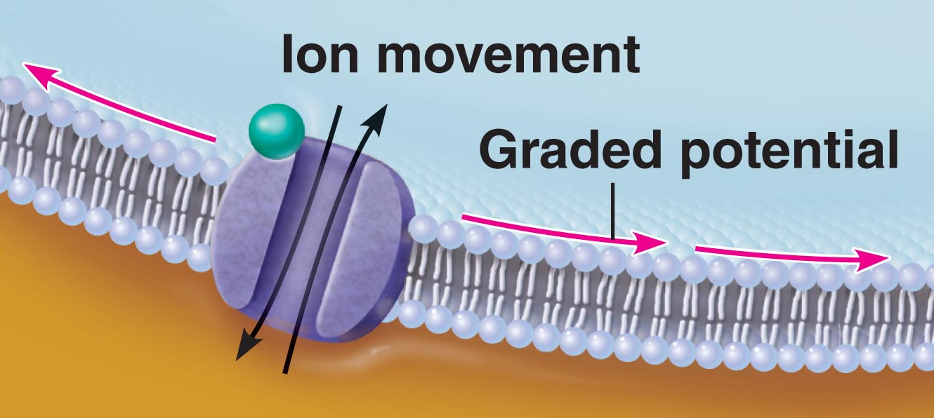
2.2.4.2 illustrate and describe the main features of chemical synaptic transmission; briefly describe 3 ways in which chemical synaptic transmission can be terminated
Mechanism of Synaptic Communication
Initiation:
1. Ca⁺⁺ gates open in presynaptic terminal
2. Neurotransmitter release
3. Neurotransmitter binds to postsynaptic receptors
4. Ion channels open in postsynaptic membranes
NB: ~300 vesicles emptied/impulse - So what happens when we have increased impulse frequency???
*
J. Carnegie, U of O

Slide 26
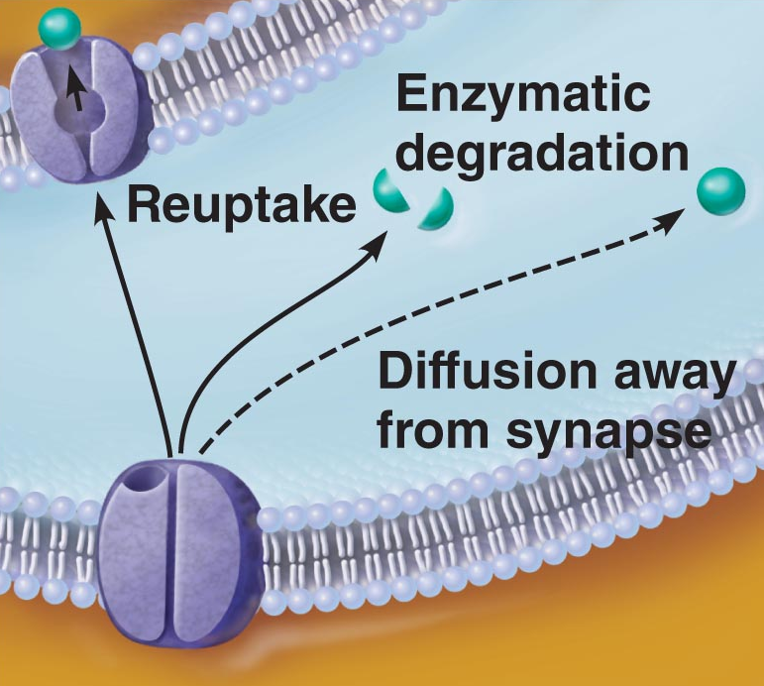
Termination:
3 options:
(i) degradation by enzymes of postsynaptic membrane (acetylcholine)
(ii) reuptake by presynaptic terminal (norepinephrine)
(iii) diffusion away from synaptic site (nitric oxide)
J. Carnegie, U of O

Slide 27
2.2.4.3 define synaptic delay
Synaptic Delay:
• slowest (rate-limiting) step of neurotransmission - Why??
• time for NT release, diffusion & receptor binding: 0.3-5 ms
2.2.4.4 distinguish between EPSPs and IPSPs in terms of channels opened and end results in terms of membrane potential/ease of generating an action potential
Postsynaptic Potentials
channels respond to chemicals rather than changes in membrane potential
channels mediate local changes in membrane potential: graded per amount of NT
2 types of PSPs:
(i) excitatory postsynaptic potentials (EPSPs)
(ii) inhibitory postsynaptic potentials (IPSPs)

Slide 28
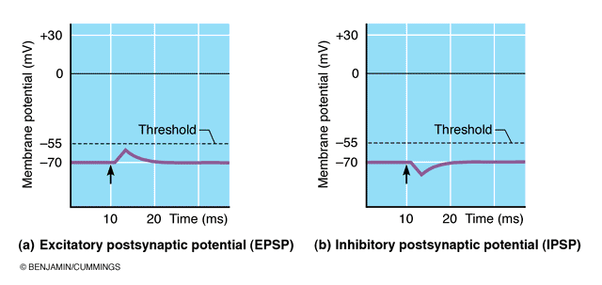
EPSPs:
NT binding ➔ membrane depolarization; opens one channel for both Na⁺ & K⁺
electrochemical gradient for Na⁺ steeper than for K⁺; what is end result??
what is generated is NOT an AP; only axonal membranes can generate APs!!; get local, graded depolarizations called EPSPs; if strong enough to reach axon hillock, then get AP
IPSPs:
NT binding ➢ membrane hyperpolarization by inc. permeability to K⁺ or Cl⁻
What is the end result in terms of membrane potential?
What is end result in terms of ease of generating an AP?
Fig. 11.18

Slide 29
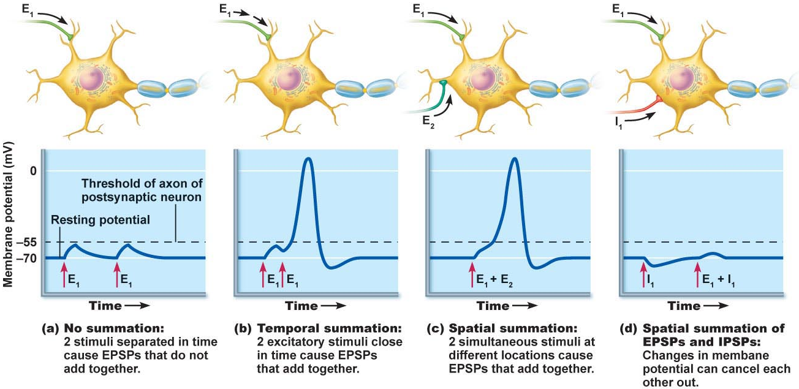
2.2.4.5 define (in terms of EPSPs & IPSPs): temporal summation, spatial summation; justify the role of the axon hillock as the neural integrator
C1. Summation by Postsynaptic Neuron
single EPSP cannot generate an AP
2 types of summation (EPSPs & IPSPs):
(i) temporal: (ii) spatial:
axon hillock = neural integrator (numerous EPSPs & IPSPs)
most effective synapses:closest to axon hillock – why??
Fig. 11.19

Slide 30
https://www.youtube.com/watch?v=bcnf3ZRl5ug
The human brain has a huge number of synapses. Each of the 10¹¹ (one hundred billion) neurons has on average 7,000 synaptic connections to other neurons. It has been estimated that the brain of a three-year-old child has about 10¹⁵ synapses (1 quadrillion)
Connections are constantly evolving, in a toddler
at the rate of 700 per second.

Slide 31
ANP 1105C Review Sept 30
2.3.1 Describe the microscopic structure of skeletal muscle fibers and explain the cellular mechanisms of excitation-contraction (pp. 279-288)
2.3.2 Describe the neuromuscular junction (pp. 288-295)

Slide 32
2.3.1.2
Muscle Functions
1. Generate movement: locomotion, manipulation, blood flow & pressure, respiration, propelling of food, urine, etc..
2. Maintain posture: constantly working against gravity
3. Joint stabilization: eg: shoulders, knees when moving parts of skeleton
4. Generation of heat: maintenance of body temperature
esp: skeletal muscle (at least 40% of body mass)
Functional Characteristics of Muscle
1. Excitability (Irritability): “ability to receive and respond to a stimulus”
stimulus usually a chemical (NT, hormone, pH)
response = AP along sarcolemma + muscle contraction
Contractility: “ability to shorten forcibly when adequately stimulated”
Extensibility: “ability to be stretched or extended”
4. Elasticity: “ability to resume resting length after being stretched”
J. Carnegie, U of O

Slide 33
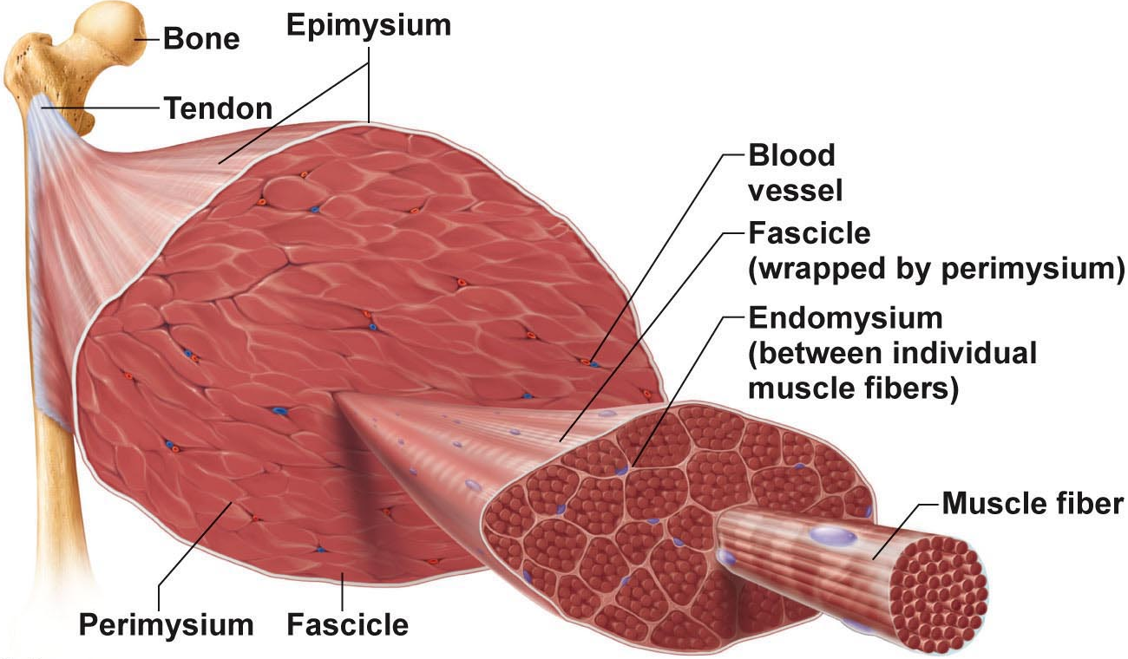
each muscle fiber (cell) consists of parallel myofibrils
~80% of cell volume (100s to 1000s per cell)
myofilaments (actin, myosin, etc.) arranged in a pattern, forming end-to-end sarcomeres
Myofibrils
Figure 9.1

Slide 34
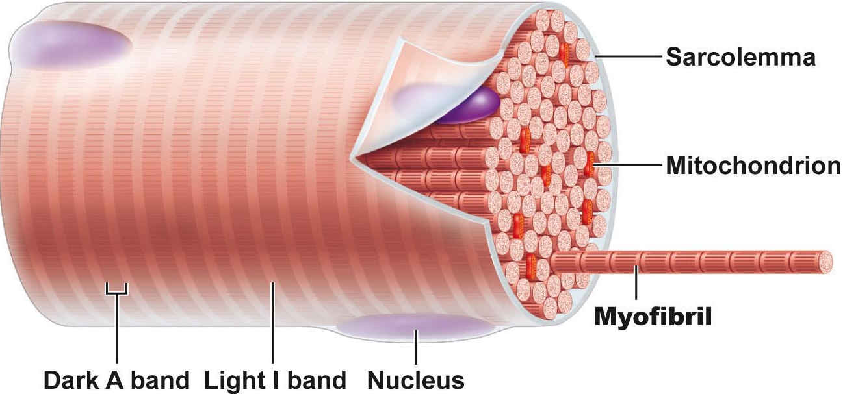
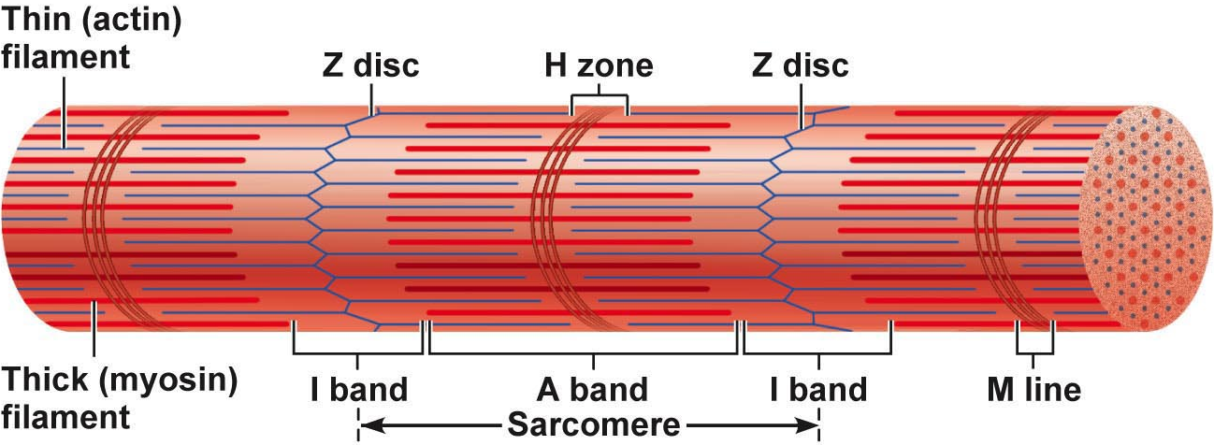
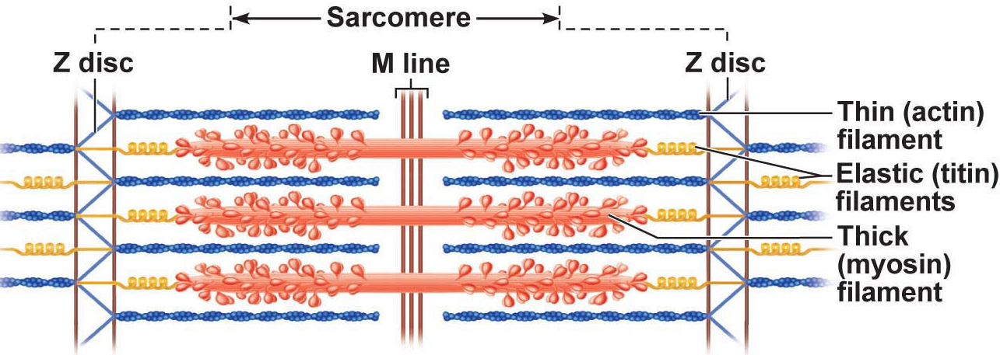
Myofibrils (cont)
sarcomeres extend from one Z disc to the next Z; sarcomeres give this muscle type the name “striated muscle”
myofilaments:
actin: = thin filaments - across I band & partly into A band
myosin: = thick filaments - entire width of A band
zones & lines:
Z disc = anchors thin filaments & connects all myofibrils of a cell (nebulin, connectin)
H zone: area with no thin filaments (relaxed muscle)
M line: fine strands connecting adjacent thick filaments (desmin)
Figure 9.2

Slide 35
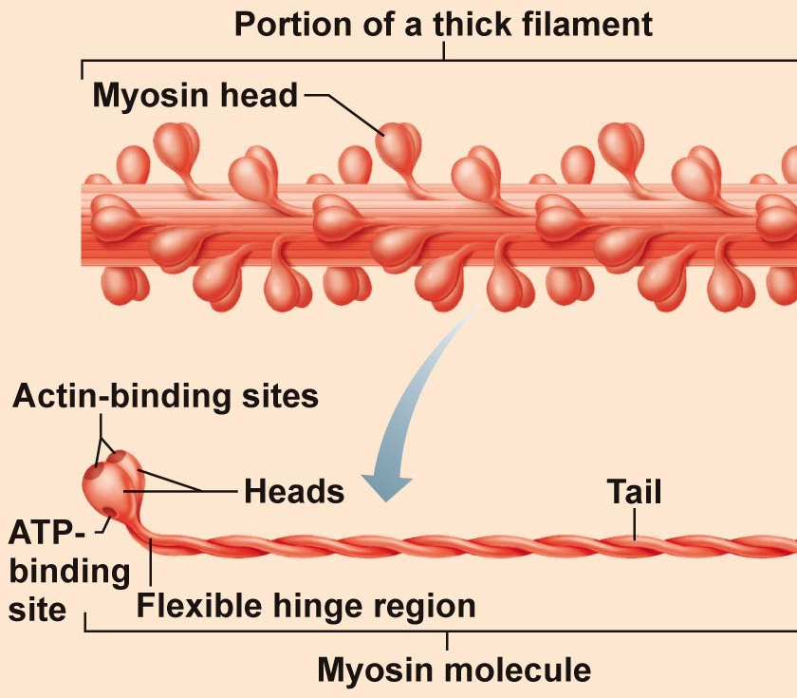
Ultrastructure & Molecular Composition of Myofilaments
Thick (myosin) filaments (16 nm)
rod-like tail (2 heavy chains) + 2 globular heads (ends of heavy chains + 2 light chains = cross bridges)
cross bridges are the business ends of the thick filaments –
each thick filament = ~200 myosins; arrayed so central part smooth & each end studded with many myosin heads
myosin heads contain ATPase
Fig. 9.3
J. Carnegie, UofO

Slide 36
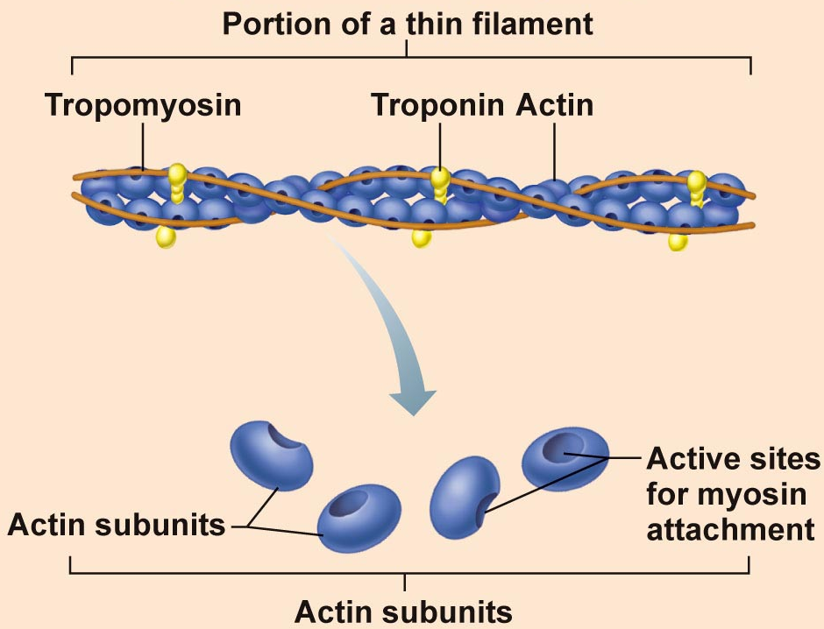
2.3.1.5
Thin filaments (7-8 nm)
binding sites for myosin [crossbridges]
strands are F-actin; 2 strands wound as a helix
What do “G” and “F” stand for?
Additional Components:
Tropomyosin: 2 strands
● stiffen filament
● blocks crossbridge binding
Fig. 9.3
J. Carnegie, UofO

Slide 37
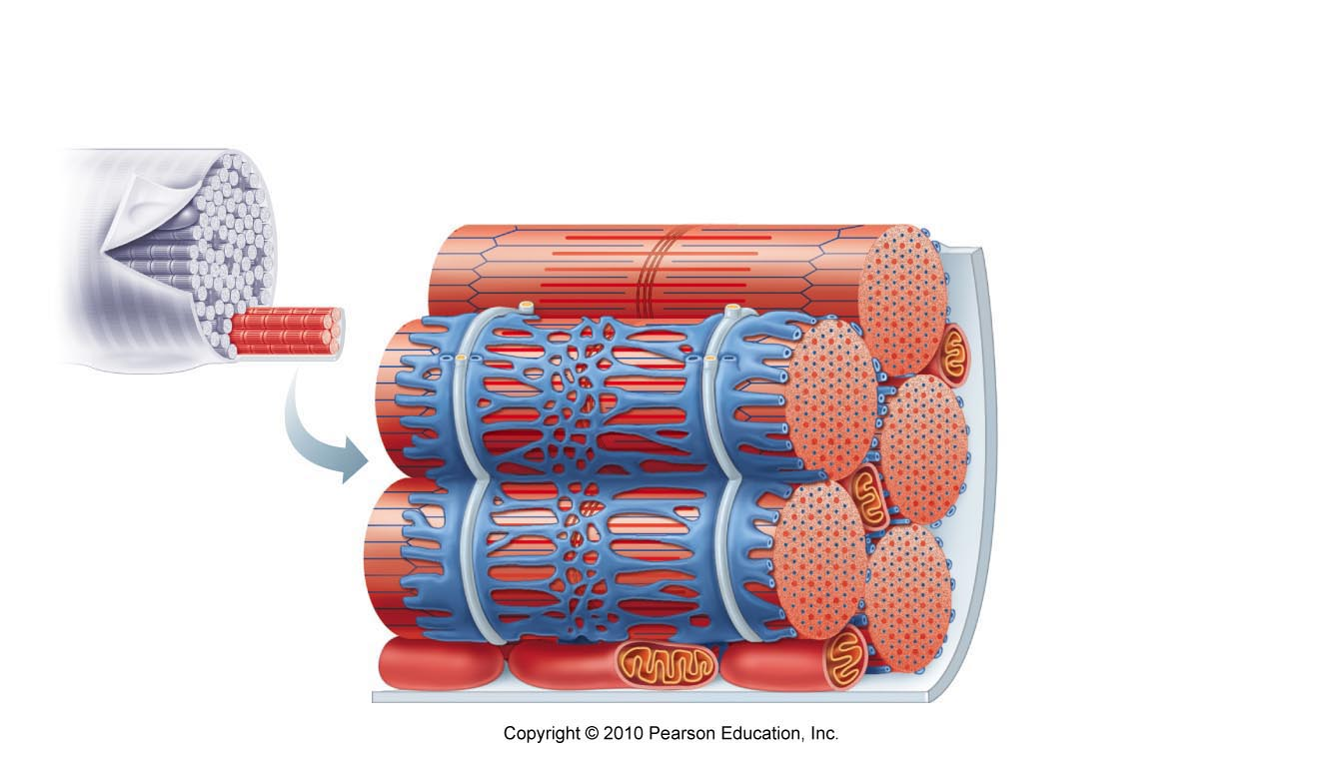
2.3.1.6
Sarcoplasmic Reticulum:
• elaborate web of ER around each myofibril inside PM
• most SR tubules run longitudinally; pairs of terminal cisternae across A-I junctions
ROLE: regulate intracellular Ca⁺⁺; storage depot for Ca⁺⁺ ➢➢ releases it when muscle stimulated to contract
T Tubules:
at A-I junction sarcolemma penetrates cytoplasm to form hollow elongated tubes; T-tubule = transverse tubule (lumen continuous with ECS)
triad: group of 3 structures - 2 terminal cisternae + 1 T-tubule (middle)
T system: thousands (2/sarcomere) of T-tubules in a single muscle cell
What do T-tubules do? What is advantage to large muscle cell of having a system of tubules extending deep into the cell cytoplasm??
Fig. 9.5

Slide 38
T Tubules:
at A-I junction sarcolemma penetrates cytoplasm to form hollow elongated tubes; T-tubule = transverse tubule (lumen continuous with ECS)
triad: group of 3 structures - 2 terminal cisternae + 1 T-tubule (middle)
T system: thousands (2/sarcomere) of T-tubules in a single muscle cell
What do T-tubules do? What is advantage to large muscle cell of having a system of tubules extending deep into the cell cytoplasm??

Slide 39
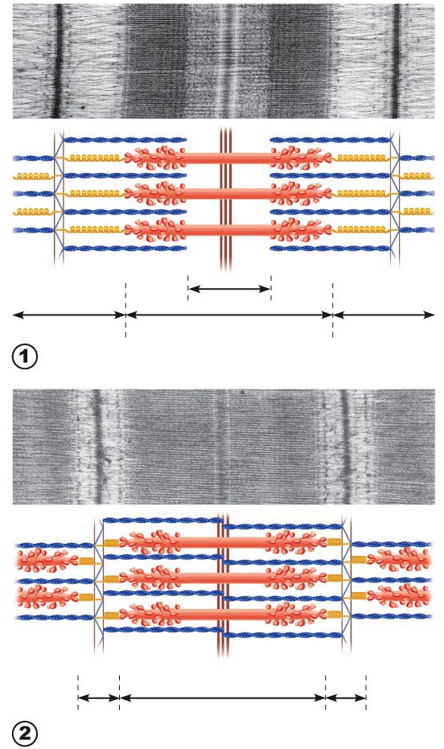
Fig. 9.6: The sliding filament model of contraction
Fully relaxed sarcomere
Fully contracted sarcomere
J. Carnegie, UofO

Slide 40
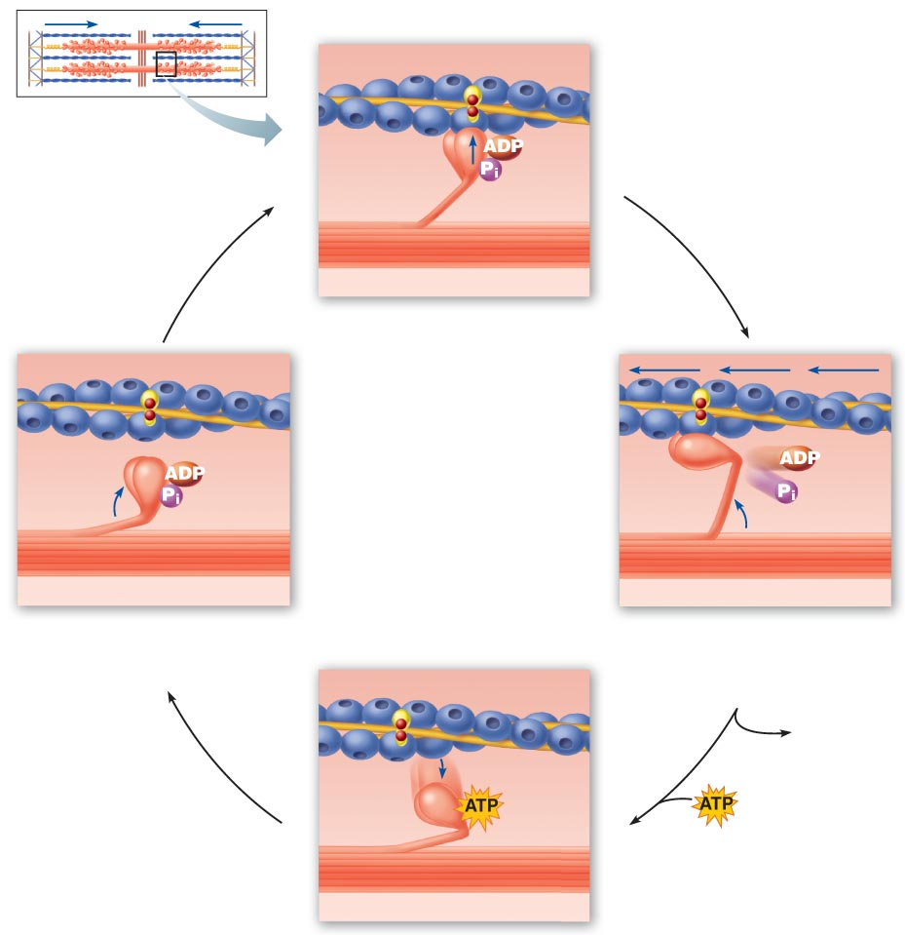
Ca⁺⁺ influx has exposed cross bridge binding sites on actin
Fig. 9.12

Slide 41
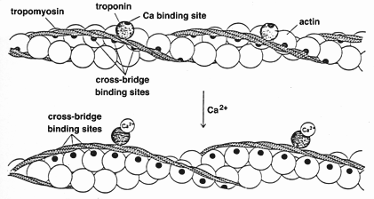
Details on the Mechanism
intracellular [Ca⁺⁺] low: myosin binding sites on actin blocked by tropomyosin
Ca⁺⁺ influx: binds to troponin >> shape change & brief detachment from actin >> moves tropomyosin away from myosin binding sites >> sites are exposed
http://physioweb.med.uvm.edu/muscle_physio/cntrctl_systm/cntrctl_troponin.htm
• single power stroke of all cross bridges ➔ 1% shortening;
How much muscle shortening occurs on average??
• only ½ of myosin heads actively pulling at one time
• relaxation occurs as SR reclaims Ca⁺⁺
J. Carnegie, U of O

Slide 42
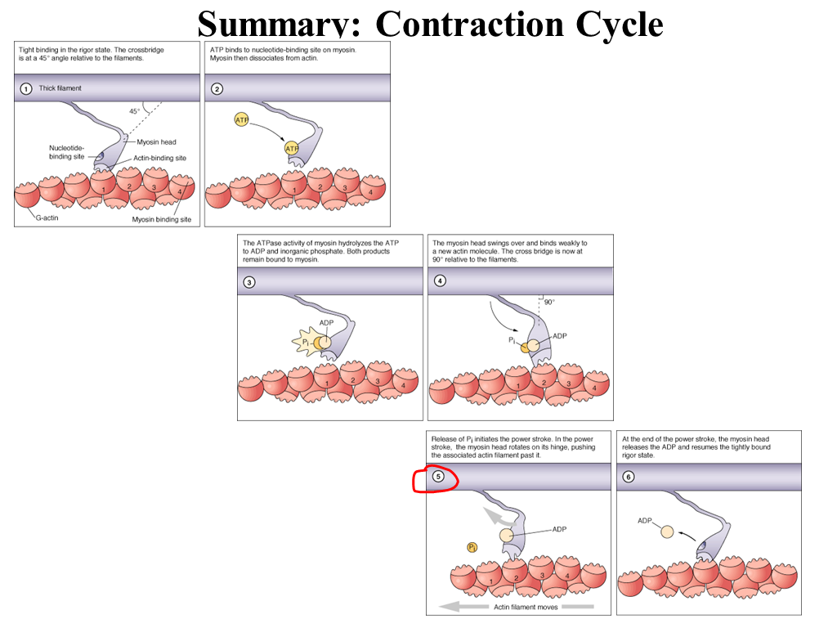

Slide 43
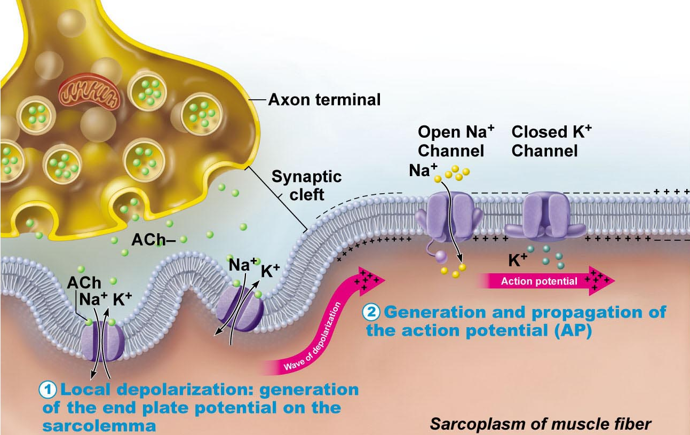
2.3.2.1 describe the structural organization of a neuromuscular junction; justify the latent period of excitation-contraction coupling
Regulation of Contraction – What is excitation-contraction coupling?
Fig. 9.9 (8th edition)
Neuromuscular junction & nerve stimulus:
• skeletal muscles stimulated by motor neurons of somatic ns
• 1 NMJ in ~middle of fiber - synaptic cleft; NT is acetylcholine
• What is the motor end plate?
• events at nerve-muscle synapse identical to those in nerve-nerve synapse
J. Carnegie, U of O

Slide 44
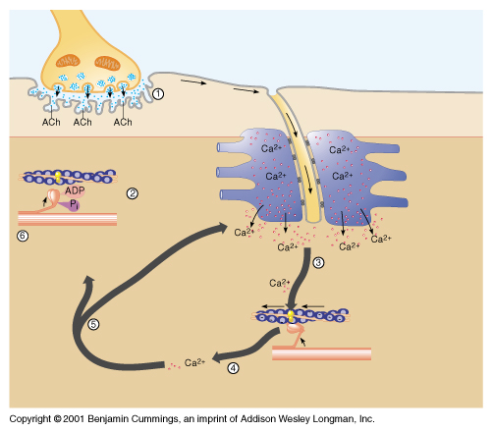
Destruction of acetylcholine:
• acetylcholinesterase (AChE) = enzyme on sarcolemma of NMJ
Fig. 9.9 (7th edition)

Slide 45
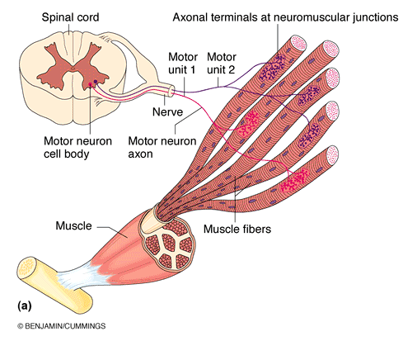

CONTRACTION OF A WHOLE SKELETAL MUSCLE
2.3.3.1 define motor unit; describe the influences of wave summation and motor unit summation on the contractile response of skeletal muscle; define tetanus in terms of muscular contraction
The Motor Unit
motor nerve (at least 1/muscle)
hundreds of motor neuron axons
each axon to many axonal terminals
each axonal terminal to NMJ of a single muscle fiber (cell)
• avg. no muscle fibers/neuron = 150 (range = 4 to hundreds)
• when neuron fires, all fibers contract
MOTOR UNIT = 1 motor neuron + all muscle fibers it supplies
Fig. 9.13
J. Carnegie, UofO

Slide 46
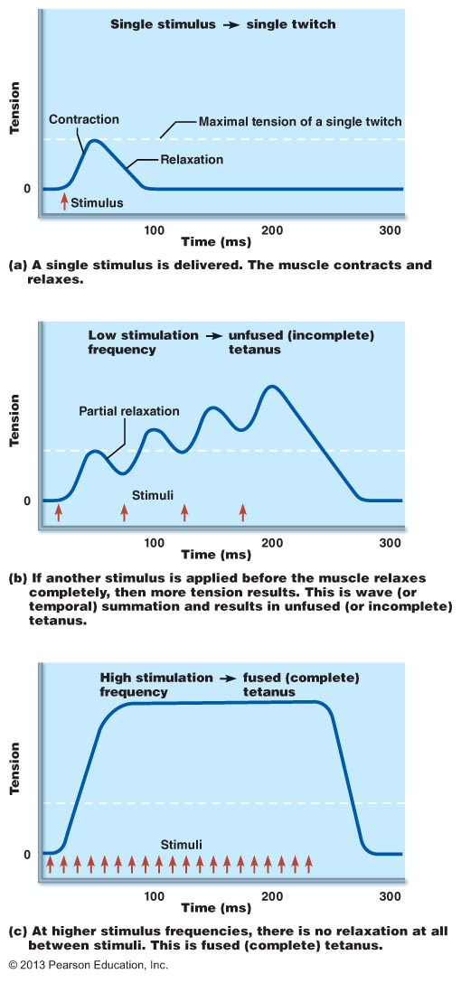
1. Speed of stimulation: wave summation & tetanus:
• rapid rate of stimuli: each contraction builds on the previous one
• but AP refractory period is always honoured
• tetanus: fused contractions - inter-stimulus interval too short to allow inter-twitch muscle relaxation - eventually followed by muscle fatigue
• primary goal: smooth, continuous contractions
Fig. 9.15

Slide 47
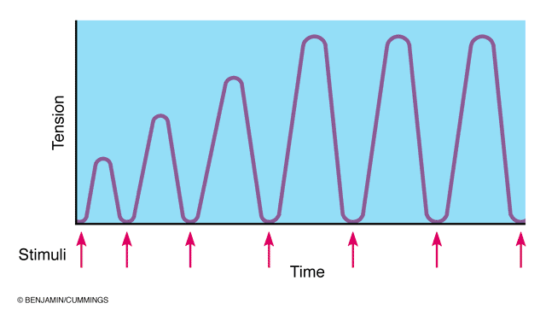
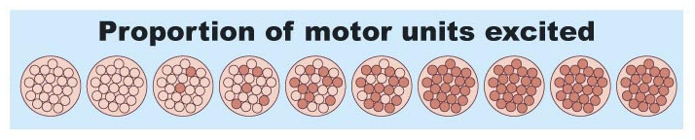
2. Multiple motor unit summation:
• a means of increasing strength of contraction
• threshold stimulus: first observable response
• maximal stimulus: strongest stimulus that produces an increase in contractile force (more motor units recruited)
√ smallest motor units controlled by most excitable neurons
√ more intense stimulation recruits larger motor units
• all units can be recruited simultaneously, but usu staggered ⇒ result is ???
Fig. 9.16 – Recruiting more motor units
Muscle tone:
even relaxed muscle a bit contracted (tone) due to spinal reflexes activated by stretch receptors ➢ effects on muscles, joints, posture??

Slide 48
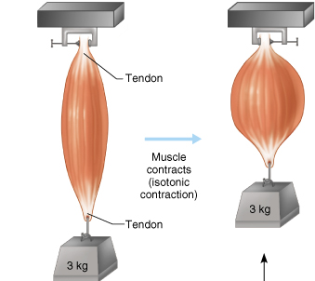
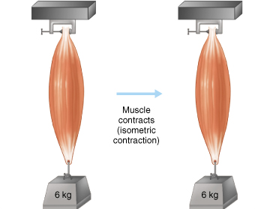
2.3.3.2 differentiate between isotonic and isometric contractions, giving an example of each
(1) isotonic: muscle changes in length & moves load - what are concentric vs eccentric isotonic contractions?
NB: eccentric contractions are 50% more forceful, use less ATP/O₂ & fewer muscle fibers but more prone to delayed-onset soreness than concentric contractions
(2) isometric: tension increases but muscle remains same length
• most body movements are a mix of isotonic and isometric contractions
• realize that in isotonic contractions, the thin filaments are sliding, but in isometric contractions the cross bridges are generating force, but do not move thin filaments

Slide 49
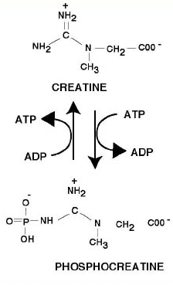
2.3.4.1 List the 4 sources of energy for muscle contraction and the conditions under which each energy source would be used
1. Stored ATP:
• ATP for cross bridge movement & detachment; Ca⁺⁺ pump
• only 4-6 sec stored ATP; regenerated immediately & continuously by (A2-A4)
2. Direct phosphorylation of ADP by creatine phosphate:
• CP = unique high-energy molecule stored in muscles
CP + ADP ➔ creatine + ATP
• enzyme = creatine kinase; but CP reserves quickly gone (CP & ATP = 15-20 sec; @ maximum muscle power)
http://www.rice.edu/~jenky/sports/creatine.html
J. Carnegie, U of O

Slide 50
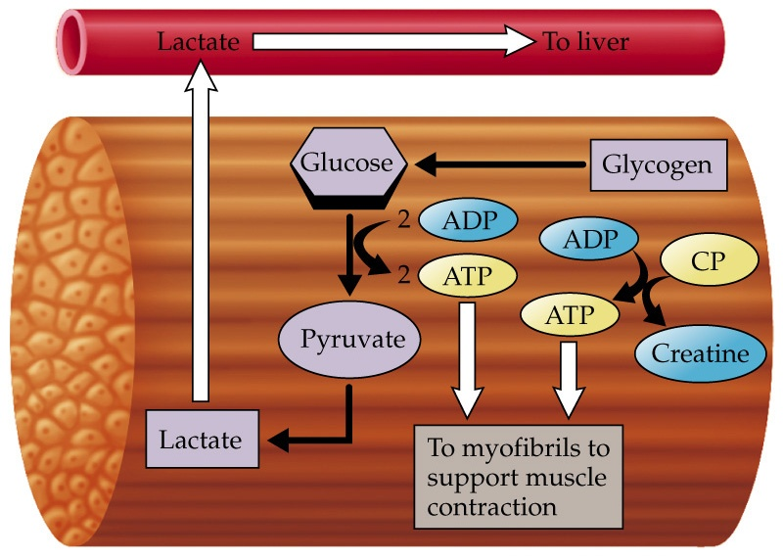
3. Aerobic respiration:
• high ATP yield but slower (many steps); requires continuous O₂/nutrients
4. Anaerobic glycolysis:
• only 2 ATP/glucose but O₂ not used and is fast
• usually pyruvic acid then enters aerobic pathway; but if ~70% activity for long period, blood vessels compressed by muscles & aerobic respiration too slow
• pyruvic acid converted to lactic acid; reconverted back to pyruvic acid once exercise over; aerobic respiration used to replenish ATP stores
anaerobic pathway produces ~5% ATP of aerobic pathway, but is 2.5x faster >> important during vigorous muscle activity
http://cwx.prenhall.com/bookbind/pubbooks/mcmurrygob/medialib/media_portfolio/text_images/FG23_09-02UN02.JPG

Slide 51
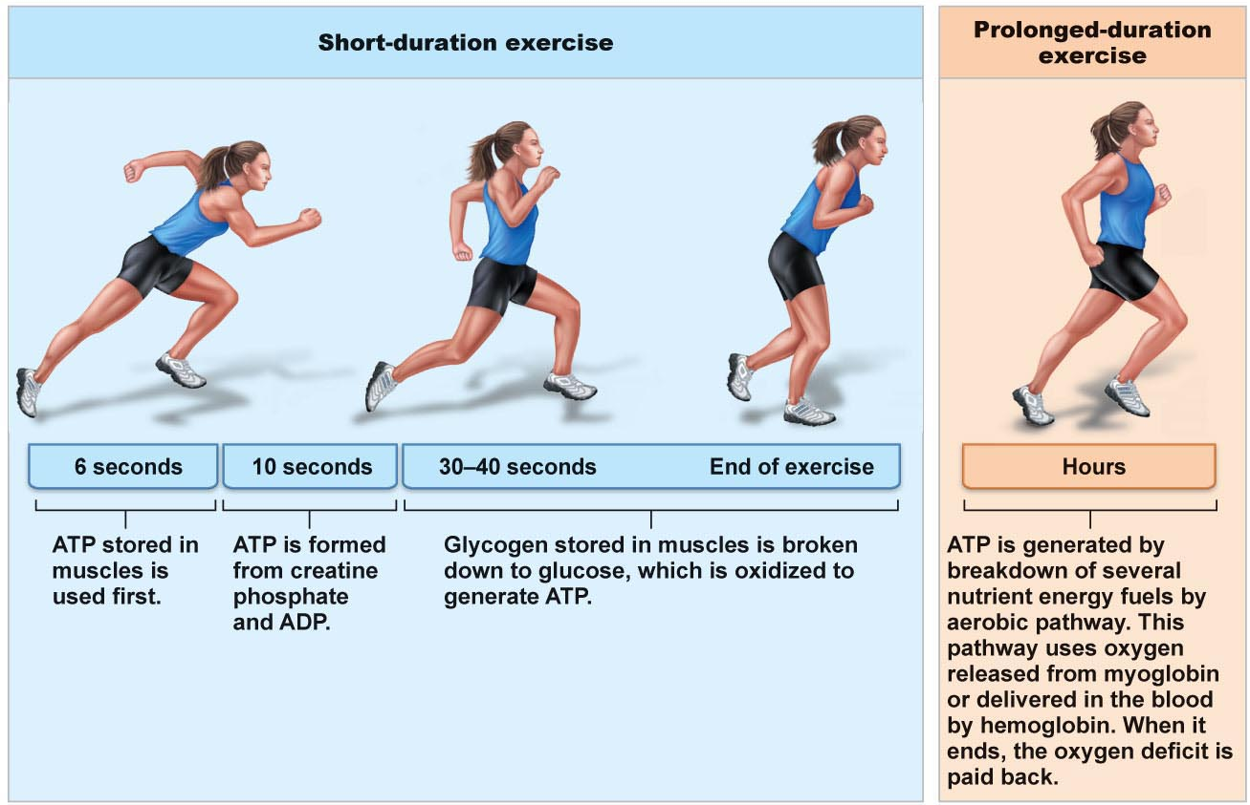
Fig. 9.20: Energy sources during short- and long-duration exercise

Slide 52
2.3.5.2 define muscle fatigue, oxygen debt
Energy systems used during sports activities:
• weight lifting, diving, sprinting: ATP & CP - WHY??
• tennis, soccer, 100 m swim: almost entirely anaerobic - WHY??
• marathon runs, jogging: mainly aerobic; but anaerobic may function until aerobic reaches full efficiency 32 ATP
aerobic endurance: length of time a muscle can use aerobic
anaerobic threshold: point at which muscle converts to anaerobic
Muscle Fatigue
• = state of physiological inability to contract; results from a relative deficit of ATP (total absence would cause contractures – what is an example of this?)
• contributors: build-up of lactic acid, ion imbalances (Na⁺/K⁺ pump requires ATP!)
J. Carnegie, UofO

Slide 53
C. Oxygen Debt
• post exercise need to: replenish O₂ reserves, convert lactic acid to pyruvic acid, replace glycogen stores, restock ATP & CP
• liver converts additional lactic acid to glucose/glycogen (Cori cycle)
• oxygen debt: extra amount of oxygen needed to be taken in to accomplish the above (lactic acid indirectly stimulates respiratory centre of brain)
new term is excess post-exercise oxygen consumption (EPOC)
D. Heat Production during Muscle Activity
• ATP-driven muscle contraction 20-25% efficient; dissipated by body’ s cooling mechanisms

Slide 54
5.3.3
Muscle fiber type:
a) Slow oxidative fibers: thin cells with slow-acting myosin ATPases - - contract slowly (red = lots of myoglobin); primary energy fuel is fat
• lots of mitos, capillaries, aerobic enzymes: oxidative
• fatigue-resistant, but not powerful (thin) -
b) Fast glycolytic fibers: large, pale (white), little myoglobin & diameter 2x that of slow oxidative fibers; fast-acting myosin ATPases & contract quickly
• few mitochondria; lots of glycogen reserves: glycolytic
• will fatigue (WHY?), but powerful
c) Fast oxidative fibers: red or pink, intermediate cell size; fast-acting myosin ATPases & contract quickly; high myoglobin content & O₂-dependent; fairly fatigue-resistant
most body muscles have a mixture of fiber types; genetics can alter distributions & subsequent athletic strengths
Endurance-type activities like: …………………………………..
best for short-term, rapid, intense movements like: …………………………….
best for intermediate activities like: ………………………………………………………
J. Carnegie, UofO

Slide 55
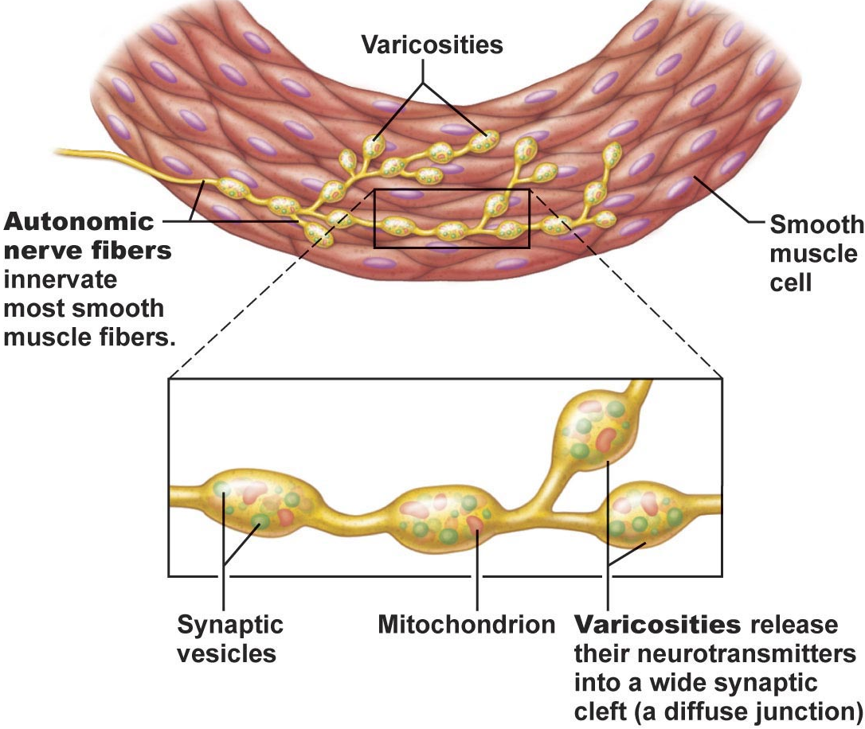
Arrangement of Fibers & Microscopic Structure
small, spindle-shaped cells; one centrally-located nucleus
diameter 2-10 um; length 100-500 um
cells separated by fine CT; sheets of closely opposed fibers; usually at least 2 sheets with opposite orientations
alternating contractions of opposing layers provide mixing, peristalsis, expelling
varicosities instead of NMJs; bulbous swellings of autonomic ns - release NT into wide synaptic cleft near smooth muscle cells - diffuse junctions
Fig. 9.26
J. Carnegie, U of O

Slide 56
• SR less developed than in skeletal muscle; no T tubules; but SR touches sarcolemma & smooth muscle cells have large SA/volume ratio
• no striations, but do have interdigitating thick & thin filaments:
1) ratio of thick:thin=1:13 (smooth) vs 1:2 (skeletal); but smooth muscle myosin has actin-gripping heads along entire length >> strength
2) tropomyosin but no troponin (calmodulin instead)
3) no sarcomeres: thick & thin filaments spiral down smooth muscle cell
4) noncontractile intermediate filaments & dense bodies (attach to thin filaments)
Contraction of Smooth Muscle
Mechanism:
• electrical coupling via gap junctions ➢ slow, synchronized contractions
• some smooth muscle cells are pacemaker cells
Mechanism:
1) actin & myosin interact by sliding filament mechanism
2) final trigger is rise in intracellular Ca⁺⁺
3) sliding process is energized by ATP
J. Carnegie, U of O

Slide 57
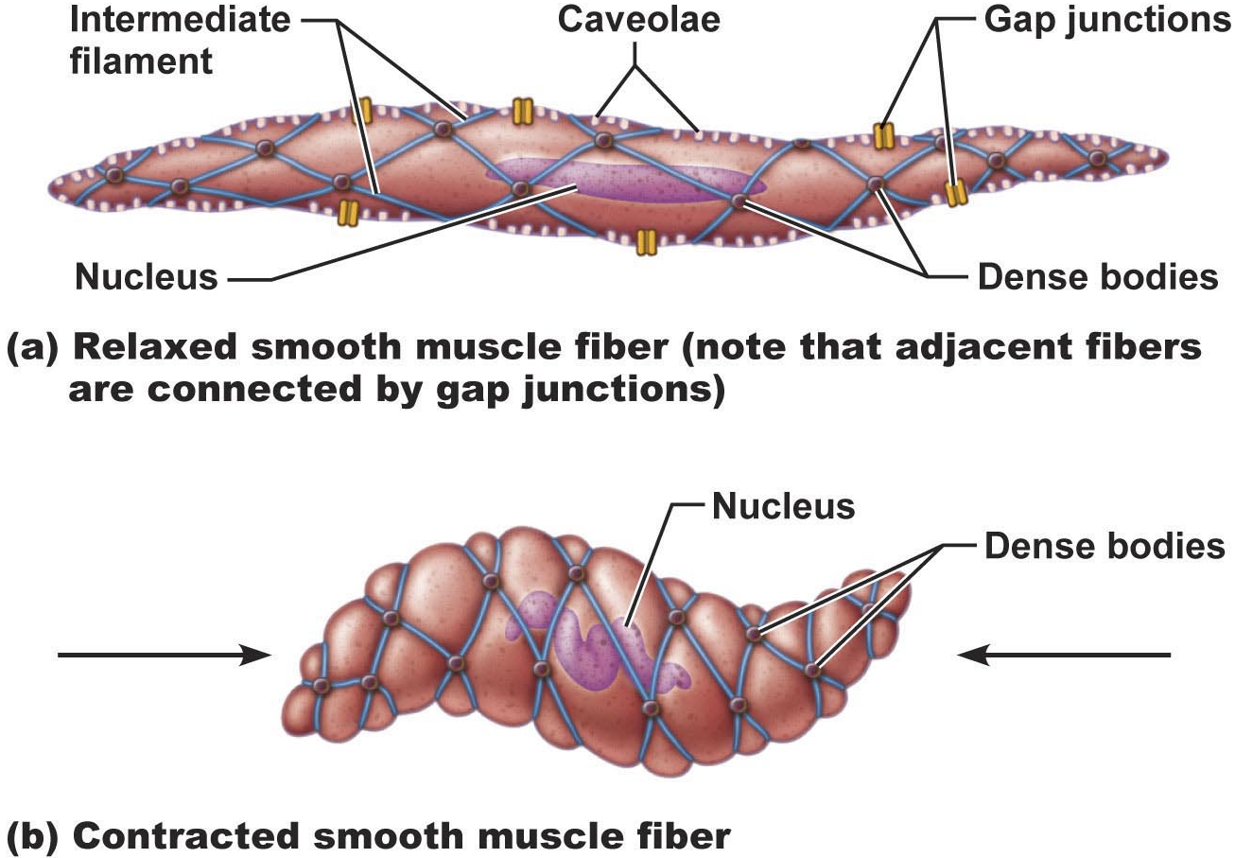
• contraction of smooth muscle is slow (30x), sustained, fatigue-resistant (24-h maintenance of tone of blood vessels, visceral organs)
• few mitos; most ATP generated aerobically – why does that work??
Fig. 9.27
J. Carnegie, U of O

Slide 58


