Slide 1
Arguments
An Introduction: Part 1

Slide 2
Main Questions
What is an argument?
What is the basic structure of arguments?
What is not an argument?
How do I recognize when an argument is present or not?

Slide 3
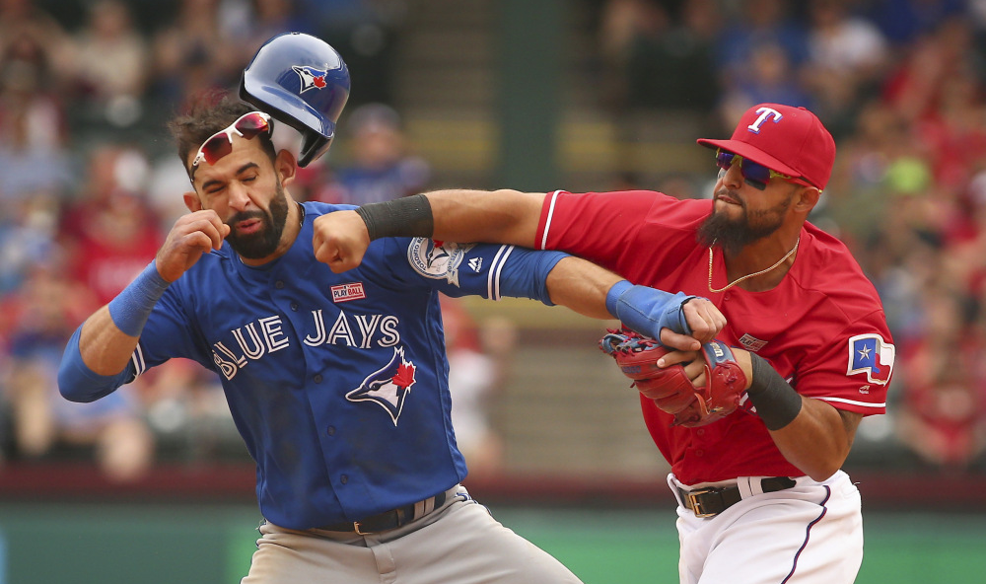
What is an argument?
Notes:
https://usatftw.files.wordpress.com/2016/05/sw_blue_jays.jpg?w=1000&h=680

Slide 4
An argument is…
A set of claims or statements whose aim is to convincingly justify another claim or statement.

Slide 5
Example
    On Wednesdays we wear pink. Today is Wednesday. You should wear pink.

Slide 6
Lets break it down:
    On Wednesdays we wear pink. Today is Wednesday. You should wear pink.
Claim 1: On Wednesdays we wear pink.
Claim 2: Today is Wednesday.
Claim 3: You should wear pink.
Ask yourself: What is the relationship between the first two claims and claim 3?

Slide 7
Premises and Conclusions
An argument tries to make a convincing case for a claim, which is the conclusion.
The supporting reasons that serve to justify the conclusion are the premises.
In critical reasoning and thinking, an inference describes the activity of deriving a conclusion from a premise or premises.

Slide 8
The Structure of Inference
Premise(s)
⬇
Conclusion

Slide 9
Practice exercises
  (1) Dogs are great companions because they have a lot of character and intelligence.
  (2) Since Wal-Mart offers all the hottest new products at low, low prices, you should definitely shop there.
  (3) Only people who hate the U.S. and everything it stands for wouldn’t stand at attention during the national anthem. Therefore, Colin Kaepernick hates his country.

Slide 10
Practice Exercises
(4) Since he is leading in the polls, Trump will win the election.
(5) Don’t bother going to class at all, since it’s a complete waste of your time.

Slide 11
Questions…
Can a single claim be an argument? Why or why not?
If some set of statements is not an argument, then what is it?

Slide 12
What is not an argument?
Single statements
      This beer is delicious.
Questions
      Is that beer delicious?
Descriptions
      Beer is a fermented drink.
Explanations
      Beer is alcoholic due to fermentation.
Report of facts
      The main ingredients of Steam Whistle are spring water, malted barley, hops, and yeast.

Slide 13
Detecting the presence of an argument
How do we determine whether an argument is present or not?
    Being versus Appearance
    Convincing case that versus explanation why
    Look for indicator words

Slide 14
Short list of some common indicators
Common Premise Indicators | Common Conclusion Indicators
Because | Therefore
Since | Thus
Due to the fact that | It follows that
As | Consequently
For the reason that | Hence
Inasmuch as | So
As indicated by | We can conclude that
For | As a result
Given that | Ergo

Slide 15
Practice Exercise
Find the conclusion
Identify any indicator words
Iron Man is cooler than Thor because technology is way more interesting than mythology.

Slide 16
Practice Exercise
Find the conclusion
Identify any indicator words
Belief in God entails the idea that He created a universe governed by the necessity of natural laws. Therefore, if you believe in miracles, which by definition contradict natural laws, you are an atheist. [17th Century Philosopher Baruch Spinoza]

Slide 17
Tips: Detecting the Presence of an Argument
Is there an argument actually present and in conformity with the definition of an argument?
If an argument is present, then what is the conclusion?
    Premise and conclusion indicator words

Slide 18
Practice Exercise
Is there an argument present? If yes, then what is the conclusion. If no, then what is it?
Enrolments are up in all Ontario universities this year, but enrolments have not increased as much in some university departments as they have in others. The number of students living in residence is also up compared to last year.

Slide 19
Practice Exercise
Is there an argument present? If yes, then what is the conclusion. If no, then what is it?
Prior to the twentieth century humans had no idea how the sun generated its energy. The sun is powered by nuclear energy, and nuclear energy was not discovered until the 1920s.

Slide 20
Practice Exercise
Is there an argument present? If yes, then what is the conclusion. If no, then what is it?
I just missed the bus I normally get and it only comes once every half an hour, so while I was waiting for the bus I was freezing.

Slide 21
Practice Exercise
Is there an argument present? If yes, then what is the conclusion. If no, then what is it?
He was unable to continue his studies because he was injured in a car accident, and had to be admitted to the hospital.

Slide 22
Practice Exercise
Is there an argument present? If yes, then what is the conclusion. If no, then what is it?
Don’t touch that rock! There is probably a black widow under it and they are really poisonous.

Slide 23
Review Questions
What are the two main components of an argument?
What is an inference?
What are some strategies for determining if an argument is present?
What is not an argument and why?

Slide 24
Next Class
Meet the teaching assistants
Simple and Complex Arguments
Implicit premises and conclusions
The principle of charity and fair assessment
Introduction to the formalization of arguments

