Slide 1
Redox chemistry
September 19th, 2016

Slide 2
Last week, we covered:
All of chapter 1, which included:
  Avogadro’s number and the mole
  Molar mass and mass-mole-number and mass-mole-atom conversions
  Solutions & dilutions
  Concentration of ionic species
  Stochiometry, stoichiometry ratio, limiting reagent, and yields
Chapter 9.1, which included:
  Solutions
  Molarity, mass percent, mole ration, molality

Slide 3
Today’s class:
Electron transfer reactions
  How to recognize a redox reaction
  How to determine oxidation numbers
  Learn how to balancing redox reactions
Chapter 17, sections 17.1 and 17.2

Slide 4
But first, let’s finish the Haber-Bosch example from Wednesday’s class.

Slide 5
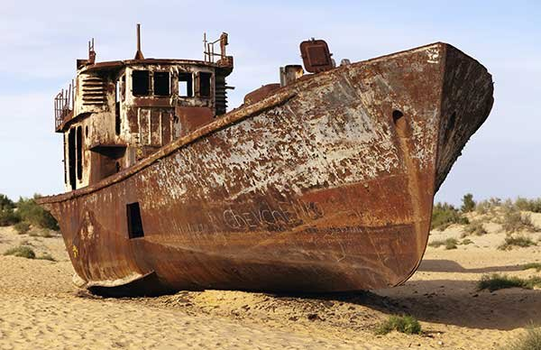
Redox reaction
Redox reactions: where one chemical species loses electrons and another chemical species gains elections
Example of redox reaction:
  Corrosion;
  Magnesium reaction with HCl;
  Ammonia reacting with bleach to form Cl₂ and N₂H₄
Notes:
Photo: http://www.boatus.com/Assets/www.boatus.com/magazines/boatus/2015/june/img/boat-corrosion.jpg
Hydrazine is used a rocket propellant because the in the presence of oxygen produces water and H2
Note that a redox reaction is characterized by not only a loss of a electrons but also a gain of elections: one substance must be reduced and the other oxidized.

Slide 6
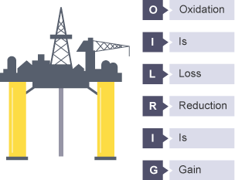
Important characteristics of redox reactions
Redox = Reduction & Oxidation
Oxidation: the lost of electrons from a chemical substance
Reduction: the gain of electrons from a chemical substance
Notes:
Important to note that redox reactions also follow the law of conservation of masses: charges must be balanced.
Photo 1: http://a.files.bbci.co.uk/bam/live/content/zsg34wx/small

Slide 7
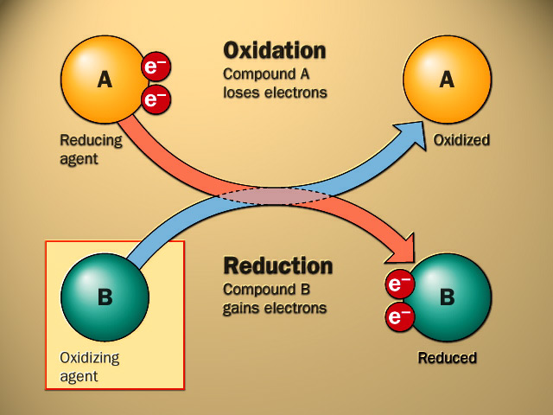
Important characteristics of redox reactions
Oxidizing agent: species that gains elections and thus causes the oxidation of another substance
  Commonly referred to as an oxidant
  Oxidizing agents are reduced
Reducing agent: species that lose elections and thus cause the reduction of another substance
  Reducing agents are oxidized
Notes:
Photo 1: http://www.ict4us.com/r.kuijt/images/en_oxidation_reduction.jpg

Slide 8
Some examples of common oxidizing and reducing agents
Oxidizing agents:
  Oxygen;
  Ozone (O₃);
  Sulfuric acid;
  Chlorine gas (Cl₂)
  Peroxides (H₂O₂, etc.)
Reducing agents:
  Free metals (Na, K, etc.);
  Hydrides (LiAlH₄, etc.);

Slide 9
How do we identify redox reactions?
Major issue: Is a chemical reaction that is a redox reaction?
We need a method to identify which chemical reactions involve electron transfer
Oxidation number (or state): the charge the atom would have if each of its bonding electrons were assigned to the most electronegative atom involved in the bond
Notes:
Why is this challenging? Because in a chemical formula and questions we do now show the elections.

Slide 10
Oxidation number and redox reaction
If there is a change in an atom’s oxidation number, then chemical reaction is a redox reaction
How do we determine the oxidation number of atoms?
  Firstly, we need to assign the valence electrons to specific atoms
  Secondly, we assume that electrons are completely transferred to the more electronegative atom
  Thirdly, assume that chemical compounds are ionic
Notes:
Firstly point = it is the charge the atom would have IF the compound were composed of ions. Obviously, most compound contain covalently bonds.

Slide 11
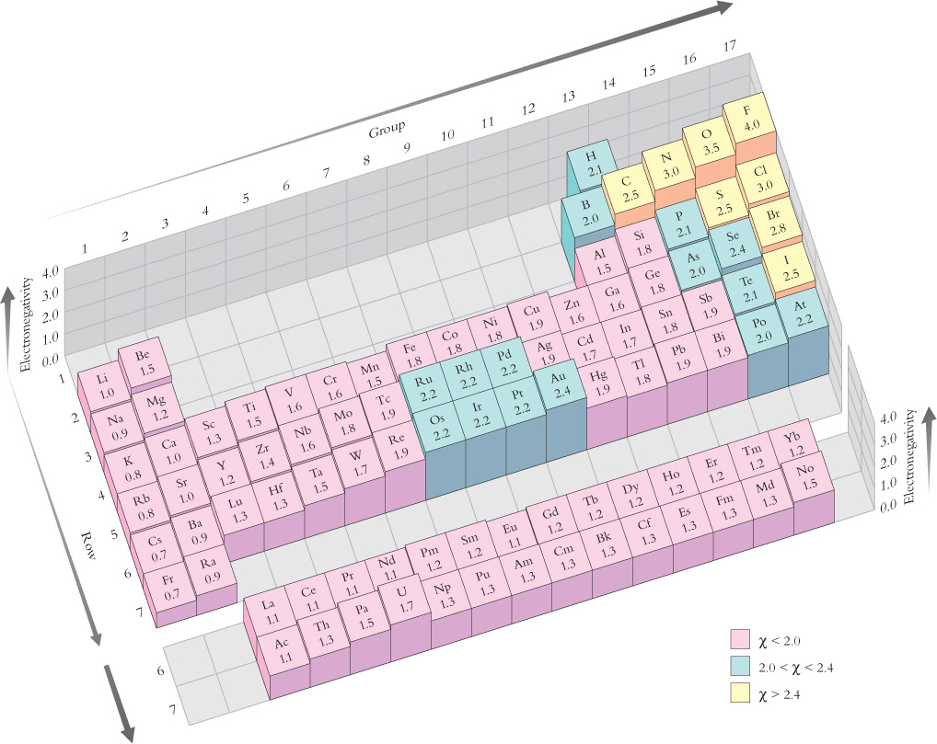
Oxidation number and redox reaction
We need to assign valance electrons and completely transfer electrons to the more electronegative atom
Notes:
We care only about the valance electrons because they are the only electrons that are accessible to bonding.
Photo from chapter 6, figure 6-7

Slide 12
Oxidation number and redox reaction
For example, let us consider the following example:
According to the electronegativities, we know that Al (1.5) and Cl (3.0):
δ-
δ+
δ-
δ-
Notes:
We know that if AlCl3 was ionic, that the Cl would each have a charge of minus 1 and aluminum would then need an overall charge of +3. Thus, you would have a neutral molecule.

Slide 13
Oxidation number and redox reaction
We know from the periodic table that:
Therefore, the oxidation numbers for aluminum chloride are:
Cl = 5 valence electrons
Al = 3 valence electrons
Notes:
If you are having difficulty, review chapter 6.
Note that AlCl3 does not exist as an ionic compound, there are formal covalent bonds. But, we assume ionic in order to keep track of electrons.

Slide 14
Method for determining oxidation number
Step 1:
  Treat polyatomic ions separately
Step 2:
  The sum of all oxidation numbers must be equal to the charge of the species
Step 3:
  Hydrogen usually has an oxidation number of +1
Step 4:
  The most electronegative atom in a species has a negative oxidation number equal to the number of electrons needed to complete its valance octet
Notes:
Exception to step 3, metal hydrides.
Excpetion to step 4, peroxides.

Slide 15
Method for determining oxidation number
Additional methods that you can use to help determine oxidation number:
  Pure element (Mg, Cu, etc.) has an oxidation number of O;
  For monoatomic ions, the oxidation number is equal to the charge of the ion (ex: Fe³⁺ has an oxidation number of +3);
  Fluorine is always -1 in compounds with other elements;
  Cl, Br, and I are always -1 in compounds except when combined with oxygen and fluorine;

Slide 16
Balancing redox reactions
Similar to non-redox chemical reactions, redox reactions must also be balanced!
In order to help balance redox reactions, we need to split the chemical equation into half-reactions
Half-reaction: a reaction that isolates a reduction or oxidation and explicitly shows the electrons involved
Notes:
Balanced due to the law of conservation of mass → electrons loss must equal the electrons gained.
We chemists write chemical reactions, we often do not show the electrons involved.
Need to balance redox reactions using half-reaction strategy

Slide 17
Balancing redox reactions using half-reaction strategy
For half-reaction strategy, need to split the chemical reaction into the reduction and oxidation step
Before we begin, note the following:
  The number of electrons gained must equal the number of electrons lost
  We must balance the electrons as well as the atoms
  Any element that appears on the reactant half reaction must also appear on the products
Notes:
Oxidation and reduction always happen together!

Slide 18
Rules for half-reaction strategy
Step 1:
  Balance all elements, other than oxygen and hydrogen, by adjusting the stoichiometric ratio
Step 2:
  Balance oxygens by adding H₂O to the side that has less oxygens
Step 3:
  Balance hydrogens by adding H₃O⁺ cations to the side of the reaction with less hydrogens. Then, add an equal amount of H₂O to the other side.
Step 4:
  Balance net charge by adding electrons to the side that is more positive
Notes:
Step three, if the reaction is basic, add H2O to the deficient side and add –OH to the non-deficient side

Slide 19
Rules for half-reaction strategy
We have the reaction below:
Identify the half-reactions:
Cu(s) + NO₃²⁻ (aq) → Cu²⁺ (aq) + NO (g)
Oxidation: Cu(s) → Cu²⁺ (aq)
Reduction: NO₃²⁻ (aq) → NO (g)
Notes:
Similar elements should appear on the same side of the reaction.

Slide 20
Rules for half-reaction strategy
We can confirm the half-reactions by determining oxidation numbers:
0
+2
Cu(s) → Cu²⁺ (aq)
+4
+2
-2
N O ₃²⁻ (aq) → N O (g)
3 (-2) = -6

Slide 21
Rules for half-reaction strategy
Step 1:
  Balance all elements, other than oxygen and hydrogen, by adjusting the stoichiometric ratio
  Based on this, all the non-hydrogen and non-oxygens have been balanced!
Oxidation: Cu(s) → Cu²⁺ (aq)
Reduction: NO₃²⁻ (aq) → NO (g)

Slide 22
Rules for half-reaction strategy
Step 2:
  Balance oxygens by adding H₂O to the side that has less oxygens
Oxidation: Cu(s) → Cu²⁺ (aq)
Reduction: NO₃²⁻ (aq) → NO (g) + 2 H₂O

Slide 23
Rules for half-reaction strategy
Step 3:
  Balance hydrogens by adding H₃O⁺ cations to the side of the reaction will less hydrogens. Then, add an equal amount of H₂O to the other side.
Oxidation: Cu(s) → Cu²⁺ (aq)
Reduction: NO₃²⁻ (aq) + 4 H₃O⁺ → NO (g) + 2 H₂O + 4 H₂O
Notes:
At this point, do not unbalance the oxygens

Slide 24
Rules for half-reaction strategy
Step 4:
  Balance net charge by adding electrons to the side that is more positive
These are now two balanced half reactions!
Oxidation: Cu(s) → Cu²⁺ (aq) + 2 e⁻
Reduction: NO₃²⁻ (aq) + 4 H₃O⁺ + 2 e⁻ → NO (g) + 6 H₂O
Notes:
Note where I am adding elections!

Slide 25
To finalized the half-reaction strategy, need to recombined half-reactions
Additional step 5: combine half-reactions and cancel any species that are duplicated:
If we combine without cancelling:
Oxidation: Cu(s) → Cu²⁺ (aq) + 2 e⁻
Reduction: NO₃²⁻ (aq) + 4 H₃O⁺ + 2 e⁻ → NO (g) + 6 H₂O
Cu(s) + NO₃²⁻ (aq) + 4 H₃O⁺ + 2 e⁻ → Cu²⁺ (aq) + 2 e⁻ + NO (g) + 6 H₂O

Slide 26
Combine and cancel half-reactions
If we combine without cancelling:
If we combine with cancelling, the final balanced redox is:
Cu(s) + NO₃²⁻ (aq) + 4 H₃O⁺ + 2 e⁻ → Cu²⁺ (aq) + 2 e⁻ + NO (g) + 6 H₂O
Cu(s) + NO₃²⁻ (aq) + 4 H₃O⁺ → Cu²⁺ (aq) + NO (g) + 6 H₂O

Slide 27
Final notes:
To simplify the redox process, remember:
  First: Identify if it is a redox reaction
    Use the oxidation number strategy
  Second: separate half reactions
    Find the substance that is reduced and the substance that is oxidized
  Third: balance the half reactions
    Follow the strategy!
  Fourth: combine half reactions
    Remember to cancel!
  Fifth: relish the joy of balancing a redox reaction

Slide 28
Now let’s do some practice problems!

