Slide 1
BIOLOGY 201
After Midterm

Slide 2
What is Evolution?
An inheritable change from one generation to the next in characteristics of individuals in a population
change in allele frequency over time

Slide 3
Give an example of human evolution
New world monkeys, old world monkeys, gibbons, humans, gorillas, bonobo, etc

Slide 4
What is Natural Selection?
A functional association between individual traits and average reproductive success
Natural Selection is when organisms with certain characteristics tend to produce more offspring than other organisms in the same population

Slide 5
What is Directional selection?
Natural selection in which individuals at one end of the phenotypic range survive or reproduce more successfully than do other individuals

Slide 6
What is Stabilizing (Balancing) Selection?
Natural selection in which intermediate phenotypes survive or reproduce more successfully than do extreme phenotypes

Slide 7
What is Disruptive selection?
Natural selection in which individuals on both extremes of a phenotypic range survive or reproduce more successfully than do individuals with intermediate phenotypes

Slide 8
What is adaptions?
inherited characteristic of an organism that enhances its survival and reproduction in a specific environment

Slide 9
What is Sexual selection?
Natural selection Including sexual selection) is the only known mechanism that drives the evolution of adaptions

Slide 10
What is genetic drift?
changes in allele frequency due to chance

Slide 11
Linnean classification system
Domain- eukarya, archaea, bacteria (both archaea and bacteria are prokaryotic. Within Eukarya is the kingdom)
Kingdom- Animalia, Plantae, fungi, etc
Phylum – Chordata, Echinodermata, arthpoda, annelida, etc
Class- mammalia, aves, crocodilian, amphibia, dipnoi
Order- primates, rodentita, catacea, carnivore, sirenia
Family- hominidae, hylobatidae, lemuridae, tarsidae
Genus- homo, pan, gorilla, pongo
Species- homo sapiens, h. errectus

Slide 12
Observations of Darwin
Organisms differ from each other, they are variable
Some of the differences among organisms are inherited
More organisms are produced than survive to reproduce in their turn
Some of the variations among organisms will affect their ability to survive and reproduce

Slide 13
What happens if natural selection acts on characteristics that are inherited?
evolution may result

Slide 14
Characteristics of Biochemistry
Pseudogenes
University of DNA as the genetic material
University of codons
Pattern of genetic similarity among related groups, even in non-coding DNA
A two-ton carnivorous, aquatic whale is more genetically similar to a sheep that is two a two-ton carnivorous, aquatic fish, (chimpanzees/humans)

Slide 15
Homologous structures
demonstrates common descent
Structures in different species that are similar because of common ancestry

Slide 16
Vegistal structures
demonstrates descent with modification
A feature of an organism that is a historic remnant of a structure that served a function in the organism’s ancestry

Slide 17
Superfluous embryonic structures
Demonstrated descent with modification
Agrees with fossil record and biochemical evidence

Slide 18
Dermal tissue function
Protection from injury and dehydration
exchange of materials with the environment

Slide 19
Ground tissue function
Photosynthesis
Food storage
Mechanical support

Slide 20
Vascular tissue function
Makes up the transport system of vascular plants
Provides movement of materials through roots, stems and leaves

Slide 21
What are the two types of vascular tissues?
Xylem
Phloem

Slide 22
What is the function of Phloem tissue?
Transport sugar in the plant
Does this with two different types of cell. 1st is called the Sieve-tube member (at maturity cells lose their nuclei and most organelles) & Companion cells: (maintain sieve-tube members)

Slide 23
What is the function of Xylem tissue?
Transport water and minerals from the roots
Two different types of cells found in xylem
1st is the vessel element and 2nd is Tracheid’s. They do the same thing as in the phloem, but at maturity cell dies, leaving tube of cell wall

Slide 24
Function of Roots
Anchoring the plant in the soil
Absorb water and dissolved minerals
Store food

Slide 25
Function of Stems
Hold leaves up
Transports between leaves and roots
Carries out photosynthesis (cactus: only plant that photosynthesis is carried out thru the stem)
Stores food

Slide 26
Primary and Secondary tissues in stems mature from what?
Primary tissues: mature from apical meristem
Secondary tissues: mature from cambium

Slide 27
Function of Leaves
Photosynthesis
Protection

Slide 28
Function of Flowers
sexual reproduction

Slide 29
Function of seeds
Reproduce the plant

Slide 30
Monocot vs Dicot
Monocot: One cotyledon per seed
Dicot: Two cotyledons per seed

Slide 31
What is mycelium?
Body of a fungi

Slide 32
What is hyphae?
individual filaments

Slide 33
What is Chitin?
A carbohydrate
Found in the cell walls of certain fungi and algae.

Slide 34
What are the two life cycles of Fungi?
Phylum Zygomycetes
Phylum Basidiomycota

Slide 35
What is Phylum Zygomycetes?

Slide 36
What is Phylum Basidiomycota?

Slide 37
What do you know about Kingdom Animalia?
Chemoheterotrophic
Multicellular
Made up of tissues, organs
Maintains homeostasis : the steady-state physiological condition of the body

Slide 38
4 Main types of animal tissue
Epithelial tissue
Connective tissue
Muscle tissue
Nervous tissue

Slide 39
What is epithelial tissue?
It is found covering or lining the body or certain organs
Sheet composed of one or more layers tightly packed cells in a dense layer of extracellular matric called the basal lamina (not typically visible)

Slide 40
What is connective tissue?
Aka structural tissue
It holds organs in place
Attaches epithelial tissue to other underlying tissues.

Slide 41
What is muscle tissue?
Consists of three types of muscle tissue, which are:
Skeletal
Cardiac
Smooth

Slide 42
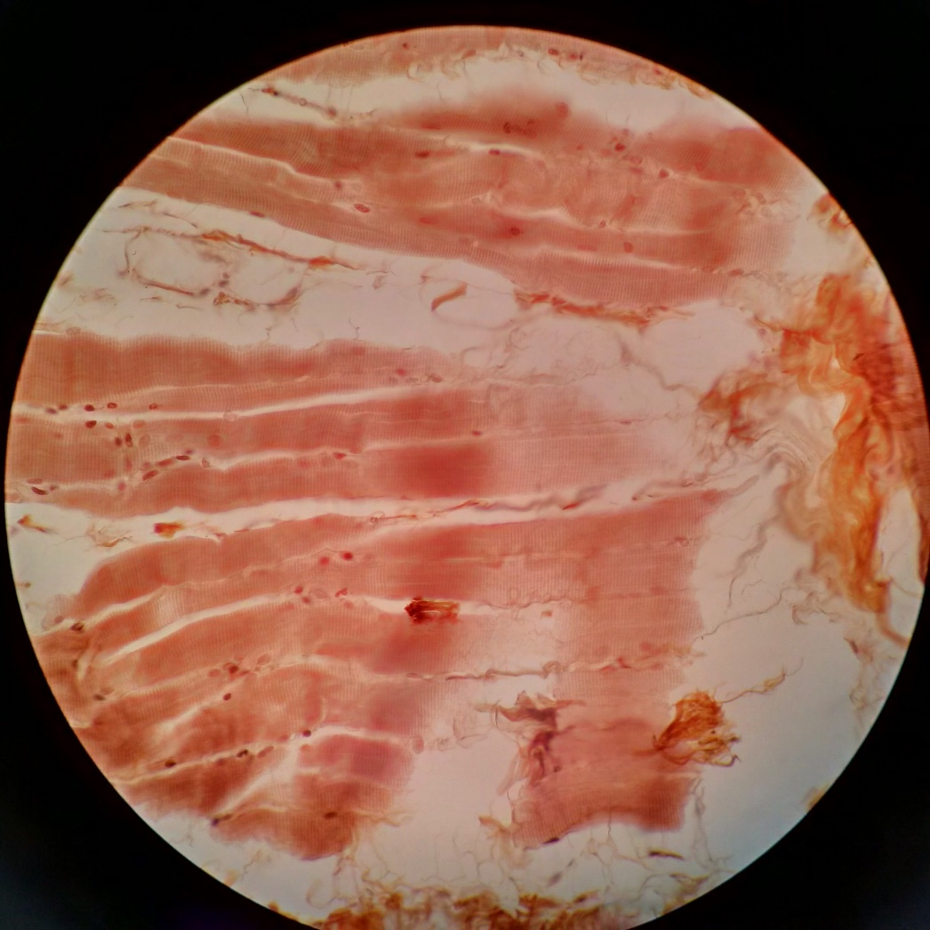
Skeletal muscle tissue
Voluntary muscle, usually attached by tendons to bones
A.K.A Striated muscle tissue

Slide 43
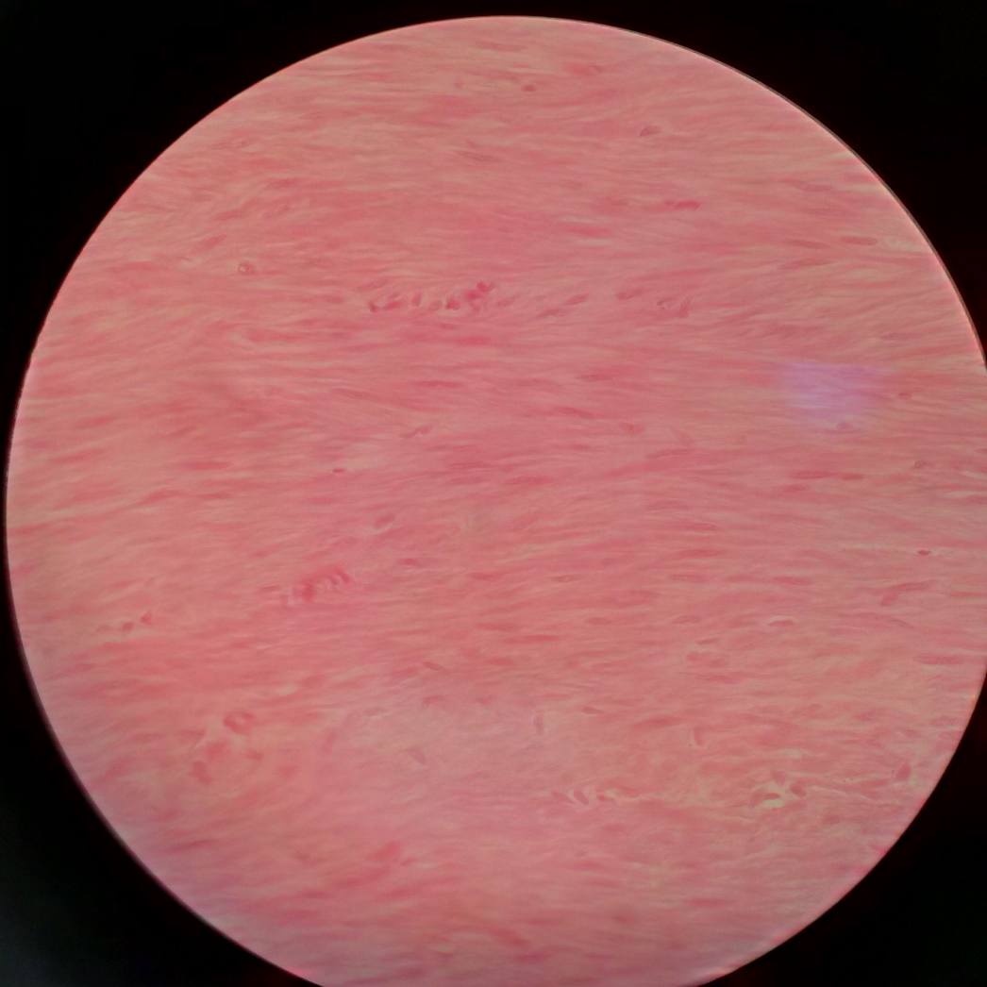
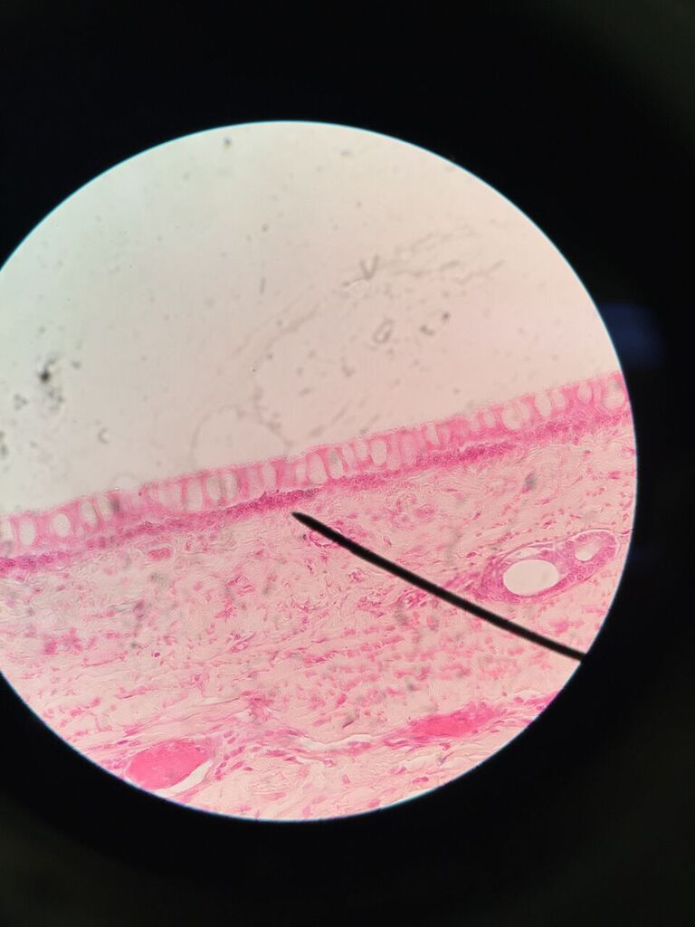
Smooth muscle tissue
Function:
Change the diameter of some tubes
Move materials through other tubes
Tubes ex; Trachea, & intestines
Involuntary, muscle is not attached to bones
Found in the walls of internal organs, blood vessels, air passages and various duct
Trachea

Slide 44
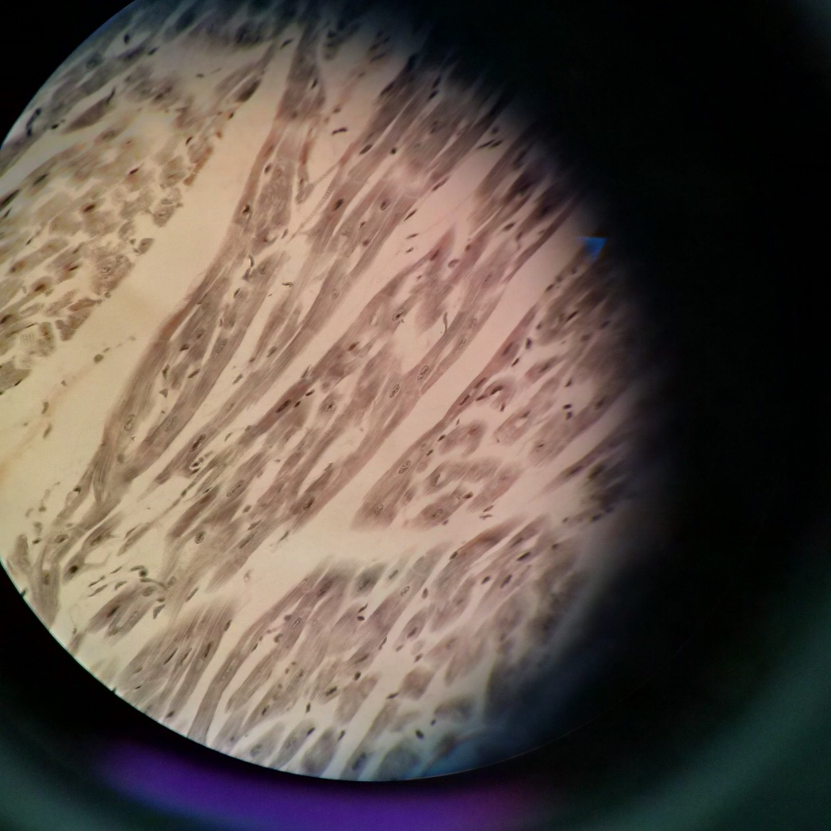
Cardiac muscle tissue
Contraction is involuntary
Makes up the heart muscle; therefor is responsible for pumping blood through the body
Muscle fibres are short
Connected by intercalated discs into long branched chains of cells

Slide 45
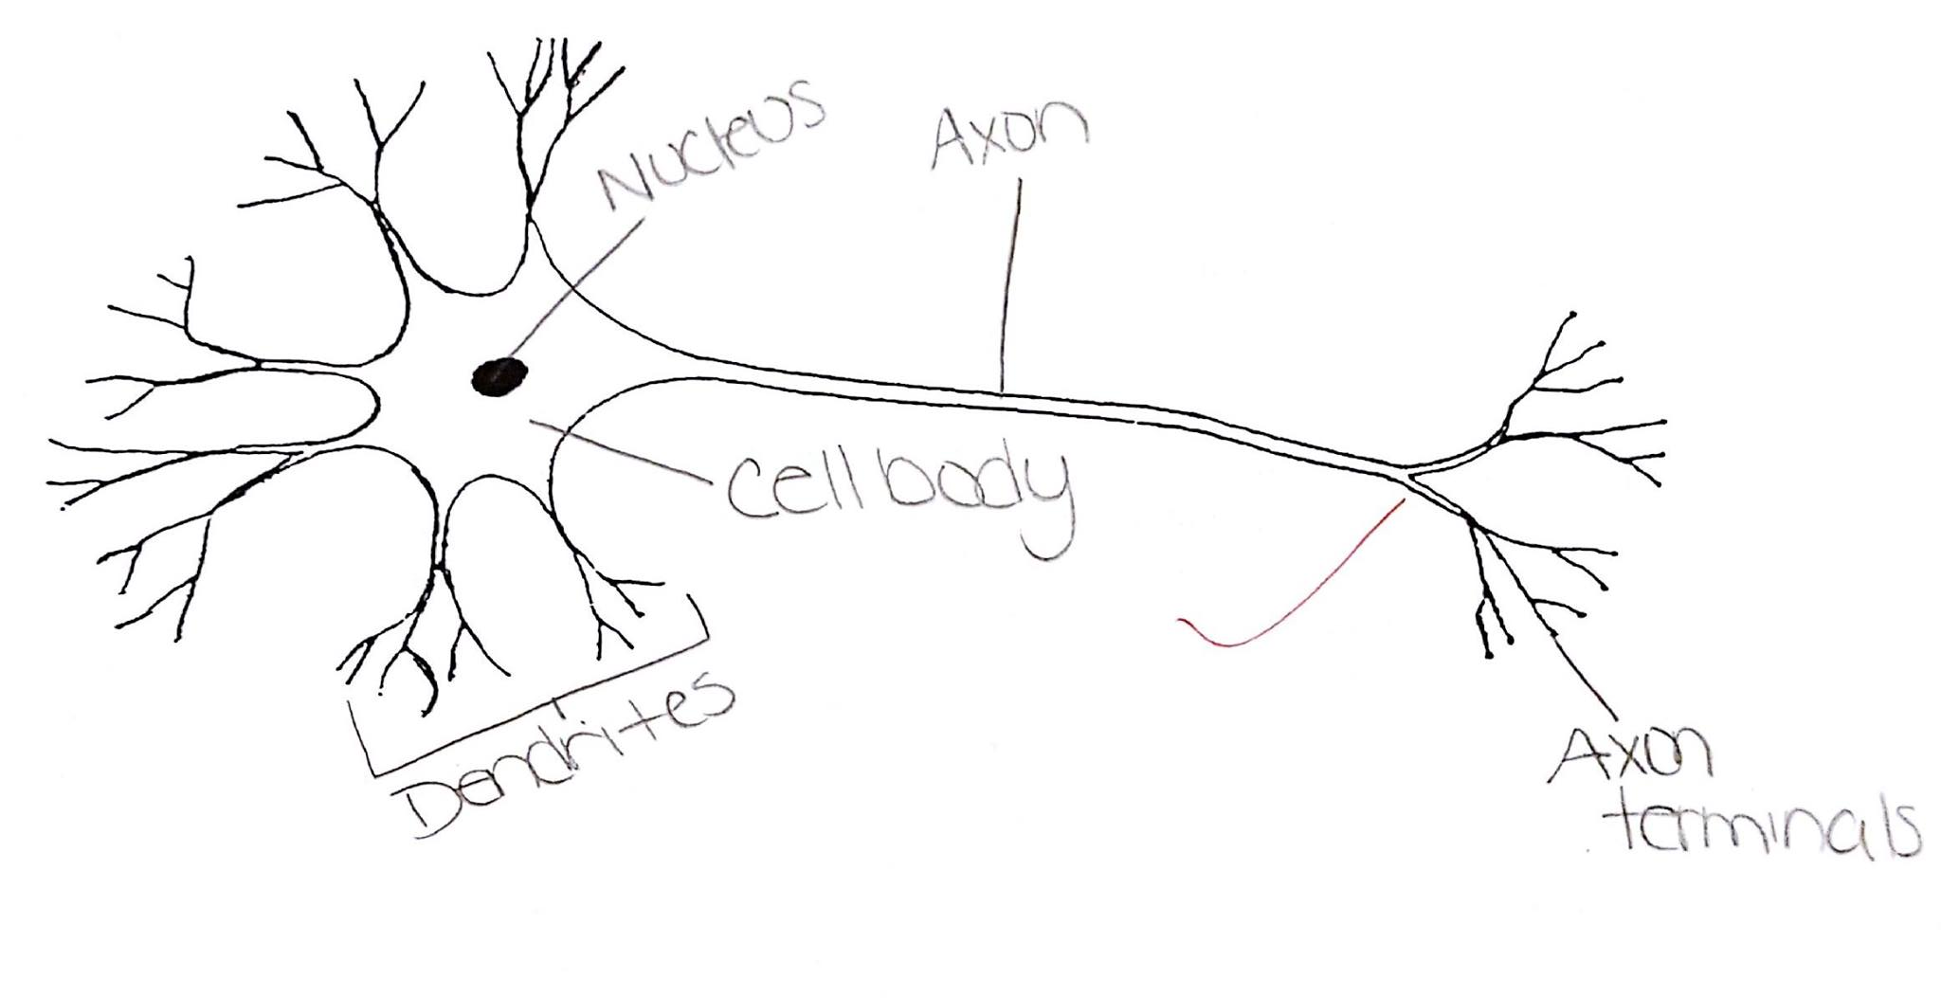
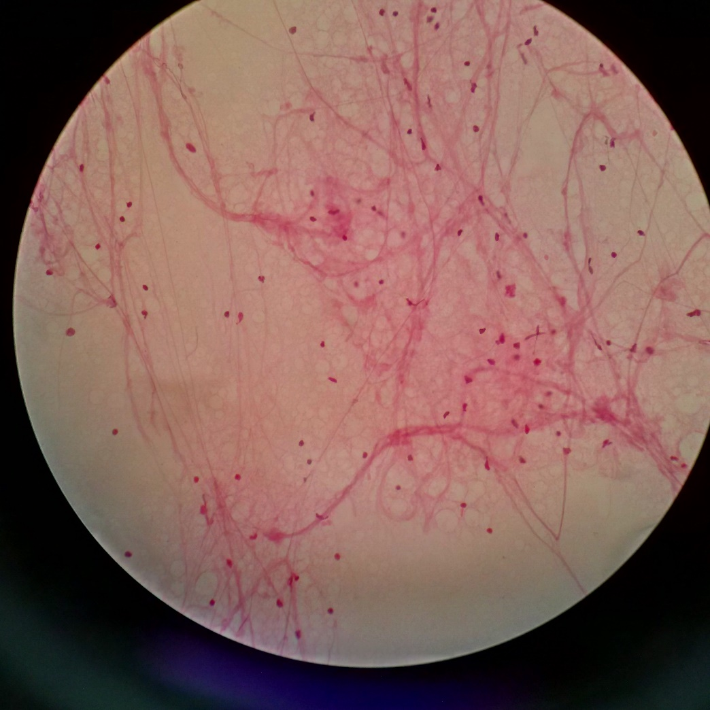
What is Nervous tissue?
is the main component of the two parts of the nervous system; the brain and spinal cord of the central nervous system (CNS), and the branching peripheral nerves of the peripheral nervous system (PNS), which regulates and controls bodily functions and activity
Spinal Nerve Cell

Slide 46
What is the integumentary system?
It protects from mechanical injury
Immunity
osmoregulation
thermoregulation
sensing the environment

Slide 47
What is the muscular system?
All the muscles we have
movement
protection from mechanical injury
thermoregulation (generate heat)

Slide 48
What is the skeletal system?
protection from mechanical injury
support (for organs)
leverage for movement
storage of minerals (e.g. calcium)
production of blood cells

Slide 49
What is in the animal phyla?
porifera (sponges)
Cnideria (sea anemone, sea jelly, coral, hydra)
Platyhelminthes (flatworm)
Mollusca (snail, slug, limpet, chiton, clam,. mussel, scallop, squid, octopus, cuttlefish, nautilus
Annelida (segmented worm)
Nematoda (roundworms)
Arthropoda (centipede, millipede, insect, spider, scorpion, crustacean)
Ecginodermata (sea star, sea urchin)
Chordata (vertebrate) (tunicate, fish, amphibian, reptile, bird, mammal)

Slide 50
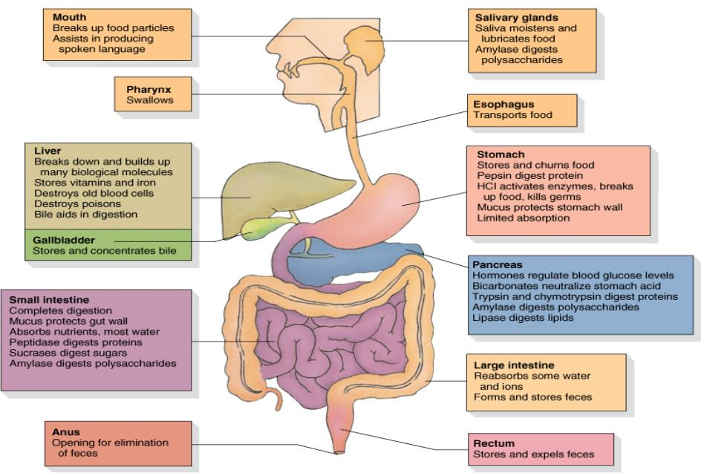
DIGESTIVE SYSTEM

Slide 51
Mouth
Aka. Oral cavity
Food enters the digestive system through the mouth

Slide 52
Teeth function?
Grinding/chewing food

Slide 53
Salivary Glands function?
Produce saliva
Helps to hold and lubricate the lump of food together
Makes it slippery to help with swallowing
There are chemical enzymes in saliva

Slide 54
Tongue function?
muscular organ
Pushes food around
Helps with chewing and then swallowing
Pushes food back to the pharynx (throat)

Slide 55
What are the two openings in the back of your throat?
Glottis (which leads to the lungs)
Esophagus (which leads to the stomach)

Slide 56
Esophagus function?
Carries food to the stomach

Slide 57
What is peristalsis?
Contracting in the esophagus, which allows the food to be squeezed down into the stomach

Slide 58
Epiglottis function?
Flap that helps prevent choking
Traps the food from going into the glottis

Slide 59
Sphincter function?
ring of muscle
when it contracts it closes the esophagus off, allowing the food to sit in the stomach

Slide 60
Where are gastric glands located and what does it do?
Located in the surface of the stomach
Releases gastric juices & digestive enzymes
Also releases HCl (activates the enzymes, helps break down the food in the stomach)
Mucus is also released, which is slimy and it protects the stomach from ‘digesting itself’, in other words protects it from the enzymes and the HCl

Slide 61
Basic function of the stomach?
Stores food
Digests food
Kills bacteria

Slide 62
Small intestines main function?
Digests food
Final steps occur here
Absorption of nutrients

Slide 63
What happens in the small intestine?
Pancreas releases pancreatic juice into the small intestine.
Bicarbonate which neutralizes the acidic contents that came from the stomach
Liver (which is the largest internal organ in your body) produces bile
Bile is not a digestive enzyme, it is produced slowly but it does emulsify fast (emulsification acts like a detergent and allows the fats to mix with the water)

Slide 64
Gall Bladder function?
Stores bile

Slide 65
Villi function and location?
fingerlike projections that are in the small intestine
contains epithelial cells which have micro villi (brush boarder)
Helps with absorbing nutrients

Slide 66
Large intestine function?
Absorption of H2O and some minerals

Slide 67
Rectum function?
Stores feces

Slide 68
Anus function?
Releases feces from the body

Slide 69
RESPIRATORY SYSTEM purpose?
Absorption of oxygen
Elimination of carbon dioxide
conducts, filter, warm and humidifies the air

Slide 70
Function of the nostrils/oral cavities
Breathe in through the nasal cavity and oral cavity

Slide 71
Pharynx
Aka. Throat
Connected to the esophagus

Slide 72
Larynx
Aka. ‘atoms apple’
Must stay open all the time in order to allow air to pass through. It is also known as the voice box.

Slide 73
Epiglottis
closes the glottis off

Slide 74
Trachea
Carries air down into chest cavity
Has rings of cartilage around it. Must stay open. Splits into two branches called bronchus or bronchi

Slide 75
Bronchi
Each bronchus is going to branch into smaller and smaller tubes which is what are known as the bronchioles

Slide 76
Bronchioles
smallest tubes of the bronchi.
Tubes are similar to the trachea but it does not have cartilage ring around it, it is surrounded by alveoli.
Which is where gas exchange occurs.
Alveoli must stay moist to work best.

Slide 77
Where is the heart located?
in the middle of the bronchioles

Slide 78
Diaphragm
Dome shaped
When muscles contract it goes down. (breathing in)
When the muscles relax it goes back to its normal shape and the air is released

Slide 79
How do lungs stay inflated?
Air pressure

Slide 80
How and where do unicellular organisms get respiration from?
From their environment
Via Diffusion

Slide 81
What is diffusion?

Slide 82
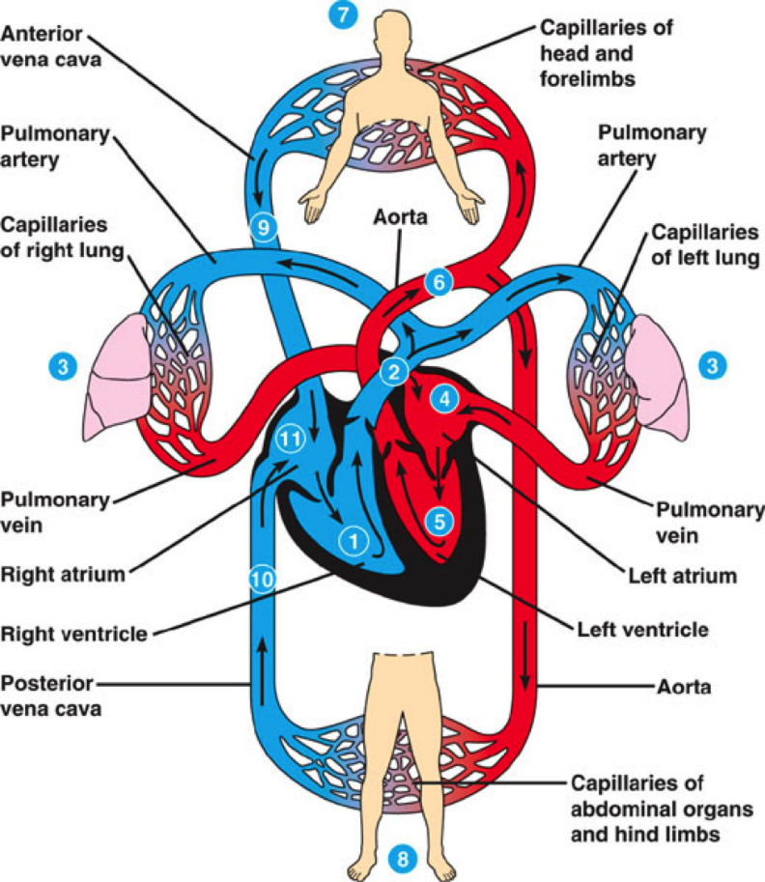
CIRCULATORY SYSTEM purpose?
Distribution of materials in the body

Slide 83
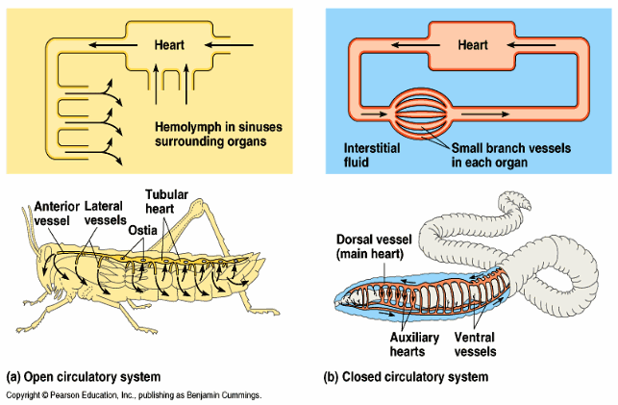
Open vs Closed circulatory system

Slide 84
What is endothelium tissue?
Forms a single layer of cells lining various organs and cavities of the body, especially the blood vessels, heart, and lymphatic vessels
It is formed from the embryonic mesoderm

Slide 85
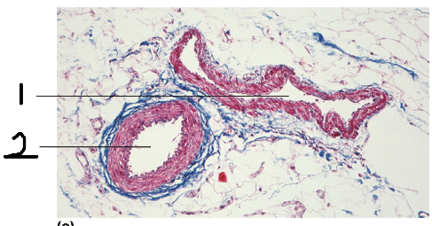
Arteries vs veins?
Arteries carry blood away from the heart
Arteries: smooth muscle helps to control blood pressure, out side of smooth muscles is a layer of connective tissue which is important because as high pressure blood comes from the ventricle, it will swell up
Veins carry blood to the heart
Capillary only has endothelium. One way valves
  Vein
  Artery

Slide 86
Capillaries function?
Exchange materials with other surrounding tissues
Blood slows down as it passes through the capillaries

Slide 87
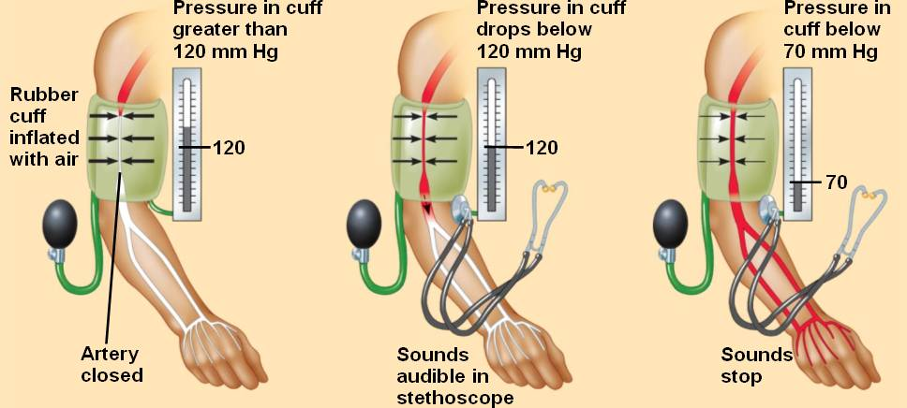
How can we indicate that our blood is flowing in the same direction?
Blood pressure
Number must be higher on the left

Slide 88
Do we humans have an open or closed circulatory system?
Closed

Slide 89
Red blood cells function?
Aka erythrocytes
Transport oxygen

Slide 90
White blood cells function?
Aka leukocytes
Fight infections

Slide 91
Platelets function?
Blood clotting

Slide 92
EXCRETORY SYSTEM
PURPOSE?
Disposal of NH3 (ammonia) and other metabolic wastes

Slide 93
What is Osmoregulation?
Regulation of solute concentration and water balance

Slide 94
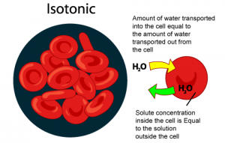
Define Isotonic
The concentration of solute in a solution is equal to the concentration of solute in a reference solution.

Slide 95
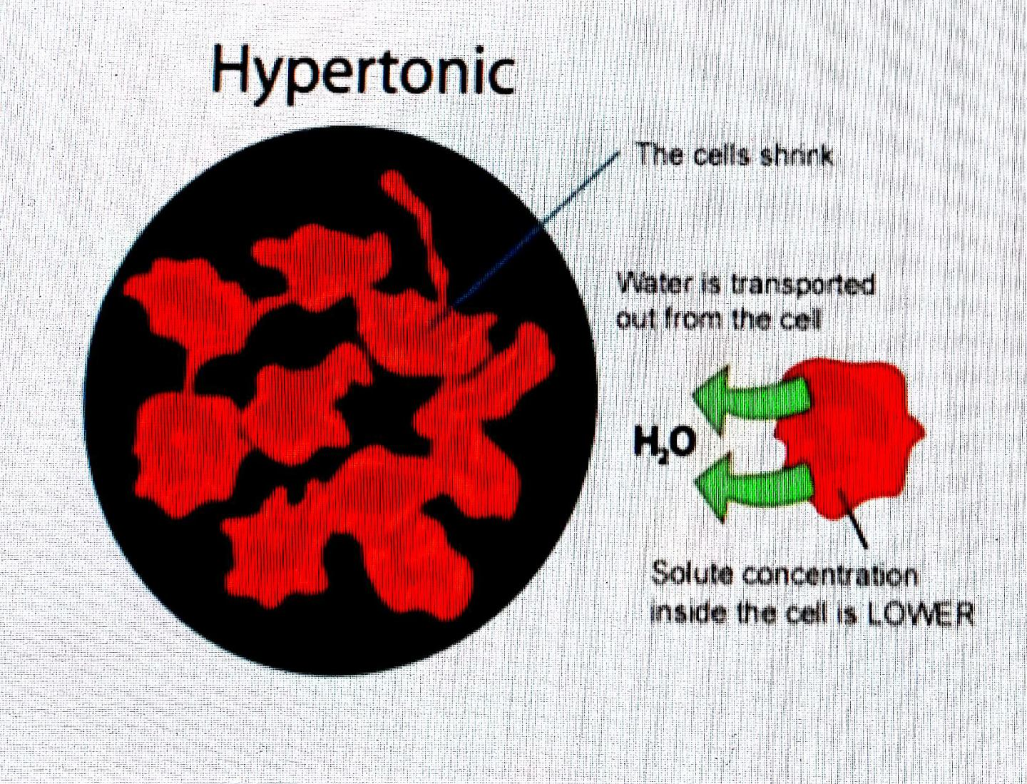
Define Hypertonic
The concentration of solute is higher compared to the reference solution.
The concentration of solvent is therefore lower compared to that reference solution

Slide 96
Define Hypotonic
The concentration of solute is lower, compared to a reference solution
The concentration of solvent is therefore higher compared to that reference solution

Slide 97
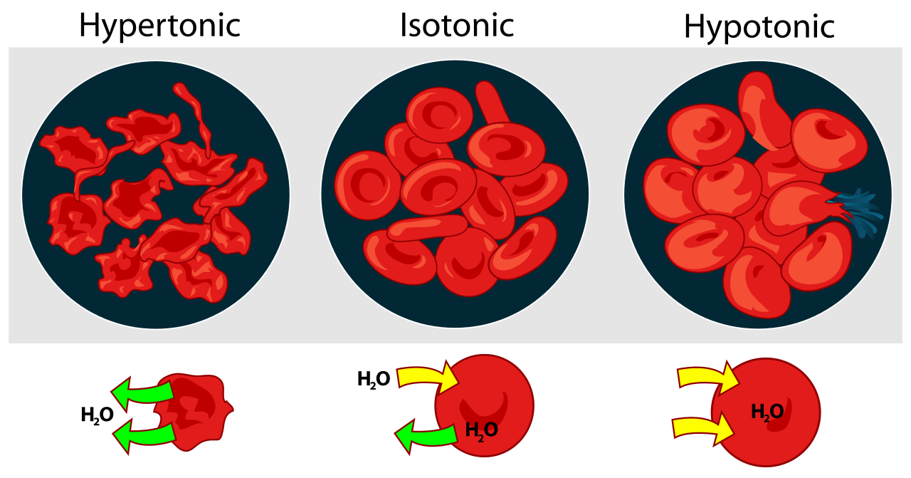

Slide 98
Lymphatic system
Recycling- lymphatic capillaries balance fluids by draining and cleansing that fluid leaving the circulatory system
Immunological protection- Lymph passes through connective tissue called lymph nodes. Lymph nodes are filled with pathogen-fighting white blood cells
  Retrieving nutrients- the lymphatic system allows microvilli to absorb nutrients from the small intestine

Slide 99
What does the immune system do?
Fights infections
Returns fluid to blood

Slide 100
The division of immune system
Physical barrier - First defense against pathogens and keeps them out of the body. Consists of skin mucous membranes and their associated anti-pathogen secretions
Non specific immunity - provides defense when pathogens make it past the physical barrier and into the body. These immune cells attack any and all pathogens that enter the body (Referred to as the innate system)
Specific immunity - deals with pathogens that have been mussed by the non-specific system, recognizing very specific infectious agents. Takes longer for the system to respond to a specific infection

Slide 101
Non specific division of the immune system
Identify the invader - recognizes molecules found on the surface of pathogens and binds to them, making them as invaders
Chemical signaling - Immune cells secrete chemical messengers called cytokines. Cytokines recruit more immune cells to the site of infection or warn other cells to protect themselves
Attack and removal of the invader - Specialized immune cells destroy, break down and ingest both pathogens and any cells they’ve infected

Slide 102
What inflammatory response cause?
Redness
Heat
Pain
Ultimately tissue healing

Slide 103
How does the immune system recognize pathogens?
Antigens

Slide 104
What are antigens?
any molecule or fragment of a molecule which induces a specific immune response

Slide 105
How does the immune system respond to pathogens?
Antibodies

Slide 106
What are antibodies?
Circulating proteins that recognizes a specific antigen

Slide 107
The specific division of adaptive immunity
Humoral immunity - Protects against pathogens and toxins found in the body fluids, such as blood and lymph
Cell mediated immunity - Protects against pathogens and toxins found within the body cells

Slide 108
B CELLS VS T CELLS
B cells: Develops and mature in the bone marrow
T cells: Develops in the bone marrow and matures in the thymus

Slide 109
How does the immune system remember pathogens it has come into contact with previously?
Memory B & T cells
Vaccines

Slide 110
What happens when the immune system malfunctions?
Before immune cells are released into the body they are tested for self-tolerance
Autoimmunity: immune system responds inappropriately to the individuals own cells

Slide 111
What kind of autoimmune diseases are there?
Rheumatoid arthritis makes joints around the body ache
Type 1 diabetes Pancreas cannot produce enough insulin

Slide 112
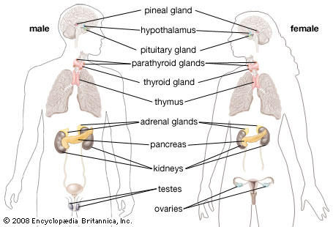
The Human Endocrine system

Slide 113
Growth Hormone
Aka GH
Bone growth

Slide 114
Thyroid stimulating Hormone
Aka TSH
Stimulated the thyroid
releases thyroxine, which then inhibits the pituitary gland to release TSH

Slide 115
Thyroid Gland function?
Releases thyroxine
Increases metabolic rate
Blood levels controlled by negative feedback

Slide 116
What is Negative Feedback?
a form of regulation in which accumulation of an end product of a process slows the process

Slide 117
Pancreas function?
Releases insulin
Lowers/Raises blood sugar
Releases glucagon

Slide 118
What are separate sexes?
Secondary sexual characteristics: Differences between the sexes that are not directly involved in reproduction

Slide 119
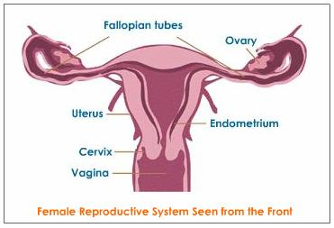
FEMALE REPRODUCTIVE SYSTEM
Picked up by the oviduct (Fallopian tubes) they connect with the pear shaped thing known as the uterus (thick layer of smooth muscle). Lined with endometrium. Base of the uterus is referred to as the cervix. Hollow space opens through the cervix is known as the Vagina

Slide 120
Ovary function?
where oogenesis begins
ovulation where the oocyte is releases

Slide 121
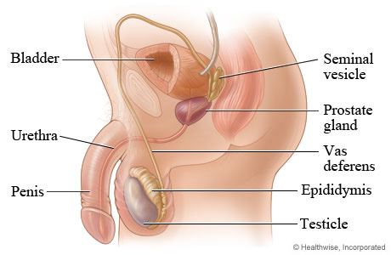
MALE REPRODUCTIVE SYSTEM
Pituitary Gland release a hormone known as FSH. Circulates around the body. It will signal spermatogenesis another hormone released will be known as LH. These cells with release testosterone from the testes
Testosterone signals primary and secondary sex characteristics, it also inhibits the pituitary gland from releasing LH

Slide 122
Testes
where spermatogenesis occurs

Slide 123
Epididymis
Accumulates sperm towards the vas deferens which is then brought into the abdomen and will then be delivered to the urethra. Passes through the penis

Slide 124
Explain Human oogenesis?
Pituitary starts by releasing FSH
Follicle develops and then goes through meiosis 1, and also increases it release of estrogen
As estrogen levels start to rise and goes back to the pituitary, it releases LH, which will cause the follicle to mature and release oocyte which triggers ovulation
Corpus luteum (yellow body): follicle becomes yellow and LH is released
After it releases estrogen, it also releases progesterone, which prevents any more follicles from developing

Slide 125
Human Birth order
Dilation of the cervix
Expulsion: Delivery of the infant
Delivery of placenta

Slide 126
Membrane potentials
Unicellular organisms maintain a membrane potential
(Negative charge on the inside and positive on the outside of the cell)
Unicellular organisms can change their behaviour in response to changes in the membrane potential

Slide 127
NERVOUS SYSTEM
All about coordinating activities of the body (Similar to the endocrine system)
Allows you to sense your environment
Allows you to respond to the environment

Slide 128
EXCITABLE TISSUE
tissue made up of cells that may rapidly alter their membrane
Example: muscle fibres & neurons

Slide 129
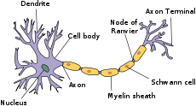
Neuron function?
Nerve cell that transmits signals

Slide 130
Schwann cells
Wrapped around the axon of myelinated neurons (no resting potential)

Slide 131
Nodes of ranvier
place where axons are exposed between adjacent Schwann cells (Resting potential occurs) Action potential jumps from N.O.R to N.O.R all through the axon

Slide 132
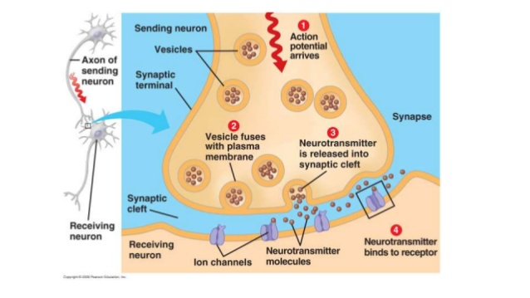
Synapse
connection between neurons [ Electrical Synapse & Chemical Synapse (more common in body) ]

Slide 133
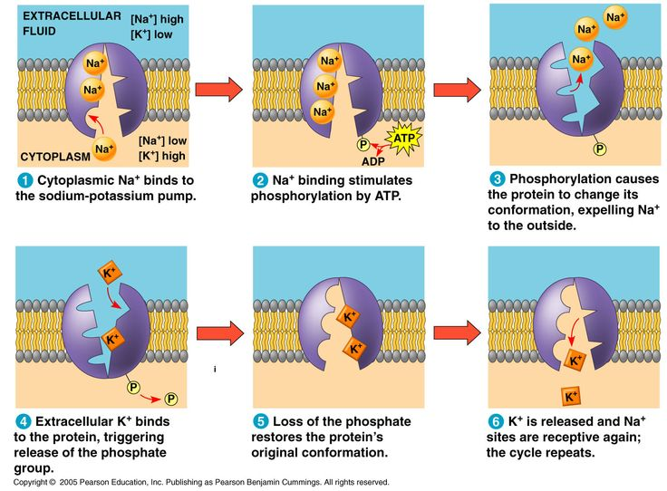
What is resting potential?
An electrochemical tension across neuron plasma membrane
Inside the neuron (relative to the outside) has a negative charge and a high concentration of potassium ions and a low concentration of sodium ions
Established with the sodium-potassium pump
For every three Na+ moved out 2 K+ are moved in
Leakage of K+ out of the cell through diffusion

Slide 134
What is Action Potential?
Sudden release of resting potential
Initiated when there is some sort of disturbance to the membrane)
Most sensitive part is the gated channels

Slide 135
Action Potential Steps (cont.)
Sodium (Na+) gates open
Because sodium is higher in [Na+] outside than in it allows sodium to diffuse into the neuron which allows the inside of the neuron to become positively charged (+)
When the inside becomes positively charged it causes the potassium(K+) gates to open. At about the same time the sodium(Na+) gates close and lock shut (impossible to open for a few moments)
Potassium(K+) can now freely diffuse out of the neuron which causes the inside of the neuron to become negatively charged again.
Potassium(K+) gates close
Sodium(Na+) gates unlock (so they can potentially be used again) (Back in resting potential stage)

Slide 136
What is Ganglia?
Cluster of nerve cell bodies that are outside of the central nervous system that is found away from the brain

Slide 137
Which Phylum's have ganglia? (hint: 4)
Mollusca
Annelida
Arthropoda
Chordata

Slide 138
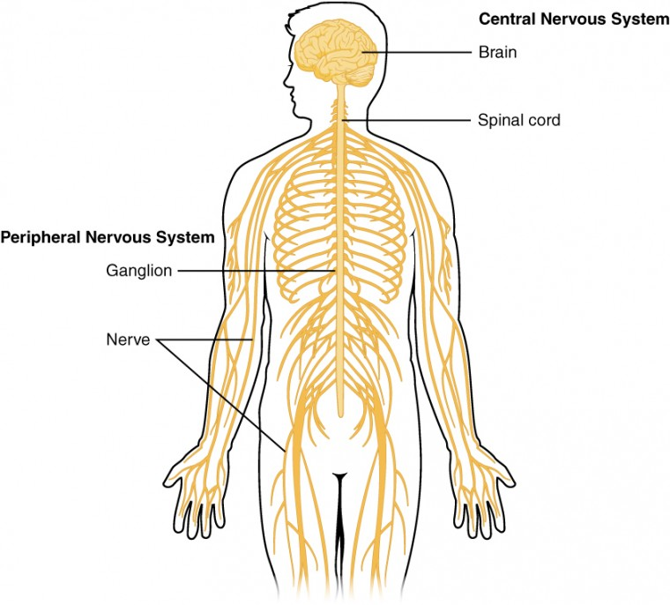
What does the human nervous system consist of?
Central Nervous System (CNS) – Brain and Spinal Cord
Peripheral Nervous System (PNS)- Ganglia and the nerves

Slide 139
Role of the CNS
process and responds information

Slide 140
Role of the PNS
Carry messages to and from the CNS

Slide 141
Which cord is dorsal hollow?
Spinal cord

Slide 142
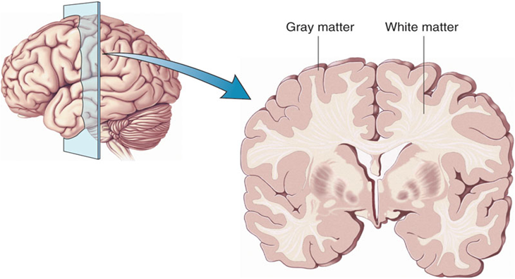
Two basic kinds of tissues found in the spinal cord?
White matter (inside) (relatively light color due to Schwann cells) made up of myelinated axons
Grey matter (outside) which is made up of Cell bodies, dendrites, unmyelinated axons etc. Grey matter is where integration occurs.

Slide 143
4 basic parts of the brain?
Brainstem
Cerebellum
Diencephalon
Cerebrum

Slide 144
Brainstem role?
takes care of alertness
Appetite
Breathing
Heart rate

Slide 145
Cerebellum role?
located behind the brainstem and mostly involves muscular coordination.

Slide 146
Diencephalon role?
Transmitting information from one part of the brain to the other
location of the pituitary gland.

Slide 147
Cerebrum role?
Takes care of ‘higher functions’ in the brain
Perception, language, volition.
Consists of the four lobes:
Frontal lobe
Parietal lobe
Occipital lobe
Temporal lobe

Slide 148
What are nerves?
bundles of myelinated axons

Slide 149
Efferent neurons split up into two major groups
Somatic nervous system
Autonomic nervous system

Slide 150
Somatic nervous system role?
carries messages to the skeletal muscles & The autonomic nervous system

Slide 151
Autonomic nervous system role?
which carries messages to smooth muscle, cardiac muscle and glands

Slide 152
The autonomic nervous system can be divided into three parts, what are they?
Enteric division
Parasympathetic division
Sympathetic division

Slide 153
Enteric division
Concerned with the routine coordination of the digestive system

Slide 154
Parasympathetic division
Sends out signals that put you into the rest and digest stage, which means it tends to be active when you are calm, relaxed, digesting food etc.

Slide 155
Sympathetic division
Opposite of the parasympathetic division
Sends signals to put you into the fight or flight stage.

Slide 156
5 senses?
Mechanoreceptors
Chemoreceptors
Electromagnetic receptors
Thermoreceptors
Pain receptors

Slide 157
What are mechanoreceptors?
They are going initiate action potentials in response to mechanical force

Slide 158
What are chemoreceptors?
They are going initiate action potentials in response to specific chemicals

Slide 159
What are electromagnetic receptors?
They are going initiate action potentials in response to electromagnetic energy

Slide 160
What are Thermoreceptors?
They are going initiate action potentials in response to temperature

Slide 161
What are pain receptors?
They are going initiate action potentials in response to damaged tissue

Slide 162
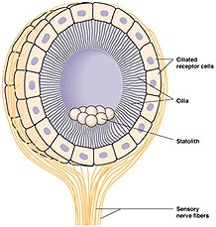
What is a statocyst?
A fluid filled capsol

Slide 163
Human ear is divided into three parts, what are they?
Outer: Pinna – auditory canal
Middle: Tympanic Membrane – Eustachian tube – ossicles
Inner: Cochlea – vestibules – 3 semicircular canals

Slide 164
Pinna
the part you see on the outside. Basically directs soundwaves into the ear. Sound is pressure waves in the ear

Slide 165
Auditory Canal
Carries soundwaves into the middle ear
Location of ear wax

Slide 166
Tympanic membrane
Aka. Eardrum
Recognizes Vibrations

Slide 167
Eustachian tube
connects the middle ear with the pharynx

Slide 168
Ossicles
transmit vibrations from the eardrum into the inner ear

Slide 169
Inside the inner ear
Cochlea, which looks like a snail shell. Off the vestibule which is embedded in a gel, there are 3 semicircular canals they are perpendicular to the other two. At the base of each there is hair cells. Basilar Membrane is located inside the cochlea. Sitting on it is receptors called hair cells.
When the Vibrations make their way through the fluid it activates action potential
the action potential is then carried off to the brain through the auditory nerve which is what allows you to hear.

Slide 170
Taste buds
Sweet
Sour
Salty
Bitter
Umami

Slide 171
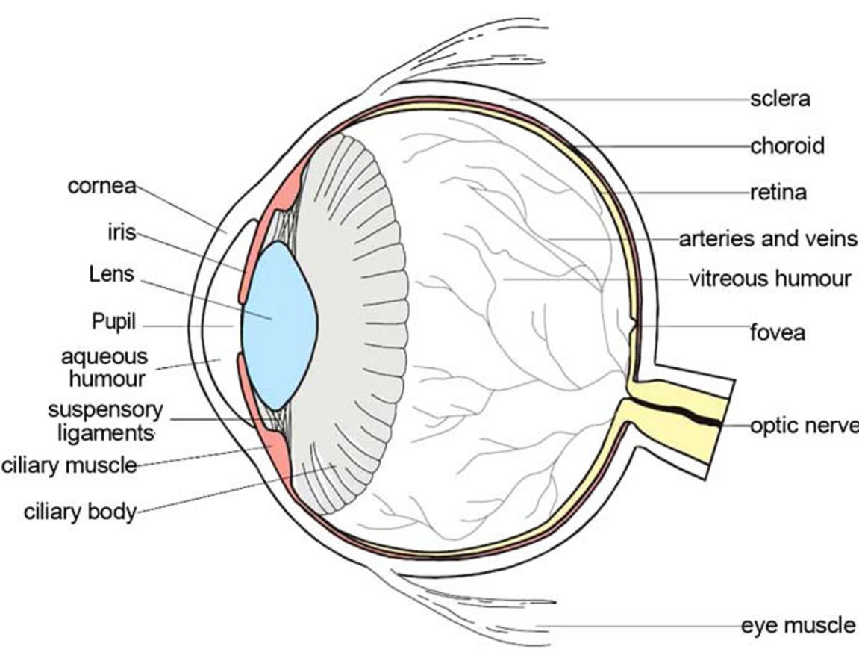
HUMAN EYE

Slide 172
Vitreous Humor role?
Inflates the eye

Slide 173
Retina role?
Where photoreceptors are located
Where cells respond to light

Slide 174
Choroid role?
Heavily pigmented
Blocks light
Feeds the retina
Light can only get in through the front

Slide 175
Sclera role?
White part of your eye
Physical structure of the eye
It protects the eye and give it its shape

Slide 176
Cornea role?
starts to focus the light that enters your eye (bends the light)

Slide 177
Aqueous Humor role?
directly behind the cornea
A fluid that basically feeds the cornea and the lens
Provides oxygen, gives it nutrients (sugar)

Slide 178
Iris role?
The part of the eye that is usually referred to when people are talking about your eye color
Can adjust the size of the pupil
Controls the amount of light that enters the eye

Slide 179
Pupil role?
Black dot in the center in your eye
A hole in the iris
Light passes through the pupil.

Slide 180
Lens role?
Finishes the job of focusing the light and it also adjusts the focus

Slide 181
Ciliary muscles
Pulling boarder of choroid towards the lens. (Near Vision)
Relax and borderer of choroid moves away from the lens (Far vision)

Slide 182
What are the two kinds of photoreceptors found in the retina?
Rods
Cones

Slide 183
Rods
respond to a wide range of colors, they also give us black and white vision
Very sensitive
125 million

Slide 184
Cones
Respond to green, red, or blue light
Colour vision
Relatively insensitive
6 million

Slide 185
What's niche?
The sum of a species uses of the biotic and abiotic resources in its environment

Slide 186
What is biomass?
the amount of organic matter in a group of organisms

Slide 187
What's primary production?
Refers to the rate at which new biomass is generated in an ecosystem

Slide 188
What is detritus?
a bunch of organic material that is dead and been discarded. For example, poop, hair, leaves

Slide 189
What is detrivore?
Usually fungi and bacteria
when they die they go back to a detritus

Slide 190
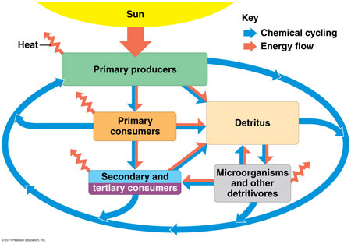

Slide 191
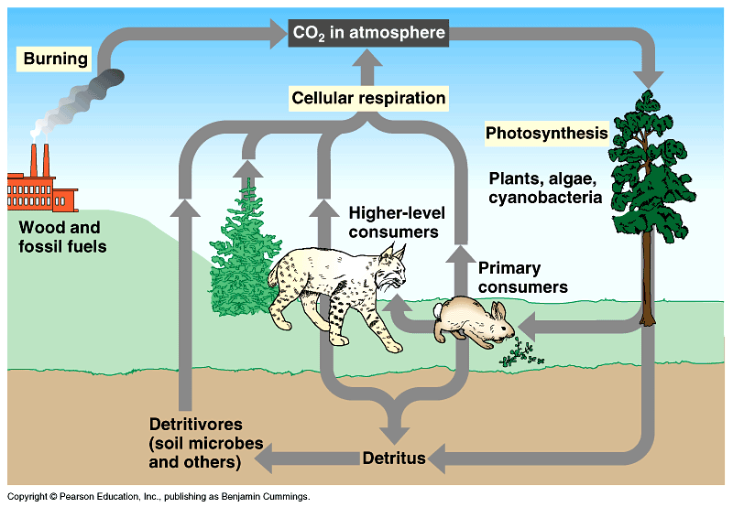
Carbon cycle

Slide 192
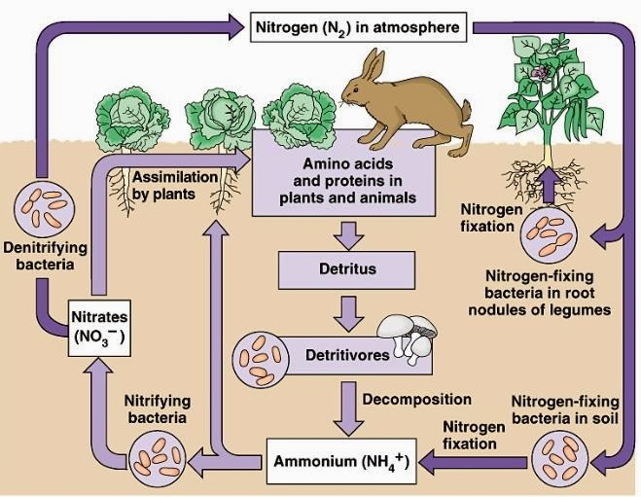
Nitrogen cycle

Slide 193
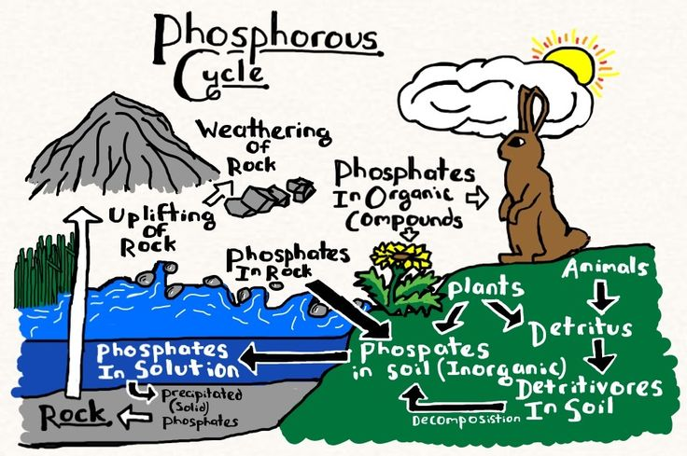
Phosphorus cycle

Slide 194
What is limiting nutrient?
The nutrient that must be added to increase primary production in an ecosystem
Typically, nitrogen or phosphorus

Slide 195
What is life?
Response to environment
Exchange of materials with the environment
Metabolism
Growth
Reproduction

Slide 196
What is a virus?
What we consider to be alive, but they are not made of cells.
All virus’ are parasitic. They are very small, even much smaller than prokaryotic cells

Slide 197
What is a capsid?
Basic structure
Layer around the outside
not like a cell wall or a plasma membrane or anything. It is just a box made of protein
No exchange of material with the environment
Inside the capsid is genetic material, unlike in cells, it may be DNA or RNA

Slide 198
What is a Viroid?
A circular RNA molecule that infects certain plants

Slide 199
What is a prion?
responsible for a number of diseases

Slide 200
What is Cancer?
Several genes are involved in control of the cycle
A mutation in one of these genes may result in uncontrolled cell division
Daughter cells inherit this uncontrolled cell division
Cells tend to be unspecialized
If the cells that are growing out of control remain in the same location, it is considered a benign tumour
If the cells spread in the body (metastasis), starting new tumours, it is considered cancer

Slide 201
Porifera | No Nervous System | No circulatory system
Cnideria | Nerve Net. They have individual sensory Neurons | No circulatory system
Platyhelminthes | Nervous system in some way is like a nerve net. Messages carried through nerve chords. Also has a brain with simple sense organs like eyes for example. | No circulatory system
Mollusca | Brain & Chords, ganglia | No circulatory system
Annelida | Brain & Chords, ganglia | Closed
Nematodes | Brain & Chords | Open
Arthropoda | Brain & Chords, ganglia | Usually open
Echinodermata | Brain & Chords | Open, have another system called water vascular system
Chordata | Brain & Chords | Closed

Slide 202
Bio 201 Completed ☺

