Slide 1
ANP1105C Neuron Sept 20 ..
TOPIC #2.2: PHYSIOLOGY OF THE NEURON 392 - 418
2.2.1 Identify the different regions of the neuron and associate each region with the functions of reception, propagation and transmission of nerve impulses (pp. 392-395)
2.2.2. Explain the phenomena (diffusion of ions, types of ion channels) that are responsible for the electrical activity of neurons (resting membrane potential, action potential) (pp. 398-401)
2.2.3 Describe the factors that influence propagation of the action potential along an axon (pp. 402-408)
2.2.4 Explain the mechanisms of synaptic transmission (synapse, post-synaptic potentials, synaptic integration (pp. 409-418)

Slide 2

2.2.1 Identify the different regions of the neuron and associate each region with the functions of reception, propagation and transmission
2.2.1.1 justify 3 special properties of neurons that set them apart from most other cells in the body
2.2.1.2 label and indicate the functions of the receptive, conducting and secretory regions of the neuron
structural units of NS: conduct electrical impulses from one body part to another
Special features:
1. Extreme longevity: adequately nourished ⇒ 100 yr+
2. Amitotic: why? what does this mean if neurons are damaged?
3. High metabolic rate: O₂/glucose requirements?
large, complex cells: all have a cell body + one or more processes
J. Carnegie, UofO

Slide 3
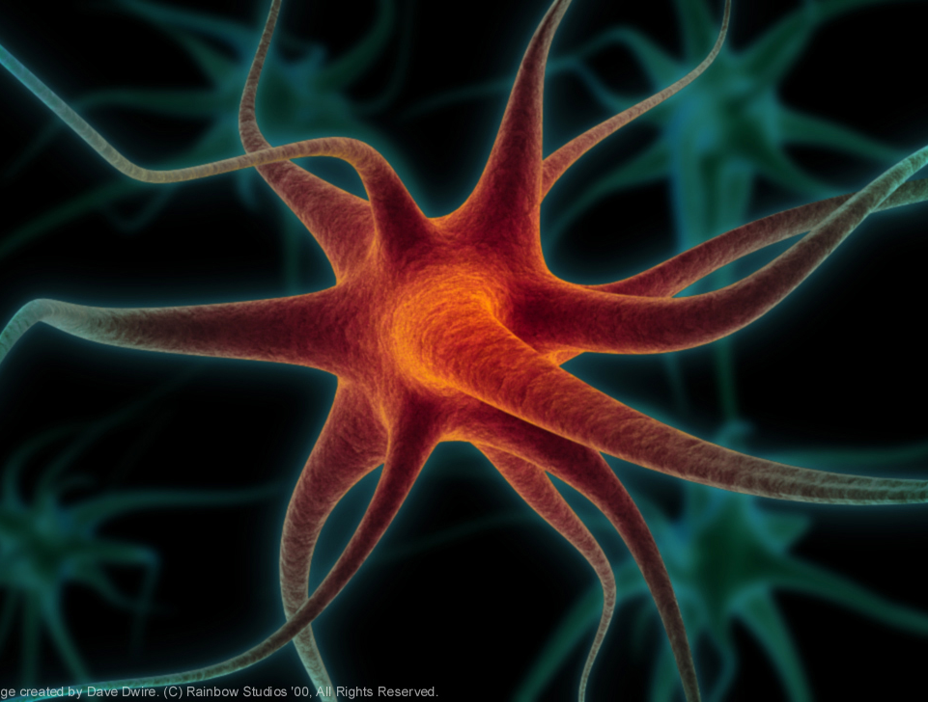
"There are perhaps about one hundred billion neurons, or nerve cells, in the brain, and in a single human brain the number of possible inter-connections between these cells is greater than the number of atoms in the universe." (Robert Ornstein and Richard Thompson, The Amazing Brain. Boston: Houghton Mifflin Company. 1984, 21)
http://www.holisticeducator.com/neuron.htm

Slide 4
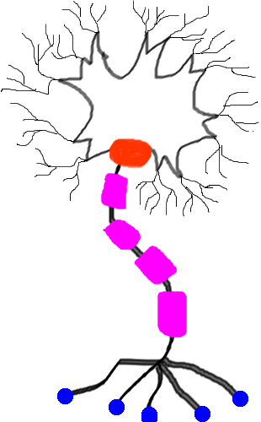
3 functional regions: (plasma membrane very important in all regions!)
1. Receptive region
2. Conducting region
3. Secretory region
http://www.ualberta.ca/~neuro/OnlineIntro/NeuronStructure.htm

Slide 5
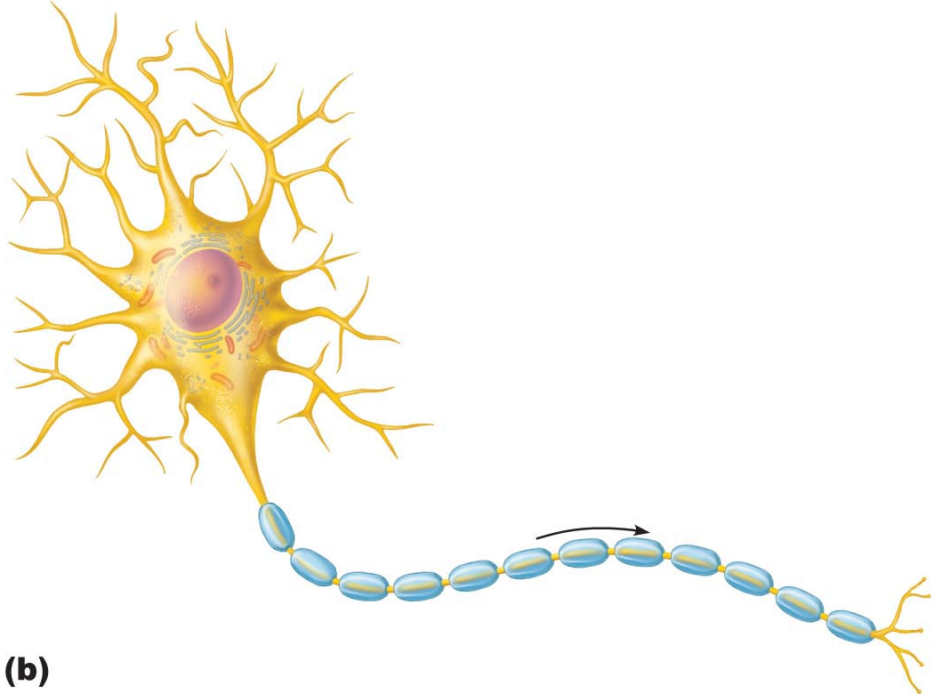
A. Neuron Cell Body
• large, spherical nucleus + granular cytoplasm ➢ biosynthetic centre
• extensive RER + ribosome clusters (Nissl bodies); also elaborate Golgi & lots of mitochondria Why??
• CNS/ PNS as a whole: What is a nucleus? What is a ganglion?
B. Neuron Processes
dendrites
axons
axonal terminals
2 more terms:
tract: bundle of nerve processes in CNS
nerve: bundle of nerve processes in PNS
Fig. 11.4
J. Carnegie, Uof O

Slide 6
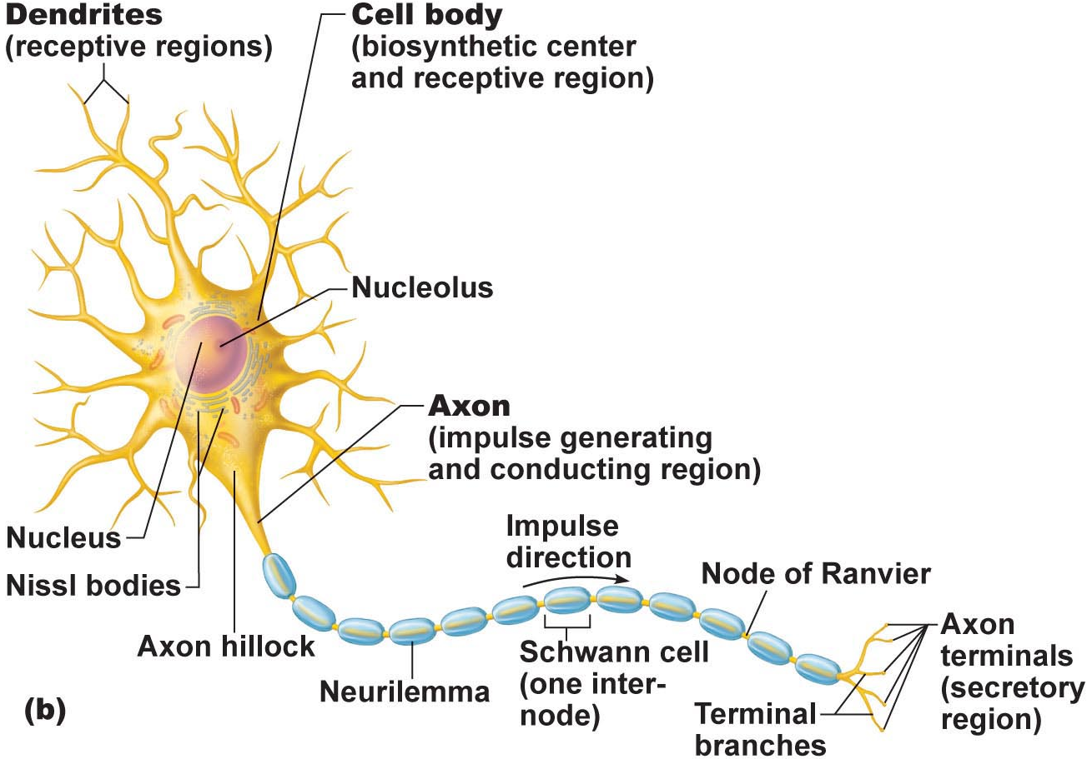
B1. Dendrites: (receptive region)
• short, tapering, branched extensions; usually hundreds/cell body
• enormous SA for reception from other neurons
• conduct impulses toward cell body
• short distance, graded potentials
J. Carnegie, Uof O
B2. Axon
• arises from axon hillock; variable length (can be > 1 metre)
• rate of conduction increases with axon diameter
• usu. 1 axon/neuron; branches at end (~10,000 telodendria) which end in axonal terminals

Slide 7

1. What is the conducting region of a neuron?
2. What is the secretory region of a neuron?
3. Where are the action potentials generated ?
4. In what direction do the action potentials travel?
5. From how many neurons does a single neuron receive information?
6. To how many neurons does a single neuron transmit information?
J. Carnegie, UofO

Slide 8

4.1.5 indicate the effect of axon diameter on neuron conduction velocity
4.1.6 distinguish between anterograde and retrograde transport
B2. Axons (cont.):
Neurotransmitters convey information from one axon to the next
Axon has same organelles as cell body, but no Nissl bodies; axons quickly degenerate if cut
Elaborate cytoskeleton in axon to move material to & fro:
anterograde (eg: mitos, cytoskeleton, membrane parts, NTs)
retrograde (eg: organelles to be degraded/recycled)
Conduction velocities depend on:
(i) axon diameter
(ii) myelin sheath
J. Carnegie, Uof O
Clinical Note:
Viruses such as polio, rabies, herpes simplex & tetanus toxin reach cell body by retrograde transport
Can this be used as a tool to introduce “corrected information” into genome???

Slide 9
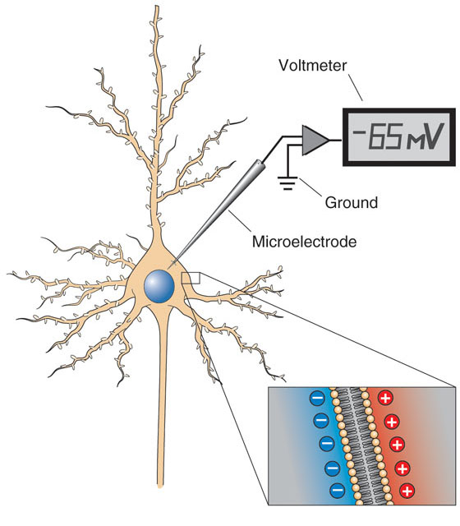
2.2.2.1 describe the resting membrane potential (RMP) of an excitable cell in terms of the differential permeability of the cell membrane to Na⁺ and K⁺; indicate which ion is found primarily inside cells and which is found primarily in the ECF
A. Creation of Resting Membrane Potential (RMP)
What do we mean when we say that neurons are excitable cells??
Some Fundamental Principles of Electricity:
voltage: electrical potential energy due to separation (PM) of oppositely-charged particles (ions) (-70 mV for many neurons)
resting membrane potential: all cells polarized; RMP cell-type-dependent (neg)
J. Carnegie, UofO
http://www.bioon.com/book/biology/whole/image/3/3-11.tif.jpg

Slide 10
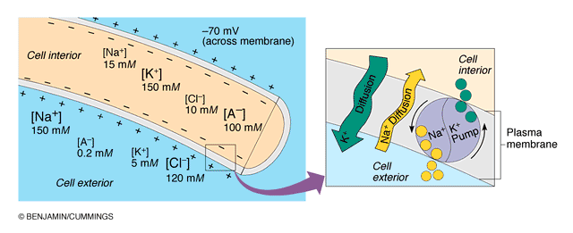
2.2.2.2. describe the Na+/K+ ATPase in terms of its role in maintaining the RMP of a neuron
NEGATIVE because INSIDE of cell negative compared to OUTSIDE
negativity only at level of membrane
RMP due to differential permeability of membrane to Na⁺ and K⁺ ions
Which ion primarily inside cells??
Which ion primarily outside cells??
3. At rest: membrane somewhat permeable to K⁺ but only very slightly permeable to Na⁺; so what happens??? What is the net result???
Fig. 11.8b (7th edition)

Slide 11
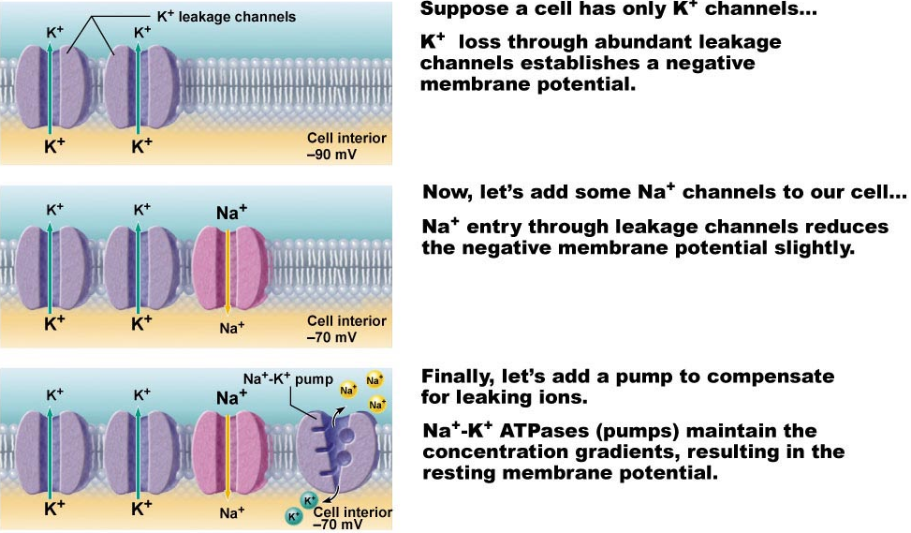
2.2.2.3 define electrochemical gradient; see also pages 79-82
We have:
1. Differential resting membrane permeabilities to Na⁺ & K⁺
2. Also, Na⁺/K⁺ pump moves 3 Na⁺ OUT for every 2 K⁺ IN
Fig. 11.8

Slide 12
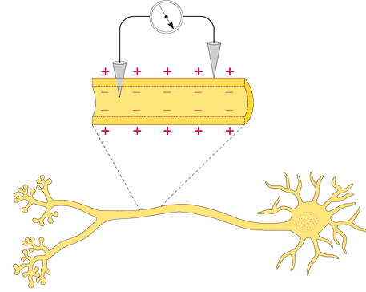
B. Measurement of Resting Membrane Potential (RMP)
RMP for a neuron is -40 to -90 mV (how is this measured???)
Fig. 11.7

Slide 13
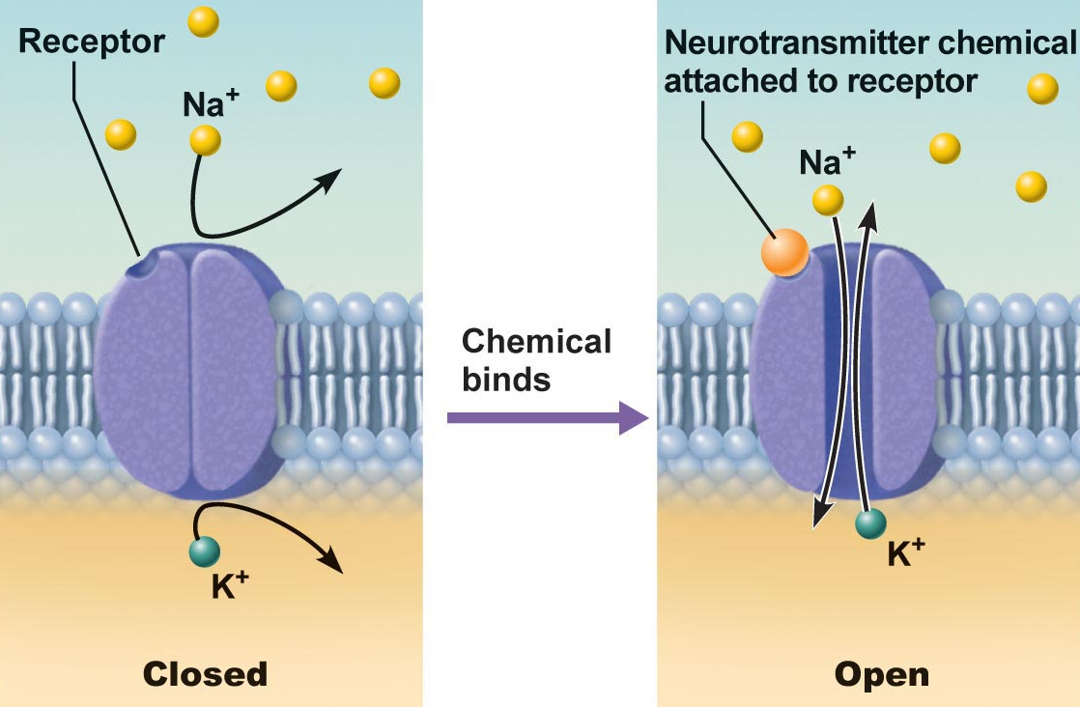
2.2.2.4 distinguish between passive (leakage) and active (gated) channels; list & describe the functioning of the 2 types of gated channels
Channels in plasma membranes:
1. Passive or leakage channels: always open
2. Active or gated channels: signal required to open/close
a) chemically-gated (neurotransmitter/hormone)
b) voltage-gated (change in membrane potential)
channels ion-specific: channels open ➔ ions move in response to electrochemical gradients
Fig. 11.6a
J. Carnegie, Uof O

Slide 14
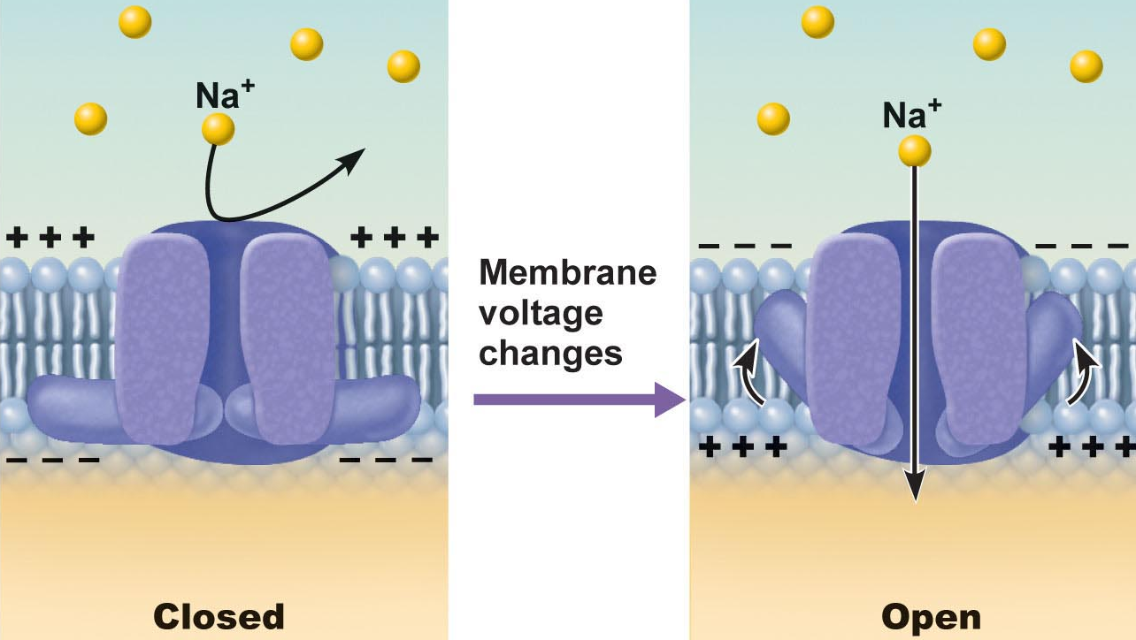
Fig. 11.6b
Fig. 11.6b
● neurons & muscle cells communicate by changing membrane potentials
● 2 types of signals:
graded potentials:……………………………………
action potentials:………………….…………………
J. Carnegie, UofO

Slide 15
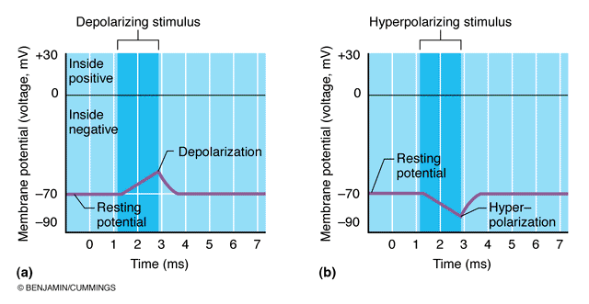
2.2.2.5 distinguish between depolarization and hyperpolarization
Fig. 11.9
remember that depolarization increases the probability of producing nerve impulses; hyperpolarization decreases this probability

Slide 16
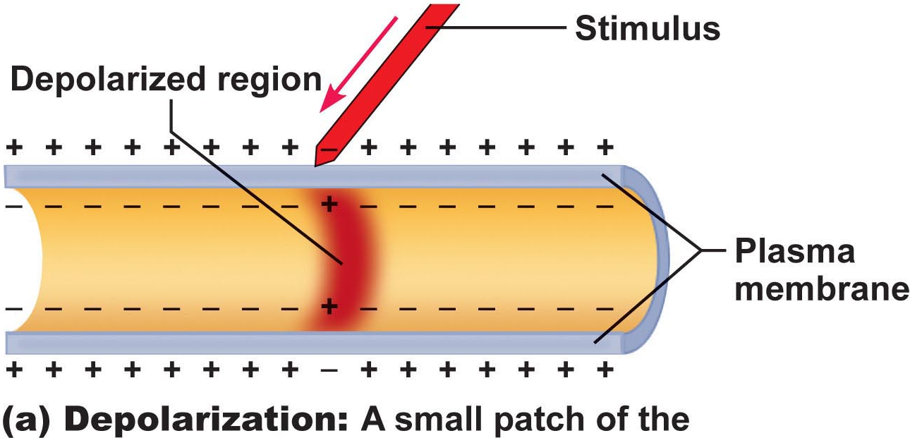
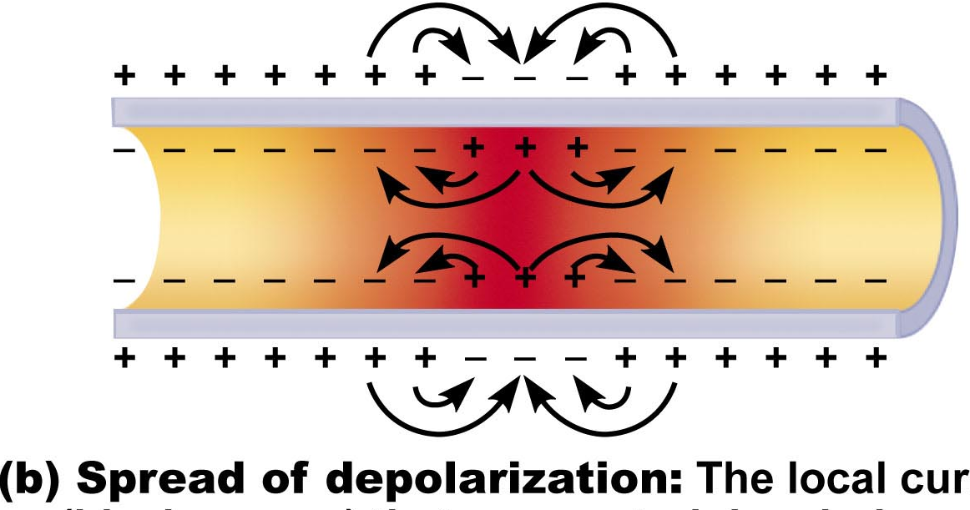
Graded Potentials
short-lived depolarizations or hyperpolarizations
current decreases with distance traveled
graded because magnitude determined by strength of stimulus
Initial stimulus depolarizes or hyperpolarizes local area of membrane
↓
decremental movement of ions on either side of membrane propagates signal for short distance
Fig. 11.10a
Generator potential
Postsynaptic potential
Fig. 11.10b

Slide 17
Check all descriptions that apply to a resting neuron:
1. Its inside is negative relative to its outside.
2. Its outside is negative relative to its inside.
3. The cytoplasm contains more Na⁺ and less K⁺ than does the ECF.
4. The cytoplasm contains more K⁺ and less Na⁺ than does the ECF.
5. A charge separation exists at the plasma membrane.
6. The electrochemical gradient for the movement of Na⁺ across the membrane is greater than that for K⁺.
7. The electrochemical gradient for the movement of K⁺ across the membrane is greater than that for Na⁺.
8. The membrane is more permeable (leaky) to Na⁺ than to K⁺.
9. The membrane is more permeable (leaky) to K⁺ than to Na⁺.
J. Carnegie, UofO

Slide 18
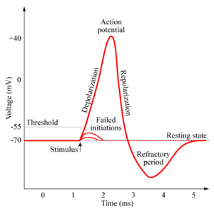
2.2.2.6 describe and graph a typical action potential, illustrating the 3 consecutive, overlapping changes in membrane permeability to specific ions; define: threshold, hyperpolarization undershoot, absolute refractory period, relative refractory period
Definition: a brief reversal of membrane potential; total amplitude = ~100 mV (from -70 to +30 mV)
• cells with excitable membranes (neurons, muscle cells) can generate action potentials; in neurons, only axons can generate action potentials
APs do not decrease in amplitude with distance travelled!!
• voltage-gated channels on axons open & close in response to local currents (graded potentials)
http://www.chm.bris.ac.uk/webprojects2006/Cowlishaw/mech%20synaptic%20transmission.htm
J. Carnegie, UofO

Slide 19
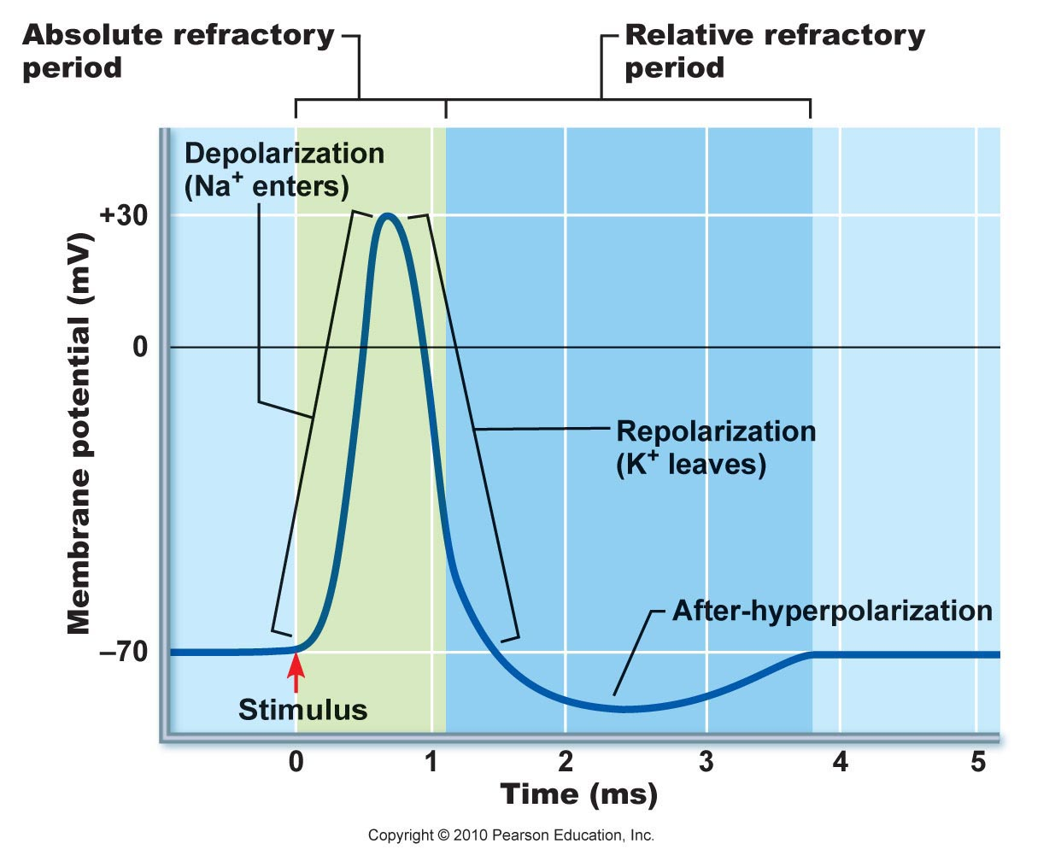
Generation of an Action Potential
transient increase in Na⁺ permeability
restoration of Na⁺ impermeability
transient increase in K⁺ permeability
(i) Increase in Na⁺ permeability
resting state: voltage-gated Na⁺ & K⁺ channels closed; normal leakage
local depolarization: voltage-gated Na⁺ channels open (fast activation gates)
What does threshold (-55 to -50 mV) mean? Why is AP then self-sustaining?
What is the spike of an AP? Concept of positive feedback
Fig. 11.14
Depolarizing Phase:
Both Na⁺ gates must be open for entry; closure of either gate stops Na⁺ entry
J. Carnegie, Uof O

Slide 20
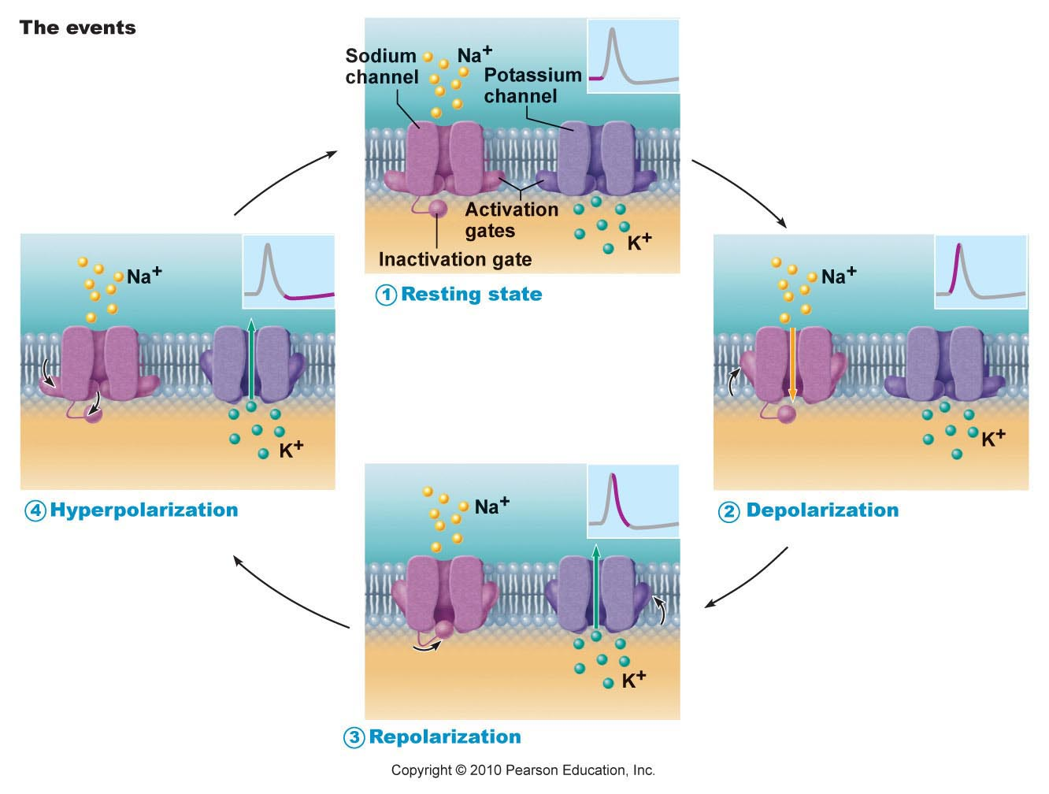
Fig. 11.11

Slide 21
(ii) Decrease in Na⁺ permeability
as membrane potential passes 0 mV, inside positivity resists further Na⁺ entry
Na⁺ gates begin to close; turning point in spike
cell will now begin to repolarize
Repolarizing phase:
(iii) Increase in K⁺ permeability
K⁺ leaves cell along electrochemical gradient & repolarizes cell
also slow gates: so slow that do not close quickly enough →
after-hyperpolarization
Na⁺/K⁺ pumps quickly restore ion gradients across membrane
J. Carnegie, Uof O

Slide 22
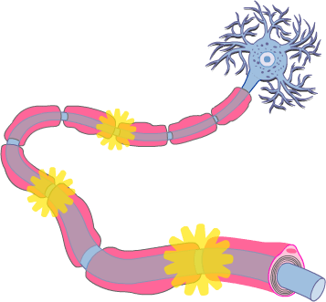
2.2.3.1 justify the unidirectional propagation of an AP and the description of an AP as an “all-or-none” event; indicate how stimulus intensity is coded in action potential production
Propagation of an Action Potential
• AP must traverse length of neuron to signal next neuron
• propagation rather than conduction of an AP - Why??
• unidirectional - Why?? What do we mean when we say that an area of a neuron is refractory to further stimulation? What does this mean about the Na⁺ channels??
J. Carnegie, UofO
http://www.getbodysmart.com/ap/nervoussystem/neurophysiology/actionpotentials/menu/menu.html

Slide 23
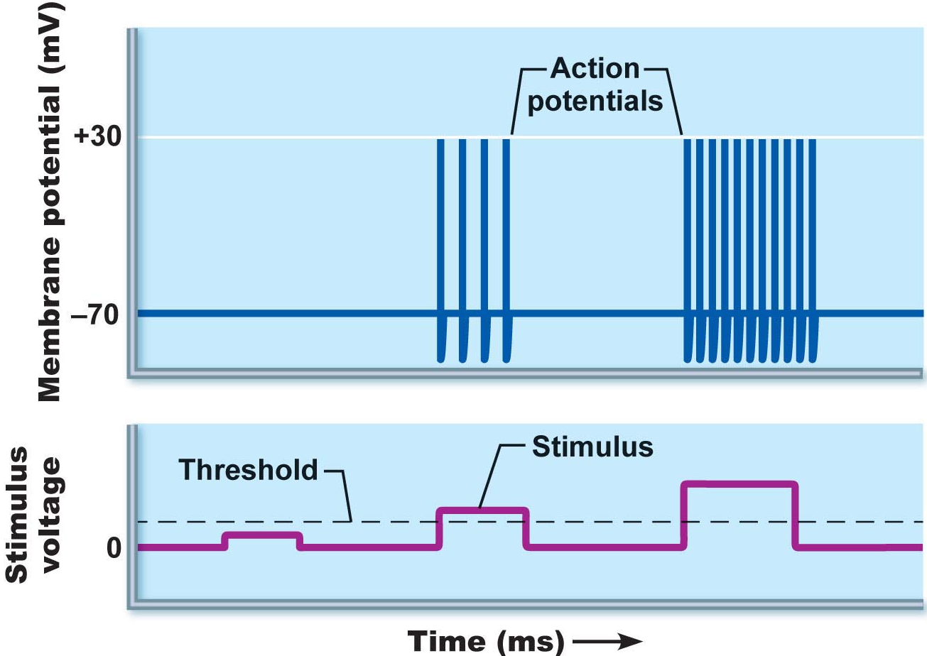
Threshold and All-or-None Phenomenon
outward K⁺ current = inward Na⁺ current (~20 mV of depolarization)
can go either way!!
local depolarizations (graded) must sum to reach threshold or no AP
Why do we say that an AP is an all-or-none event?
NB: APs are all the same size: stimulus intensity is indicated by AP frequency
Fig. 11.13

Slide 24
Absolute & Relative Refractory Periods
Absolute RP: Na⁺ gates open & second depolarization impossible
Relative RP: Na⁺ gates closed but K⁺ gates open; can only be stimulated by a very strong stimulus (greater than threshold); a means of increasing frequency when incoming stimulus is strong
Fig. 11.14

Slide 25
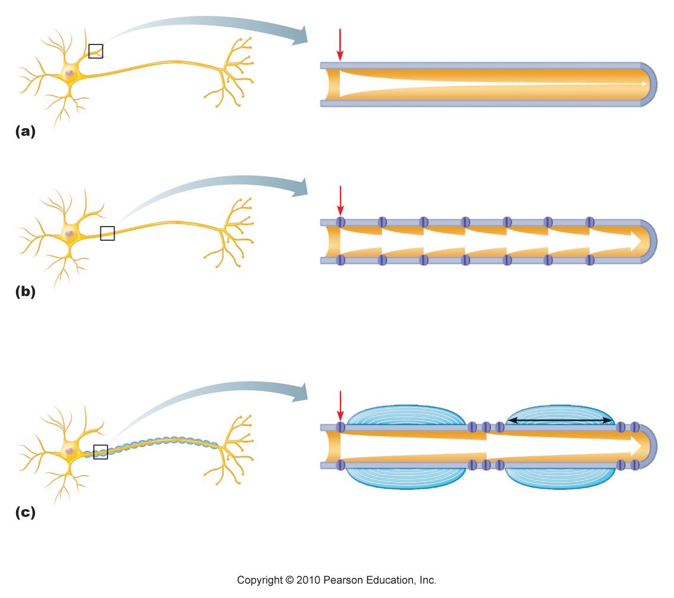
2.2.3.2 describe the production of myelin sheathes around peripheral neurons and indicate their role in AP propagation; define: Schwann cell, node of Ranvier, saltatory conduction, oligodendrocytes, multiple sclerosis as a disease affecting the myelin sheath
Myelin Sheath:
• white, lipid-protein; insulates/protects peripheral nerves
• increases (up to 150 X) rate of impulse propagation
• Schwann cells: membranes <25% protein (minimal channels ➢ Why?)
Node of Ranvier? saltatory conduction? Are dendrites myelinated?
Fig. 11.15. Myelin sheath speeds up impulse propagation

Slide 26
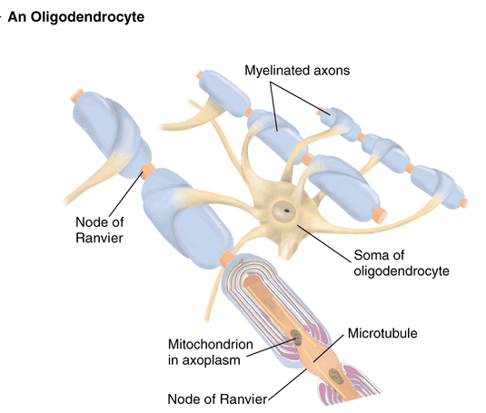
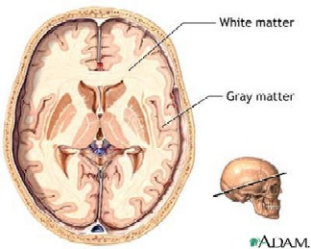
myelinated nerves also in CNS: oligodendrocytes; white vs gray matter
http://homepage.psy.utexas.edu/homepage/class/Psy332/Salinas/Cells/Cells.html
http://reinventioninc.blogspot.com/2005_01_01_reinventioninc_archive.html

Slide 27

A Clinical Note
Multiple Sclerosis:
persistent inflammatory response in which myelin sheaths gradually destroyed (autoimmune? persistent virus?)
cycles of relapse and remission: flare-ups and then some healing and myelin regeneration; axons develop more Na⁺ channels in demyelinated areas
blindness (optic nerve), muscle weakness, clumsiness, urinary incontinence
ultimately myelin destruction is permanent and axons “drop out” or degenerate
Therapy:
(1) reduce inflammatory destruction
(2) manage symptoms
(3) promote repair of damaged myelin
J. Carnegie, UofO

Slide 28
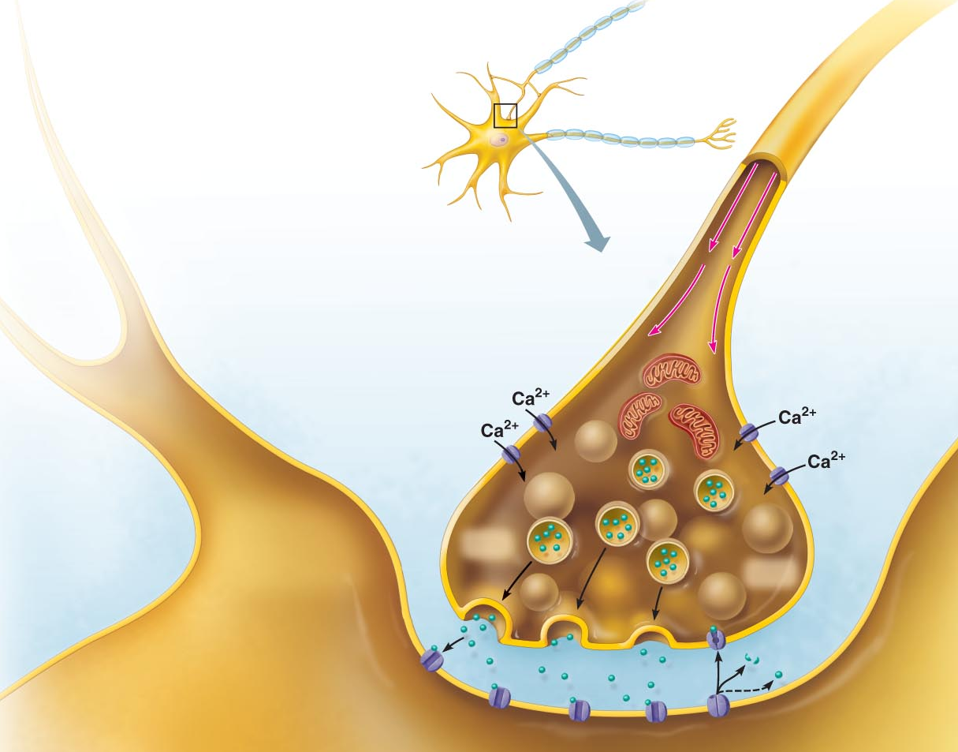
2.2.4 Explain the mechanisms of synaptic transmission (synapse, post-synaptic potentials, synaptic integration)
2.2.4.1 differentiate between electrical and chemical synapses in terms of relative frequencies, distributions, mechanism, speed and properties of inter-neuron communication
Fig. 11.18 (7th edition)
THE SYNAPSE
junction between 2 neurons or neuron + effector
presynaptic vs postsynaptic neuron (most neurons are both)
2 types of synapses: electrical and chemical

Slide 29
A. Electrical Synapses
much less common; like gap junctions
direct current flow - protein channels
rapid transmission (electrically-coupled)
neurons can be synchronized
primarily embryonic, also eye movement; in non-nervous tissue, found in cardiac & smooth muscle where can synchronize contractions
Chemical Synapses
release and binding of neurotransmitters
“Neurotransmitters . . .function to open or close ion channels that influence membrane permeability and, consequently, membrane potential.” (Marieb, /98)
2 parts: (i) axonal terminal:
(ii) receptor region:
What events occur in the synaptic cleft (fluid-filled space of 30-50 nm)?
Why is synaptic transmission unidirectional?

Slide 30
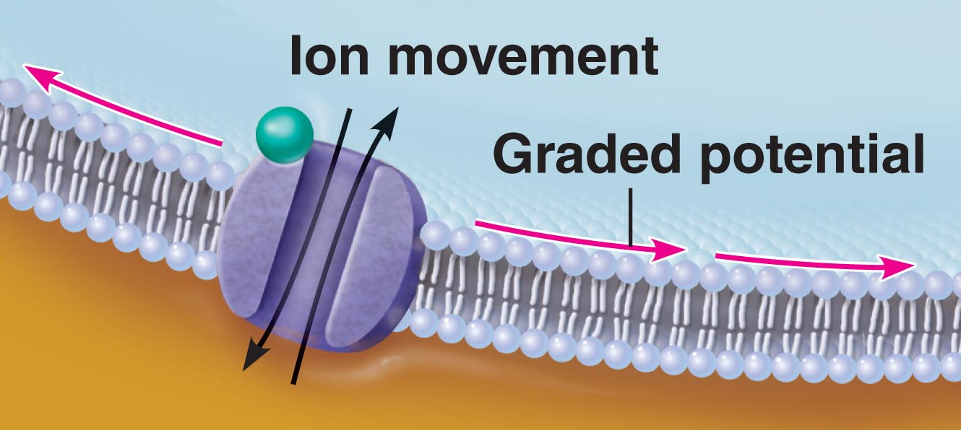
2.2.4.2 illustrate and describe the main features of chemical synaptic transmission; briefly describe 3 ways in which chemical synaptic transmission can be terminated
Mechanism of Synaptic Communication
Initiation:
1. Ca⁺⁺ gates open in presynaptic terminal
2. Neurotransmitter release
3. Neurotransmitter binds to postsynaptic receptors
4. Ion channels open in postsynaptic membranes
NB: ~300 vesicles emptied/impulse - So what happens when we have increased impulse frequency???
J. Carnegie, U of O

Slide 31
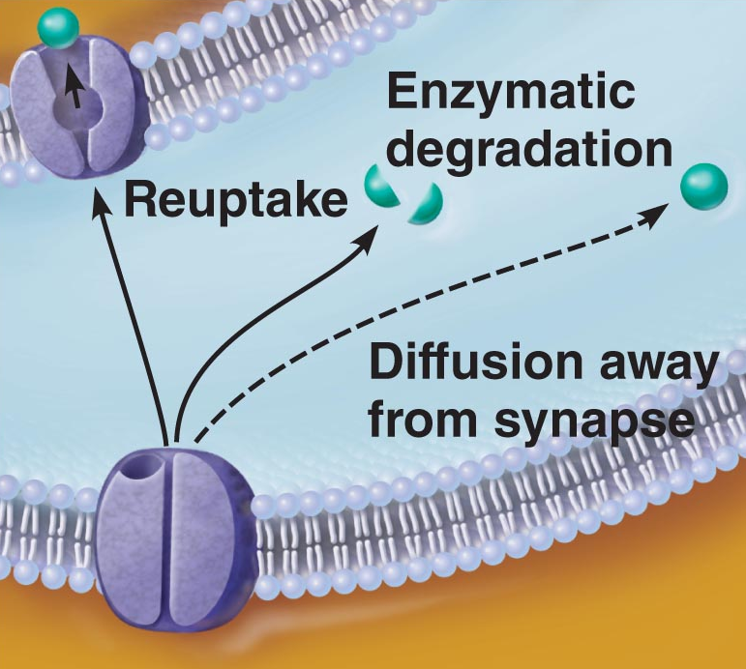
Termination:
3 options:
(i) degradation by enzymes of postsynaptic membrane (acetylcholine)
(ii) reuptake by presynaptic terminal (norepinephrine)
(iii) diffusion away from synaptic site (nitric oxide)
J. Carnegie, U of O

Slide 32
2.2.4.3 define synaptic delay
Synaptic Delay:
• slowest (rate-limiting) step of neurotransmission - Why??
• time for NT release, diffusion & receptor binding: 0.3-5 ms
2.2.4.4 distinguish between EPSPs and IPSPs in terms of channels opened and end results in terms of membrane potential/ease of generating an action potential
Postsynaptic Potentials
channels respond to chemicals rather than changes in membrane potential
channels mediate local changes in membrane potential: graded per amount of NT
2 types of PSPs:
(i) excitatory postsynaptic potentials (EPSPs)
(ii) inhibitory postsynaptic potentials (IPSPs)

Slide 33
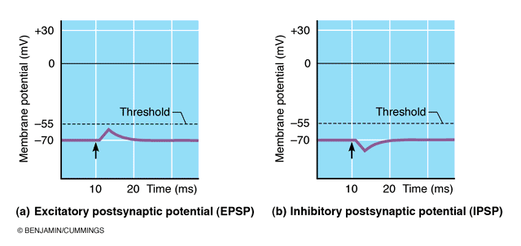
EPSPs:
NT binding ➔ membrane depolarization; opens one channel for both Na⁺ & K⁺
electrochemical gradient for Na⁺ steeper than for K⁺; what is end result??
what is generated is NOT an AP; only axonal membranes can generate APs!!; get local, graded depolarizations called EPSPs; if strong enough to reach axon hillock, then get AP
IPSPs:
NT binding ➢ membrane hyperpolarization by inc. permeability to K⁺ or Cl⁻
What is the end result in terms of membrane potential?
What is end result in terms of ease of generating an AP?
Fig. 11.18

Slide 34
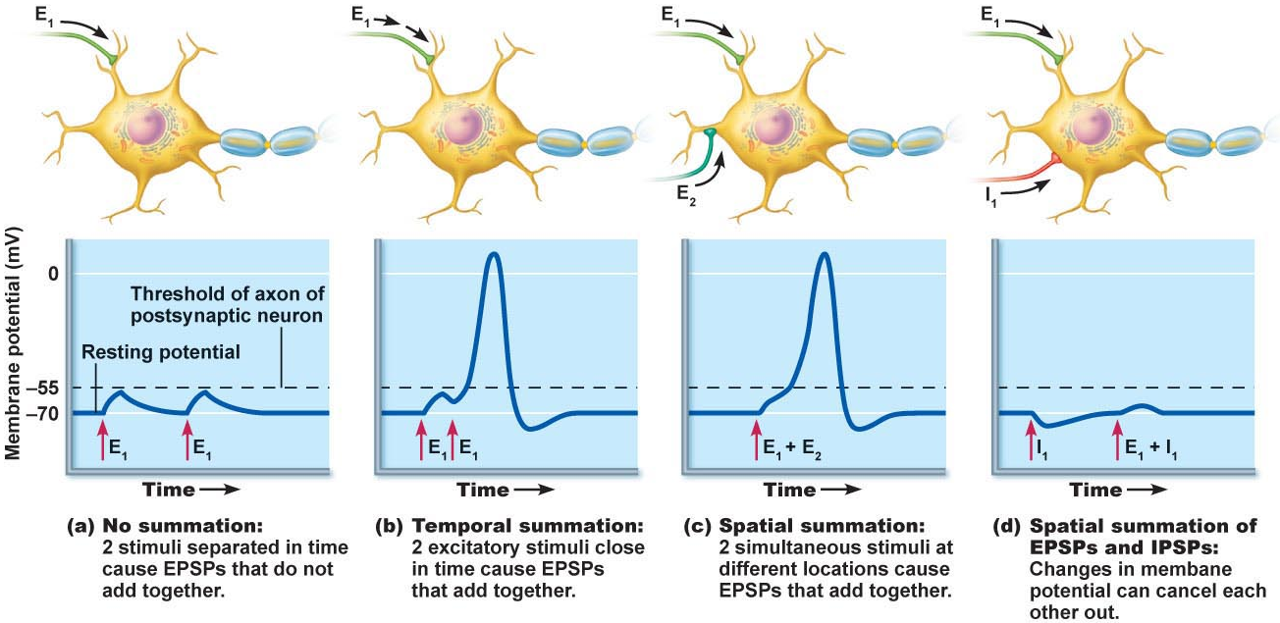
2.2.4.5 define (in terms of EPSPs & IPSPs): temporal summation, spatial summation; justify the role of the axon hillock as the neural integrator
C1. Summation by Postsynaptic Neuron
single EPSP cannot generate an AP
2 types of summation (EPSPs & IPSPs):
(i) temporal: (ii) spatial:
axon hillock = neural integrator (numerous EPSPs & IPSPs)
most effective synapses:closest to axon hillock – why??
Fig. 11.19

Slide 35
https://www.youtube.com/watch?v=bcnf3ZRl5ug
The human brain has a huge number of synapses. Each of the 10¹¹ (one hundred billion) neurons has on average 7,000 synaptic connections to other neurons. It has been estimated that the brain of a three-year-old child has about 10¹⁵ synapses (1 quadrillion)
Connections are constantly evolving, in a toddler
at the rate of 700 per second.

