Slide 2
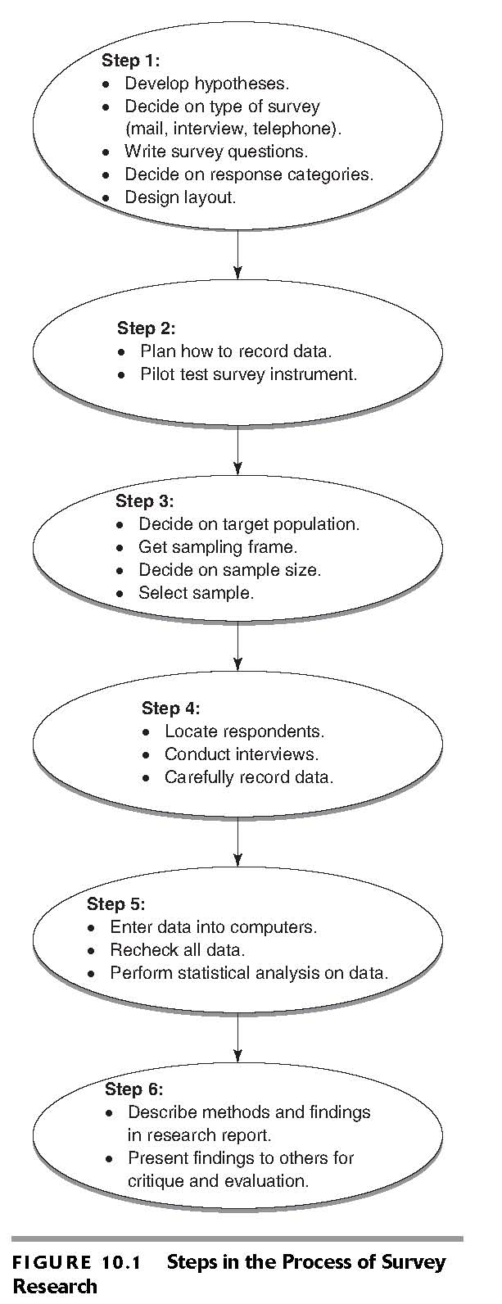
Survey Design Logic
Steps in Conducting a Survey

Slide 3
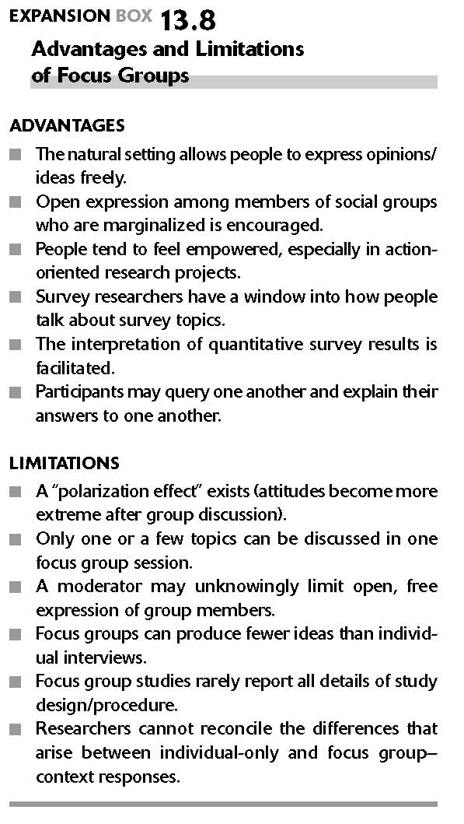
Focus Groups

Slide 4
Things to Avoid when writing survey questions
Avoid jargon, slang and abbreviations
  Snake to a plumber means something different to another. Avoid abbreviations. Basic terminology, about ¼ of the sample population in the U.S. (20% of Americans with less than a high school degree) have difficulty understanding sexual terms such as “vaginal intercourse” (Binson & Catania, 1998)
Avoid ambiguity, confusion, and vageness
  What is your income? (could mean monthly, weekly, annually) or Do you jog regularly? (What is regular, once a week, once a day, once a month…..?)
Avoid emotional language and prestige bias.
  Emotional words such as freedoms, steal, peace, murderous..
Avoid double barrelled questions.
  Does this company have pension and health insurance benefits?
Avoid overlapping or unbalanced response categories.
  5-9, 10-19…….NOT 5-10, 10-20

Slide 5
Things to Avoid when writing survey questions
Avoid Leading Questions
  A leading question is one that leads the respondent to choose one response over another by its wording. You do not smoke, do you?
  Do you favour or oppose legal abortions? (Correct),,, You wouldn’t say you were in favour of legal abortions, would you?
Avoid asking questions that are beyond the respondents capabilities.
  How did you feel about your brother when you were 6 years old?
  Which do you believe has a greater impact on determining future employment, Gross Domestic Production or International Bond rating?
Avoid false premises.
  Do not begin a question with a premise with which respondents may not agree, and then ask about choices regarding it.
Avoid asking about future intentions.
  Respondents are poor predictors of future behaviour.
Avoid response sets
  Tendency to answer all questions in a specific direction regardless of their content. Occurs if the set of questions is presented together with same response format, especially when they relate to the same topic
Avoid threatening Questions
  Topics that might be embarrassing or difficult to answer, such as gambling habits, drinking, or sexual preferences….

Slide 6
Focus
Questions must have a single, specific focus :
  Example : Marketers are interested in what is actually purchased not what they prefer.
Bad : Do you agree or disagree with the new exam regulations?
  Better : The college is proposing that the final examination period be reduced to ten consecutive days. Do you agree or disagree with this proposal?
  More specific for 2nd question.
Bad : How much literature do you read?
  Better :How many fiction novels have you read in the past four weeks?
Bad : Do you think City Hall is managing money well and helping small business? (Double barrelled)
Bad : do you Exercise regularly to avoid heart trouble? (Yes, I exercise regularly, but not to avoid heart trouble) (Double Barrelled)

Slide 7
Question Brevity
Bad : Could you please tell me how many children you have, and in what year each of them was born?
  Better : What are the ages of your children?
Bad : Textbooks can be purchased at many different places. Thinking about your textbooks for this year, where exactly did you buy your books?
  Better : Thinking about your book (s) for this course, where did you buy it (them) ?
Bad : Are you a drunk driver?
  Better : Sometimes people will drink alcohol under a variety of circumstances-for example, at a social event-after which they drive a motor vehicle-for example, to get home. Have you done this within the last twelve months?

Slide 8
Clarity of Questions
Asking all respondents the same questions does not necessarily mean that each will hear the same question. Terms such as “wine” and “exercise” may mean different things to different people.
Bad : Have you had any wine to drink in the past month?
  Better : Table wines, sparkling wines, champagne, sherries, brandies, and similar drinks are increasingly popular in Canada. Did you drink any wine in the past month?
Bad : Do you know any vegans?
  Better : Vegans are people who abstain from eating meats and animal products, including items such as milk, eggs, and fish. Do you know any vegans?
  Introducing negative phrasing is needless….
Bad : Marijuana should not be decriminalized.
  Better : Marijuana use should remain illegal.
Bad : Cyclists should not be disallowed from following the rules of the road.
  Better :Cyclists should follow the rules of the road.
Try to avoid using “not” since it leads to double negatives…….

Slide 9
Bias or leading Questions
Careful with wording when no particular response is desired. Using strong words will skew responses……
Bad : Do you agree or disagree that students who whisper in classes should be expelled from the classroom?
  Better : Do you agree or disagree that students who whisper in classes should be asked to leave the classroom?
Time Frames
Researchers have an interest in determining if respondents have good accurate memories. Yet overtime details get lost and become blurred, and values and norms affect how we choose to recall past events….
Open ended questions with no time frame do not work well.
Bad : How often do you go to the dentist?
  Better : In the past six months, how often have you gone to your dentist?
Bad : How often do you eat fast food ?
  Better : Over the last seven days, how many times have you eaten a fast-food snack or meal?
With commonplace or routine events (cups of coffee drank) a much shorter time frame is needed. (Thinking back to yesterday, could you tell me how many cups of coffee you drank?

Slide 10
Response Formats for Survey Statements
Measuring Interpersonal Conflict
How many times in the past 12 months have you insulted or swore at him or her?
□ Once □ twice □3-5 times □6-10 times □ 11-20 times □ more than 20 times
Measuring Job Anxiety
How likely do you think that you will lose your job or be laid off?
□ Very Likely □ Fairly Likely □ Not too likely □ Not at all likely
Measuring Attitude Toward Military Service
For most young women, do you think military service is a good experience or not?
□ Definitely Good □ Probably Good □ Probably not Good □ Definitely not good
Measuring Characteristics of jobs
How important do you personally consider job security as a characteristic of a job?
Unimportant Important
1 2 3 4 5

Slide 11
Social Conversation As an Outline Guide
1. Introduction | (Introduction)
2. Exploring the relationship | (Characteristics of the respondent)
3. Building up to a main topic | (opening questions, including justification)
4. The main Topic | (detailed questions)
5. The transition | (questions to bridge two main topics)
6. The build up to next main topic | (opening questions, including justifications)
7. The next main topic | (detailed questions)
8. Transition to the end | (questions wrapping up final topic)
9. Closing the interview | (general questions related to the survey, and closing remarks) Thanks and good bye

Slide 12
Characteristics of the Respondent
Asking of general questions
  Members of the household
  Characteristics of household members
  Characteristics of dwelling unit
  Age
  Income
  Education
  Job
  Marital status

Slide 13
Using Section Headings to Provide Transition
Section
B
Financial Concerns This section will address the factors that are of concern to you in your financial transactions
______________________________________________________________________________
9. Please check the category that best applies to you for each of the following statements.

Slide 14
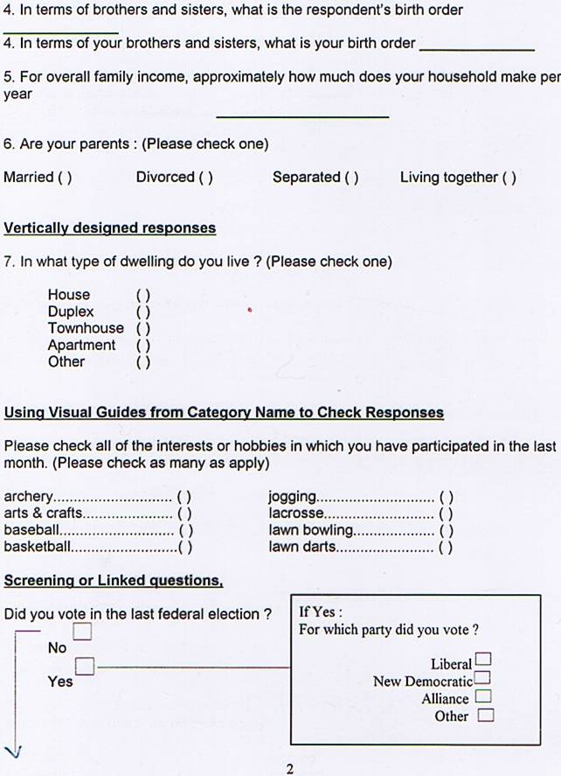

Slide 15
Index versus Scales
Index : is a composite measure in which separate indicators of a phenomenon are combined to create a single measure.
  Use Yes and No
  Ask questions about Delinquent acts
  Use a 10 item list
    Has the person been truant from school in the last year
    Has the person shoplifted in the last year
    Has the person vandalized any property in the past year
  A score of 0 would mean no delinquent activity
  A score of 10 would mean a person chose “Yes” option to all 10 items
  Can have ordinal or interval ratio scales

Slide 16
Index versus Scales
Scale : is a multiple-item measuring device in which there is a built-in intensity structure, potency, or natural levels of feeling to the items that make up the scale.
Developing Indexes & Scales
Four Advantages over single item measures
  Improved Validity : multiple-item measure is more valid than a single item
  Improved Reliability : More items contained in a measure the more reliable
  Reduced Measurement Error : more items used to measure a variable the lower the error
  Increased level of measurement : Single item measures often produce data that are nominal, or possibility a order (ordinal)
CONSIDER USING EXISTING INDEXES…SAVES RELIABILITY ISSUES.

Slide 17
Index versus Scales
Developing multiple-item measures involves :
Developing or locating many potential items, far more than will appear in the final document
Eliminating items that are irrelevant, redundant, ambiguous, or for some reason inappropriate
Pre testing the remaining items for validity, reliability or other measurement issues
Eliminating items that do not pass # 3
Repeat steps 3 & 4 as necessary to reduce the index….

Slide 18
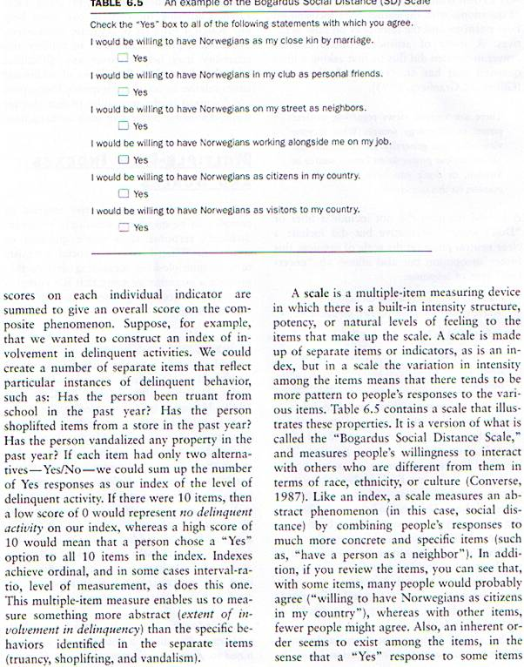
Below is an example of the Bogardus Social Distance Scale
It is the willingness of individuals to interact with others who are different from
Them in terms of race, ethnicity, or culture.

Slide 19
Likert Scales
Consists of a series of statements fro the respondent to express themselves about a statement….
Range from “Strongly Agree” to “Strongly Disagree”
  Intensity items built into the scale
  Can use “strongly approve” to “strongly disapprove”
  Can use “very satisfied” to “very dissatisfied”
Common number of alternatives is 5
  Higher the number of alternatives the more reliable and valid the results
Known also as a “summated rating scale” you sum the score.
Check the grammar, The exact wording of the response alternatives in a Likert Scale must be grammatically consistent with the wording in the statements….
Likert scales are ordinal, but the sum total can be treated as interval ratio.
  Gives broader range of statistics…

Slide 20
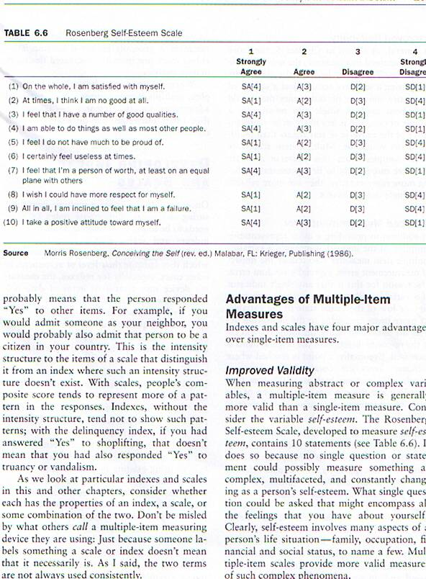
Rosenberg Self Esteem Scale
Self esteem involves a number of aspects of social life. Family,
occupation, financial, And social status. This form of scale allows
for access to complex phenomena.

Slide 21
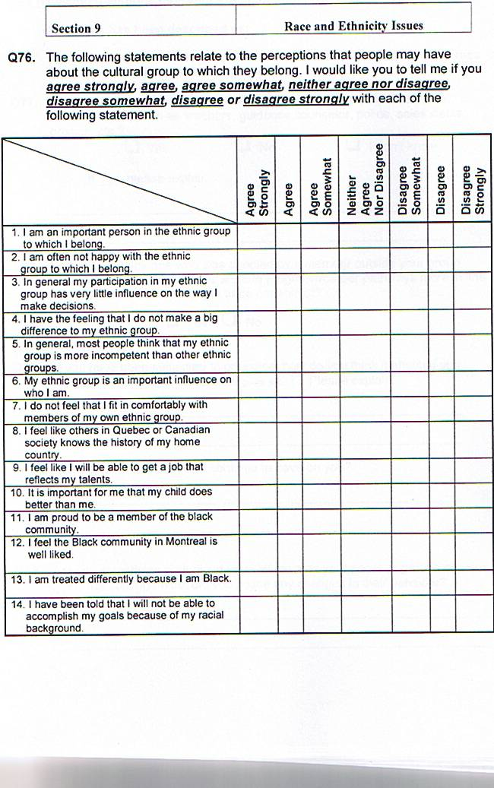

Slide 22
Scales for Question 76
Scale 1: private collective self-esteem
  Q2 + Q6 + Q10 + Q14
Scale 2 : public collective self-esteem
  Q3 + Q7 + Q11
Scale 3 : Membership esteem
  Q1 + Q5 + Q9 + Q13
Scale 4 : Importance of Identity
  Q4 + Q8 + Q12
Issue of code reverse……

Slide 23
Thurstone Scales
Uses equal appearing intervals…it is assumed that the distance between any two adjacent points on the scale are the same.
Allows justification for treating the data as interval-level…..
People can respond quicker to this scale, than a Likert
Thurstone Scale has to be longer

Slide 24
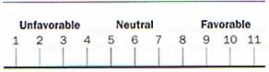
Example of Equal Appearing Intervals in Thurstone Scale

Slide 25
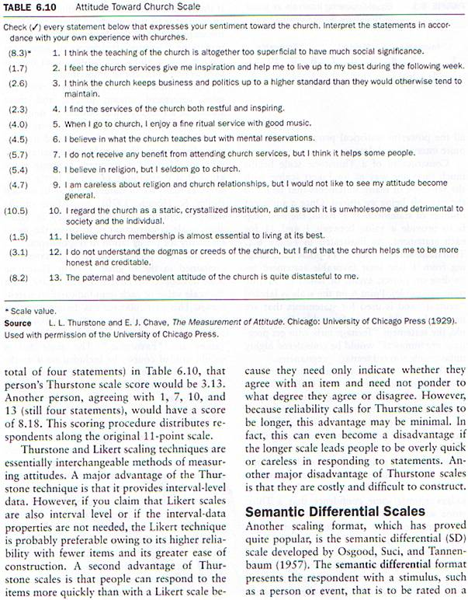
Example of Thurstone Scale of Attitude toward Church Scale
Used 13 of 45 questions on a 11 point scale.
If you add question results from 2, 4, 8 and 12 (1.7 + 2.3 + 5.4 + 3.1 = 12.5
12.5/4 = 3.13 Thurstone Score…

Slide 26
Semantic Differential Scales
Developed by Osgood, Suci and Tannenbaum.
It presents the respondent with a stimulus, such as a person or event to be rated on a scale between a series of polar opposite adjectives.
Scale has 7 points (use 10 or 11)
Alternate negative & positive responses, usually positive on left negative on the right….
Analyzed :
  Responses to the adjectives are studied to find if there is an underlying, more abstract aspects or factors…
  Adjectives are assumed to be indicators of underlying attitudes or factors
  Can use Factor Analysis excluded
Cross correlation of any 4 to 8 adjective pairs for each dimension to reach .80 or better
Easy to construct

Slide 27
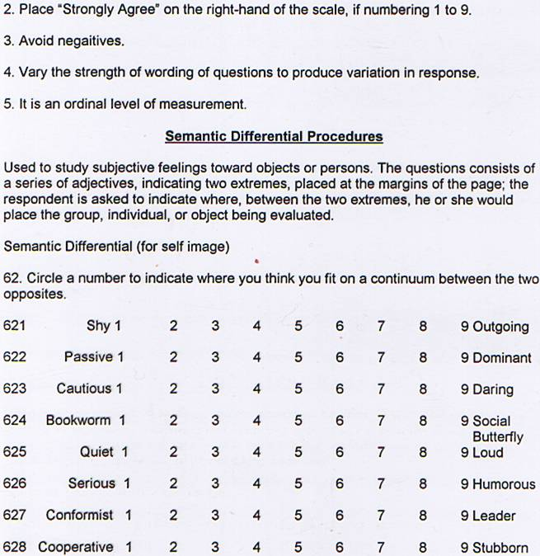
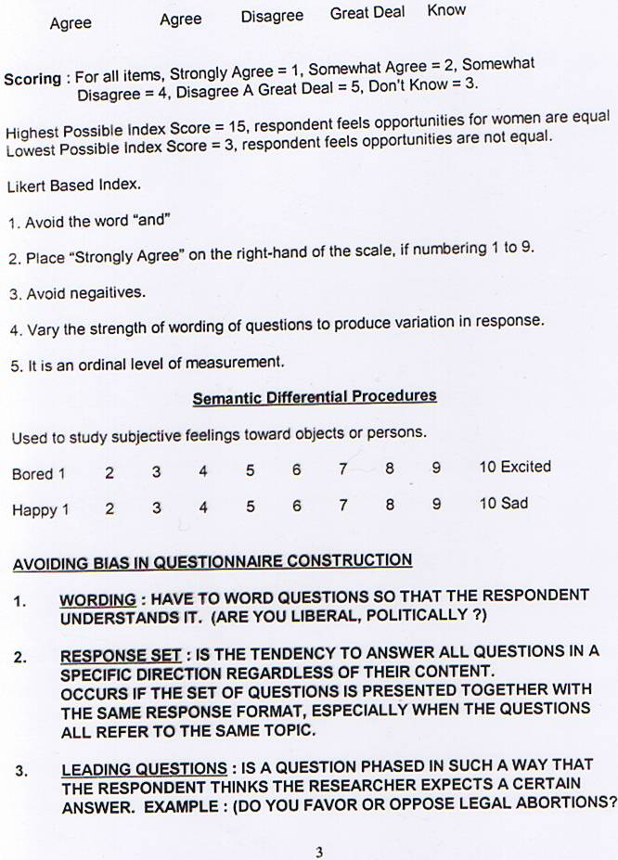

Slide 28
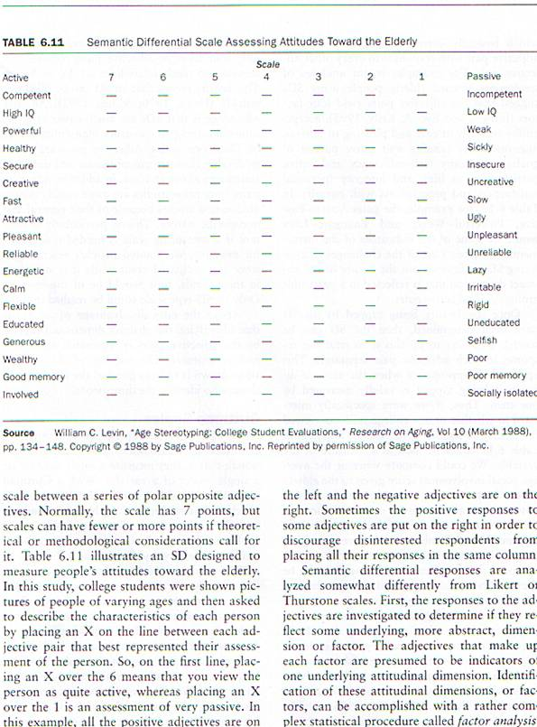
Assessing Attitudes toward the Elderly
Semantic Differential Scale

Slide 29
Guttman Scale
Logic is that some items under consideration can be more extreme indicators of the variable than others…
Anyone who gives a strong indicator of some variable will also give the weaker indicators.
Questions range from least serious to most serious or from harder items to easier items.
  This means that most people are likely to agree with them, hard means that fewer are likely to agree
All questions have to be dichotomized into yes and no/ or agree and disagree.
Sort questions by yes and no
Draw a scale response line, which is the point where the minimal number of errors will occur.
Error pattern is based on when an individual responded “yes” to an item that was harder than another item to which that person had responded “no”
Hierarchical relationship measurement
Logic is that someone will say “yes” to all responses and someone will say “no” to all responses.

Slide 30
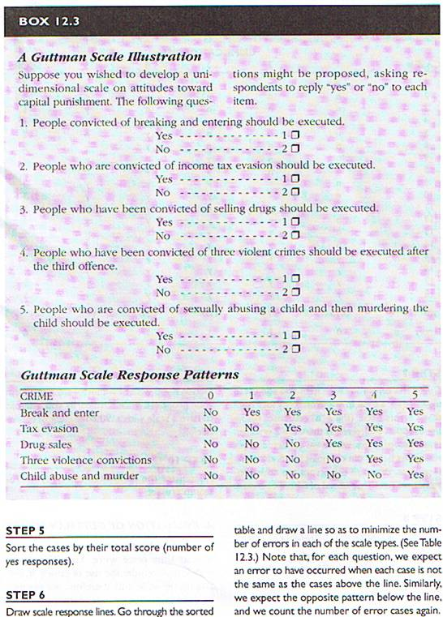
Guttman Scale toward Capital Punishment

Slide 31
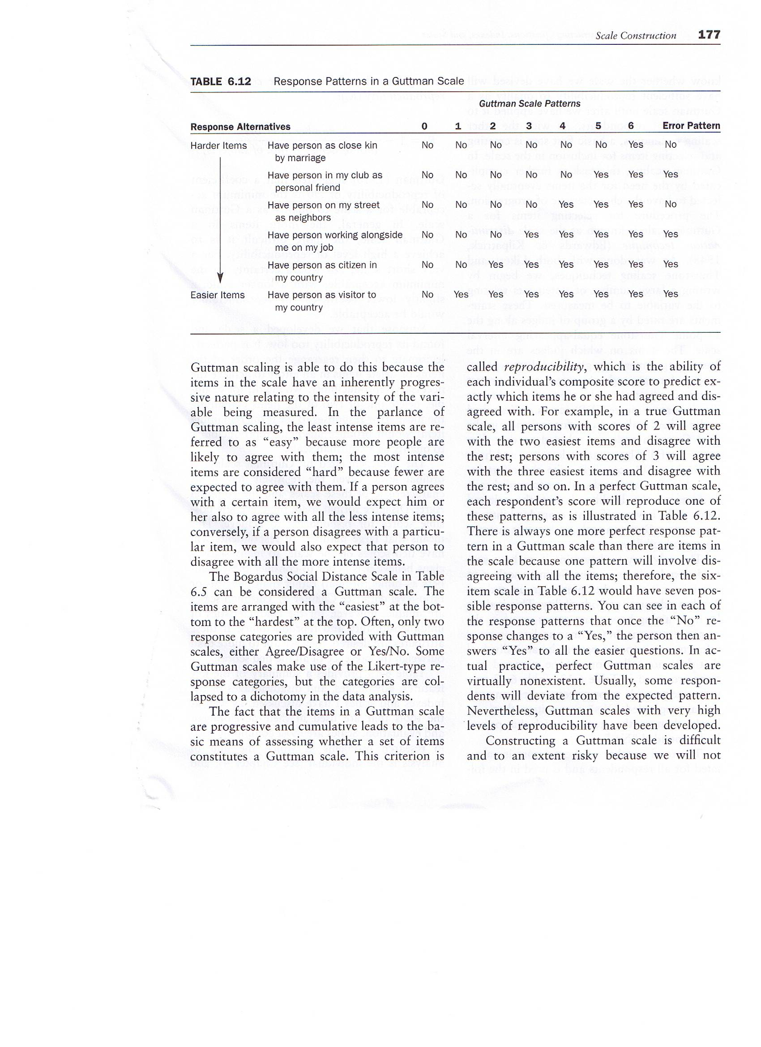
Bogardus Social Distance Scale

Slide 32
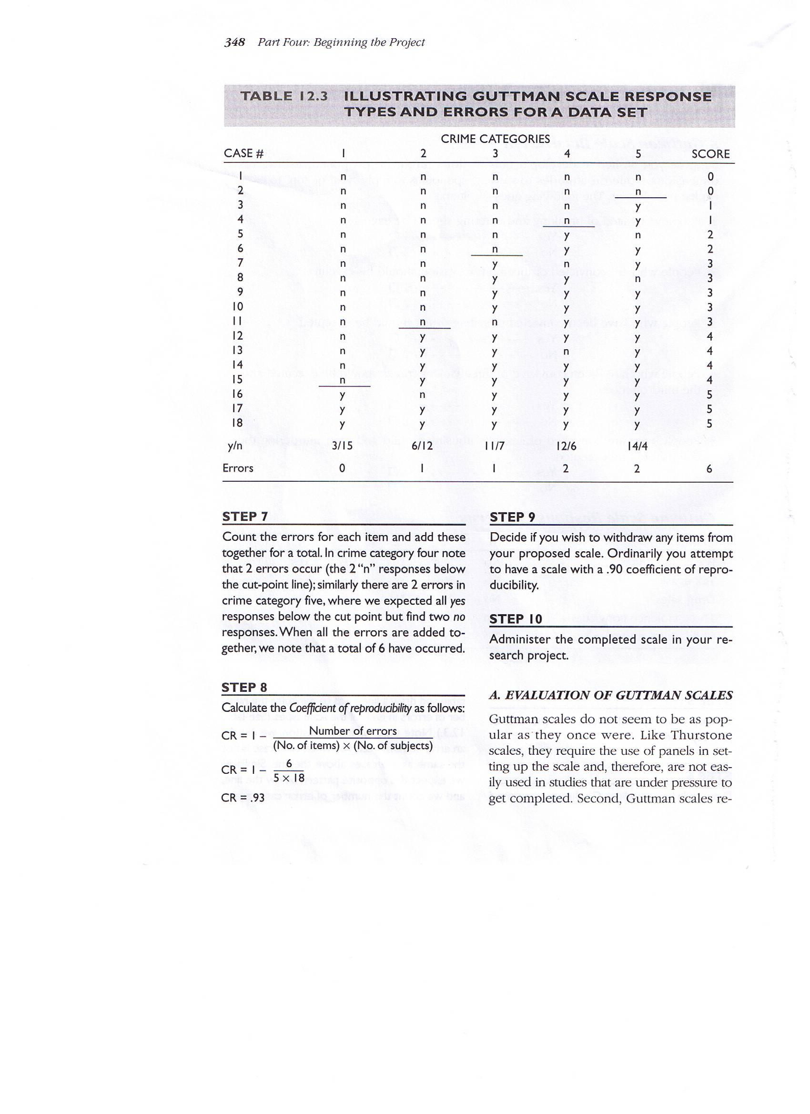
Guttman Scale response Types and Errors for a Data Set
Calculate the Coefficient of reproducibility
CR = 1 – Number or Errors _____
(no of items) x (no. of subjects)
CR = 1 - _6___ = .93
5 x 18

Slide 33
Ranking
Used when the degree of importance or priorities people give to a set of attitudes or objects.
Provides a sense of order
Useful for understanding “quality of life” or status which cannot be given precise numerical values.
Ordinal level of measurement….

Slide 34
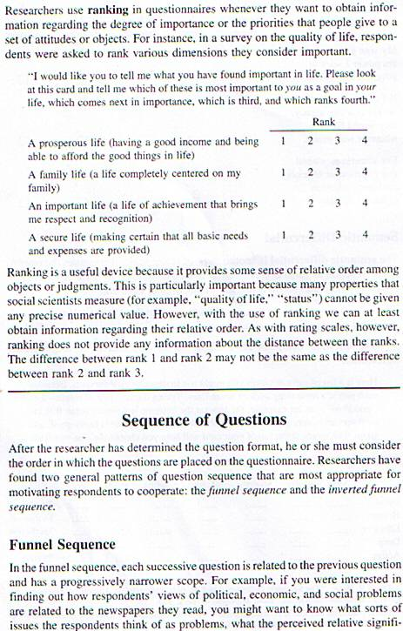
Example of Ranking

Slide 35
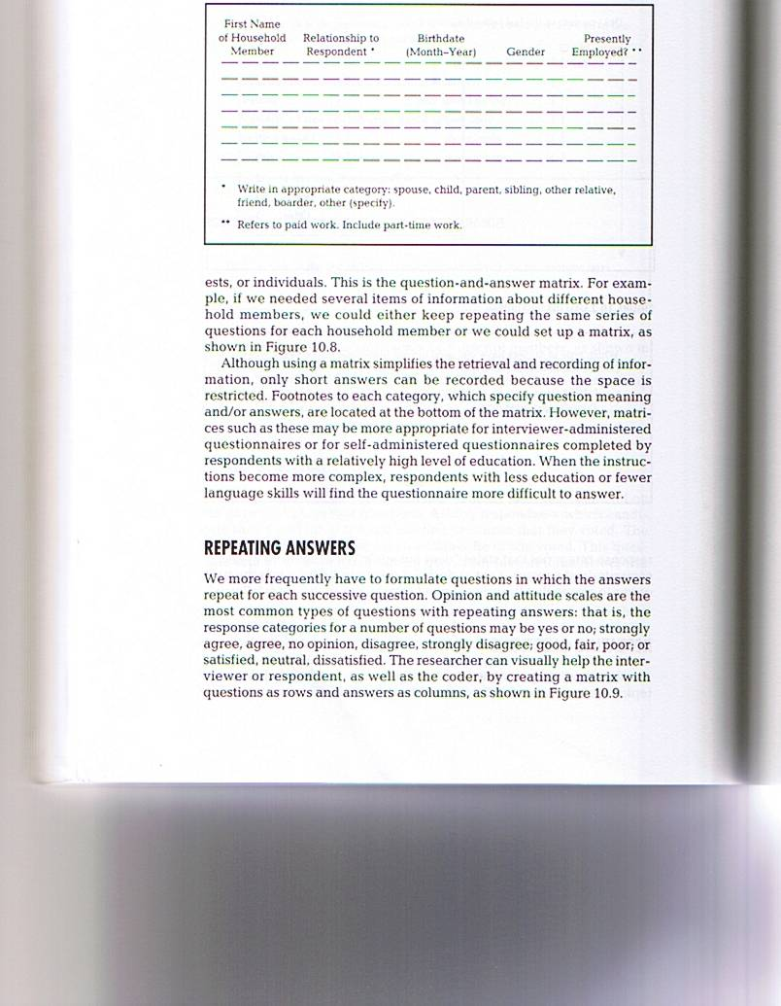
Identifies several items of information about different household members,

Slide 36
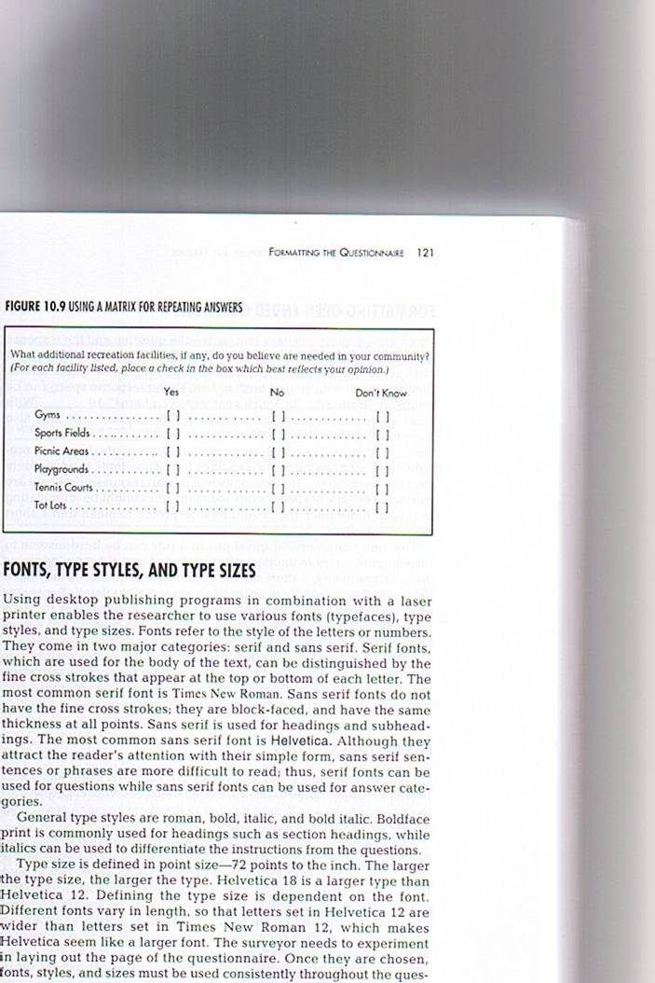
Creating a matrix for attitude and opinion scales

Slide 37
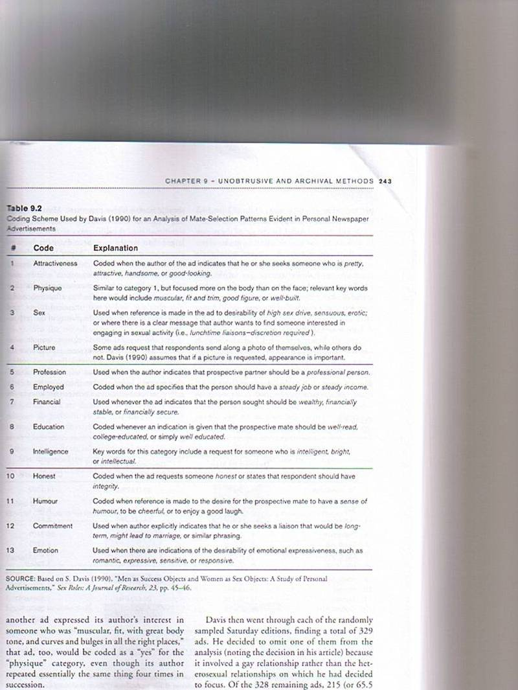

Slide 38
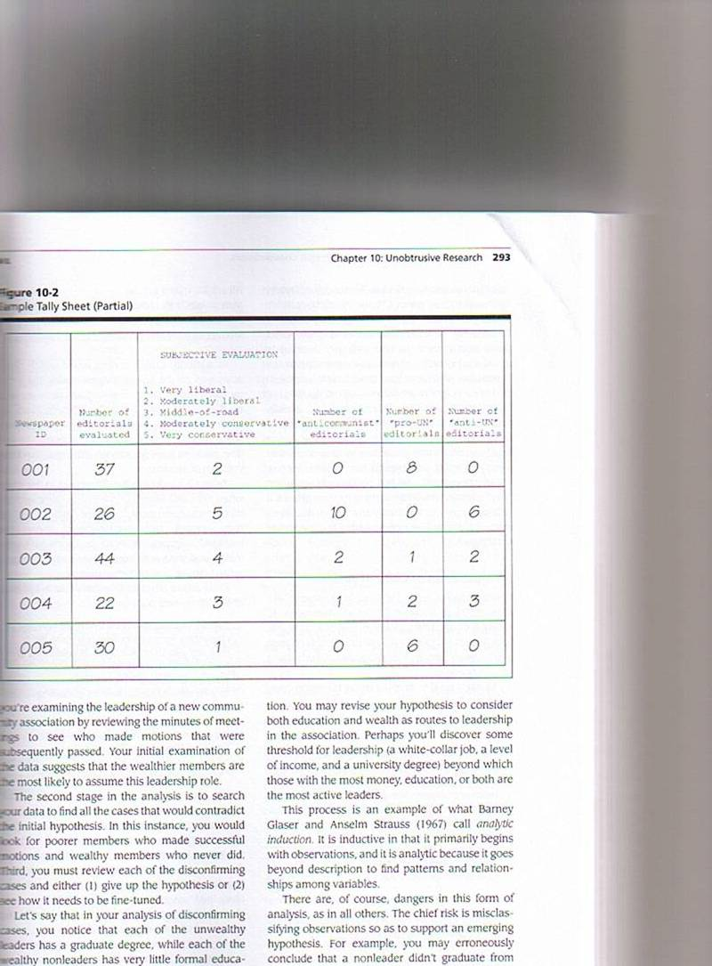

Slide 39
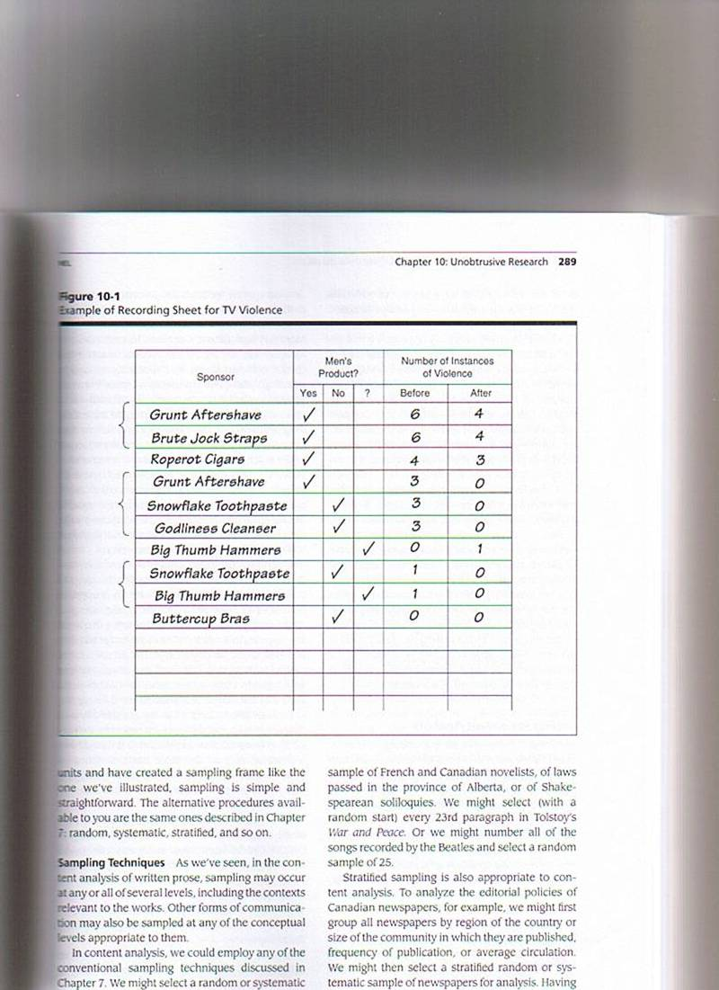

Slide 40
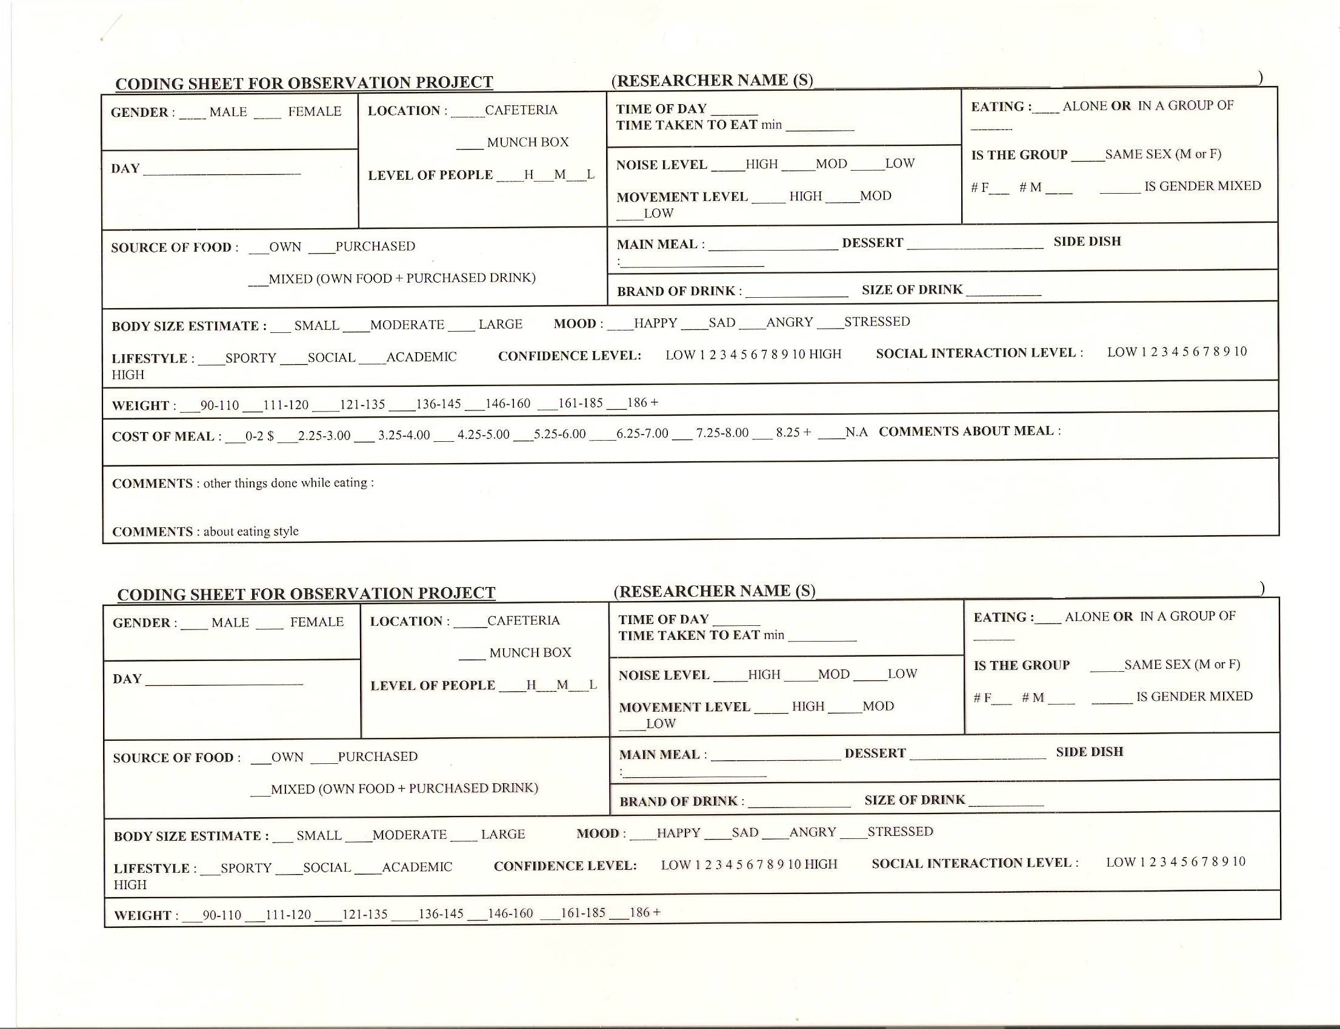

Slide 41
Looking for Data
Data can take any form, it exists through the decision of the researcher..
Historical-comparative data tends to be available data; data that was accumulated or collected for reasons other than the research purpose…
Secondary Data Analysis is the re analysis of data collected for some other research project…
Physical Traces : are physical objects or evidence that result from people’s activities that can be used as data to test hypothesis
  Erosion Measures :
Accretion Measures : are those involving materials that are deposited or accumulated because of human activity. “Garbology”
Meta Analysis : use of inferential statistics to analyze and draw conclusions about other researchers’ statistical analysis.
  Most useful when one wants to synthesize previous studies in statistical form

Slide 42
Content Analysis
Requires two approaches for written material:
  Specification of the characteristics of the content that you want to measure
  Application of the rules : a researcher must use for identifying and recording the characteristics appearing in the texts to be analyzed.
Recording Unit : is the smallest body of content that may be examined when characterizing a recording unit.
Context Unit : largest body of content that may be examined when characterizing a recording unit.
Example : a recording unit could be a single word or expression, but you have to consider the entire sentence (context unit)

Slide 43
Content Analysis
A time space system : based on measures of space (column size in terms of length, number of words) or units of time (minutes used for a news item on radio, or T.V.) to describe the relative emphases of different categories in the analyzed material

Slide 44
Content Analysis
Is any technique for making inferences by systematically of objectively identifying specified characteristics of messages.
An Appearance System : in which coders search the material for appearances of certain attributes.
A Frequency System : in which every occurrence of a given attribute is recorded
An Intensity system : utilized in studies dealing with attitudes and values

Slide 45
Content Analysis
For written forms it consists of
  Words or terms, themes, characters, paragraphs and items.
Item is the whole unit the producer or designer utilizes for a message. The item could be an entire book, an article, a speech …etc.

Slide 46
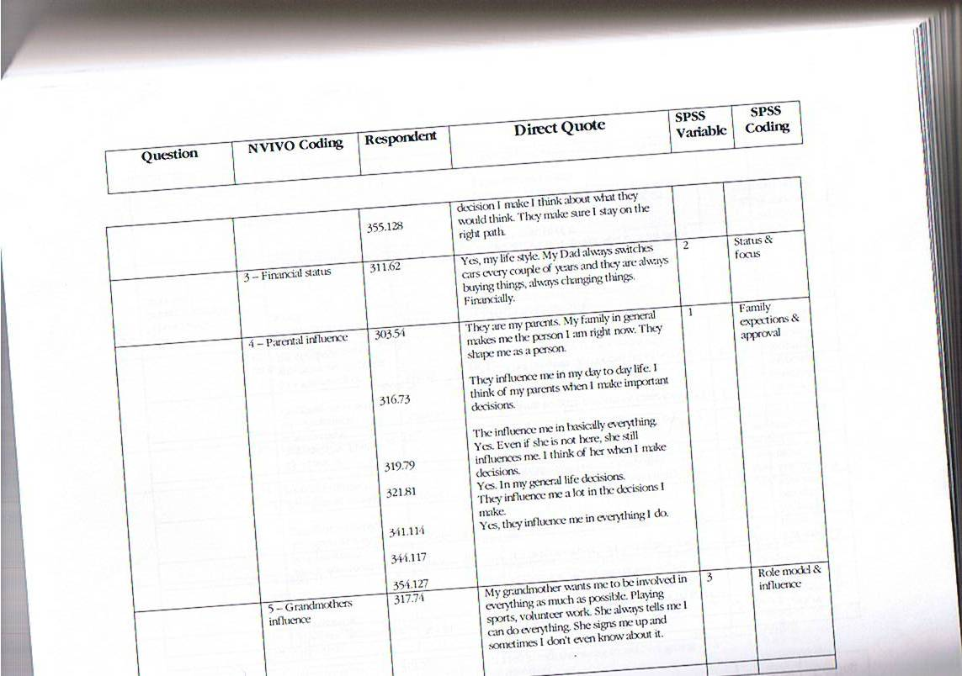
Is your family influencing you in any other way?

Slide 47
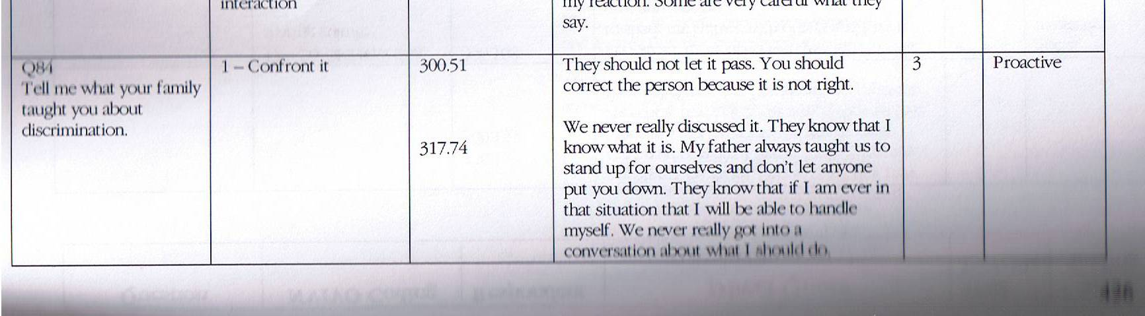

Slide 48
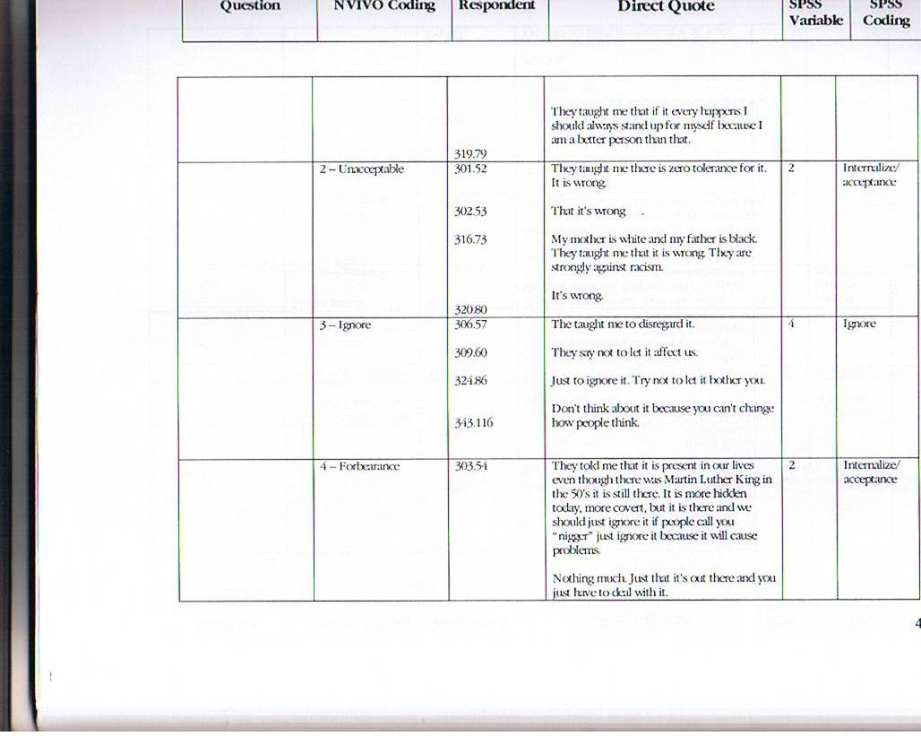

Slide 49
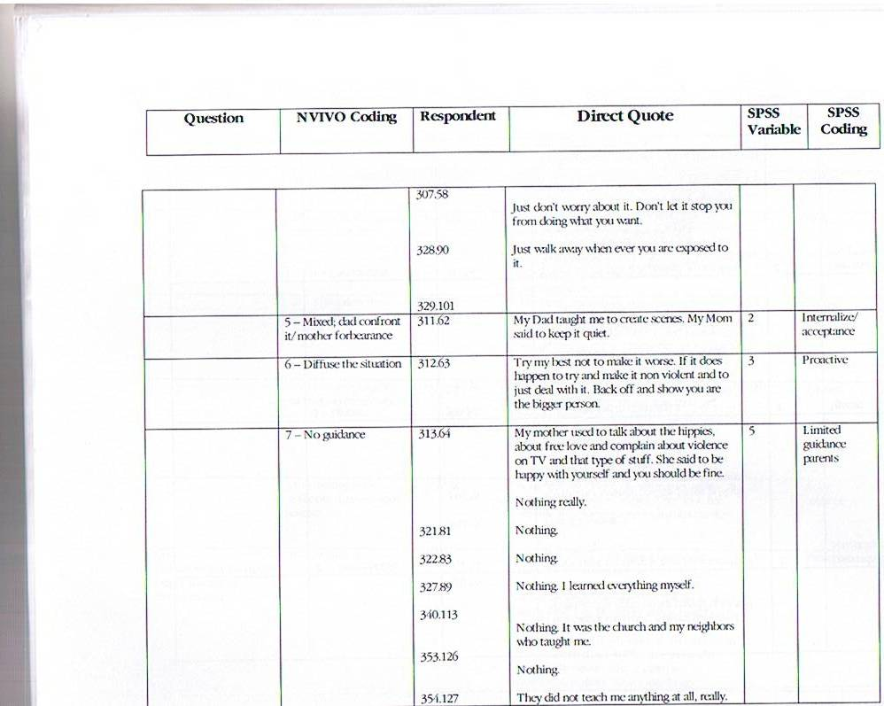

Slide 50
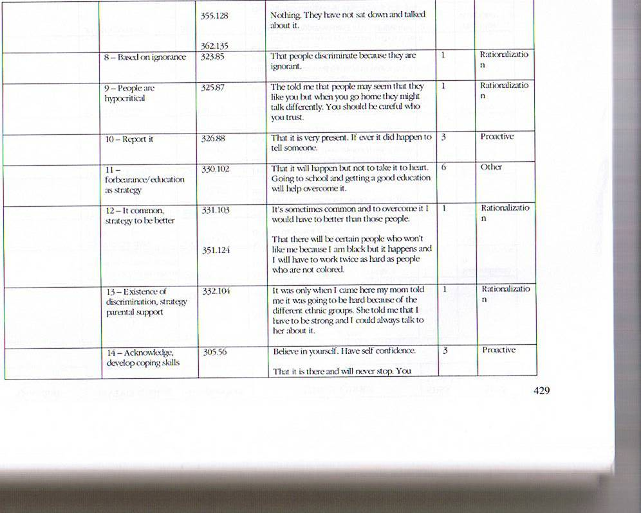

Slide 51
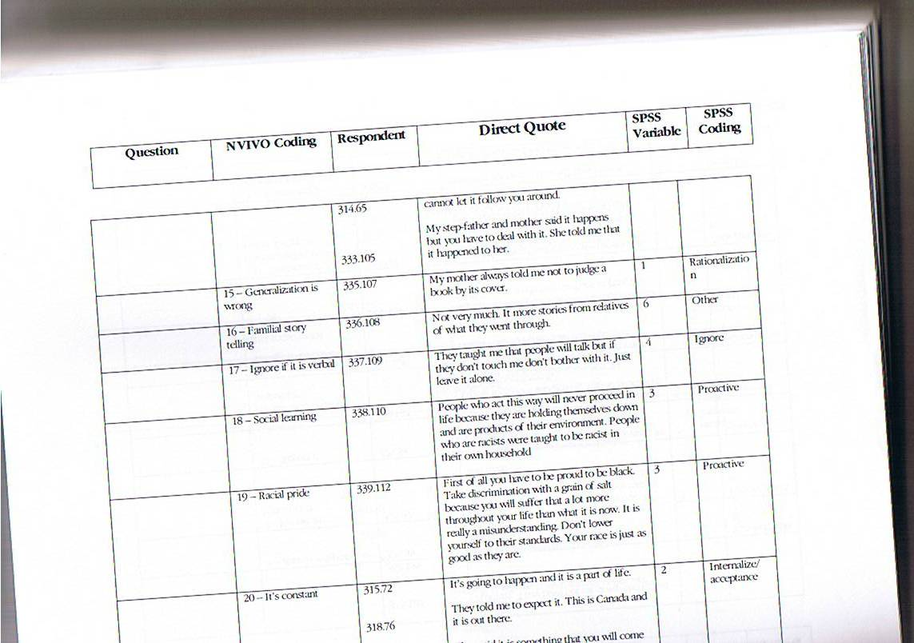

Slide 52
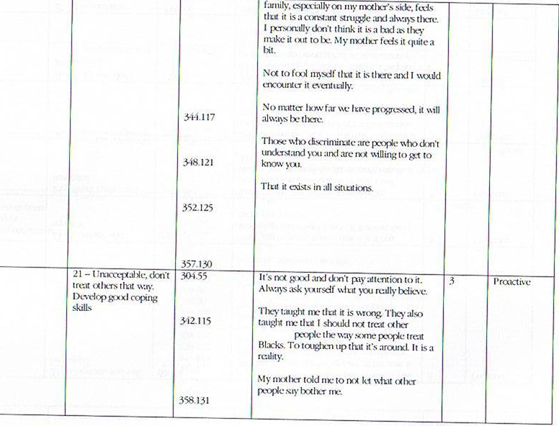

Slide 53
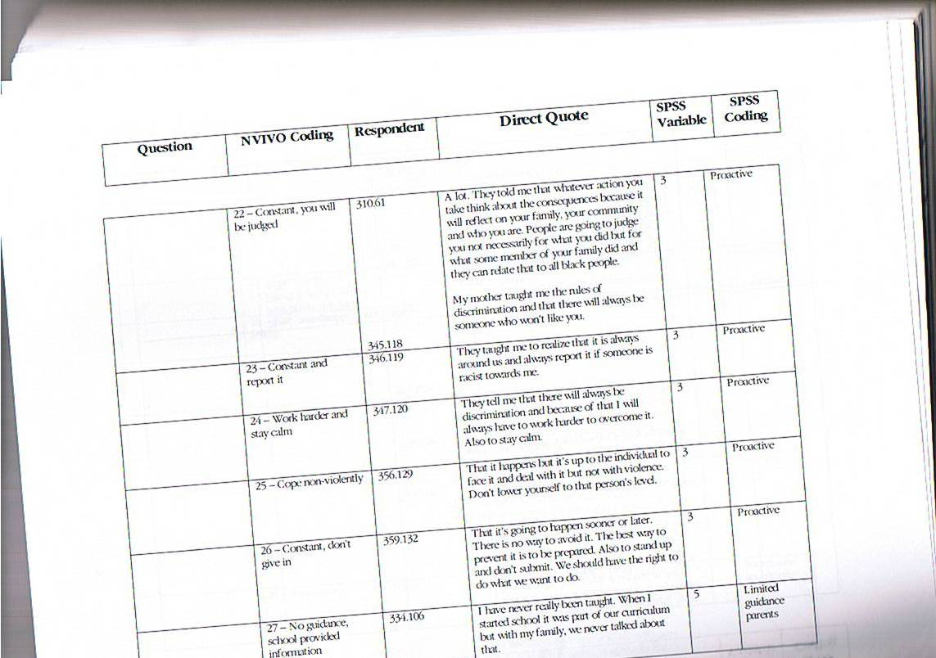

Slide 54
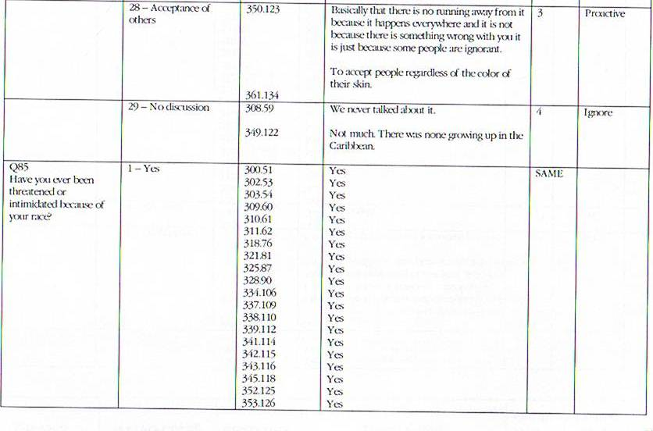

Slide 55
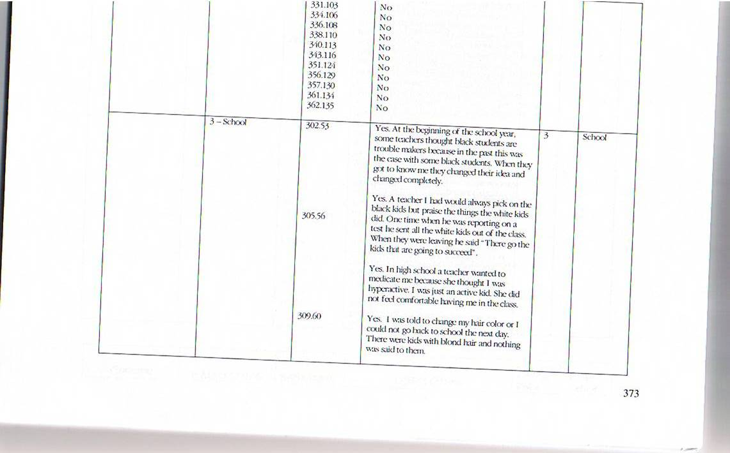
Have you ever had the feeling that you experienced prejudice by an authority figure
Such as teachers, guidance counsellors, police, sales clerks, bosses.,,etc ? Yes
please Explain.

Slide 56


