Slide 1
We’ll approach this poem in four steps:
1. What is “Ode on a Grecian Urn” about? That is, what sort of an object is he talking about? What do Grecian urns look like?
2. Any other basic problems of vocabulary or cultural references that are puzzling. Did you spot the typo?
3. What is an ode and what kind of an ode is this? The genre, the Romantic lyric or meditative Romantic lyric. How does it work? Why did it annoy some people? This approach may help us look for a certain pattern in the poem, like a dramatic arc.
4. Finally, we will consider two other poems that either rework “Ode on a Grecian Urn” or explore somewhat analogous themes. (Deciding exactly what those themes are is the key to this exercise.)

Slide 2
A Grecian Urn, like the Sosibios vase in the Louvre (ca. 200 B.C.)
Keats saw prints of the vase and copied one of them.

Slide 3
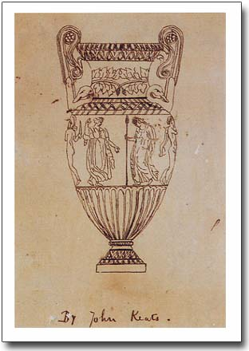
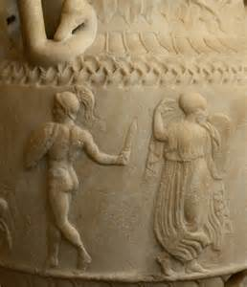
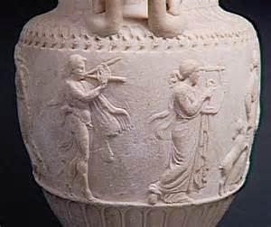

Slide 4
Keats also saw the Elgin marbles (ca. 500 B.C., taken by Lord Elgin in 1801) in the British Museum
.

Slide 5
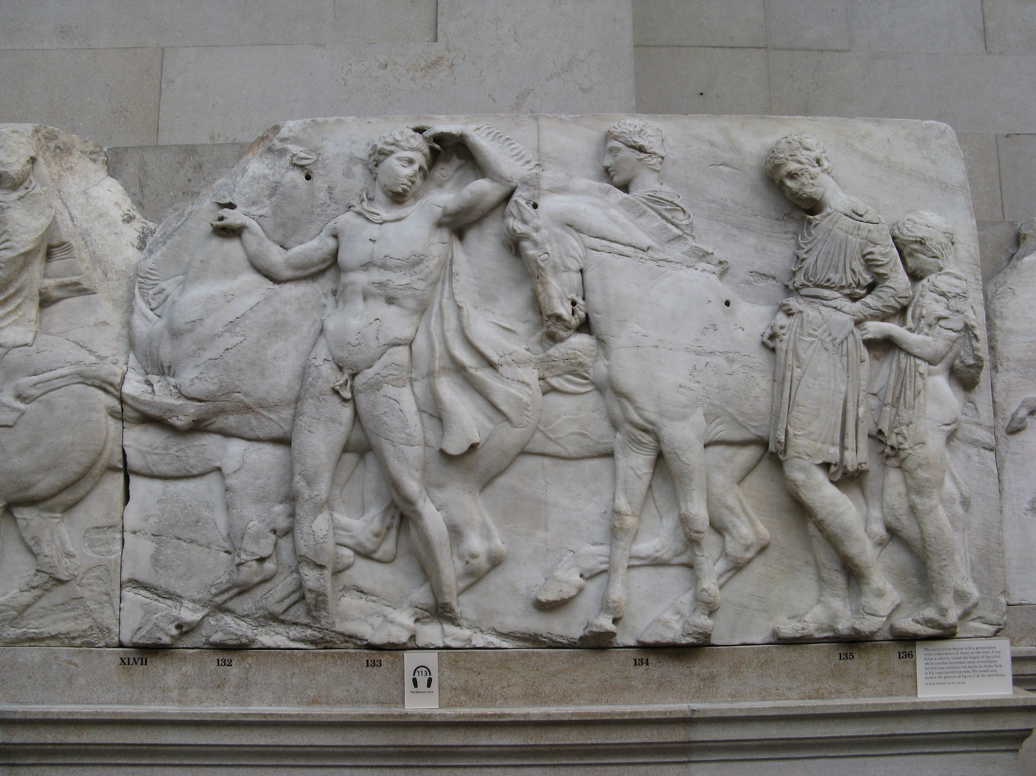

Slide 6
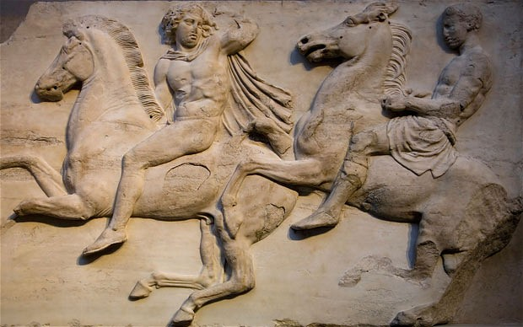

Slide 7
Keats also drew on other scenes on vases, such as those involving sacrifices of an ox or heifer, men and women dancing to pips and tambourine, or a God or satyr pursuing a maiden
.

Slide 8
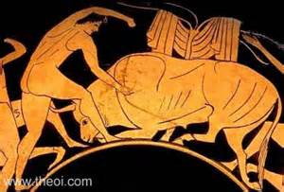
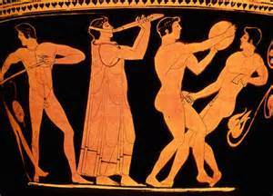

Slide 9
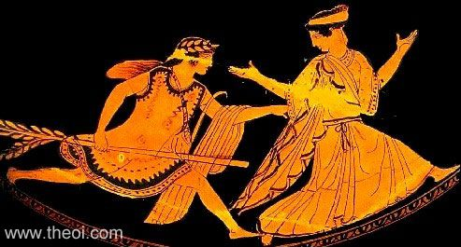
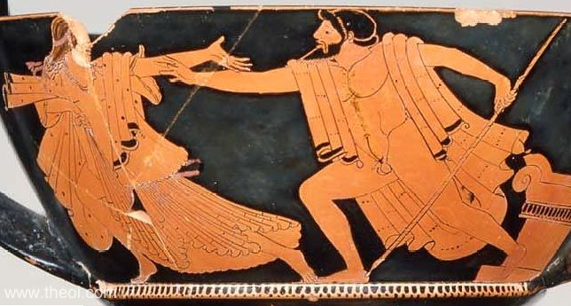

Slide 10
What are the common elements in these scenes?

Slide 11
Common elements in these scenes
Rapid motion (dancing, running)
Music or noise, loud and soft (``pipes and timbrels,`` ``soft pipes``
Violence threatened but never completed
None of them are quite as elaborate as the scenes that Keats describes. He has created a super-urn.

Slide 12
2. Ode on a Grecian Urn
Are there any words or phrases you don’t understand?

Slide 13
Ode on a Grecian Urn
unravish`d Attic
Sylvan overwrought
Tempe brede
Arcady Cold Pastoral
timbrels
ditties
melodist

Slide 14
unravish`d
Sylvan of the woods, rural
Tempe pleasant valley in northern Greece favoured by the Gods, especially Apollo; near Olympus, home of the Gods
Arcady isolated area in southern Greece known for its simple pastoral life and celebrated by Vergil; idyllic land
timbrels tambourine
ditties songs
melodist composer of songs

Slide 15
Attic or Attica, area around Athens; name given to early classical Greek
overwrought worked over, decorated
brede decorative braid work, decorative band
Pastoral a work of literature displaying an idealized form of rural life, the life of shepherds, free form the corruption and ambition of the city or the court

Slide 16
Reversals of normal word order
``All breathing human passion far aboveʺ means
``Far above all breathing human passionʺ

Slide 17
3. What is an ode?
Odes were originally formal songs of praise for athletes and most odes are songs of praise to something
``A long lyric poem that is serious in subject, elevated in style, and elaborate in its stanzaic structure.ʺ Abrams, Glossary of Literary Terms
``lyric poem usually marked by exaltation of feeling and style, varying length of line, and complexity of stanza formsʺ Webster`s Dictionary

Slide 18
W. H. Abrams ``Greater Romantic Lyric``
They present a determinate speaker in a particularized, and usually localized, outdoor setting, whom we overhear as he carries on, in a fluent vernacular which rises easily to a more formal speech, a sustained colloquy, sometimes with himself or with the outer scene, but more frequently with a silent human auditor, present or absent. The speaker begins with a description of the landscape; an aspect or change of aspect in the landscape evokes a varied but integral process of memory, thought, anticipation, and feeling which remains closely intervolved with the outer scene. In the course of this meditation the lyric speaker achieves an insight, faces up to a tragic loss, comes to a moral decision, or resolves an emotional problem. Often the poem rounds upon itself to end where it began, at the outer scene, but with an altered mood and deepened understanding which is the result of the intervening meditation. . . .
(“Structure and Style in the Greater Romantic Lyric”, 1965, 76-77)

Slide 19
Critical reaction was often hostile to this exploration of the poet`s emotional state
Mr Keats, seemingly, can think or write of scarcely anything else than the 'happy pieties' of Paganism. A Grecian Urn throws him into an ecstasy: its 'silent form,' he says, 'doth tease us out of thought as doth Eternity,'—a very happy description of the bewildering effect which such subjects have at least had upon his own mind; and his fancy having thus got the better of his reason, we are the less surprised at the oracle which the Urn is made to utter:
'Beauty is truth, truth beauty,'—that is all
Ye know on earth, and all ye need to know.
That is, all that Mr Keats knows or cares to know. But till he knows much more than this, he will never write verses fit to live.
Josiah Conder, Eclectic Review September 1820

Slide 20
Can we trace the development of the poem using the stages suggested by Abrams?
Where does Keats allude to his own situation?

Slide 21
Stanza III
All breathing human passion far above,
That leaves a heart high-sorrowful and cloy`d,
A burning forehead and a parching tongue.`

Slide 22
Is the final resolution, with its claim that truth and beauty are the same, meaningless or trite?

Slide 23
4. Many poets have reworked the ʺOde on a Grecian Urn.ʺ Stevens is but one example.
How can we justify the claim that “Anecdote of the jar” reworks “Ode on a Grecian Urn”?

Slide 24
Points in common and differences
Both are about the power of art to impose order or control (the jar “took dominion everywhere”)
A vase depicting scenes from classical antiquity becomes a jar in the wilderness
Crucial point: the jar represents something (e.g. art, or artifice, or American art, or masculinist art, or, in each case, art but especially poetry).
Whatever the jar represents is opposed to “the wilderness,” whatever that represents

Slide 25
Some key points made by Frank Lentricchia in Ariel and the Police about “Anecdote of a Jar”
It’s an anecdote about the jar
It does not “centrally involve the human actor who places the jar”
“It has to do with the jar’s ideal form, its jarness not its thisness”
There is a tension that runs along gender lines
The jar becomes the agent
Nature is slovenly, and the unusual word is stressed by metrical substitution
But, maybe Stevens lets nature get “the last word in by characterizing the autonomous jar of art, at the end of the poem, as an absence of nature. Nature: maternal, creative, pliant: the jar: a receptacle that doesn't receive and from which nothing emerges—inflexible, hard, and possessed by a classic case of womb envy. “it did not give of bird or bush/ Like nothing else in Tennessee.”

Slide 26
Can we compare “Aunt Jennifer’s Tigers” to either Keats’s Ode to a Grecian Urn or Stevens “Anecdote of the Jar”?
Again, the poem is based on an opposition, this time Aunt Jennifer to the tigers on the screen (a cloth fire screen, which she, or some other woman, would have decorated with needlepoint).
Begin by describing both. What are the most telling words?
What do the tigers on the screen represent? (It is not quite the same thing as either the jar or the urn).
What does Aunt Jennifer “represent”?
Here, as with Godot or any of the characters in Waiting for Godot we need to be careful in our wording.

Slide 27
“X represents” can seem heavy-handed and reductive. You would never catch Beckett admitting that one of his character simply represented something.
The formula x is … (with variations) works better
Olivia is not neurotic, but her obsession with death is a psychological barrier she must overcome.
Vladimir and Estragon are, like Feste, outside society, but they lack his moral authority and are in no positon to criticise social mores, as he does.
Aunt Jennifer is “terrified,” whether by life in general or her husband or both.

