Slide 1
Lecture 6: Poems of Mourning and Veneration
Question for Wednesday, May 25: In what ways could we see Komunyakaa’s “Slam, Dunk, and Hook” as a reworking of Hopkins’ “The Windhover”?
Send me a one sentence answer by 9:00 am on Wednesday
Today we will look at Roethke’s “Elegy for Jane”; the Old English “The Wanderer”, Donne’s “Batter My Heart”, and Hopkin’s “The Windhover.” We probably will not get to Oliver’s “The Singular and Cheerful Life”

Slide 2
Theodore Roethke (1908-1963) reads Elegy for Jane
http://www.bing.com/videos/search?q=Theodore+Roethke+Elegy+for+Jane&Form=VQFRVP

Slide 3
Old English poetry The Wanderer
Preserved in the Exeter Book, a manuscript that belongs to Exeter Cathedral, copied by a monk in the 10th century
Reflects a combination of Germanic war band values (those of the comitatus) and Christian values
England was a Celtic country until it was invaded by Germanic tribes, Angles and Saxons, in the 6th century A.D. The Celts were pushed to the margins. The Anglo-Saxons converted to Christianity in the following centuries. Religious life centred on monasteries.

Slide 4
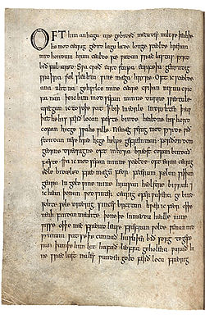

Slide 5
Tacitus, Roman historian, 1st century A.D. Germania, chapter 14.
The comitatus or war band: loyalty to leader, bound by treasure-giving
In the day of battle, it is scandalous to the Prince to be surpassed in feats of bravery, scandalous to his followers to fail in matching the bravery of the Prince. But it is infamy during life, and indelible reproach, to return alive from a battle where their Prince was slain. To preserve their Prince, to defend him, and to ascribe to his glory all their own valorous deeds, is the sum and most sacred part of their oath. The Princes fight for victory; for the Prince his followers fight. Many of the young nobility, when their own community comes to languish in its vigour by long peace and inactivity, betake themselves through impatience to other States which then prove to be in war.

Slide 6
For, besides that this people cannot brook repose, besides that by perilous adventures they more quickly blazon their fame, they cannot otherwise than by violence and war support their huge train of retainers. For from the liberality of their Prince, they demand and enjoy that war-horse of theirs, with that victorious javelin dyed in the blood of their enemies. In the place of pay, they are supplied with a daily table and repasts; though grossly prepared, yet very profuse. For maintaining such liberality and munificence, a fund is furnished by continual wars and plunder. Nor could you so easily persuade them to cultivate the ground, or to await the return of the seasons and produce of the year, as to provoke the foe and to risk wounds and death: since stupid and spiritless they account it, to acquire by their sweat what they can gain by their blood.

Slide 7
Of him anhaga Often him the solitary one
Are gebideth For mercy waits
Metudes miltse, The Measurer’s mildness
Theah the he modcearig Although he, mind-troubled
Geond lagulade Beyond the sea
Longe sceolde For a long time must
Hreran mid hondum, Move by hand (row)
Hrimcealde sae The rim-cold sea
Wadan wraeclastas Tread exile paths.
Wyrd byth ful araed. Fate is fully fixed.

Slide 8
Key terms:
Parataxis (paratactic structure) Short phrases piled up without subordination
Hypotaxis (hypotactic structure) Clauses are linked together into long and complex sentences, with logical links and subordination (one idea depends upon an other)

Slide 9
Key terms:
Sprung rhythm * A line with a majority of stressed syllables
* composing as if the spondee were the basic unit
* draws on Old English poetry
Examples
Lashed rod (example Hopkins gives)
One, two,
Buckle my shoe
March dust, April showers
Bring forth May flowers
(both lines, according to Paul Fussell, if you take showers and flowers as monosyllables)
Paul Fussell, Poetic Meter and Poetic Form

Slide 10
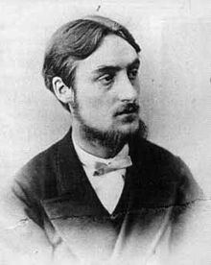
Gerald Manley Hopkins (1844-1899)
Professor of Classics, Victorian poet, Jesuit
* Drew on Old English for his poetic form (sprung rhythm

