Slide 1
English 1121PA: Lecture IV
The Power of Imagery and Allusion
(with tips on how to write an essay in literary criticism!)

Slide 2
Today’s texts:
Briefly, the power of punctuation (Yay!) in e.e cummings’ “[the Cambridge ladies who live in furnished souls]” (1922) and Ted Hughes’ “The Horses” (1957).
Then: “The Death of the Ball-Turret Gunner,” “The Grauballe Man,” “Marked with D.”, “A Green Crab’s Shell,” and “The Paper Nautilus.”
*** We will use “The Paper Nautilus” to reassure you all that there IS a discernable, and learnable, method to crafting an essay in literary criticism!***

Slide 3
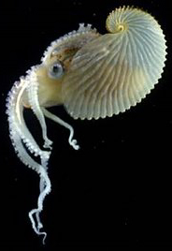
The paper nautilus! (a pelagic (open-sea) octopus)

Slide 4
My fairly polished, but still “working,” thesis:
“The power of Marianne Moore’s poem “The Paper Nautilus” lies significantly in its complex interweaving of natural imagery with (mostly) classical allusion. What seems at first reading nothing more than a rather convoluted description of the maternal habits of the pelagic octopus, emerges as a poignant meditation, through a series of echoing paradoxes, on the force of aggression (?)---and the very different strength of love.”

Slide 5
A note about imagery
Imagery = all the vivid details that make a poem concrete rather than abstract.
Imagery works to build a vivid image in our mind’s eye. . . That is, an image that incorporates other senses.
“ . . . .The Cambridge ladies do not care, above
Cambridge if sometimes in its box of
sky lavender and cornerless, the
moon rattles like a fragment of angry candy.”

Slide 6
A note about allusions . . .
. . . which are passing references, without explicit identification, to a literary or historical person, place, or event, or to another literary work or passage.
“Batter my heart, three-personed God.” John Donne.
The problem: Allusions assume a common storehouse of knowledge. If such a storehouse is not shared, readers may fail to understand, and see, not wit / wisdom, but confusion.
So. You will sometimes need to do some research! ☺ But there are rewards to be had.

Slide 7
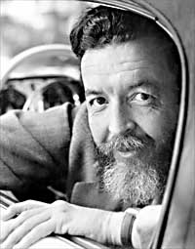
Randall Jarrell, (1914-1965). American poet, and during World War II, a “celestial navigation tower operator”

Slide 8
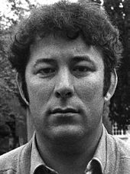
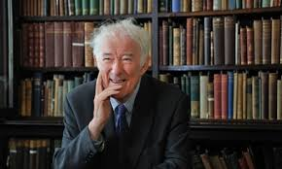
Seamus Heaney, 1939-2013. (Irish poet, Nobel Prize recipient, 1995)

Slide 9
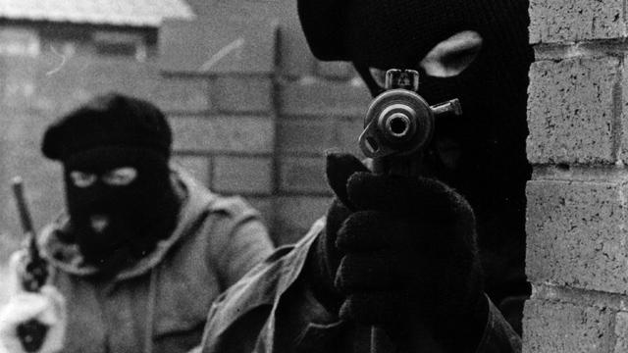
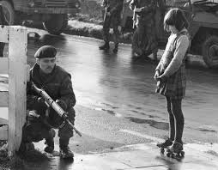
“The Troubles” in Northern Ireland (mostly): Guerrilla war-fare between Catholic and Irish paramilitaries: October 1968 – April 1998. 3500 killed (2000 civilians. 50,000+ maimed or injured).

Slide 10
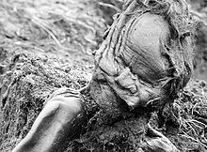
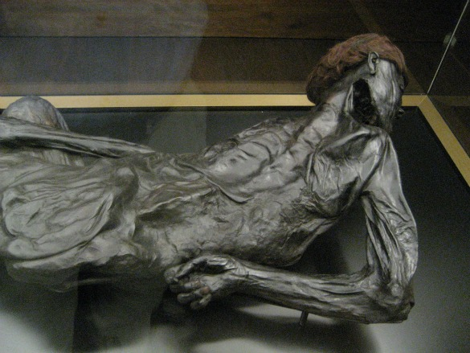
“The Grauballe Man” (died, probably as human sacrifice, around 300 B.C. E., about 30 years old. Exhumed from a Danish bog in 1952.)

Slide 11
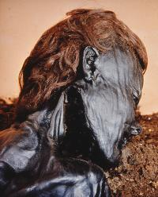
“The cured wound / opens inward to a dark / elderberry place.”

Slide 12
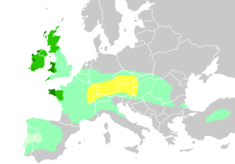
Range of the Celtic peoples (750 B.C.E to 1 C.E, the most powerful people in central and northern Europe. Defeated by the Romans.) .

Slide 13
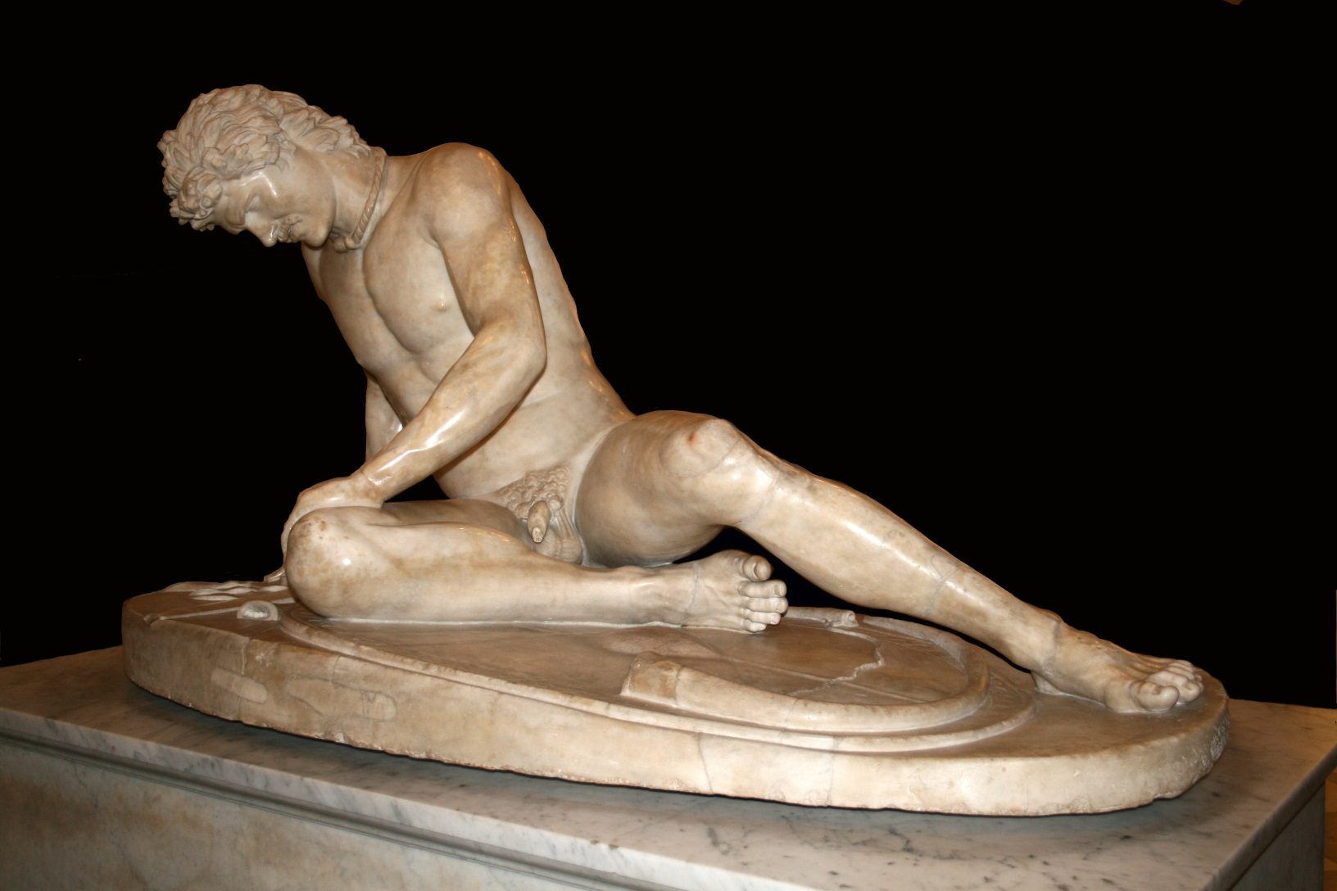
“The Dying Gaul” commissioned in late 3rd century B.C.E to celebrate defeat of Gauls in Anatolia. (Turkey)

Slide 14
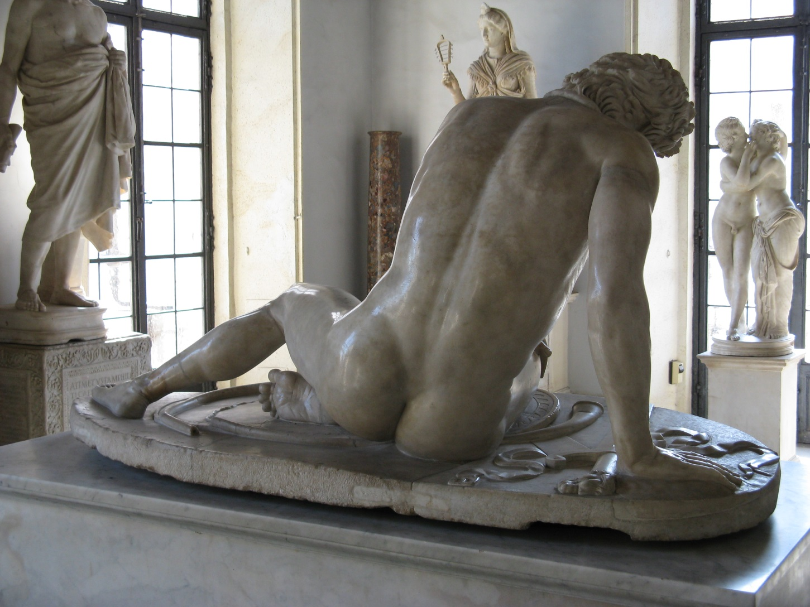

Slide 15
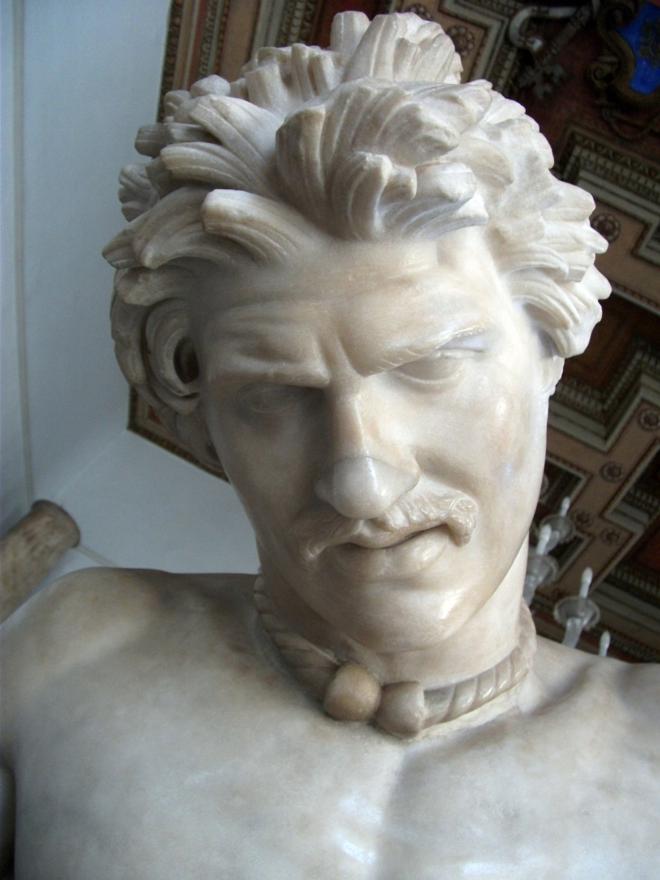

Slide 16
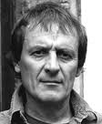
Tony Harrison, b. 1937

Slide 17
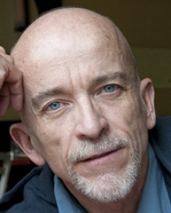
Mark Doty, b. 1953

Slide 18
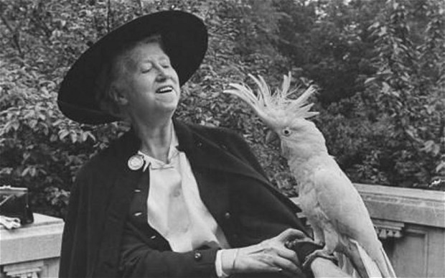
Marianne Moore

Slide 19
The Paper Nautilus (also known as the Argonaut)

Slide 20
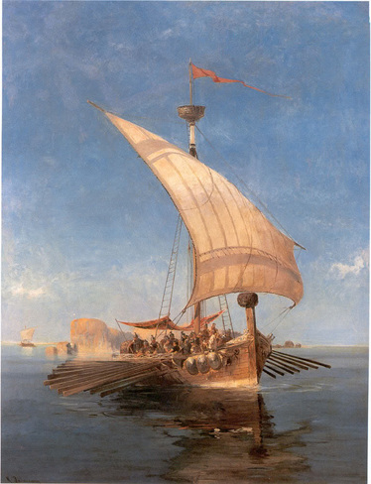
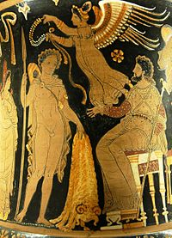
From the classical myth, Jason and the Argonauts and the Quest for the Golden Fleece
Jason’s ship: The Argo
The Golden Fleece: a symbol of authority and kingship.

Slide 21
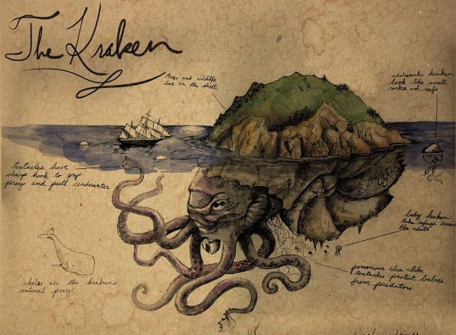
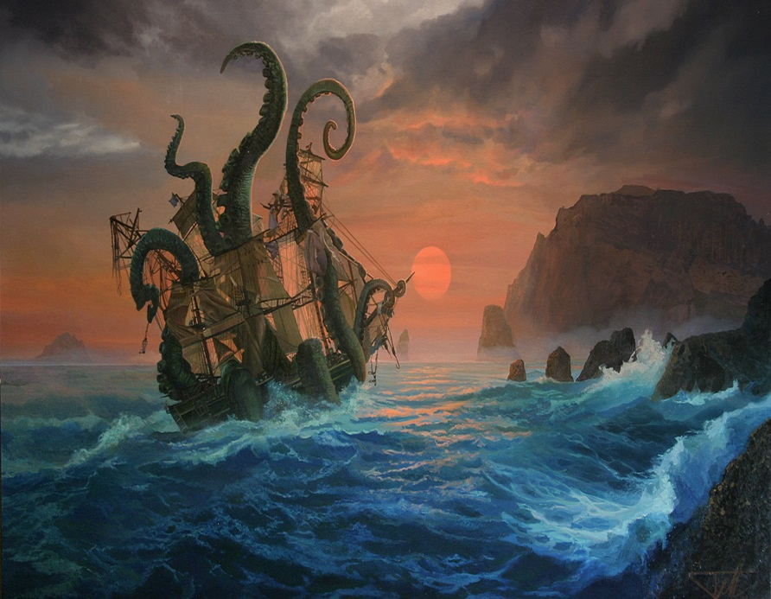
A Krakken (devil-fish)

Slide 22
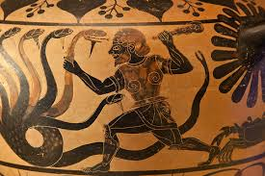
Hercules and the Hydra (and the crab).

Slide 23
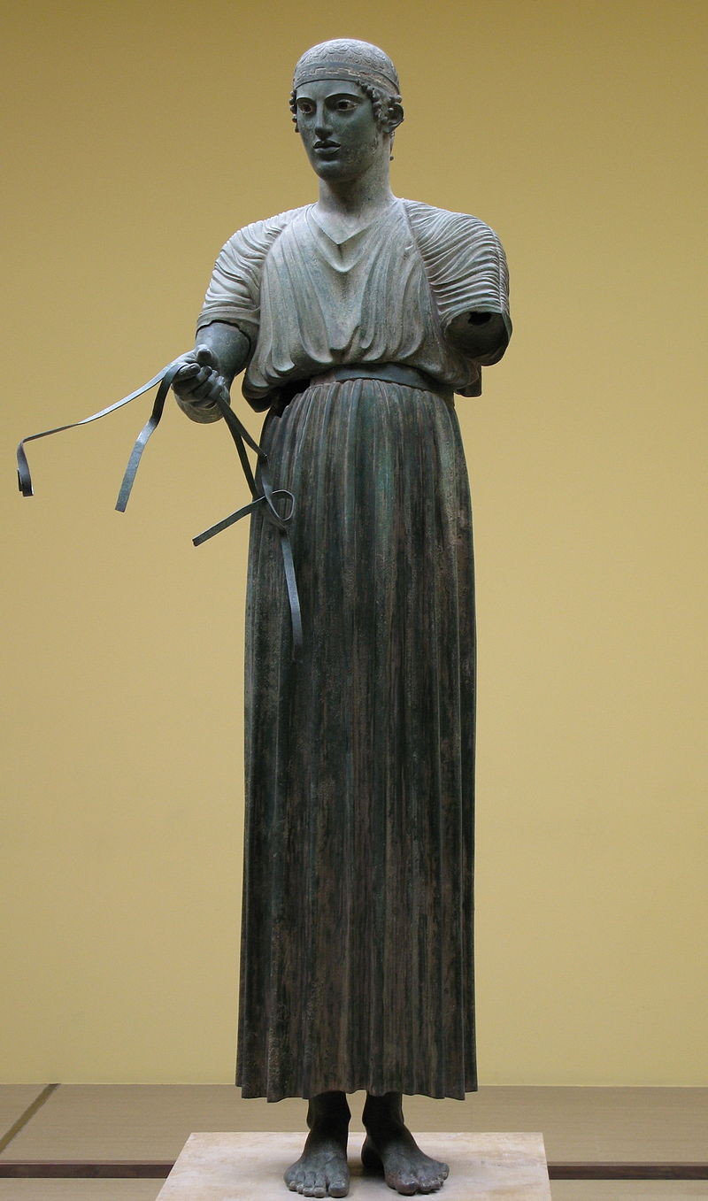
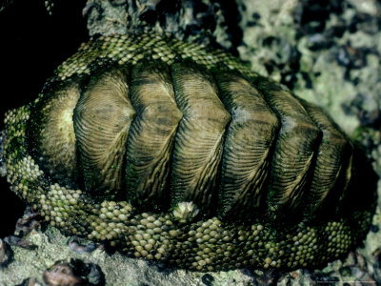
Chitons
Classical Greek Robe (sometimes also refers to body armour of Greek warriors)
Mollusc: Also known as “sea-cradle” and “coat-of-mail” snail

