Slide 1
The Idea of Business History

Slide 2
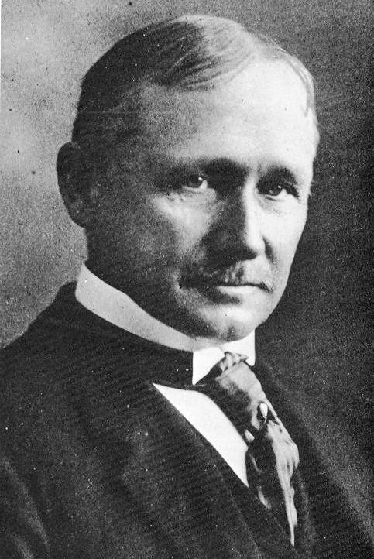
The Idea of Business History
The Rise of ‘Big Business’: The economic transformations of the late nineteenth century that led to the creation of large companies made it much more difficult to manage these companies;
  Led to managerial revolution; part of larger ‘efficiency movement’
  Frederick Winslow Taylor, ‘The Principles of Scientific Management’ (1911)

Slide 3

The Idea of Business History
The Establishment of Business Schools: In order to meet the needs of the new economy, new business schools within colleges were established
  Wharton is the first school of business (1881)
  Harvard is first to offer MBA program
These business schools offer more practical training designed to train managers to work in the new economy; this practical approach represents a challenge to the traditional mission of colleges
  In training a new generation of managers/experts, these schools are also training a new middle class which is based on skill rather than social status or wealth

Slide 4
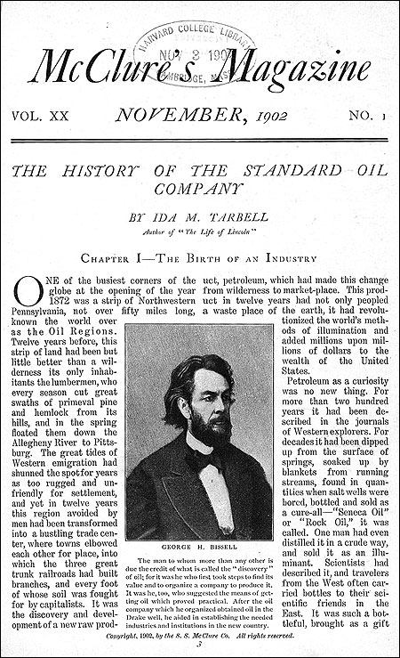
The Idea of Business History
The Emergence of Business History: There was little sense that business had a history; business histories were presented through the lens of morality, presenting executives as either heroic or sinister
By the late nineteenth century there was a growing sense that businessmen were ruthless crooks:
  Upton Sinclair, The Jungle (1906)
  Ida Tarbell, The History of the Standard Oil Company (1904)
  Jacob Riis, How the Other Half Lives (1890)
  Matthew Josephson, The Robber Barons (1934)
There is an alternate view, the so-called ‘industrial statesmen’ thesis, epitomized by Allen Nevins John D. Rockefeller: The Heroic Age of American Enterprise (1940) , suggesting that capitalists like Rockefeller were central players in the transformation of America into a global economic power.

Slide 5
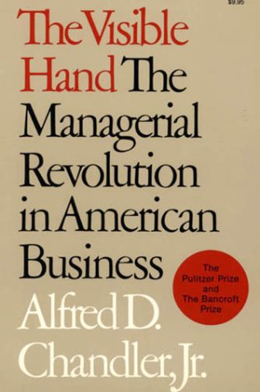
The Idea of Business History
The New Business Historians
Norman S.B. Gras (1884-1956): Considered the founder of modern business history; offered the first business history course
  Professor of Business History at Harvard Business School
  Business and Capitalism (1939)
Alfred D. Chandler (1918-2007): Moved beyond the morality plays of earlier generation to produce a history of business that more fully explored the interplay between business organization and the workings of the market
  Professor of Business History at Harvard Business School
  The Visible Hand (1977)
    This Pulitzer Prize winning book argues that managers functioned as the ‘visible hand’ directing the market; this challenges Adam Smith’s contention that the ‘invisible hand’ of the market determines the allocation of resources

