Slide 1
THEORIES

Slide 2
Fundamental business theories
Chandler on business success
Greiner on evolution/growth of organizations
Tannenbaum & Schmidt on leadership
Collins & Porras on company vision
Mintzberg on the manager’s job
French and Raven on social power
Barney on internal resources and capabilities
Kaplan & Norton on performance measurement and evaluation
Handy on managing change
Herzberg on motivation

Slide 3
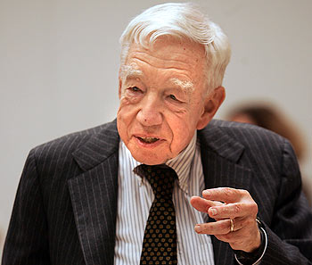
A. Chandler
“The enduring logic of industrial success” (1990)
A theory of organizational success
Alfred Chandler (1918-2007)
Credited with creating the field of business history
According to one of his students,
Dr Chandler could "explain the sea to the fish who swim in it."

Slide 4
Review: Chandler’s concepts
Economies of scale & economies of scope
Functional divisions, management hierarchy & geographical expansion
First movers & challengers
Research & development (innovation)
Related & unrelated diversification
Separation of top and middle managers (in the case of unrelated diversification)
Entrepreneurial enterprise (staying small)
Stock market pressure (due to ownership pattern)
Short-term thinking (due to market pressure)

Slide 5
Review: Chandler’s claims
IF YOU WANT TO COMPETE ON AN INTERNATIONAL LEVEL, YOU AVE TO BE BIG
Successful firms capitalize on economies of scale & scope, create management structures and invest in research & development
  Once a firm loses the opportunity to be a first mover, it is difficult to regain competitive advantage
  Growth (diversification) through unrelated diversification is a poor corporate strategy
  Business ownership patterns have diminished the likelihood of long-term success
Notes:
5

Slide 6
Two key concepts
Economies of scale:
  Large plants can produce products at a much lower cost
Economies of scope:
  Large plants can use many of the same production processes to make a variety of different products
To have benefits from them:
Flow of materials kept constant
National (and international) marketing and distribution functions must be created
Teams of lower and middle managers need to be recruited

Slide 7
First movers
By: Ruoqu Chen
Concept Map
Chandler, “The enduring logic of
industrial success”
management hierarchy
Related diversification
geographical expansion
R&D
Economies of scale
Economies of scope
Competitors

Slide 8
Exercice - Samsung
First movers: no it would be Apple. Samsung provided the knowledge but they don’t take the risk. They go in once the market is tested.
Related Diversification: unrelated, because it’s too wide. Exa cellphones not similar to TV
Economies of scale: yes, Samsung grows bigger and its prices go down too.
R&D: yes, a lot.

Slide 9
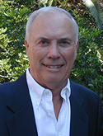
Larry Greiner
“Evolution & Revolution as organizations grow” (1994)
A theory of organizational life cycles, with a focus on growth
University of Southern
California
Notes:
9

Slide 10
Review: Greiner – key concepts
Age of the organization
Size of the organization
Stages of evolution
Stages of revolution
Growth rate of industry
Management style
Organizational structure
Notes:
10

Slide 11
Greiner claims
Organizational growth is characterized as a series of developmental phases
Management practices that work well in one phase bring on a crisis in the next
Organizations grow through a series of evolution and revolution phases that are function of the age and the size of the organization
Sub Claims:
Organizations should not try to skip phases
Top managers whose style is no longer appropriate should remove themselves
Growth is not inevitable
Notes:
11

Slide 12
Concept map
Phase 1 : Creativity
Phase 2: Direction
Entrepreneur comes with a concept
Crises of Leadership
Solution: hire a leader
Set structure in the company
Crises of autonomy
Solution: hire managers
Phase 3 : Delegation
Phase 4 : Coordination
Different level of manager and ?
Crises of control
Solution: establish head office function& separe work
Work becomes too much due to amount of bureaucracy
Red tape crises
Solution: new culture and structure
Phase 5 : Collaboration

Slide 13
The five phases of growth
Creativity
Direction
Delegation
Coordination
Collaboration
Crisis of leadership
Crisis of autonomy
Crisis of control
Red-tape crisis
?

Slide 14
Greiner’s concept map
For each evolution phase, student should know:
  The exact name of the evolution phase
  The characteristics of the evolution phase (what is happening)
  The issues that lead to a crisis
  The exact name of the crisis
  The required solution for the crisis
Notes:
14

Slide 15
TANNENBAUM & SCHMIDT

Slide 16
Tannenbaum & Schmidt: How to choose a leadership pattern -- concept map

Slide 17
How to lead?
Force in Manager
Force in Subordinate
Value system (same as company)
Confidence in subordinates(so they can handle more stuff)
Own Leadership inclinations
Feelings of security
High need for independence
Readiness to assume responsibility
High tolerance for ambiguity
Identify with the organization’s problems and goals
Have knowledge and experience
Learned to be part of decision making
Force in Situation
Type of organization
Group effectiveness
Long-run strategy
Objectives to be attained
Nature of the problem
Time pressures

Slide 18
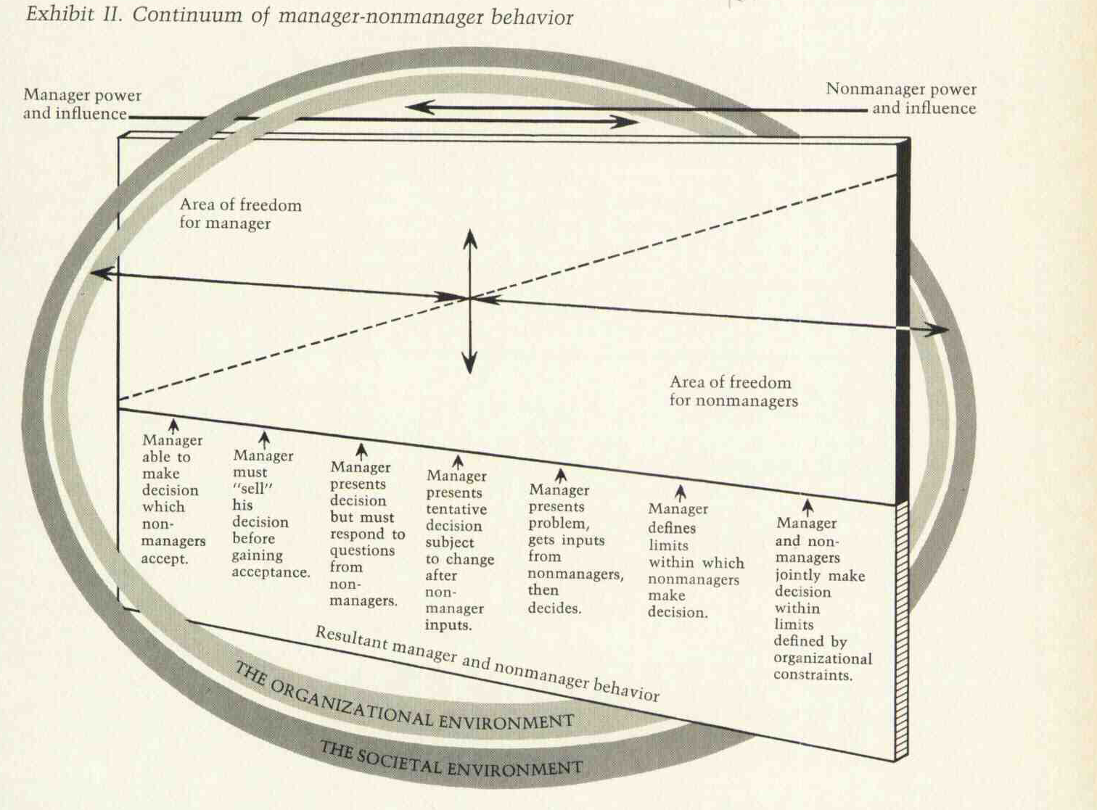
Tannenbaum & Schmidt: New Concept Map

Slide 19
Old vs New
More enjoyable, fair and fun
Creativity
Manager is a guide in the team

Slide 20
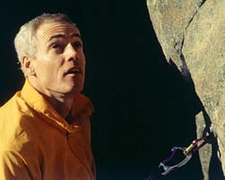
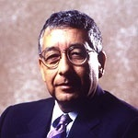
Jim Collins: Teacher and Business consultant
Jerry Porras: Professor of Organizational Behaviour at Stanford University in the US
Notes:
20

Slide 21
Main claim
« VISION provides guidance about
what CORE to preserve, and what
FUTURE to stimulate progress toward. »
Building your company’s vision; HBR – Sept./Oct. 1996; p.66

Slide 22
Core ideology:
  Enduring character of an organization – a consistent identity that transcends product
  Glue that holds the organization together.
Core values:
  small set of timeless guiding principles
  The “Code of Ethics” or “How we do business”
Core purpose:
  The organization’s reason for being
  Why do we exist?

Slide 23
“Discovering” core ideology
  You do not create or set core ideology
  Description of what actually exists, not what we wish existed
  Needs to be meaningful and inspirational only to people inside the organization
  Find people who are predisposed to share the organization’s core values and purpose

Slide 24
VISION
Core ideology
Envisioned future
What we stand for
What we aspire to become
Enduring character of the organization;
Glue that holds the org. together
Audacious and vivid goals that stimulate
progress
Core Value
Core Purpose
Audacious goal
Goal achievement
100 yr test
Organization’s most fundamental reason for existence
Can never be fulfilled
10-30 years
BHAG:
Unifying focal point
Catalyst for team spirit
Clear finish line
Vivid description
What it will be like to achieve BHAG
Picture people can carry around
Passion, emotion, conviction: essential
3 – 5 values
Small set of timeless guiding principles
Require no external justification
Have intrinsic value to those inside the organization
Preserve the core & stimulate progress

Slide 25
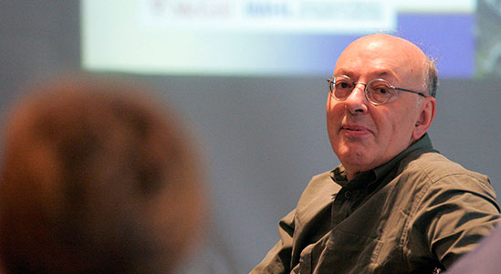
Henry Mintzberg
1939-
“Business Guru”
of Canadian origin
The practices of managers

Slide 26
Mintzberg’s manager’s roles
Interpersonal roles (establish communication)
  Figurehead (someone inside the firm who represents the firm)
  Leader (role model, how to act, to proceed)
  Liaison (social network, try to build a relation with other firm)
Informational roles
  Monitor (what could be beneficial, what is relevant for who)
  Disseminator (who needs to do what)
  Spokesperson
Decisional roles
  Entrepreneur (project manager)
  Disturbance-handler (assure harmony in the company)
  Resource-allocator (more % to who)
  Negotiator

Slide 27
Types of Power: French & Raven
“who holds it over whom”
Reward Power, you let someone have power on you (or vice-versa) and get(give) a reward
Coercive Power, you can be punish if you don’t obey (hell life)
Legitimate Power, when someone has a legitimate right to prescribe behaviour for you (parents, religion)
Referent Power, based on one’s identification with the other ( which group you fit more in)
Expert Power, when someone has some special knowledge or expertise higher than you

Slide 28
Types of Power: French & Raven
REWARD COERCIVE REFERENT EXPERT LEGITIMATE
1. Share my experience & special skills
2. Tell them that they have commitments to meet
3. Give them tough, undesirable jobs to do
4. Make them feel like I approve of them
5. Make them feel important
6. Give them a good peer evaluation
7. Provide good technical suggestions
8. Make them recognize they have tasks to accomplish
9. Provide them with special benefits
10. Make things unpleasant for them
11. Influence their getting a pay increase
12. Make them feel they have commitments to meet
13. Make the work difficult for them
14. Provide them with good task-related advice
15. Make them feel personally accepted

Slide 29
Forms of managerial influence
Role
Figurehead
Leader
Liaison
Monitor
Disseminator
Spokesperson
Entrepreneur
Disturbance-handler
Resource-allocator
Negotiator
Social Power
Reward power
Coercive power
Expert power
Legitimate power
Referent power

Slide 30
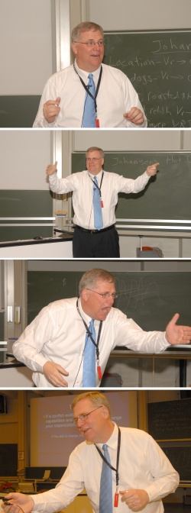
Jay Barney
Jay Barney is one of the most influential contributors within the field of strategy today. He is also a professor at Fisher College of Business at Ohio State University.

Slide 31
The SWOT framework
SWOT Analysis is the traditional tool for strategic analysis. It is not Barney’s theory
SWOT framework has two components: Internal and External Environment analysis
Internal Environment
Internal resources and capabilities of the firm
SWOT
Strengths
Weaknesses
Opportunities
Threats
External Environment
Business & societal trends, industry conditions and competitive environment

Slide 32
Barney’s major claims
Firm sustained competitive advantages if its resources and capabilities are valuable, rare, inimitable and organized in a way that allows it to exploit potential opportunities.
Firm successful if it has resources with the right attributes and characteristics.

Slide 33
Barney’s major claims
No analysis of firms’ competitive environments can explain their success.
Strategists need to analyze the competitive implications of firms’ internal strengths and weaknesses

Slide 34
The Firm’s Resources and Capabilities
4 type of assets are used by the firm to develop, manufacture and deliver products and services to its customers.
Financial: debt, equity, retained earnings, etc…
Physical: machines, manufacturing facilities, buildings.
Human: experience, knowledge, judgment, wisdom, etc…
Organizational: history, relationships, trust, culture, formal reporting structure, patents, etc….

Slide 35
Four important questions about resources and capabilities
The Question of Value: Does a firm’s resources and capabilities enable it to exploit an opportunity, and/or neutralize a threat?
The Question of Rareness: How many competing firms already possess these valuables resources and capabilities?
The Question of Imitability: Do firms without a resource or capability face a cost disadvantage in obtaining it compared to firms that already possess it?
The Question of Organization: Is a firm organized to exploit the full competitive potential of its resources and capabilities?

Slide 36
Question of value
Add value to the business
Internal : add weight to the products and the cmpany
Precise value to the product (customers will pay more for the product)
Bring something that they want : monitored , follow what is changing in the market, ask if it’s valuable.
May add value in the past but because of changes in customer tastes, industry structure, technology => less value in the future
Evaluate whether or not their firms’ resources and capabilities continue to add value, despite the changes in the competitive environment

Slide 37
Question of Rareness
Value but not rare: competitive parity
Value and rare: competitive advantage (at least temporarily)
Nobody has it

Slide 38
Question of Imitability
Can not copy => product, history, relationship with customers
Somebody copies you, easy to copy you
2 ways that can occur: duplication (when the imitating firm uses the same resource), substitution(looks similar but isn’t produce the same way)

Slide 39
Reasons why these internal attributes may be costly to imitate
The importance of history: Valuable and rare resources acquired or developed through unique historical circumstances can be a source of sustained competitive advantage
Ex Coca Cola
The importance of numerous small decisions: A firm’s competitive advantage seems to depend on numerous “small decisions” (rather than big ones) through which a firm’s resources and capabilities are developed and exploited.
Competitor: difficult to see small decisions to imitate. So big decisions are easier to imitate.
The importance of socially complex resources: Reputation, trust, friendship teamwork and culture, while not patentable, are difficult to imitate.

Slide 40
Question of Organization
Employees understand what company has + being inside = difficult to imitate
Formal reporting structure, management control systems and its compensation policies
Use of resources efficiently
Company should be organized and planed everything correctly

Slide 41
Applying the VRIO Framework
Value, Rarity, Inimitable, Organized Properly
Summary of VRIO, Competitive Implications, and Economic Implications
Valuable? | Rare? | Costly to Imitate? | Organized Properly? | Competitive Implications | Economic Implication
No | No | No | No | Disadvantage | Below
Yes | No | No | No | Parity
Yes | Yes | No | No | Temporary Advantage | Above (at least for some amount of time)
Yes | Yes | Yes | Yes | Sustained Advantage | Above

Slide 42
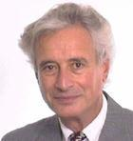

Kaplan & Norton’s balanced scorecard
Robert Kaplan, Harvard Business School professor
David Norton, Consultant

Slide 43
Kaplan & Norton’s balanced scorecard
The Balanced Scorecard is a
Performance measurement system/tool

Slide 44
Kaplan & Norton’s balanced scorecard
What you measure is what you get!
The traditional financial performance measures worked well for the industrial era
The “bottom line” is not enough

Slide 45
Kaplan & Norton’s balanced scorecard
Four perspectives for a balanced scorecard
  Customer perspective
    What matters most to customers?
  Internal business perspective
    How can we meet customer expectations?
  Innovation & learning perspective
    How can we make continual improvements?
  Financial perspective
    How can we ensure profitability for shareholders?

Slide 46
ECI’s Balanced Business Scorecard
Financial Perspective
GOALS | MEASURES
Survive | Cash flow
Succeed | Sales & operating income
Prosper | Increase market share
Customer Perspective
GOALS | MEASURES
New products
Responsive supply
Preferred supplier
Customer Partnership
Internal business Perspective
GOALS | MEASURES
Technology capability
Manufacturing excellence
Design productivity
New product introduction
Innovation & Learning Perspective
GOALS | MEASURES
Techno leadership
Manuf. learning
Product focus
Time to market

Slide 47
Kaplan & Norton’s balanced scorecard
Financial “bottom line” measures
Measures of innovation
Customer-related measures
VISION
STRATEGY
Measures of operational effectiveness

Slide 48
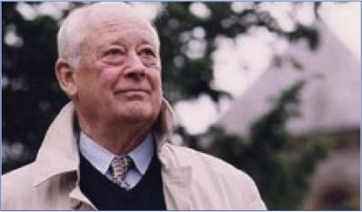
Charles Handy: Sigmoid Curve

Slide 49
Sigmoid curve: Key to effective growth
Depleted resources; too late
B
A
Begin building a new curve
Why are we changing?! We were doing fine!! Moan, moan!
Dip in curve = Period of initial learning

Slide 50
1. come up with a product
2. Product takes off
2 - A – B. every one wants the product
3. (After B) if you don’t evolve the product, it goes down. Cash goes down, moral employees goes down, lowest point in the company.
SOLUTION: Before it takes off, you should have a plan (ex new product). Before point A, organize & motivate teams to work on different things. Between A-B it’s a period of change

Slide 51
Sigmoid curve: Key to effective growth
The Paradox of Time:
  By the time you know where you ought to go, it’s too late to go there
  If you keep on going the way you are, you will miss the road to the future
Because it is easy to explain things when looking backward, we think that we can predict them going forward.
The S-shaped curve:
  Empires, Corporations, Product life cycle, Love and relationships, Personal career, etc..
  The 2 curves: When should the 2nd curve begin?
  Who should lead the 2nd curve?
  Turmoil: Time of great confusion

Slide 52
Sigmoid curve: Key to effective growth
The discipline of the 2nd curve:
  How company knows where they are? Many ways depends on the type of company.
  Keeping the 2 curves going should be a habit
    Benefits of the discipline of devising the 2nd curve.
    The traditional four-stage of discovery: Questions; Ideas; Test; Review
Curvilinear logic:
  The paradox of success: « What got you where you are won’t keep you where you are»
  It means starting life again, and it is harder as you become older
  The more stagnant you become, the less good there is.
Fertilizing the 2nd curve:
  Seniors: Permission + Encouragement
  New ideas can co-exist with old

Slide 53
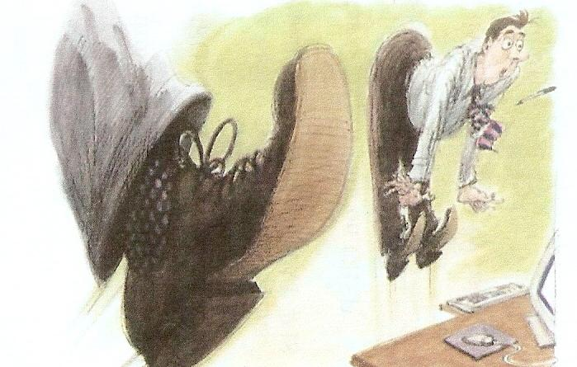
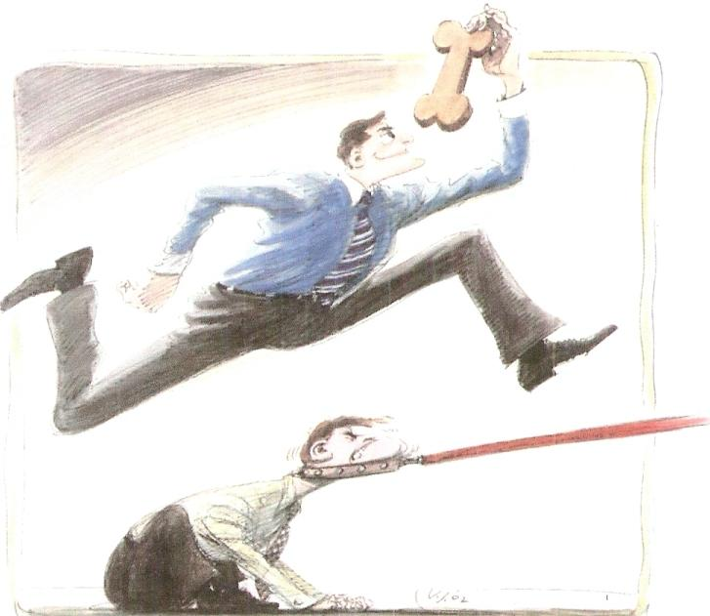
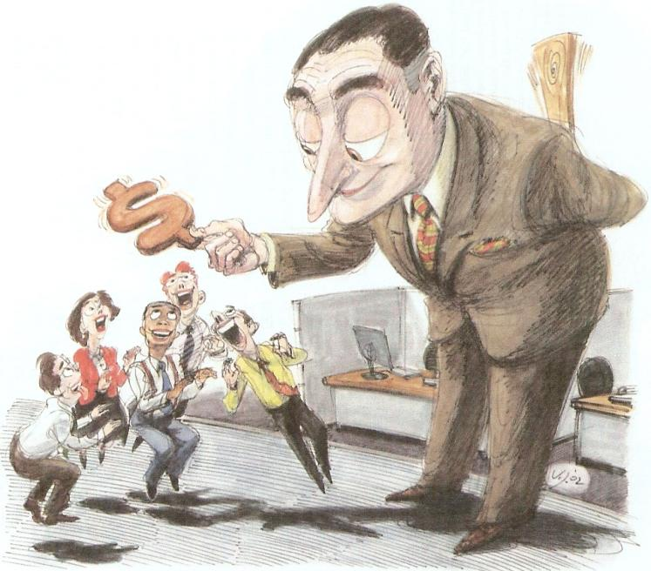
Hygiene factors and motivators
HERZBERG
© Harvard Business Review

Slide 54
Herzberg’s concepts:
How do you motivate employees?
Hygiene factors
Motivators
Dissatisfaction
Satisfaction
Job enrichment/Vertical job loading
Job enlargement/Horizontal job loading
Negative KITA
Positive KITA

Slide 55
Factors of Motivation
Hygiene factors = dissatisfaction
Motivators = satisfaction
Company Policy
Supervision
Relationship with Boss
Work Conditions
Salary
Relationship with Peers
Achievement
Recognition
The work itself
Responsibility
Advancement
Growth

Slide 56
Principles of vertical job loading
Remove some controls while retaining accountability
Increase accountability of individuals for own work
Give person a complete natural unit of work
Grant additional authority; job freedom
Make periodic reports directly available to workers themselves rather than supervisors
Introduce new, more difficult tasks
Assign workers to specialized tasks, enabling them to become experts

Slide 57
Some steps for job enrichment
Select jobs, approaching them with the conviction that they can be changed
Brainstorm possible changes
Screen to remove hygiene suggestions & horizontal loading
Avoid direct participation by the employees whose jobs are to be enriched
Be prepared for an initial drop in performance
Expect first-line supervisors to experience some anxiety

Slide 58
Horizontal job loading
reduces the personal contribution rather than giving opportunities for growth
Its impact on the work environment is not always the most positive due to the fact that it is largely just an increase in work for the employee and not really a step up in responsibility

Slide 59
KITA (A Kick In The Ass)
POSITIVE
NEGATIVE
A reward, an incentive, more status, a promotion…
Herzberg don’t think they motivate. Other companies think it does.
For Herzberg, it is seduction
Physical:they're not what today's workers are looking for in a job and they have a choice.
Psycological: all kinds of emotional games and manipulations to make someone perform more. Ego boost.
http://www.yourcoach.be/en/employee-motivation-theories/herzberg-motivators-hygiene-factors-theory.php

Slide 60
Two factor theory - Herzberg
Two factor theory- Herzberg
Employees
dissatisfied
and
unmotivated
Employees
not
dissatisfied
but
unmotivated
Employees
satisfied
and
motivated
Hygiene Factors
Motivation Factors
Source: www.valuebasedmanagement.net
Notes:
60

