Slide 1
MANA 201
Introduction to Business and Management
WINTER 2016
CLASS 9

Slide 2
Objectives for today
Preliminary Stuff (as usual)
Mid-Term: A few points of note!
  You can view your mid-terms after class
Chapter 9: Innovation & Organizational Change
Chapter 10: Human Resource Management
Wrap up

Slide 3
Important Dates
3/16 (Class 10): Group Project Due
  Are we all good?

Slide 4
Remaining Schedule
CLASS DATE TOPICS, READINGS & NOTES
9 09-Mar CHAPTER 9: Innovation & Organizational Change
  CHAPTER 10: Human Resource Management
10 16-Mar CHAPTER 11: Leadership & Communication
GROUP PROJECT DUE IN CLASS
11 23-Mar CHAPTER 12: Individual Behaviour
CHAPTER 14: Motivation Theory & Practice
12 30-Mar CHAPTER 15: Teams, Teamwork & Collaboration
CHAPTER 16: Control Processes & Systems
13 06-Apr REVIEW
TBD Make up ANYTHING MISSED

Slide 5
Chapter 10:
Human Resource Management
Management 3e - Chapter 10
5

Slide 6
Human Resource Management
Major human resource management responsibilities:
  Attracting a quality workforce
    Human resource planning, recruitment, and selection
  Developing a quality workforce
    Employee orientation, training and development, and performance appraisal.
  Maintaining a quality workforce
    Career development, work-life balance, compensation and benefits, employee retention and turnover, and labour-management relations.
Management 3e - Chapter 10
6

Slide 7
Human Resource Management
Challenges in managing a global workforce
  Keeping track of expertise
  Availability of visas for foreign workers
Discrimination in employment
  Occurs when someone is denied a job or job assignment for reasons that are not job relevant.
Employment equity
  The right to employment without regard to race, color, national origin, religion, gender, age, or physical or mental ability.
  Canadian Human Rights Act of 1977
Management 3e - Chapter 10
7

Slide 8
Human Resource Management
Current legal issues in HRM
  Sexual harassment
  Equal pay and comparable worth
  Pregnancy discrimination
  Legal status of independent contractors
  Workplace privacy
Management 3e - Chapter 10
8

Slide 9
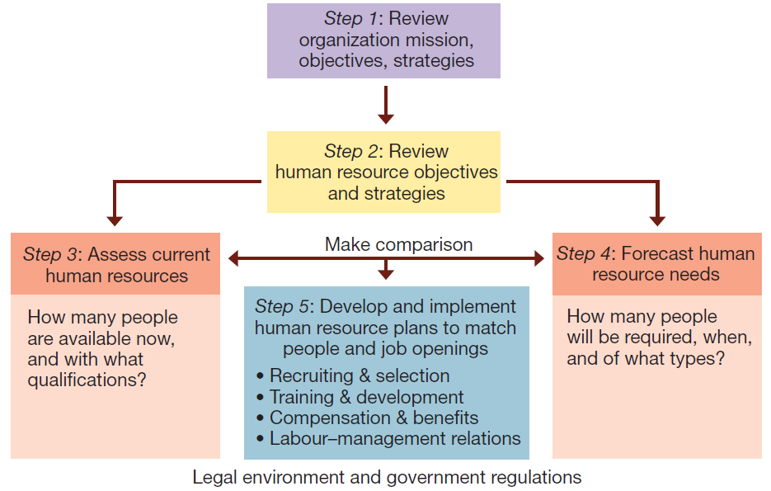
Steps in strategic human resource planning.
Management 3e - Chapter 10
9

Slide 10
Attracting a Quality Workforce
The foundation of human resource planning is job analysis.
  The orderly study of job facts to determine just what is done, when, where, how, why, and by whom in existing or potential new jobs.
Job analysis provides information for developing:
  Job descriptions
  Job specifications
Management 3e - Chapter 10
10

Slide 11
Attracting a Quality Workforce
Recruitment
  Activities designed to attract a qualified pool of job applicants to an organization.
  Steps in the recruitment process:
    Advertisement of a job vacancy.
    Preliminary contact with potential job candidates.
    Initial screening to create a pool of qualified applicants.
Management 3e - Chapter 10
11

Slide 12
Attracting a Quality Workforce
Recruitment methods:
  External recruitment — candidates are sought from outside the hiring organization.
  Internal recruitment — candidates are sought from within the organization.
  Traditional recruitment — candidates receive information only on most positive organizational features.
  Realistic job previews — candidates receive all pertinent information.
Management 3e - Chapter 10
12

Slide 13
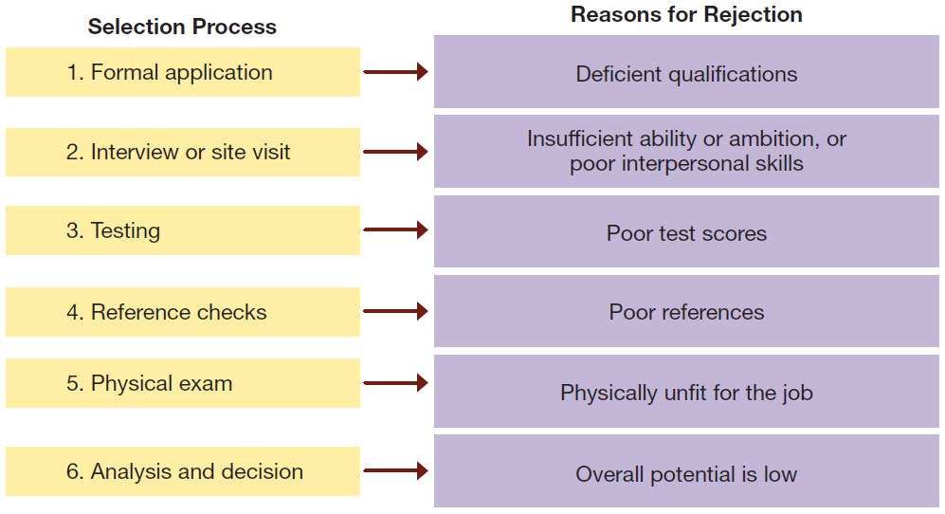
Steps in the selection process:
The case of a rejected job applicant.
Management 3e - Chapter 10
13

Slide 14
Developing a Quality Workforce
Orientation
  Set of activities designed to familiarize new employees with their jobs, coworkers, and key aspects of the organization.
Socialization
  Process of influencing the expectations, behaviour, and attitudes of a new employee in a way considered desirable by the organization.
Management 3e - Chapter 10
14

Slide 15
Developing a Quality Workforce
Training
  A set of activities that provides the opportunity to acquire and improve job-related skills.
On-the-job training
Job rotation
Coaching
Mentoring
Modeling
Off-the-job training
Management development
Management 3e - Chapter 10
15

Slide 16
Developing a Quality Workforce
Performance management systems ensure that—
  Performance standards and objectives are set.
  Performance results are assessed regularly.
  Actions are taken to improve future performance potential.
Management 3e - Chapter 10
16

Slide 17
Developing a Quality Workforce
Performance appraisal
  Formally assessing someone’s work accomplishments and providing feedback.
  Purposes of performance appraisal:
    Evaluation — lets people know where they stand relative to objectives and standards.
    Development — assists in training and continued personal development of people.
Management 3e - Chapter 10
17

Slide 18
Developing a Quality Workforce
Graphic rating scales
  Uses checklists of traits or characteristics to evaluate performance.
  Relatively quick and easy to use.
  Questionable reliability and validity.
Management 3e - Chapter 10
18

Slide 19
Developing a Quality Workforce
Behaviourally anchored rating scales (BARS)
  Describes actual behaviours that exemplify various levels of performance achievement in a job.
  More reliable and valid than graphic rating scales.
  Helpful in training people to master important job skills.
Management 3e - Chapter 10
19

Slide 20
Developing a Quality Workforce
Critical-incident techniques
  Keeping a running log or inventory of effective and ineffective behaviours.
  Documents success or failure patterns.
Multiperson comparisons
  Formally compare one person’s performance with that of one or more others.
  Types of multiperson comparisons:
    Rank ordering
    Paired comparisons
    Forced distributions
Management 3e - Chapter 10
20

Slide 21
Developing a Quality Workforce
Alternatives to supervisory appraisal:
  Peer appraisal
    Occurs when people who work regularly and directly with a jobholder are involved in the appraisal.
  Upward appraisal
    Occurs when subordinates reporting to the jobholder are involved in the appraisal.
  360° feedback
    Occurs when superiors, subordinates, peers, and even internal and external customers are involved in the appraisal of a jobholder’s performance.
Management 3e - Chapter 10
21

Slide 22
Maintaining a Quality Workforce
Work-life balance
  How people balance career demands with personal and family needs.
  Progressive employers support a healthy work-life balance.
  Contemporary work-life balance issues:
    Single parent concerns
    Dual-career couples concerns
    Family-friendliness as screening criterion used by candidates
Management 3e - Chapter 10
22

Slide 23
Maintaining a Quality Workforce
Compensation and benefits: base compensation—salary or hourly wages
Pay for performance
  Paying people for performance is consistent with:
    Equity theory
    Expectancy theory
    Reinforcement theory
  Merit pay
    Awards a pay increase in proportion to individual performance contributions.
    Provides performance contingent reinforcement.
    May not succeed due to weakness in performance appraisal system or lack of consistency in application.
Management 3e - Chapter 10
23

Slide 24
Maintaining a Quality Workforce
Incentive compensation systems:
  Skill-based pay
    Links pay to the number of job-relevant skills an employee masters.
  Bonus pay plans
    One-time or lump-sum payments based on the accomplishment of specific performance targets or some extraordinary contribution.
Management 3e - Chapter 10

Slide 25
Maintaining a Quality Workforce
Incentive compensation systems:
  Profit-sharing plans.
    Some or all employees receive a proportion of net profits earned by the organization.
  Gain-sharing plans.
    Groups of employees share in any savings realized through their efforts to reduce costs and increase productivity.
  Employee stock ownership plans.
    Employees own stock in the company that employs them.
Management 3e - Chapter 10
25

Slide 26
Maintaining a Quality Workforce
Compensation and benefits
  Fringe benefits
    Include non-monetary forms of compensation
  Family-friendly benefits
    Help in balancing work and non-work responsibilities
  Employee assistance programs
    Help employees deal with troublesome personal problems.
Management 3e - Chapter 10
26

Slide 27
Maintaining a Quality Workforce
Retention and turnover
  Replacement is the management of promotions, transfers, terminations, layoffs, and retirements.
  Replacement decisions relate to:
    Shifting people between positions within the organization.
    Retirement.
      Early retirement incentive programs
    Termination.
Management 3e - Chapter 10
27

Slide 28
Maintaining a Quality Workforce
Labour-management relations
  Labour unions deal with employers on the workers’ behalf.
  Labour contracts specify the rights and obligations of employees and management regarding:
    Wages.
    Work hours.
    Work rules.
    Seniority.
    Hiring.
    Grievances.
    Other conditions of employment.
Management 3e - Chapter 10
28

Slide 29
Maintaining a Quality Workforce
Labour-management relations
  Collective bargaining – process of negotiating, administering, and interpreting a labour contract
  Two-tier wage system – pays new hires less than workers already doing the same work with more seniority
Management 3e - Chapter 10
29

Slide 30
Organizational Culture and Diversity
Organizational culture: “the way we do things here” – helps to distinguish them from one another and bind members together with some sense of collective identity
Socialization: builds strong cultures by acclimating new members
Management 3e - Chapter 10
30

Slide 31
Organizational Culture and Diversity
Strong cultures:
  Commit members to do things that are in the best interests of the organization
  Discourage dysfunctional work behaviour
  Encourage functional work behaviour
The best organizations have strong cultures that:
  Are performance-oriented
  Emphasize teamwork
  Allow for risk taking
  Encourage innovation
  Value the well being of people
Management 3e - Chapter 10
31

Slide 32
Organizational Culture and Diversity
What is observable culture?
  What one sees and hears when walking around an organization.
Elements of observable culture:
  Heroes
  Stories
  Rites and rituals
  Symbols
Management 3e - Chapter 10
32

Slide 33
Organizational Culture and Diversity
What is the core culture?
  Underlying assumptions and beliefs that influence behaviour and contribute to the observable culture.
Core culture and values:
  Core values are beliefs and values shared by organization members
  Strong cultures have a small but enduring set of core values.
  Commitment to core values is a key to long-term success.
Management 3e - Chapter 10
33

Slide 34
Organizational Culture and Diversity
Value-based management:
  Describes managers who actively help to develop, communicate, and enact shared values.
  Criteria for evaluating core values:
    Relevance
    Integrity
    Pervasiveness
    Strength
Management 3e - Chapter 10
34

Slide 35
Organizational Culture and Diversity
Workplace spirituality:
  Practices that create meaning and shared community among organizational members.
  Sample values include:
    Meaningful purpose
    Trust and respect
    Honesty and openness
    Personal growth and development
    Worker friendly practices
    Ethics and social responsibility
Management 3e - Chapter 10
35

Slide 36
Organizational Culture and Diversity
Symbolic leadership
  Symbolic leaders use symbols well to establish and maintain a desired organizational culture.
  Symbolic leaders behave in ways that espouse organization’s values.
  Symbolic leaders:
    Use language metaphors
    Highlight and dramatize core values and observable culture
    Use rites and rituals to glorify performance
Management 3e - Chapter 10
36

Slide 37
Organizational Culture and Diversity
Organizational subcultures
  Cultures based on shared work responsibilities and/or personal characteristics.
  Ethnocentrism is the belief that one’s subculture is superior to all others
Common subcultures include:
  Occupations and Functions
  Ethnicity and National
  Gender and Generations
Management 3e - Chapter 10
37

Slide 38
Organizational Culture and Diversity
Challenges faced by minorities and women:
  Glass ceiling
  Misunderstanding and lack of sensitivity
  Sexual harassment
  Pay discrimination
  Job discrimination
Minorities may adapt by exhibiting biculturalism—adopting characteristics of the majority culture
Management 3e - Chapter 10
38

Slide 39
Preparation for next Week
Read and prepare for next class
CHAPTER 11: Leadership & Communication
  CASE STUDY: Belvedere Place Development Ltd.
GROUP PROJECT DUE IN CLASS

