Slide 1
Introduction to PSY1101J and Prologue: The Story of Psychology
January 11th, 2016

Slide 2
Syllabus
Professor: Jenna Boulanger, jboul064@uottawa.ca
Office Hours: Monday 5pm-7pm in VNR2026
TA: Rupali Sharma, rsharm3@uottawa.ca
E-mails can take up to 48 hours.

Slide 3
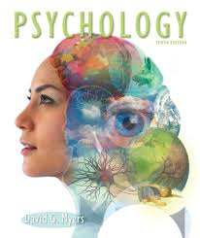
Textbook
Textbook: Psychology 10th Edition by Myers (http://bcs.worthpublishers.com/myers10e/)
Final based souly on the book, not cumulative

Slide 4
Exams
Midterms: February 22nd and April 4th:
  Each worth 25.5% ;
  Not cumulative;
  If absent, email me as soon as possible;
  Everything can be on the midterm exams, including material from the book that wasn’t covered in class and vice-versa.
Final exam: Date to be determined:
  Worth 45%;
  Cumulative;
  If absent, email cbeeson@uottawa.ca as soon as possible;
  Will only feature material that is covered in the textbook.
Suggested method of study (Hint: Based off of the Close-Up on page 12 = could be on the exams!):
  Testing Effect: Use the Study Guide, questions found in the book;
  FINAL (SQ3R method): Actively process information using this studying method: Survey, Question, Read, Retrieve, and Review.

Slide 5
Integrated System of Participation in Research (ISPR)
Participation in research will be worth 4% of your final grade;
For information about the ISPR program, check out: https://www.youtube.com/watch?v=x_3wJK-pac0 ;
To participate, go to: http://uottawa.sona-system.com;
Must be completed between January 19th and April 12th;
For questions about the program, contact ispr@uottawa.ca.

Slide 6
Course Content
Prologue: The Story of Psychology (pages 1-15)
Chapter 1: Thinking Critically with Psychological Science (pages 16-45)
Chapter 2: The Biology of the Mind (pages 46-83)
Chapter 3: Consciousness and the Two-Track Mind (pages 84-127)
Chapter 6: Sensation and Perception (pages 216-263)
Chapter 7: Learning (pages 264-297)
Chapter 8: Memory (pages 298-335)
Chapter 12: Emotion (pages 458-486)
Chapter 11: Motivation and Work (pages 402-457)

Slide 7

What is Psychology?
Today, we define psychology as the study of behaviour and mental processes:
  Behaviour: Anything the organism does ,any action that can be observed and recorded;
  Mental processes: The internal, subjective experiences we can infer from behaviour (i.e. sensations, perceptions, dreams, thoughts, beliefs, and feelings).

Slide 8
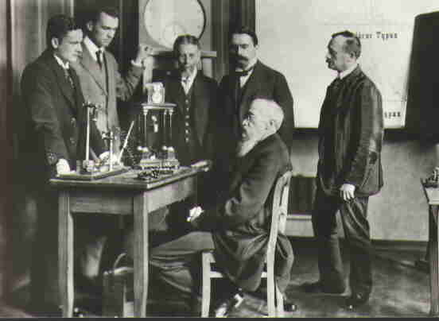
Psychology’s Roots
Aristotle (4th century BCE) was the first to ask questions regarding the relationship between the body and the mind;
Wilhelm Wundt (1879) created the first experimental psychology laboratory in 1879:
  When psychology became a science.

Slide 9
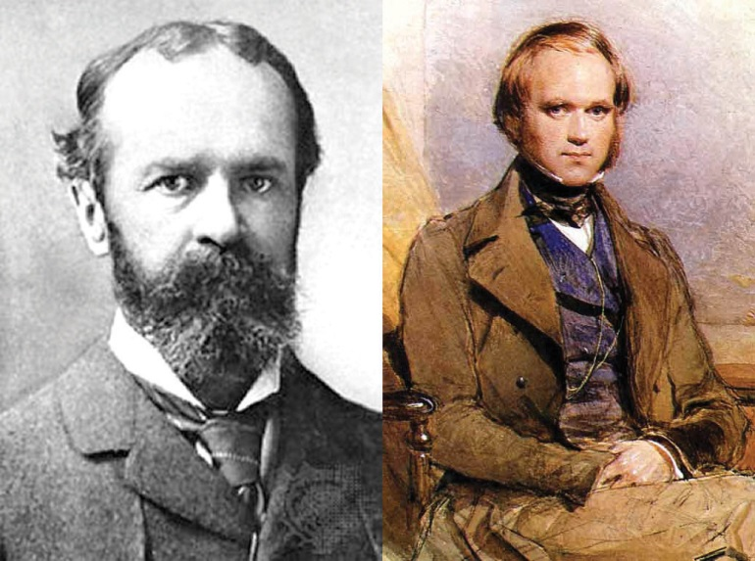
Trends is Psychological Science: Structuralism vs Functionalism
Structuralism:
  Edward Titchener used introspection to uncover the mind’s structure;
Functionalism:
  William James asked this
  question: What function does
  the mind and consciousness
  serve?
    It is adaptive, it served an evolutionary purpose;
  William James also wrote the first psychology textbook and mentored Mary Whiton Calkins.

Slide 10
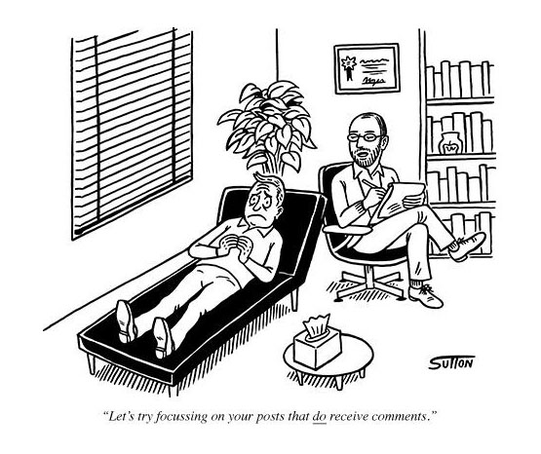
Trends in Psychological Sciences: Psychoanalysis and Behaviorism
Psychoanalysis: Led by Freud,
posits that unconscious
thoughts and emotional
reactions to childhood
experiences determine
behaviour;
  Created talk-therapy.
Behaviourism: Founded by Watson and Skinner in 1920s, redefined psychology as the study of observable behaviour.

Slide 11
Trends in Psychological Science in the 1960s: Humanistic Psychology and Cognitive Neuroscience
Humanistic Psychology: Led by Carl Rogers and Abraham Maslow who believed that humans are fundamentally good and motivated to reach their full potential;
  Led to the development of positive psychology.
Cognitive Psychology: Studies mental processes such as attention, memory, perception, and language using a rigorous scientific approach;
  Cognitive Neuroscience: Interdisciplinary study that looks at the brain activity underlying mental processes.

Slide 12
Contemporary Psychology: The Biopsychosocial Approach
Psychology has three main levels of analysis:
The deep level, Biology:
natural selection, genetics, brain mechanisms, neurotransmitters, hormones, reflexes, sensation
The outer level, Environment: social Influences, culture, education, relationships
In the middle, Psychology: thoughts, emotions, moods, choices, behaviors, traits, motivations, knowledge, perceptions, passed experiences

Slide 13
Contemporary Psychology: Psychology’s Current Perspectives
Perspective | What they study
Neuroscience | How the body and the brain generate emotions, memories and sensory experiences.
Evolutionary | How natural selection of traits ensure the perpetuation of certain genes.
Behaviour genetics | Try to establish the measure to which genes and the environment influence individual differences.
Psychodynamic | How behaviour comes from unconscious motivations and conflicts.
Behavioural | How we learn from observable behaviours.
Cognitive | How we code, process, store and get access to information.
Social-cultural | How behaviours and mental processes vary across situations and cultures.

Slide 14
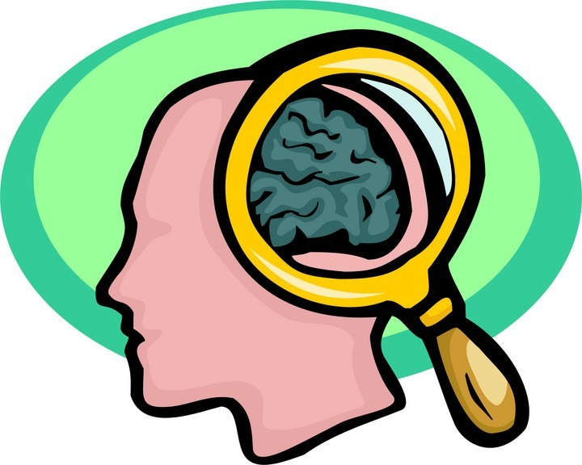
Contemporary Psychology: Psychology’s Subfields
Basic research: Aims to increase psychology’s knowledge base;
Applied research: Aims to solve a specific, practical problem;
Applied psychology: Creates interventions based on evidence of effectiveness.

Slide 15
Contemporary Psychology: Psychology’s Subfields
Basic research:
Type of research | Research examples
Biological | Explore the structural problems in the brain that may be part of autism.
Developmental | Study how the stages of cognitive and emotional development vary in autism.
Cognitive | Clarify the difficulties autistic children have with understanding sarcasm.
Personality | Decide whether traits like neuroticism need to be measured differently in autism.
Social | Find how autistic children can learn social skills as procedures if not by intuition.
Positive Psychology | Explore what contributes to life satisfaction in autistic children and adults.

Slide 16
Contemporary Psychology: Psychology’s Subfields
Applied psychology:
Subfield | Example of how they can apply knowledge
Clinical | Use exposure therapy to decrease phobic reactions in a traumatized client.
Psychiatry | Prescribe antipsychotic drugs to someone suffering from schizophrenia.
Counseling | Help someone achieve career goals, despite family conflict and self-doubt.
Industrial-organizational | Figure out how a factory can improve the coordination of tasks, roles and personalities.
Community | Help coordinate a city’s efforts to understand and prevent elder abuse.

Slide 17
** Final**Contemporary Psychology: Recap
Someone who looks at how our genes and our environment influences our individual differences adopts the Behaviour______ perspective to psychology.
  Evolutionary
  Neuroscience
  Cognitive
  Behaviour genetics
Dr Kerry works with companies to help them determine which type of employee they should hire. Dr Kerry is most likely a(n) applied reasearche psychologist.
  Social
  Clinical
  Basic research
  Applied research
A medical doctor that can prescribe medications to treat psychological disorders is called a physchiatrist_______.
  Psychiatrist
  Clinical psychologist
  Therapist
  Counselling psychologist
When preparing a diagnostic, Dr Lemon looks at her patient’s genetic predispositions, emotional responses, and family and peer influences. Dr Lemon therefore adheres to the: D
  Biological perspective
  Behavioural perspective
  Social-cultural perspective
  Biopsychosocial approach

Slide 18
Psychology’s Biggest Question: The Nature-Nurture Issue
Nature: To what extent are our traits already in place at birth?
  Plato: we inherit character and intelligence;
  Descartes: some ideas are innate;
  Darwin: natural selection – we inherit the traits that contribute to our species survival.
Nurture: To what extent do our traits develop in response to our environment/experience?
  Aristotle: all knowledge comes from the senses;
  Locke: the mind is a blank slate written on by experience.

Slide 19
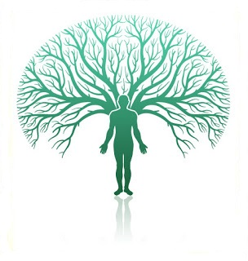
Psychology’s Biggest Question: The Nature-Nurture Issue
Nurture works on what nature endows.

