Slide 1
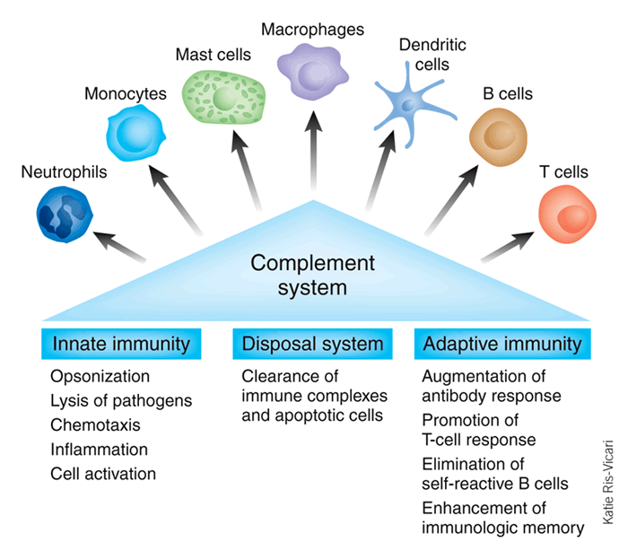
Introduction to the Immune System
Chapter 17: pp. 644-649
Chapter 21: pp. 771-799

Slide 2
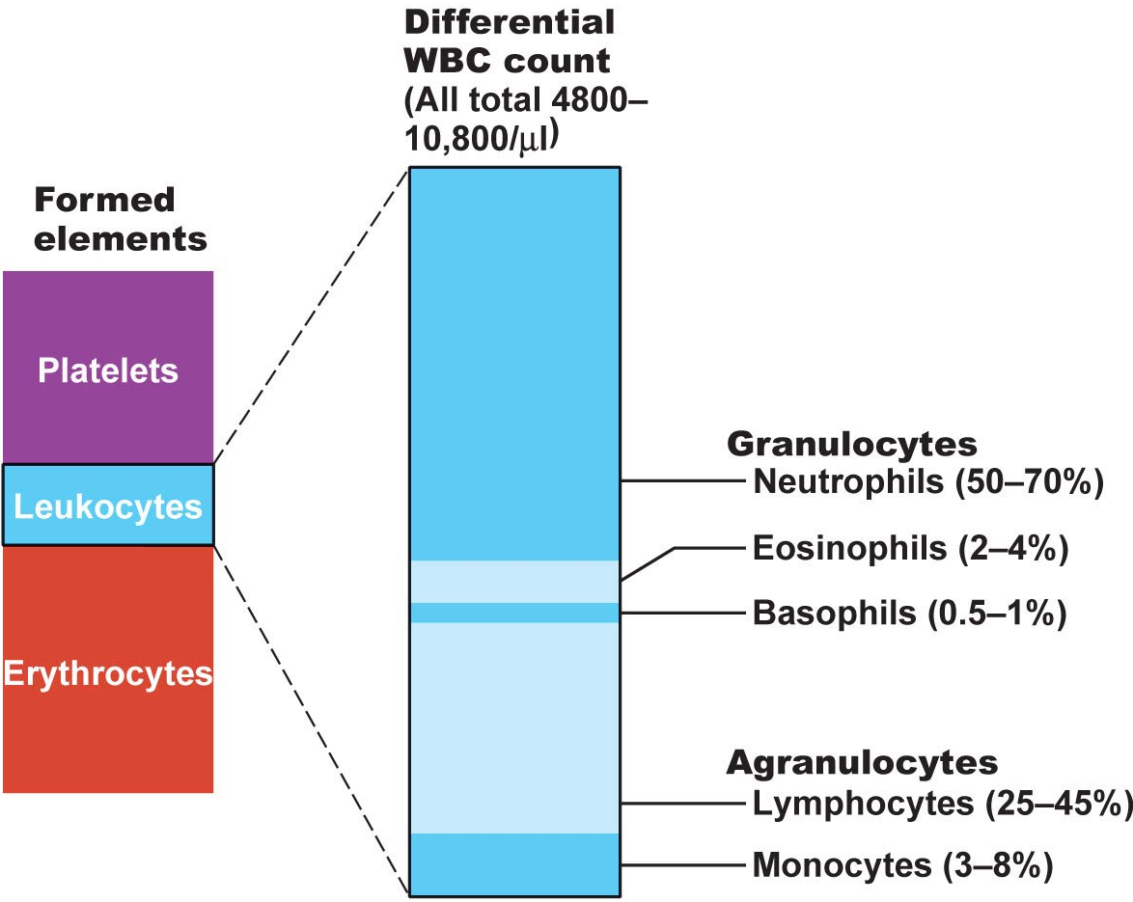

3.1 list the 5 different types of leucocytes and give a brief description of the structure and function of each
Leukocytes
only formed elements that are complete cells
• <1% total blood volume; usu 4000- 11,000 WBCs/μl
• protection against bacteria, viruses, parasites, toxins, tumor cells
• can leave bloodstream (diapedesis) to mount immune and/or inflammatory response
• amoeboid motion, + chemotaxis
leukocytosis: (count>11,000/μl) - body’s response to bacterial or viral invasion - # can double within hrs
• granulocytes & agranulocytes
Never Let Monkeys Eat Bananas
Fig. 17.9
See also Table 17.2
J. Carnegie, UofO

Slide 3
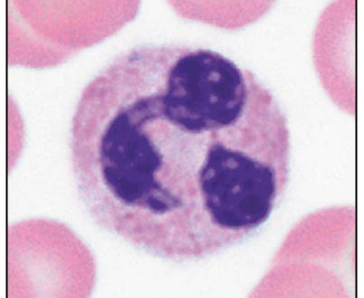
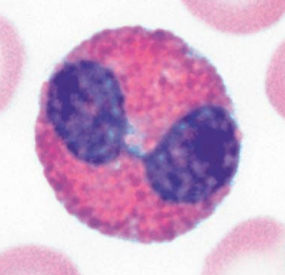
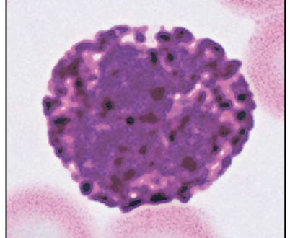
B1. Granulocytes
• neutrophils, basophils, eosinophils
• spherical, larger than RBCs, lobed nuclei, cytoplasmic granules, Wright’s stain
(i) Neutrophils: > 50% leukocytes; cytoplasm contains 2 types of granules that take up both acidic & basic dyes - granules contain hydrolytic enzymes & some antibiotic-like proteins (defensins) = polymorphic leukocytes
• phagocytes: ingest & destroy bacteria; (eg: meningitis, appendicitis)
(ii) Eosinophils: 2-4% all leukocytes; blue-red nucleus (telephone receiver) + coarse, red granules
> ***parasitic worms; cannot be phagocytized, but surround & release digestive enzymes
> modulate immune response → allergies, asthma
(iii) Basophils: rarest WBCs (0.5% of leukocytes); cytoplasmic granules contain histamine (vasodilator, makes blood vessels leaky & attracts other WBCs); S- or U-shaped dark purple nucleus
J. Carnegie, UofO

Slide 4
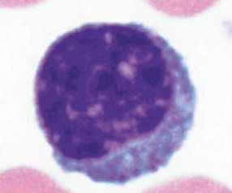
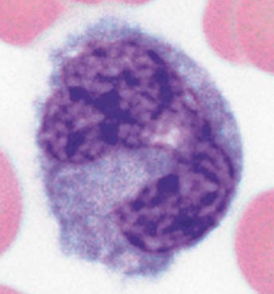
B2. Agranulocytes:
• includes lymphocytes, monocytes
• no visible granules; nuclei spherical or kidney-shaped
(i) Lymphocytes: 2nd most common leukocyte; large, dark purple nucleus + rim of pale blue cytoplasm; classified by size ; some in bloodstream, but most in lymphoid tissue (lymph nodes, spleen, etc)
T lymphocytes (T cells): act directly against virus-infected cells, tumor cells
B lymphocytes (B cells): give rise to plasma cells that produce antibodies
Monocytes: largest leukocytes; gray-blue cytoplasm + U- or
kidney-shaped nucleus; in tissue, differentiate into macrophages
> phagocytic in chronic infections (eg: TB)
> also against viruses, some bacteria
J. Carnegie, UofO

Slide 5
3.2 in flow chart form, summarize the main steps of leukopoiesis
• leukopoiesis is hormonally regulated according to body’s situation:
• interleukins and colony-stimulating factors: hormones that regulate production of leukocytes, as needed
Hemocytoblast
myeloid stem cell lymphoid stem cell
Stem cells
myeloblast monoblast lymphoblast
Committed cells
eosinophil neutrophil basophil monocyte lymphocyte
Products
• bone marrow stores mature granulocytes (not erythrocytes); usu contains 10- 20X more granulocytes than in blood
• lifespan of granulocytes = 0.5-9.0 days (most die in line of duty)
J. Carnegie, UofO

Slide 6
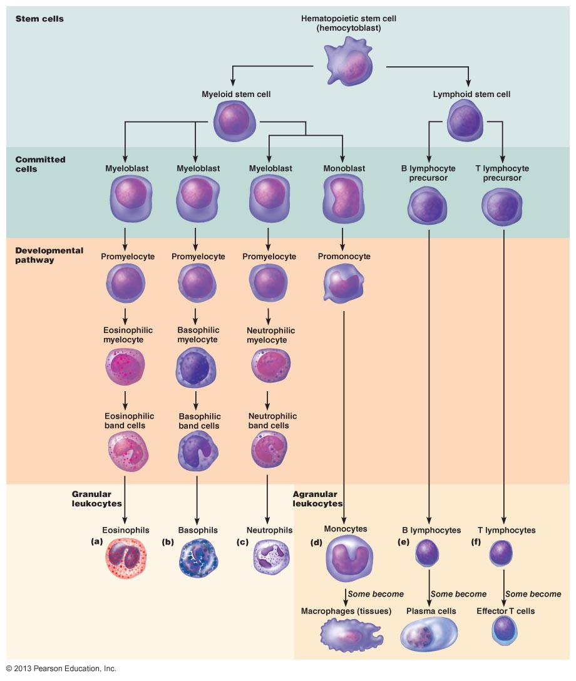
Fig. 17.11

Slide 7
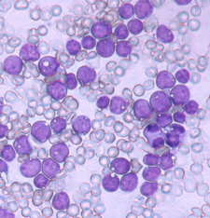
3.3 discuss briefly each of these leukocyte disorders in terms of causes & consequences: leukemia, infectious mononucleosis, leukopenia
Leukemias: cancer of WBCs - usu descendents of a single cell remain unspecialized & mitotic
> acute if derives from blast-type cell; chronic if from cells at later stages
bone marrow taken over by cancerous cells ➢ severe anemia, clotting problems (also fever, weight loss, bone pain)
> NB: WBCs numerous but non-functional - death usu from internal bleeding & overwhelming infections
> Treatment: irradiation & admin of anti-leukemic drugs; bone marrow transplant
http://www.stanford.edu/group/cleary/leukemia.jpg
J. Carnegie, UofO

Slide 8
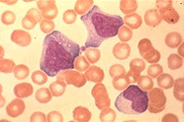
Infectious mononucleosis: caused by Epstein-Barr virus; excessive numbers of enlarged and abnormally-shaped lymphocytes (initially mistaken as monocytes), many abnormal (tired, achy, chronic sore throat, low-grade fever); rest the only treatment
Leukopenia: abnormally low WBC count - usu due to drugs, esp glucocorticoids & anticancer agents
Infectious mononucleosis & production of atypical lymphocytes; eduserv.hscer.washington.edu/.../

Slide 9
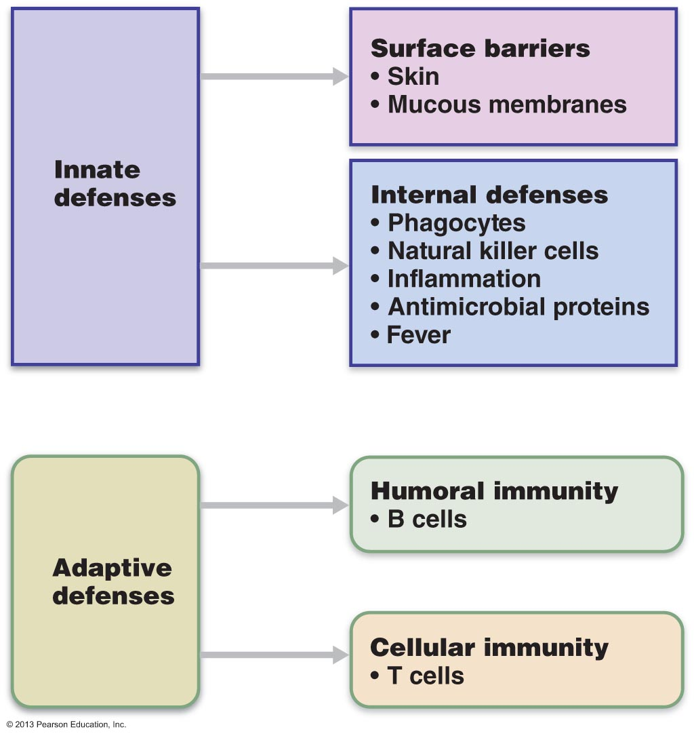
THE IMMUNE SYSTEM
Innate (nonspecific) defenses: protect against foreign substances/abnormal cells without having to specifically identify them (generalized carbohydrate/lipid cell surface markers)
Adaptive (specific) defenses: (acquired immunity) – subpopulations of lymphocytes recognize the specific target (usually specific cell surface proteins) and attack the target
Fig. 21.1

Slide 10
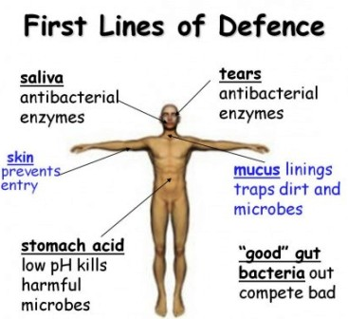
INNATE DEFENSES
Skin & Mucous Membranes
• effective, but can be breached
• ACID: acidity of skin, vaginal and stomach secretions deters growth of bacteria
• ENZYMES: lysozyme in saliva, respiratory mucus, lacrimal fluid; also protein-digesting enzymes in stomach
• MUCIN: digestive and respiratory passageways – sticky, traps microorganisms
• DEFENSINS: broad-spectrum anti-microbial peptides secreted by mucous membranes and skin
OTHER CHEMICALS: some lipids in sebum and dermicidin inn eccrine sweat are toxic to bacteria
http://4.bp.blogspot.com/-x6_92YIWEOA/UKEUN5vk-zI/AAAAAAAAByE/LlHatSUli6k/s1600/first+line+of+defense.jpg

Slide 11
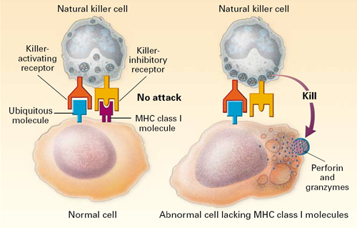
Natural Killer Cells
police blood and lymph; part of innate immune system
can kill virus-infected cells or cancer cells even before adaptive immune system activated
don’t identify invaders; just recognize abnormalities on surface of body cells such as loss of self-antigens – recognize cells that are “stressed”
contact target and inject toxins inducing it to undergo apoptosis
NK population greatly reduced in people with AIDS
http://sphweb.bumc.bu.edu/otlt/MPH-Modules/PH/Ph709_Defenses/PH709_Defenses4.html

Slide 12
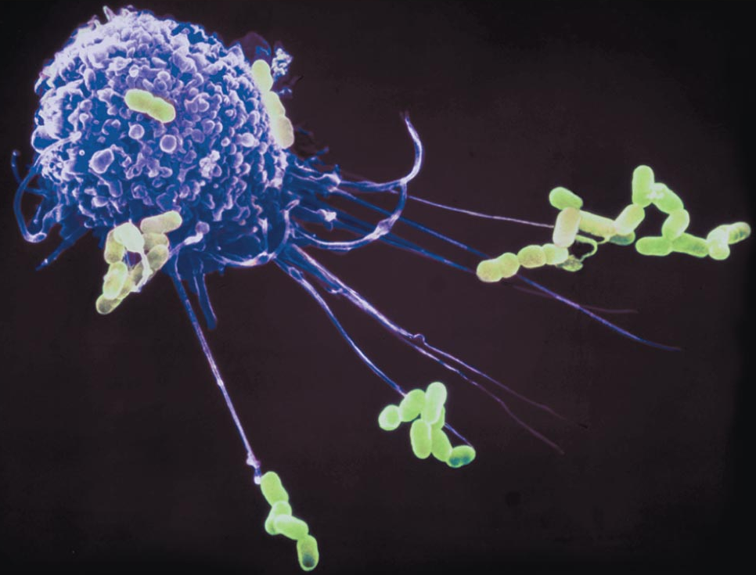
Inflammation
• a response to any type of injury – eg:
• 4 key signs: redness, heat, swelling, pain
(i) prevents spread of damaging agents to nearby tissues
(ii) disposes of cell debris & pathogens
(iii) sets the stage for repair processes
(iv) alerts the adaptive immune system
inflammation occurs as part of nonspecific defenses and can be amplified by specific immune system responses
inflammatory chemicals (e.g. histamine, kinins, prostaglandins, complement) released by injured cells, macrophages, lymphocytes
Fig. 21-2

Slide 13
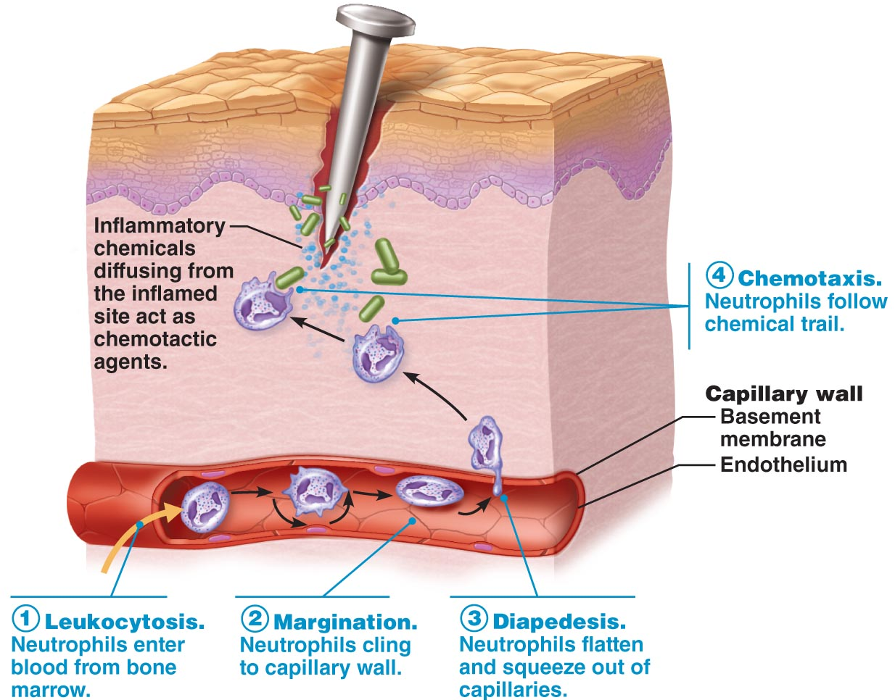
What causes pain during inflammation?
Why is inflammation a helpful response to tissue injury?
Define: margination, diapedesis, chemotaxis
Fig. 21.4

Slide 14
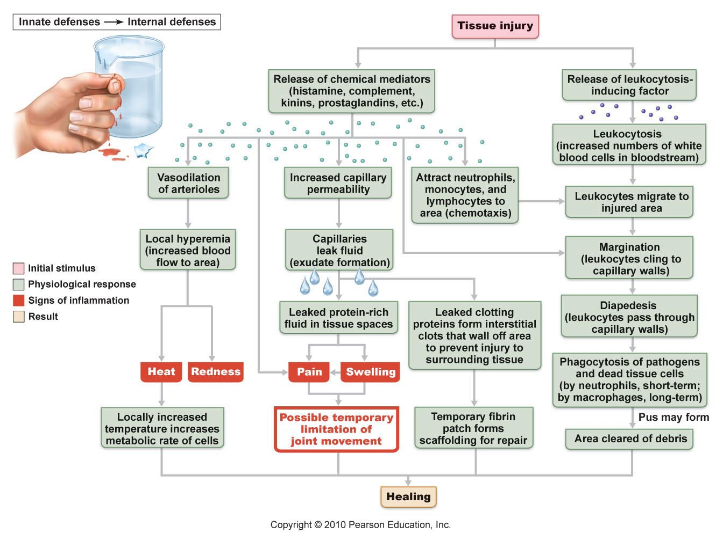
Fig. 21.3: Inflammation

Slide 15
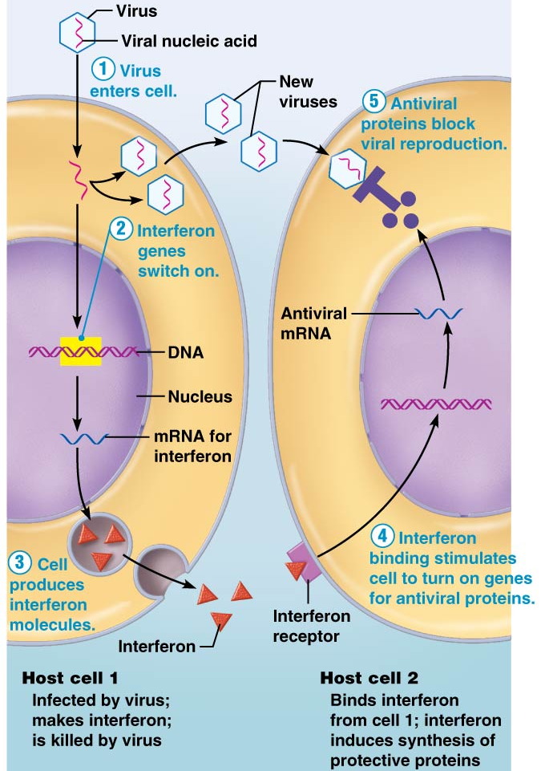
The Body’s Antimicrobial Proteins
Interferon:
• secreted by virus-infected cells – diffuse to nearby non-infected cells & block protein synthesis, also degrade viral RNA
• NOT virus-specific
• interferons also activate macrophages & mobilize natural killer cells, allowing for some anti-cancer effects as well
Fig. 21.5
J. Carnegie, UofO

Slide 17
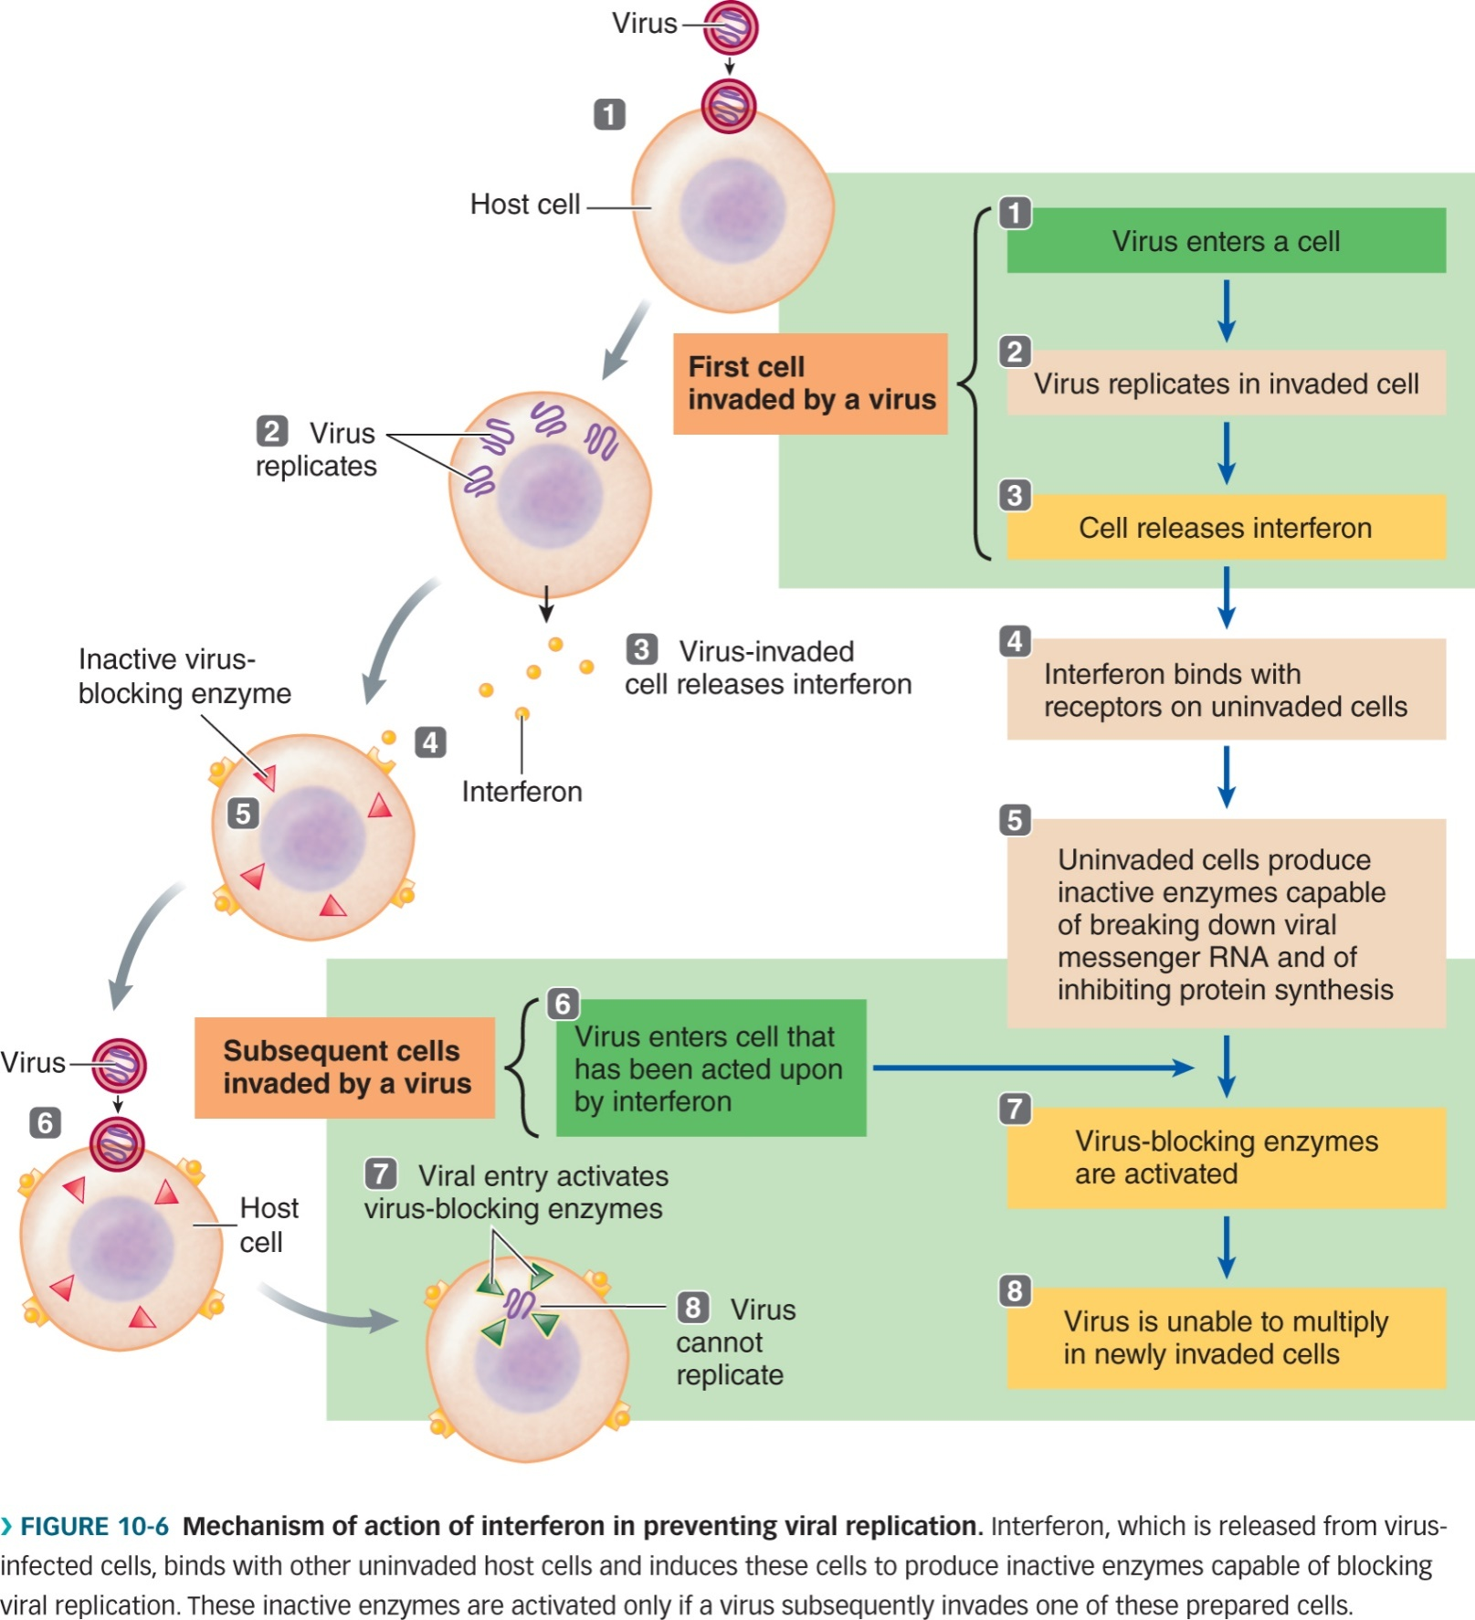
Fig. 10-6 (Sherwood): Interferon Mechanism

Slide 18
Complement:
• refers to a group of at least 20 plasma proteins circulating in an inactive state
• once activated, various components amplify all aspects of inflammatory process
Fig. 18-5. C3b functions as an opsonin – what does this mean?
J. Carnegie, UofO

Slide 19
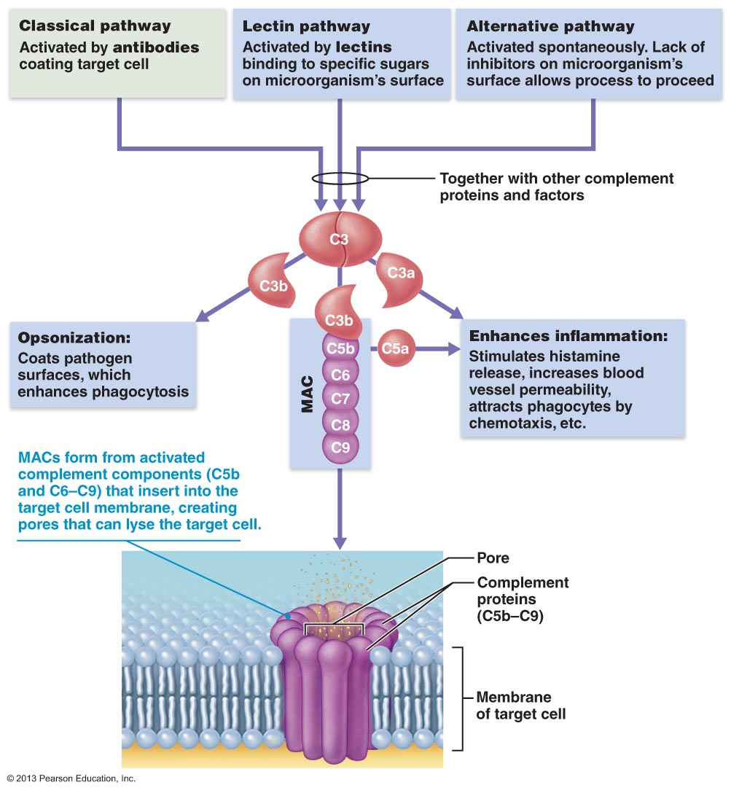
MAC = membrane attack complex
Link to animation: http://highered.mcgraw-hill.com/sites/0072556781/student_view0/chapter31/animation_quiz_1.html

Slide 20
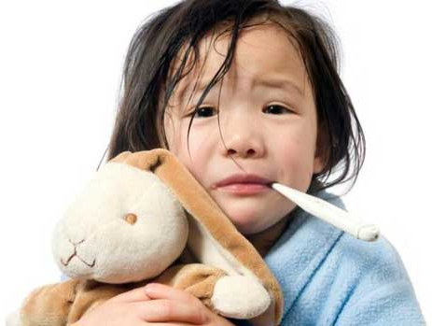
Fever
• body’s thermostat normally set at …………
• reset by pyrogens released by leukocytes & macrophages exposed to bacteria & other foreign substances
• high fever is dangerous – why??
• moderate fever is helpful:
(i)
(ii)
J. Carnegie, UofO

Slide 21
Adaptive Mechanisms

Slide 22
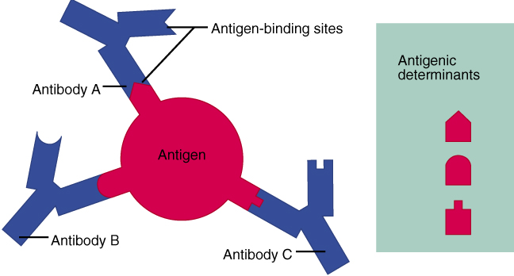
3 crucial cell types involved in body immunity are:
1) B lymphocytes (humeral immunity)
2) T lymphocytes (cell-mediated immunity)
3) macrophages (antigen-presenting cells)
Lymphocytes
• originate in red bone marrow from hemocytoblasts
• initially, all lymphocytes identical - whether becomes B- or T-lymphocyte depends on where in body acquires immunocompetence (what is this??)
What is an antigen??
What is the major histocompatibility complex?
Fig. 21.7
J. Carnegie, UofO

Slide 23
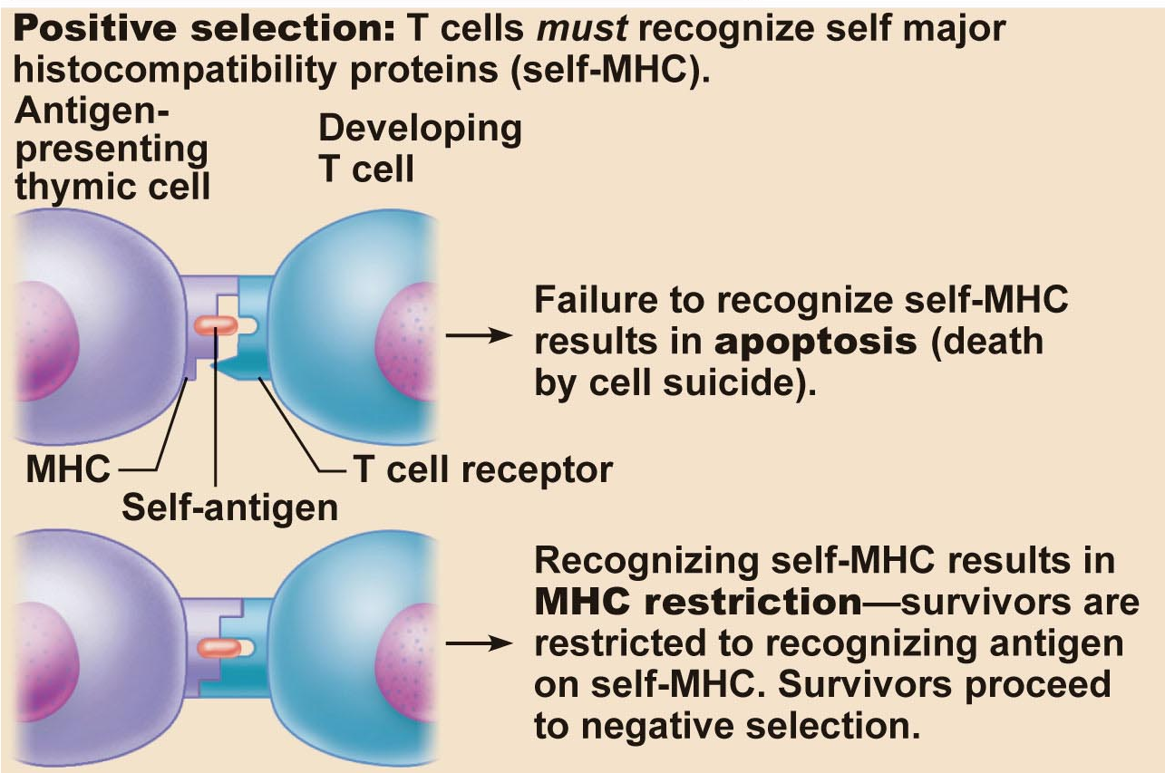
T-cells: migrate to thymus where undergo maturation (2-3 d) under direction of thymic hormones
1.
Fig. 21.9
J. Carnegie, UofO

Slide 24
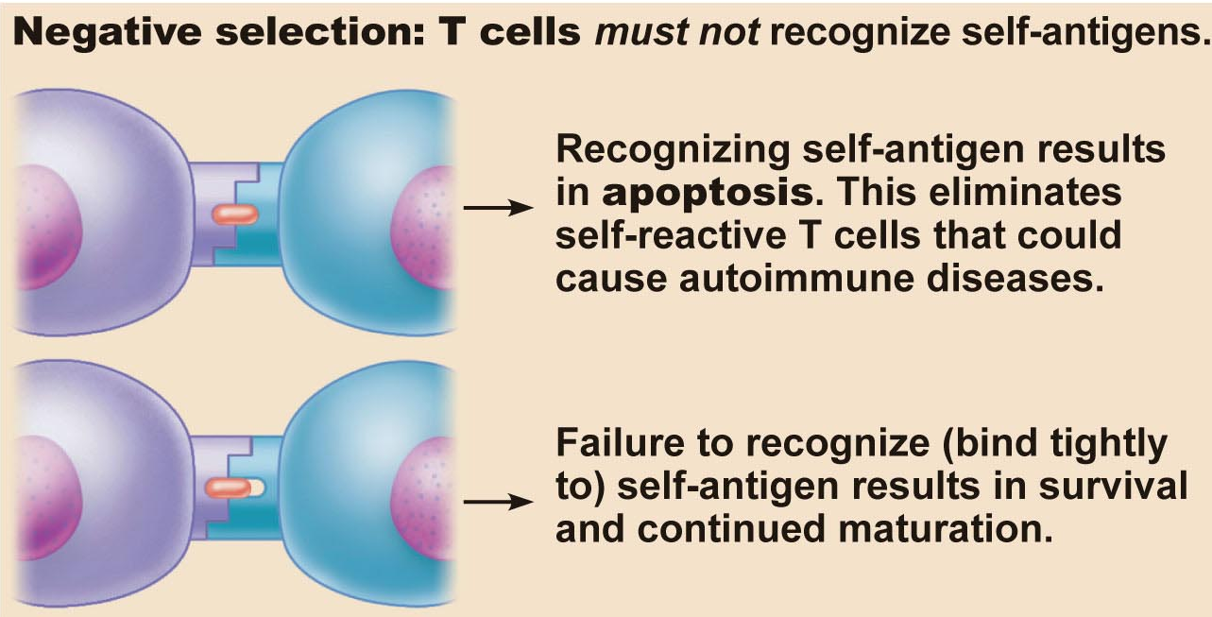
2.
B-cells: immature lymphocytes undergo maturation in bone marrow; self reactive ones again weeded out
once immunocompetent, display unique receptor on cell surface which makes them able to react to one & only one foreign antigen
lymphocytes become immunocompetent before meeting antigens they may later attack
“It is our genes, not antigens, that determine what specific foreign substances our immune system will be able to recognize and resist.”

Slide 25
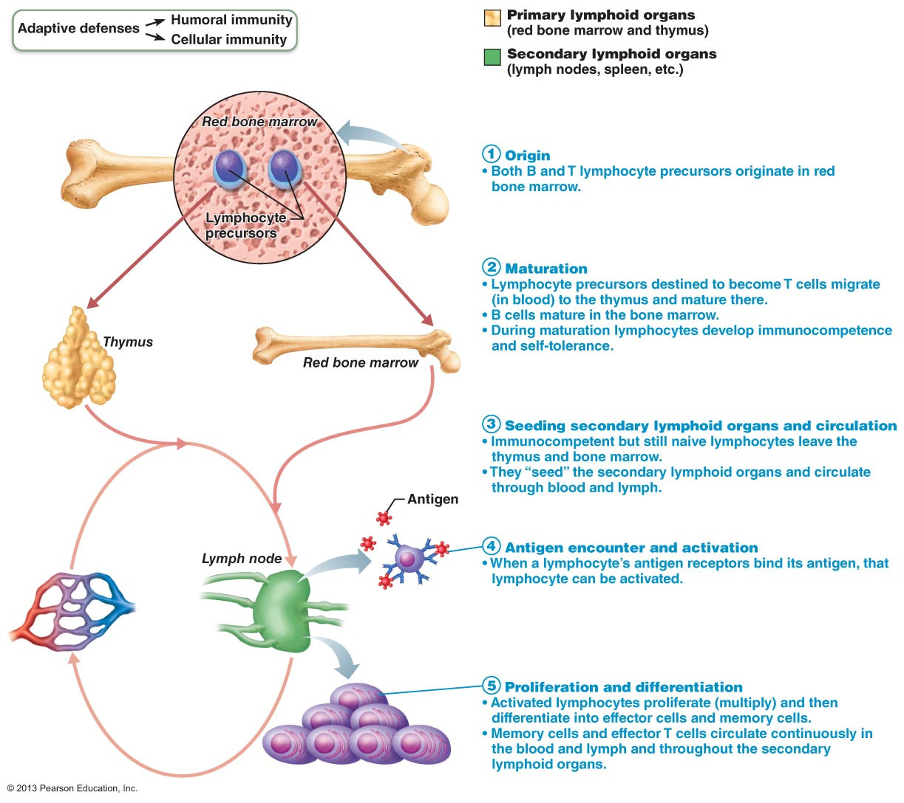
Fig. 21.8. Lymphocyte development, maturation & activation

Slide 26
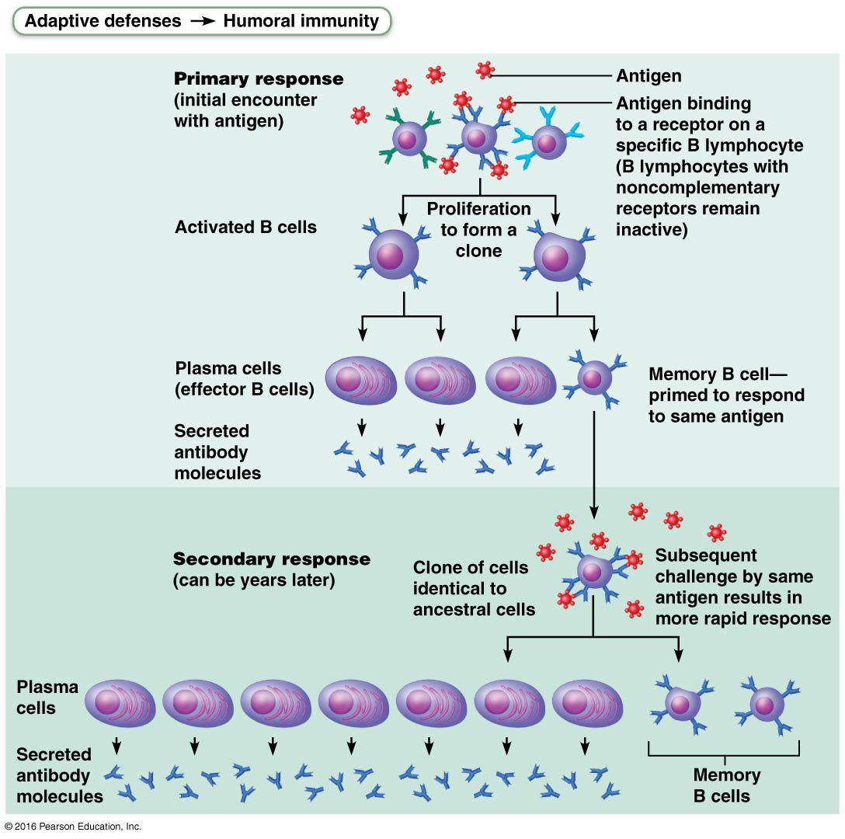
Humoral Immune Response
• antigen challenge usually in spleen or lymph node
• if lymphocyte is a B-cell ➢ humoral immune response is evoked
(i) plasma cells turn out specific antibodies at a terrific rate; last 4-5 days
(ii) antibodies circulate & bind to free antigen ➢ destruction
(iii) clone cells that don’t become plasma cells remain as memory cells; can be called upon years later
Fig. 21.11

Slide 27
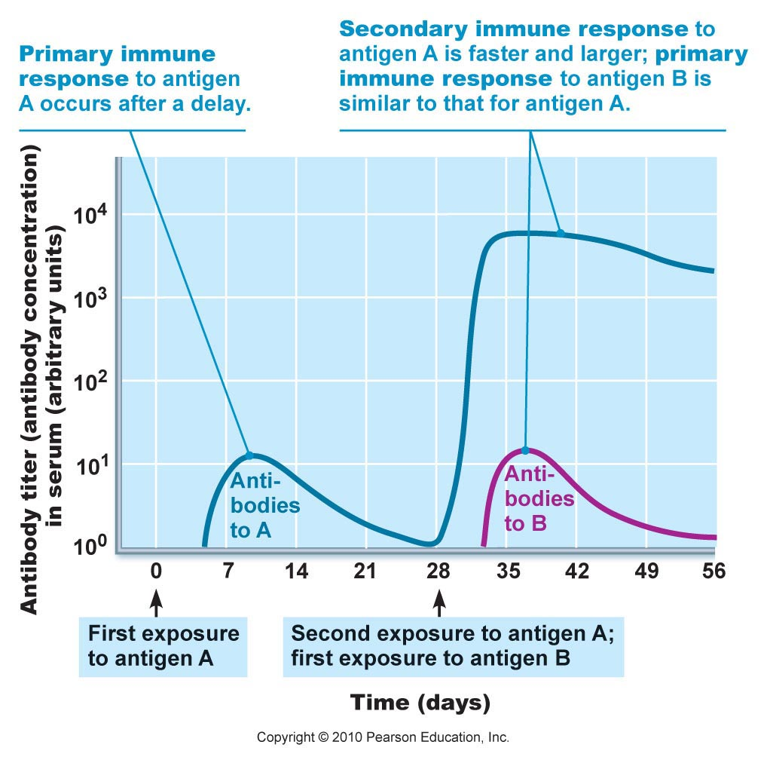
Where do vaccines fit into this?
Understand the concept of immunological memory.
Fig. 21.12

Slide 28
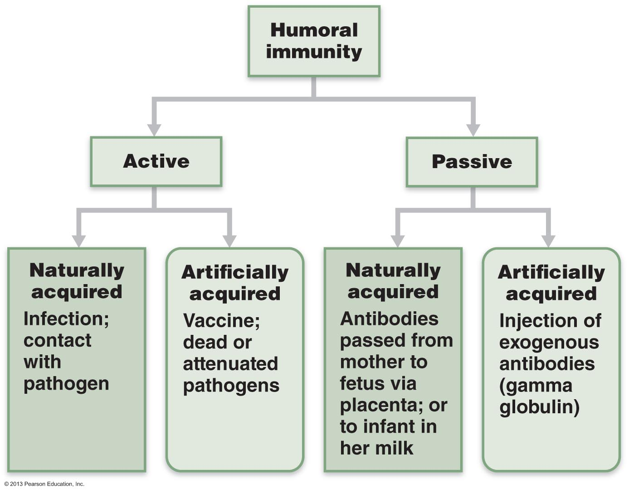
Only active immunity is able to establish immunological memory!

Slide 29
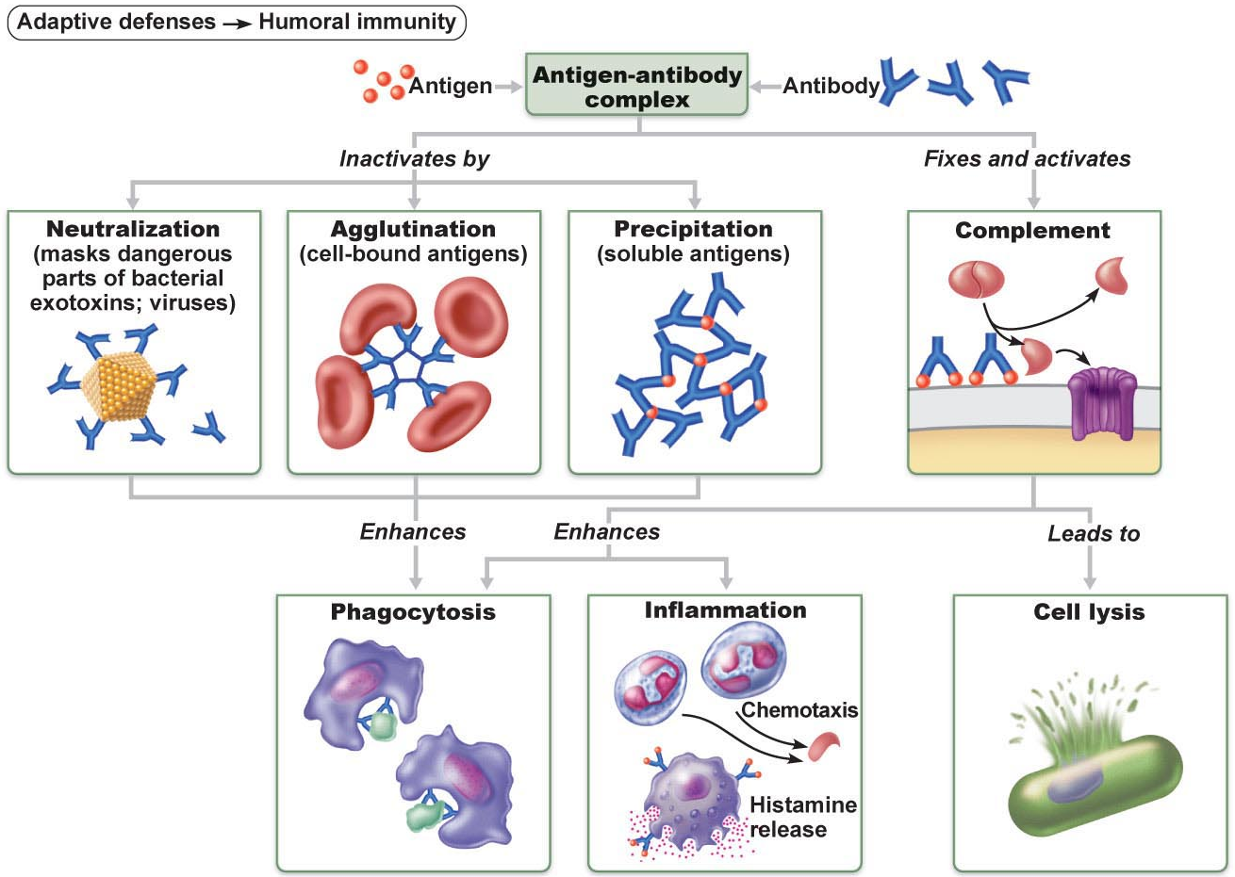
Fig. 21.15: Mechanisms of Antibody Action

Slide 30
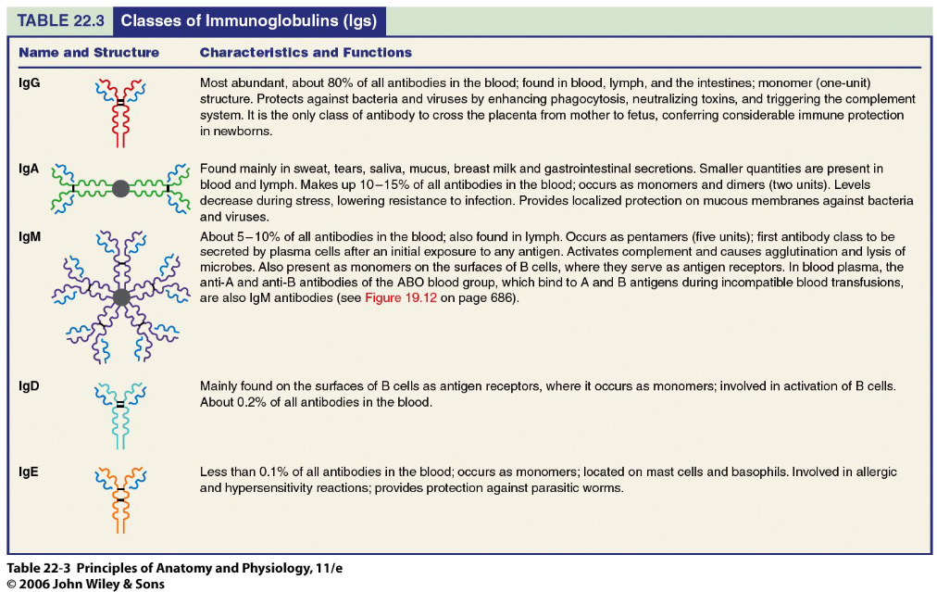

Slide 31
Cell-Mediated Immune Response (T-Cells)
• antibodies can handle only obvious antigens (outside cells) - cannot, eg, fight TB bacillus or viruses that multiply inside cells
• involves various types of T-cells - don’t respond to free antigens; « see » only processed antigen fragments displayed on body’s own cells
• direct attack against body cells infected by viruses, bacteria; also abnormal or cancerous cells, cells of infused/transplanted foreign tissues
There are three main subpopulations of T-cells:
CD8 cells = Cytotoxic T cells: killer T cells - attack & kill other cells using perforin
CD4 = Helper T cells: stimulate proliferation & activity of other lymphocyte subpopulations (including plasma cells) – most prevalent type of T-cell
Regulatory T cells: wind down/stop immune response – a small subset of CD4 cells
J. Carnegie, UofO

Slide 32
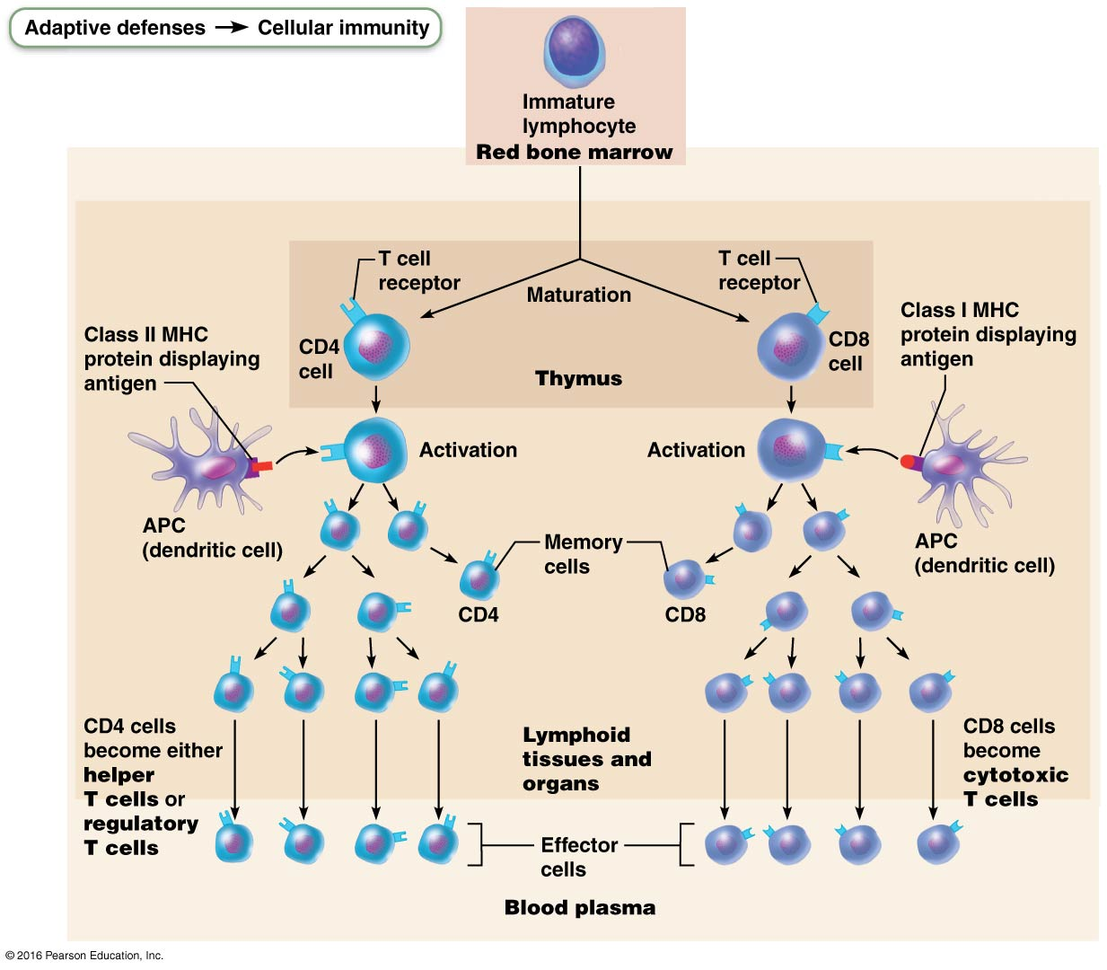
Fig. 21.16

Slide 34
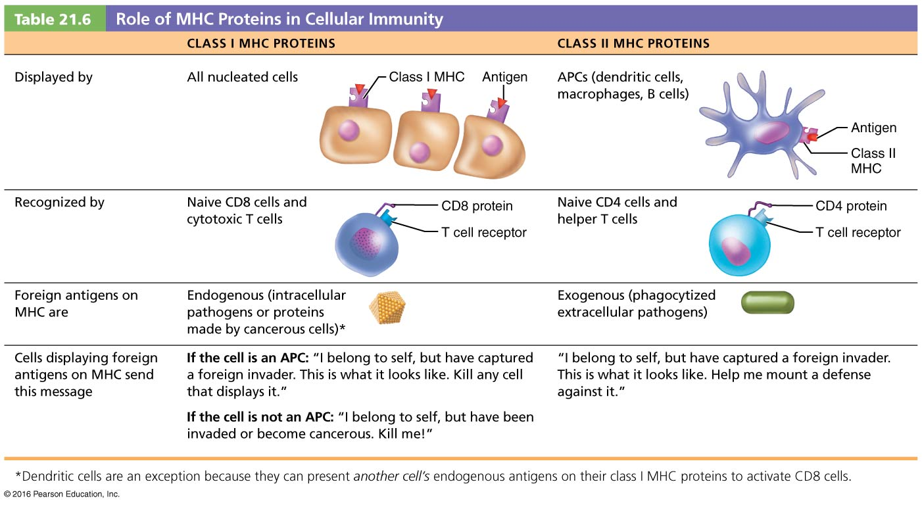
NB: CD4 and CD8 are cell differentiation glycoproteins expressed on cell surfaces; CD4 cells become helper cells while CD8 cells become cytotoxic T cells

Slide 35
Macrophages
• arise from monocytes formed in bone marrow
(i) major role is to engulf foreign particles & present fragments of these antigens on own surfaces so can be recognized by T-cells (antigen presenters)
(ii) also secrete soluble proteins that activate T cells → activated T cells then secrete factors that activate macrophages
• macrophages tend to remain in lymphoid organs waiting for antigens to come to them; T-cells circulate freely, increases chances of contact with foreign antigens
• lymph capillaries pick up proteins & pathogens from nearly all body tissues; eg: source of microorganisms for tonsils??? for spleen???
• effectiveness of immune system in fighting disease depends on:
(i) ability to recognize foreign antigens by binding to them
(ii) ability to communicate with one another so whole organism mounts a specific immune response to those antigens

Slide 36
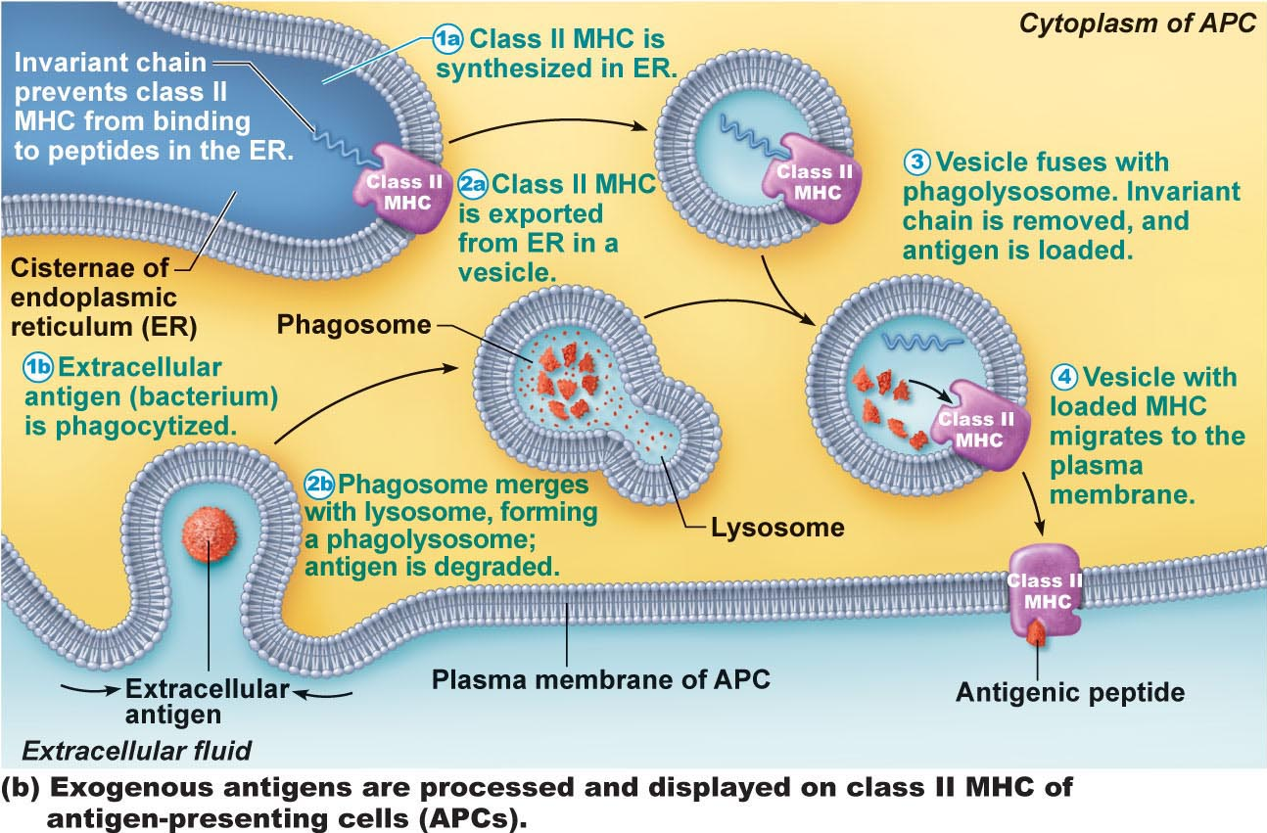
Fig. 21.17b (9th edition): Antigen Presentation

Slide 37
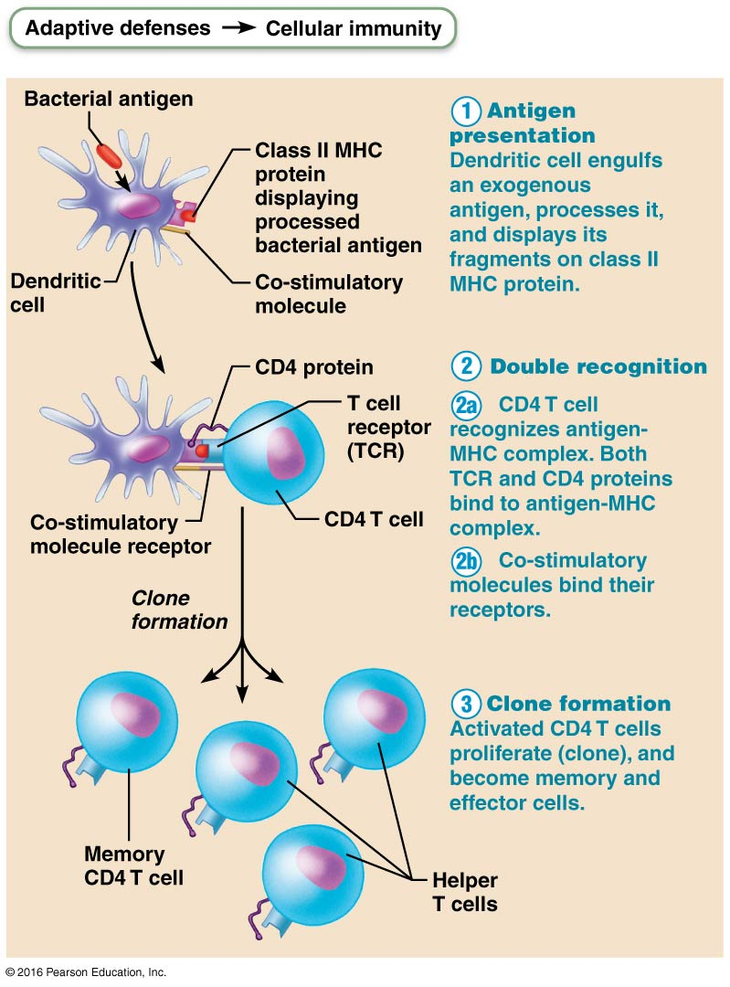
Clonal selection of T cells involves simultaneous recognition of self and non-self.
Fig. 21.17

Slide 38
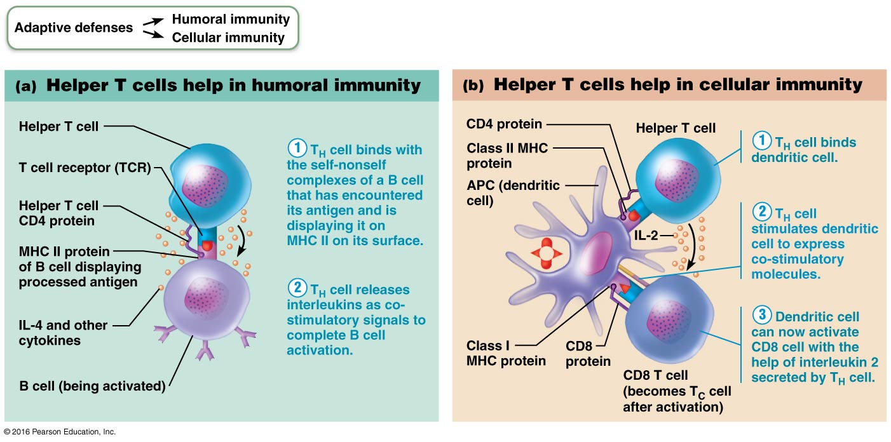
Fig. 21.18: The central role of helper T cells in mobilizing both humoral and cellular immunity.

Slide 39
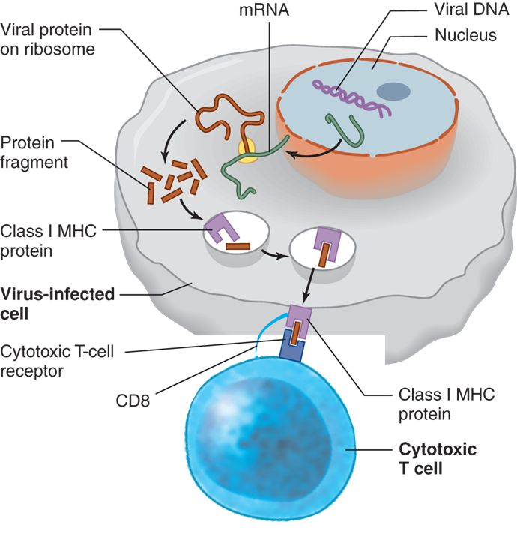
Fig. 18.15 (V): How do cytotoxic T cells recognize cancerous cells, cells that have been infected with viruses?
Cytotoxic T Cells recognize antigens presented via class 1 MHC [expressed by almost all cell types]

Slide 40
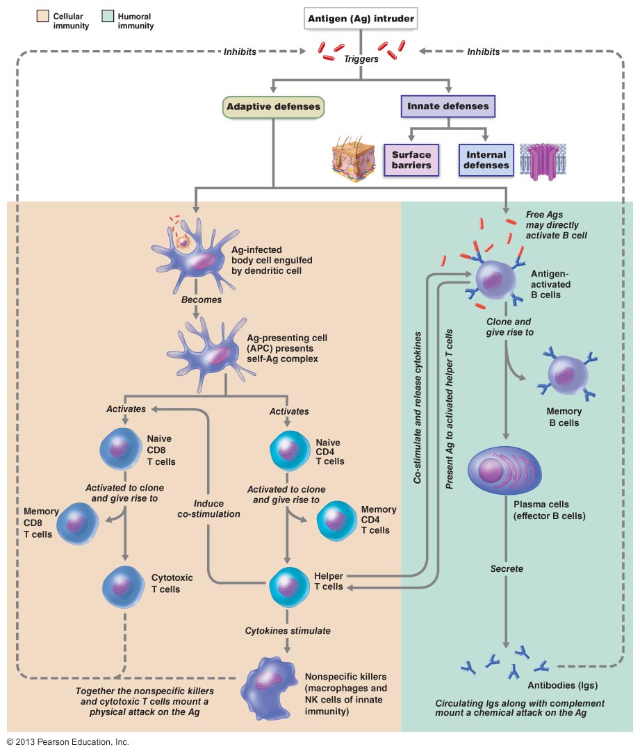
Fig. 21.20
Simplified summary of primary immune response

