Slide 1
E-Business Strategy

Slide 2
Learning Outcomes
Follow an appropriate strategy process model for e-business
Apply tools to generate and select e-business strategies
Outline alternative strategic approaches to achieve e-business.

Slide 3
Management Issues
How does e-business strategy differ from traditional business strategy?
How should we integrate e-business strategy with existing business and information systems strategy?
How should we evaluate our investment priorities and returns from e-business?

Slide 4
Michael Porter on the Internet
‘The key question is not whether to deploy Internet technology – companies have no choice if they want to stay competitive – but how to deploy it’
Porter, M. (2001) Strategy and the Internet,
Harvard Business Review, March 2001, 62–78.

Slide 5
Alternative Definitions of Strategy
What is strategy?
  ‘Defines how we will meet our objectives’
  ‘Sets allocation of resources to meet goals’
  ‘Selects preferred strategic option to
  compete within a market’
  ‘Provides a long-term plan for the development of the organization’.

Slide 6
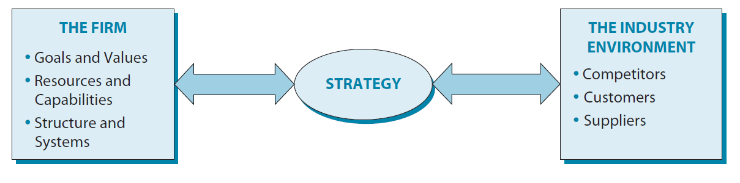
“Without a strategy the organization is like a ship without a rudder.”
        Joel Ross and Michael Kami

Slide 7
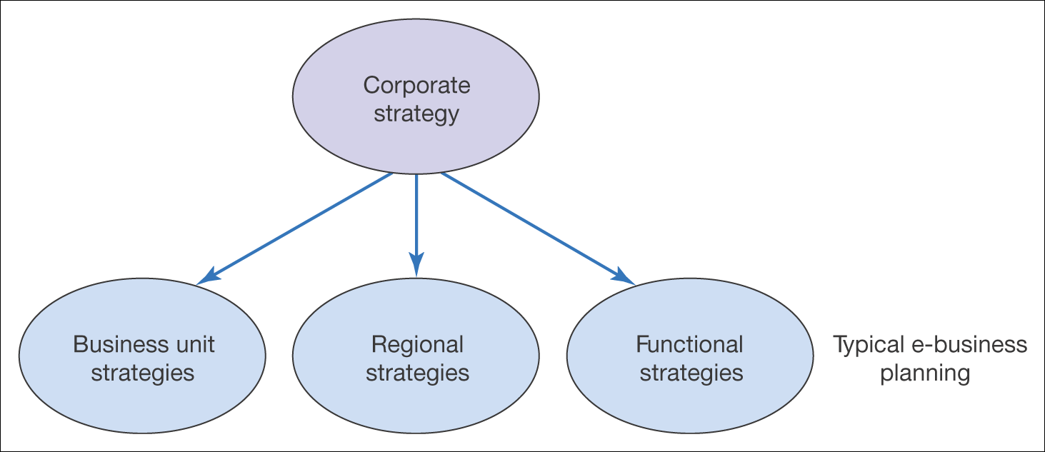
Figure 5.1 Different forms of organizational strategy

Slide 8
Sell-Side E-Commerce Strategy or E-Marketing / E-CRM Strategy
Sell-side e-commerce is a channel strategy
Objectives for online contribution percentage
should drive our strategy
Our e-commerce strategy defines how we should
    Hit our channel leads and sales targets
      Acquisition, Conversion, Retention, Service, Profitability
    Communicate benefits of using this channel
    Prioritize products available through channel
    Prioritize audiences targeted through channel
    Select partners for this channel
Channel strategy thrives on differentials
BUT, need to manage channel integration.

Slide 9
Buy-Side E-Commerce Strategy or E-Supply Chain Management Strategy
Buy-side e-commerce strategy is about maximizing operational efficiencies while improving customer service quality
Operational efficiency KPIs should drive our strategy
Our buy-side e-commerce strategy defines how we should
    Automate internal processes
    Link internal resource management systems with external purchasing systems
    Prioritize suppliers/partners collaborating using this channel
    Prioritize applications for E-SCM – create a roadmap
Involves selection of appropriate strategic partners.

Slide 10
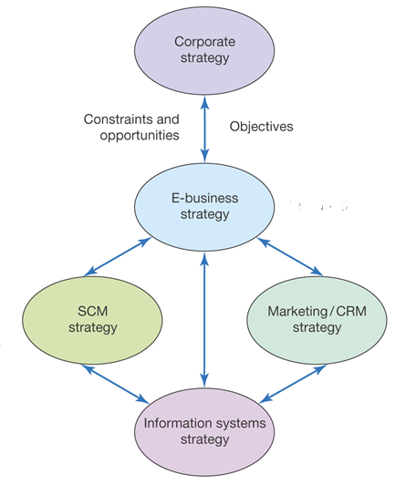
Figure 5.2 Relationship between e-business strategy and other strategies

Slide 11
What Happens Where There Is
No E-Business Strategy?
Missed opportunities for additional sales on the sell-side and more efficient purchasing on the buy-side
Fall-behind competitors in delivering online services – may become difficult to catch-up, for example, Tesco, Dell
Poor customer experience from poorly integrated channels.

Slide 12
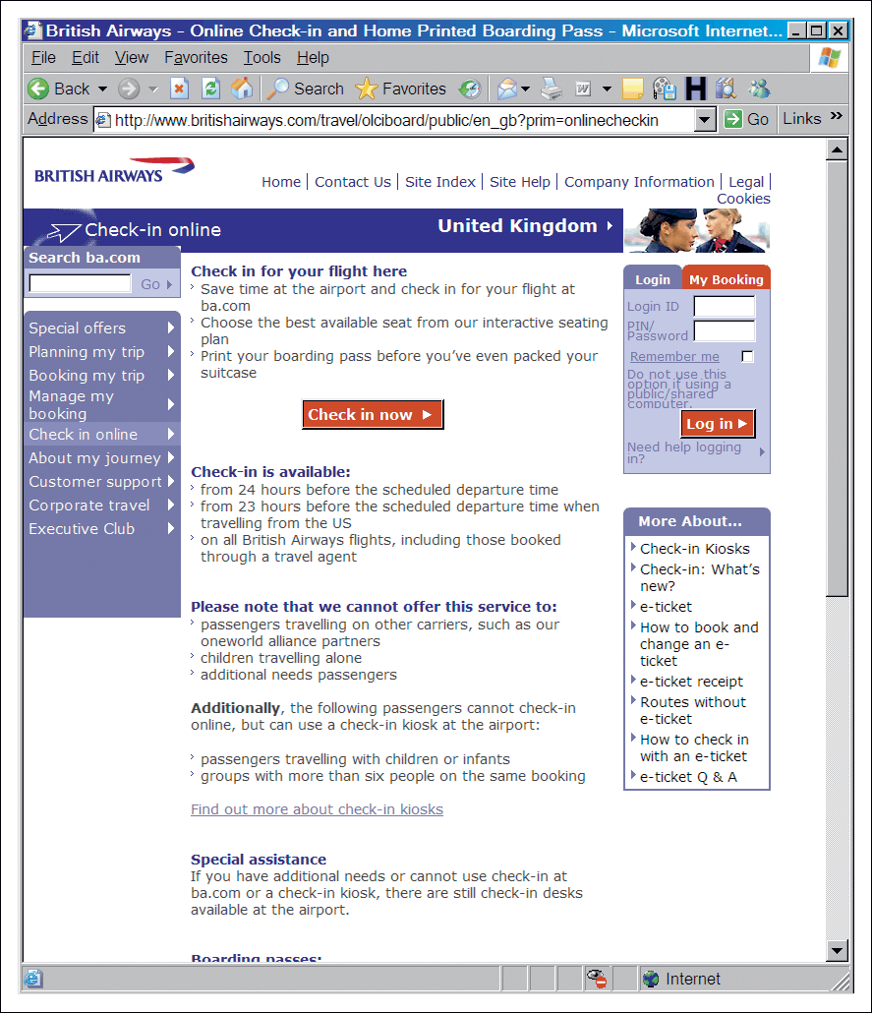
Figure 5.3 BA communicates its online value proposition
Source: Based on Revolution (2005); wwwbritishairways.com

Slide 13
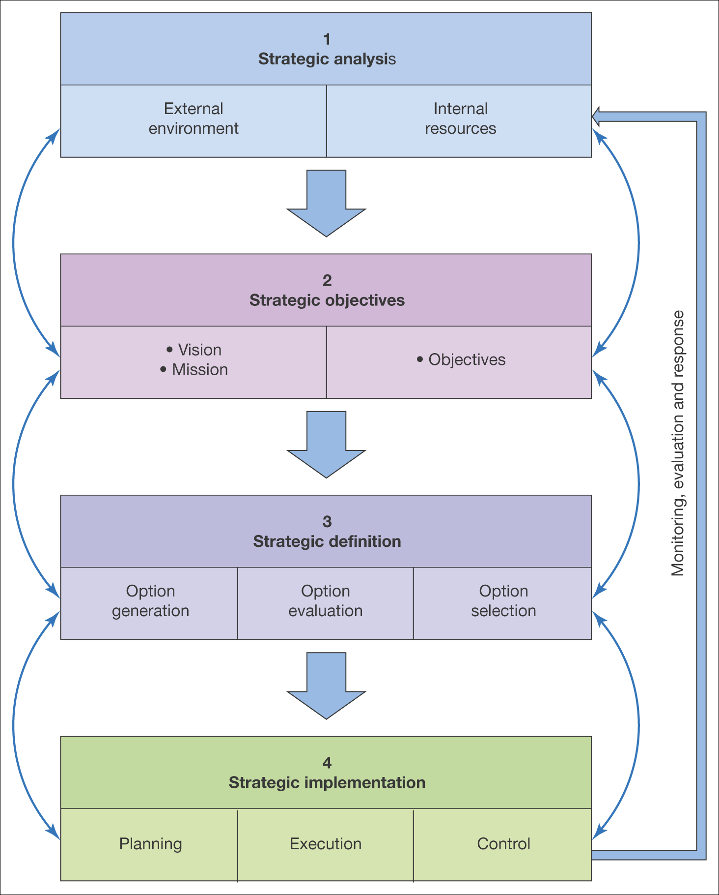
Figure 5.4 A generic strategy process model

Slide 14
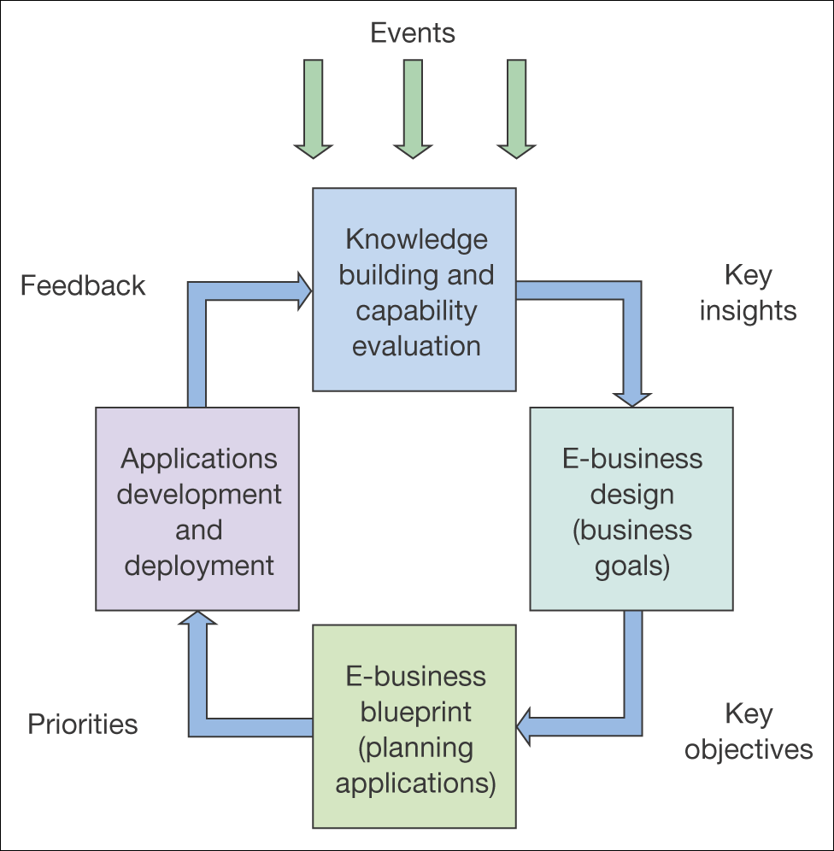
Figure 5.5 Dynamic e-business strategy model
Source: Adapted from description in Kalakota and Robinson (2000)

Slide 15
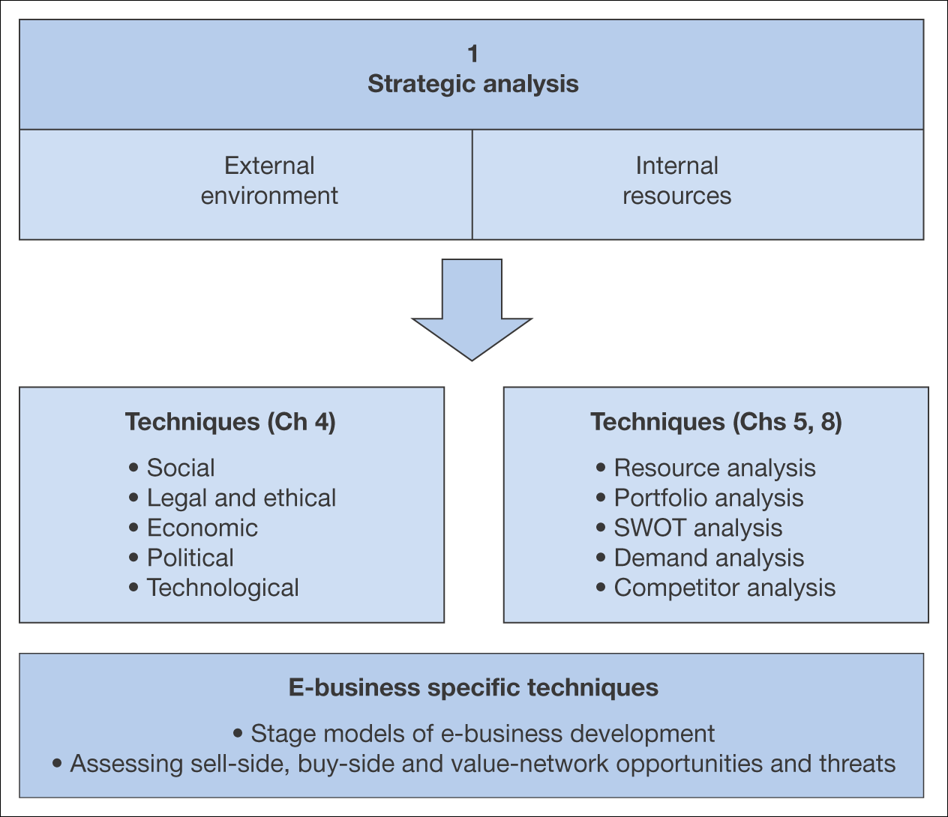
Figure 5.6 Elements of strategic situation analysis for the e-business

Slide 16
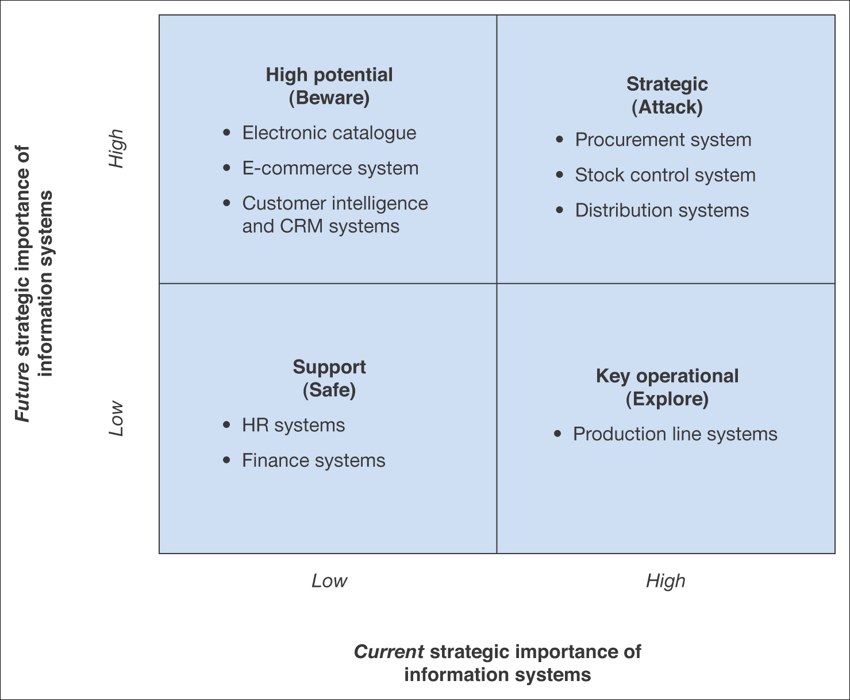
Figure 5.7 Summary applications of a portfolio analysis for an example B2B company

Slide 17
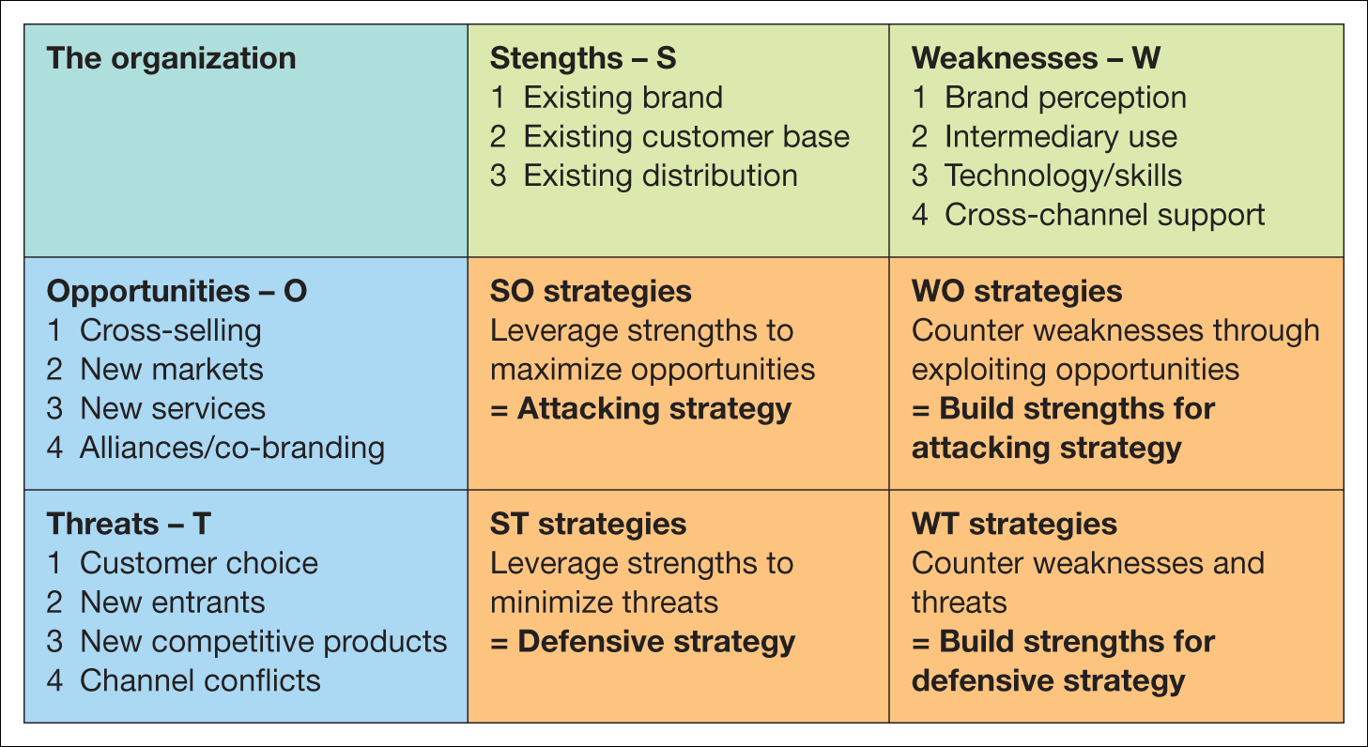
Figure 5.8 SWOT analysis

Slide 18
Activity
Impact of Internet
For one of the industries below, assess how the Internet has changed the competitive forces, for example, has it increased or decreased power of suppliers and customers?
Industries:
  Banking
  Supermarkets
  Oil industry
  Rail industry

Slide 19
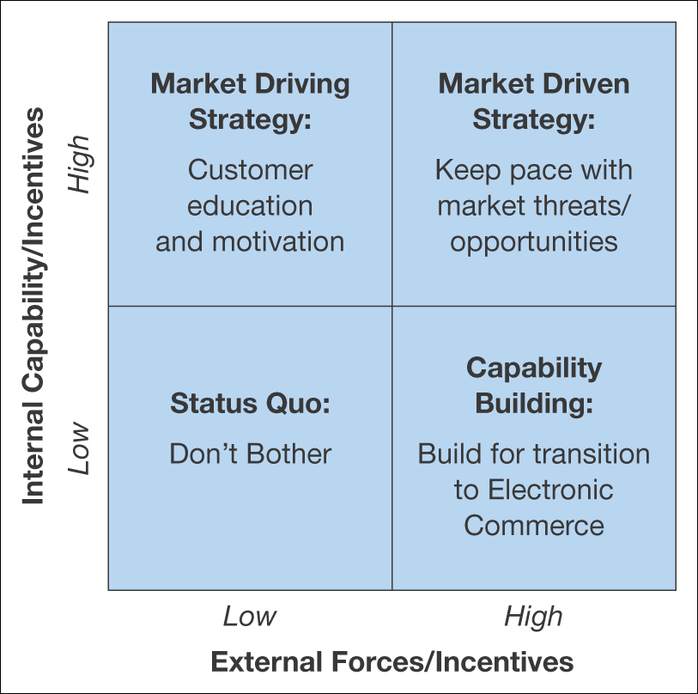
Figure 5.9 Matrix for evaluation of external capability against internal capability
Source: Perrott (2005)

Slide 20
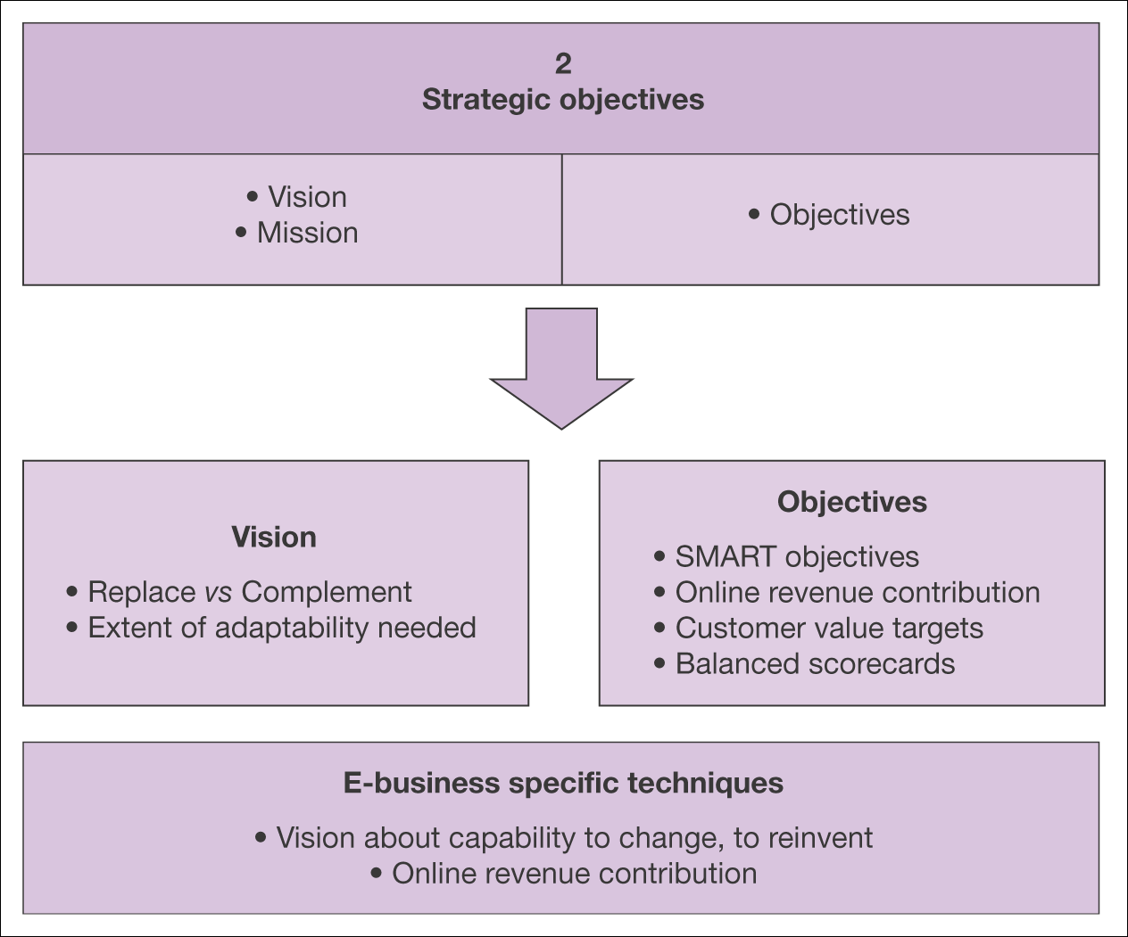
Figure 5.11 Elements of strategic objective setting for the e-business

Slide 21
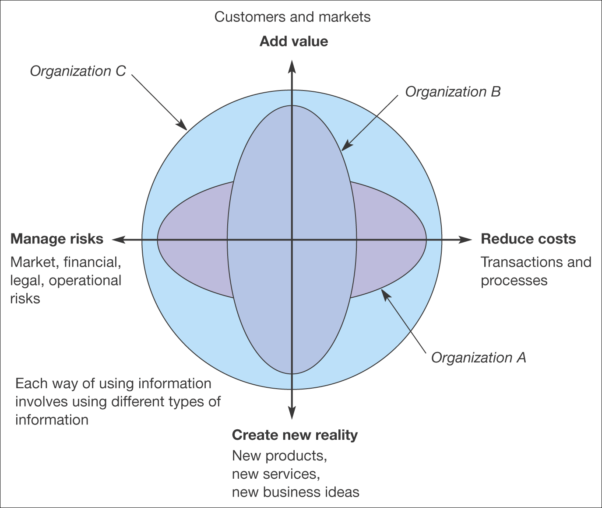
Figure 5.12 An evaluation tool relating information to business value. An organization’s
use of information on each axis can be assessed from 1 (low use of
information) to 10 (high use of information)
Source: Marchand et al. (1999)

Slide 22
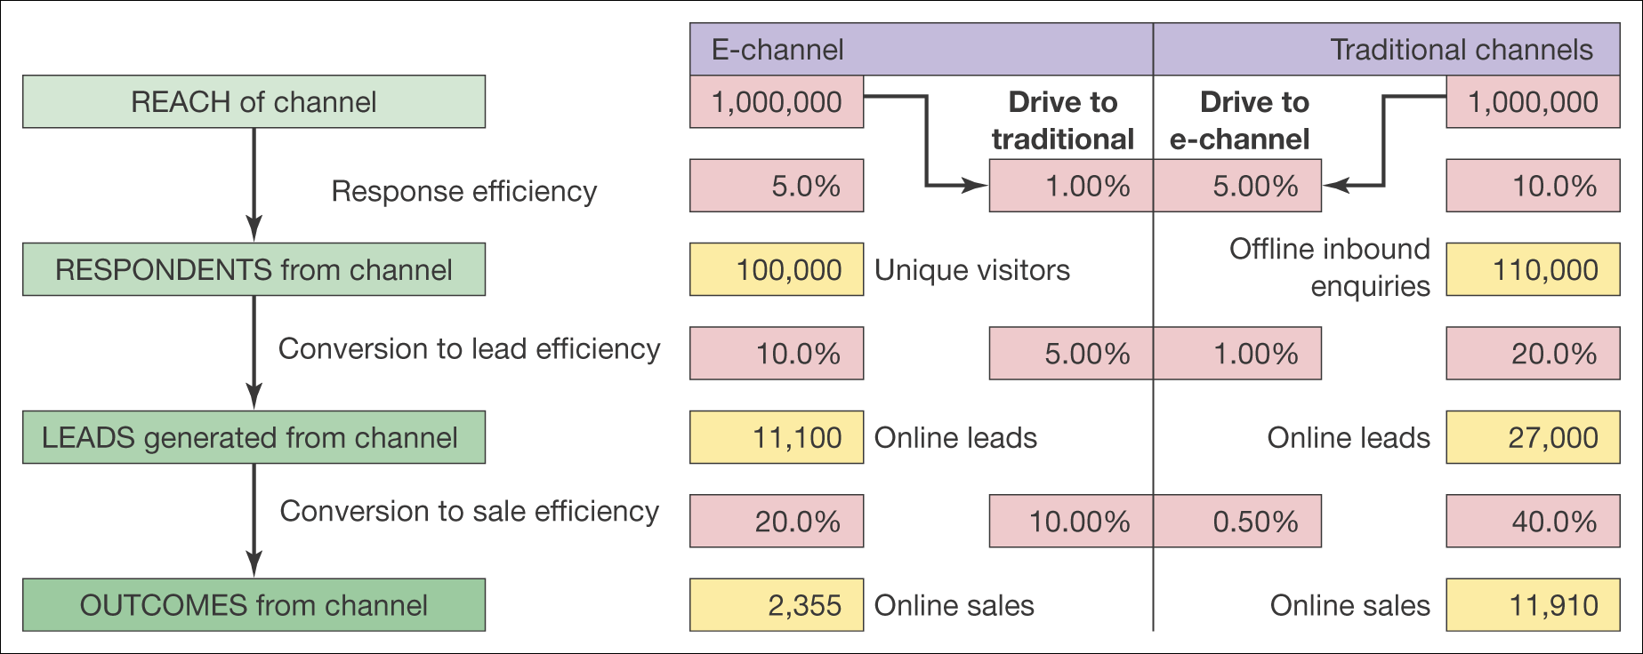
Figure 5.14 An example of conversion modelling for an online retailer

Slide 23
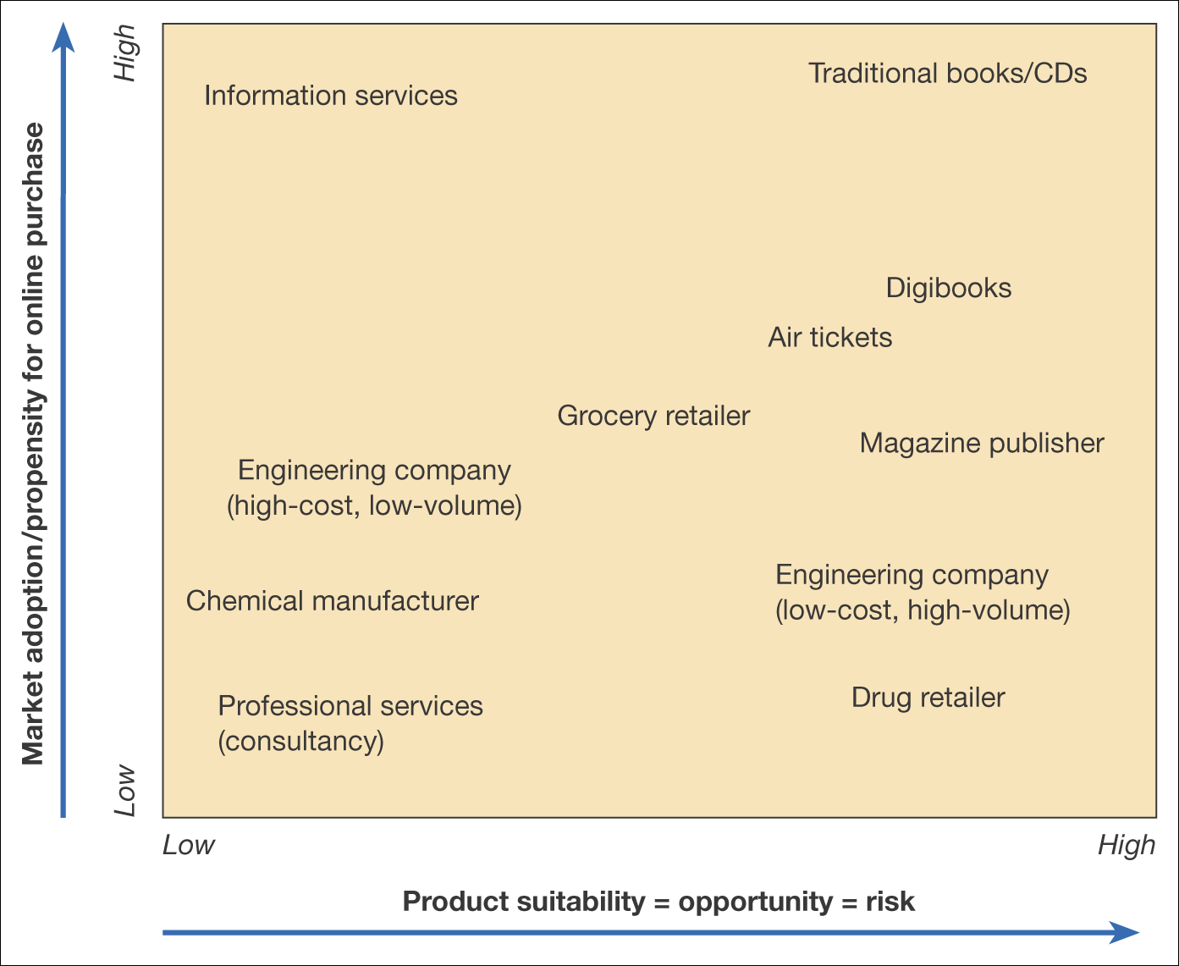
Figure 5.15 Grid of product suitability against market adoption for transactional
e-commerce (online purchase)

Slide 24
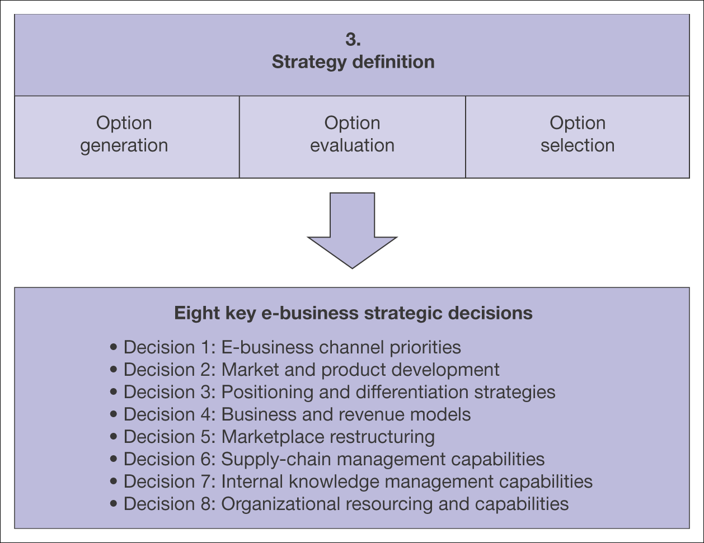
Figure 5.16 Elements of strategy definition for the e-business

Slide 25
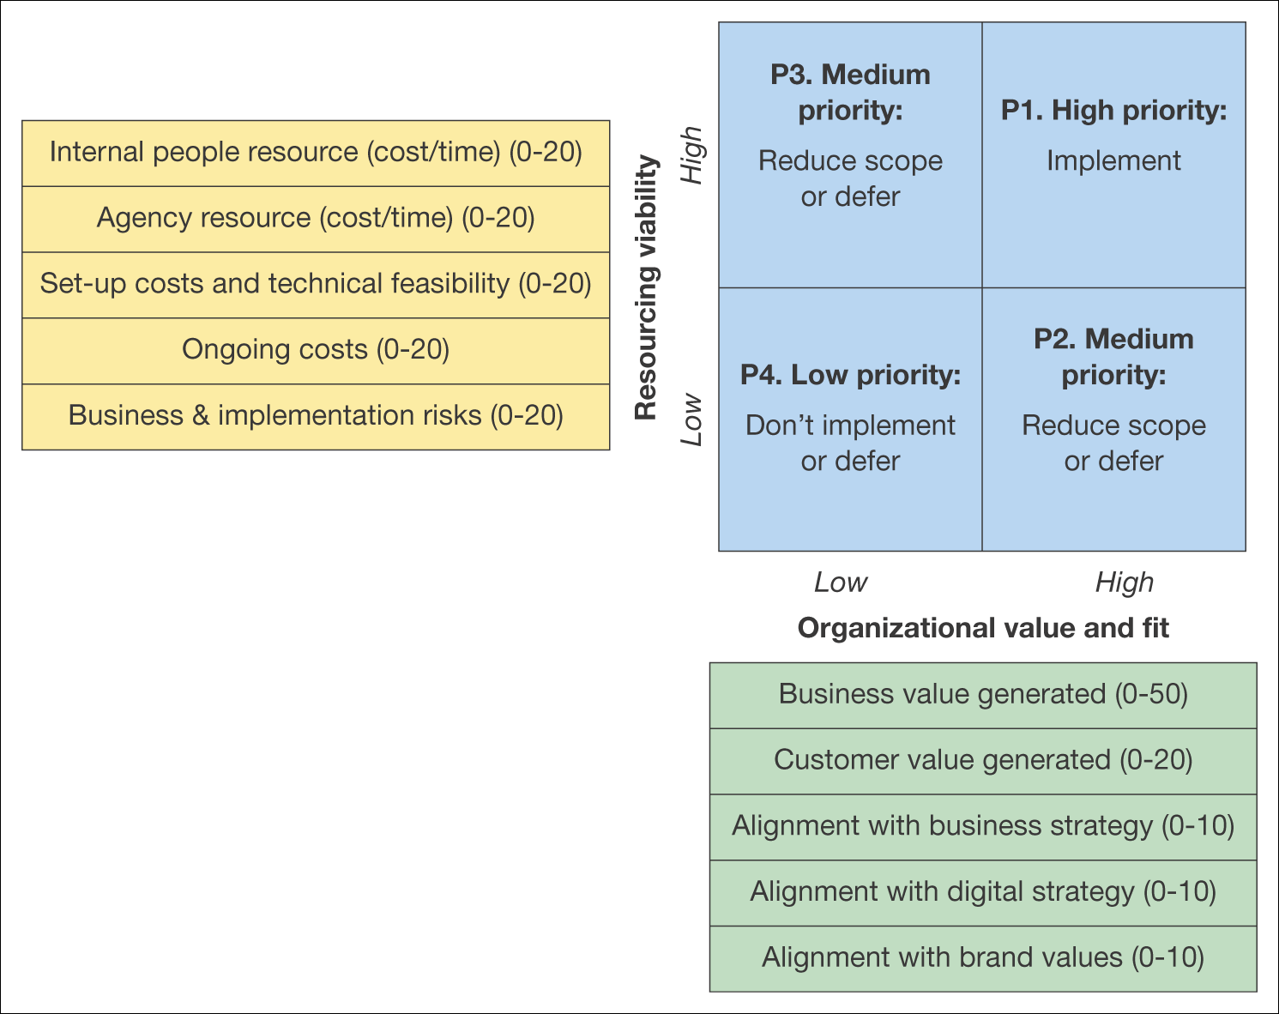
Figure 5.17 Matrix for evaluating e-business strategy alternatives
Source: E-consultancy (2008a)

Slide 26
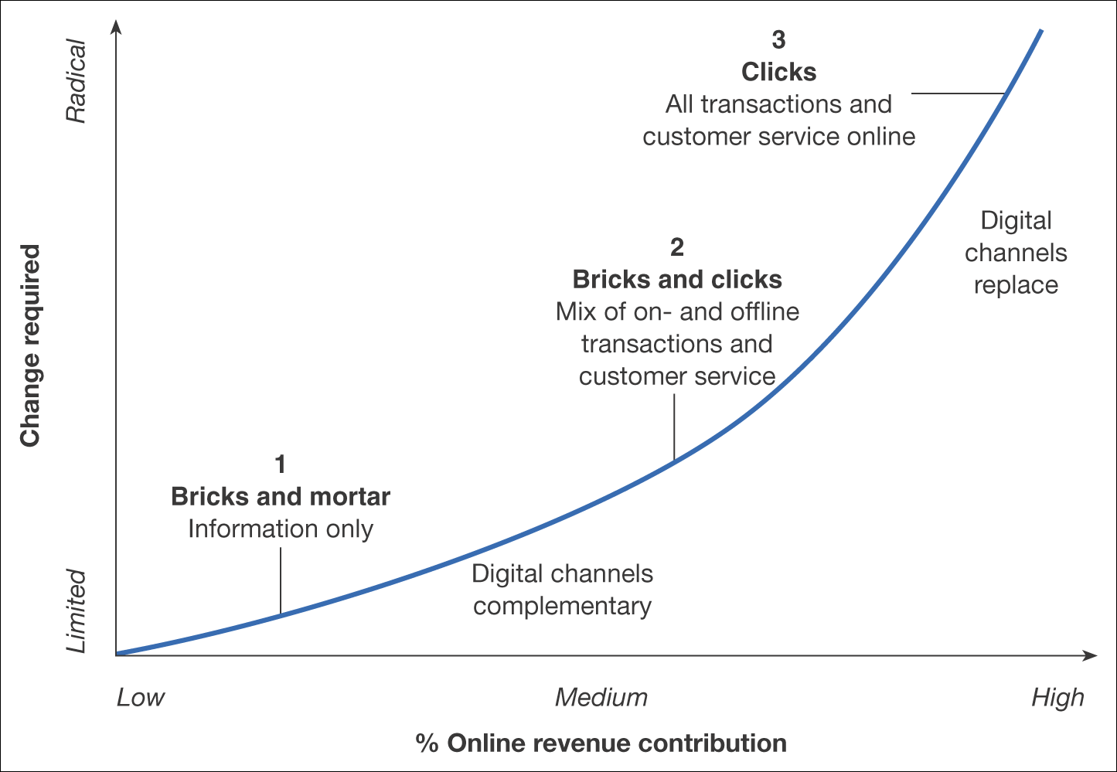
Figure 5.18 Strategic options for a company in relation to the importance of the Internet as a channel

Slide 27
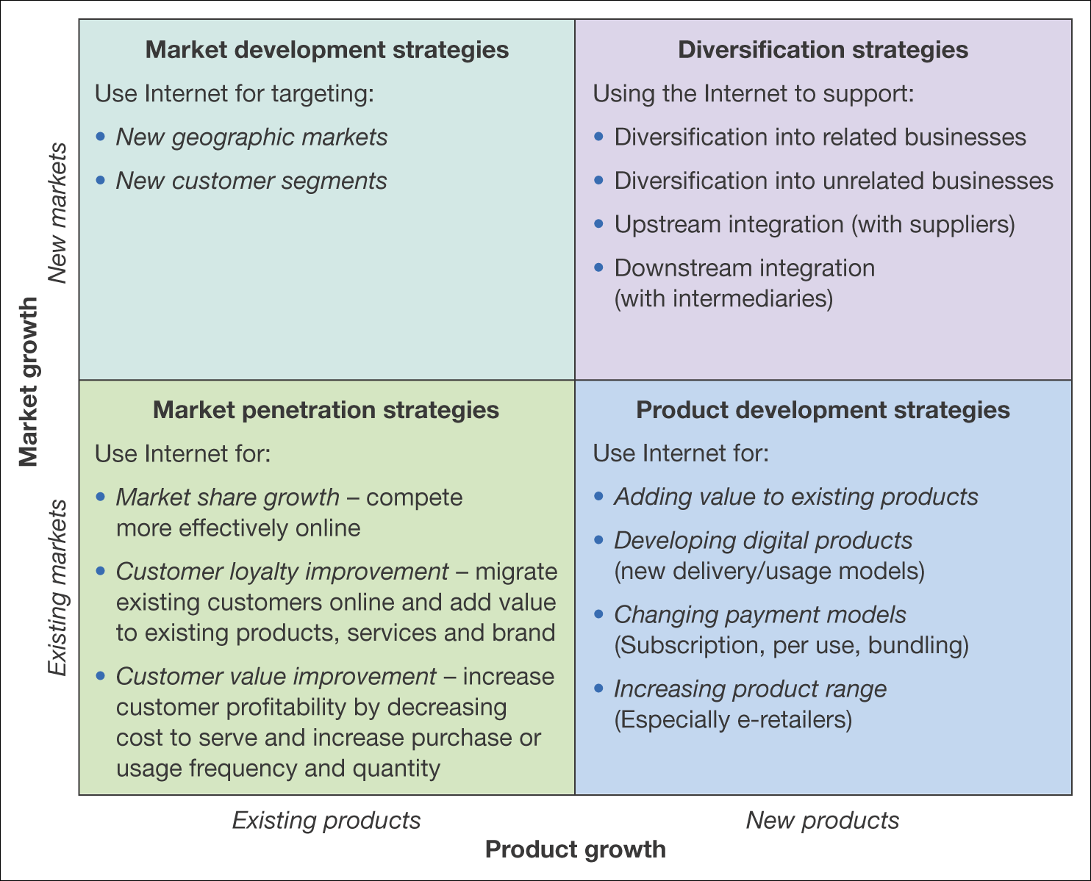
Figure 5.19 Using the Internet to support different growth strategies

Slide 28
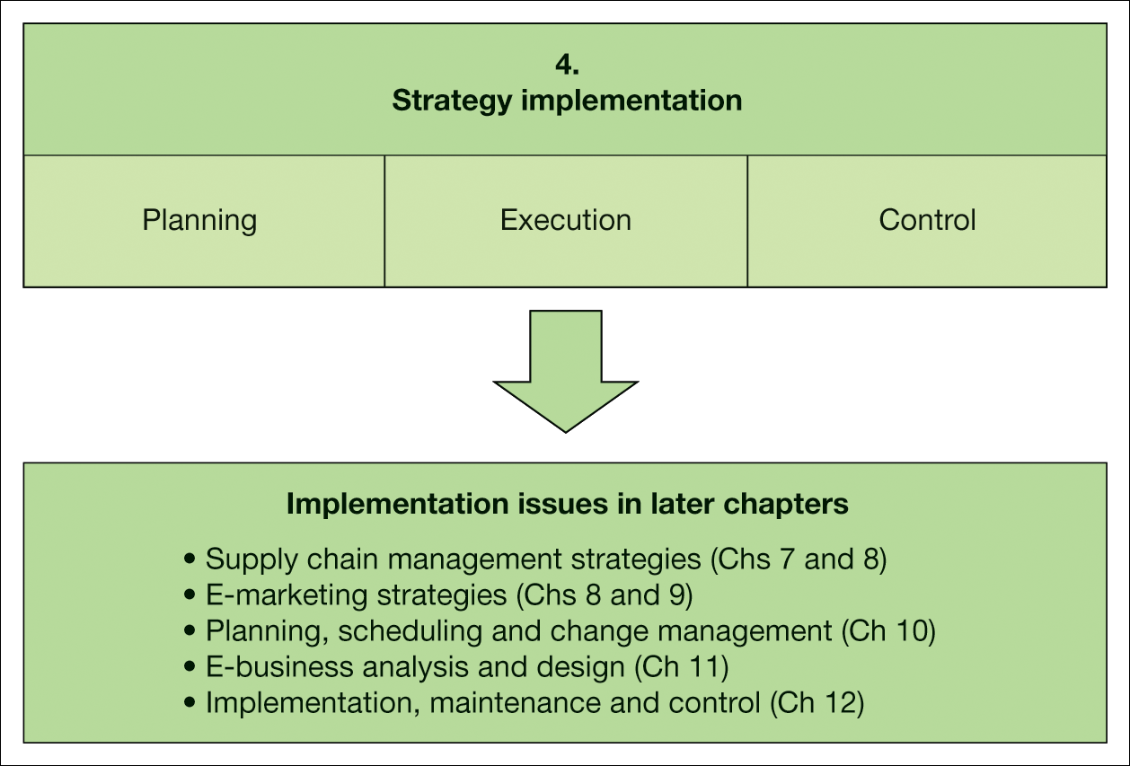
Figure 5.20 Elements of strategy implementation for the e-business

