Slide 1
E-Environment

Slide 2
Learning Outcomes
Identify the different elements of an organization macro-environment that impact on an organization’s e-business and e-marketing strategy
Assess the impact of legal, privacy and ethical constraints or opportunities on a company
Assess the role of macro-economic factors such as economics, governmental e-business policies, taxation and legal constraints.

Slide 3
Management Issues
What are the constraints such as legal issues placed by the e-environment on developing and implementing an e-business strategy?
How can trust and privacy be assured for the customer while seeking to achieve marketing objectives of customer acquisition and retention?
Assessment of the business relevance of technological innovation.

Slide 4
Activity
Introduction to Social, Legal and Ethical Issues
List all the social, legal and ethical issues that the manager of a sell-side e-commerce website needs to consider to avoid damaging relationships with users of his or her site or which may leave the company facing prosecution. You can base your answer on issues which may concern you, your friends or family when accessing a website.

Slide 5
Activity Answer – This Lecture
Cookies – laws and consumer perception on placing these
Are we limiting access to information from certain sections of society (social exclusion)?
Privacy of personal information entered on a website
Sending unsolicited e-mail
Replying promptly to e-mail
Copyright
Site content and promotional offers/adverts are in keeping with the different laws in different countries
Providing text, graphics and personality in keeping with social mores of different countries.

Slide 6
SLEPT Factors
Macro-environment
  Social
  Legal
  Economic
  Political
  Technological

Slide 7
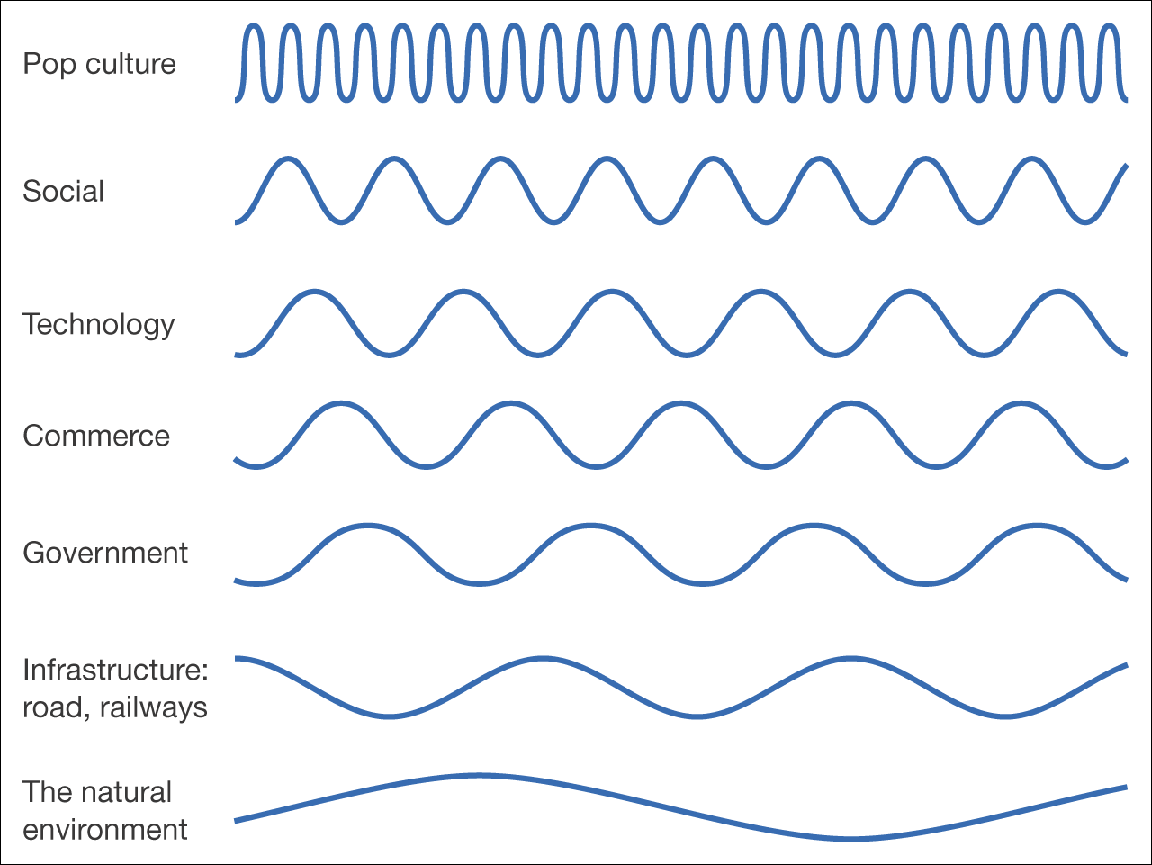
Figure 4.1 ‘Waves of change’ – different timescales for change in the environment

Slide 8
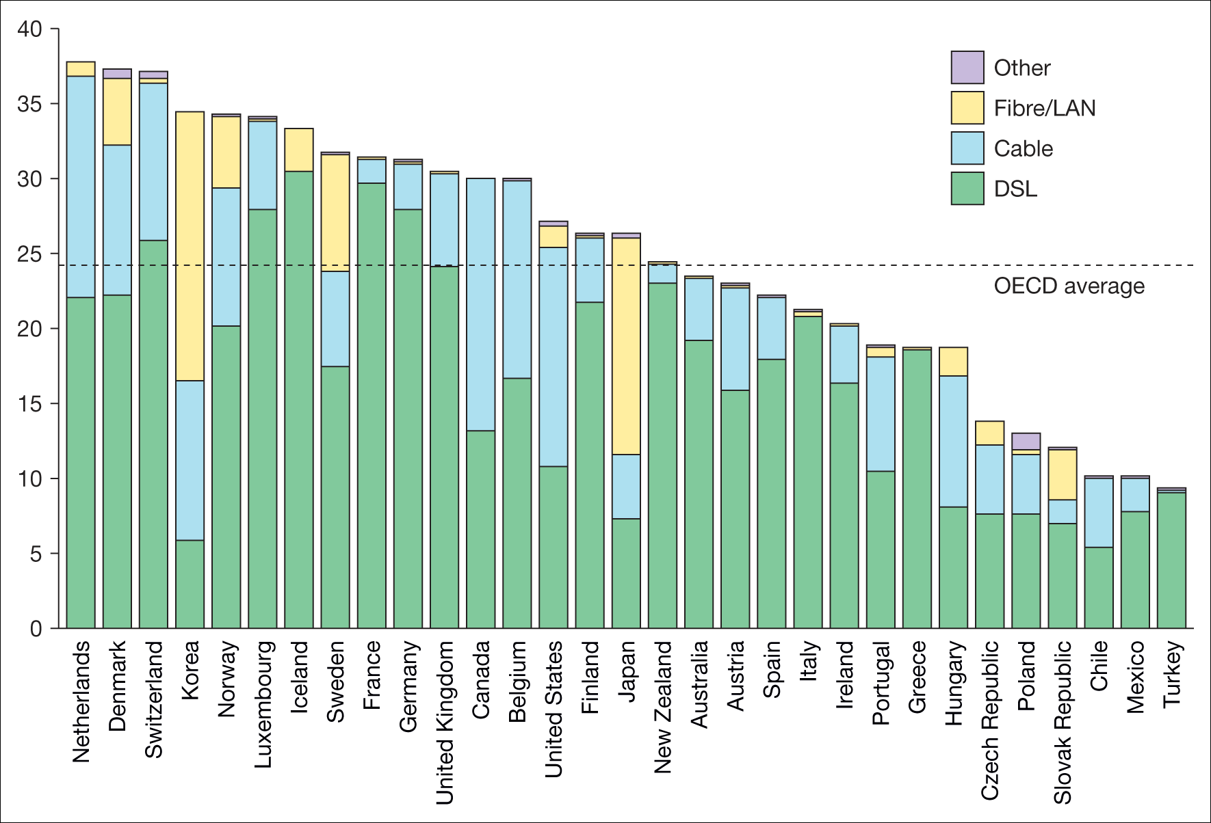
Figure 4.2 Variation in broadband subscribers per 100 inhabitants, by technology, December 2009
Source: OECD (www.oecd.org/dataoecd/21/3539574709.xls)
Notes:
Replace with Figure 4.2

Slide 9
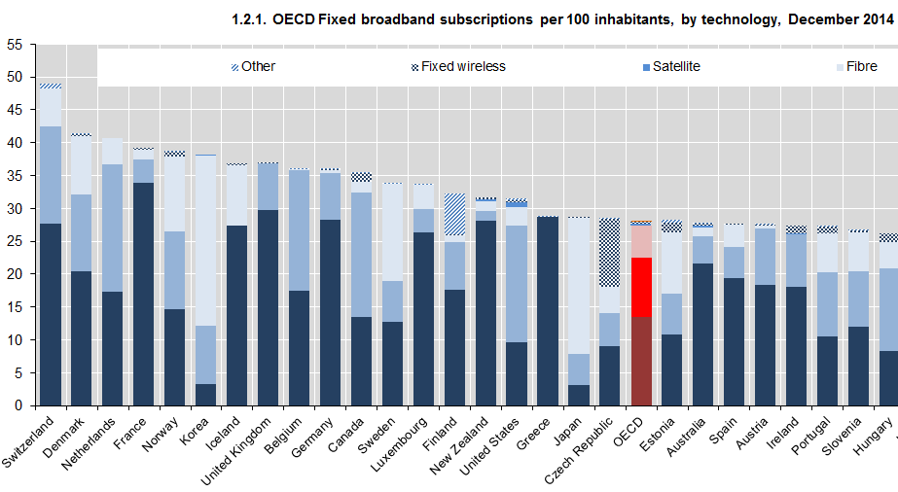

Slide 10
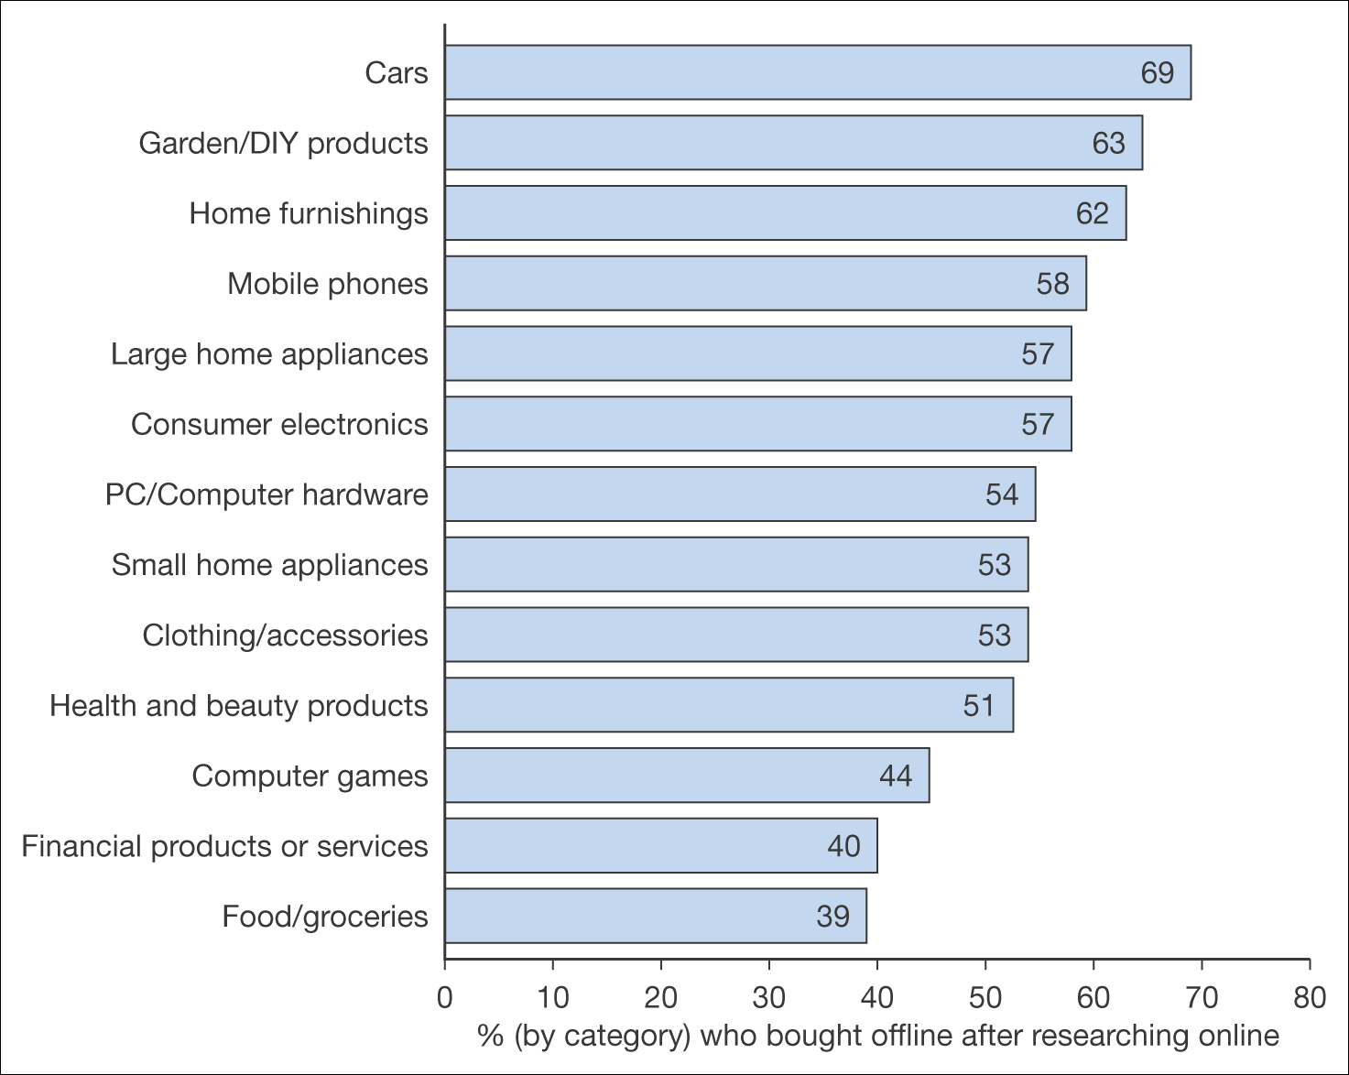
Figure 4.3 Percentage by category who bought offline after researching online
Source: BrandNewWorld: AOL UK / Anne Molen (Cranfield School of Management) /Henley Centre, 2004

Slide 11
New York – Aug. 26, 2014 – Online purchase intentions around the world have doubled since 2011 for many durable and entertainment-related categories including e-books, event tickets, sporting goods and toys, according to a new study conducted online by Nielsen. Nearly half of global respondents intend to make an online purchase in the next six months in high-prominence categories including clothing (46%), and airline (48%) and hotel (44%) reservations.
http://www.nielsen.com
Though not boasting the same 1:1 ratio, shoppers for consumable goods are not far off:
Cosmetics: 33% browse online, 31% buy online
Personal care: 31% browse online, 29% buy online
Groceries: 30% browse online, 27% buy online
Pet products: 24% browse online, 21% buy online
Baby supplies: 23% browse online, 20% buy online
Flowers: 20% browse online, 18% buy online
Alcoholic drinks: 20% browse online, 17% buy online
http://www.olapic.com

Slide 12
Trust in Different Information Sources
The role of social media and friends in influencing sales was highlighted by this research from EIAA (2009) which rated key sources for research indicating the level of trust amongst European consumers for different online and offline information sources:
  Search engines (76%)
  Personal recommendations (72%)

Slide 13
Trust in Different Information Sources
(Continued)
  Price comparison websites (61%)
  Websites of well-known brands (59%)
  Newspapers/magazines (58%)
  Customer website reviews (58%)
  Expert website reviews (57%)
  Retailer websites (56%)
  Sales people in shops (50%)
  Content provided by ISPs (38%).

Slide 14
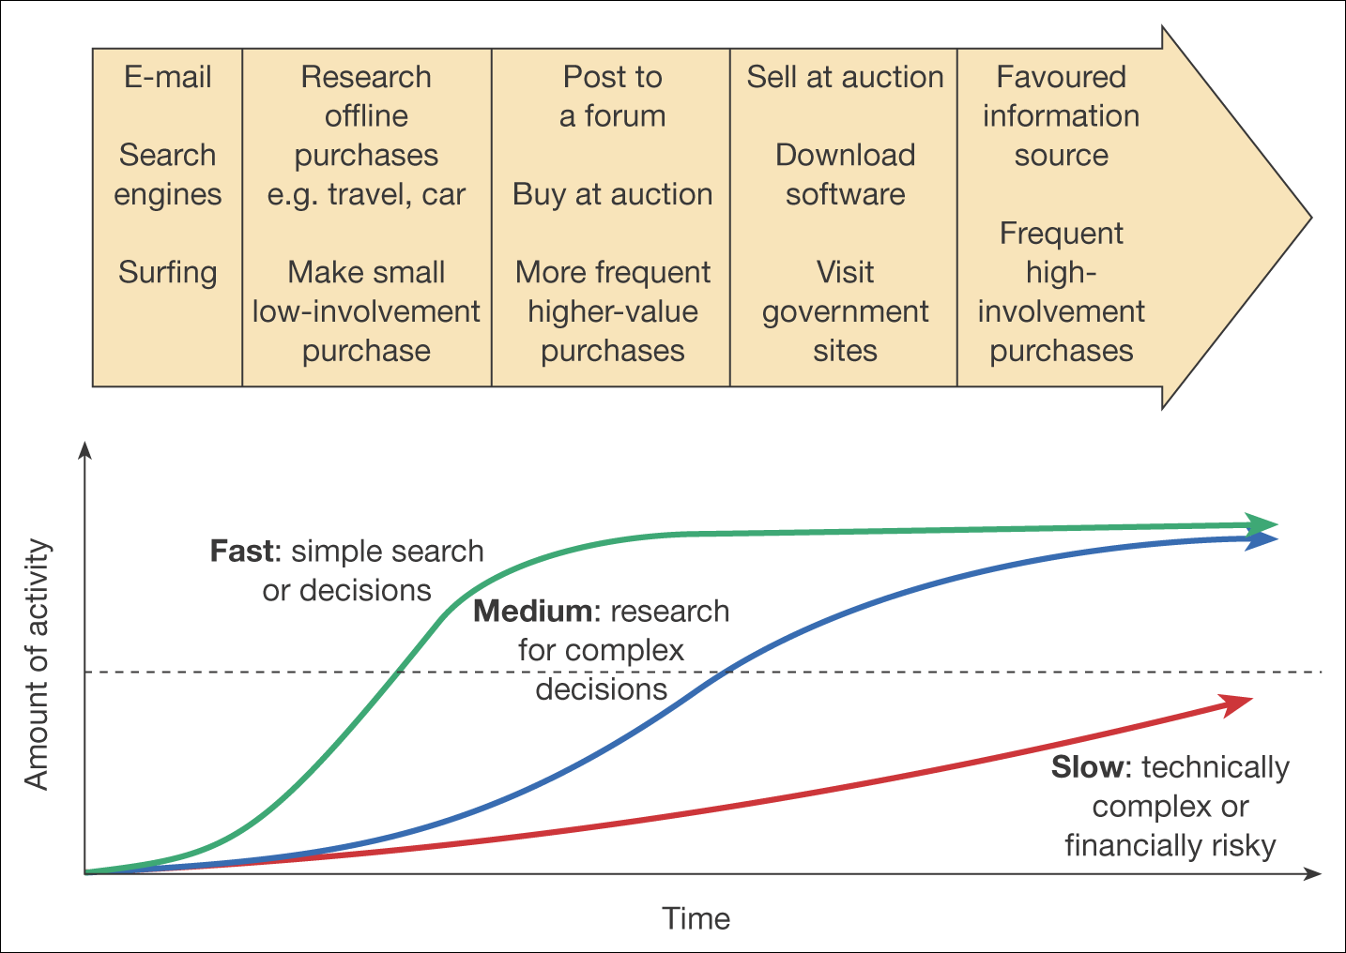
Figure 4.4 Development of experience in Internet usage

Slide 15
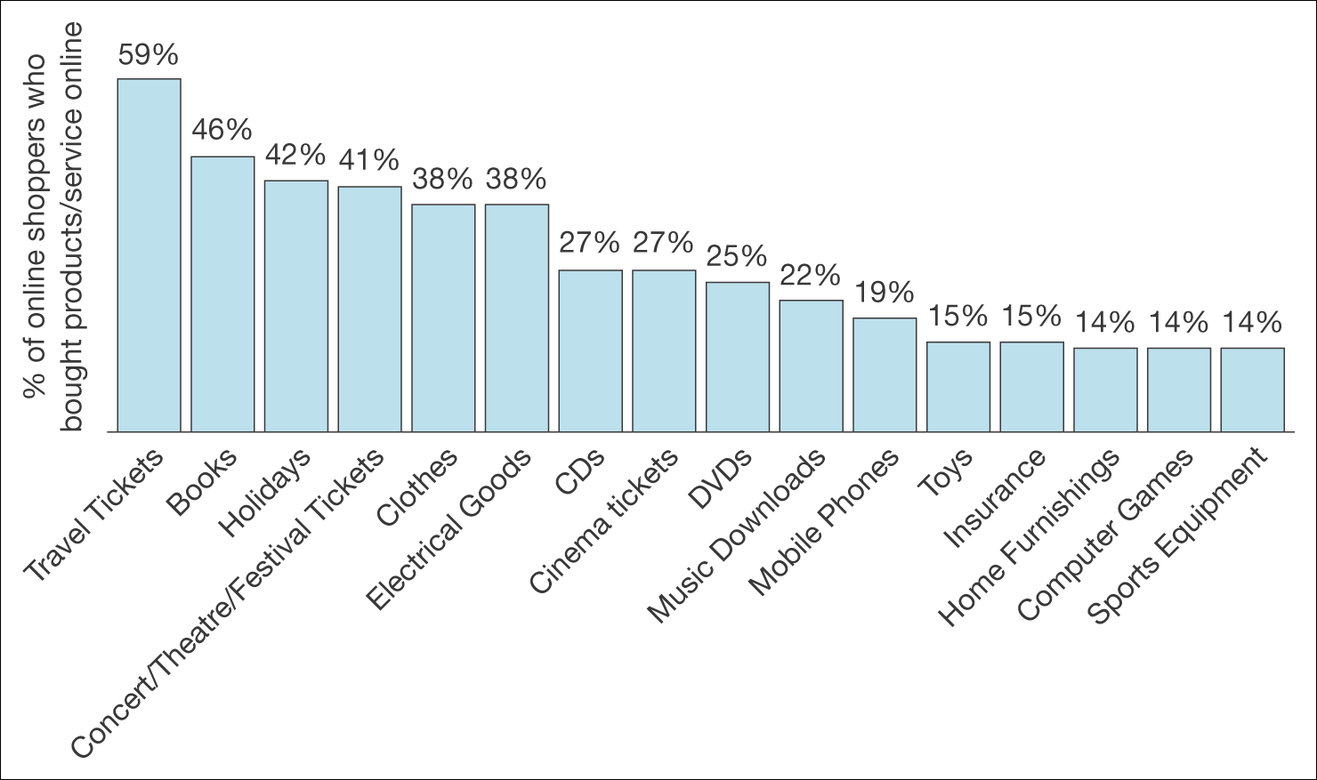
Figure 4.5 Variation in purchase rates of online products and services in Europe
Source: European Interactive Advertising Association (www.eiaa.net), Mediascope Eupore 2008

Slide 16
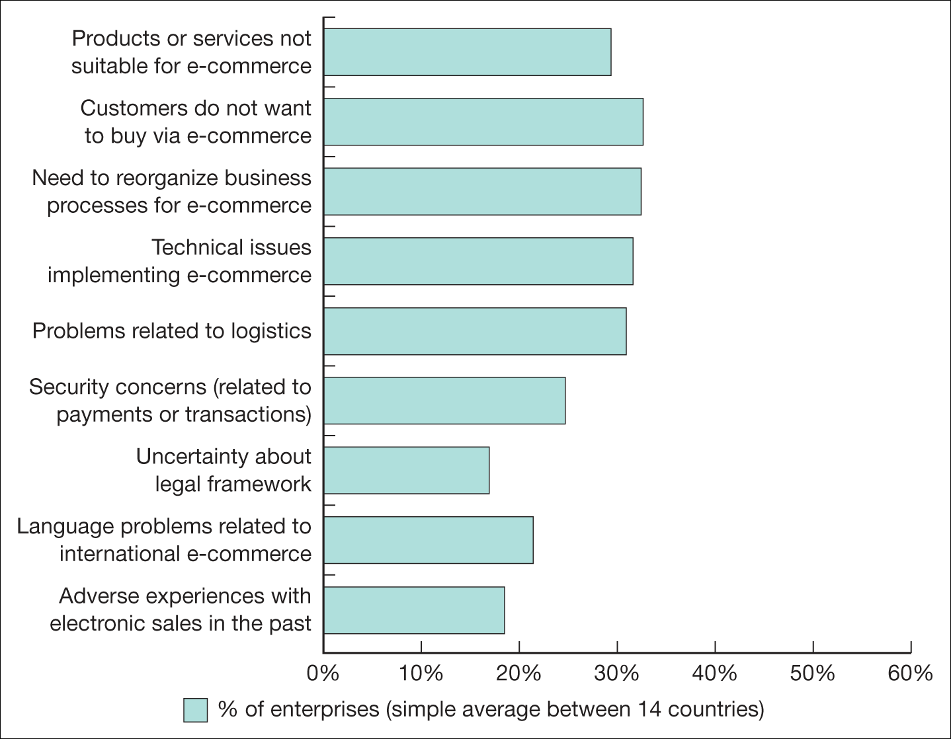
Figure 4.6 Barriers to adoption of e-commerce services of European countries
Source: European Commission (2010): http://ec.europa.eu/information_society/digital-agenda/documents/edcr.pdf
Notes:
Replace with Figure 4.6

Slide 17
Ethical Issues and Data Protection
Ethical issues concerned with personal information ownership have been usefully summarized by Mason (1986) into four areas:
Privacy – what information is held about the individual?
Accuracy – is it correct?
Property – who owns it and how can ownership be transferred?
Accessibility – who is allowed to access this information, and under which conditions?

Slide 18
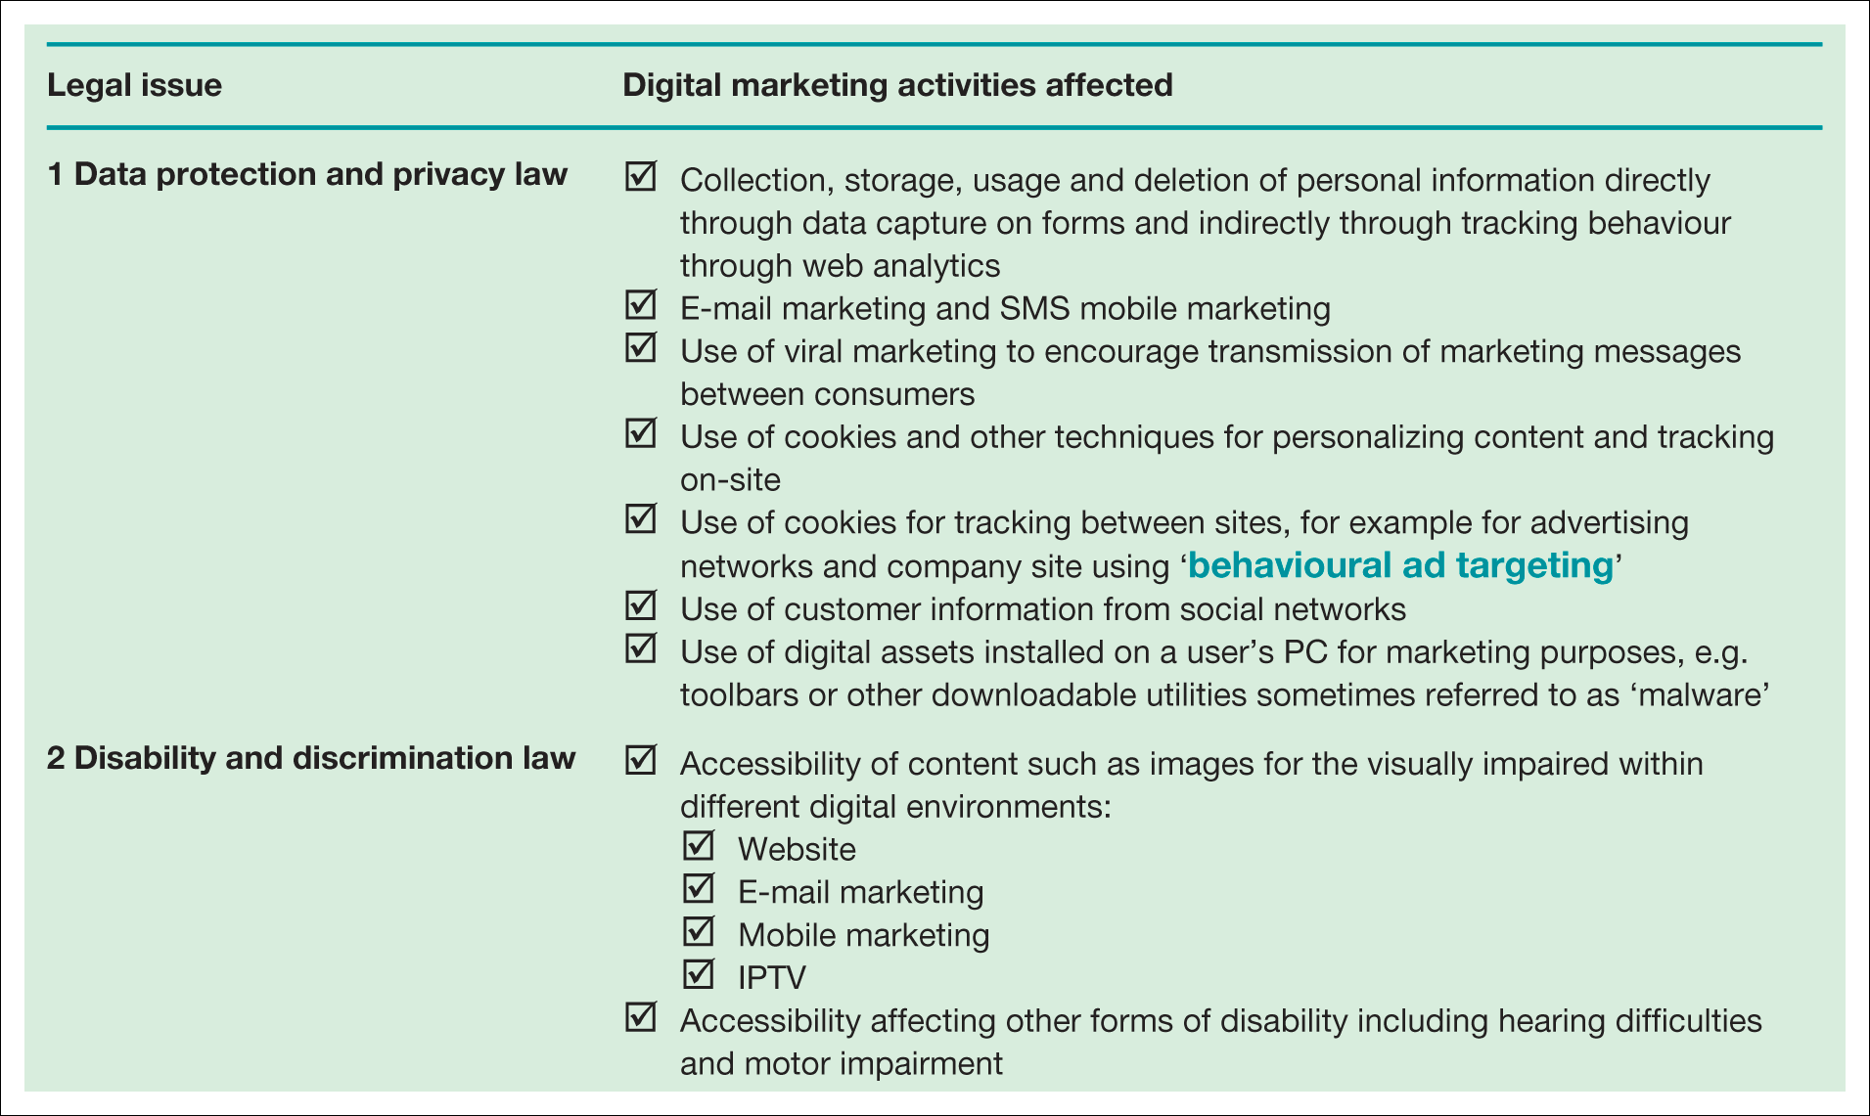
Table 4.2 Significant laws which control digital marketing

Slide 19
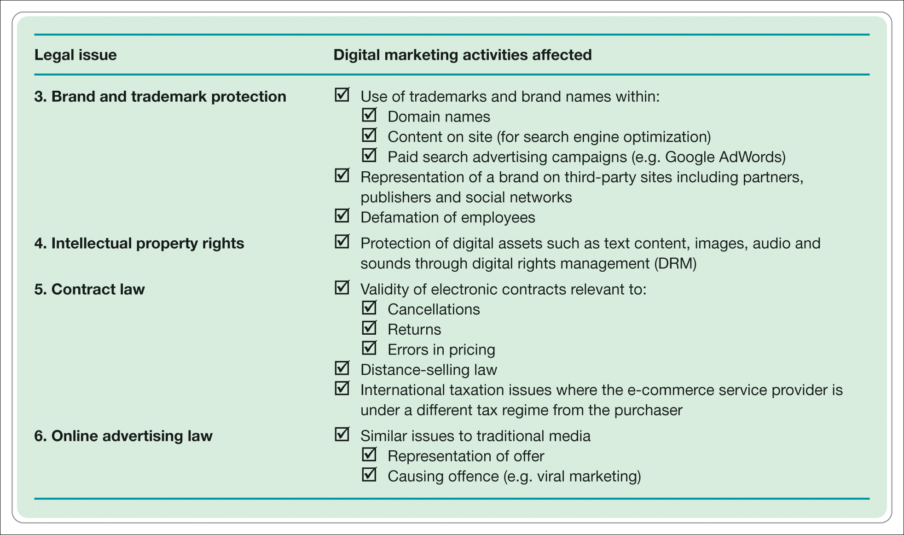
Table 4.2 Significant laws which control digital marketing (Continued)

Slide 20
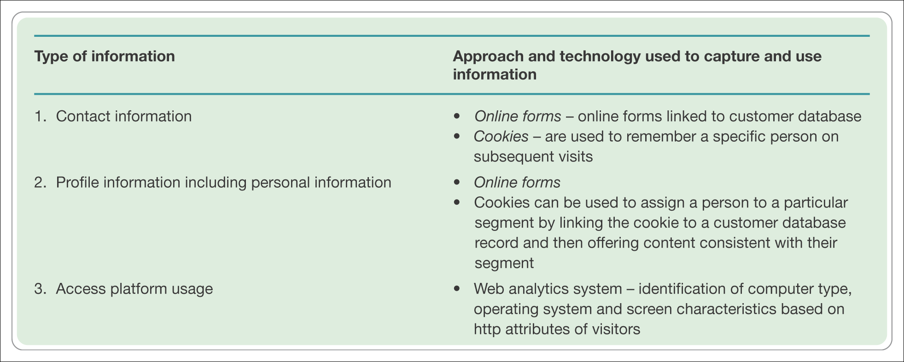
Table 4.6 Types of information collected online and related technologies

Slide 21
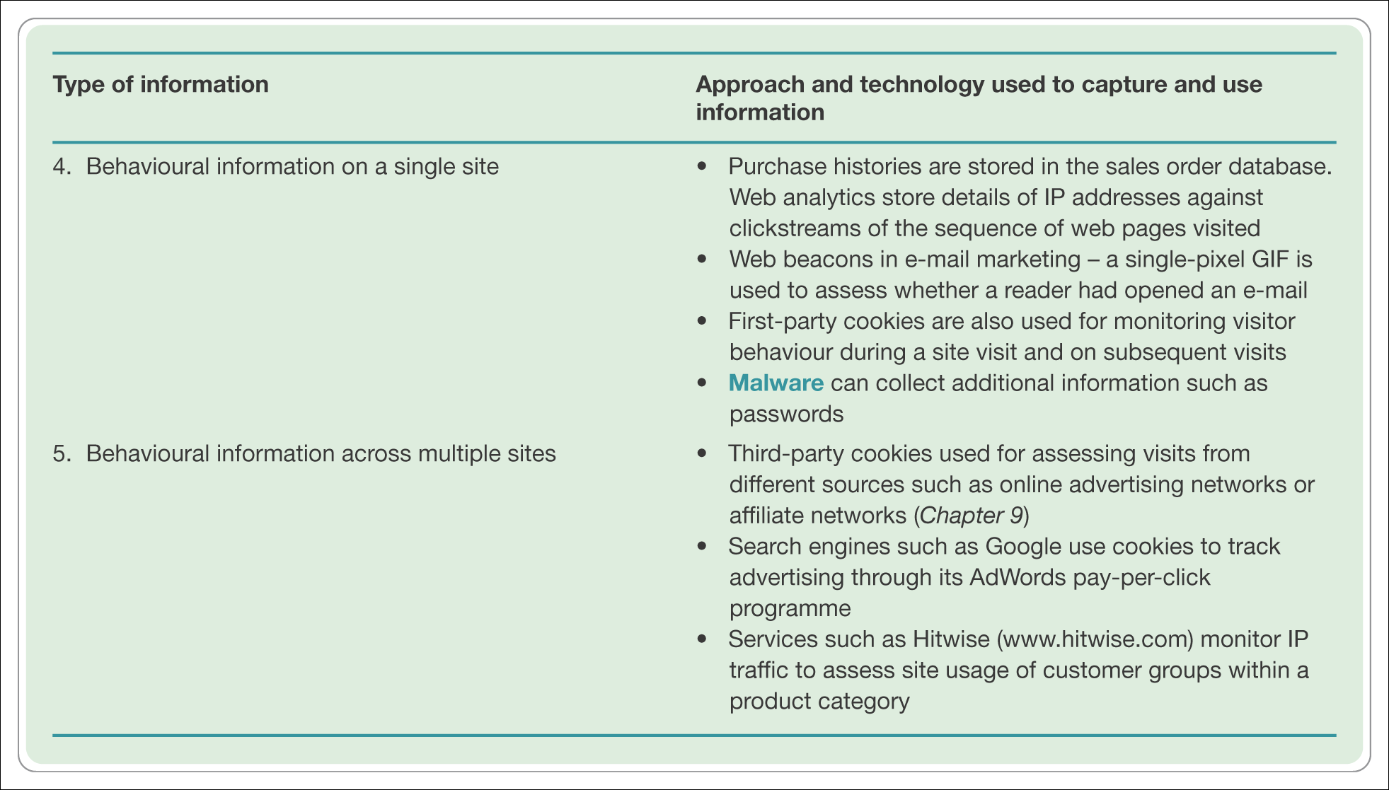
Table 4.6 Types of information collected online and related technologies (Continued)

Slide 22
Ethics – Fletcher’s View
Fletcher (2001) provides an alternative perspective, raising these issues of concern for both the individual and the marketer:
Transparency – who is collecting what information?
2. Security – how is information protected once collected by a company?
3. Liability – who is responsible if data is abused?

Slide 23
The Eight Principles for Data Protection
Fairly and lawfully processed
Processed for limited purposes
Adequate, relevant and not excessive
Accurate
Not kept longer than necessary
Processed in accordance with the data subject's rights
Secure
Not transferred to countries without adequate protection.
www.dataprotection.gov.uk

Slide 24
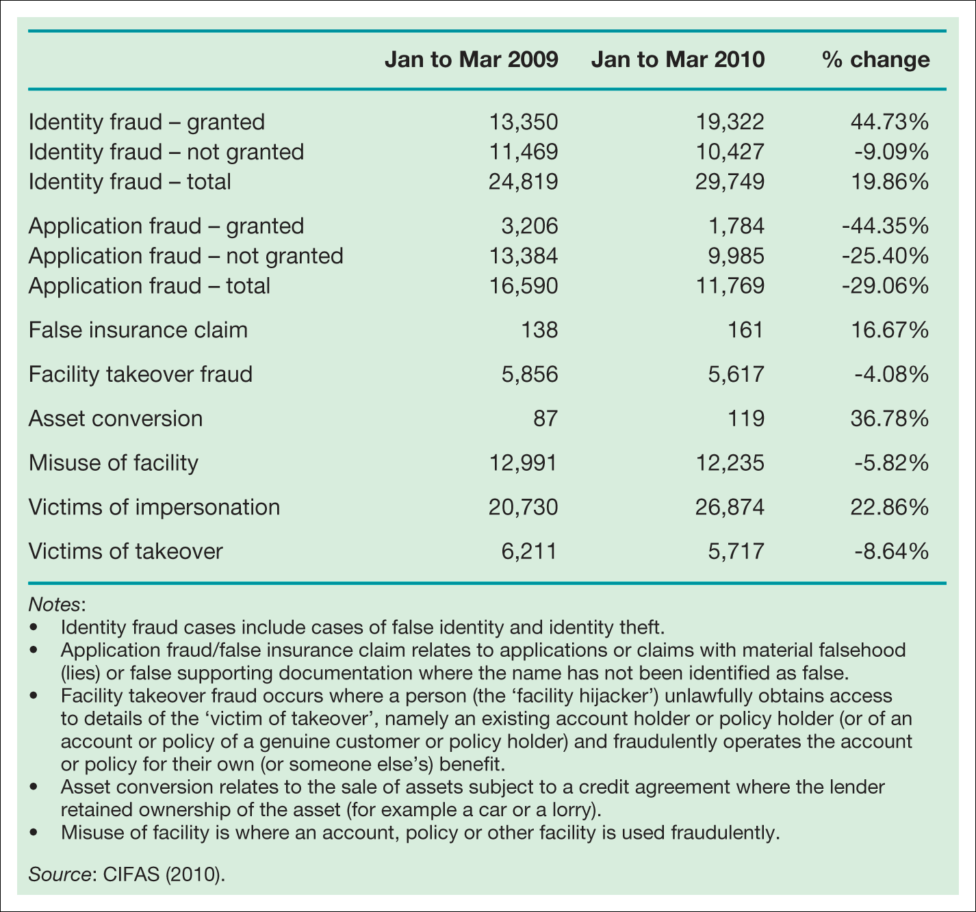
Table 4.5 Identity fraud categories in the UK
Notes:
Insert Table 4.5

Slide 25
Identity fraud up by 27% in first quarter of 2015
The number of recorded victims of identity fraud increased by 31%, from 24,482 to 32,058.
Credit cards (14,103 confirmed cases - 41% of all identity frauds) and bank accounts (9,349 cases - 27% of all identity frauds) are the identity criminals’ preferred targets.
Over 80% of all identity fraud in the first quarter was attempted or perpetrated online.
The average age for both male and female identity fraud victims is 46 years old.
Those in the 21-30 age range continue to be increasingly targeted - 3,970 people in this age range were targeted by identity criminals (16% of all identity fraud victims): a 26% increase from 2014.
Source: CIFAS, UK

Slide 26
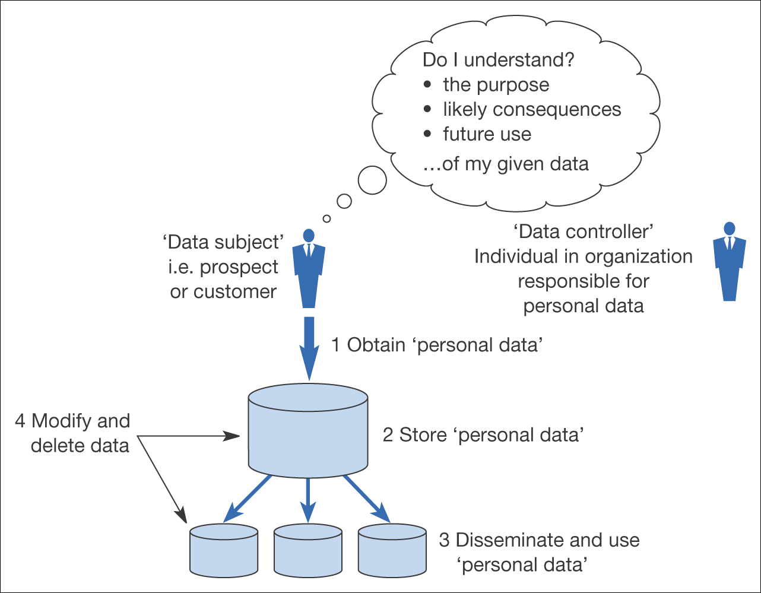
Figure 4.8 Information flows that need to be understood for compliance with data protection legislation

Slide 27
Localization
Singh and Pereira (2005) provide an evaluation framework for the level of localization:
  Standardized websites (not localized). A single site serves all customer segments (domestic and international)
  Semi-localized websites. A single site serves all customers; however, there will be contact information about foreign subsidiaries available for international customers. Many sites fall into this category
  Localized websites. Country-specific websites with language translation for international customers, wherever relevant. 3M (www.3m.com) has adapted the websites for many countries to local language versions. It initially focused on the major websites

Slide 28
Localization (Continued)
  Highly localized websites. Country-specific websites with language translation; they also include other localization efforts in terms of time, date, postcode, currency formats, etc. Dell (www.dell.com) provides highly localized websites
  Culturally customized websites. Websites reflecting complete ‘immersion’ in the culture of target customer segments; as such, targeting a particular country may mean providing multiple websites for that country depending on the dominant cultures present. Durex (www.durex.com) is a good example of a culturally customized website.

Slide 29
Economic / Political
Ensuring companies competitiveness
  Funding for education and technology
  Promoting new technology for example, broadband 12% in UK, 70% Taiwan, South Korea
Achieving government efficiencies
  E-government – all Canadian services online by 2007?
  Singapore ‘Intelligent Island’
Taxation regimes
  Legislation for offshore trading.

Slide 30
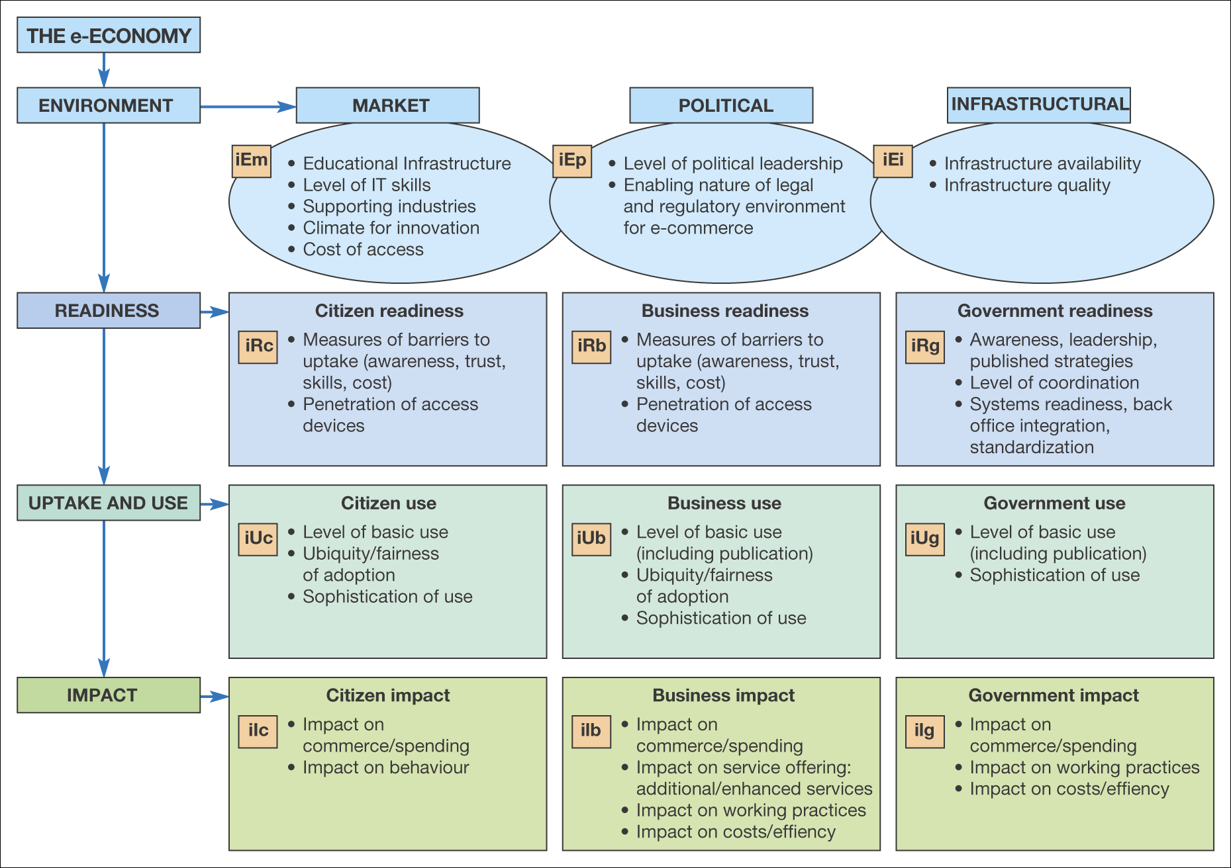
Figure 4.11 A framework describing the e-economy
Source: from International E-Economy: Benchmarking the World’s Most Effective Policy for the E-Economy, report published 19 November, London,
www.e-envoy.gov.uk/oee/nsf/sections/summit_benchmarking/$file/indexpage.htm (Booz Allen Hamilton 2002), Crown Copyright material is reproduced with permission under the terms of the Click-Use Licence

Slide 31
Technological Issues
Rate of change
  Which new technologies should we adopt?
    Monitoring for new techniques
    Evaluation, are we early adopters?
    Re-skilling and training
Are our systems secure?

Slide 32
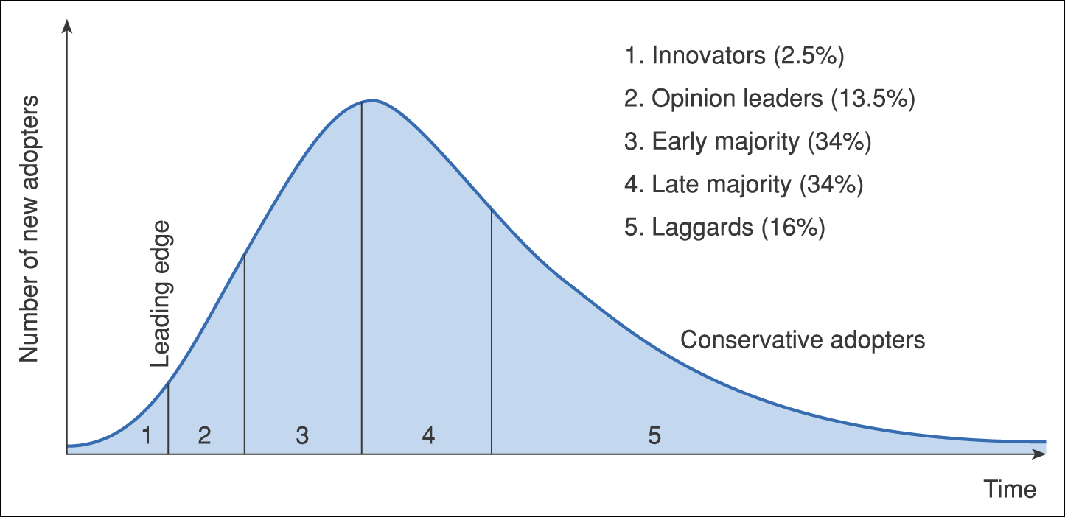
Figure 4.12 Diffusion–adoption curve

Slide 33
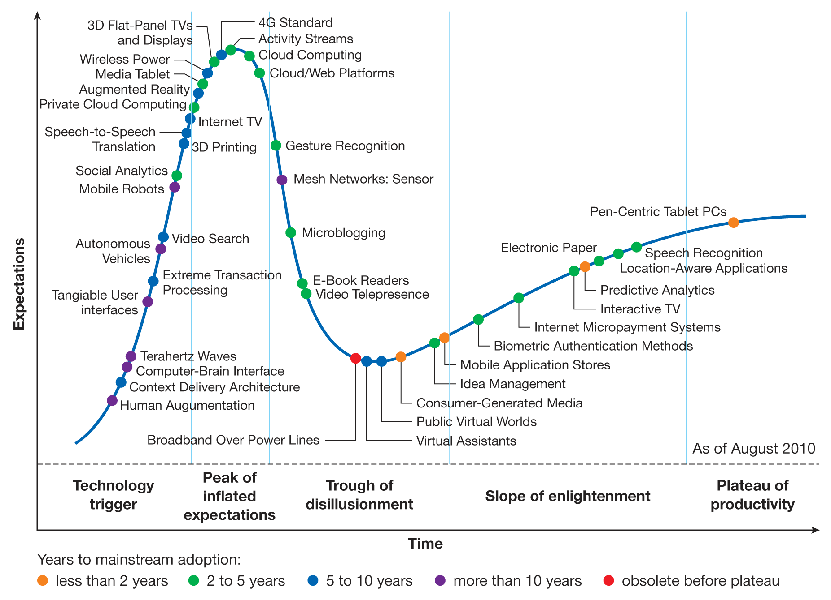
Figure 4.13 Example of a Gartner hype cycle
Source: Gartner (2010)
Notes:
Replace with 4.13

Slide 34
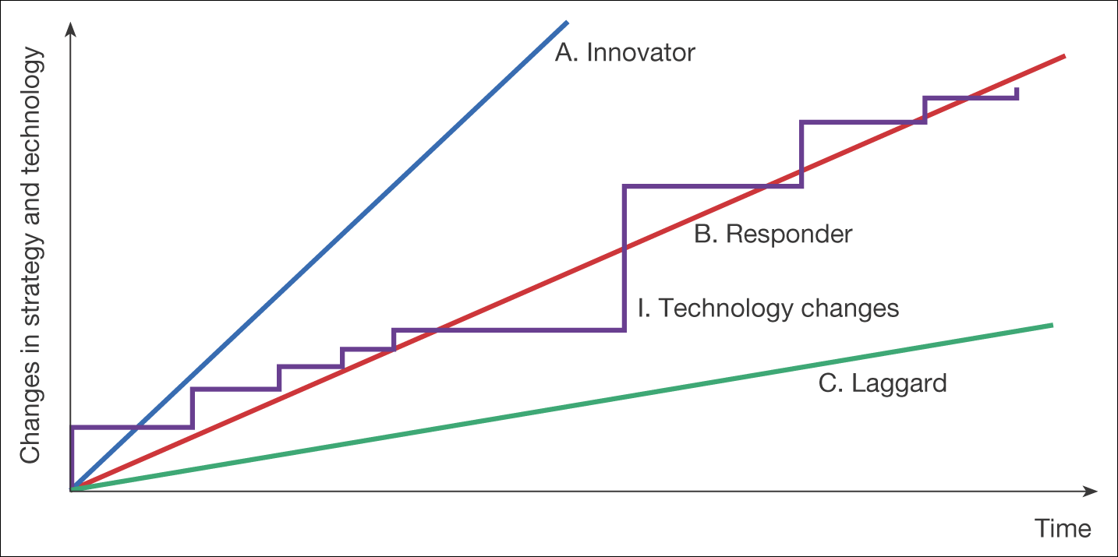
Figure 4.15 Alternative responses to changes in technology

