Slide 1
E-Business
Infrastructure

Slide 2
Learning Outcomes
Outline the hardware and software technologies used to build an e-business infrastructure within an organization and with its partners
Outline the hardware and software requirements necessary to enable employee access to the Internet and hosting of e-commerce services.

Slide 3
Management Issues
What are the practical risks to the organization of failure to manage e-commerce infrastructure adequately?
How should staff access to the Internet
be managed?
How should we evaluate the relevance of web services and open source software?

Slide 4
Why the Jargon?
Why do business managers need to know about the jargon and technology?

Slide 5
Activity 1
Infrastructure Risk Assessment
Make a list of the potential problems for customers of an online retailer
You should consider problems faced by users of e-business applications who are both internal and external to the organization
Base your answer on problems you have experienced on a website that can be related to network, hardware and software failures or problems with data quality.

Slide 6
Typical Problems
Website communications too slow
Website not available
Bugs on site through pages being unavailable or information typed in forms not being executed
Ordered products not delivered on time

Slide 7
Typical Problems (Continued)
E-mails not replied to
Customers’ privacy or trust is broken through security problems such as credit cards being stolen or addresses sold to other companies.

Slide 8
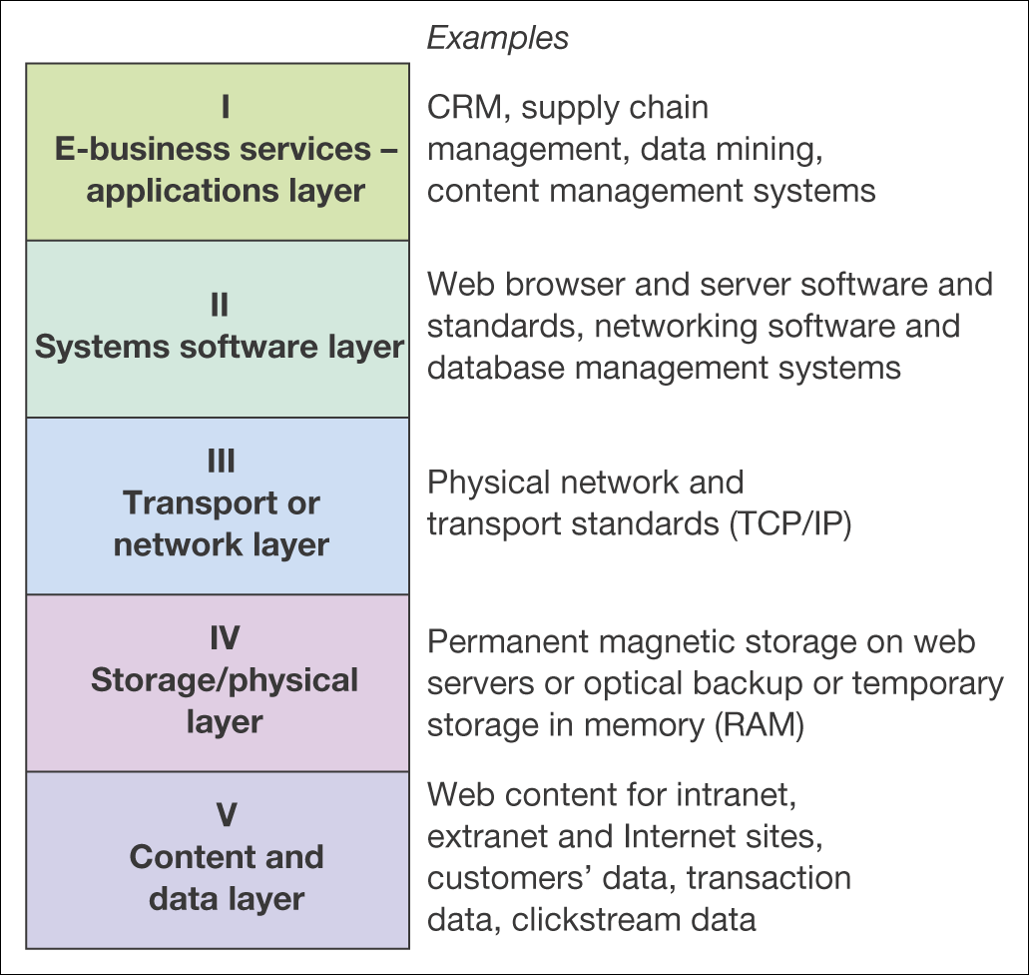
Figure 3.1 A five-layer model of e-business infrastructure

Slide 9
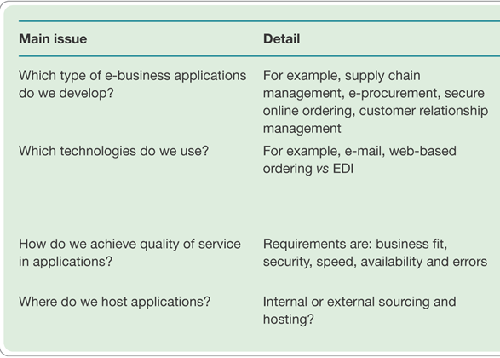
Table 3.1 Key management issues of e-business infrastructure

Slide 10
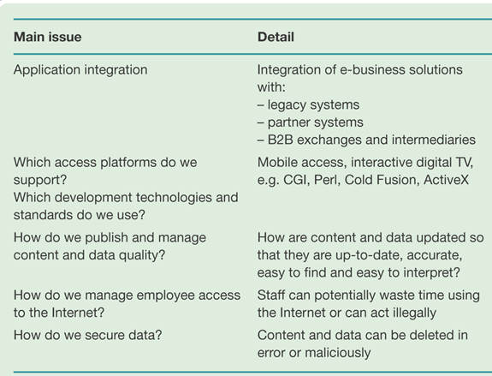
Table 3.1 Key management issues of e-business infrastructure (Continued)

Slide 11
Activity 2
Internet Infrastructure Components
Write down all the different types of hardware and software involved from when a user types in a web address such as www.uottawa.ca to the website being loaded.

Slide 12
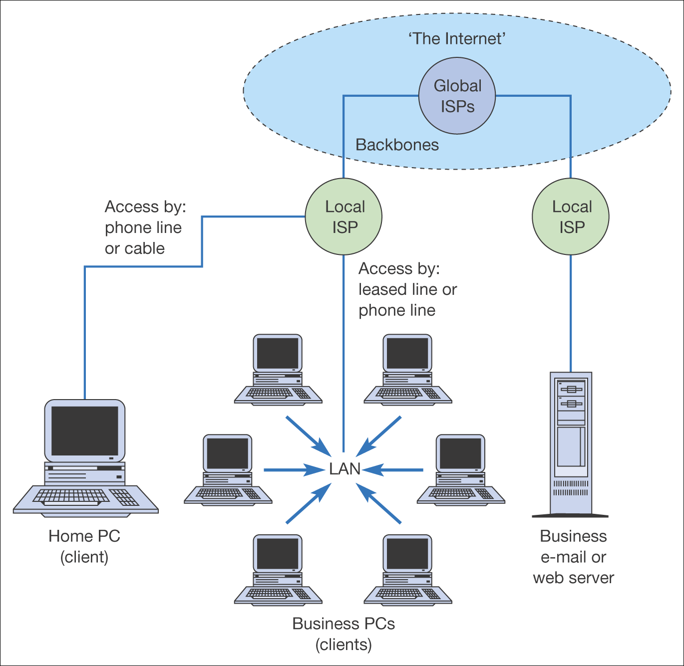
Figure 3.2 Physical and network infrastructure components of the Internet (Levels IV and III in Figure 3.1)

Slide 13
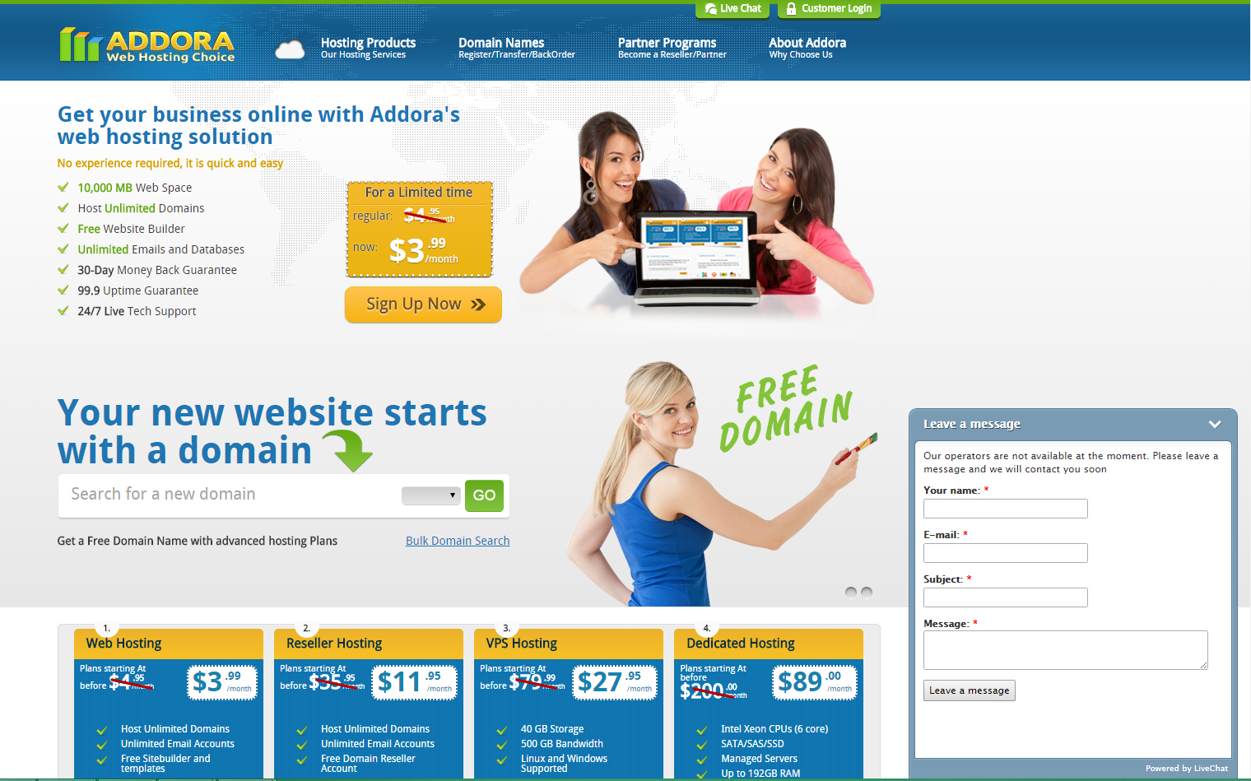
Figure 3.3 Example hosting provider Addora
Source: www.Addora.com

Slide 14
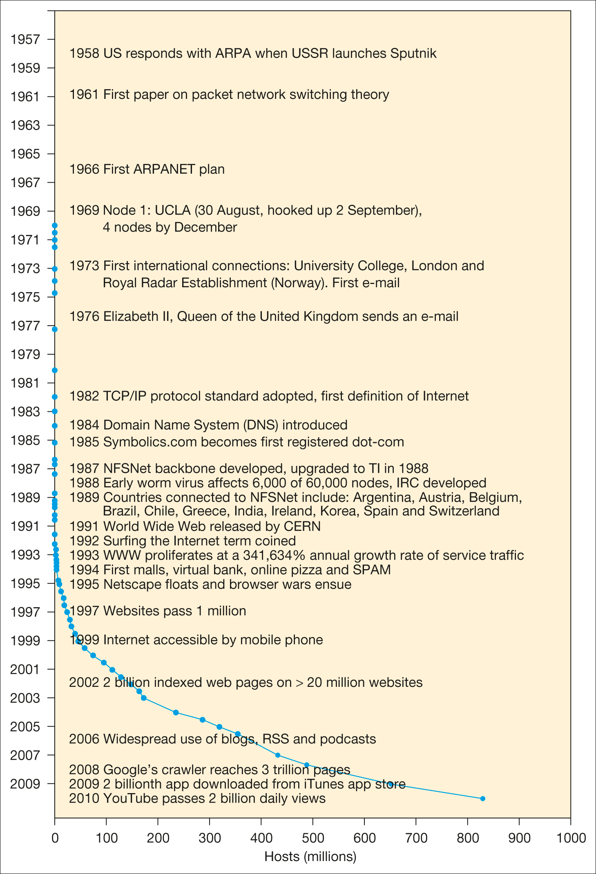
Figure 3.4 Timeline of major developments in the use of the Internet and digital technologies
Notes:
Replace with Figure 3.4

Slide 15
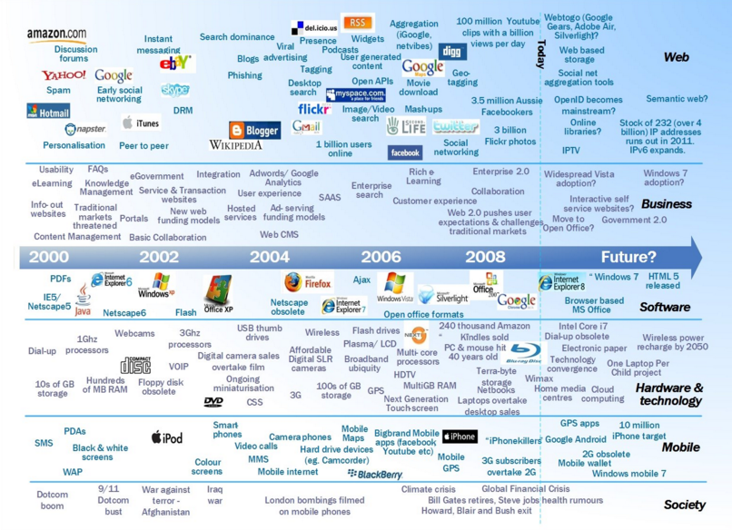

Slide 16
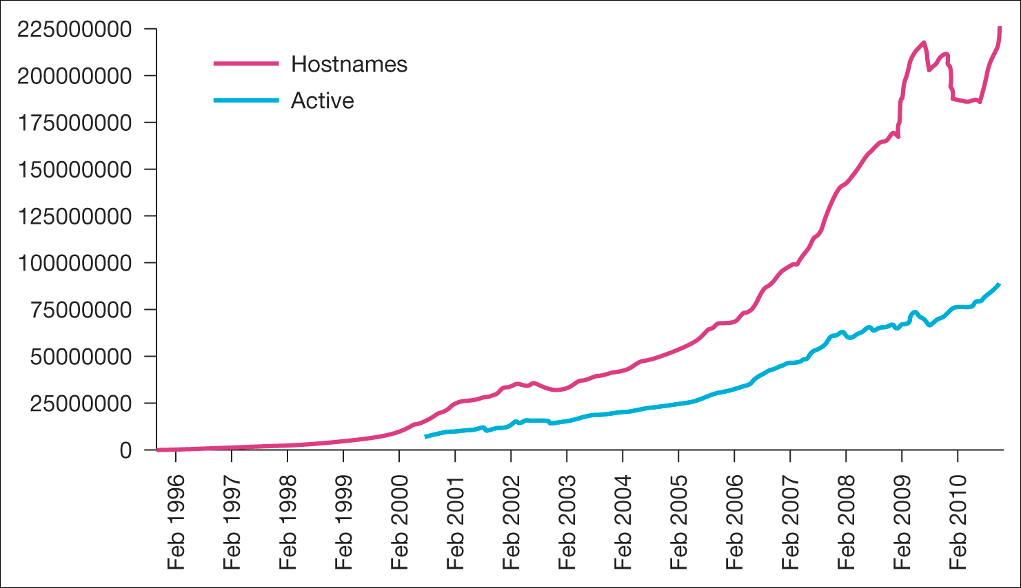
Figure 3.5 The Netcraft index of number of servers
Source: Netcraft web Server Survey. http://news.netcraft.com/archives/web_server_survey. html. Netcraft
Notes:
Replace with Figure 3.5

Slide 17
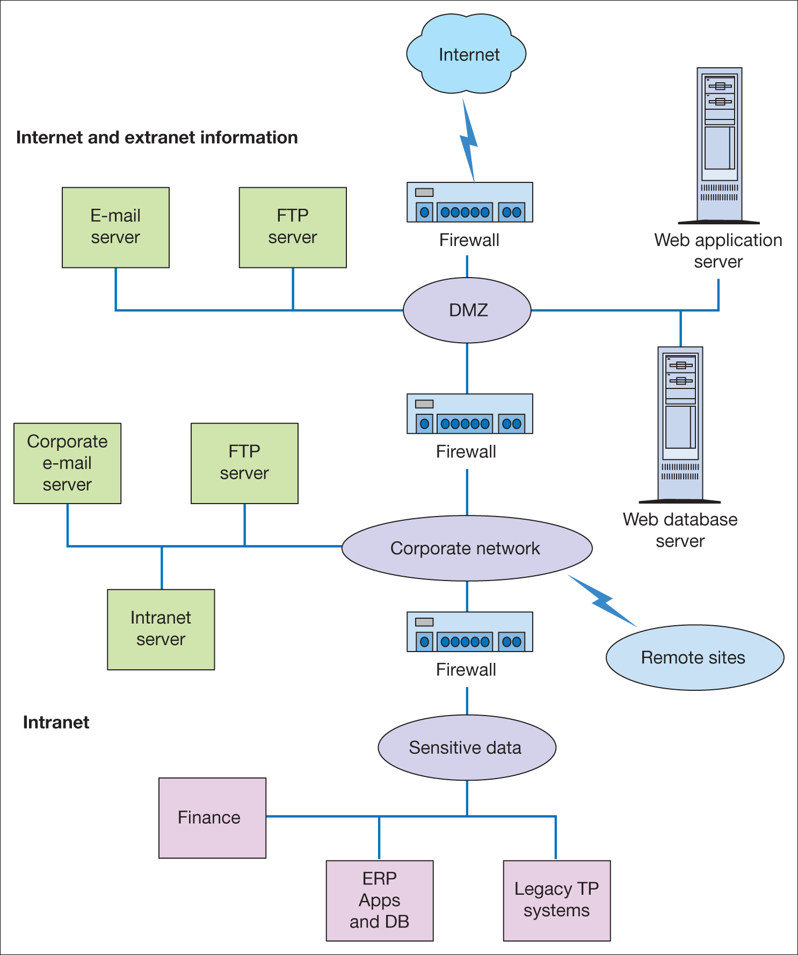
Figure 3.6 Firewall positions within the e-business infrastructure of the B2B company

Slide 18
Activity 3
A Common Problem with Intranets and Extranets
A B2B company has found that after an initial surge of interest in its intranet and extranet, usage has declined dramatically. The e-business manager wants to achieve these aims:
Increase usage
Produce more dynamic content
Encouraging more clients to order (extranet).
What would you suggest?

Slide 19
Suggested Answers
Identify benefits
Involve staff with development
Find system sponsors, owners and advocates
Train on benefits
Keep content fresh, relevant and where possible, fun
Use e-mail to encourage usage

Slide 20
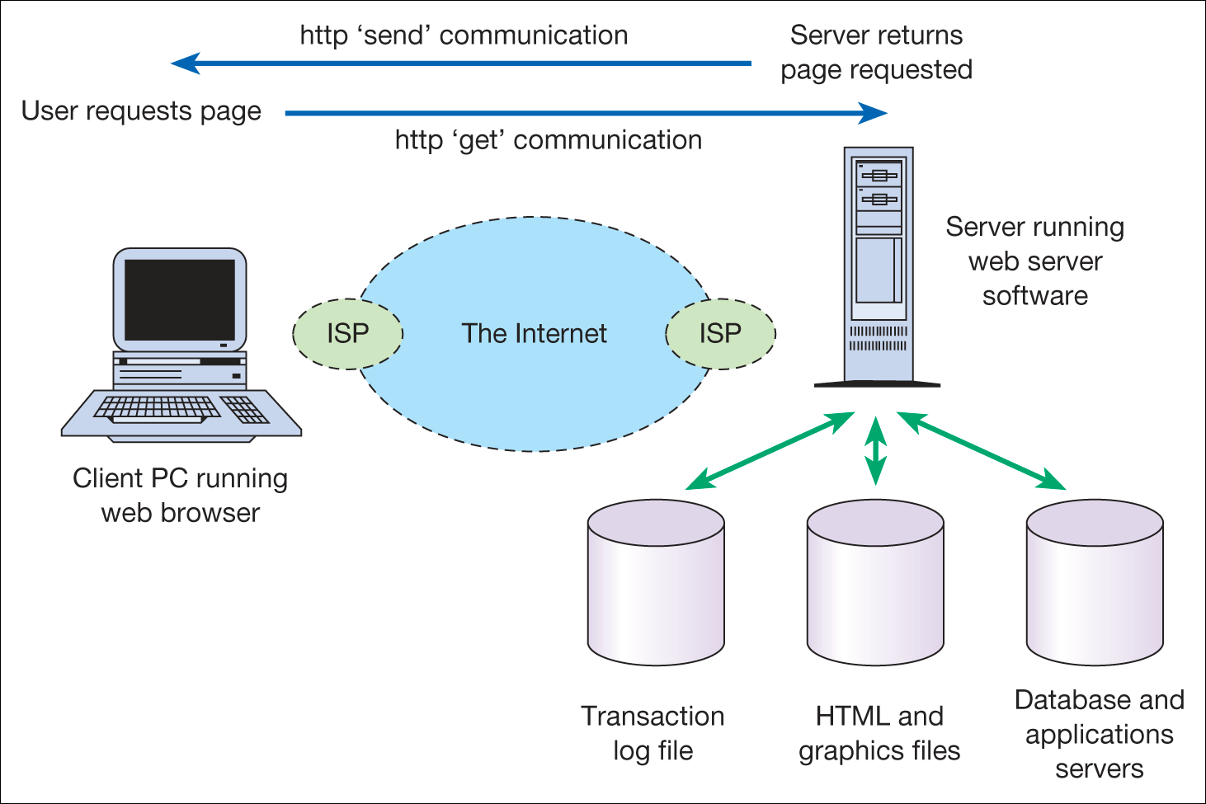
Figure 3.7 Information exchange between a web browser and a web server
Notes:
Place Figure 3.7 here

Slide 21
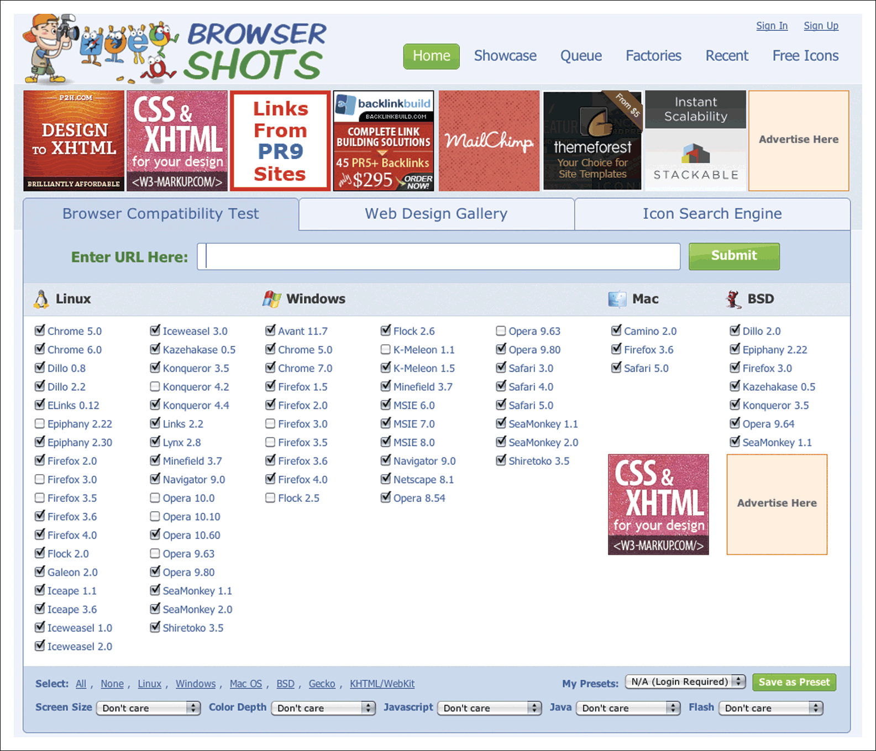
Figure 3.9 Browsershots – a service for testing cross-browser compatibility
Source: www.browsershots.org

Slide 22
Understanding Internet Access Tools and Concepts – Match the Definitions
Blogs
Feeds
IPTV
Peer-to-peer
Social networks
Tagging
VOIP

Slide 23
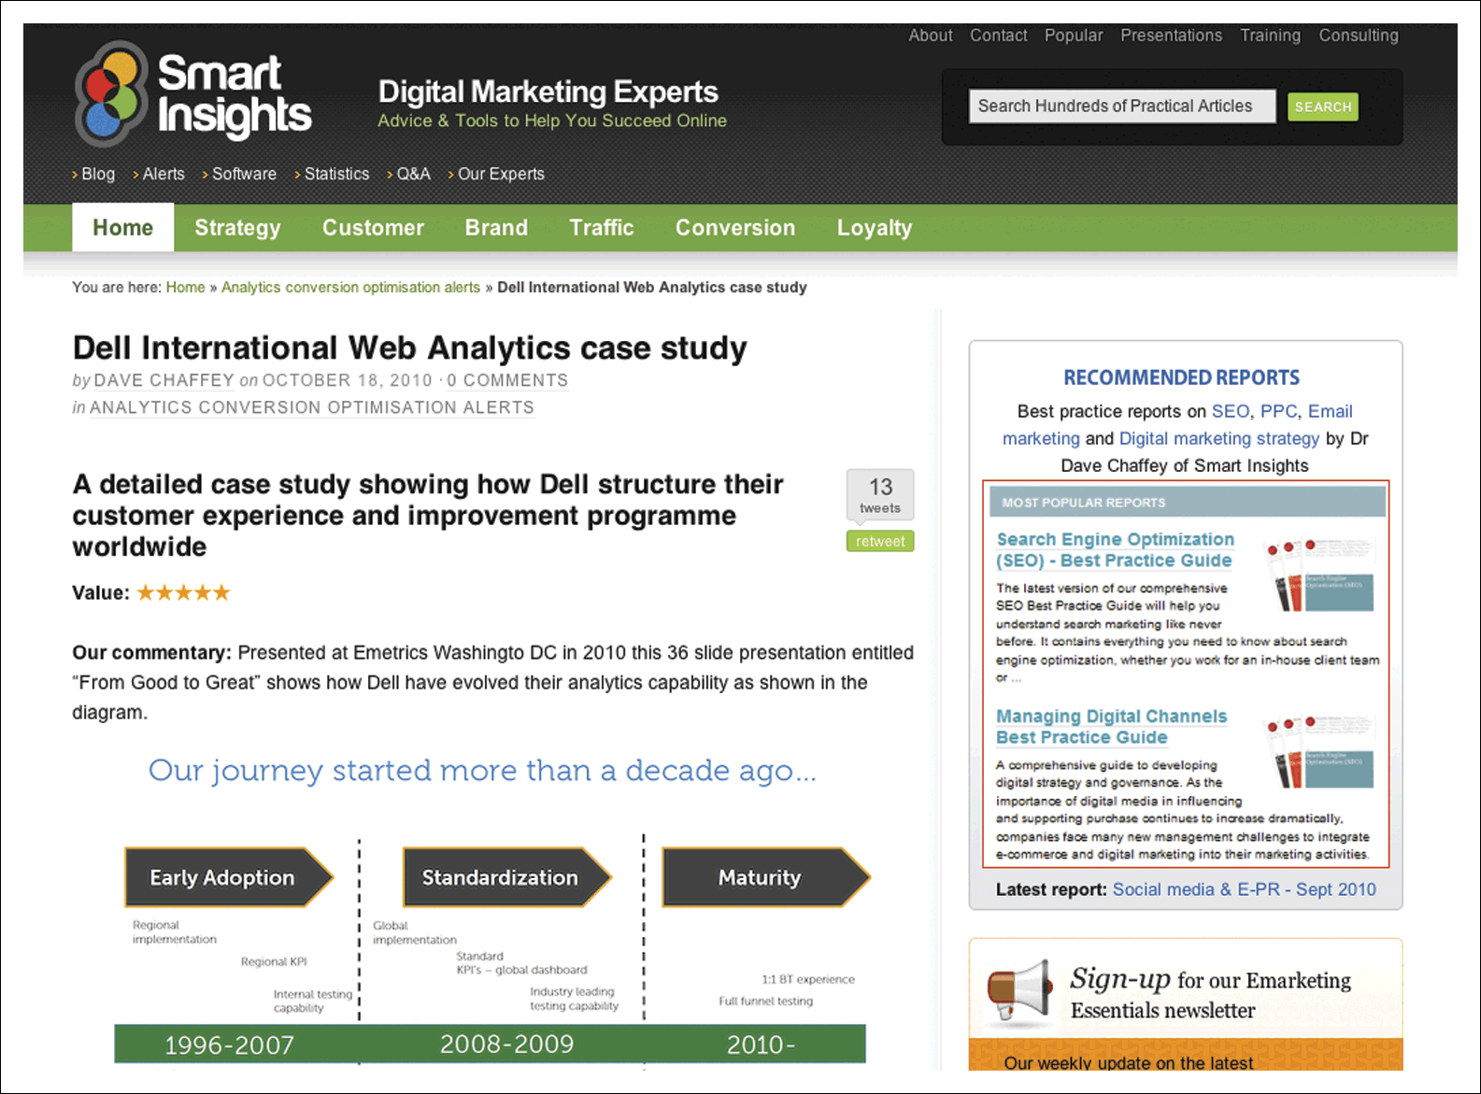
Figure 3.11 Smart Insights Blog
Source: www.smartinsights.com
Notes:
Replace with Figure 3.11

Slide 24
URLs and Domain Names
Web addresses are structured in a standard way as follows:
http://www.domain-name.extension/filename.html
What do the following extensions or global top level domains stand for?
  .com
  .co.uk, .uk.com
  .org or .org.uk
  .gov
  .edu, .ac.uk
  .int
  .net
  .biz
  .info
  .mobi
  .asia

Slide 25
Box 3.3
Identify URL Components
Protocol
Host or hostname
Subdomain
Domain name
Top-level domain or TLD
Second-level domain (SLD)
The port
The path
URL parameter
Anchor or fragment
http://video.google.co.uk:80/videoplay?docid=7246927612831078230&hl=en#00h02m30s

Slide 26
HTML and XML
HTML (Hypertext Markup Language)
A standard format used to define the text and layout of web pages. HTML files usually have the extension .HTML or .HTM
XML or eXtensible Markup Language
A standard for transferring structured data, unlike HTML which is purely presentational

Slide 27
XML Example
Product>
<Action Value5”Delete”/>
<ProductID>118003-008</ProductID>
</Product>
<Product Type5”Good” SchemaCategoryRef5”C43171801”>
<ProductID>140141-002</ProductID>
<UOM><UOMCoded>EA</UOMCoded></UOM>
<Manufacturer>Compaq</Manufacturer>
<LeadTime>2</LeadTime>
<CountryOfOrigin>
<Country><CountryCoded>US</CountryCoded></Country>
</CountryOfOrigin>

Slide 28
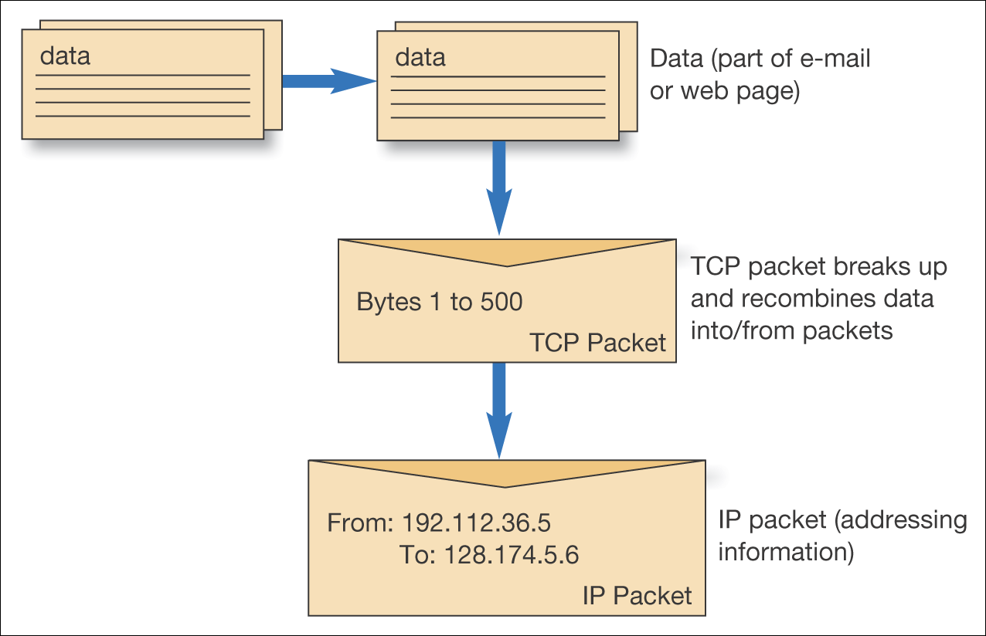
Figure 3.13 The TCP/IP protocol

Slide 29
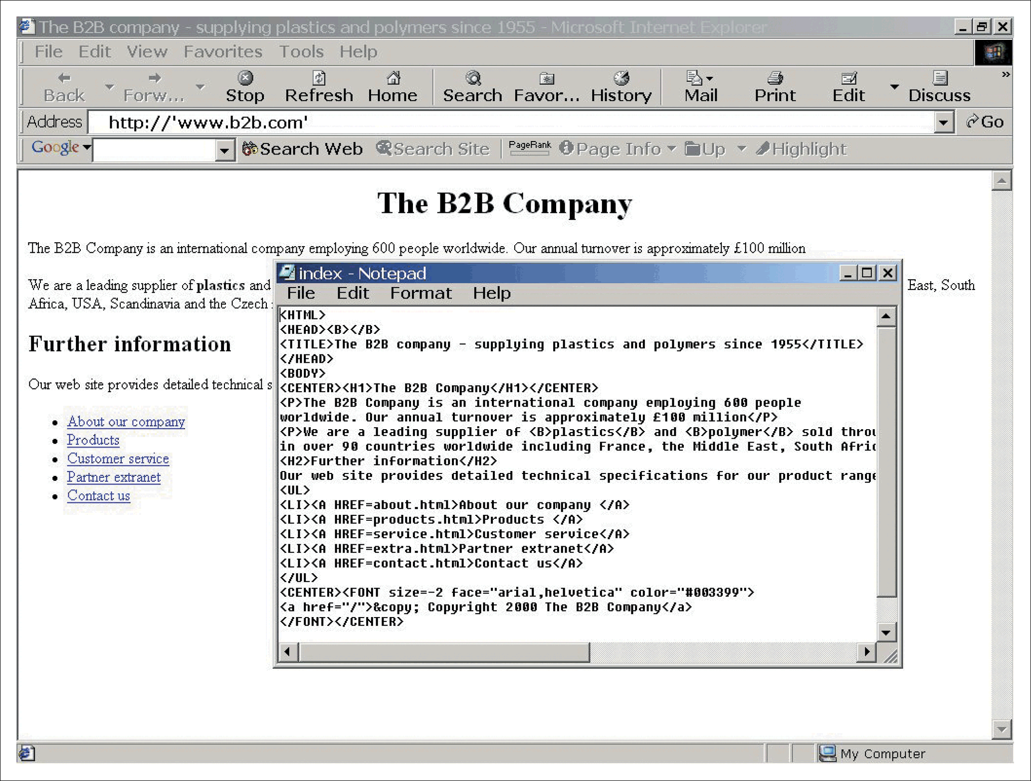
Figure 3.14 Home page index.html for an example B2B company in a web browser showing HTML source in text editor

Slide 30
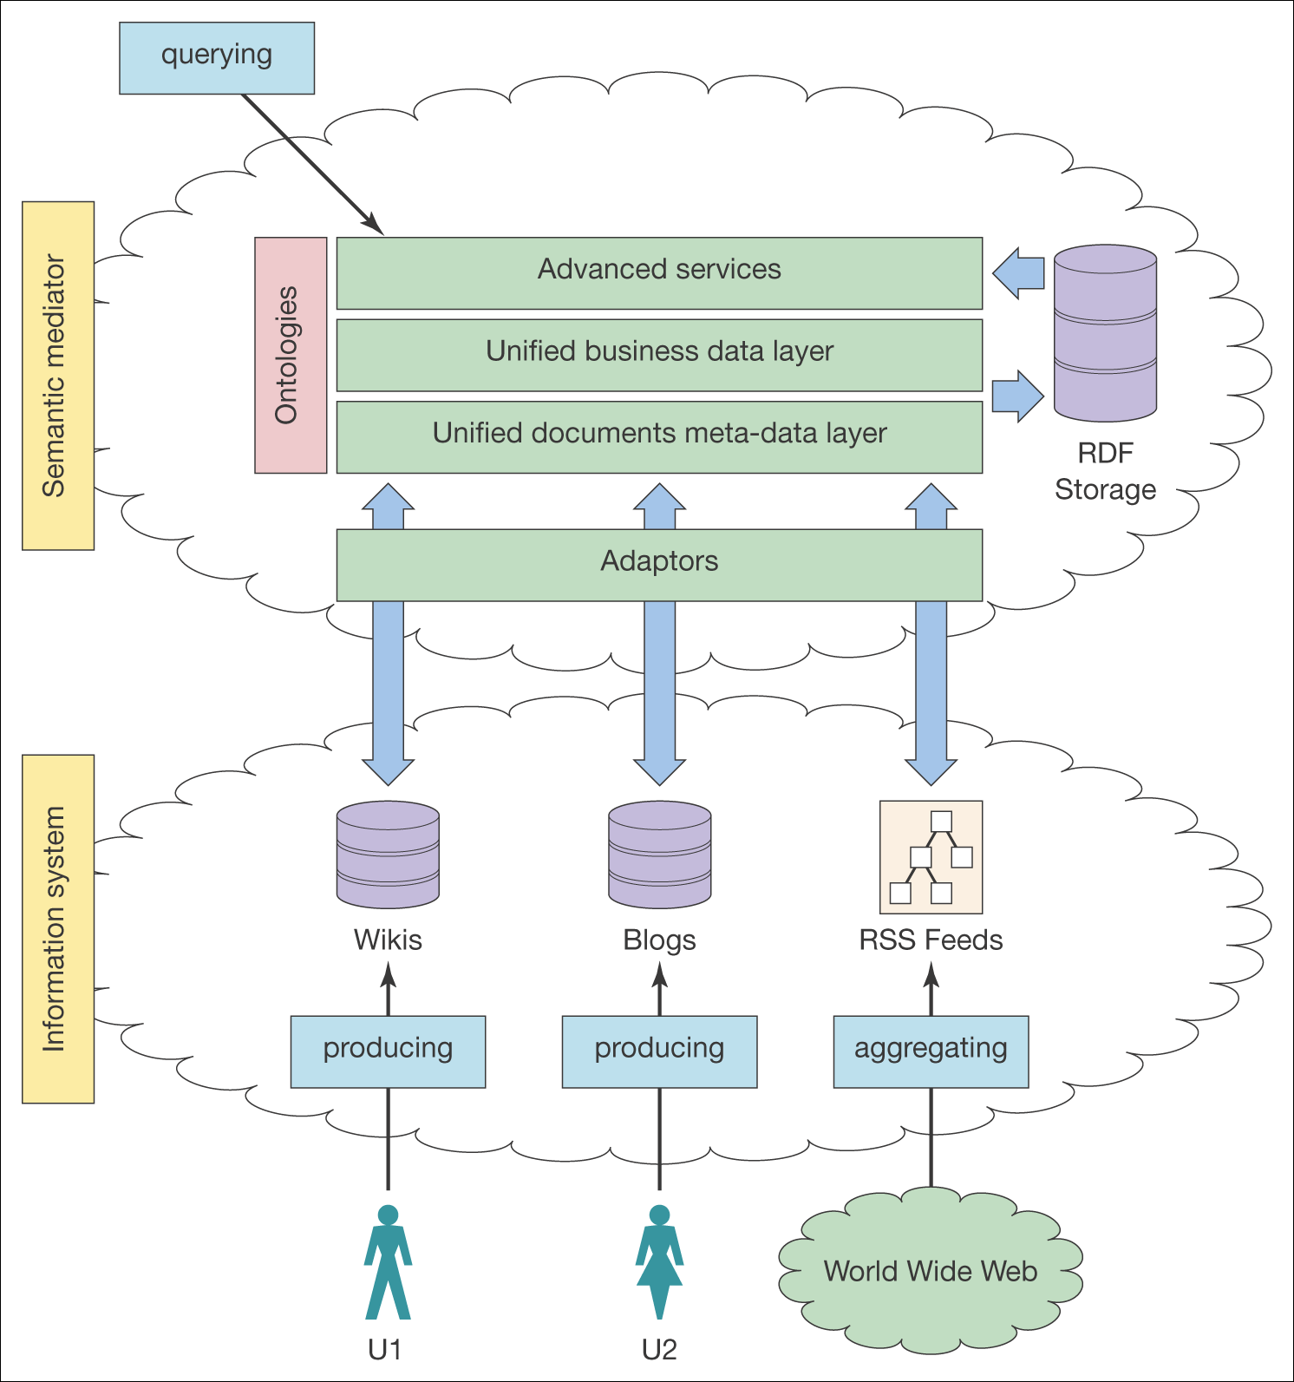
Figure 3.15 Architecture of a semantic web system

Slide 31
Media Standards
GIF (Graphics Interchange Format) A graphics format and compression algorithm best used for simple graphics.
JPEG (Joint Photographics Experts Group) A graphics format and compression algorithm best used for photographs.
Streaming media Sound and video that can be experienced within a web browser before the whole clip is downloaded e.g. Real Networks .rm format
Video standards include MPEG and .AVI
Sound standards include MP3 and WMA

Slide 32
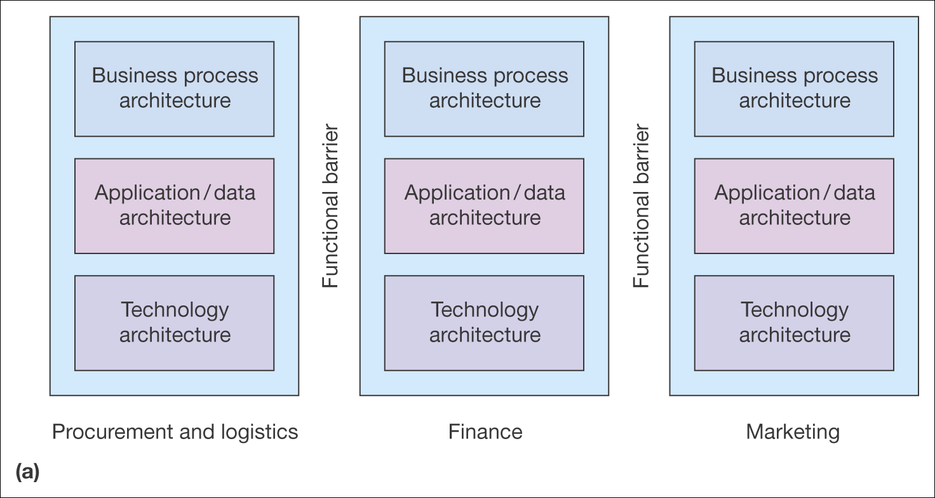
Figure 3.17 (a) Fragmented applications infrastructure, (b) integrated applications infrastructure
Source: Adapted from Hasselbring (2000)

Slide 33
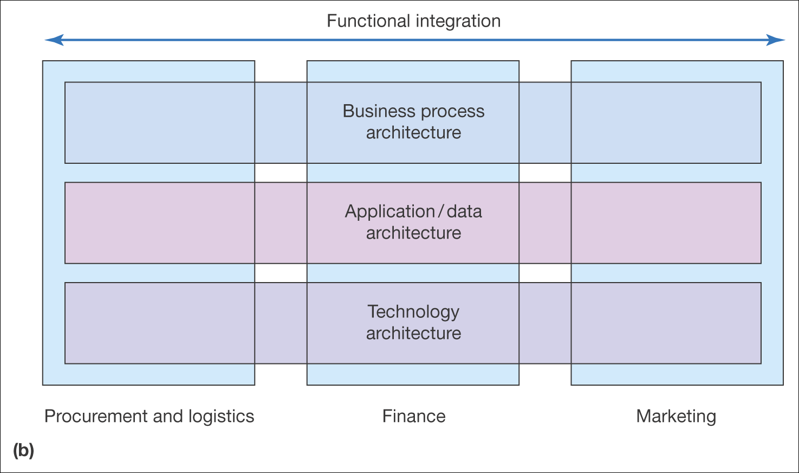
Figure 3.17 (a) Fragmented applications infrastructure, (b) integrated applications infrastructure (Continued)
Source: Adapted from Hasselbring (2000)

Slide 34
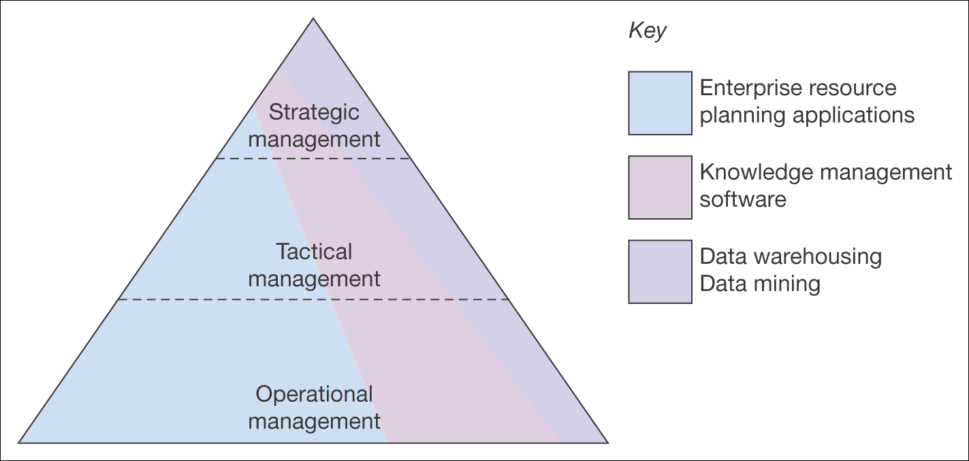
Figure 3.18 Differing use of applications at levels of management within companies

Slide 35
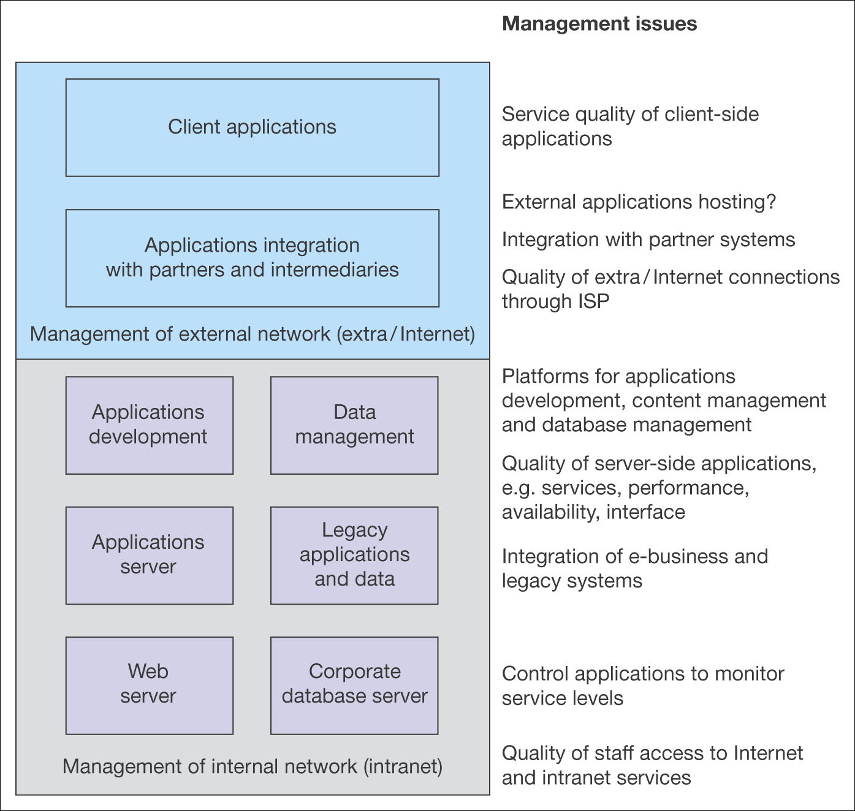
Figure 3.19 Elements of e-business infrastructure that require management

Slide 36
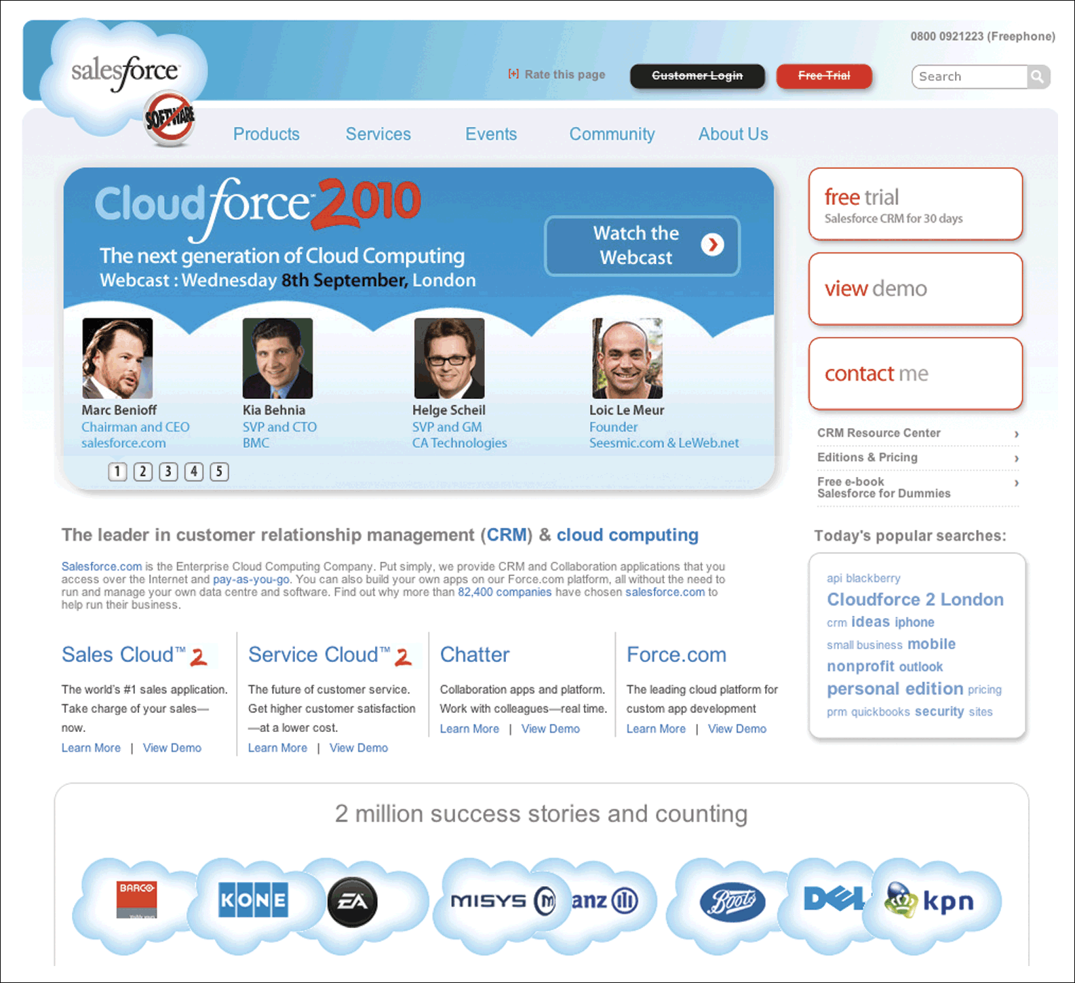
Figure 3.20 Salesforce.com
Source: www.salesforce.com
Notes:
Replace with Figure 3.20

Slide 37
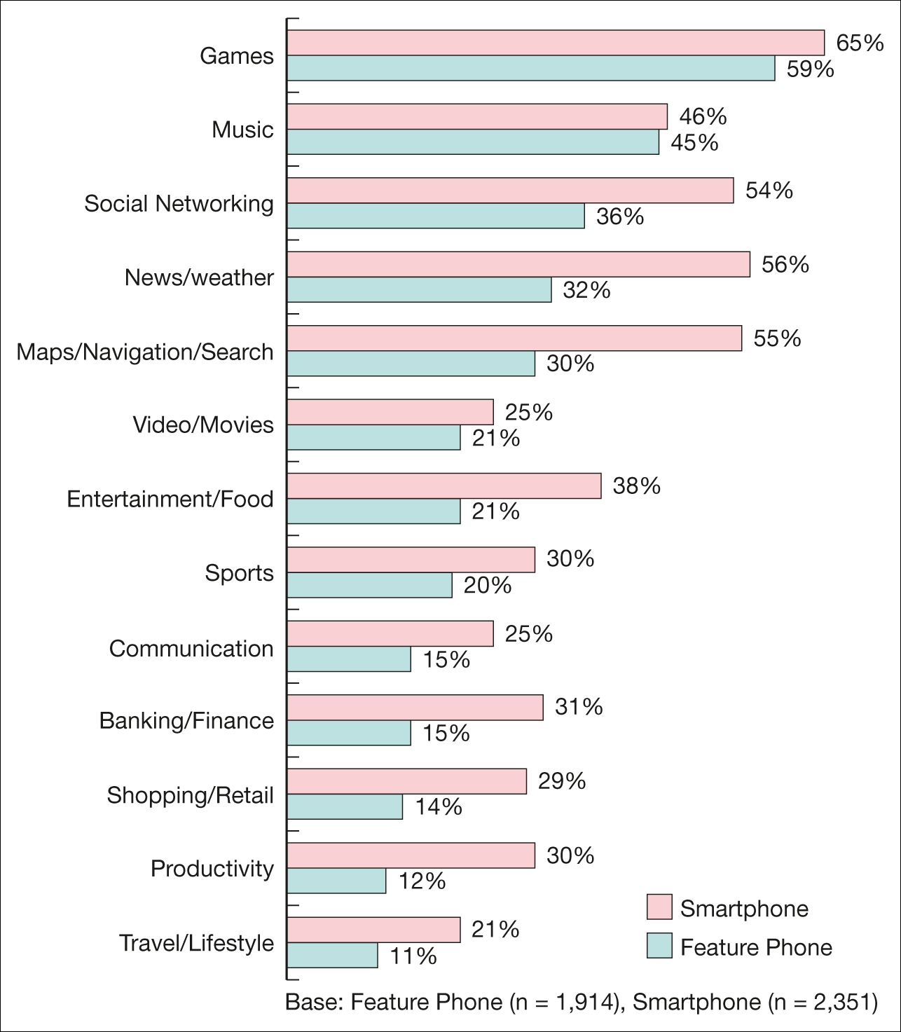
Popularity of different mobile app categories, 2012
Source: The State of Mobile Apps, 1 June 2012, Nielsen Wire, http://blog.nielsen.com/nielsenwire/online_mobile/the-state-of-mobile-apps
Notes:
Replace with Figure 3.21

