Slide 1
Marketplace Analysis for
E-Commerce

Slide 2
Management Issues
What are the implications of changes in marketplace structures for how we trade with customers and other partners?
Which business models and revenue models should we consider in order to exploit the Internet?
What will be the importance of online intermediaries and marketplace hubs to our business and what actions should we take to partner these intermediaries?

Slide 3
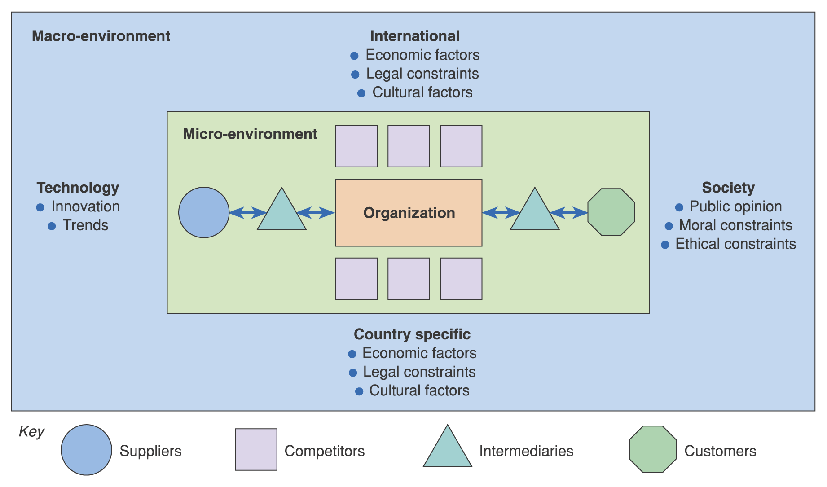
Figure 2.1 The environment in which e-business services are provided

Slide 4
Activity – The E-Commerce Environment
For each of the environment influences shown in Figure 2.1, give examples of why it is important to monitor and respond in an e-business context. For example, the personalization mentioned in the text is part of why it is important to respond to technological innovation.

Slide 5
Environment Constraints and Opportunities
Customers – which services are they offering via their web site that your organization could support them in?
Competitors – need to be benchmarked in order to review the online services they are offering – do they have a competitive advantage?
Intermediaries – are new or existing intermediaries offering products or services from your competitors while you are not represented?

Slide 6
Environment Constraints and Opportunities (Continued)
Suppliers – are suppliers offering different methods of procurement to competitors that give them a competitive advantage?
Macro-environment
Society – what is the ethical and moral consensus on holding personal information?
Country specific, international legal – what are the local and global legal constraints, for example, on holding personal information, or taxation rules on sale of goods?

Slide 7
Environment Constraints and Opportunities (Continued)
Country specific, international economic – what are the economic constraints of operating within a country or global constraints?
Technology – what new technologies are emerging by which to deliver online services such as interactive digital TV and mobile phone-based access?

Slide 8
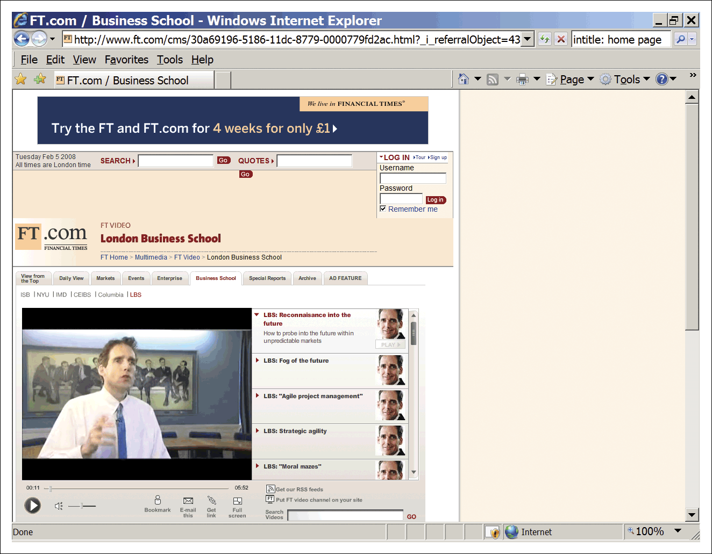
Figure 2.2 Professor Donald Sull of London Business School talks about strategic agility
Source: www.ft.com

Slide 9
http://video.ft.com/62156786001/London-Business-School-The-fog-of-the-future/Management
https://www.youtube.com/watch?v=UgQAYLz4A0E

Slide 10
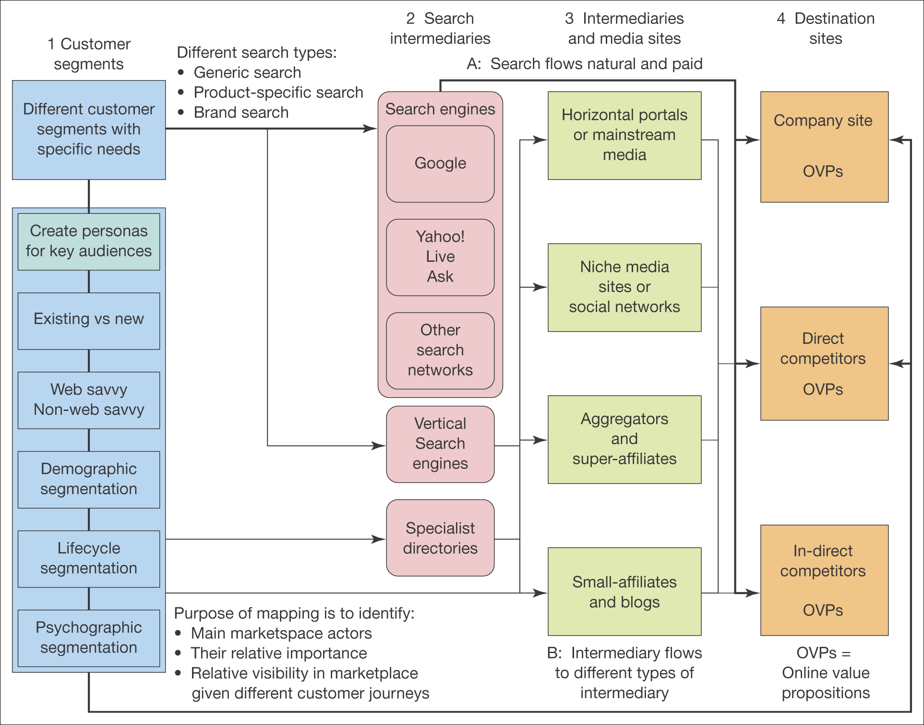
Figure 2.3 An online marketplace map

Slide 11
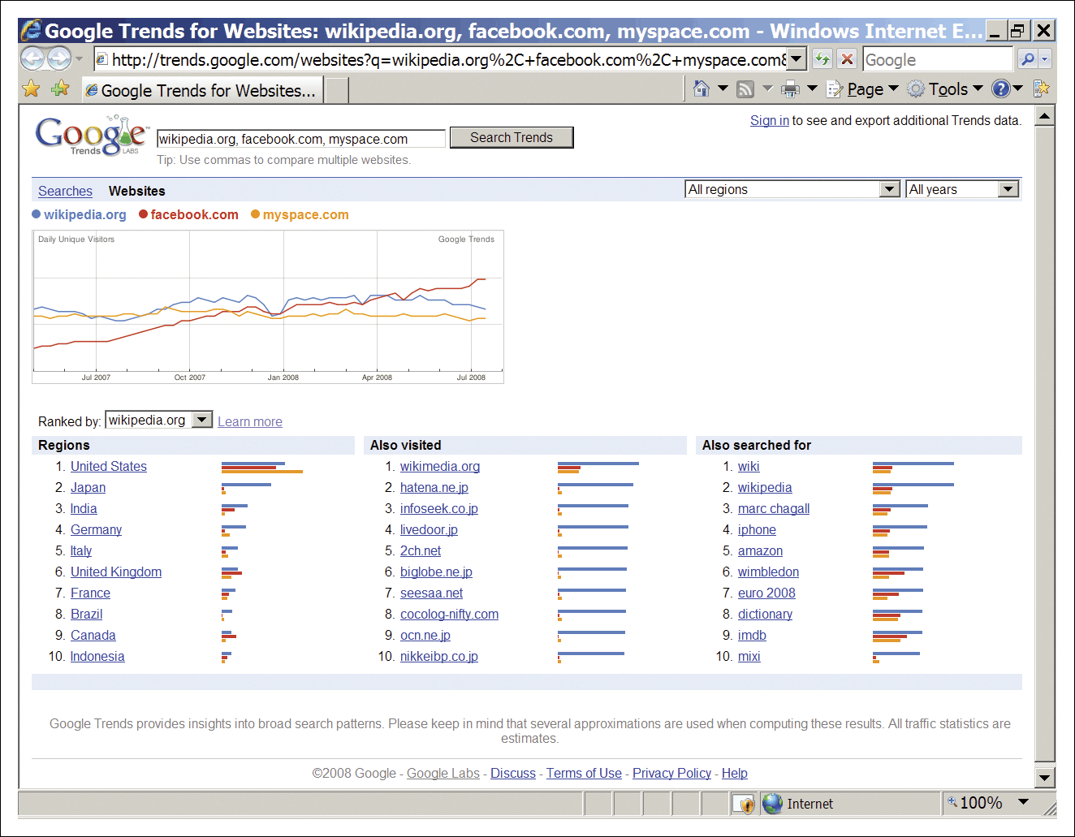
Figure 2.4 Google Trends for websites – useful for benchmarking the growth of online intermediaries and destination sites
Source: http://trends.google.com/websites

Slide 12
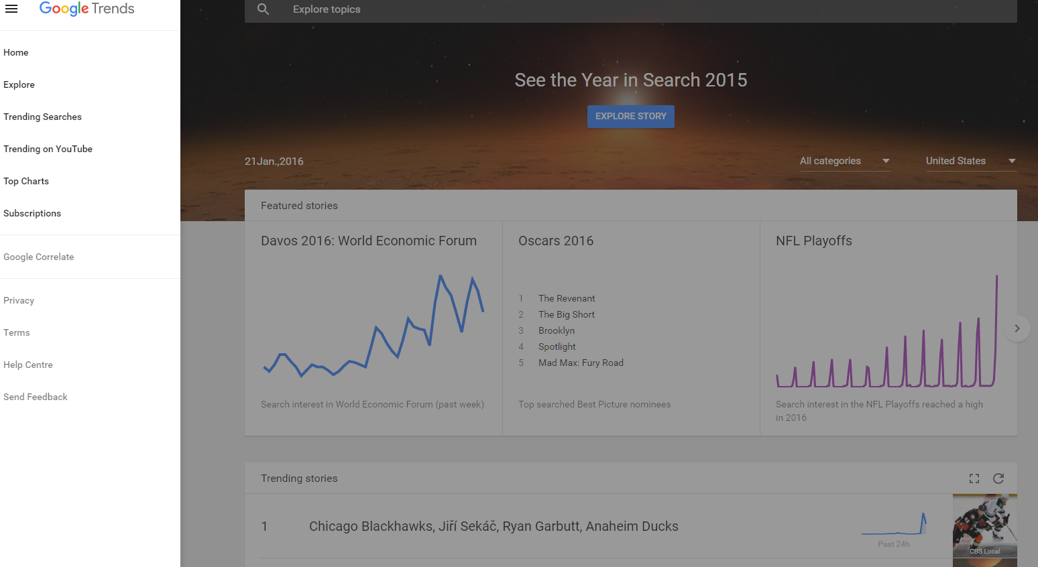
Google Trends for websites – useful for benchmarking

Slide 13
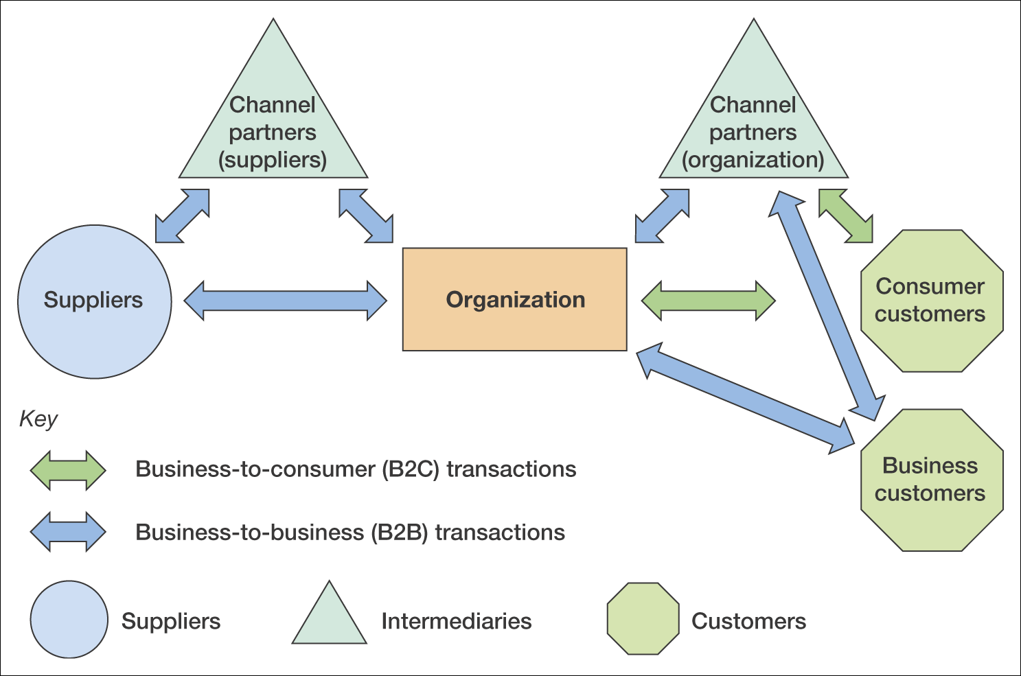
Figure 2.5 B2B and B2C interactions between an organization, its suppliers and its customers

Slide 14
B2B and B2C Characteristics
Characteristic | B2C | B2B
Proportion of adopters with access | Low to medium | High to very high
Complexity of buying decisions | Relatively simple – individual and influencers | More complex – buying process involves users, specifiers, buyers, etc.
Channel | Relatively simple – direct or from retailer | More complex, direct or via wholesaler, agent or distributor
Purchasing characteristics | Low value, high volume or high value, low volume. May be high involvement | Similar volume/value. May be high involvement. Repeat orders (rebuys) more common
Product characteristic | Often standardized items | Standardized items or bespoke for sale

Slide 15
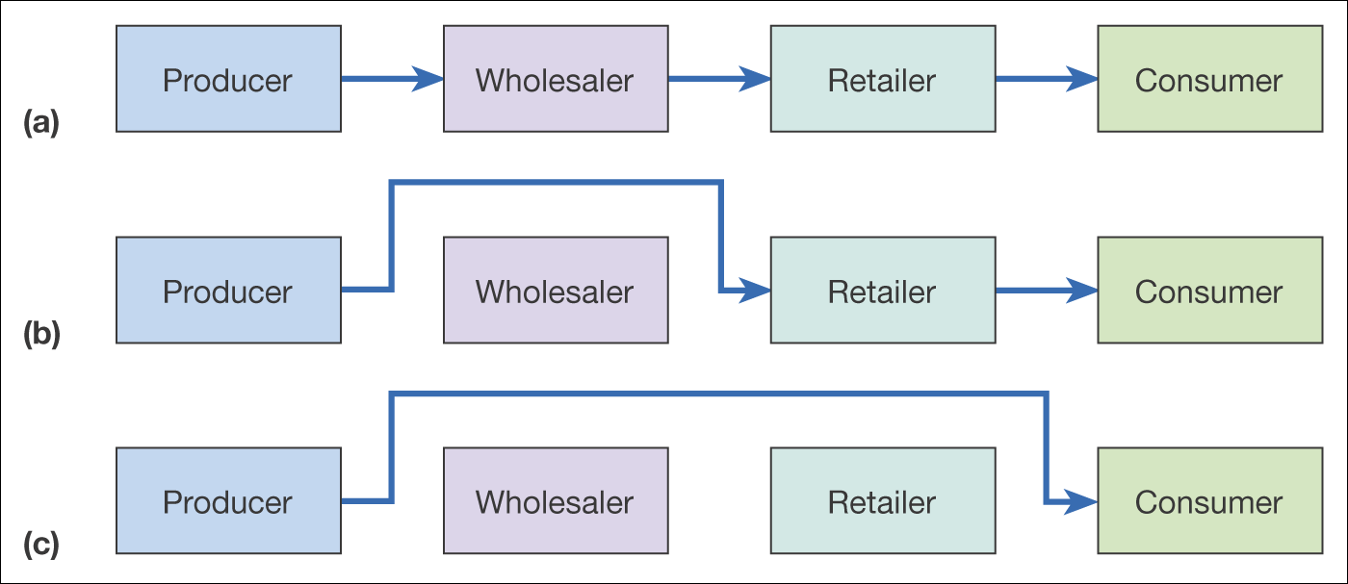
Figure 2.6 Disintermediation of a consumer distribution channel showing (a) the original situation, (b) disintermediation omitting the wholesaler, and
(c) disintermediation omitting both wholesaler and retailer

Slide 16
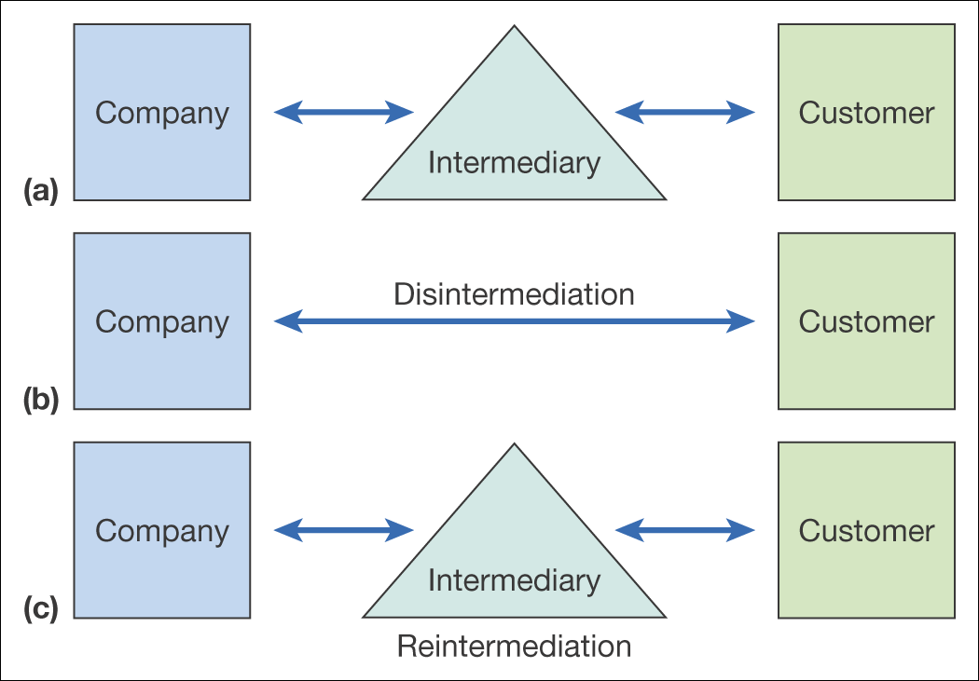
Figure 2.7 From original situation (a) to disintermediation (b) and reintermediation (c)

Slide 17
Counter-Mediation
Creation of a new intermediary
Example:
  B&Q www.diy.com
  Opodo www.opodo.com
  Boots www.handbag.com
  (www.covisint.com) Platform to enable the IoT
Partnering with existing intermediary – Mortgage broker Charcol and Freeserve.

Slide 18
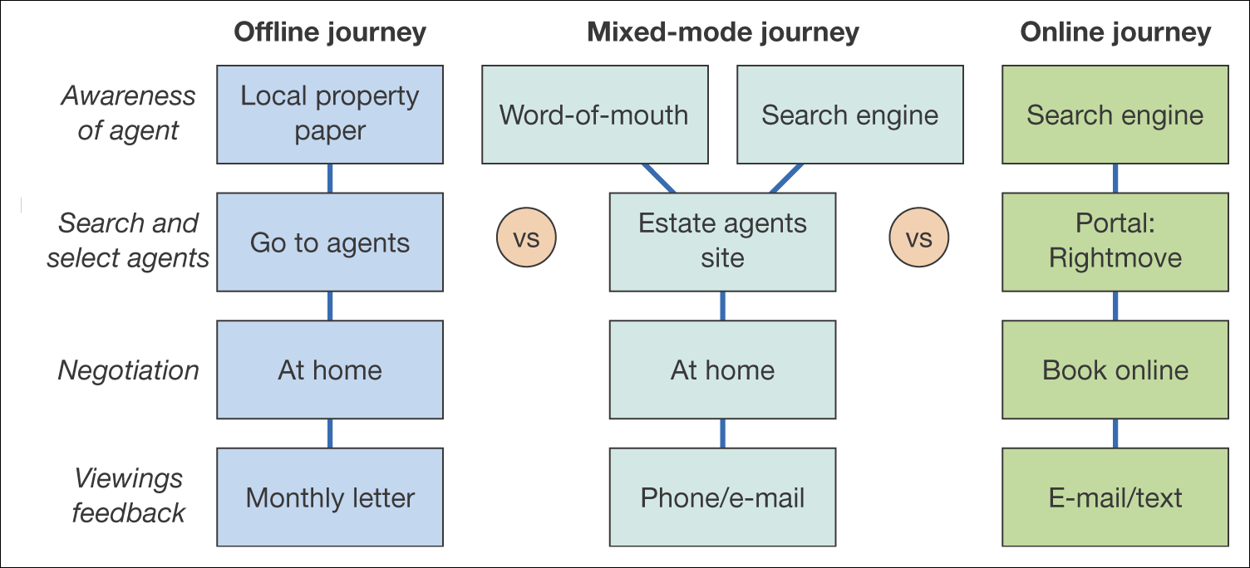
Figure 2.8 Example channel chain map for consumers selecting an estate agent to sell their property

Slide 19
Interactive Activity – Portals
Q1. Define portal
Q2. Is a search engine the same as a portal? Yes, No
Q3. Is a search engine the same as a directory? Yes, No
Q4. List search engines/portals you use and explain why.

Slide 20
Meta services
Search engines
Portal
Directories
‘A gateway to information resources and services’
News aggregators
MR aggregators
Comparers
Exchanges

Slide 21
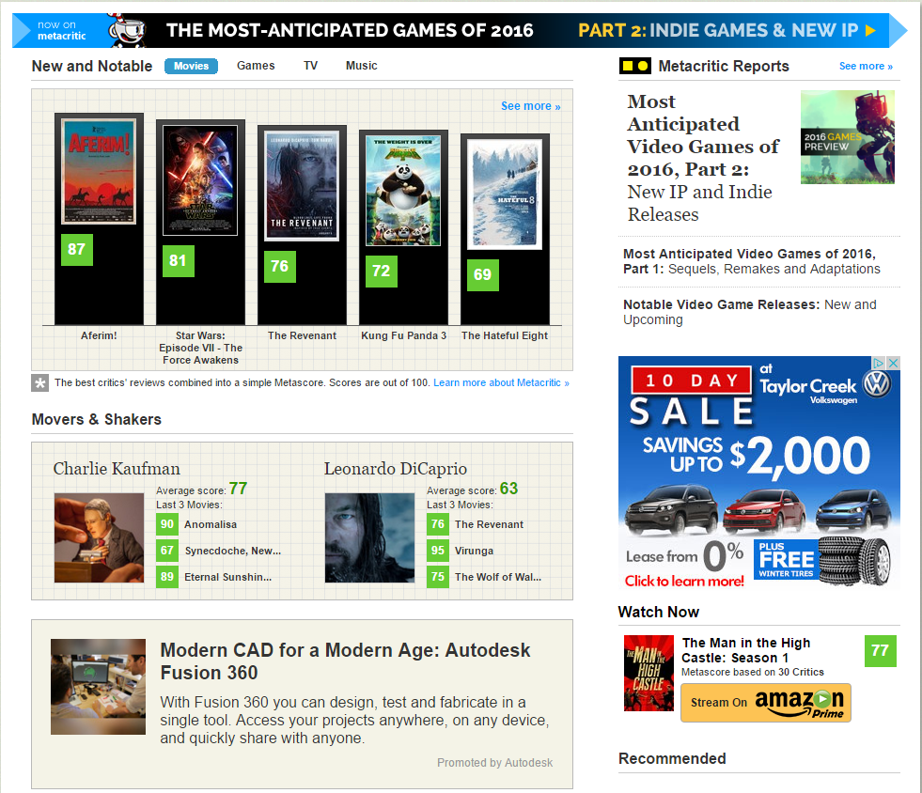
Source: CBS Interactive; www.metacritic.com
Notes:
Replace with Figure 2.9

Slide 22
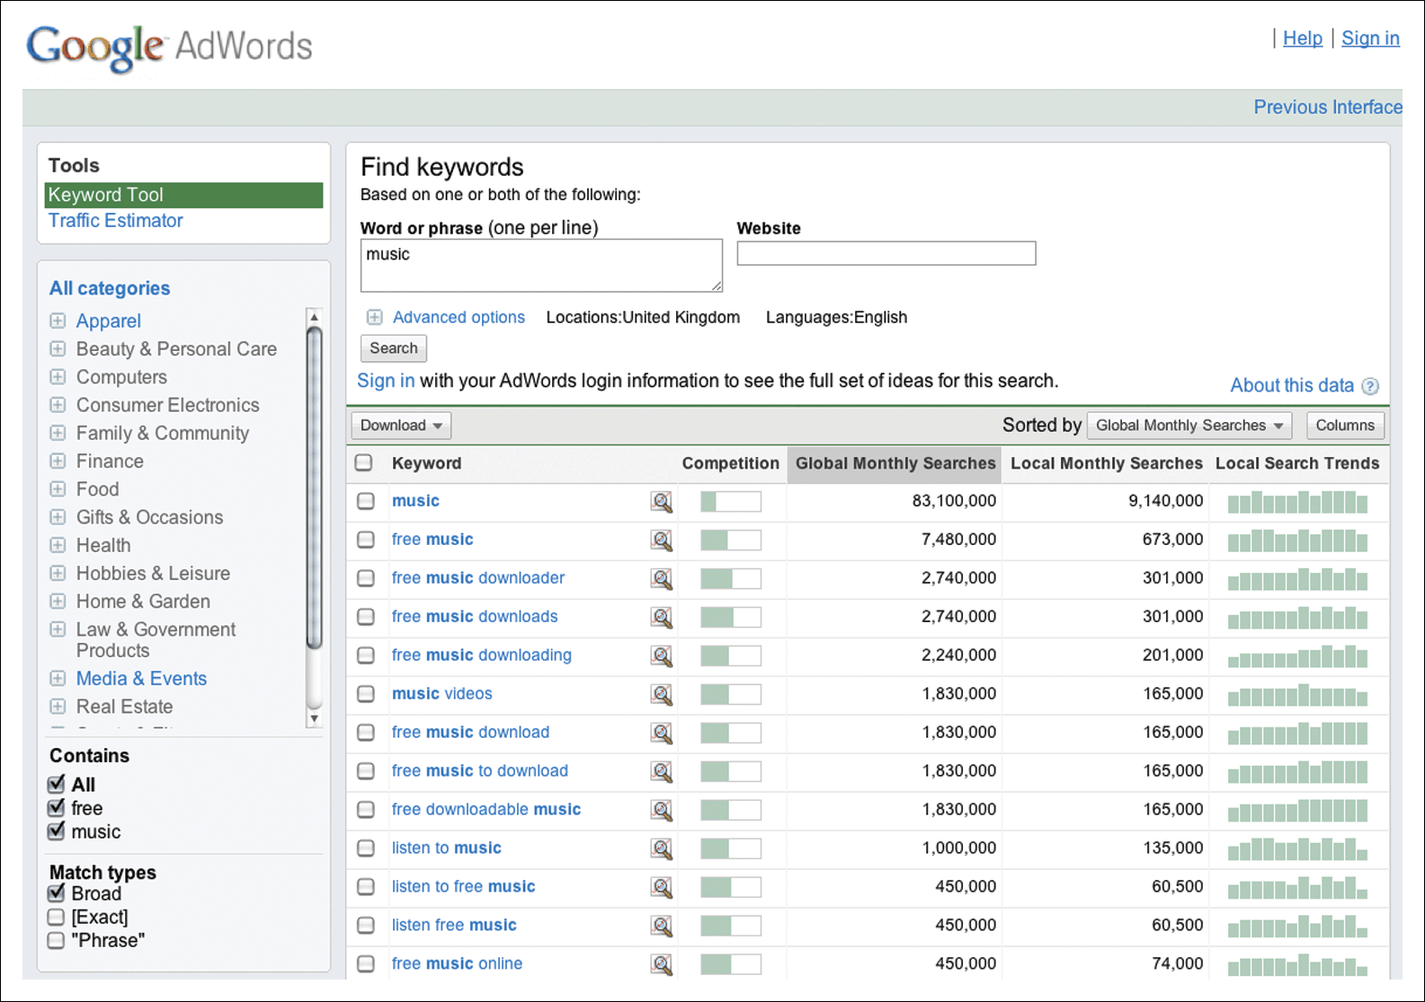
Figure 2.10 Number of searches through the Google Keyword Tool
Source: Google https://adwords.google.com/select/KeywordTool
Notes:
Replace with Figure 2.10

Slide 23
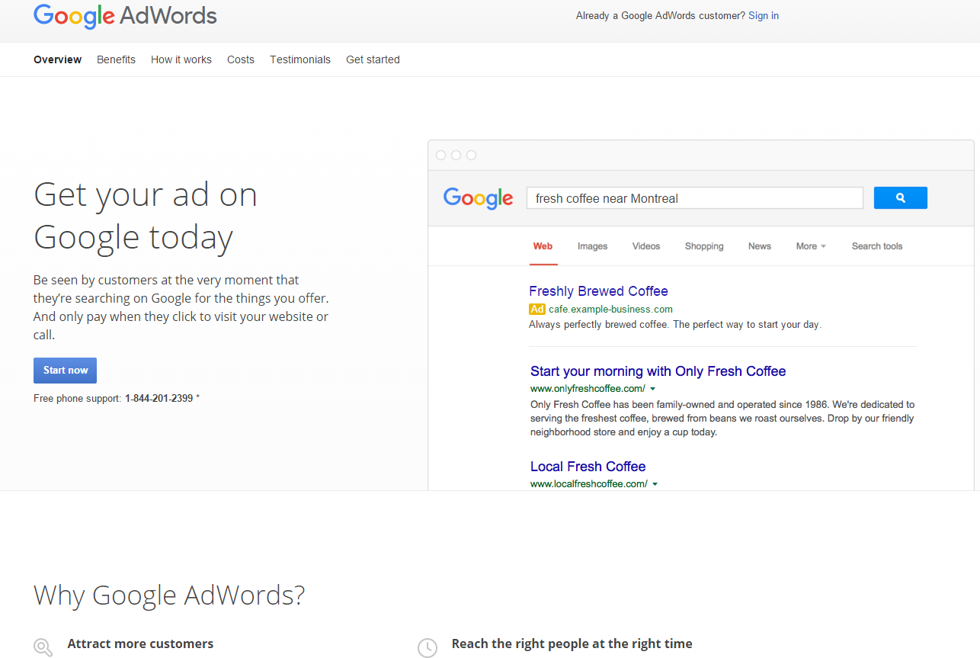
https://www.google.com/adwords

Slide 24
Business Model
Timmers (1999) defines a ‘business model’ as:
An architecture for product, service and information flows, including a description of the various business actors and their roles; and a description of the potential benefits for the various business actors; and a description of the sources of revenue.

Slide 25
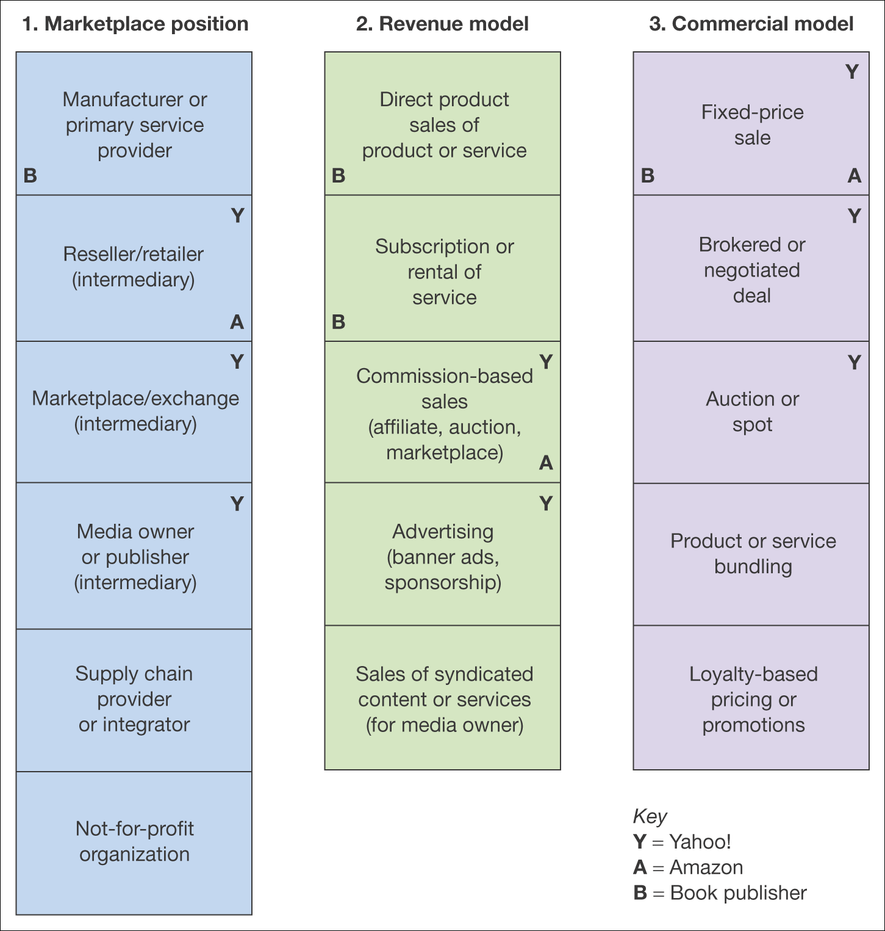
Figure 2.11 Alternative perspectives on business models

Slide 26
Revenue Models – Publisher Example
Subscription access to content
Pay per view content access
CPM display advertising
CPC advertising on site
Sponsorship of sections, content or widgets
Affiliate revenue (CPA or CPC)
Subscriber data for e-mail marketing
Access to customers for research purposes.

Slide 27
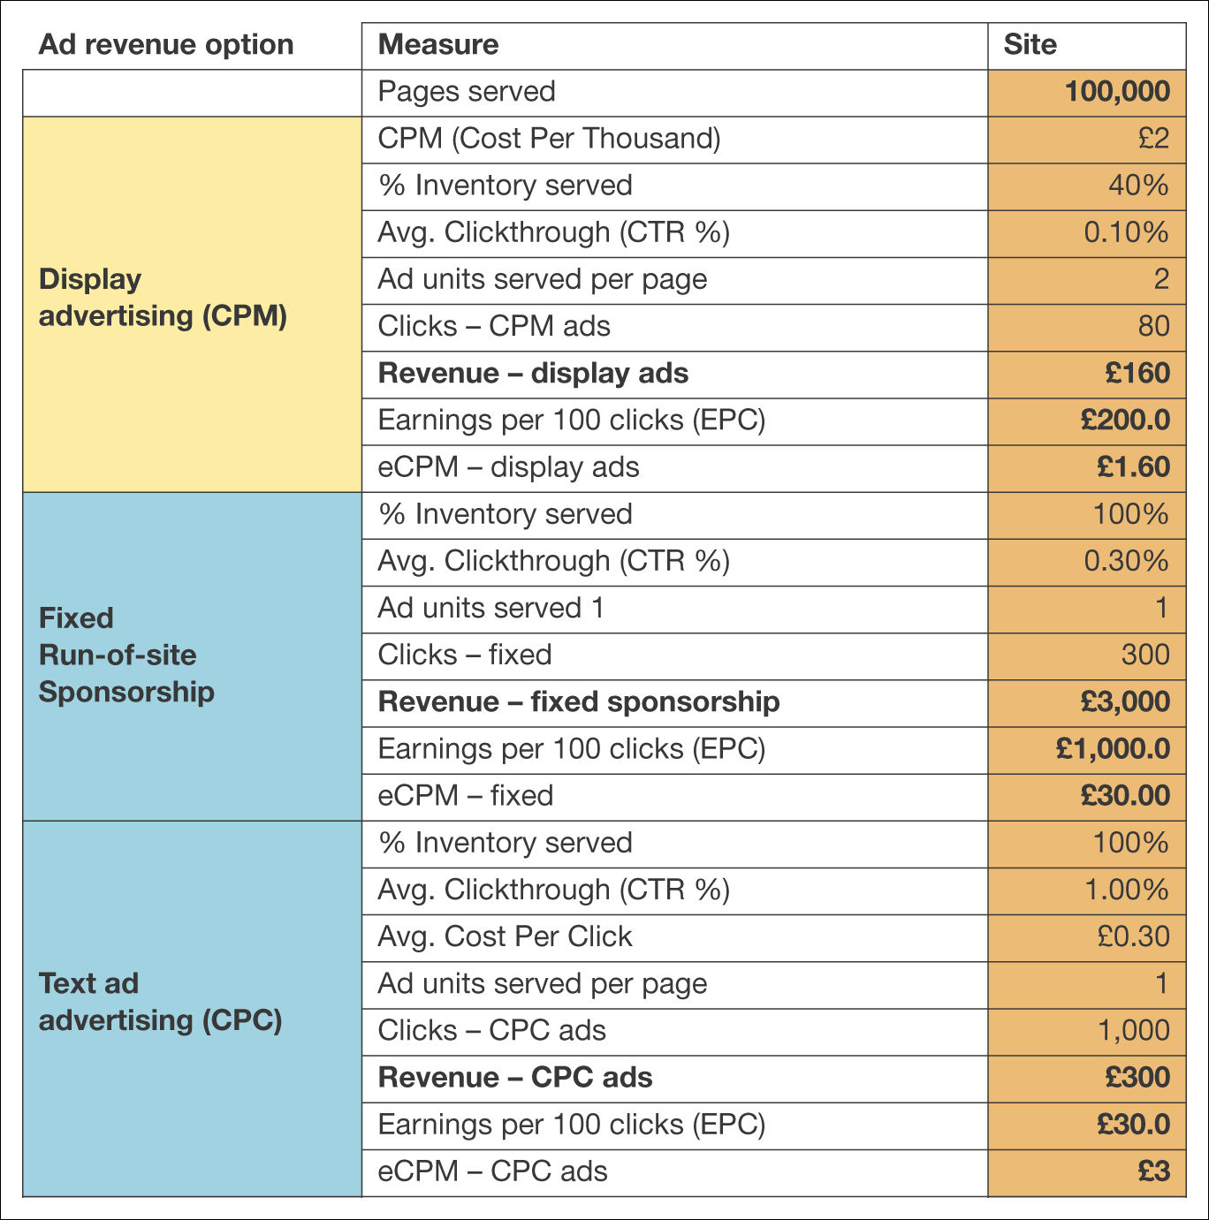
Figure 2.12 Example spreadsheet for calculating a site revenue model
Note: Available for download at www.smartinsights.com/conversion-model-spreadsheets/

Slide 28
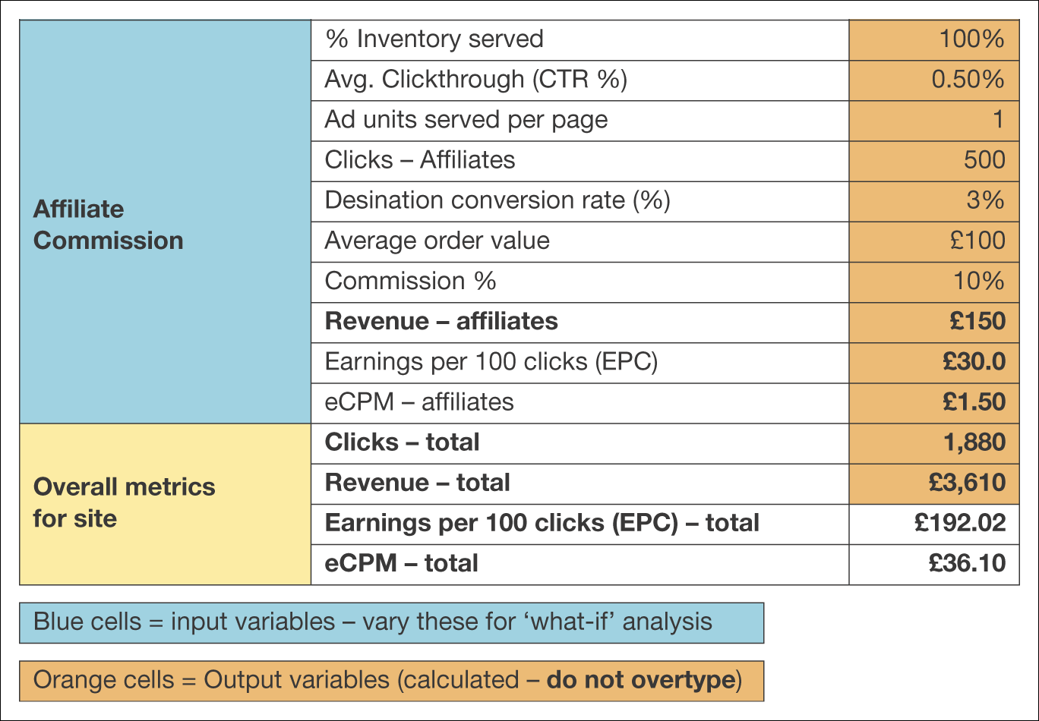
Figure 2.12 Example spreadsheet for calculating a site revenue model (Continued)
Note: Available for download at www.smartinsights.com/conversion-model-spreadsheets/

Slide 29
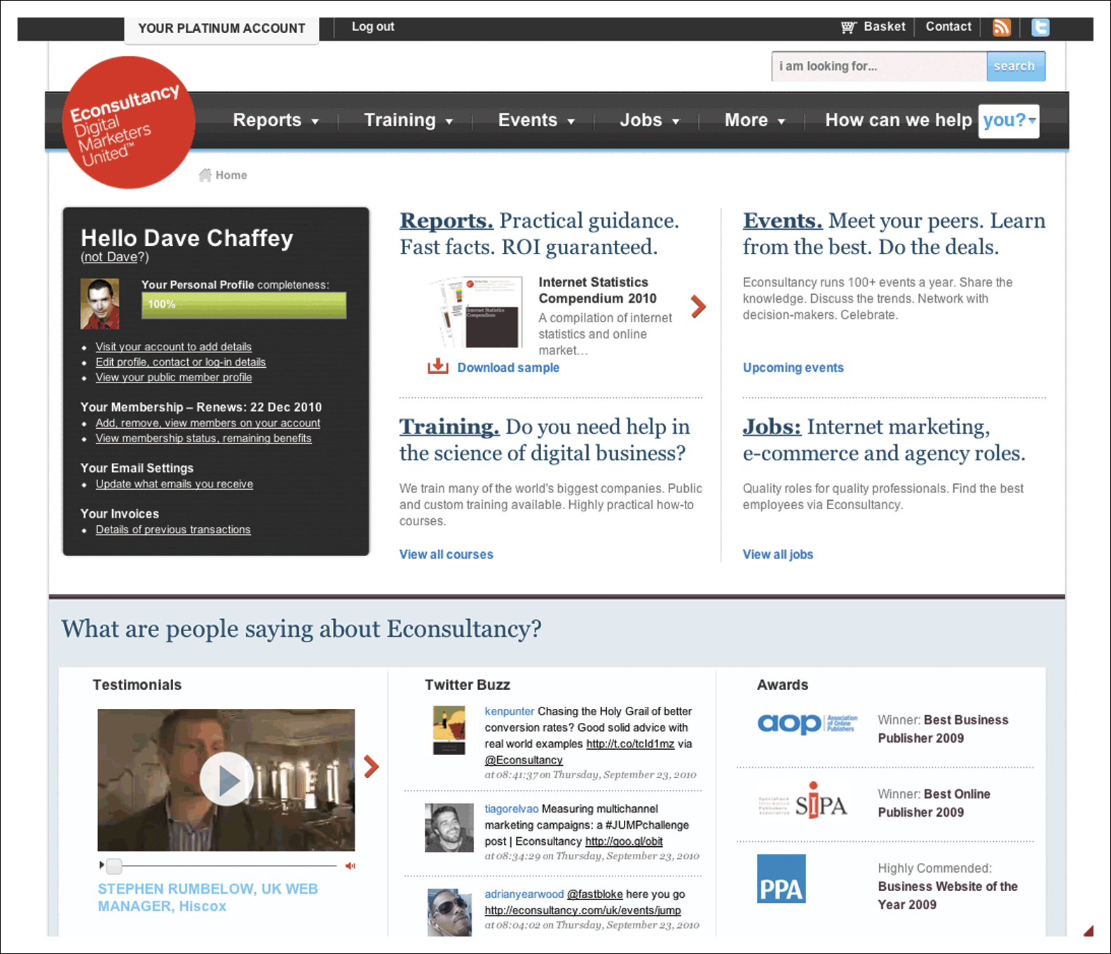
Figure 2.13 E-consultancy
Source: www.econsultancy.com
Notes:
Replace with Figure 2.13

Slide 30
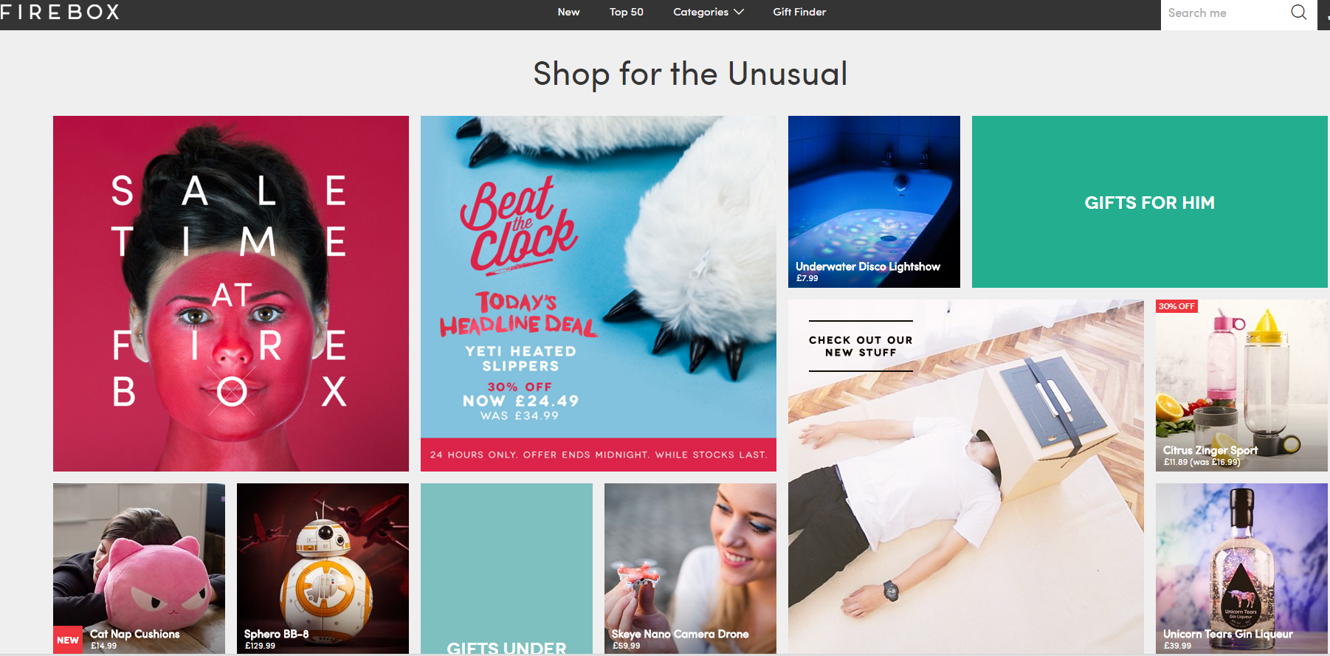
Figure 2.14 Firebox
Source: www.firebox.com
Notes:
Replace with Figure 2.14

Slide 31
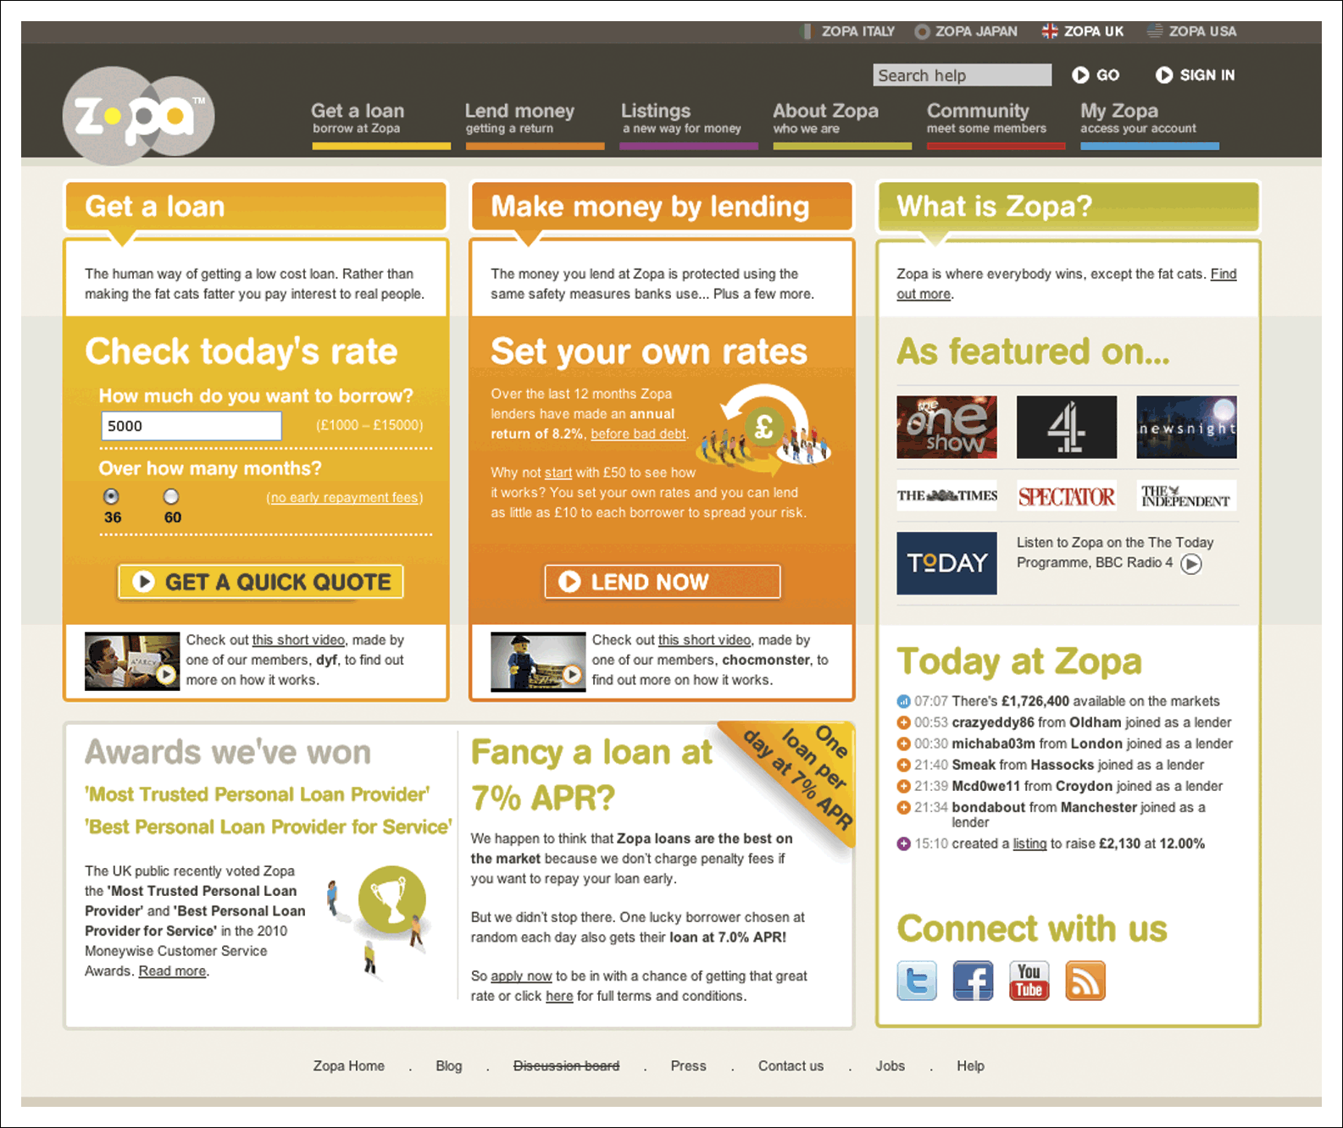
Figure 2.15 Zopa 2006
Source: www.zopa.com
Notes:
Add Figure 2.15

Slide 32
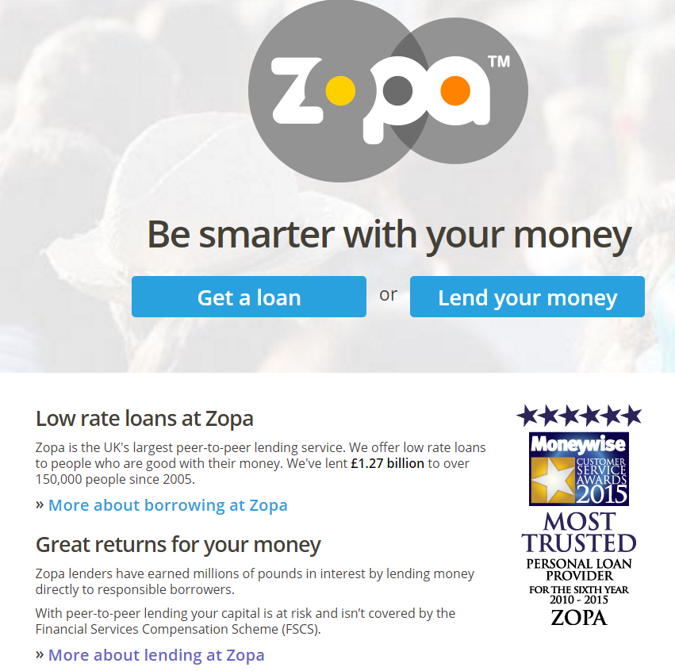
2016: www.zopa.com

