Slide 1
Introduction to E-Business and E-Commerce
Nour El Kadri
Notes:
E-Commerce is only the transaction
E-Business is the whole cycle of doing business online including reaching out. End to end
E-Commerce is a part of E-business.

Slide 2
Learning Outcomes
Define the meaning and scope of e-business and e-commerce and their different elements
Summarize the main reasons for adoption of
e-commerce and e-business and barriers that may restrict adoption
Outline the ongoing business challenges of managing e-business and e-commerce in an organization.
Notes:
2

Slide 3
Management Issues
How do we explain the scope and implications of e-business and e-commerce to staff?
What is the full range of benefits of introducing
e-business and what are the risks?
How do we evaluate our current e-business capabilities?
Notes:
3

Slide 4
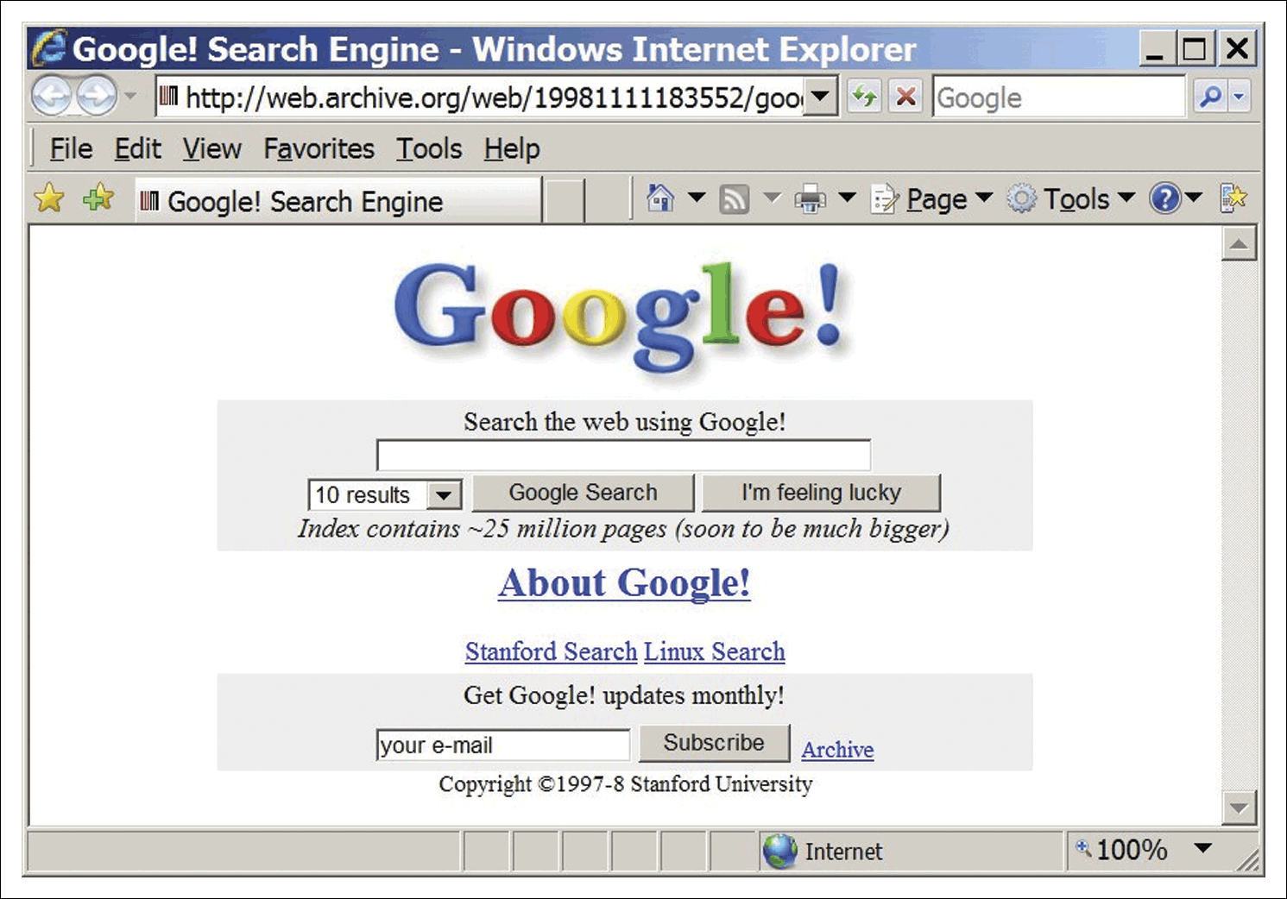
Google circa 1998
Source: Wayback machine archive: http://web.archive.org/web/19981111183552/google.stanford.edu
Notes:
4

Slide 5
E-Business Innovation and Opportunity
Since Google was launched in 1998 which
e-business start-ups have transformed the way we work, live and play?
How has Google innovated in search and its business table?
What are some of the major innovators?
Notes:
E-bay owns kijiji
Uber is worth 40billion dollars.
5

Slide 6
The Impact of the Internet on Business
Andy Grove, Chairman of Intel, one of the early adopters of e-commerce, has made a meteorological analogy with the Internet. He says:
“The Internet a typhoon force, a ten times force, or is it a bit of wind? Or is it a force that fundamentally alters our business?” (Grove, 1996).
Notes:
6

Slide 7
E-Business Opportunities
Reach
  Over 5 billion users globally
  Connect to millions of products
Richness
  Detailed product information on 50 billion + pages indexed by Google. Blogs, videos, feeds…
  Personalized messages for users
Affiliation
  Partnerships are key in the networked economy.
Notes:
7

Slide 8
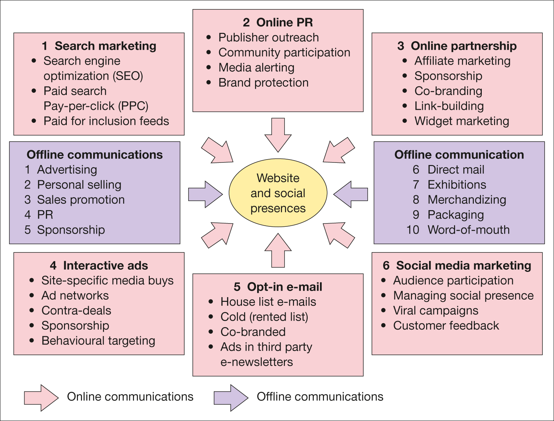
Figure 1.6 Online and offline communications techniques for e-commerce

Slide 9
Internet Risks – What Can Go Wrong with a Transactional Site?
Notes:
9
This slide left deliberately blank for student Q&A interaction.
Potential answers:
Site downtime affecting whole site or some processes
Security attack, e.g. denial of service, content hijacked
Wrong content presented for site visitor

Slide 10
What is E-Commerce and E-Business?
You are attending a role in the e-business team of a global bank
You anticipate you may be asked the distinction between e-commerce and e-business.
Give a definition for each:
E-Commerce:
E-Business:
Notes:
10

Slide 11
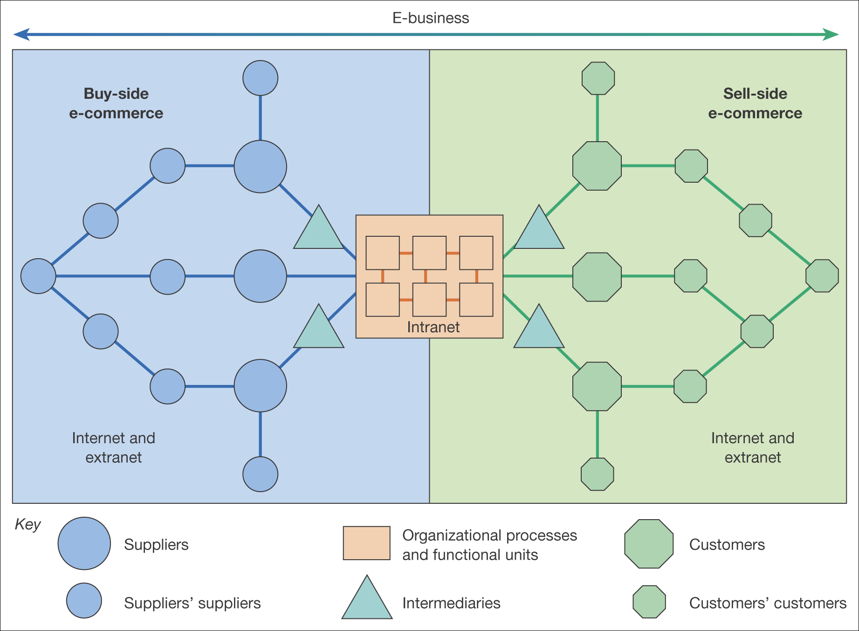
Figure 1.2 The distinction between buy-side and sell-side e-commerce
Notes:
11

Slide 12
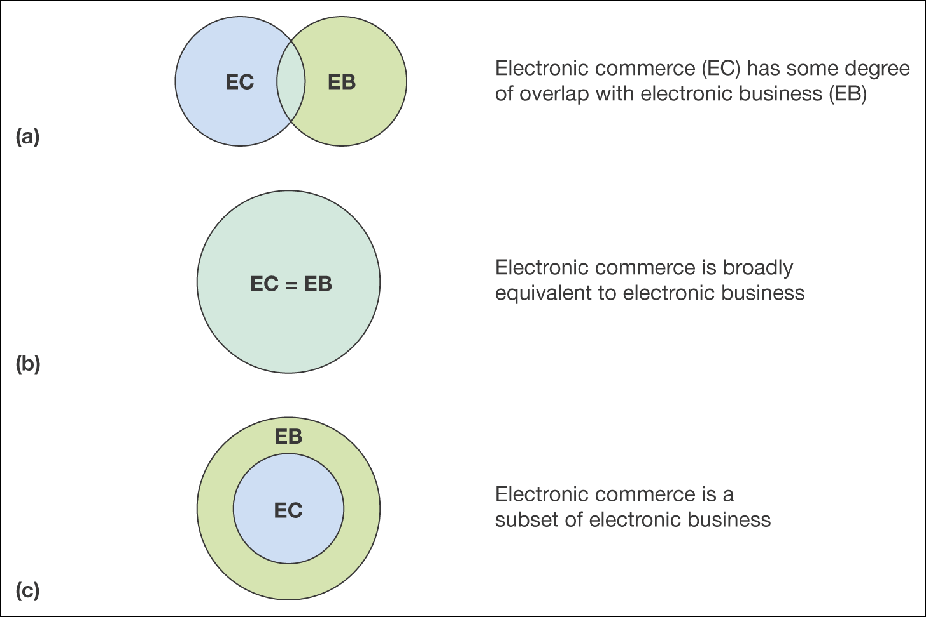
Figure 1.3 Three definitions of the relationship between e-commerce and e-business
Notes:
12

Slide 13
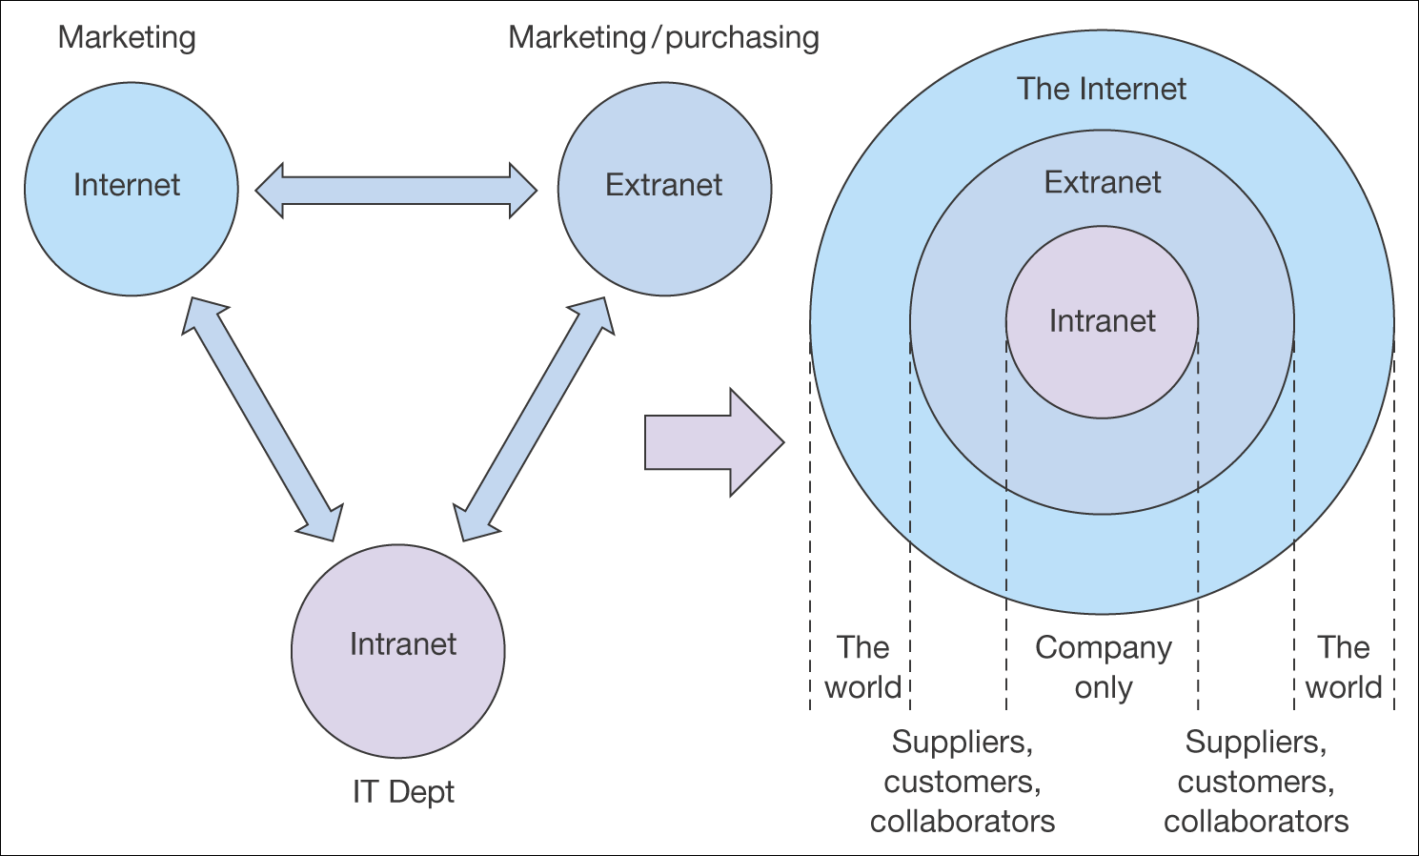
Figure 1.4 The relationship between intranets, extranets and the Internet
Notes:
13

Slide 14
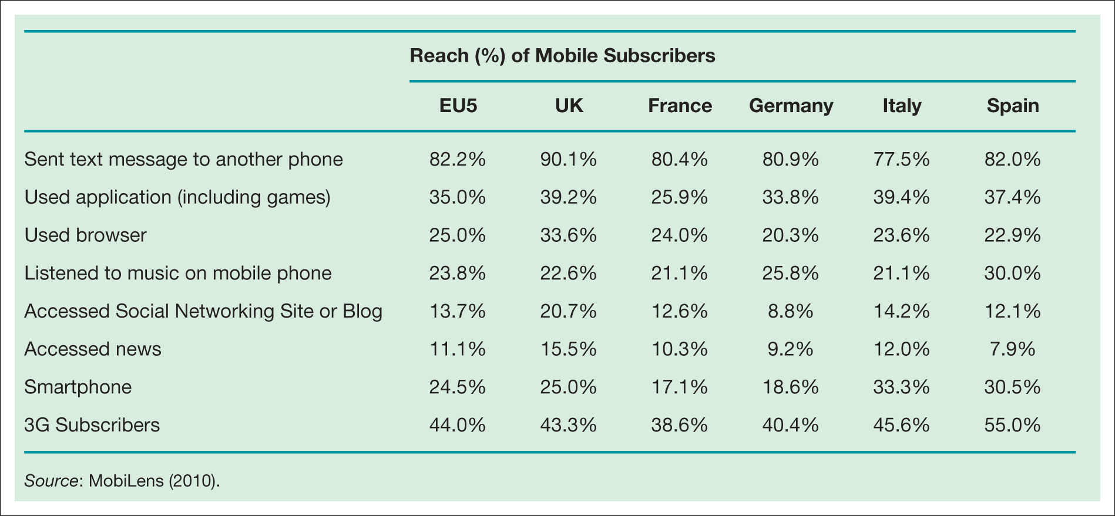
Table 1.2 Internet usage habits among mobile phone subscribers, EU-5 3-month average ending March 2010, age 13+
Notes:
Place Table 1.2 here

Slide 15
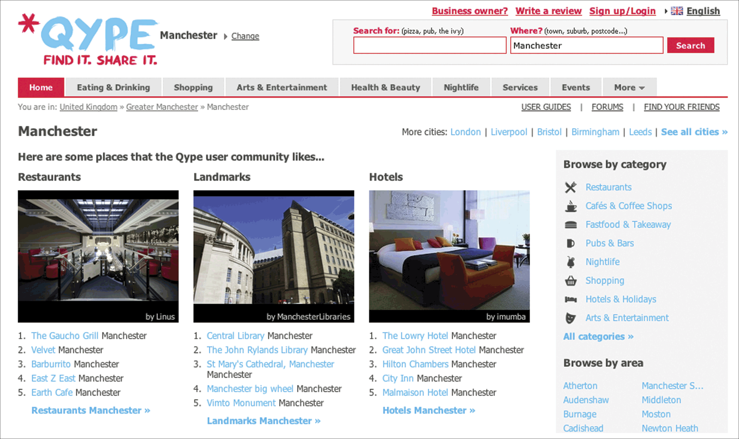
Figure 1.7 Qype
Source: www.qype.com
Notes:
Place Figure 1.7 here

Slide 16
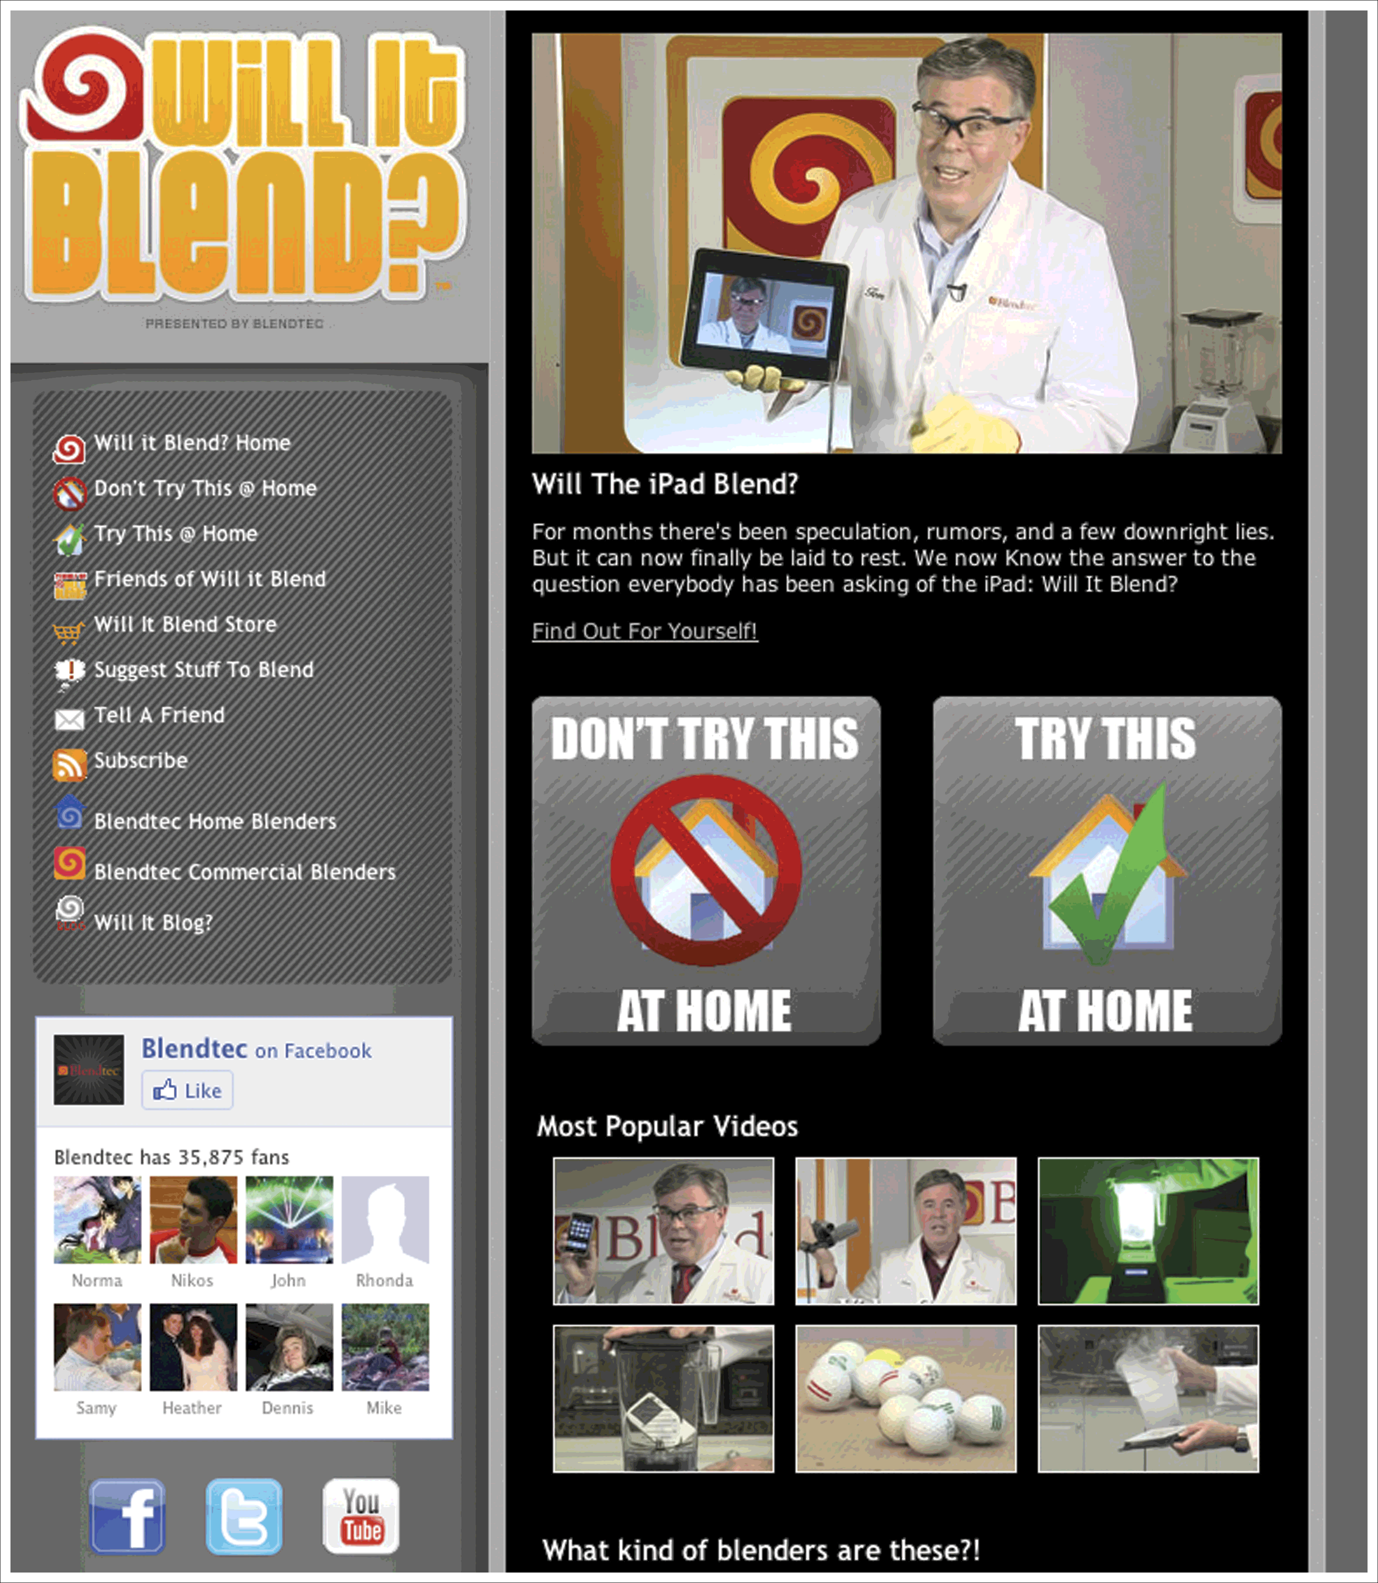
Figure 1.8 Blendtec viral campaign micro-site
Source: www.willitblend.com
Notes:
Replace with Figure 1.8
16

Slide 17
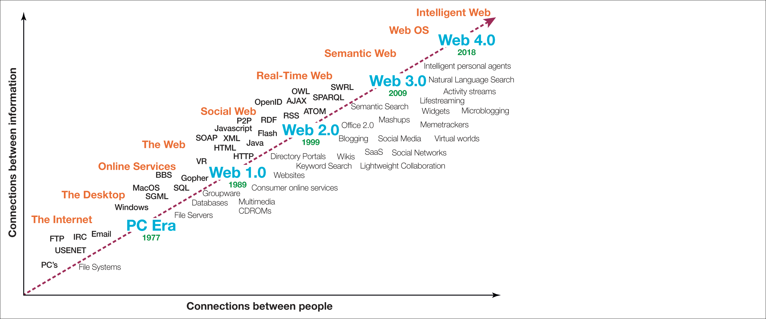
Figure 1.9 Evolution of web technologies
Source: Adapted from Spivack, 2009.
Notes:
17

Slide 18
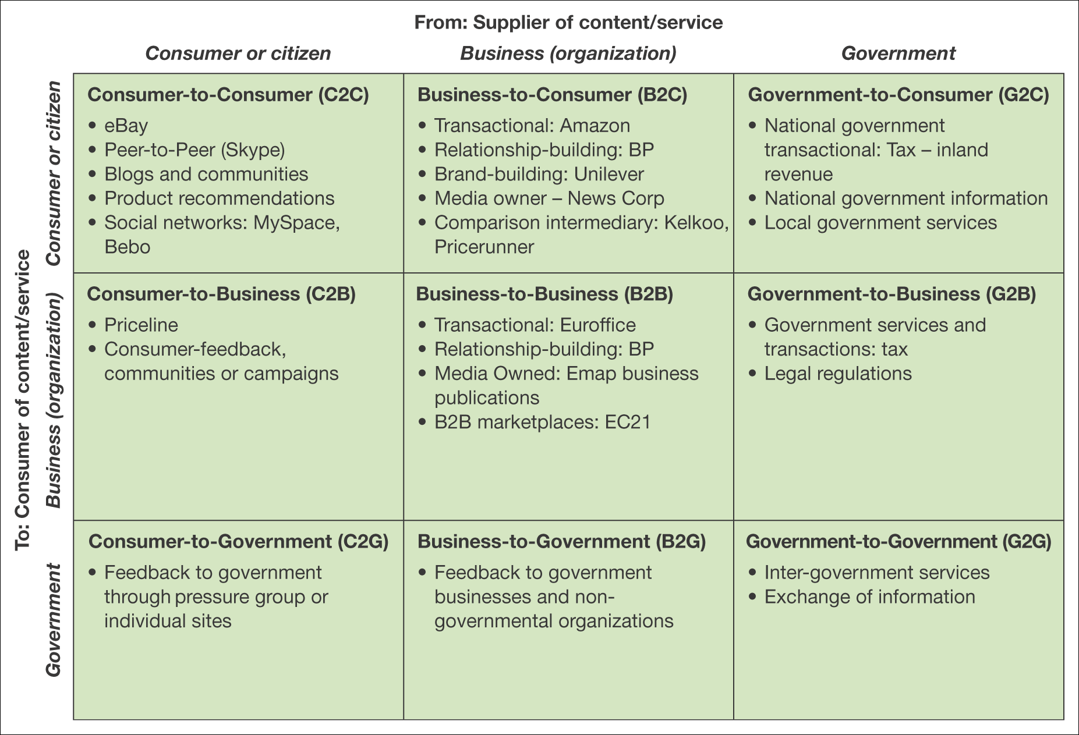
Figure 1.10 Summary and examples of transaction alternatives between businesses, consumers and governmental organizations
Notes:
18

Slide 19
Cost / Efficiency and Competitiveness
Drivers
Cost/efficiency drivers
  Increasing speed with which supplies can be obtained
  Increasing speed with which goods can be dispatched
  Reduced sales and purchasing costs
  Reduced operating costs.
Competitiveness drivers
  Customer demand
  Improving the range and quality of services offered
  Avoid losing market share to businesses already using e-commerce.
Notes:
19

Slide 20
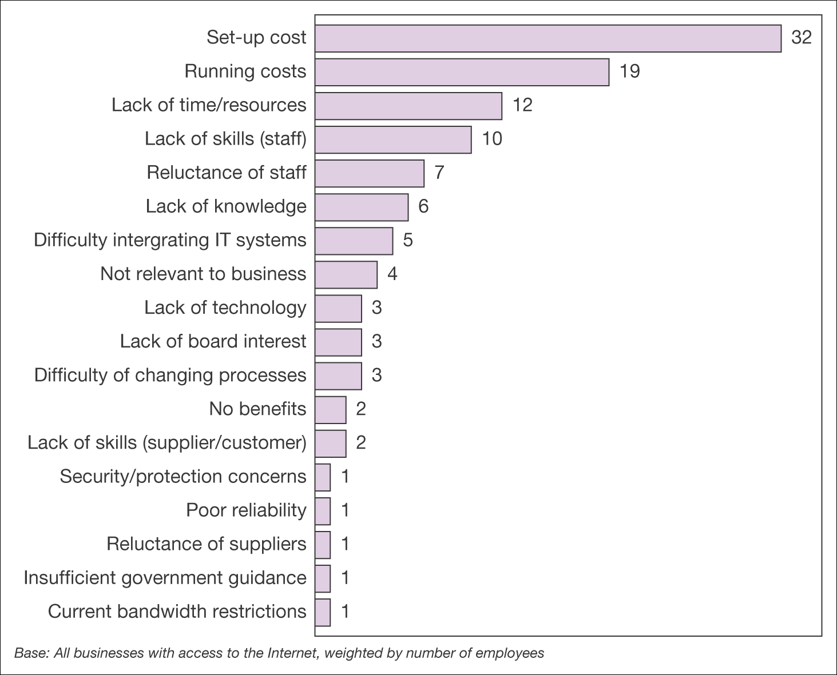
Figure 1.13 Barriers to development of online technologies
Source: DTI, 2002, from Business in the Information Age, International Benchmarking Study 2002 (2002), Crown Copyright material is reproduced with permission under the terms of
the Click-Use Licence
Notes:
There is a more recent chart if required on page 40 at http://www.businesslink.gov.uk/Growth_and_Innovation_files/ibs2004.pdf
20

Slide 21
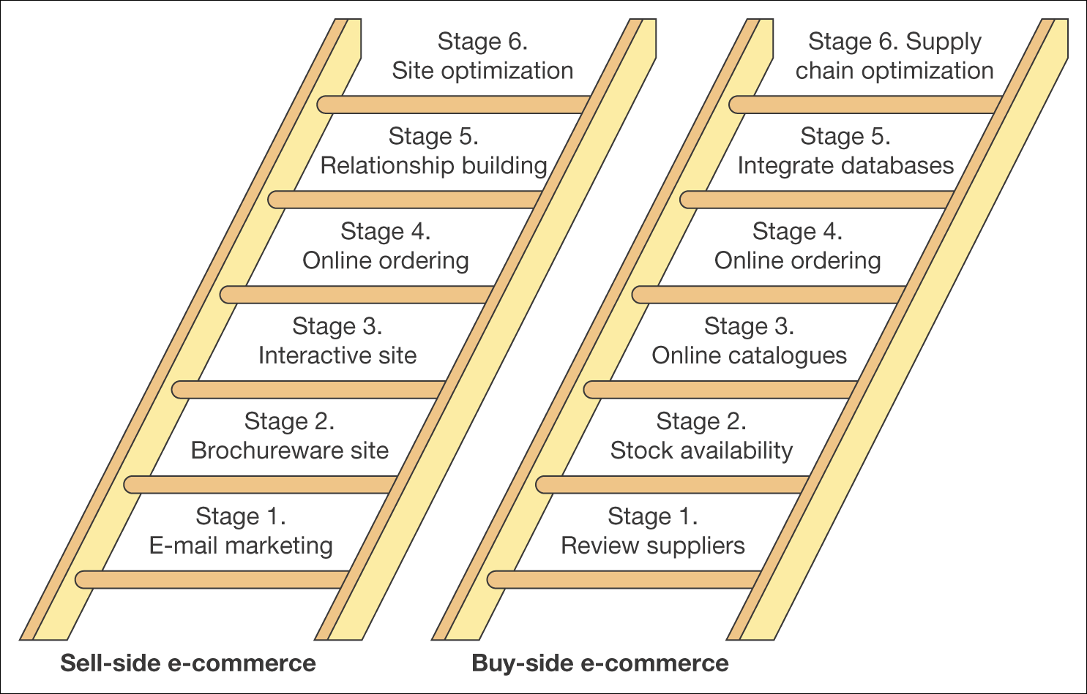
Figure 1.14 A simple stage model for buy-side and sell-side e-commerce
Notes:
21

Slide 22
Drivers of Consumer Adoption
Driver | Marketing approach
1- Content | More detailed. Content is king.
2- Customization | Email alerts, personalization
3- Community | Chat rooms, blogs, forums
4- Convenience | 24/7/365
5- Choice | Products, suppliers. (Intermediaries)
6- Cost Reduction | Direct communication
Notes:
22

Slide 23
Barriers to Consumer Adoption
Barrier
1- No Perceived Benefit
2- Lack of Trust
3- Security Problems
4- Lack of Skills
5- Cost
Notes:
23

Slide 24
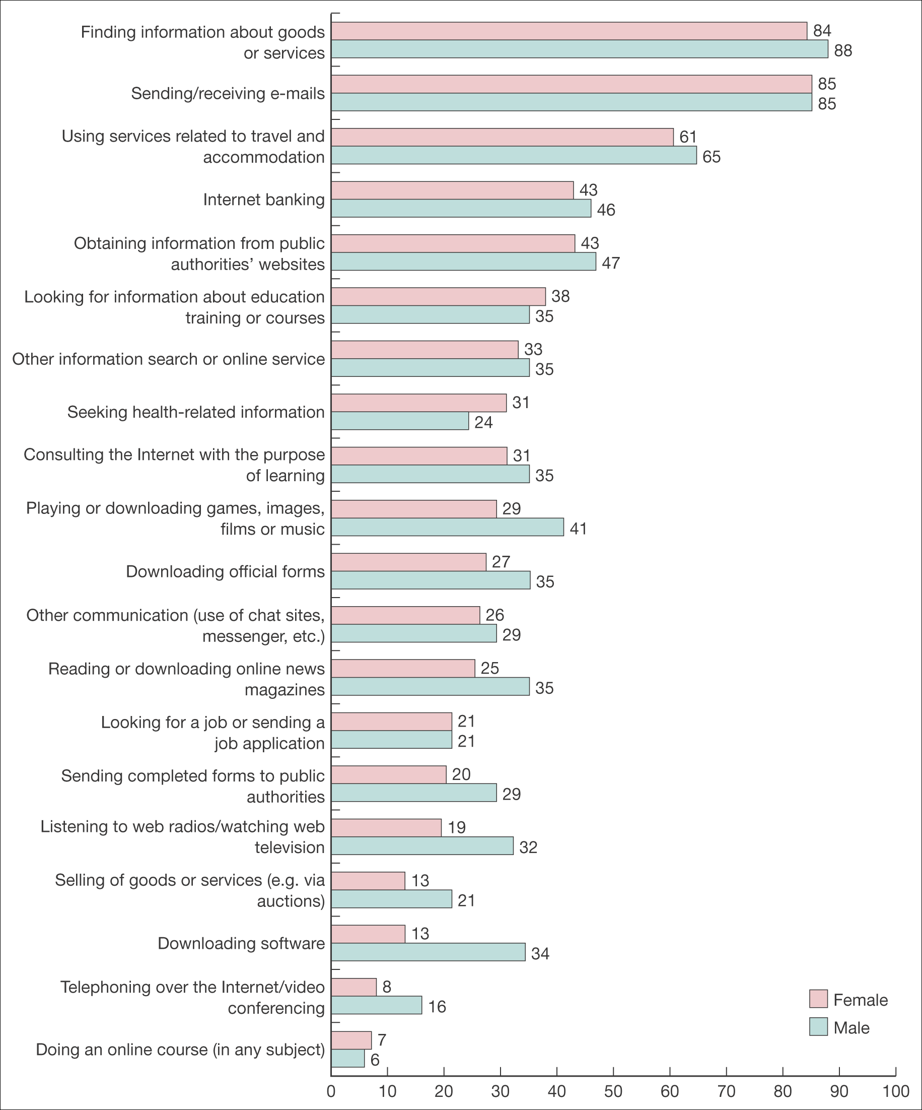
Figure 1.15 Variation in different online activities by gender
Source: UK National Statistics (2006) Individuals accessing the Internet – Report from the UK National Statistics Omnibus Survey. Published online at www.statistics.gov.uk
Notes:
Replace with Figure 1.15
24

Slide 25
Main Reference: Dave Chaffey book: E-Business and E-Commerce Management.

