Slide 1
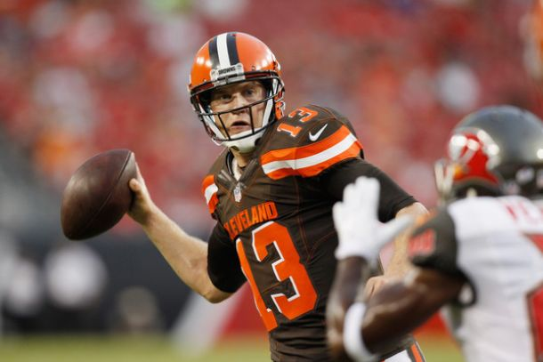
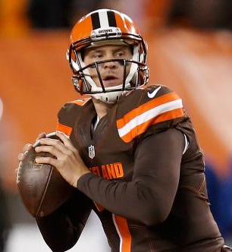

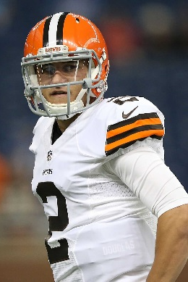
Topic 10
Monopolistic Competition

Slide 2
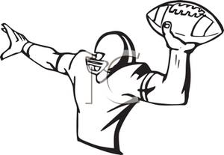
Things to Consider
My mom only used Tide detergent. Aren’t the cheaper no-name ones just as good?
Why are so many fast food restaurants clustered on Upper James? Shouldn’t they spread out to avoid competition?

Slide 3
Monopolistic Competition
Monopolistic Competition:
Many sellers.
Product differentiation: each firm’s product is at least slightly different from another firm’s.
  So, each firm faces a downward sloping demand curve, like a monopolist.
Free entry and exit (no barriers to entry).
Firms are price setters to some degree.
Examples: restaurants, most retailers

Slide 4
The monopolistically competitive firm will maximize profits when it produces where its MC = MR and charge a price based on demand (just like a monopoly).
In the SR, a monopolistically competitive firm behaves just like a monopolist.

Slide 5
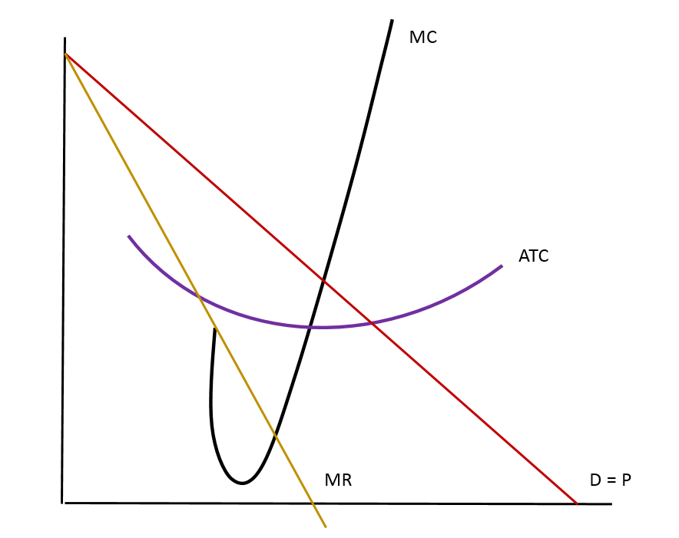

Monopolistic Competition in the Short Run
Firm Makes a Profit
Price
P
MC
ATC
P
Price
Profit
ATC
Demand
MR
0
Profit-
Quantity
maximizing
quantity
Q
Copyright©2003 Southwestern/Thomson Learning

Slide 6
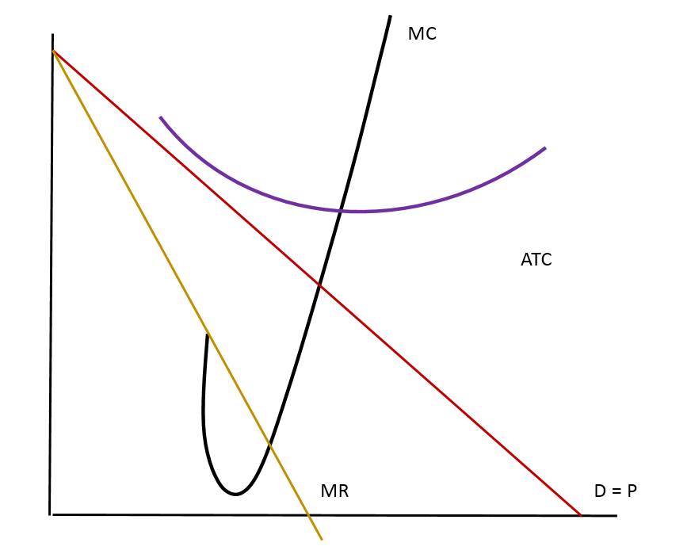
Monopolistic Competition in the Short Run
Firm Makes a Loss
P
Price
MC
ATC
ATC
Average
total cost
Loss
P
Price
Loss
Demand
MR
0
Loss
Quantity
minimizing
quantity
Q
Copyright©2003 Southwestern/Thomson Learning

Slide 7
In the Short Run,
SR economic profits encourage new firms to enter the market. This:

Slide 8
Positive profit means new entry and existing firms’ D decreases
Price
P
MC
ATC
P
Price
Profit
ATC
New Profit
Demand
MR
0
Profit-
Quantity
maximizing
quantity
Q
Copyright©2003 Southwestern/Thomson Learning

Slide 9
SR economic losses encourage firms to exit the market. This:

Slide 10
Monopolistic Competition in the Short Run
Losses means firms exit and remaining firms’ demand increases
P
Price
MC
ATC
ATC
Average
total cost
Loss
New Loss
P
Price
Loss
Demand
MR
0
Loss
Quantity
minimizing
quantity
Q
Copyright©2003 Southwestern/Thomson Learning

Slide 11
If there are positive profits or losses, firms will enter or exit until the firms are making exactly zero economic profits, just like perfect competition.
Firms make zero economic profits when
P = ATC.
However, zero profit looks different than it does for perfect competition.

Slide 12
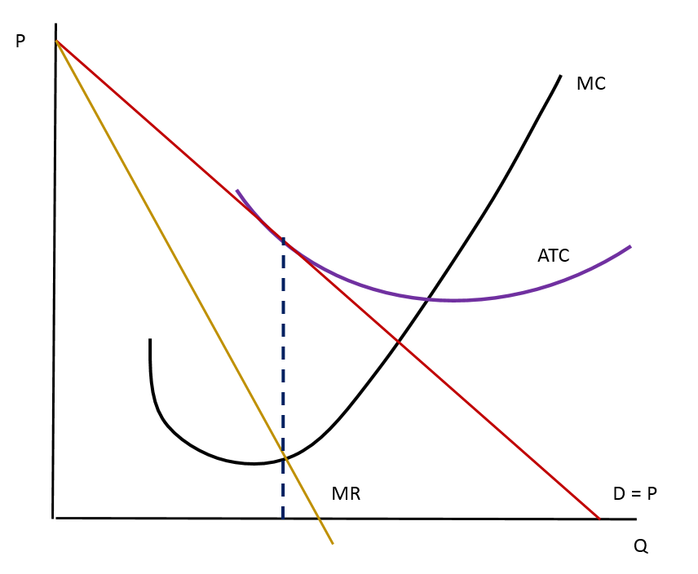
LR Equilibrium Competitive Firm in the Long Run
The ATC curve is just tangent to the demand curve in LR equilibrium.
We can’t be tangent at minATC because the demand curve is downward sloping.
MC
ATC
P=ATC
Demand
MR
MR=MC
0
Copyright©2003 Southwestern/Thomson Learning

Slide 13
Monopolistic Competition in the Short Run
Test Yourself
In the LR, there will be A) entry B) exit C) already in LR equilibrium
P
Demand
MR
0
Quantity
Q
Copyright©2003 Southwestern/Thomson Learning

Slide 14
Two Characteristics of Monopolistic Competition
As in a monopoly:
As in a competitive market:

Slide 15
One big difference between perfect competition and monopolistic competition is the Q produced in the LR.
Monopolistically competitive firms produce at a level we call excess capacity:

Slide 16
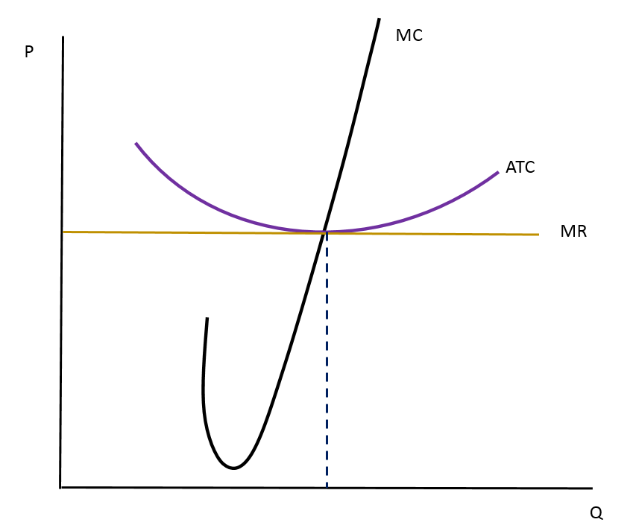
LR Equilibrium Compared
Monopolistically Competitive Firm
Perfectly Competitive Firm
Perfectly Competitive Firm
Price
Price
MC
ATC
MC
ATC
P
P
=
MC
P
=
MR
(demand
curve)
MR
Demand
0
Quantity
Quantity
0
Quantity produced =
Quantity
produced
Efficient scale
Q
Efficient Q
The monopolistically competitive firm has the ability to produce more Q (excess capacity) and lower its ATC. However, it would be making a loss because its ATC would be greater than the price it could get for that quantity.
Copyright©2003 Southwestern/Thomson Learning

Slide 17
For a competitive firm, P = MC.
For a monopolistically competitive firm, P > MC.
Because price exceeds marginal cost, an extra unit sold at the going price means more profit for the monopolistically competitive firm (adds more to TR than it does to TC).
A firms wants more customers, so it will advertise to get them.

Slide 18
Advertising
Proponents say:
It provides information to consumers about new products and services, sales and so forth.
It encourages price competition (“we’ll match any competitor’s price – just bring us their flyer”).
It allows new firms to enter an industry (they can advertise to make their presence and products known to consumers).
It signals consumers that the product is of high quality (the firm wouldn’t spend so much money to advertise a junk good because it wants repeat customers).

Slide 19
Critics say:
It could be a barrier to entry by helping existing firms build intense brand loyalty (a new firm wouldn’t stand a chance of being competitive against a firm with a committed consumer base).
It could increase prices by increasing the costs of production.
It manipulates consumers into buying stuff they don’t really want.
When aimed at children, advertising is exploitative.

Slide 20
Brand Names
Critics argue that brand names cause consumers to perceive differences that do not really exist.
Consumers’ willingness to pay more for brand names is irrational, fostered by advertising
Brand names signal information about quality.
Companies with brand names have incentive
to maintain quality, to protect the reputation of their brand names.

Slide 21
Monopolistically Competitive Firm in the Long Run
Deadweight Loss
Just like monopoly, there are deadweight losses due to monopolistic competition that make it socially inefficient.
MC
ATC
P=ATC
DWL
Demand
MR
MR=MC
0
Copyright©2003 Southwestern/Thomson Learning

Slide 22
Another way in which monopolistic competition may be socially inefficient is:
  the number of firms in the market may not be the “ideal” one; and
  there may be too much or too little entry.
  there may be externalities.

Slide 23
A product-variety externality:
A business-stealing externality:

Slide 24
Whichever externality is greater determines whether too many or too few firms exist:
If the product-variety externality is greater than the business-stealing externality, more firms are desirable.
If the business-stealing externality is greater than the product-variety externality, fewer firms are desirable.

Slide 25
The big thing to remember about monopolistic competition is that:

Slide 26
Test Yourself
Which firm would typically be part of a monopolistically competitive industry?
A) Molson’s Brewery
B) Esso Oil
C) Old Navy
D) VIA Rail

