Slide 1
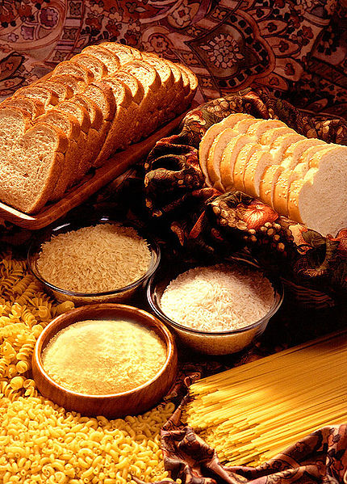
Carbohydrates

Slide 2
Carbohydrates
Another very complex group
  General formula : C_{x}(H₂O)_{y} where y may be different from x
Basic unit : simple sugar or monosaccharide
  Will not undergo acid hydrolysis to form smaller units
  Example D-glucose, as well as D-fructose

Slide 3
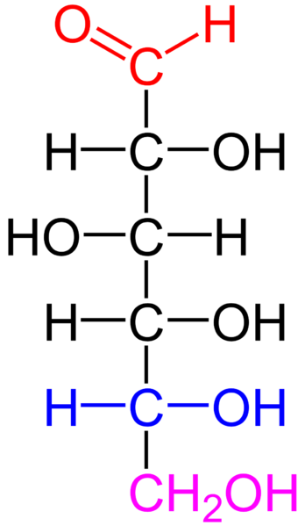
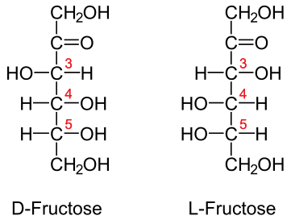
Glucose & fructose
D-glucose
Both also exist as cyclic compounds

Slide 4
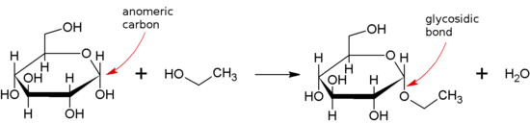
Carbohydrates - disaccharides
Disaccharides : 2 simple sugars, linked by a covalent glycosidic bond
  Specific type of ether linkage (R-O-R) between the OH on the anomeric C of a sugar to any other alcohol (usually another sugar molecule)

Slide 5
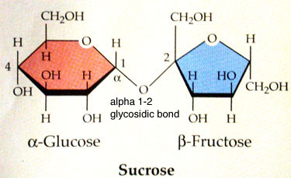
Disaccharides
Sucrose, from sugar cane or sugar beet, is made up of glucose and fructose

Slide 6
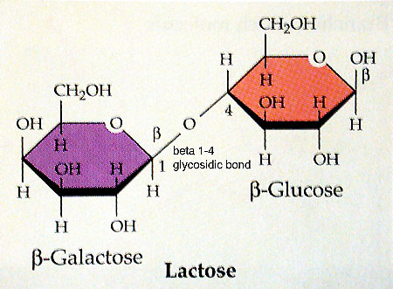
Disaccharides - 2
Lactose (milk) is a combination of glucose and galactose

Slide 7
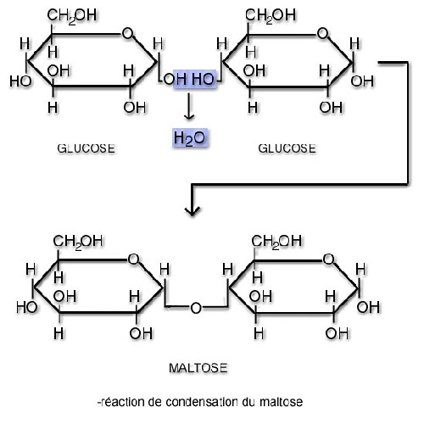
Disaccharides - 3
Maltose, from starch enzymatic hydrolysis, is made up of 2 glucose molecules

Slide 8
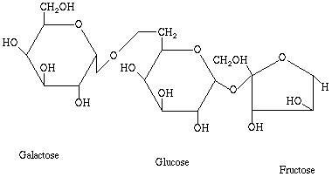
Oligosaccharides
Comprising from 3 to 10 monosaccharides linked together
Raffinose is a trisaccharide of galactose, glucose and fructose

Slide 9
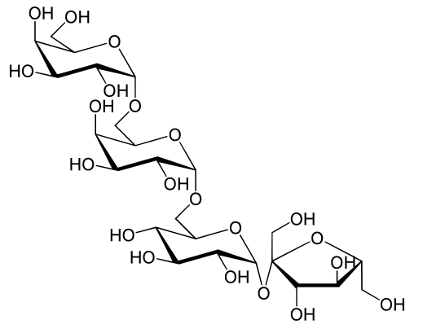
Oligosaccharides - 2
Stachyose is a tetrasaccharide of glucose, fructose, and 2 galactose

Slide 10
Stachyose – IUPAC name...
(2R,3R,4S,5R,6R)-2-[(2S,3S,4S,5R)- 3,4-Dihydroxy-2,5-bis(hydroxymethyl) oxolan-2-yl]oxy-6-[ [(2S,3R,4S,5R,6R)-3,4,5-trihydroxy-6-[ [(2S,3R,4S,5S,6R)-3,4,5-trihydroxy-6- (hydroxymethyl)oxan-2-yl]oxymethyl] oxan-2-yl]oxymethyl]oxane-3,4,5-triol

Slide 11
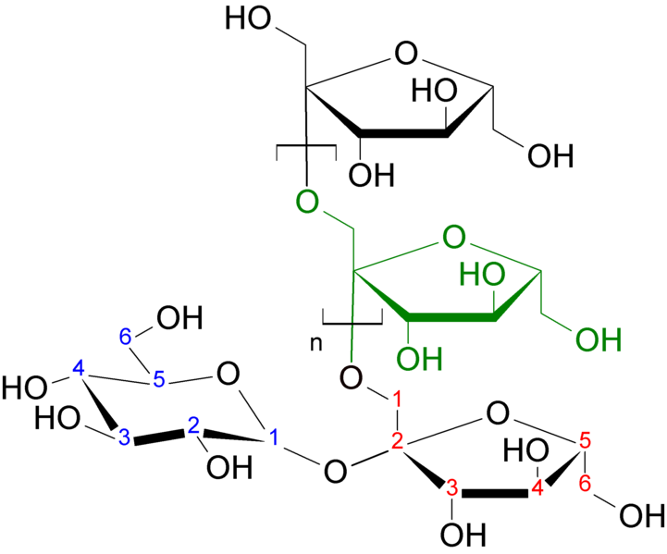
Oligosaccharides
Widely distributed
  Some are “prebiotics” , promoters of desirable intestinal flora
  Oligofructose (2-8 units)
  Inulin (9-64 units)
Inulin

Slide 12
Polysaccharides
Longer chain length polymers, found in nature
  Starch
  Cellulose
  Glycogen
  Pectin
  Xanthan gum
A variety do have food applications

Slide 13
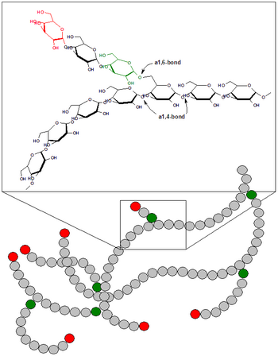
Roles of carbohydrates
Energy sources in seeds
  Starch for germination
Structural components
  Cellulose & hemicellulose in plants (including trees)
Ready supply of energy
  Mono- and disaccharides
Short term supply of energy in muscles
  glycogen

Slide 14
Carbohydrate functionality in foods
Mono- and disaccharides
  Sweetening agents
  Coloring agents
    Caramel color
  Viscosity enhancers
  Flavor production
    Caramellization / Maillard rxn
  Flavor carriers
    Plated flavors (as vanilla on sugar, for example)

Slide 15
Carbohydrate functionality - 2
Oligosaccharides
  Prebiotics
Polysaccharides
  Thickening and / or gelling agents
  Emulsion stabilizers
  Water holding / binding agents
  Production of edible films
  Encapsulation of flavors

Slide 16
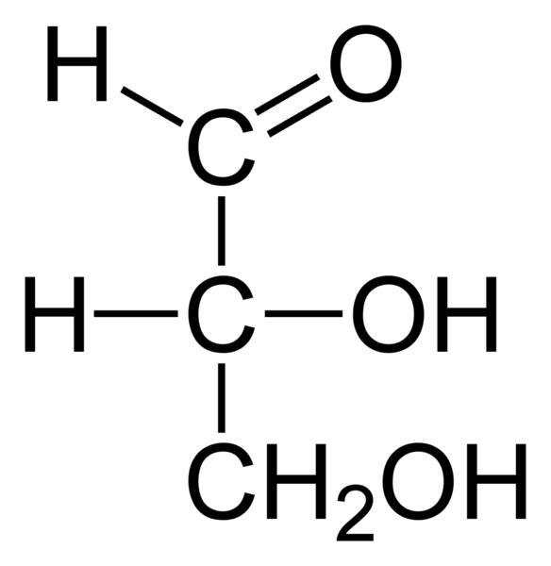
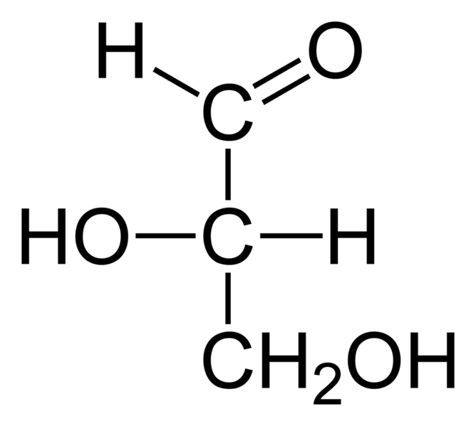
Sugar chemistry simple sugars
Monosaccharides
  C₃ to C₇ polyhydric alcohol
  Also having a carbonyl group (aldehyde or ketone)
  Simplest monosaccharide : glyceraldehyde
    Carbon chain numbered from the carbonyl down
1
2
3
chiral
D-glyceraldehyde L-glyceraldehyde

Slide 17
Glyceraldehyde - reference
As was the case with amino acids, glyceraldehyde was selected as the absolute reference to determine the D or L configuration of sugars
Glyceraldehyde has only one asymmetric (or chiral) carbon
  Most sugars have more than 1 chiral carbon
  The D or L designation of sugars is based solely on the configuration at the n-1 carbon, i.e. on the configuration of the carbon before last, when counting from the carbonyl group

Slide 18
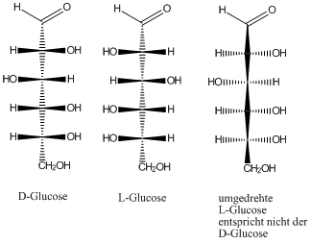
Reminder
Fischer projections
Set up for Fischer projections
Inverted L –Glucose i.e. opposite of Fischer projection

Slide 19

Sugar configuration
D-glucose ((2R,3S,4R,5R)-2,3,4,5,6-Pentahydroxyhexanal)
1
2
3
4
5 (n-1)
6 (n)
C* (n-1)

Slide 20
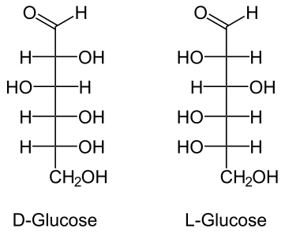
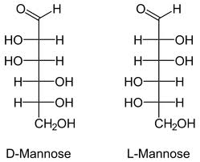
Enantiomers vs epimers
Enantiomers = mirror images (any D vs L configuration of the same sugar)
Epimers : changes at any carbon other than the n-1 carbon, for the same molecular formula
  As at C₂ in D-glucose vs D-mannose
    All epimers are considered different sugars

Slide 21
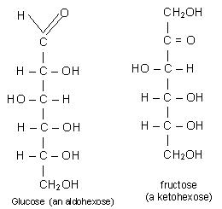
Sugar configuration
Keto form

Slide 22
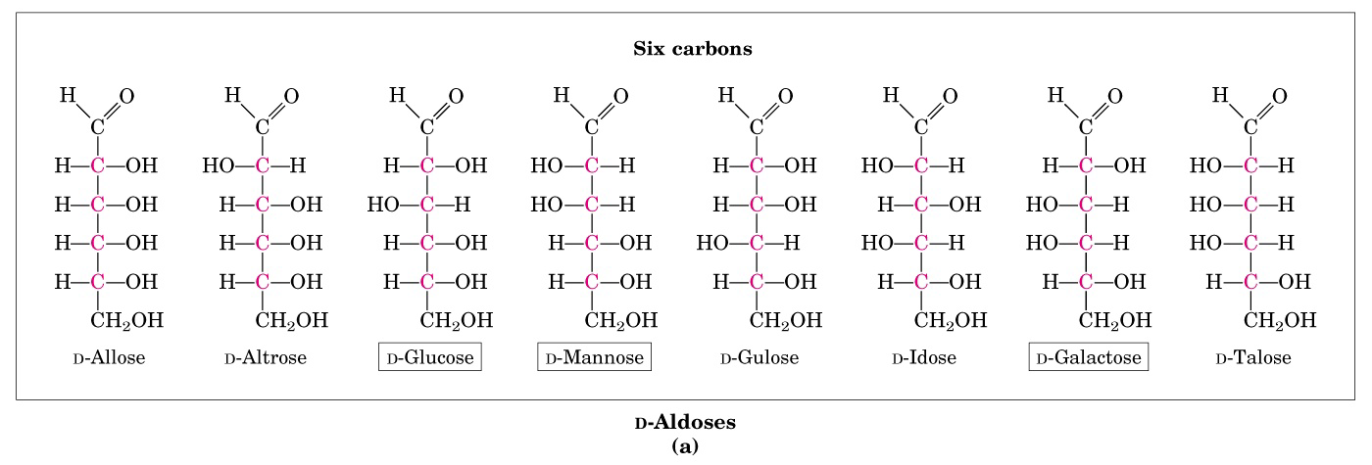
Aldohexoses

Slide 23
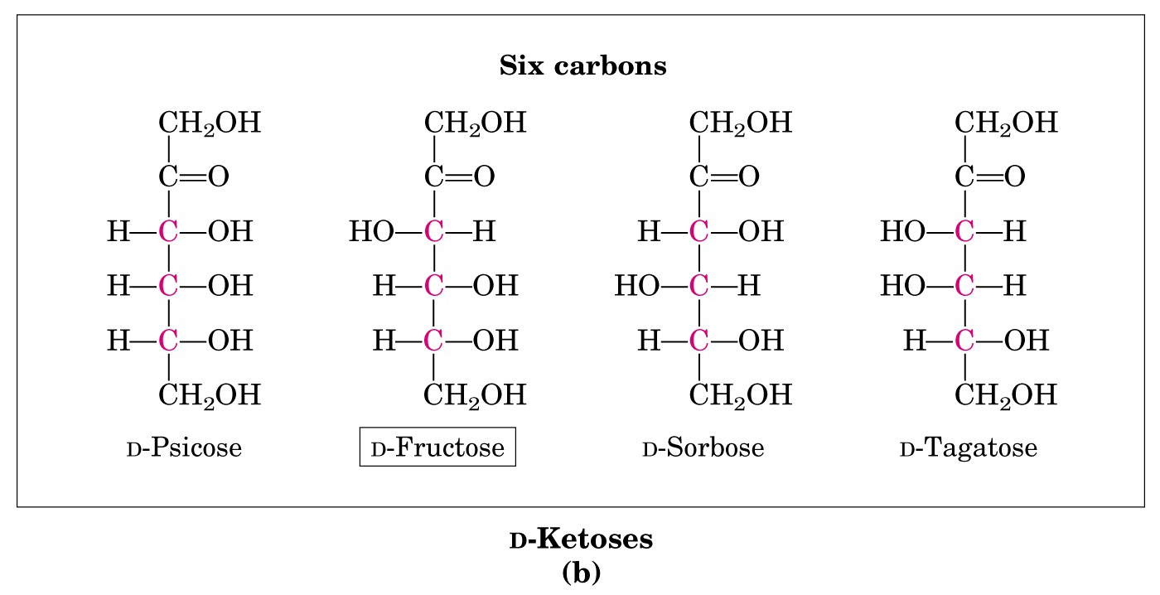
Ketohexoses

Slide 24
Monosaccharide classification
May be classified as to chain length and functional group type
  Ketohexoses : 6 C ketones (as fructose)
  Aldohexoses : 6 C aldehydes (as glucose)
For simplicity, monosaccharides are usually represented as linear molecules
  In reality (both in crystals and, predominantly, in solution) they are cyclic

Slide 25
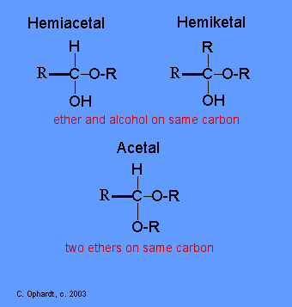
Sugars as cycles
Form internal hemiacetals and hemiketals

Slide 26
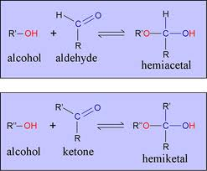
Formation of hemiacetal and hemiketal

Slide 27
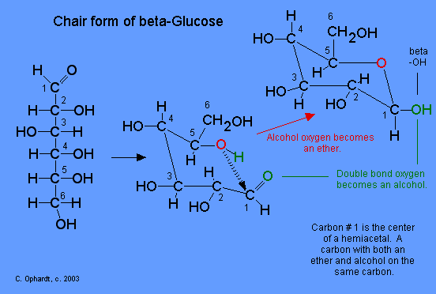
Sugar as cycles
By “internal” reaction to hemiacetal

Slide 28
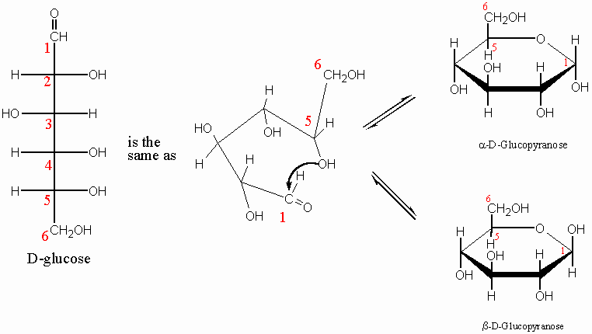
Cyclic glucose : 2 possible
α
β

Slide 29
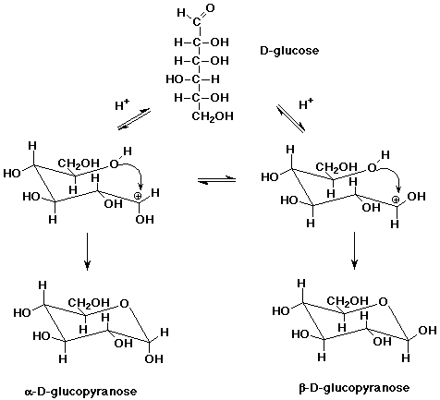
Cycle closure catalyzed by acid

Slide 30
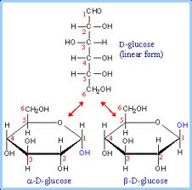
Anomeric carbon
The new chiral carbon formed at C₁ is termed the anomeric C
The α and β forms of monosaccharides are called anomers
When dissolved in solution, a dynamic equilibrium sets up between the 3 possible forms
  Open chain
  α anomer
  β anomer

Slide 31
Mutarotation
Changes in optical rotation, when a pure type of sugar is dissolved in water
  Example :
    α-D-glucopyranose’s rotation changes from 112° to 53° over time
    The pure β form would show a change from 19° to 53° over time
Termed mutarotation
  Results from the opening of one form, coming to equilibrium with the opposite anomer via the open chain form
  Moreover, it may cyclize into the 5 member-ring or into the 6 member-ring

Slide 32
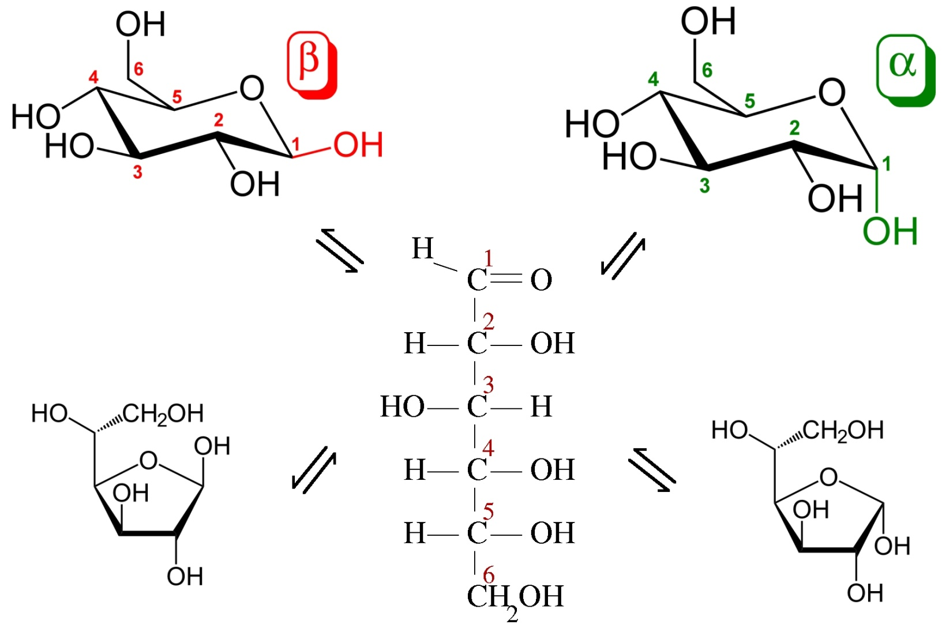
Glucose equilibria :
62% α pyranose, 37% β pyranose, <1 % open chain
pyranose
furanose

Slide 33
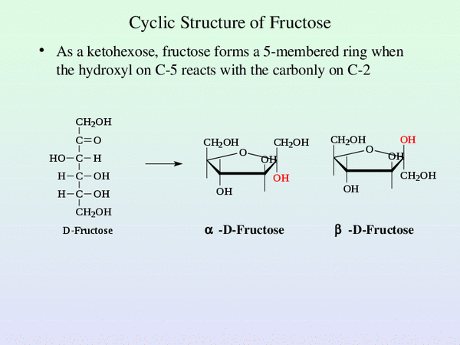
Fructose mutarotation
Mostly in a 5-member ring (furanose)

Slide 34
Cyclic structures
In general:
  6 carbon aldoses tend to form pyranose rings
  6 carbon ketoses tend to form furanose rings
  Other forms do exist, but they are of no consequence
Crystalline form of simple sugars is always cyclical

Slide 35
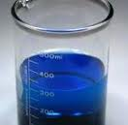


Reducing power of monosaccharides
Aldehyde group on aldose
  Strong reducing agent
  All monosaccharides are reducing sugars
  Capable of reducing metal ions and being oxidized to carboxylic acids (redox rxn)
  Fehling’s reagent only reacts with free aldehyde groups

Slide 36
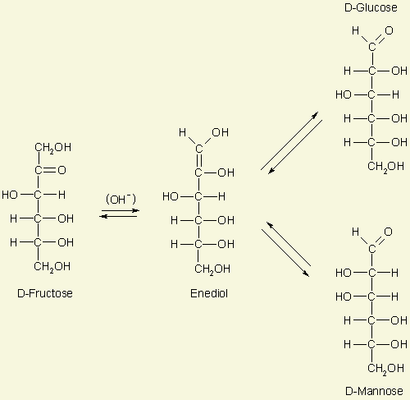
Fructose = reducing sugar?
Fructose is a ketose, thus no free aldehyde group; but it is considered a reducing sugar since it goes through a rearrangement when in basic conditions (enolization)

Slide 37
Reducing sugars
Reducing power is lost if the OH on the anomeric C is covalently bound to another group
Once the glycosidic covalent link is formed, the cycle cannot open up anymore, thus no free aldehyde can be regenerated

Slide 38
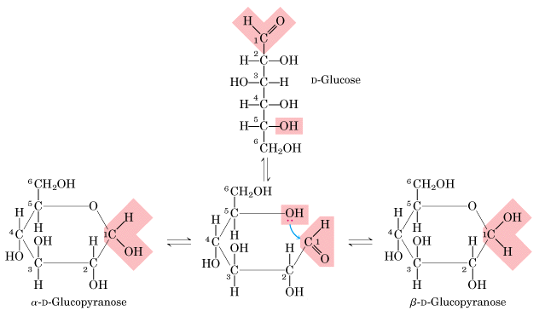
Reminder
Equilibrium returning to aldehyde requires the OH group on the anomeric C

Slide 39
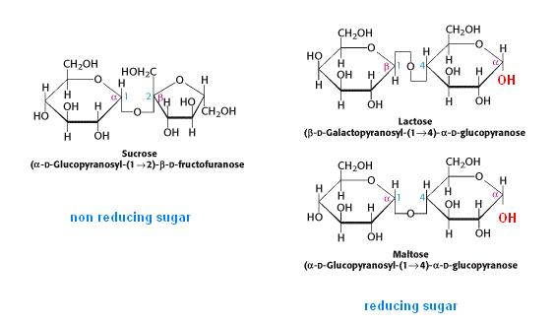
Disaccharides
Reducing sugar or not?
Sucrose is non reducing due to its glycosidic bond, where both anomeric C are tied up in making the bond; the opposite is true for maltose and lactose

