Slide 1

2140 B – Mechanics of Materials I
Leandro F. M. Sanchez, PhD, Eng.

Slide 2

Course Outline
Normal (or Axial) Stresses and Strains
Stress-Strain Diagram
Elastic Behaviour: Hooke’s Law
Plastic Behaviour: Yield point
Modulus of Elasticity
Ductile vs. Brittle Materials
Poisson’s ratio
Shear & Bearing Stress
Summary
wonderfulengineering.com

Slide 3
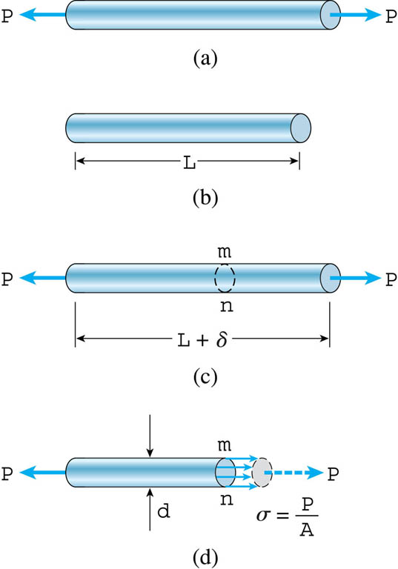
Normal (or Axial) Stress
Introduction
  Load → P;
  Stress
  Strain
?
Imperial Units
SI Units

Slide 4
Normal (or Axial) Strain
P
Introduction
  Load
  Stress
  Strain
  Dimensionless
  Often expressed as:
    mm/mm
    in/in
    μstrain = 10⁻⁶
L
?
L_{o}

Slide 5
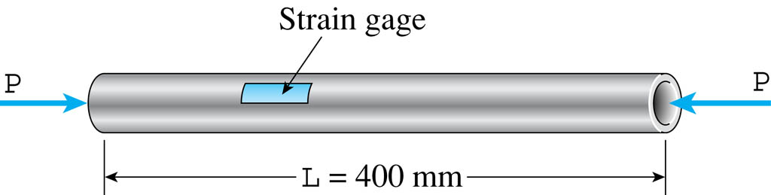
Example
Example 1
φ_{out} = 60 mm
φ_{in} = 50 mm
If ε Measured = 540×10⁻⁶, δ = ?
s = 40 MPa, P = ?

Slide 6
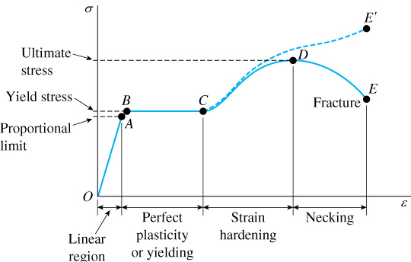
Stress-Strain Curve

Slide 7
Elastic Behaviour: Hooke’s Law
Elastic behaviour
  Elastic deformation is recoverable;
  In most materials, elastic deformation is linear;
  In some materials, elastic deformation is non-linear.
    Hooke’s Law
  Most engineering structures are designed to undergo relatively small deformations → linear elastic behaviour;
  Robert Hooke (17th century, England);
  found that the elongation of a spring was proportional to the applied force.
Stress
Unload
Slope = modulus of elasticity!
Load
Strain

Slide 8
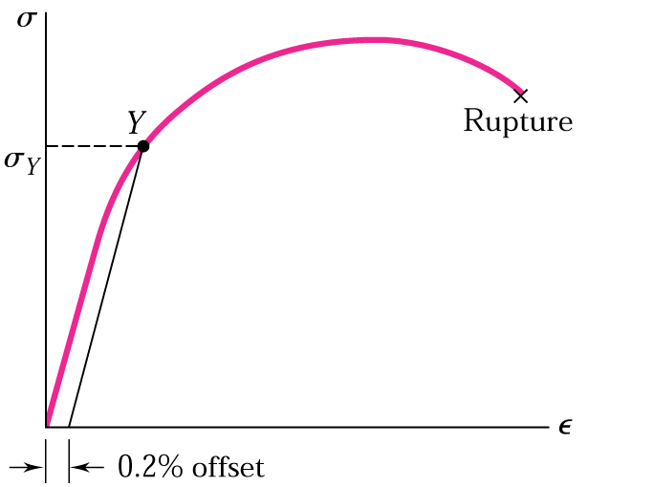
Plastic Behaviour: Yield point
Some materials, such as aluminum, do not have a clearly defined yield point.

Slide 9
Modulus of Elasticity
Three moduli corresponding to 3 stresses:
  Tension;
  Compression;
  Shear → Modulus of rigidity.

Slide 10
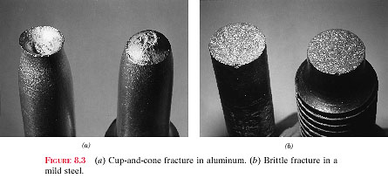
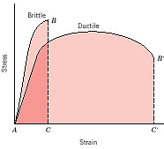
Ductile vs. Brittle Materials
Ductile
Brittle
Philpot, 2011: Mechanics of Materials
Ductile materials – undergo large permanent strains before failure;
Brittle materials – fail at relatively low values of strain.

Slide 11
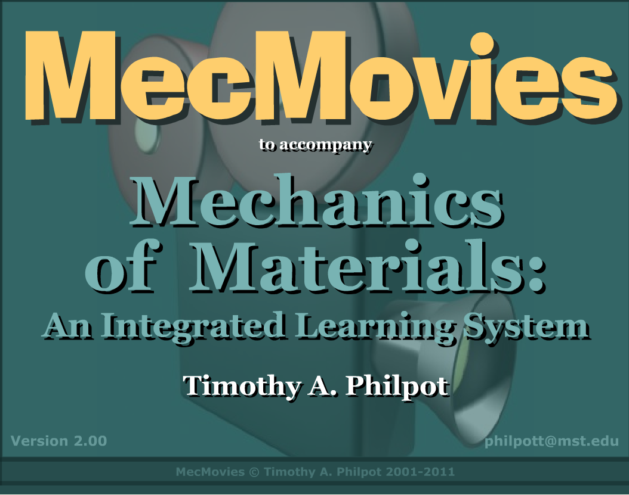
http://web.mst.edu/~mecmovie/ (Chapter 3 – Mechanical properties)

Slide 12
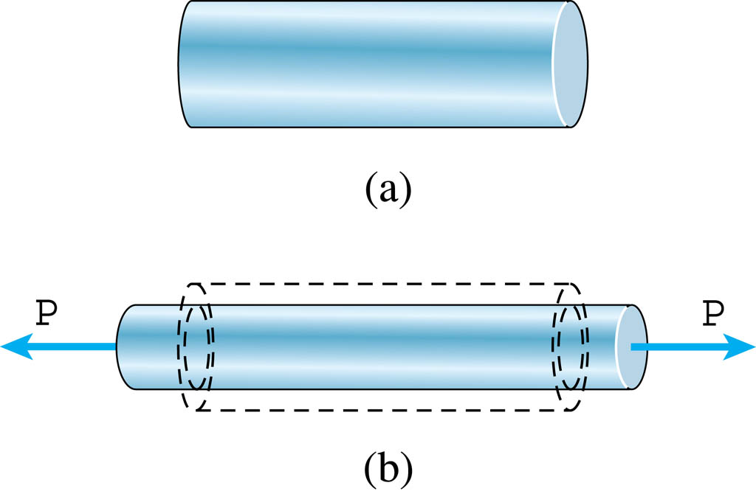
Poisson’s ratio
Isotropic material

Slide 13
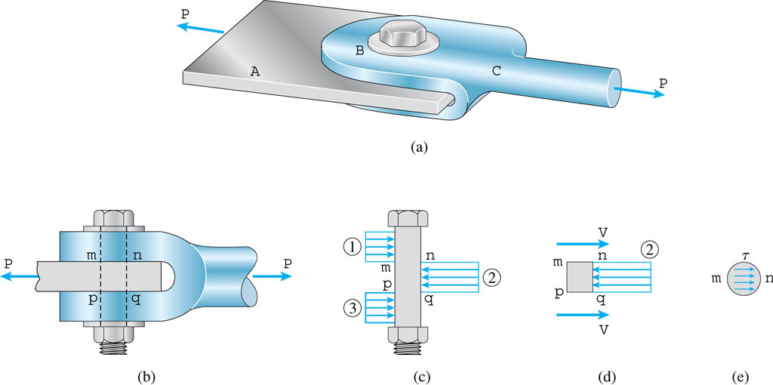
Shear & Bearing Stress
Bolt in “double shear”
Shear stress
Bearing stress

Slide 14
Shear Strain
τ
w
θ
l
τ

Slide 15
Summary
  Normal (or Axial) Stresses and Strains;
  Shear & Bearing Stress;
  Stress-Strain Diagram (Elastic & Plastic Behaviour);
  Modulus of Elasticity;
  Ductile vs. Brittle Materials.

Slide 16

Thank you!
Questions?

