Slide 1
Building Medical Words
Word formation from Latin and Greek roots

Slide 2
Word origins
Most medical words derive from either Greek or Latin roots, because both the ancient Greeks and the ancient Romans made significant contributions to the development of medicine in Europe.
In order to understand and form medical words, you need to learn both the roots that form those words and the grammatical rules that govern their formation.

Slide 3
Word types
Words fall into different categories depending on their use within a sentence. In this course, you may be asked to form or recognize several different types of words.
noun | A noun describes a person, place, or thing.
verb | A verb describes an action.
adjective | An adjective provides more information about a noun.
adverb | An adverb provides more information about a verb.

Slide 4
Singulars and plurals
Nouns can be singular or plural.
  Singular nouns refer to only one person, place, or thing (e.g., “the house”).
  Plural nouns refer to more than one person, place, or thing (e.g., “the houses”).
Some medical words use English rules to make plurals, while others use Latin or Greek rules.
  In English, you usually make a singular noun plural by adding -s to the end.
  The table on the next slide summarizes the most common ways of making a Latin or Greek word plural.

Slide 5
Plurals
 | singular ending | plural ending | example
Latin | -a | -ae | vertebra, vertebrae
 | -us | -i | nucleus, nuclei
 | -um | -a | bacterium, bacteria
 | -is | -es | diagnosis, diagnoses
 | -ex | -ices | index, indices
Greek | -is | -ides | iris, irides
 | -nx | -nges | phalanx, phalanges
 | -oma | -omata | carcinoma, carcinomata
 | -on | -a | ganglion, ganglia

Slide 6
Word parts
Many medical words contain more than one word part. These word parts fit together like puzzle pieces in order to make a whole word. There are three different word parts that you might find within a medical word: prefixes, suffixes, and combining forms.
Be careful! The number of word parts within a medical word isn’t limited to three. Some medical words can contain more than one prefix, suffix, or combining form.

Slide 7
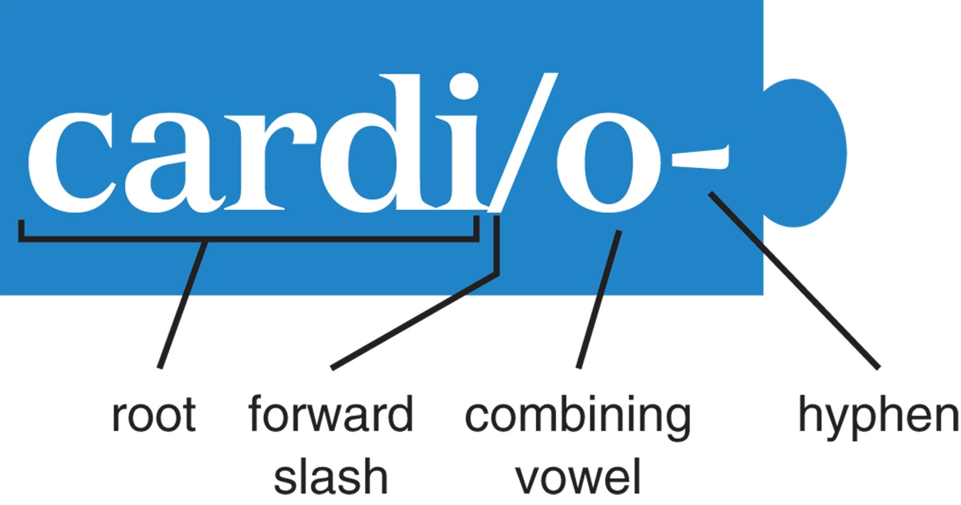
Combining forms
Combining forms are the foundation of a word. They give the word its main medical meaning.

Slide 8
Why the /o-?
Combining forms have a combining vowel after the root, often an /o-. These vowels stay with the combining form when the next part of the word begins with a consonant, but disappear when it begins with a vowel.
cardi/o- + -logy = cardiology
cardi/o + -ac = cardiac

Slide 9

Suffixes
Suffixes come at the end of a word. They modify or clarify the medical meaning of the combining form. Suffixes will always begin with a hyphen.
If you look at the glossary at the back of the textbook, you’ll quickly notice that many suffixes mean either “pertaining to” or “condition.” How do you know which one to choose?

Slide 10
Choosing a suffix
Unfortunately, there’s no hard and fast rule, but there are a few tips to help you out.
  If you’re trying to form a noun, you’re going to want a “condition” suffix; if you’re trying to form an adjective, you’re going to want a “pertaining to” suffix.
  Most combining forms use the same few suffixes over and over again, so pay attention to which suffixes are used when each new combining form is introduced in your textbook.

Slide 11

Prefixes
Prefixes come at the beginning of a word, and like suffixes, they modify or clarify the meaning of a medical word. Prefixes will always end with a hyphen.

Slide 12
Changing letters
Just as the /o- or other vowel at the end of a combining form can appear or disappear depending on what follows it, the same is true of letters in prefixes.
You need to take this into account when you’re splitting words into their component parts, because prefixes can look identical to one another once they’ve changed.

Slide 13
Prefixes before vowels or H
Many prefixes end in a vowel, and when the combining form that follows starts with a vowel or an H, the prefix’s vowel may disappear or a consonant may be added to smooth out the word.
Let’s look at an example:
without; not
collection of symptoms
pertaining to
an- + symptomat/o- + -ic = asymptomatic
pertaining to being without a collection of symptoms

Slide 14
Prefixes before vowels or H
prefix | before vowels or H | meaning
a- | an- | without; not
ana- | an- | apart; excessive
ab- | abs- | away from
anti- | ant- | against
apo- | ap- | away from
cata- | cat- | down
dia- | di- | complete; completely through
ec- | ex- | out; outward
endo- | end- | innermost; within
epi- | ep- | upon; above
hypo- | hyp- | below; deficient
meta- | met- | after; subsequent to; transition; change
para- | par- | beside

Slide 15
Prefixes with assimilation
In other cases, the consonant at the end of a prefix may change when the combining form that follows it begins with a consonant itself.
This is called assimilation, because the consonants often match.
Fortunately for you, your textbook lists these as separate prefixes.
  That’s one of the reasons that similar-looking prefixes (em- and en-, sym- and syn-) can have identical meanings.

Slide 16
Definitions
Now that you know how to make a new word from its definition, let’s try it the opposite way: taking a new word apart to find its definition.
polyneuropathy

Slide 17
Breaking down words
Start by splitting a word into its component parts: look for prefixes, combining forms, and suffixes.
polyneuropathy
poly-
neur/o-
-pathy

Slide 18
Breaking down words
Define each part separately, then put the definitions together.
polyneuropathy
poly-
neur/o-
-pathy
many; much
nerve
disease
a disease affecting many nerves

Slide 19
Context
Be careful! Language is both a science and an art. You’re going to need to supply words to create a definition that makes sense in English, because not every word in the definition will necessarily be represented in the word itself.
That means that you’re also going to have to use context to figure out which meaning of a prefix, suffix, or combining form you should use.

Slide 20
Practice
There’s only one way to be certain that you know how to break down words and put words together, what words to add, and which definitions to use when: practice!
  Your textbook has extensive exercises at the end of each chapter to help you with all these things.
You’ll also be much faster if you memorize word components instead of looking them up every time you encounter them.
  This is easier than it sounds: English has many non-medical words with Greek and Latin roots, and you already know what they mean. You just don’t realize it yet.

