Slide 1
CHAPTER 1:
THE PURPOSE AND USE OF FINANCIAL STATEMENTS

Slide 2
STUDY OBJECTIVES
SO 1: Identify the uses and users of accounting.
SO 2: Describe the primary forms of business organization.
SO 3: Explain the three main types of business activity.
SO 4: Describe the purpose and content of each of the financial statements.

Slide 3

Uses and Users of Accounting
Accounting identifies and records the economic events of an organization and communicates to interested users
There are two broad categories of users
  Internal users
  External users

Slide 4
Users of Financial Information
Internal users
  Work for the company
  Managers, employees, and others who plan, organize, and run the company
External users
  Do not work for the company
  Investors, lenders, and other creditors
  Customers, employees, labour unions
  Taxing authorities and regulators

Slide 5

Discussion Question
Identify the internal and external users of financial information for a local hospital.

Slide 6
Ethical Behaviour
For accounting information to have value, preparers must have high ethical standards
  Actions are legal and responsible
  Consider organization’s interests
Accountants, other professionals, and most companies have rules or codes of conduct to guide ethical behaviour
Companies have codes of conduct

Slide 7
Discussion Question
What are some ethical issues that might exist for financial information in a local hospital?

Slide 8
Forms of Business Organizations: Proprietorship
Owned by one person (proprietor)
Simple to set up
Owner has control over business
Limited life
Unlimited liability
Income tax paid by owner

Slide 9
Forms of Business Organizations:
Partnership
Similar to proprietorship except owned by more than one person
Formalized in a written agreement
Limited life
Each partner has unlimited liability
Income tax paid by individual partners

Slide 10
Forms of Business Organizations:
Corporations
Separate legal entity owned by shareholders (owners of shares)
Indefinite life; ease of raising capital
Shareholders enjoy limited liability
Corporation pays income tax
May be public or private:
  Public if shares are publicly traded
  Private if shares are not available to the general public

Slide 11
Generally Accepted Accounting Principles (GAAP)
Rules and practices for the preparation of financial statements
Different for publicly-traded and private corporations
  Publicly-traded corporations use International Financial Reporting Standards (IFRS)
  Private corporations may use IFRS or Accounting Standards for Private Enterprises (ASPE)
Proprietorships and partnerships generally follow ASPE for external reporting
  Not required to follow any particular standards for internal use

Slide 12
Three Types of Business Activities
All companies are involved in all three activities
  Financing
  Investing
  Operating

Slide 13
Financing Activities
Obtaining (and repaying) funds to finance the operations of the business
  Borrowing money or repaying loans (debt)
  Selling or repurchasing shares (equity)
Forms of debt
  Bank indebtedness, bank loans, noncurrent debt such as mortgages, bonds, leases

Slide 14
Investing Activities
Purchase or sale of long-lived assets needed to operate the company
Examples
  Purchase or sale of investments not held for trading
  Purchase or sale of long-lived assets such as property, plant and equipment and intangible assets

Slide 15
Operating Activities
Operating activities are the main day-to-day activities of the business
Examples
  Revenues
  Expenses
  Related accounts such as accounts receivable and accounts payable

Slide 16
Discussion Question
What are the potential operating, investing, and financing activities for a retail company? Would your answer differ for a service company?

Slide 17
Financial Statements
Income statement
  Reports revenues and expenses for a specific period of time
Statement of changes in equity
  Reports the changes in each component of shareholders’ equity during a period of time
Statement of financial position
  Shows the assets, liabilities and shareholders’ equity at a specific point in time

Slide 18
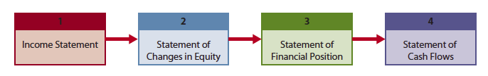
Financial Statements (continued)
Statement of cash flows
  Shows, for a specific period of time, how company obtained cash and how that cash was used
Order of preparation of statements

Slide 19
Income Statement
Revenues
  Arise from sales of a products or services
  Result in an inflow of assets
Expenses
  Costs of assets consumed or services used to generate revenues
Profit (loss)
  = Revenues - Expenses

Slide 20
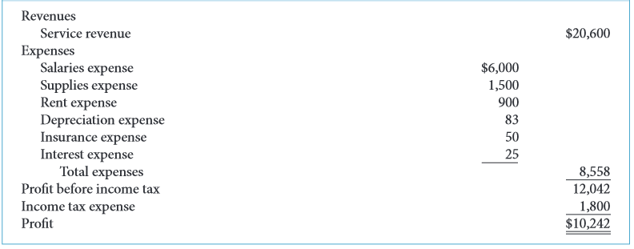
Income Statement - Example
SIERRA CORPORATION
Income Statement
Month Ended October 31, 2015

Slide 21
Statement of Changes in Equity
Shows the changes in each component of shareholders’ equity for the period
Share capital
  Amounts contributed by shareholders
  May include common and preferred classes
Retained earnings / deficit
  Cumulative profit retained in the company
  Less dividends paid to shareholders
Other shareholders’ accounts

Slide 22
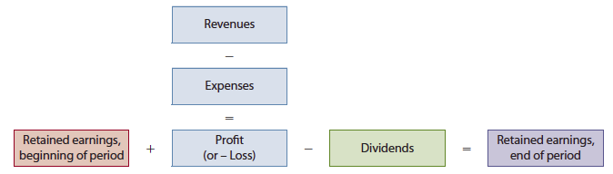
Statement of Changes in Equity (continued)
Changes in shares
Changes in retained earnings

Slide 23
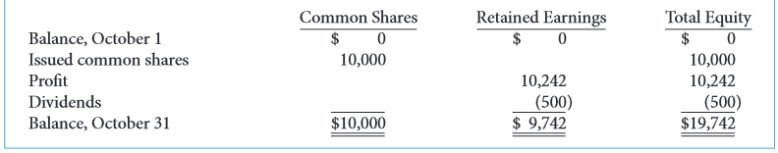
Statement of Changes in Equity - Example
SIERRA CORPORATION
Statement of Changes in Equity
Month Ended October 31, 2015

Slide 24
Statement of Financial Position
Assets
  Resources owned by a business
Liabilities
  Claims of lenders and other creditors
Shareholders’ equity
  Claims of shareholders
Accounting equation
  Assets = Liabilities + Shareholders’ Equity

Slide 25
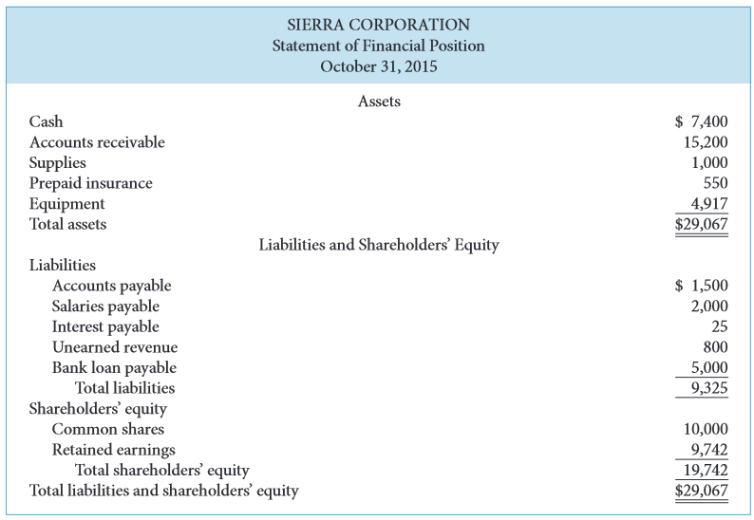
Statement of Financial Position - Example
SIERRA CORPORATION
Statement of Financial Position
October 31, 2015

Slide 26
Statement of Financial Position – Example (continued)

Slide 27
Statement of Cash Flows
Reports the effect on cash of the company’s
  Operating activities
  Investing activities
  Financing activities
Shows net increase or decrease in cash for the period

Slide 28
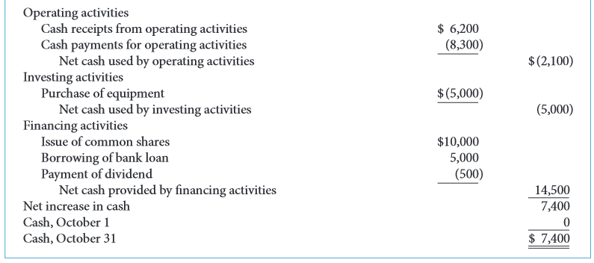
Statement of Cash Flows - Example
SIERRA CORPORATION
Statement of Cash Flows
Month Ended October 31, 2015

Slide 29
Relationships Between Statements
Statements are interrelated
  Results from some statements are used as data in other statements
Examples
  Profit from income statement is reported in statement of changes in equity
  Ending balances of each shareholders’ equity account is reported in both statements of financial position and changes in equity
  Statement of cash flows is related to statement of financial position

Slide 30
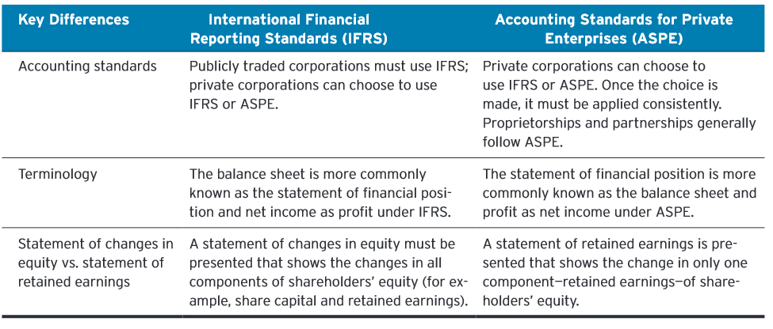
Comparing IFRS and ASPE

Slide 31
COPYRIGHT
Copyright © 2014 John Wiley & Sons Canada, Ltd. All rights reserved. Reproduction or translation of this work beyond that permitted by Access Copyright (The Canadian Copyright Licensing Agency) is unlawful. Requests for further information should be addressed to the Permissions Department, John Wiley & Sons Canada, Ltd. The purchaser may make back-up copies for his or her own use only and not for distribution or resale. The author and the publisher assume no responsibility for errors, omissions, or damages caused by the use of these programs or from the use of the information contained herein.

