Slide 1
BCH2333
Introductory Biochemistry
Winter 2015

Slide 2
Lecture 1
Origin of life,
Basic building blocks,

Slide 3
What is biochemistry
Biochemistry is the study of life on a chemical level
Biochemists use physical and chemical principles to explain (predict in some cases) biology at the molecular level.
Basic principles of biochemistry are common to all living organism
  Controlled by chemistry (fundamental chemical interactions that drive life)
  Shaped by evolution

Slide 4
Origin of life: from chemical to living
age of earth > 4.6 × 10⁹ years
    Evidence: - radiochemical dating of rocks (²³⁸U decays to ²⁰⁶Pb, ratio of 2 elements can give age of rocks
    - astrophysics
- geological uniformitarianism
oldest fossils > 3.5 × 10⁹ years (?)
            -microfossils, reminiscent of cyanobacteria (no direct evidence)
            Don’t really know when life actually occurred.
Notes:
The most important lesson we have learned from science is that the universe is enormous, in both time and distance – it is vast beyond any scale that classical philosophers had dared to imagine.
A child cannot grasp the fact that the world existed before his or her birth. Similarly, early human cultures assumed that the earth was about as old as their own cultural memories – perhaps a few thousand years. This constricted world-view has been difficult to dispel, and it remains the biggest obstacle to acceptance of the concept of evolution. The evolution of life took place over billions of years, and people have great difficulty thinking on that timescale!
The realization of the ancient age of the earth arose first from the idea of geological “uniformitarianism”. James Hutton, in the 18th C., and Charles Lyell, in the 19th C., proposed that the same geological processes occurring today - such as the deposition of sediments, erosion of valleys by flowing rivers, and laying down of new land by volcanic eruptions - could, over huge lengths of time, lead to the observed geological features of the earth. Given millions of years, the Colorado River can carve out the Grand Canyon. [Hutton’s story is presented in Bill Bryson’s bestseller, “A Short History of Nearly Everything” (ISBN 0-7679-0817-1)]. With the discovery of radioactivity, at the end of the 19th century, meaningful estimates of the age of the earth became possible. The decay rate of uranium-238 can be measured directly (using a Geiger counter to detect the decays) and corresponds to a half-life of 4.5 billion years. That fact alone doesn’t prove the universe is of such an age. But U-238 decays to lead (Pb-206). The age of a rock can be estimated from measuring the ratio between the amounts of the parent U and daughter Pb isotopes. We won’t discuss the details here, but many such independent estimates, using different “clocks-in-the-rocks”, give pretty much the same answer - that the earth is 4 or 5 billion years old.

Slide 5
Primordial earth
Reducing atmosphere
      No O2, too reactive
      Only present if something is producing it (some kind of chemical reaction, doesn’t have to be life).
no complex organic molecules
Oparin & Haldane (1920s) proposed Energy + atmosphere made complex organics
Notes:
What did primordial earth look like?
Some time about 4 billion years ago, earth had reducing atmosphere, no molecular oxygen present.
Primordial earth had stable gases, some of which are N₂, H₂O, CO2, CH4, NH3, SO2, present in the original reducing atmosphere.
These gases can be detected in other planets’ atmospheres as well.
Oparin and Haldane questions: How could complex molecules be formed? These molecules could react with energy to produce more complex molecules.
Energy types include solar UV, lightning

Slide 6
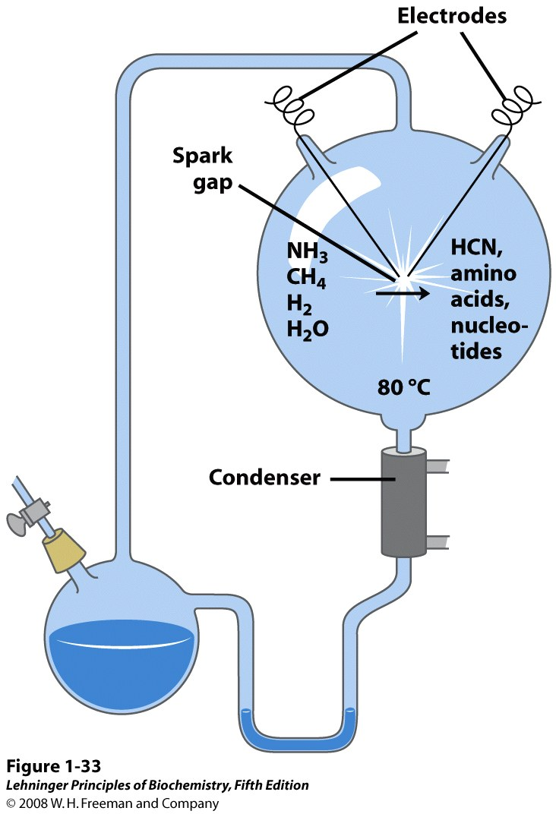
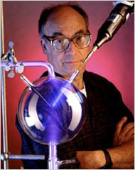
prebiotic biochemistry
Testing Oparin-Haldane’s hypothesis
Mimic lightning
Urey and Miller (1953)
Reducing
atmosphere
Produced complex
Organic molecules
Stanley Miller
(1930-2007)
Consistent with Oparin-Haldane
Hypothesis.
Notes:
In 1953, Stanley Miller (1930-2007), working with Harold Urey (and following on earlier speculations by the Russian chemist Alexander Oparin) performed a revolutionary experiment - simple in design and profound in its implications. He prepared a simulated early-earth atmosphere*, by mixing some gases in a glass vessel, and then excited the mixture with a high-voltage electrical spark. If any O₂ had been present, the flask would have blown up - but Miller prepared a mixture of reduced gases such as methane and ammonia. The electric discharge caused excitations and ionizations of the gas molecules, triggering chemical reactions. The complex mixture of products was separated and analyzed by gas chromatography (see p. 32).
From an interview with Stanley Miller (Oct. 1996):
“The experiments were done in Harold Urey's lab when I was a graduate student. ... He said it was really a very risky experiment and probably wouldn't work … So we agreed to give it six months ... If it worked out - fine; if not - on to something else. As it turned out, I got some results in a matter of weeks. ... The surprise of the experiment was the very large yield of amino acids. We would have been happy if we got traces of amino acids, but we got around 4%.”
What was the reaction to your work, in the science community?
“There was certainly surprise. One of the reviewers simply didn't believe it and delayed the review process of the paper ... But the work is so easy to reproduce that it wasn't long before the experiment was validated.”
*Geologists are still debating the question of the composition of the early earth’s atmosphere (Chyba, C.F., Rethinking earth's early atmosphere, Science 308: 962-963, 2005).

Slide 7
Urey-Miller experiment: products
Acids Nucleic acid bases Amino acids Sugars
formic acid adenine glycine ribose
acetic acid guanine isoleucine ribulose
succinic acid uracil proline
(partial list)
Key building blocks of life
In a reducing environment, complex chemical products can arise from the simplest precursors, given ...
as long as we have enough
energy and time
Notes:
Miller’s experiment started the study of “prebiotic chemistry”, that is, the organic chemistry that may plausibly have led to the origins of life.
CBC: Miller showed that complex organic compounds can be formed from simple building blocks. Many of the products formed in these “prebiotic” chemical systems are fundamental constituents of living systems, including the building blocks of proteins and nucleic acids, as well as sugars.
Did Miller “create life in a test tube”? Certainly not. But he showed that many of the building blocks of biochemistry are formed rather easily by chemical reactions that could have taken place on the early earth, and proved that the essential conditions for biogenesis - the origin of life - are not just far-fetched speculations; they can be studied by scientific methods.
If you would like to learn more about this topic, have a look at a review written by Leslie Orgel (1927-2007), one of the founders of the field: Prebiotic chemistry and the origin of the RNA world, Crit. Rev. Biochem. Mol. Biol. 39: 99-123, 2004.

Slide 8
An example of pre-biotic chemistry:
adenine forms readily from HCN (cyanic acid)
… adenine can be viewed as a pentamer of HCN units.
Adenine can easily be formed from HCN, observed in space.
Could have been present in prebiotic earth. Can make it from 5 cyanides.
NH₂
NH₂
C
N
C
N
N
C
N
C
C
H
C
H
C
C
N
C
C
H
N
H
N
N
H
H
Required for DNA, RNA, NAD+
CoA, etc.
Notes:
Here’s a stunning experimental result in prebiotic chemistry. In 1961, the Spanish biochemist Joan [pronounced “Hoe-an”] Oró showed that the simple organic compound hydrogen cyanide (HCN), which has since been found to exist even in interstellar space, when exposed to heat, forms adenine in about 1% yield (Oro, J., and Kimball, A.P., Synthesis of purines under possible primitive earth conditions. I. Adenine from hydrogen cyanide, Arch. Biochem. Biophys. 94: 217-227, 1961). We can “deconstruct” adenine as a pentamer of HCN units, as shown in the figure.
Adenine is an absolutely central building block of life! As we shall see, adenine is a component of many important biomolecules: RNA, DNA, ATP, NAD⁺, coenzyme A, etc.
Does this observation prove that adenine first arose from HCN in this way? No, but it makes it plausible. And it shows us that even complex biomolecules like adenine are not just random jumbles of atoms: their structures arise in an orderly and meaningful way … if we can only figure out the patterns.

Slide 9
Chemical Evolution
Simple building blocks combine to make polymers -> very challenging
-> need monomers at high concentrations
Polymers ultimately become self replicating
Common hypothesis – “RNA world”
Notes:
For monomers to polymerize, monomers have to be in sufficiently high concentrations.
How do monomers become self replicating? RNA world hypothesis -> best model we have, chemical molecules to complex molecules that are self replicating to systems that are self replicating.

Slide 10
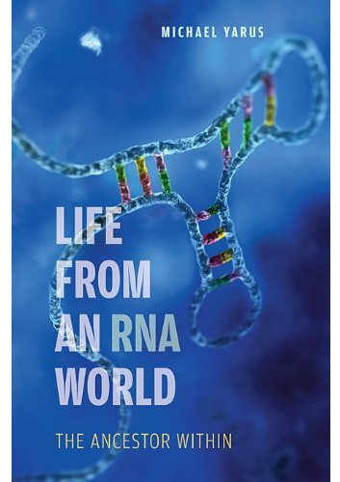
“RNA World” hypothesis
RNA can fold and template its own formation
Folded
– stability and structure
- Folds extremely well
- Folded RNA more stable
- RNA can catalyze many chemical reactions
- can be catalytic
- Proposed to catalyze their own replication
- Can catalyze their own replication
DNA and proteins improved
and refined RNA fitness
Notes:
CBC: RNA is a uniquely versatile molecule, with both catalytic and information-storage properties. RNA was almost certainly the first cellular genetic material; later, DNA took over this role.
The “chicken-and-egg” problem was solved by the discovery that RNA can catalyze chemical reactions - that is, RNA can act as an enzyme. Tom Cech won the Nobel Prize in 1989 for this discovery. Until Cech’s breakthrough, we had believed – and generations of biochemistry students had been taught! – that “all enzymes are proteins”. We now know that RNA molecules catalyze several important processes in the cell; notably, RNA plays a central part in protein synthesis, as a component of the ribosome. RNA combines the genetic-coding properties of DNA and the enzymatic activities properties of proteins. This discovery led to the “RNA World” concept: the concept that the first cells relied on RNA for both information storage and catalysis. (There’s a new book on this topic: “Life from an RNA World: The Ancestor Within”, Michael Yarus, Harvard University Press, 2010.) Later, as more complex cells evolved, DNA replaced RNA for genetic information storage (although many viruses still have RNA genomes) and proteins replaced RNA for most catalytic tasks. Without doubt, DNA is better suited than RNA for the genetic role, and protein is better suited than protein for the catalytic role – but RNA is unique in having both abilities. We will see additional evidence for the “RNA World” idea several times during this course. Strikingly, molecules that are closely related to RNA are found in a host of centrally important metabolites in the cell – ATP, NADH, and other molecules we will be encountering soon.

Slide 11
Self assembly and compartmentalization
Lead to “life”
Most common scientific definition of life
- Life possesses the properties of replication, catalysis, and mutability
Life evolved from inanimate chemicals governed by fundamental chemical principles
Fundamental chemical principles thus govern biochemistry
http://www.ibiology.org/ibioseminars/evolution-ecology/jack-szostak-part-1.html
Notes:
Just self assembly doesn’t lead to life, also need compartmentalization.
Compartmentalization -> many different self replicating molecules together. Reduces variation due to environmental changes.
Packing things into an enclosed environment.

Slide 12
Smallest unit of life: the cell
There are two major cell types: eukaryotes and prokaryotes.
Eukaryotes have a membrane enclosed nucleus encapsulating their genomic DNA.
Prokaryotes do not have a nucleus.
Prokaryotes
Bacteria,
Archaea
1-10 µm
Eukaryotes
Fungi, Protists, Animals, Plants
10-100 µm
Notes:
Karyon -> nut
Eu -> true
Pro -> before

Slide 13
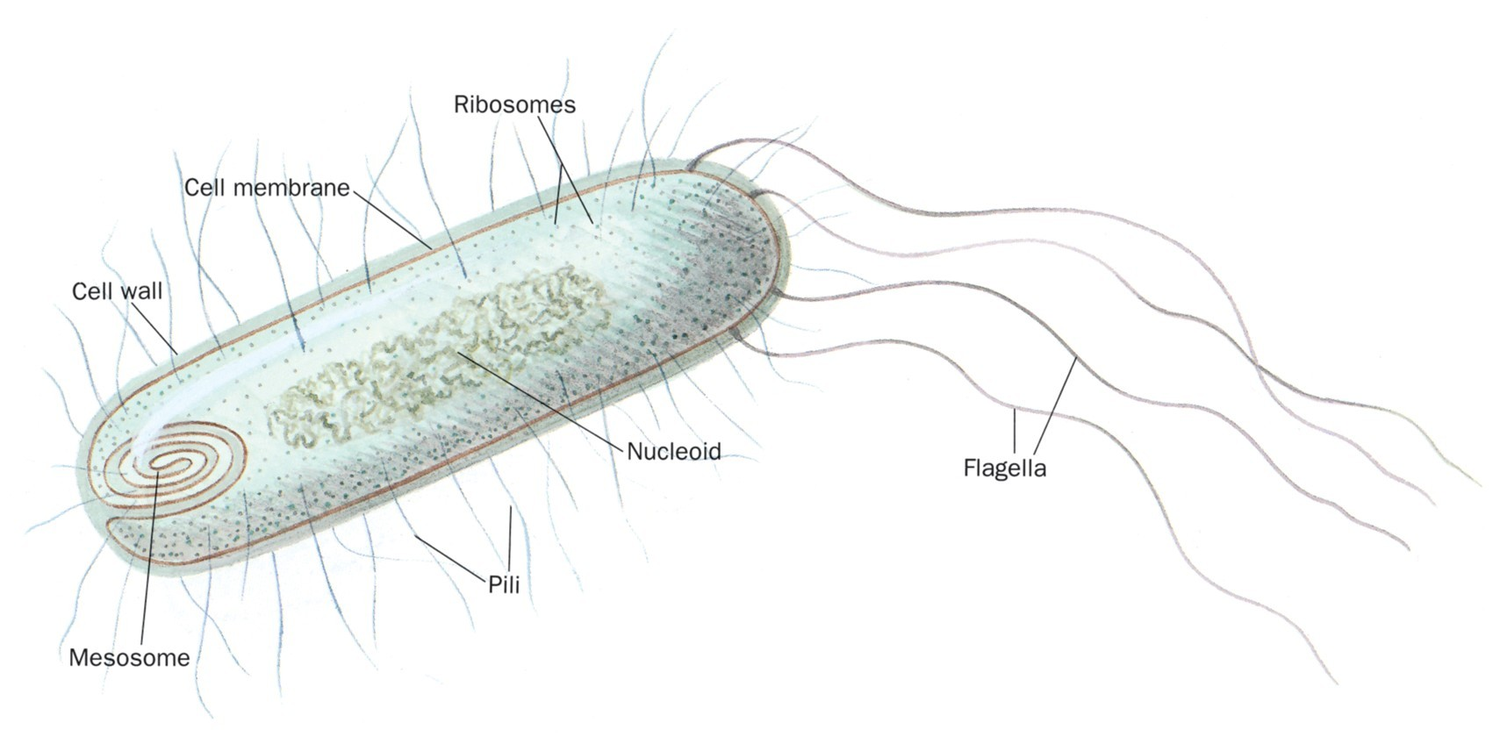
General schematic for a prokaryote cell
Notes:
All cells surrounded by approx. 70A thick cell membrane
Mesosome-might be site of DNA replication and other enzymatic functions
Genetic material (genome) found in the nucleoid region(Single chromosome containing the entire genome, bacteria will often have multiple copies of their genome at the same time).
Cytosol lacks bound organelles.
Flagella are used for movement
Pili function as conduits for DNA during conjugation (a process in which DNA is transferred from one cell to another) or aid in attachment to host cells.
6000 – 15000 different bio-molecules in e. coli.

Slide 14
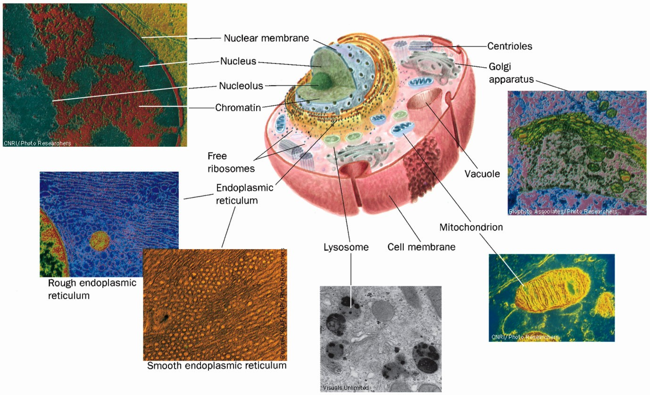
General schematic of an animal cell
Notes:
Around 100,000 different biomolecules. Much more complex than bacteria.
Mitochondria have their own DNA.

Slide 15
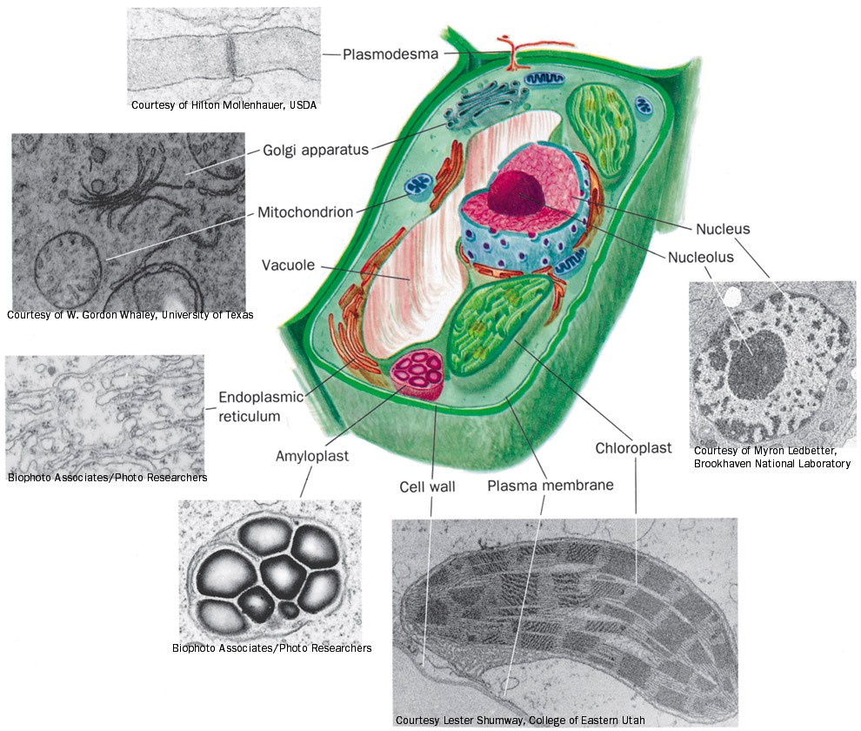
General schematic of a plant cell
Notes:
Chloroplasts have their own DNA too!

Slide 16
Extraordinary complexity of the cell
How can we hope to understand the role of molecules in a cell
Common theme:
  Biomolecules are polymers
  Limited number of building blocks -> 40 key building blocks
  Diversity of biopolymers due to order and type of monomers
Notes:
Limited number of molecules that make up the biomolecules.

Slide 17
Many Important Biomolecules are Polymers
lipids
proteins
carbo
nucleic acids
monomer
polymer
supramolecular
structure
Notes:
Monomers polymerize, then polymers can make super molecular structures where multiple polymers come together.

Slide 18
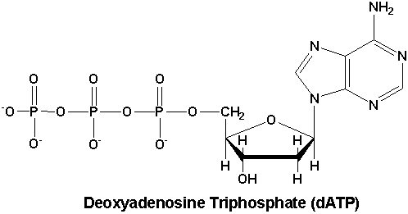
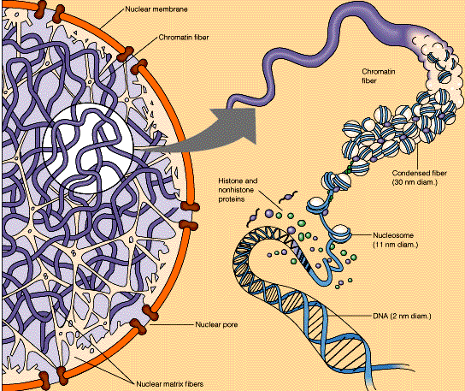
Nucleic Acids
monomer
polymer
supramolecular
structure
Notes:
Start off at monomer level with nucleosides and nucleotides.

Slide 19
Proteins
monomer
amino acid
polymer
protein subunit
supramolecular
structure
Enzyme complex
Notes:
20 building blocks (amino acids)
Polymers can fold up to make 3D structures.
Folded structures can self assemble into protein complexes.

Slide 20
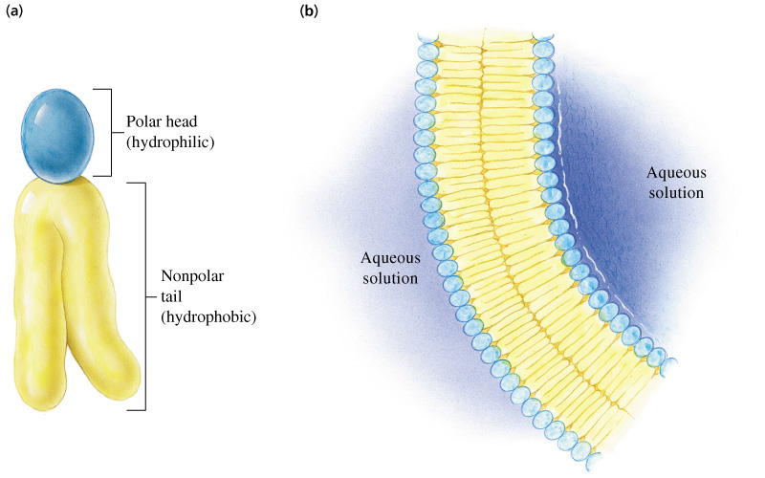
Lipids
monomer
polymer
supramolecular
structure

Slide 21
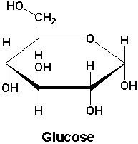
Carbohydrates
monomer
polymer
supramolecular
structure

Slide 22
MW
H,C,N,O,P,S
1-32
20 amino acids
5 aromatic bases, ribose
Palmitate, glycerol, choline
100-250
Glucose
100-800
peptides
Phospholipids
Nucleotides
Sugars
10⁴-10⁹
Proteins
Nucleic acids
Polysaccharides
10⁶-10¹⁰
Multienzyme complexes, ribosomes, chromosomes, membranes, structural elements
Organelles, Cells, Tissues, Organs, Organsims

Slide 23
Fundamental chemical principles
Water
Acid/base chemistry (pH, pKa)
Covalent and non-covalent bonding

