Slide 1
GRAM STAINING
HSS1100: MICROBIOLOGY AND IMMUNOLOGY
STUDY GROUP
HSS MENTORS UOTTAWA

Slide 2
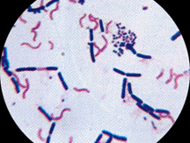
Why do we use a Gram stain?
What are we looking to find out?

Slide 3

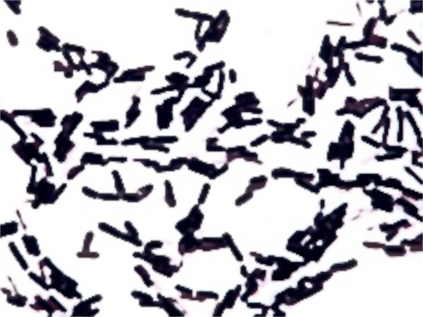
DOING A GRAM STAIN
STEP 1
Prepare the slide you want to look at; fix with heat.

Slide 4


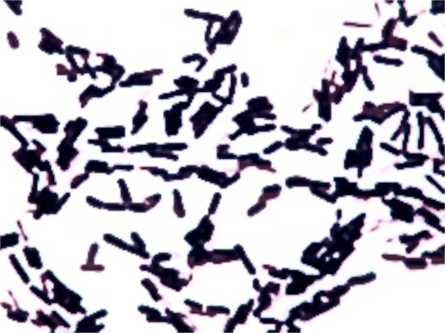
STEP 2
Add crystal violet. Wash with tap water.
GRAM NEGATIVE
GRAM POSITIVE
GRAM NEGATIVE
GRAM POSITIVE

Slide 5

STEP 3
Add Gram’s iodine. Wash with water.
GRAM NEGATIVE
GRAM POSITIVE
GRAM NEGATIVE
GRAM POSITIVE

Slide 6
STEP 4
Decolourize with 95% ethanol. Wash with water.
GRAM NEGATIVE
GRAM POSITIVE
GRAM NEGATIVE
GRAM POSITIVE

Slide 7

STEP 5
Add safranin (counter stain.) Wash with water. Dry.
GRAM NEGATIVE
GRAM POSITIVE
GRAM NEGATIVE
GRAM POSITIVE

Slide 8
Why?
?
What is different between gram negative and gram positive bacteria?

Slide 9
Online Quizzes!
http://www.funtrivia.com/playquiz/quiz2721931f29b80.html
http://highered.mheducation.com/sites/007337525x/student_view0/exercise9/gram_stain.html
http://www.mcqbiology.com/2013/02/mcq-on-gram-staining.html#.VMjvG2jF-VM
http://quizlet.com/2863553/flashcards

Slide 10
What happens if…

