Slide 1
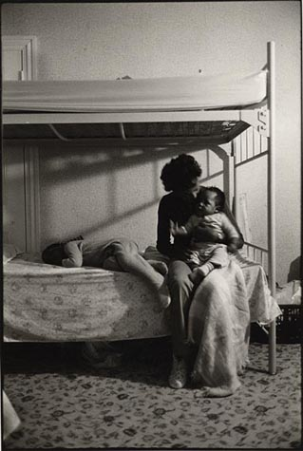

Lect 8: Feminism & the struggle for equality
Lecture 8
“Women lacked access many educational & occupational opportunities, they had difficulty obtaining birth control information, much less safe & legal abortions; problems such as rape and wife-battering were not widely acknowledged, and a great deal of sexism existed in everyday life”

Slide 2
References
Christine Delphy & Diana Leonard,
‘Familiar Exploitation’ (1992).
Mary O’Brien. The Politics of Reproduction (1981)
Ehrenreich, Barbara. ‘Nickled and Dimed’ (2001)
Mitchell, Juliet. Women's Estate (1971)
Feminist Journeys/Voies Feministes 2010.
Ed. Marguerite Anderson
Feminist History Society, Ottawa
www.feministhistories.ca

Slide 3
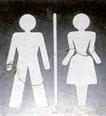
Definitions: Gender
Cultural construction of sexual difference
The way the sexes are perceived, evaluated, and expected to behave

Slide 4

Feminism
A doctrine that advocates equal rights for women
The term feminism can be used to describe a political, cultural or economic movement aimed at establishing equal rights and legal protection for women. Feminism involves political, cultural and sociological theories, as well as philosophies concerned with issues of gender difference.

Slide 5
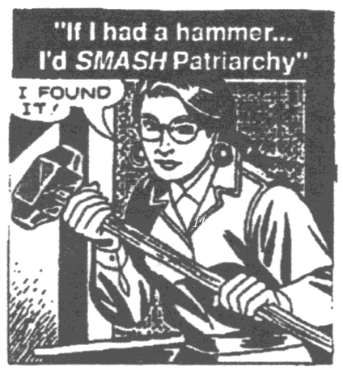
Patriarchy
Social organization marked by the supremacy of the father in the clan or family, the legal dependence of wives and children, and the reckoning of descent and inheritance in the male line

Slide 6
Gender studies
Gender studies more inclusive than feminism
Men
Trans-gendered
Homosexual

Slide 7
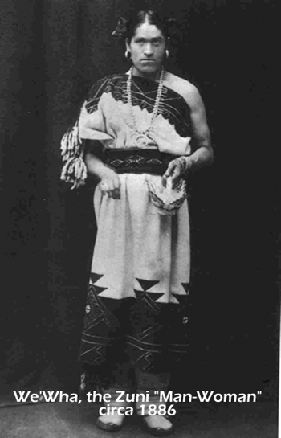
Third Genders
Berdache (pejorative)
Two Spirits
Winkte
We’wha

Slide 8
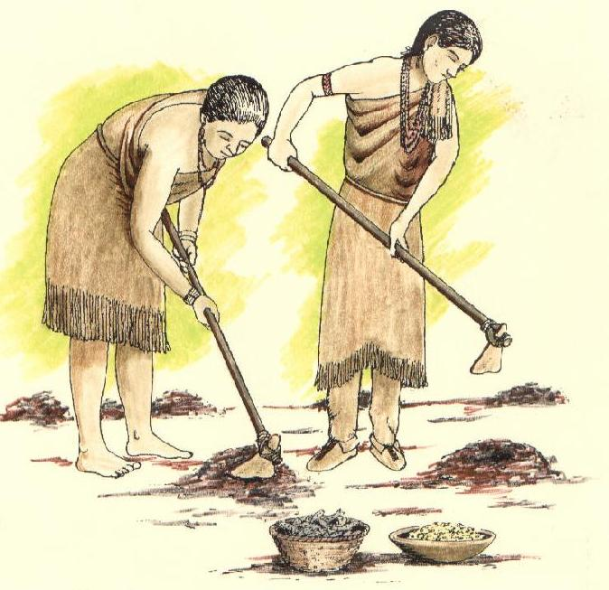
Women’s Work
Amongst the Iroquois women ‘tended’ the fields, cooked the food, were responsible for manufacturing of clothing and the maintenance of the longhouse
Iroquois women also held a ‘veto’ over the selection of chiefs

Slide 9
Developments
First wave: Suffragettes, legal inequalities
Second Wave: refers to a period of feminist activity which began during the early 1960s and lasted through the early 1990s. Concentration on continuing legal inequalities, but also focus on sexuality, family, the workplace, and reproductive rights
Third Wave: 1980s – today, less dogmatic, more oriented to self-help, bodies etc.
Arose in response to perceived 2nd wave failures Less structured, more diversified, addresses women in developing world, race, class etc.

Slide 10
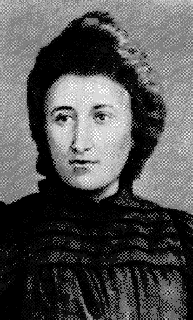
Dr. Rosa Luxemburg 1871-1919
Born 1871 Polish town of Zamosc
‘Bloody Rosa’
Spoke Russian German polish
Univ. of Zurich
History, political science, social science
Refused to assume the stereotypical roles women usually fill
1900 - Reform or Revolution
1906 - The Mass Strike
1912 - Women’s Suffrage & Class Struggle
Executed by German ‘nationalists’

Slide 11
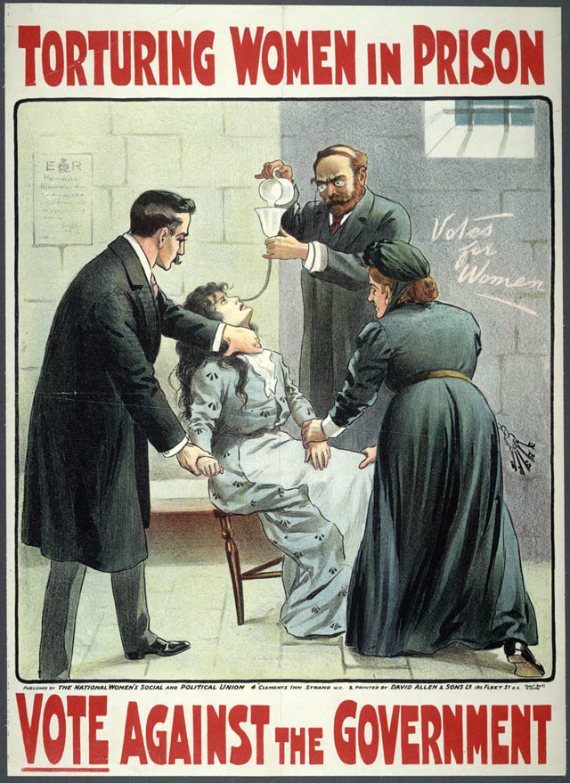
Suffragettes
The move for women to have the vote had really started in 1897 when Millicent Fawcett founded the National Union of Women's Suffrage.
Notes:
"Suffrage" means the right to vote and that is what women wanted - hence its inclusion in Fawcett's title.

Slide 12
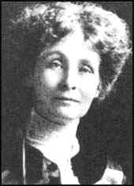
Suffragettes
1903 the Women's Social and Political Union was founded by Emmeline Pankhurst and her daughters Christabel and Sylvia.

Slide 13
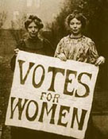
Suffragettes
Christabel Pankhurst and Annie Kenney interrupted a political meeting in Manchester to ask two Liberal politicians (Winston Churchill and Sir Edward Grey) if they believed women should have the right to vote. Neither man replied. As a result, the two women got out a banner which had on it "Votes for Women“.

Slide 14
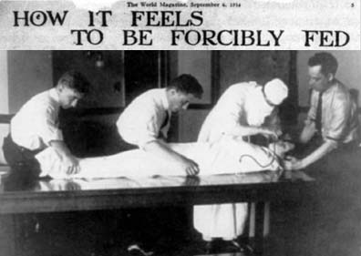
Hunger strikes
Marion Dunlop was the first in 1909. She was released, as the authorities did not want her to become a martyr.
Other suffragettes in prison also undertook hunger strikes. The prison authorities subjected them to force-feeding, which the suffragettes categorized as a form of torture.
Mary Clarke, Jean Hewart, Katherine Fry and several others died as a result of force-feeding.

Slide 15
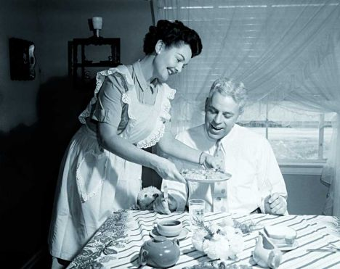
In the West an image of matrimonial harmony and submissive womanhood becomes almost a national obsession

Slide 16
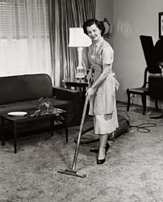
“The “true “ woman and the “true” family are images of peace and plenty: in actuality they may be both sites of violence and despair”.
However, the latter half of 20th century witnesses many positive developments, incremental changes

Slide 17
Reading
1970s & 19080s: grievances persist, relative depravation
New organizational vehicles:
The New Left (Marxist), Liberal Groups
Political Opportunities
  Electoral realignments
  Democrat Party loses many voters over Civil Rights

Slide 18

Future & Feminism
“Until there is a revolution in production the labour situation will prescribe women's situation within the world of men” (Juliet Mitchell)
“Probably it is only in the highly developed societies of the West that an authentic liberation of women can be envisioned today”

Slide 19
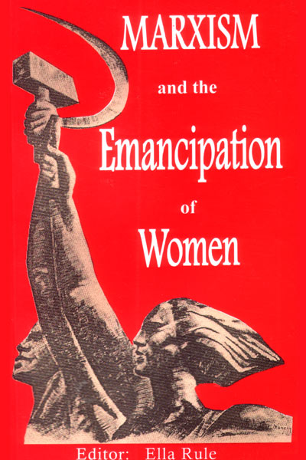
Marxist Feminism
“We should ask feminist questions but try to come up with some Marxist answers”
Asks why oppressed, and how
Two issues:
  Exploitation within workforce
  Exploitation within home
Alliance of Marxist analysis with ‘gender’ studies
Uneasy Fit
Productive literature & Scholarship

Slide 20
Questions
Should the analysis of women’s oppression be part of the class or minority analyses or separate?
Must situate the argument in terms of the particular society (one size does not fit all).
The level of social formation is NB
Some women (in more traditional cultures) are either more empowered or more exploited

Slide 21
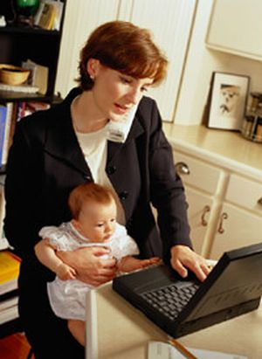
Domestic Labour Debate (Marxism)
Women are exploited by men in the home and by capitalists in society.
Women’s work does not, directly, produce surplus value, nor exchange value.
Men are an exploiting class, women an exploited class.

Slide 22
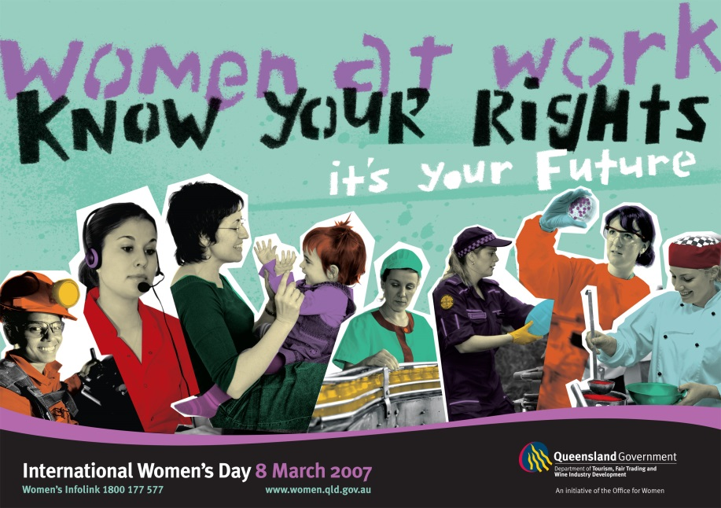
Alienation of the worker is compared to that of the stay at home mom
Unpaid labour
RRSPs & Divorce

Slide 23
3rd Wave: Newer Focus
Feminist studies focus on other aspects of stratification and discrimination
Black females
Lesbian females
Ethnic females
Examine the role of women in the developing world
Analysis and publications regarding women and globalization

Slide 24
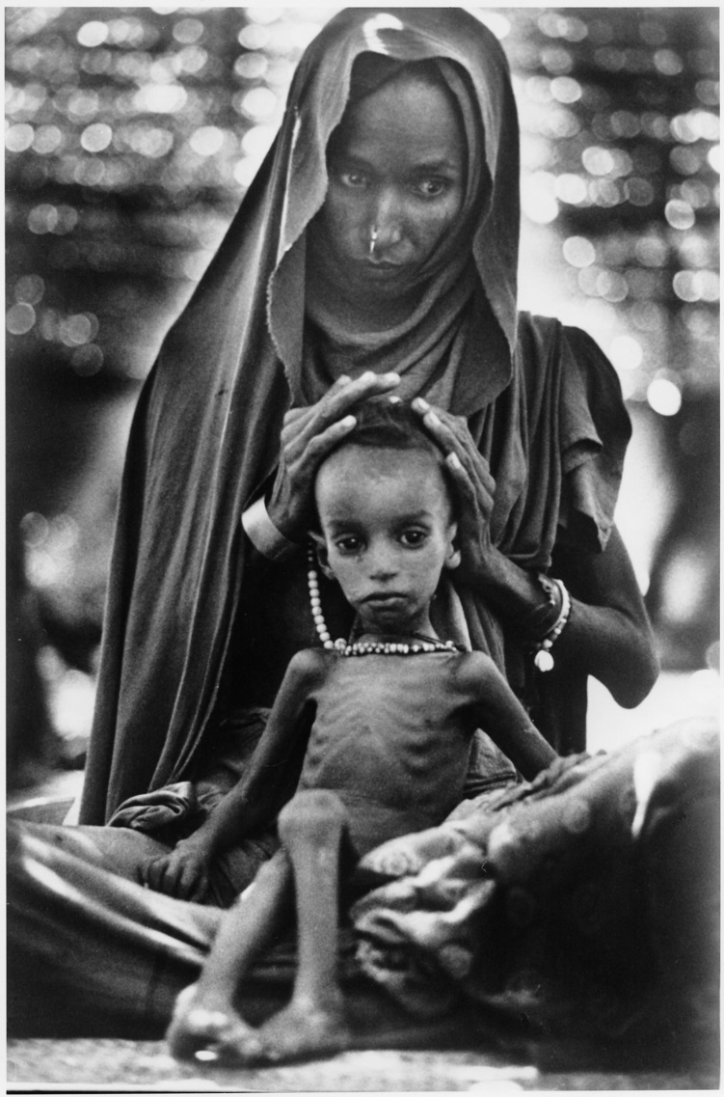
Women and Development
Loss of political power and property rights among women, cross-culturally
Obstacles created through “male bias” in development projects
Women’s “domestication”
Women, independently, have formed organizations to improve their lives
Dr. L.Kilmurray
Notes:
24

