Slide 1
Patterns of Choice
There are 4 patterns describing how people choose to respond to a risk.
1. Absorb
View the risk as unproblematic or deny it outright
The probability is deemed to low to worry about
Fate is determined by the capacity to absorb losses. (where you live, and wealth etc… changes ability to absorb losses)
Example: San Andreas fault

Slide 2
Patterns of Choice
2. Accept
There is awareness of the hazard (no denial)
Passive attitudes (there is little that can be done to reduce impacts)
Hazards are often viewed as acts of God
Example:
Nigeria drought

Slide 3
Patterns of Choice
3. Reduce
there is awareness of the hazard (no denial)
Action is taken to reduce the impacts
Typically there is reactive response and some preparation
Usually people stay in place
Example:
flooding events, snow and wind related hazards

Slide 4
Patterns of Choice
4. Change
There is awareness of the hazard (no denial)
Radical action may be taken (move away or change the land use)
Example:
Australia drought

Slide 5
Social Amplification of Risk
After many years of research on public responses to risk, no comprehensive theory exists to explain why apparently minor risk events (as assessed by experts) sometimes produce massive public reactions.
What is an example of a hazard that typically evokes massive public reactions that are more severe than what the hazard likely warrants?
What are some potentially negative impacts of such reactions?

Slide 6
Evocative Hazards
These are hazards that are not likely to be serious but typically evoke much public reaction.
Ex: pesticides
Canadians take pride in having attractive lawns around their homes and many use lawn care products to maintain them.
However, pesticide use for lawn care has become an issue in many communities across Canada due to increasing awareness of the potential impact.

Slide 7

Banal Hazards
These are hazards that are known to be relatively more serious but typically evoke little public reaction.
According to a Consumers Union study, eating peanut butter (which contains an average level of 2 parts per billion of aflatoxin) once every 10 days presents a cancer risk of 7 in one million. Small as that may seem, it is higher than the estimated risk of cancer from most pesticides.

Slide 8


Amplification and Attenuation of Risk
Amplification
-Involves hazards that have a low probability as assessed by experts.
-Elicit strong public concern
Attenuation
Involves hazards that may have serious physical impacts and a relatively higher probability
Elicit weak public concern

Slide 9
Amplification and Attenuation of Risk
Transmitter
-generates and sends the message about the risk
(e.g. media)
Signal
-the message itself
Receiver
The target audience for message signals
The original signal may be considerably modified by the time it is received.

Slide 10
Signal Value
Signals can be prescribed values by the receiver.
This is related to the characteristics of the event and the hazard it reflects.
High signal values may suggest that a new risk has appeared or that the risk is different than previously understood.

Slide 11
Examples of Signal Value
A large accident that takes many lives may have a low signal value if it occurs as part of a familiar and understood system (such as a car crash).
A small accident in an unfamiliar or poorly understood system (nuclear power plant, laboratory) may have high signal value and cause concern since people may perceive the risk is uncontrollable.

Slide 12
Stigmatization
This is a process by which negative images are ascribed to places, technologies, or people.
The risk perception of a future event in the area could be altered simply because of past events there.
Example:
Love Canal

Slide 13
Impacts
Spread of Impact
Impacts can spread like ripples and often extend well beyond the local area.
Entire countries, technologies (medications), industries (meat) can be affected.
Secondary Impacts
Property values and insurance rates may change

Slide 14
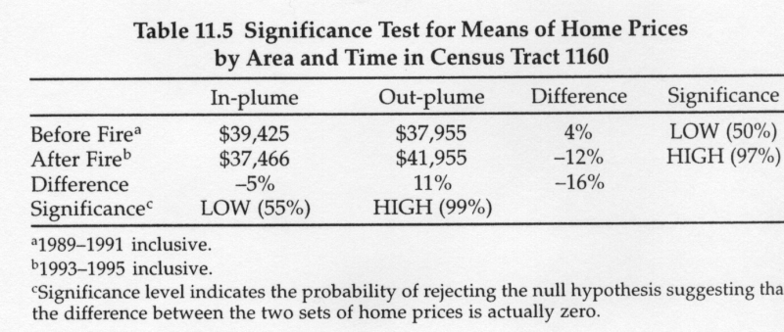
Secondary Impacts
Stigma and property values are typically intertwined.
Example:
There were significant differences between house prices in wildfire-affected areas and non-affected areas of Phoenix after a wildfire (even though the risk of another wildfire there was very low).

Slide 15
Risk Perception Theories
Question:
Why do some people feel that some technologies (e.g. nuclear energy or chemical pesticides) are a major concern while others feel that they are not a concern?
There are 5 theories that attempt to explain this:
- Knowledge
- Personality
- Economic
- Political
- Cultural

Slide 16
Knowledge Theory
How was this theory tested?
-Education level
-Self-reported knowledge
(People were asked to provide an estimate of annual fatalities from 8 technologies (aviation, nuclear energy, lawn mowers, etc)). Their answers were then compared to actual fatality data.
Hypothesis:
Greater knowledge of fatality data leads o a greater perceived threat from the technology.

Slide 17
Personality Theory
This theory was tested using validated measures and questionnaires developed by psychologists.
Hypothesis:
There is consistency between the personality type and the perceived threat from technological hazards.

Slide 18
Economic Theory
This theory is based on the annual income of the people tested.
Hypotheses:
The wealthy are more willing to take risks with technology because they may benefit more or have better access.
The poor are less willing because they may deal with any associated burdens (pollution).

Slide 19
Political Theory
This theory was tested by determining the political ideology of the subjects (through completion of a 20 question survey).
Hypothesis:
Personal views toward risk are related to the political party (and policies) that people support.

Slide 20
Cultural Theory
This theory is based on the way of life of the people (urban, rural, retired, child-rearing, etc.).
It is supported by personal worldviews (i.e. the way the person believes the world operates or should operate).
Examples: hierarchical, egalitarian, individualist
Hypothesis: The worldview is correlated to how the person perceives risk.

Slide 21
Hierarchical Worldview
This view defines boundaries between superiors and subordinates.
Examples of this view:
Strong patriotism
Support for country, right or wrong
Strong respect for authority (law, order, and obedience are strongly valued)
Strict ethical standard
Concern about lack of discipline in youth

Slide 22
Egalitarian Worldview
This view centres on political solutions to inequality.
Examples of this view:
belief that world conflict can be eliminated with a more equal distribution of resources
Support for government efforts to reduce poverty
Support for high tax burdens on the wealthy
A lack of trust in large corporations
Notes:
As people age they go from Egalitarian to Hierarchical.

Slide 23
Individualism Worldview
This worldview emphasizes personal freedom and choice.
Examples of this view:
constraints on individuals should be minimized (lack of support for heavy government regulation)
Belief that a welfare state destroys individual initiative.
Continued economic growth and private profit are keys to quality of life.

Slide 24
Results
Tests of the 5 theories were performed in a study by Wildavsky and Dake.
134 people participated in the study.
Knowledge Theory
The results suggested that greater knowledge resulted in a greater perceived benefit from technological activities but results were not statistically significant.

Slide 25
Results
Personality Theory
Those who perceived technological activities as high risk had less aggressive personality types.
There is no accepted explanation for this but there are consistencies with the cultural theories
Those with a les aggressive personality were more likely to have hierarchical worldviews.

Slide 26
Results
Economic Theory
The results were inconsistent since there was little correlation between income and personal views toward the risks of technological activities.
Political Theory
Those who identified as left-wing were more likely to see the technological activities as threatening.

Slide 27
Results
Cultural Theory
Only the highest correlations are listed on the table and all those listed are statistically significant.
 | grave problem | risk worth taking | perceived benefit
egalitarianism | 0.51 | -0.42
hierarchism |  | 0.43 | 0.37
individualism |  | 0.32 | 0.34

Slide 28
Summary of Results
Theory |  | Result
knowledge | → | inconclusive
personality | → | conclusive
economic | → | inconclusive
political | → | conclusive
cultural | → | conclusive
The cultural theory was found to be the best explanation for how people perceived the risk.

Slide 29
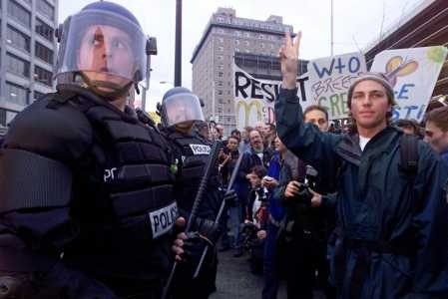
Worldviews and Social Conflict
The clash of worldviews can sometimes result in conflict whether or not the views are based on actual fact.
Example:
A wealth of scientific evidence shows warming average temperatures worldwide.
Environmentalists lobby governments to regulate emissions
-Economic growth advocated cast doubt on the quality of the data

Slide 30
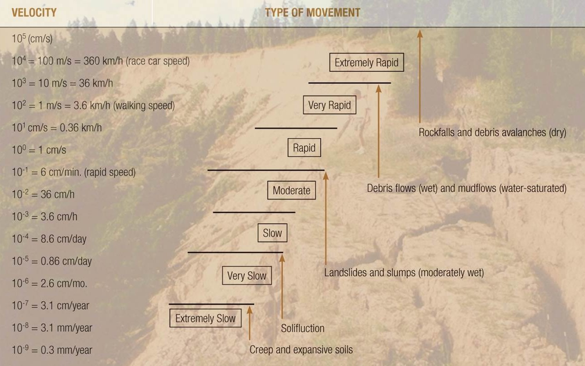
Landslides
Definition:
Downslope movements of rock or sediment as a result of gravity.
Movement is classified as rapid if it can be detected by eye.

Slide 31
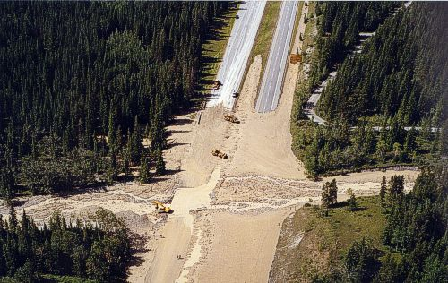
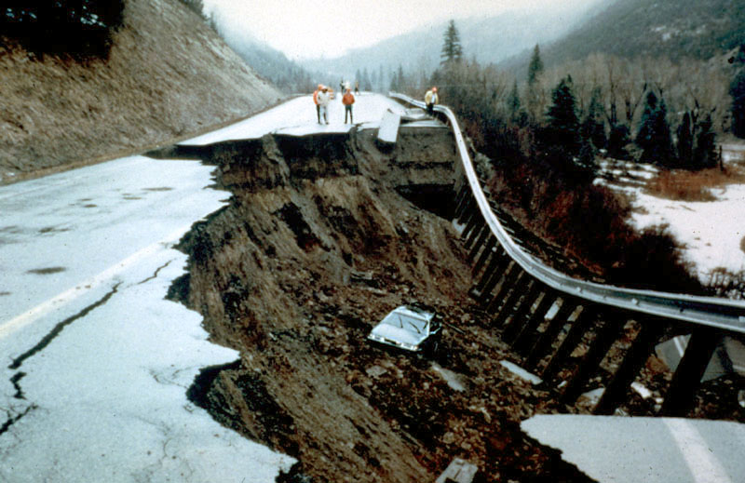
Classification of Landslides
This is based on 4 variables:
-mechanism of movement
-type of material
-amount of water present
-speed of movement

Slide 32
Mechanisms of Movement
There are 3 basic mechanisms:
Fall
Rock or sediment dropping off the face of a cliff.
Slide
-Downslope movement along a
discrete failure plane.
Flow
- Movement of particles semi-independently of one another, commonly with the aid of water.

Slide 33
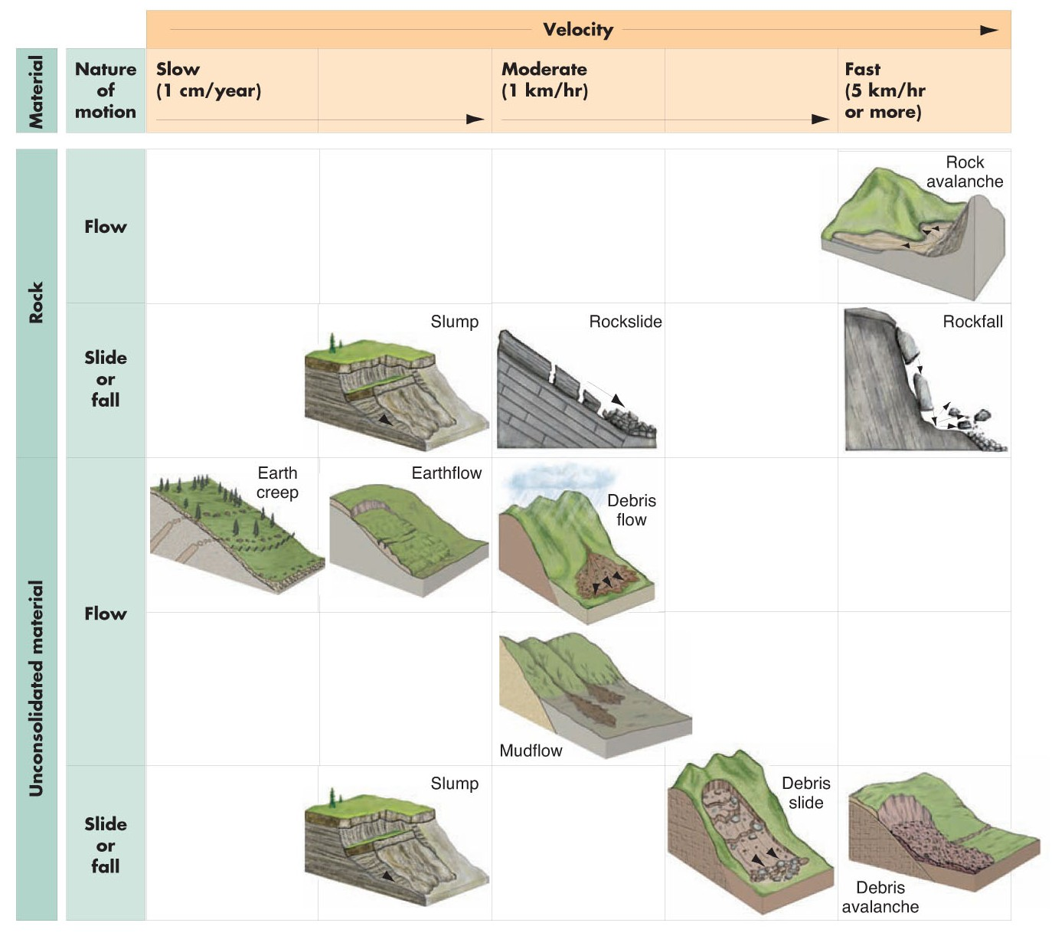
Types of Landslides

Slide 34
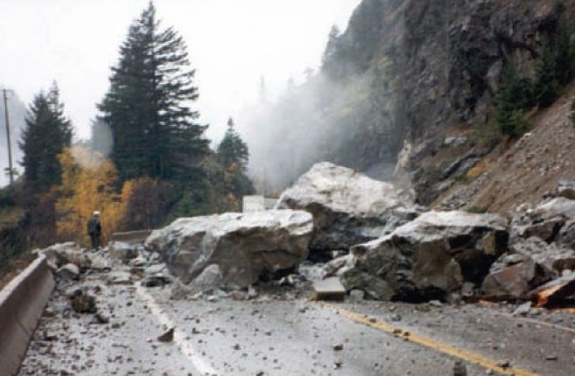
Rock Fall
This mass movement is caused by a fall mechanism.
It involves rock rolling down a steep slope of falling through the air.

Slide 35
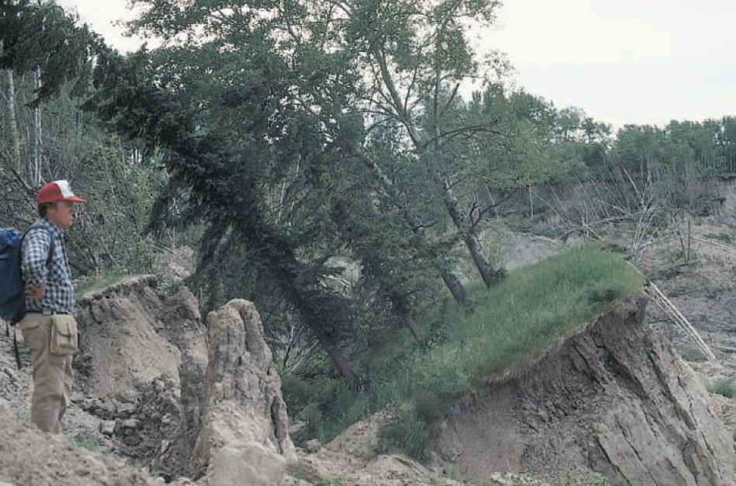
Slump
This mass movement is caused by a slide mechanism.
In a slump, the failure plane is curved upward.

Slide 36
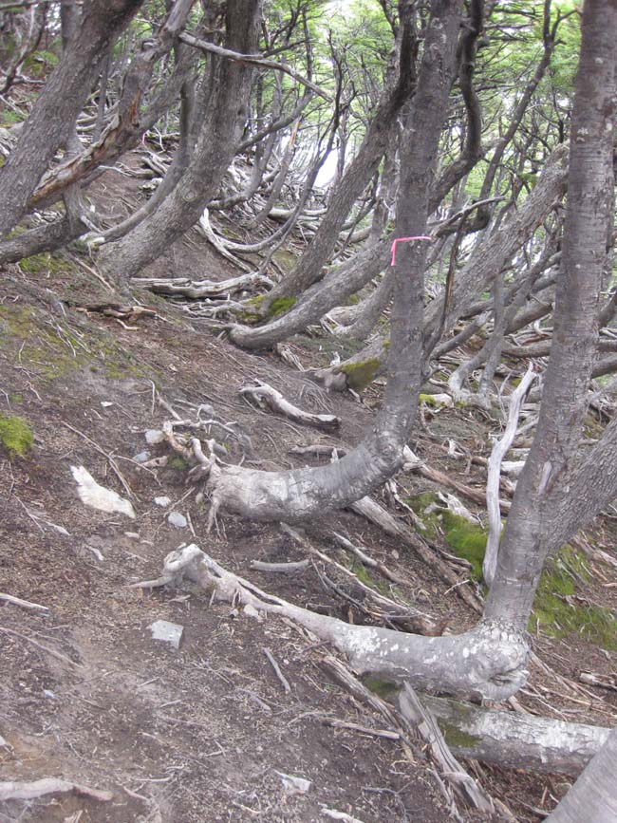
Creep
This mass movement is caused by a flow mechanism.
Speed of movement ranges from a few millimeters to a meter annually.

Slide 37
Forces on Slopes
The stability of a slope is based on the balance between two types of forces:
Driving Forces
These move material downslope; they are based on the weight of the material from vegetation, water, etc.
Resisting Forces
These oppose downslope movement; they are based on the shear strength of the material.

Slide 38
Factor of Safety
Definition:
The ratio of resisting forces to driving forces.
FS= RF/DF
When the ratio is over 1, the slope is stable.
When the ratio is under 1, the slope is unstable.
If the factor of safety equals 1, resisting forces equal the driving forces.
The forces are determined by relationships among: material type, slope and topography, climate, vegetation, and water.
Notes:
FS=Factor of safety
RF=Resisting force
DF=Driving force

Slide 39
Role of Material Type
The degree of consolidation and the presence of weakness planes can increase the risk of landslides.
Slumps are most common in unconsolidated sediment
Slumps are rotational slides as opposed to translational slides.
Translational slides often occur where sediment overlays bedrock; the failure plane is generally at the boundary between the soil and the bedrock.
Notes:
Translational slide- a type of landslide where material moves downslope along a discrete plane.
Rotational – type of landslide where material moves downslope along an upward curved surface

Slide 40
Role of Slope and Topography
The steeper the slope, the greater the driving forces.
-Steepest slopes are associated with rock falls.
-Moderate slopes are associated with flows.
-Gentle slopes are associated with flows
Topographic Relief: The height of a hill or mountain above the land around it.
Dangerous landslides are more likely in areas of high relief.

Slide 41
Role of Climate
The climate of an area influences the amount of water that infiltrates and erodes the soil.
In dry summers, vegetation is sparse, soil is thin and bare rock is exposed in many areas.
Rock falls are more likely in those areas.
In humid climates, soil is thick and rock is generally covered with soil and vegetation.
Thus, flows and creep are more likely in those areas.

Slide 42
Role of Vegetation
Dense vegetation can slow surface erosion.
How?
Roots add strength and cohesion to the slope.
Therefore, improper deforestation often increases the frequency of landslides.

Slide 43
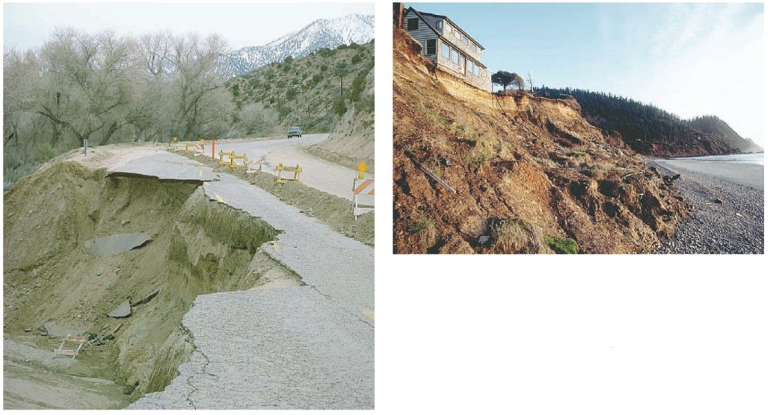
Role of Water
Water saturates soil increasing the likelihood of flows.
Following prolonged periods of deep water infiltration, slumps can develop.
Water can also erode the base of a slope therefore decreasing its resisting force.

Slide 44
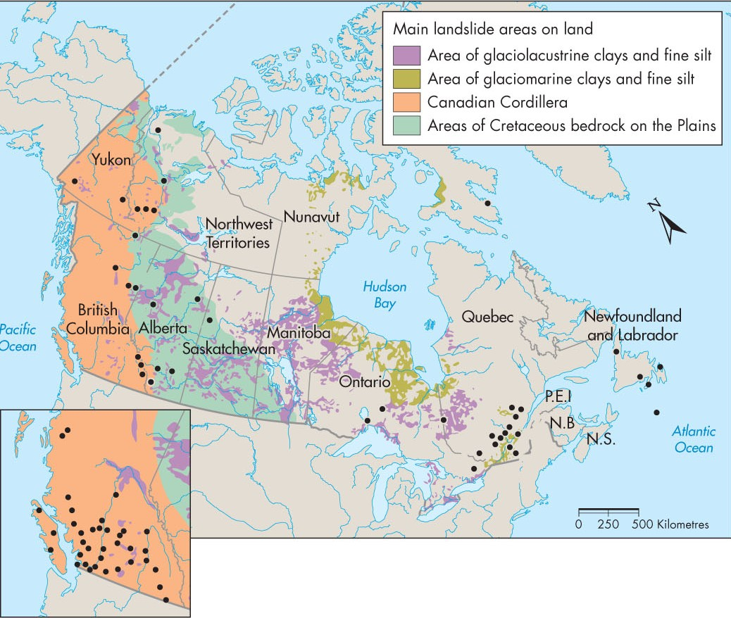
Regions at Risk
Any location with significant variation in topography is at risk.
Factors that increase risk include urban development, deforestation, and climate change.

Slide 45
The Frank Slide
It is Canada’s best-known landslide.
It occurred in 1903 on Turtle Mountain near Frank, Alberta.
The landslide killed 76 people, dammed the Crowsnest River creating a lake, and buried 5km of railway.
The exact cause of the landslide is unknown but glaciation, mining, and heavy snow are likely contributors.

Slide 46
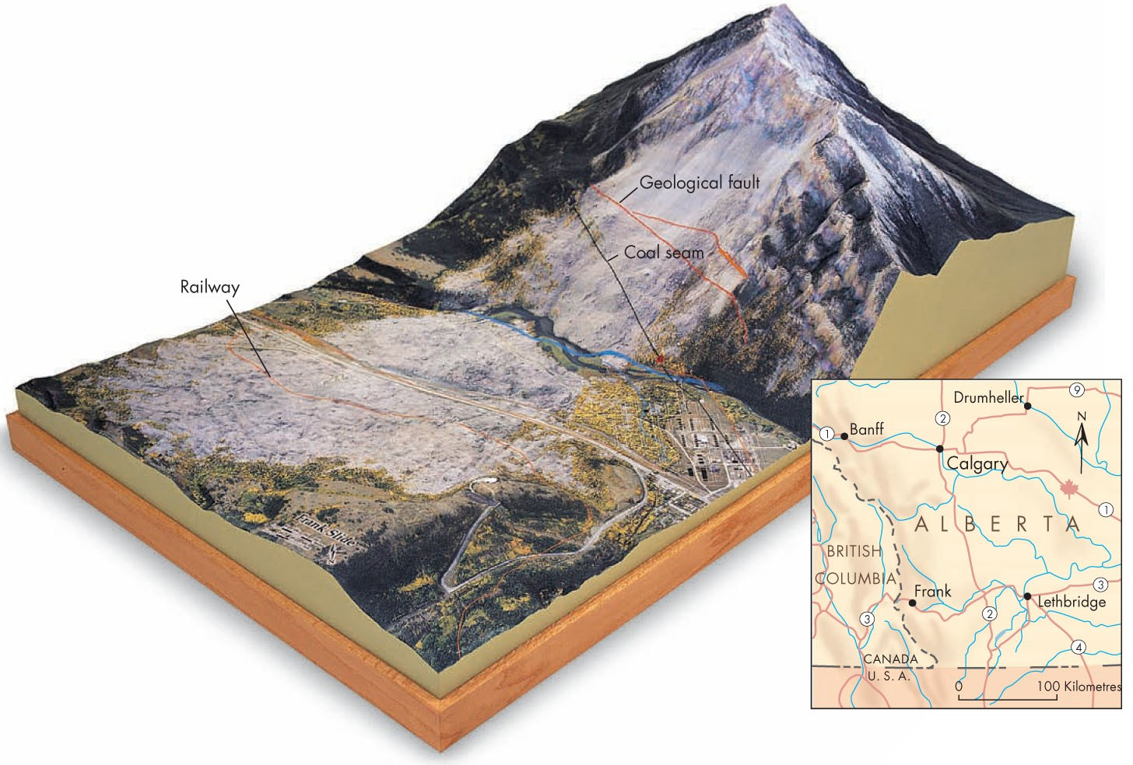
The Frank Slide

Slide 47
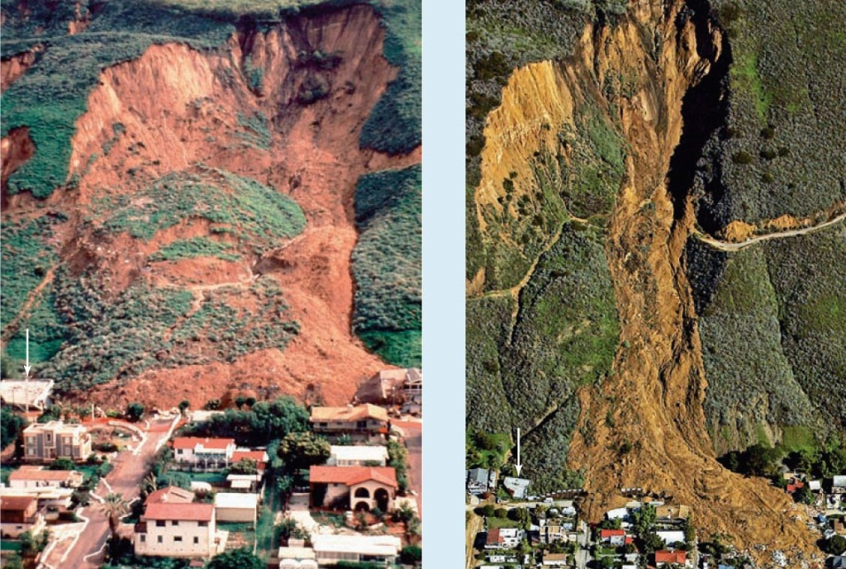
Effects of Landslides
Approximately 30 people are killed by landslides annually in North America.
Landslides can block railways and highways in isolated areas thus severely impacting travel.
As urban areas continue
to grow, property
damage will increase.

Slide 48
Natural Service Functions
Landslides can result in the development of new habitats in forests and aquatic ecosystems.
This produces an increase of biodiversity.
Landslides can carry sediments that contain valuable minerals which become concentrated at the base of a slope following an event.

Slide 49
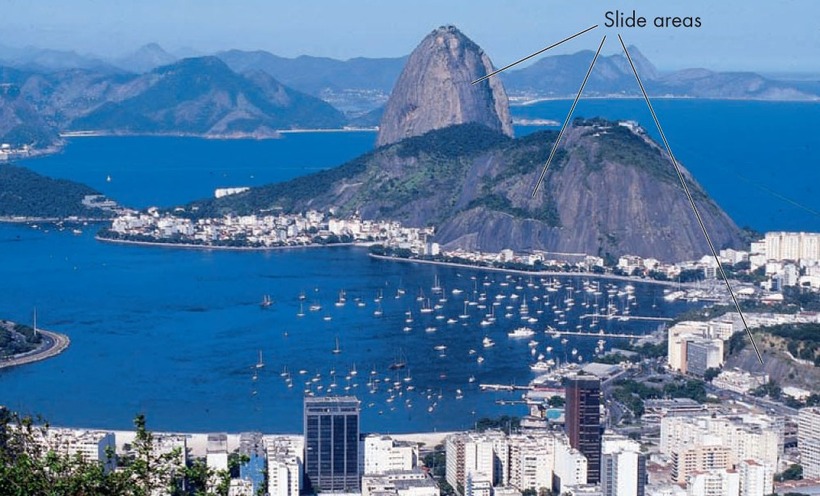
Human Interaction with Landslides
Grading of land surfaces for new home and building construction can increase probability of slope failure.
Harvesting timber and urbanization are currently the leading human causes for the increase in landslides.

Slide 50
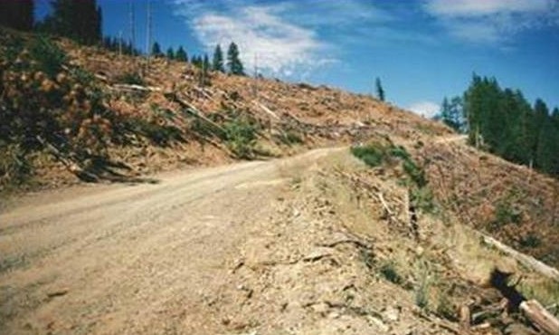
Human Interaction with Landslides
Timber Harvesting
Clear-cutting and the construction of logging roads can cause landslides in geologically unstable areas.
A lack of surface vegetation and a lack of tree roots enhances soil erosion.

Slide 51
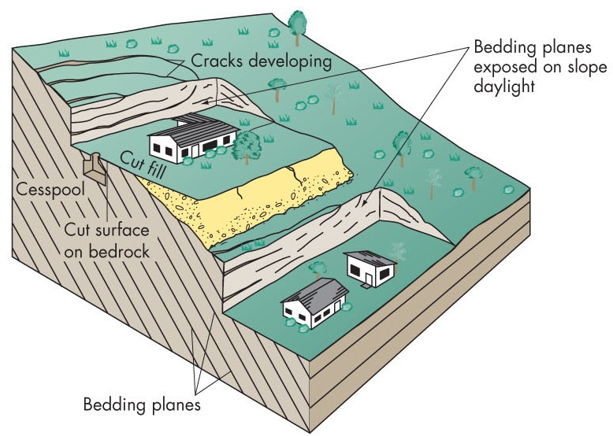
Human Interaction with Landslides
Urbanization
Modern engineering has allowed us to turn hilly slopes into flat land for construction.
Slopes are destabilized when rock is removed, lawns are watered, septic systems are installed, and buildings are constructed.
All of these add weight to the slope increasing the driving force.

Slide 52
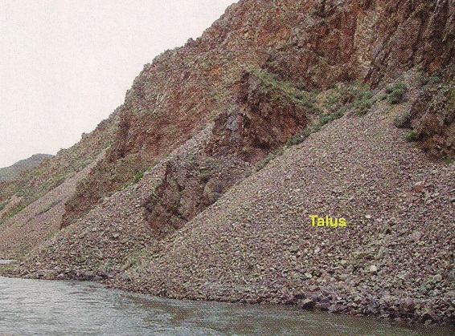
Minimizing the Landslide Hazard
An important first step is recognizing where they are most likely to occur.
Features indicative of unstable slopes include:
-Cracks on a hillside
-Recessed crest of a valley wall
Large boulders or talus at a cliff base
Tilted trees
Exposed bedrock
An irregular land surface at a slope base
Aerial photos are used to detect some of these features and then hazard maps can be produced.
Notes:
Recessed crest- on side some material has fallen in
Talus- fragments of rock moving down a slope and accumulated at its base.

Slide 53
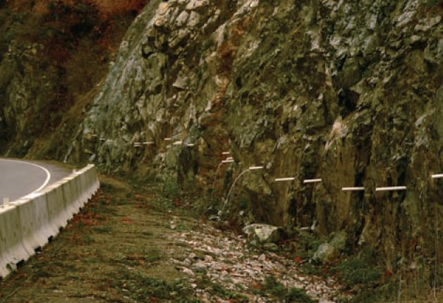
Prevention of Landslides
Complete prevention is impossible but certain engineering practices can minimize the hazard:
Drainage Control
- The objective is to remove excess water from the soil by pipes and drains.

Slide 54
Prevention of Landslides
Levelling the Slope
- Material from the upper slope can be moved to the slope base with modern technology.
Slope Supports
Examples of these include retaining walls, rock bolts, and metal screens.

Slide 55
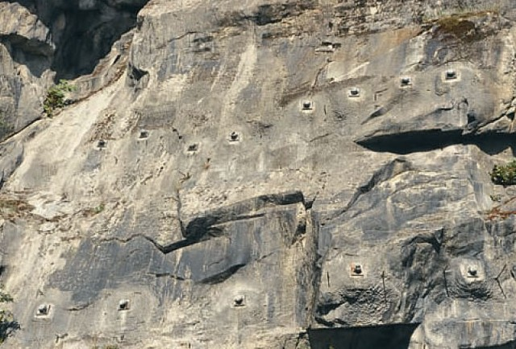
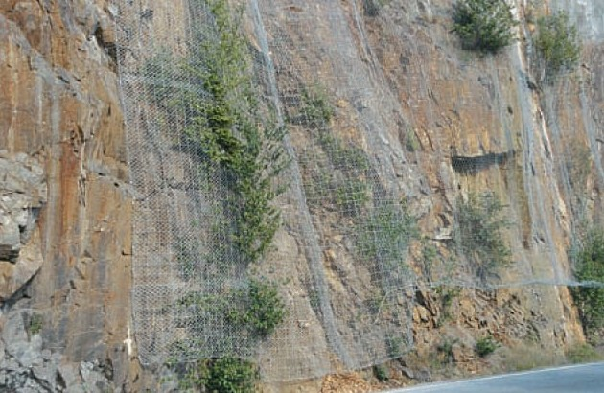
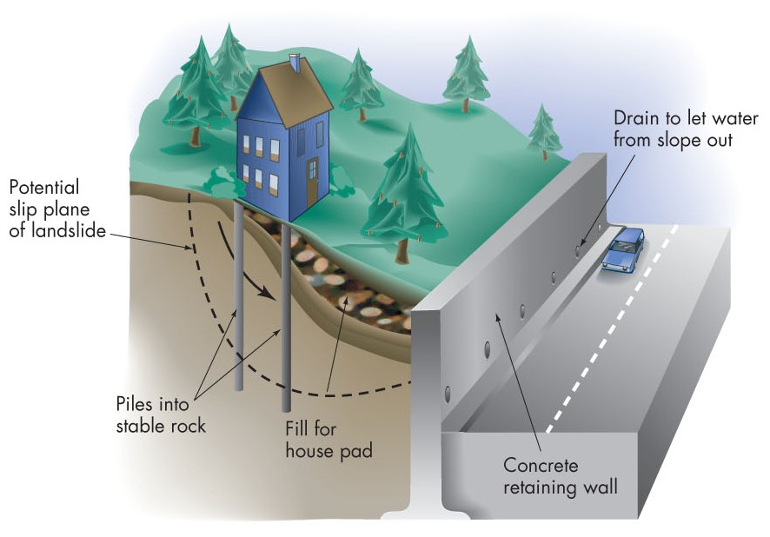
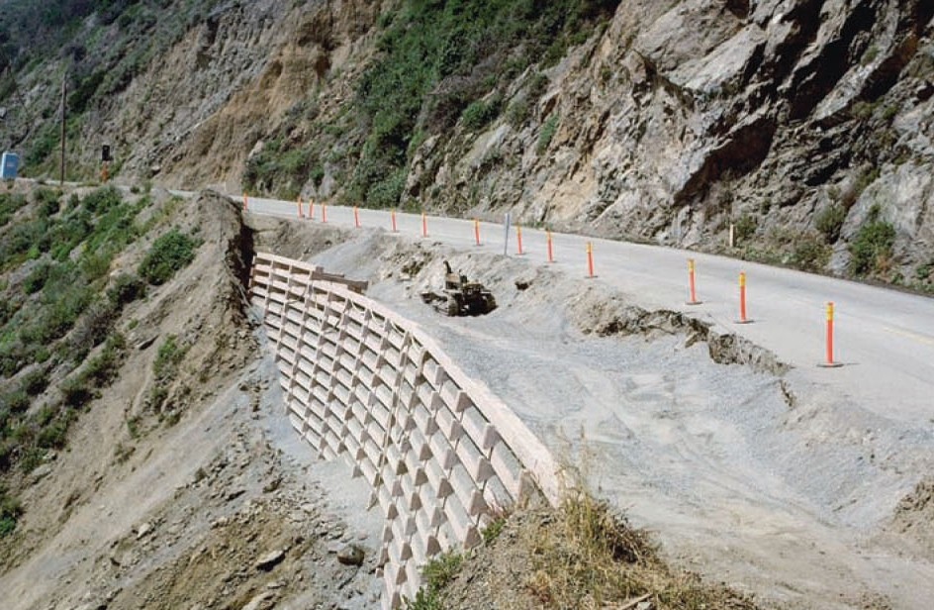
Slope Supports

Slide 56
Landslide Warning Systems
Tiltmeters are currently used to detect vibrations along a slope.
Measure small changes from the horizontal level (is angle changing of slope)
Some rock fences along railways in western North America are linked to signal systems.
Rain gauges on slopes can identify when a precipitation threshold has been reached.
Notes:
Tiltmetres – measure small changes from the horizontal level

Slide 57
Perception of the Landslide Hazard
The relative infrequency of large landslides tends to reduce awareness of this hazard.
It is especially a concern where evidence of past events is not visible.
People continue to build in areas prone to landslides.
This requires adjustments in order to minimize deaths and property damage.

Slide 58
Adjustments to the Landslide Hazard
It is crucial to safely cite critical facilities (hospitals, schools, power plants, etc) away from landslide-prone areas.
Reducing water pressure by way of good drainage is the best corrective measure to counter the hazard since this will decrease the driving force.
Analyzing landslide hazard maps and avoiding the purchase of a home in a hazardous area is the best way to reduce risk.

