Slide 1
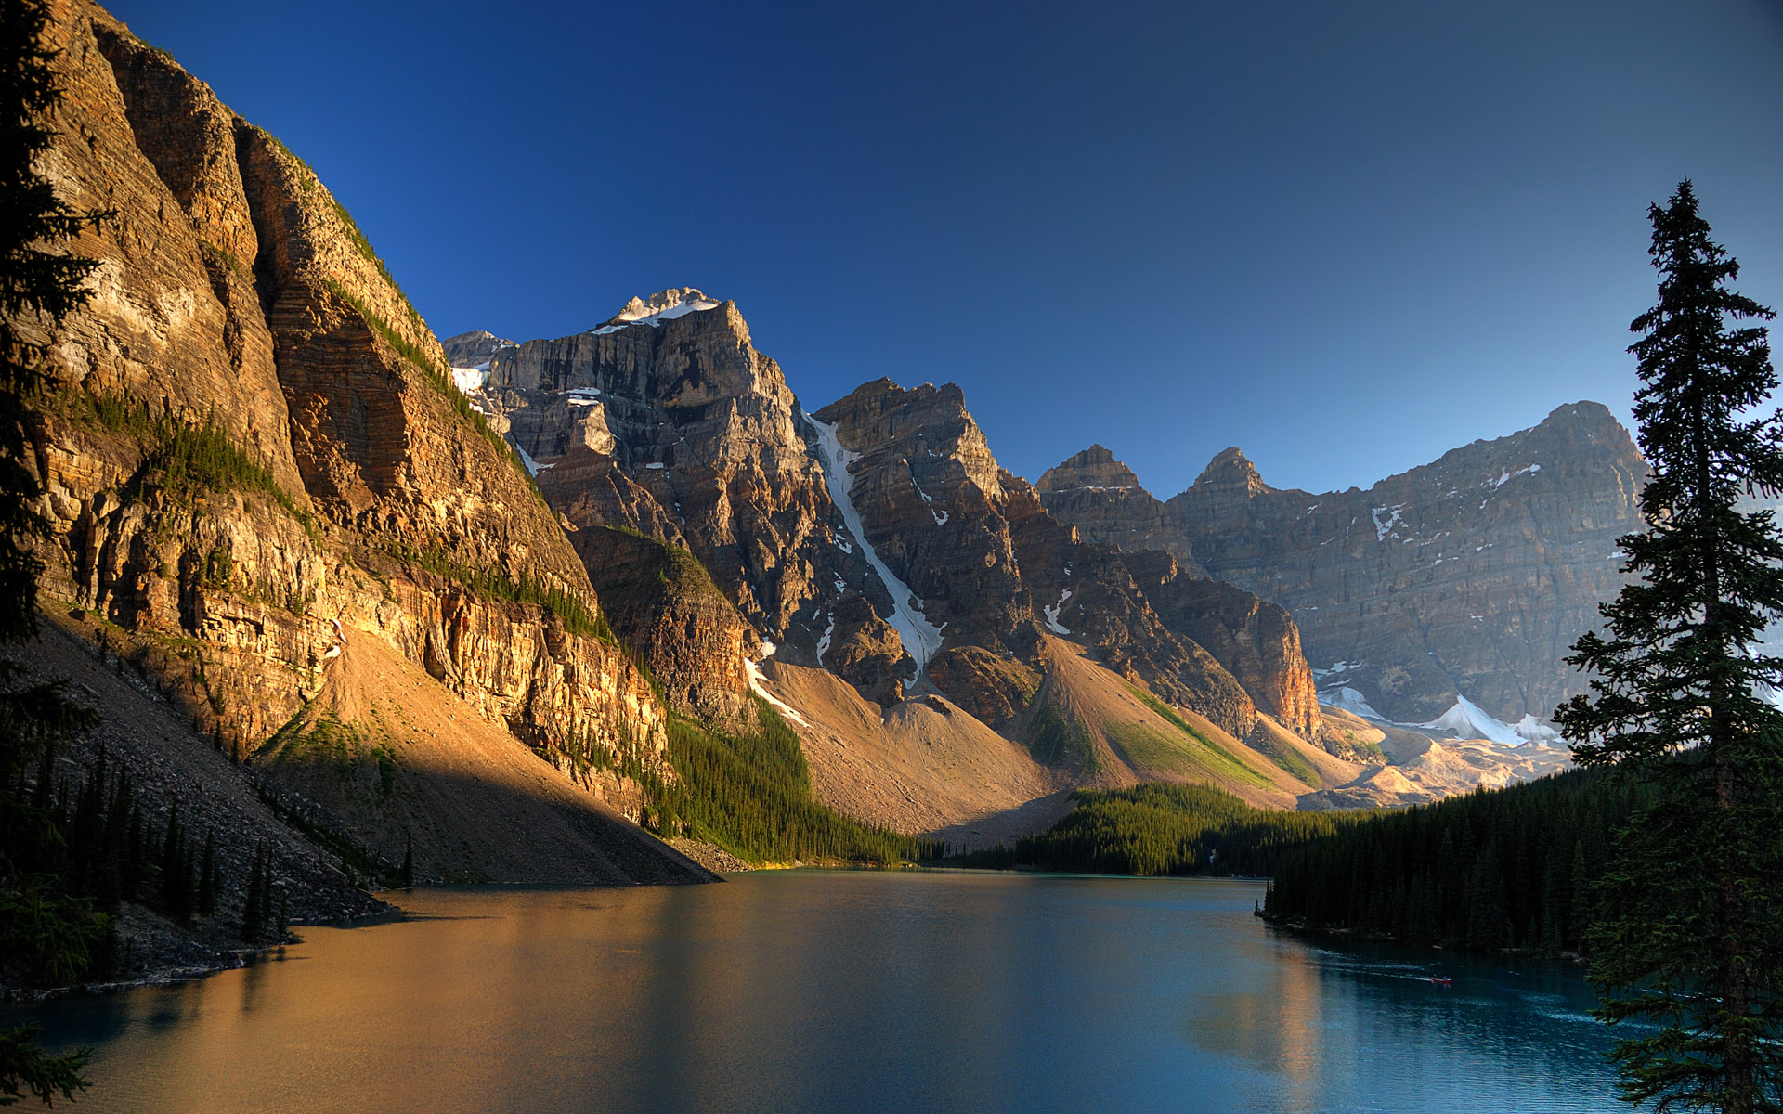
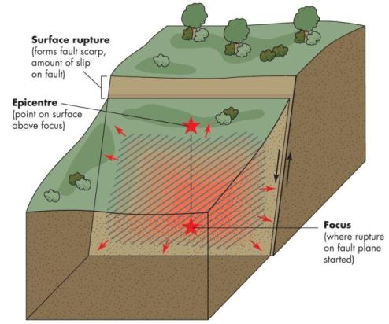
Earthquakes
They result from the rupture of rocks along a fault.
Energy from an earthquake is released in the form of seismic waves.
They are mapped according to the epicentre; the focus is located directly below the epicentre.
They are measured by
seismographs and compared
by magnitude

Slide 2
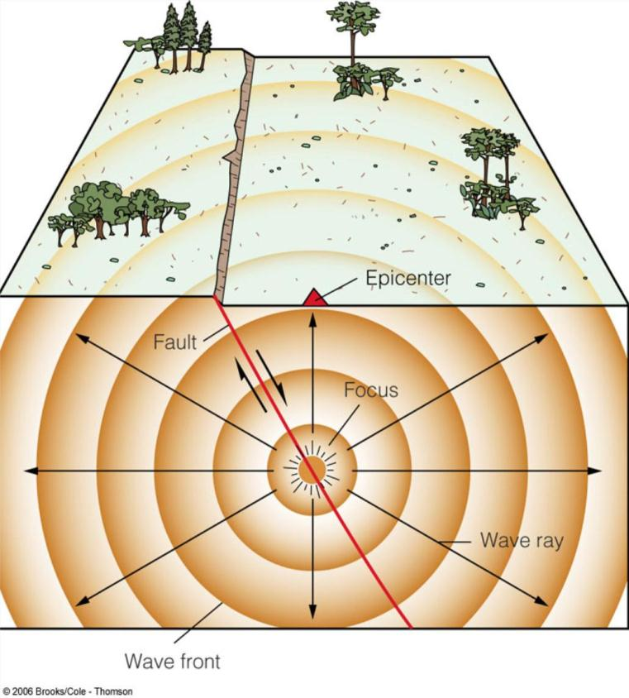
Earthquakes

Slide 3
Earthquake Magnitude
The magnitude of an earthquake is expressed as a number to one decimal place.
This type of measurement was first developed by Richter in 1935.
The Richter Scale was a measure of the strength of a wave at a distance of 100 km from the epicentre.
Since then, more accurate methods have been developed and the Richter Scale is no longer in use.

Slide 4
The Moment Magnitude Scale
Today, earthquakes are measured using the Moment Magnitude scale (M).
The scale is determined by:
-the area ruptured along a fault
-the amount of movement long the fault
-the elasticity of the crust at the focus
Similar to the Richter Scale, it is a logarithmic scale.
Example: An M7 earthquake represents 10 times the amount of ground motion as an M6 earthquake.

Slide 5
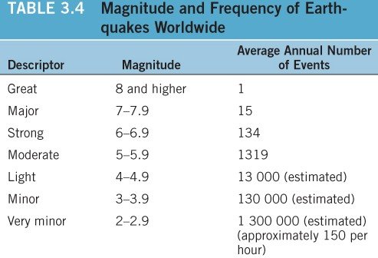
Magnitude and Frequency of Earthquakes
Except for very large earthquakes, the magnitude on the Moment Magnitude Scale is similar to the Richter Scale.
The strongest earthquake to
ever occur is M9.5 in Chile
in 1960. In Canada, it is
M8.1 in B.C. in 1949.
There are only a few M9+
earthquakes each century.

Slide 6
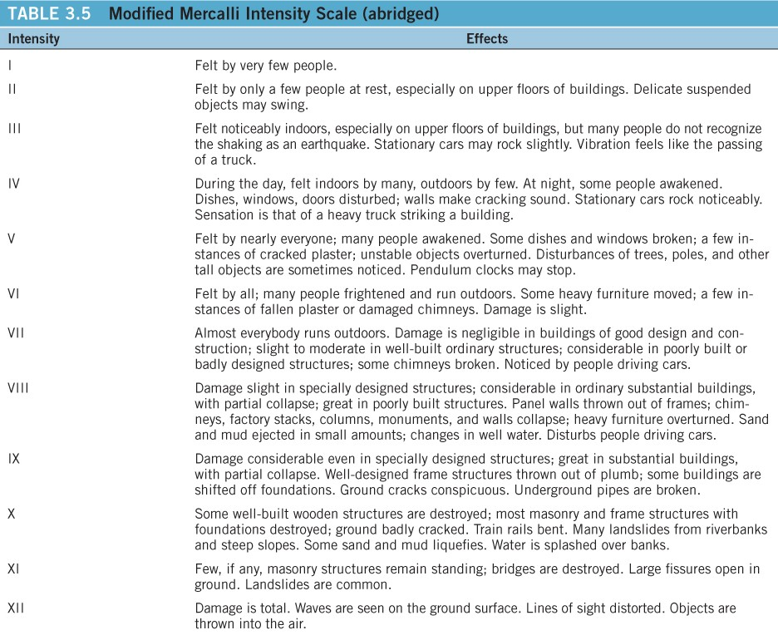
Earthquake Intensity
The Modified Mercalli Intensity Scale is a qualitative scale based on damage to structures and the affect on people. It is based on 12 categories.

Slide 7
Earthquake Processes
Earthquakes are most common at or near plate boundaries.
Motion at plate boundaries is not usually smooth or constant.
Friction along plate boundaries events a force (stress) on the rocks, exerting strain or deformation.
When the stress exceeds the strength of the rocks, there is a sudden movement along a fault.

Slide 8
Earthquake Processes
The movement (or rupture) starts at the focus and propagates in all directions, called seismic waves.
Thus, faults are considered seismic sources.
Identifying faults is necessary to evaluate the risk of an earthquake in a given area.
Not all faults reach the Earth’s surface. Blind faults are located below the surface.

Slide 9
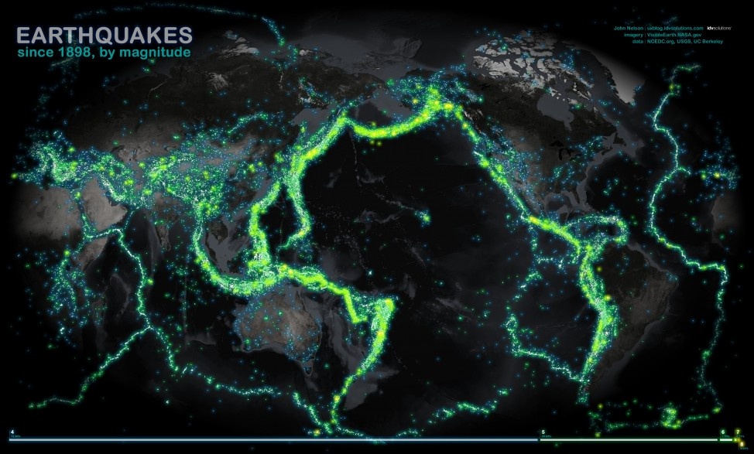
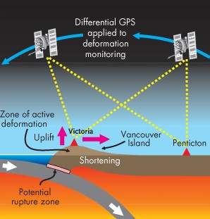
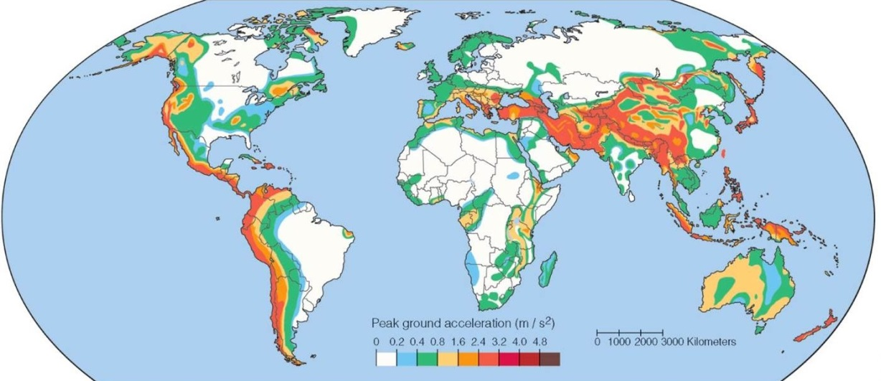
Earthquake Distribution

Slide 10
Fault Types
There are two basic types of geologic faults distinguished by the direction of the displacement of rock or sediment.
Strike-slip faults
-displacements are horizontal
Dip-slip faults
-displacements are vertical

Slide 11
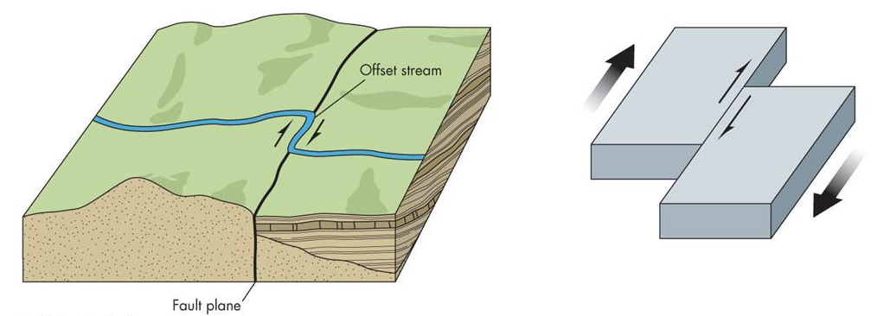
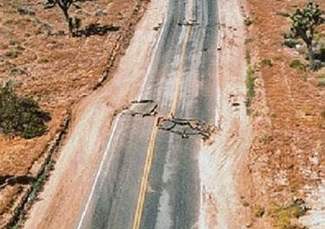
Strike-Slip Faults
The San Andreas Fault is the best example of this type.

Slide 12
Dip-Slip Faults
There are three types:
-reverse-faults, thrust faults, and normal faults
They are comprised of two walls on an incline defined by miners:
-Footwall (Where miners placed their feet)
-Hanging-wall (where miners placed their lanterns)

Slide 13
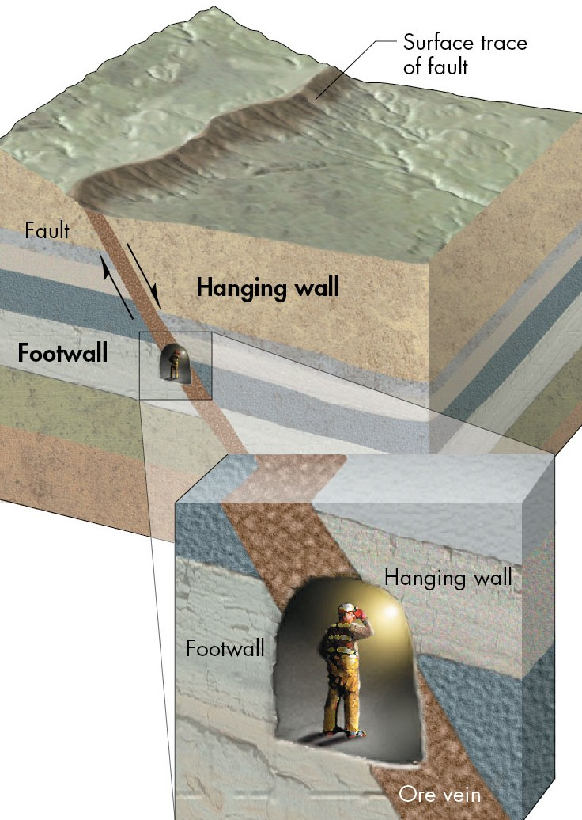
Dip-Slip Faults

Slide 14
Dip-Slip Faults
Reverse Fault:
The hanging wall has moved up relative to the footwall inclined at an angle steeper than 45 degrees
Thrust Fault:
These are similar to reverse faults except the angle is 45 degrees or less
Normal Fault:
The hanging wall has moved down relative to the footwall.

Slide 15
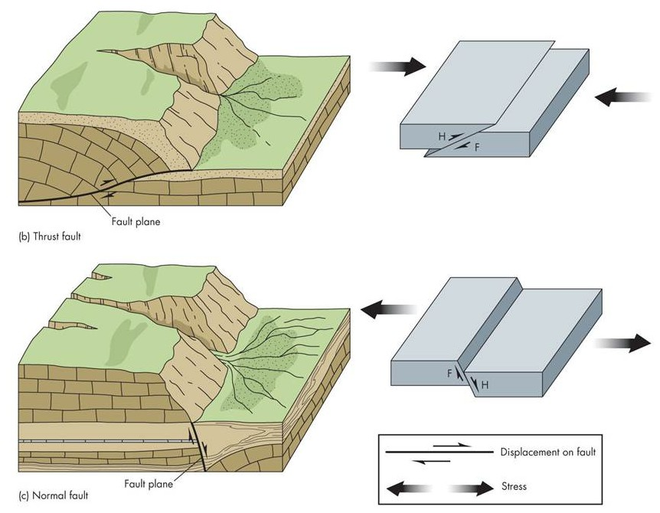
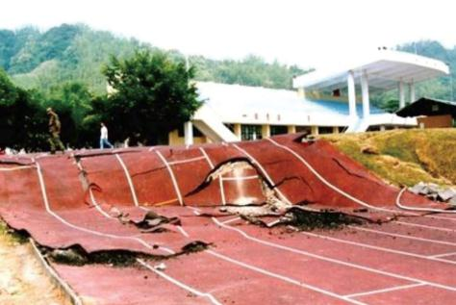
Dip-Slip Faults

Slide 16
Fault Activity
In terms of activity, faults can fall into one of three categories:
Active
-Movement during the past 11,600 years
Potentially Active
- Movement during the past 2.6 million years
Inactive
-No movement during the past 2.6 million years

Slide 17
Tectonic Creep
Definition:
The slow movement of rock or sediment along a fracture caused by stress.
It is also referred to as fault creep.
This can damage roads and building foundations (movement of a few cm per decade).
Along these faults, periodic sudden displacements producing minor earthquakes can also occur.

Slide 18
Seismic Waves
Some seismic waves generated by fault rupture travel within the body of the Earth and others travel along the surface.
Body waves: These include P waves and S waves
P waves
They are also called primary or compressional waves
They move fast with a push-pull motion and can travel through solids or liquids

Slide 19
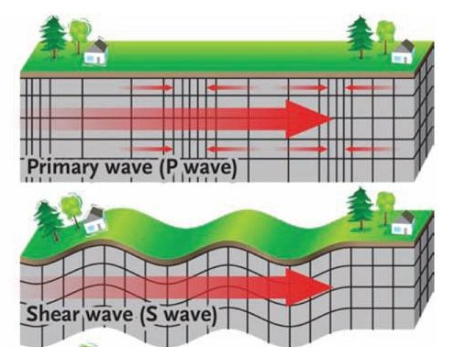
Seismic Waves
S waves
They are also called secondary or shear waves.
They move more slowly, in an up-and-down motion and can only travel through solids.

Slide 20
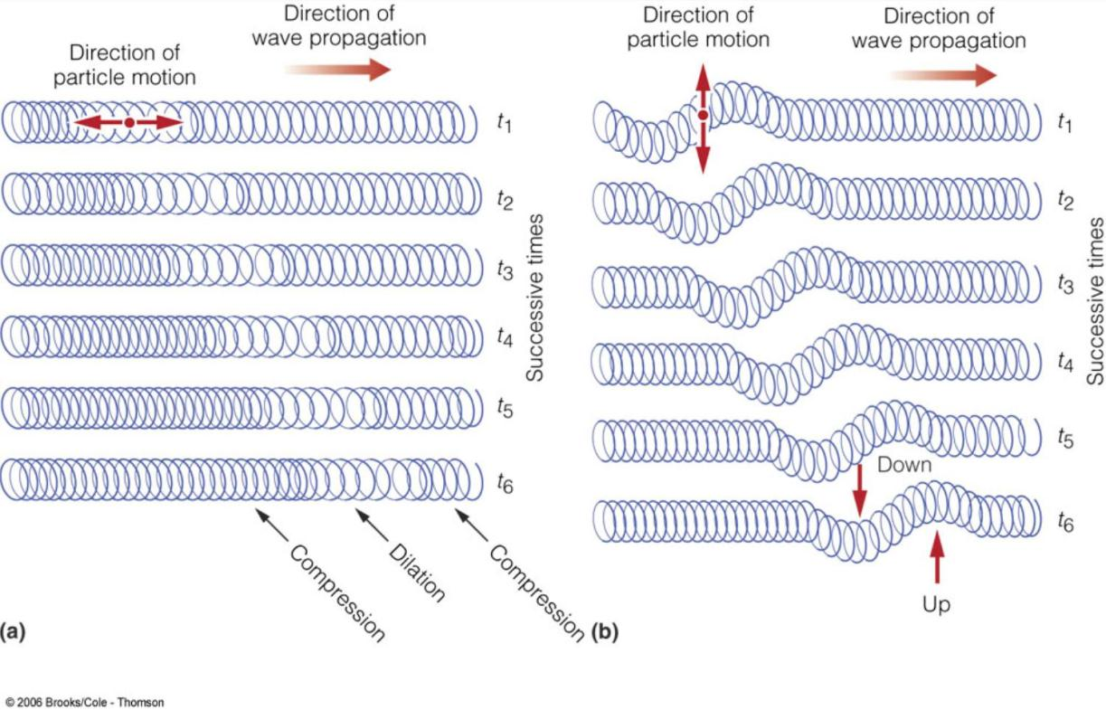
Seismic Waves
P waves S waves

Slide 21
Surface Waves
Definition:
Seismic waves that form when P and S waves reach Earth’s surface and then move along it.
These waves move more slowly than body waves.
Surface waves are responsible for damage near the epicenter.

Slide 22
Earthquake Shaking
Factors that determine the shaking people experience during an earthquake (in order of importance):
-magnitude
- Distance to the epicenter
-focal depth
-direction of rupture
-local soil and rock types
-local engineering and construction practices

Slide 23
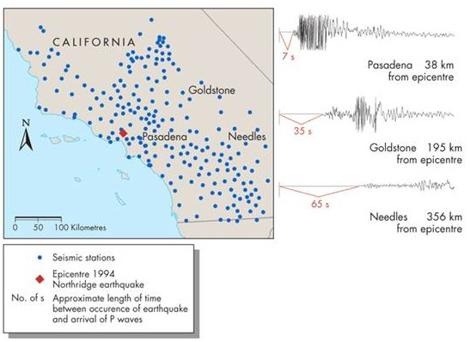
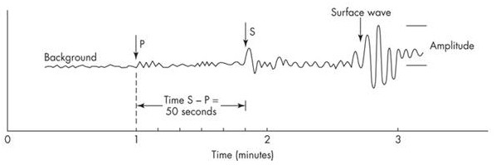
Earthquake Shaking
Seismographs record the arrival of waves to a recording station.
Because P waves travel faster than S waves, they appear first on a seismogram
Earthquake shaking decreases with distance from the epicenter

Slide 24
Distance to the Epicentre
The difference between the arrival times of the first P and S waves at different locations determine the distance to the epicentre.
The distance to the epicenter is calculated at 3 different seismic stations.
A circle with radius equal to that distance is drawn around the station.

Slide 25
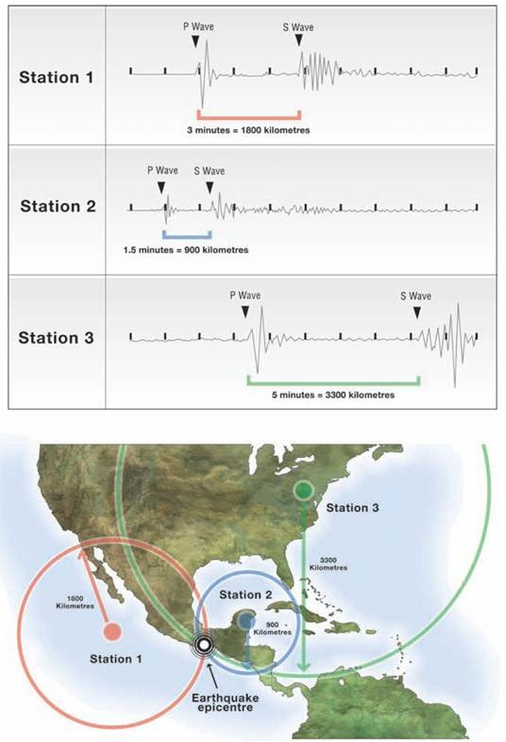
Locating an Earthquake
The epicentre is located where the circles intersect; this process is called triangulation.

Slide 26
Focal Depth
Seismic waves become less intense as they spread outward toward the surface.
Therefore, the greater the focal depth, the less intense the shaking at the surface.
The reduction of energy is referred to as attenuation.

Slide 27
Direction of Rupture
Earthquake energy is focused in the direction of rupture.
This is known as directivity and contributes to increased shaking.
Radiated waves are sometimes stronger in the direction along the fault.

Slide 28
Local Soil and Rock Types
The local geology influences the amount of ground motion.
Dense homogeneous crust (bedrock) can transmit earthquake energy quickly
Seismic energy slows down in areas with heterogeneous, folded, faulted crust.
Implication:
Earthquakes in eastern North America are felt over larger areas than those in western North America

Slide 29
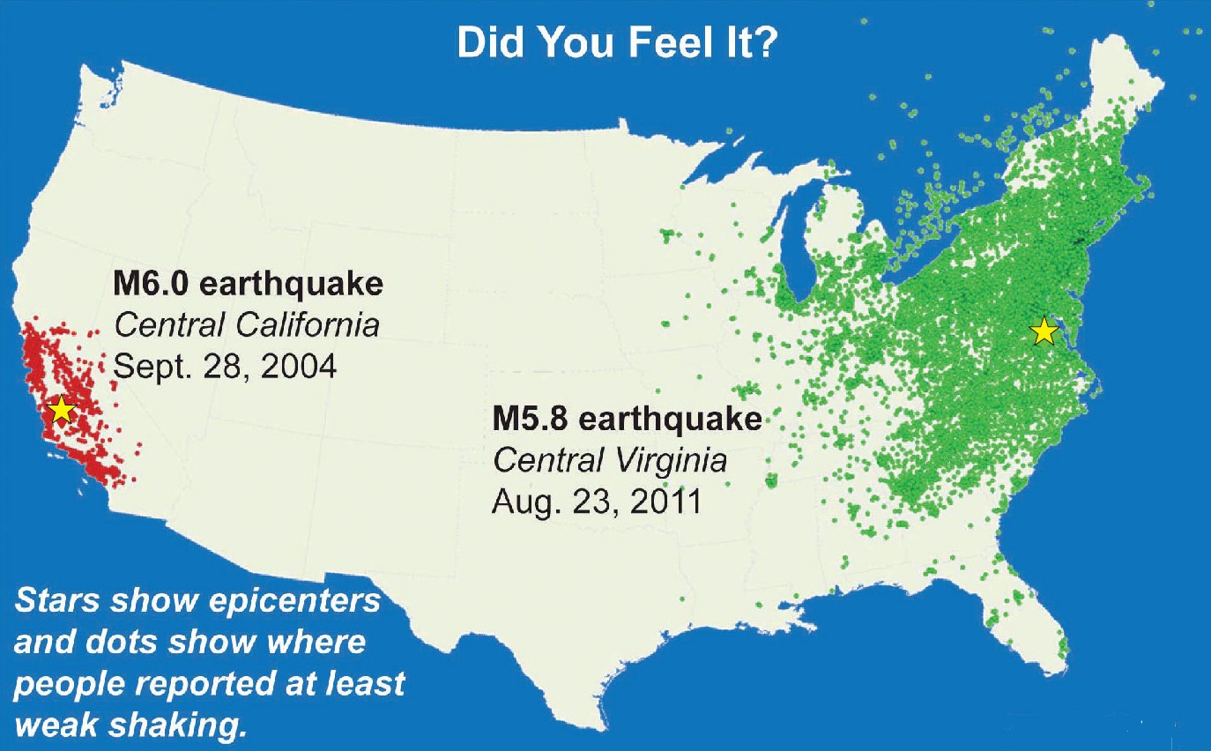
Shaking by Region

Slide 30
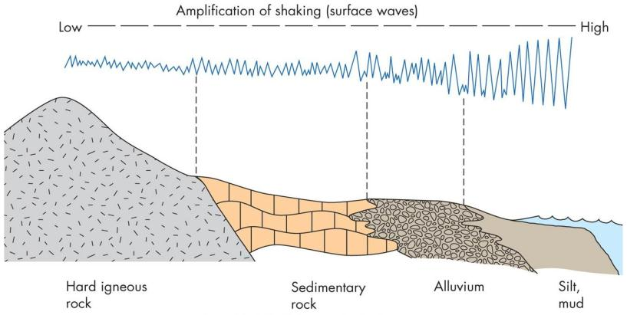
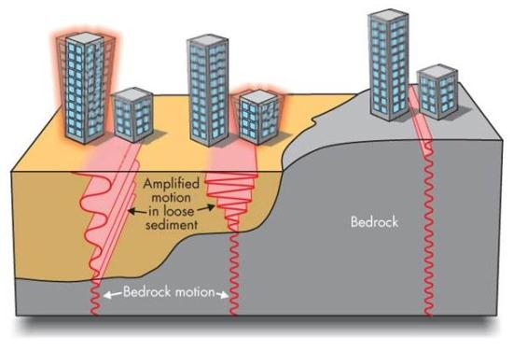
Amplification
Definition:
An increase in ground motion during an earthquake
P and S waves slow as they travel through alluvial (deposited by water) sand, gravel, clay, soil, etc.
As the waves slow, some of their energy is transferred to surface waves.
Notes:
Alluvial: Material that was deposited by water

Slide 31
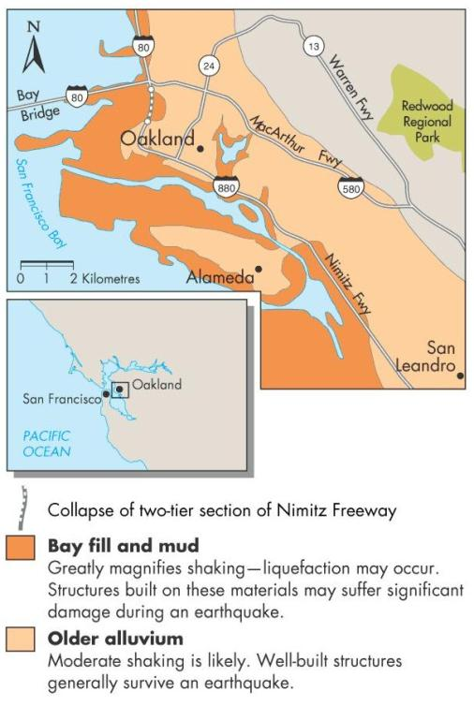
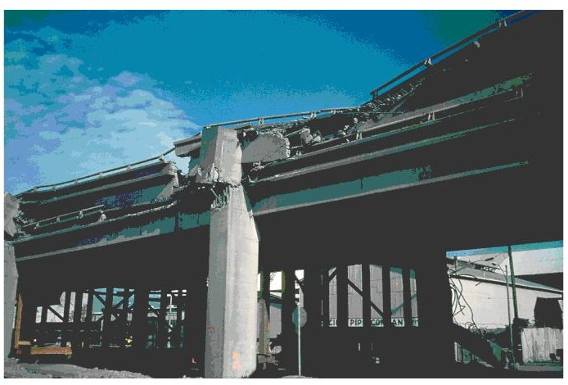
Amplification
Amplification has historically enhanced damage in San Francisco area earthquakes.

Slide 32
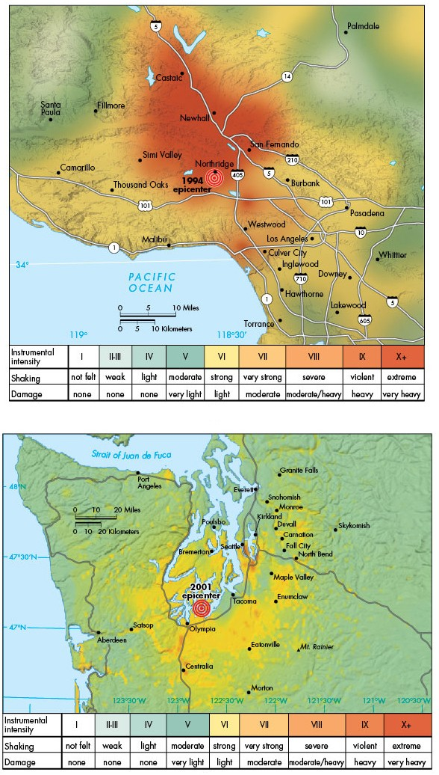
Shake Maps
The combination of all of these effects results in widespread variation of the shaking felt in the vicinity of an earthquake.
Therefore, 2 earthquakes that have the same magnitude can have very different impacts

Slide 33
The Earthquake Cycle
Definition:
A hypothesis that explains successive earthquakes on a fault
It is based on the idea that strain drops abruptly after an earthquake and then slowly accumulates until the next earthquake.
As stress continues to increase, the deformed material will eventually rupture.

Slide 34
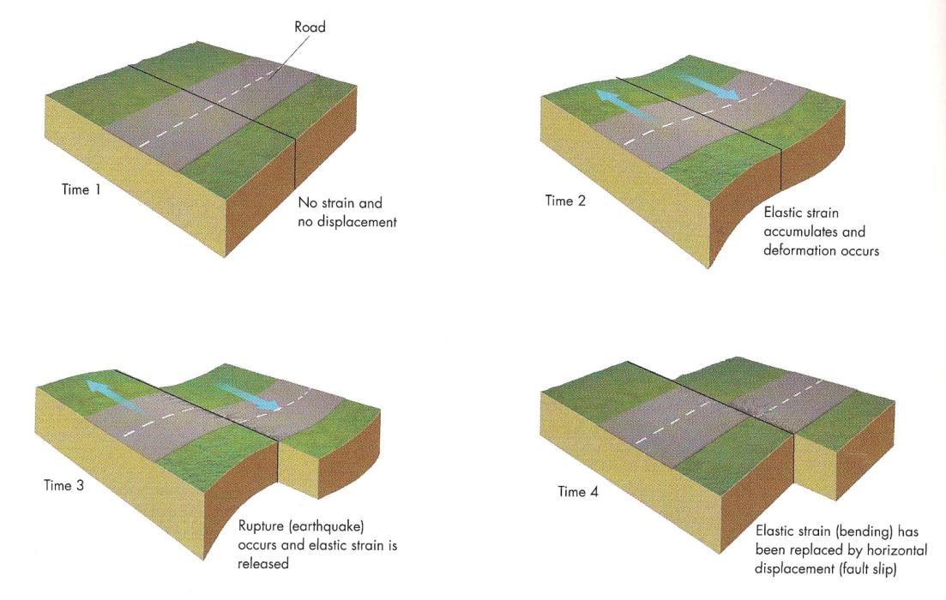
The Earthquake Cycle

Slide 35
The Earthquake Cycle
A typical cycle has several stages:
- an inactive period
A period where strain produces minor earthquakes
A period of foreshocks prior to a major release of stress (this stage does not always occur)
Notes:
Foreshock- a small to moderate (M4 or M5) earthquake that occurs before and in the same general area as the mainshock
Mainshock- The largest earthquake in a series of associated earthquakes

Slide 36
The Earthquake Cycle
- a period where the mainshock occurs allowing the fault to release built-up stress
-a period of aftershocks with epicenters in the same general area as the mainshock
The time between each stage varies.

Slide 37
Geographic Regions at Risk from Earthquakes
Earthquakes are not randomly distributed.
Most earthquakes occur along plate boundaries:
Pacific Ring of Fire, Himalayan Mountains, Middle East
North American cities at high risk of earthquakes:
Anchorage, Vancouver, Victoria, Seattle, Portland, San Fransisco, Los Angeles, Mexico City
However, not all areas at risk of earthquakes are near plate boundaries.

Slide 38
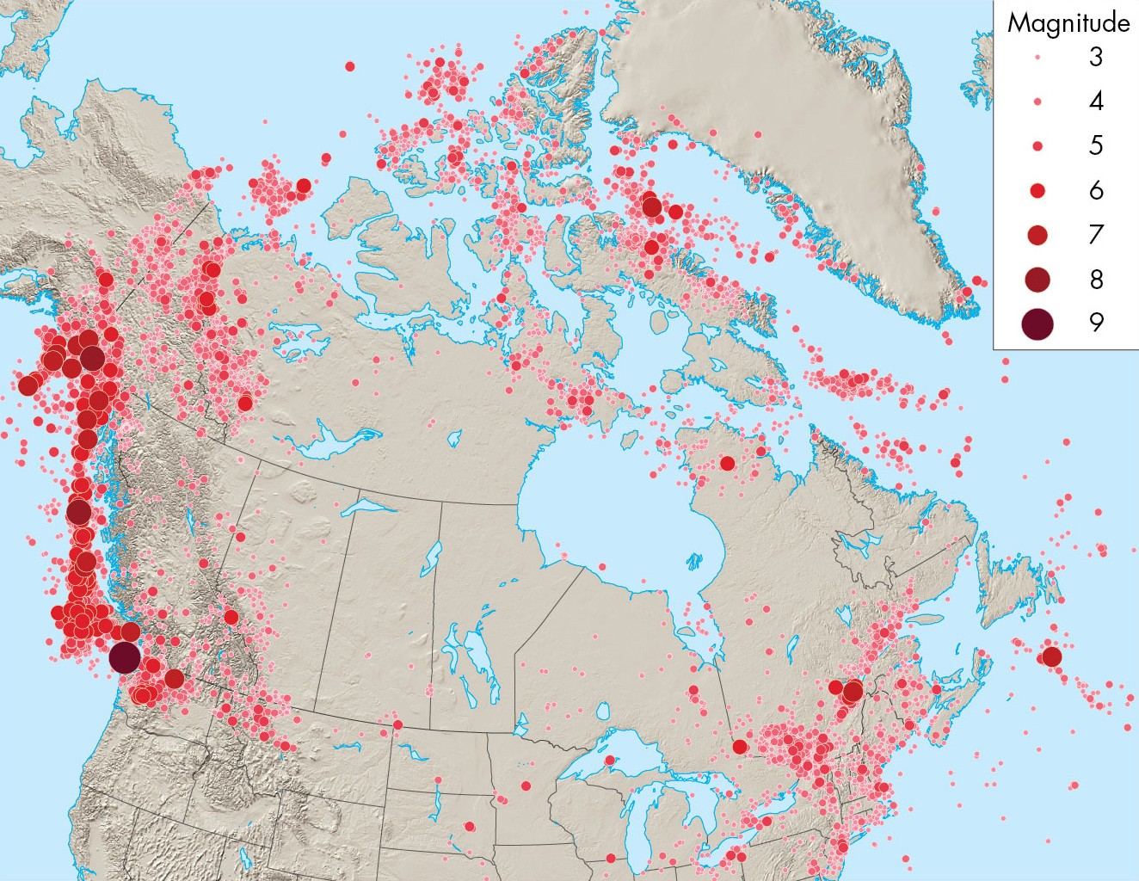
Earthquakes in Canada

Slide 39
Plate Boundary Earthquakes
Definition:
Earthquakes that occur on faults separating lithospheric plates.
There are three types:
-Strike-slip earthquakes
-Thrust earthquakes
-Normal fault earthquakes

Slide 40
Strike-Slip Earthquakes
These earthquakes occur along transform faults where plates slide horizontally past one another.
They are common in California along the San Andreas fault.
The best known strike-slip earthquake is the Loma Prieta earthquake that disrupted the 1989 World Series in Oakland, California.

Slide 41
Thrust Earthquakes
These earthquakes occur on faults that separate converging plates.
They are also called subduction earthquakes.
They are common off the coast of B.C., Washington, and Oregon
These earthquakes are the strongest on Earth (some are larger than M9) and can produce tsunamis.

Slide 42
Normal Fault Earthquakes
These earthquakes occur on faults associated with divergent plate boundaries.
They are common along the mid-Atlantic Ridge
Most are located under oceans and are generally smaller than M6.

Slide 43
Intraplate Earthquakes
Definition:
An earthquake on a fault in the interior of a continent, far from a plate boundary (Eg. In Ontario)
These earthquakes are typically smaller than plate boundary earthquakes.
However, damage could be considerable due to lack of preparedness

Slide 44
Intraplate Earthquakes
Because of dense continental bedrock, these earthquakes are felt over large areas.
There are two relatively active intraplate zones in North America: Central Mississippi River Valley, and St. Lawrence River Valley
The New Madrid earthquakes in Missouri (1811-12) were over M7.5 and felt over the entire continent.
The recurrence interval in this area is likely several hundred years.

Slide 45
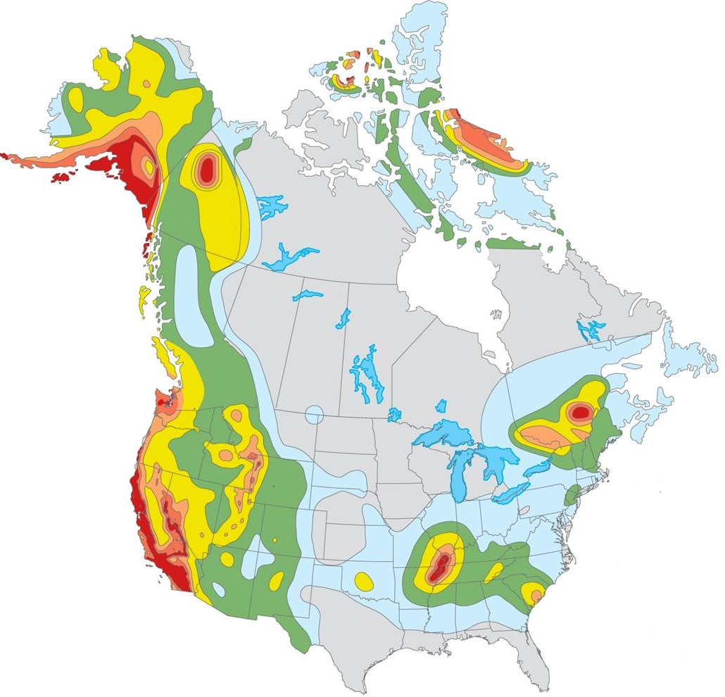
Earthquake Hazard Map

Slide 46
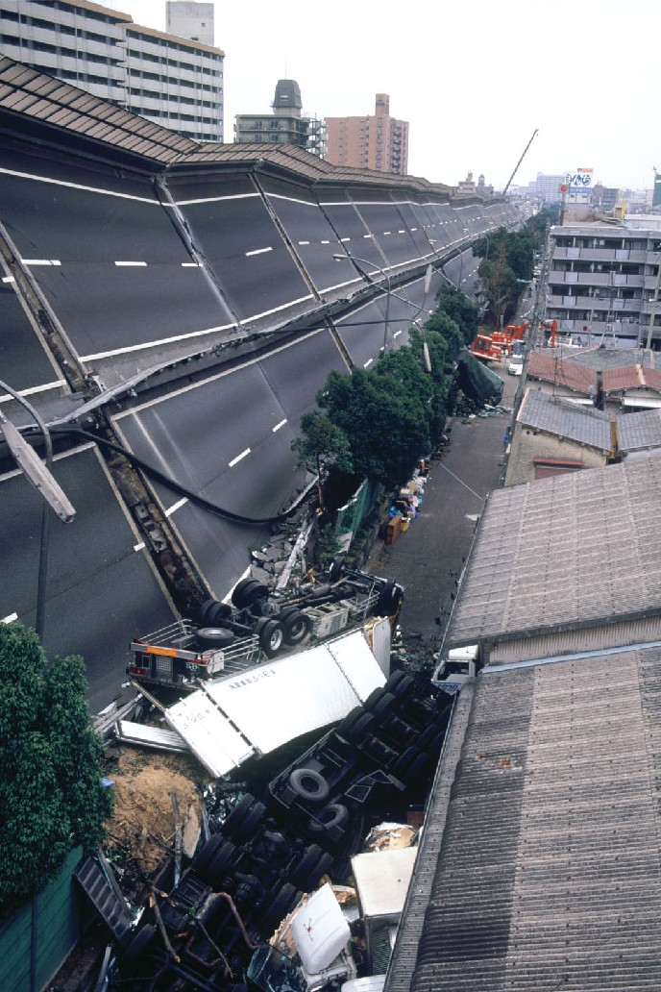
Effects of Earthquakes
Several different effects related to earthquakes contribute to deaths and property destruction.
Primary effects:
Ground shaking, surface rupture
Secondary effects:
Liquefaction, land-level change, landslides, fire, tsunamis
Notes:
Recurrence interval- time between successive events

Slide 47
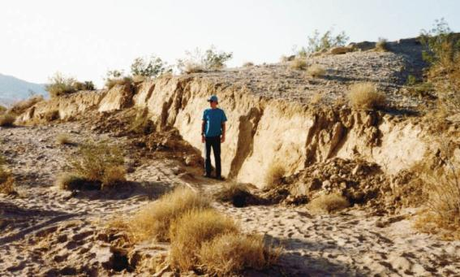
Ground Rupture
Displacement along faults causes cracks in the surface.
During strong earthquakes, fault scarps can be produced that extend for hundreds of kilometers
Notes:
Fault Scarp- linear escarpment at earths surface, formed by movement along a fault, that only forms during an earthquake.

Slide 48
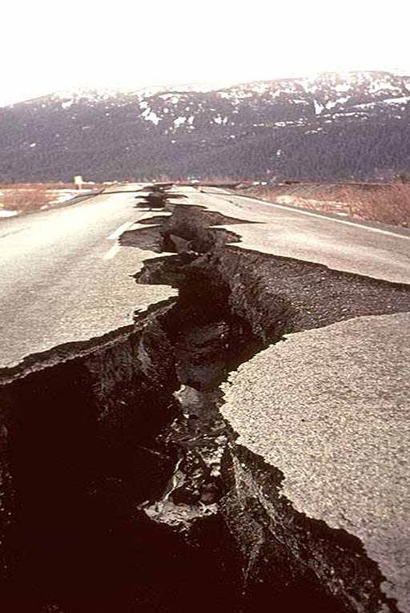
Ground Rupture
Ground rupture can uproot trees, collapse buildings, and destroy bridges, tunnels, and pipelines.

Slide 49
Liquefaction
Definition:
The transformation of water-saturated sediment from solid to liquid
This may occur during strong earthquakes when water pressure becomes high enough to suspend particles of sediment within the soil.
Once the pressure decreases, the sediment compacts and regains its strength.

Slide 50
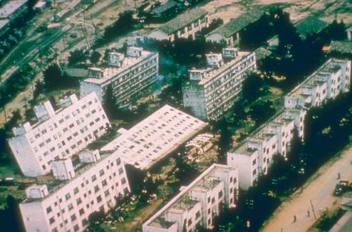
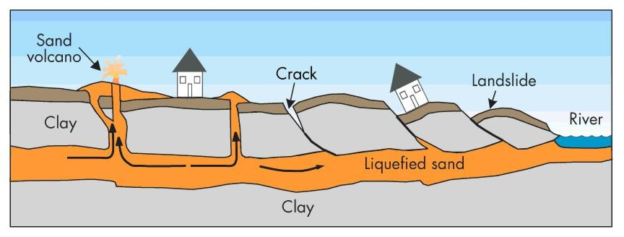
Liquefaction
Watery sand and silt may flow upward along fractures in the overlying solid material.
This effect can cause extensive damage.

Slide 51
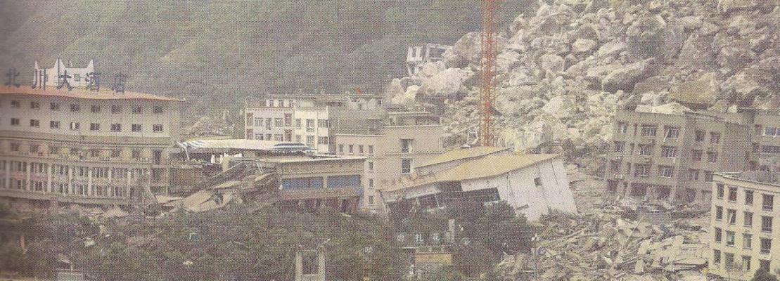
Landslides
Ground motion produced by an earthquake can cause rock and sediment to move downslope.
A single earthquake in a mountainous area can cause thousands of landslides.

Slide 52
Fires
Ground shaking and rupture can sever power and gas lines, starting fires.
Appliances may topple over causing gas leaks that ignite
80% of the damage during the 1906 San Francsisco earthquake was caused by fire.

Slide 53
Natural Service Functions of Earthquakes
Faults provide pathways for the downward flow of surface water.
They can channel groundwater to surface discharge points (springs)
New mineral resources can be found- some minerals are preferentially deposited in faults
Scenic landscapes (hills, valleys) can develop in fault zones over millions of years.

Slide 54
Earthquakes Caused by Human Activity
Several human activities are known to trigger small to moderate earthquakes.
The weight from water reservoirs produced by dams can create new faults
Injecting liquid waster deep in the Earth can increase pressure and cause slippage along fractures
Testing nuclear weapons leads to explosions that may increase strain in an area.

Slide 55
Minimizing the Earthquake Hazard
Earthquakes cause death and destruction because they often occur with little warning.
At present, we can forecast the likelihood that an earthquake will occur in an area, but not exactly when it will occur.
The Geological Surveys of Canada and the U.S. are developing programs to reduce the hazard from earthquakes.

Slide 56
Earthquake Hazard Reduction Programs
The programs have 5 goals:
- improve national seismograph networks
develop awareness of earthquake sources
Determine earthquake potential
Predict effects of earthquakes on buildings
Communicate research to educate the public

Slide 57
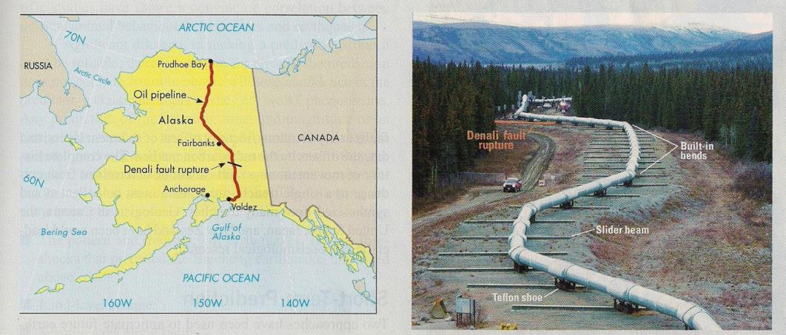
Planning for Earthquakes
The Denali earthquake in Alaska (2002) demonstrated the value of planning for earthquakes
Where the Trans-Alaska oil pipeline crossed the Denali fault, its construction was altered to withstand a large earthquake.

Slide 58
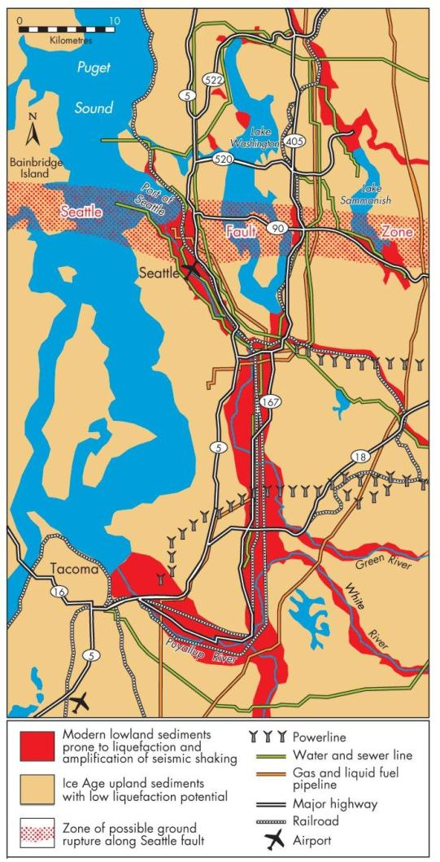
Estimating Seismic Risk
Hazard maps identify areas of risk associated with earthquake effects.
They include areas prone to liquefaction, zones of possible ground rupture, and historic epicenters

Slide 59
Precursors to Earthquakes
If accurate predictions are possible, they will most likely be based on precursors:
1. The pattern and frequency of earthquakes
-based on foreshocks and microearthquakes
2. Land-level change
Uplift or subsidence may precede earthquakes
-GPS stations can recognize small changes in elevation.

Slide 60
Precursors to Earthquakes
3. Seismic gaps along faults
-Areas along a fault that have not seen recent earthquakes mat be more likely to experience one
4. Physical and chemical changes
-changes in groundwater levels and chemistry may occur if rocks expand prior to an earthquake.

Slide 61
Earthquake Forecasting
There have been modest incidences of successfully forecasting earthquakes.
All forecasts must be scientifically reviewed before they are released.
Research projects along the San Andreas Fault are aiding in understanding the conditions that occur before an earthquake.
Current earthquake warning systems provide 15 to 30 seconds of warning and only warn of an earthquake that has already occurred.

Slide 62
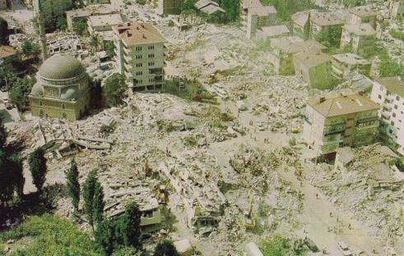
Perception of the Earthquake Hazard
Survivors of strong earthquakes often report traumatic stress.
Typically, one community’s experience with an earthquake has not stimulated other communities to enhance their preparedness.
Earthquakes have exposed
shoddy construction practices.

Slide 63
Community Adjustments to the Earthquake Hazard
It is not possible to prevent people from living in earthquake prone areas.
Therefore, we must take a number of steps to minimize seismic risk:
-Critical facilities should be located as safely as possible
- buildings must be designed to withstand vibrations (in many cases, retrofitting is required)

Slide 64
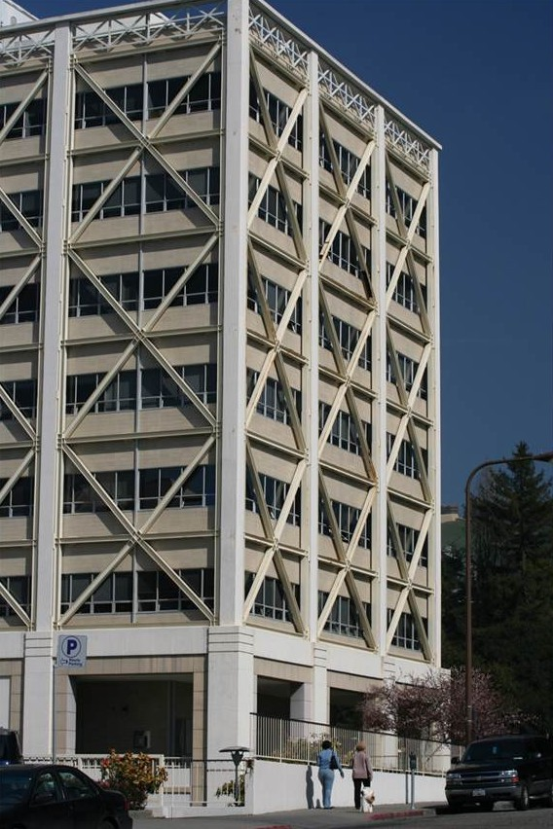

Community Adjustments to the Earthquake Hazard
- education is a component of preparedness (workshops, training sessions, earthquake drills)
-Earthquake insurance should be made available.

Slide 65
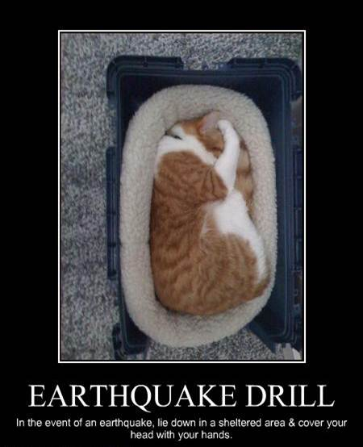
Personal Adjustments
Most earthquake casualties result from building collapse and falling objects.
During an earthquake, it is best to stay away from windows and tall furniture.
The safest locations are under desks and tables.

