Slide 1
Study Slide show
Lecture 1

Slide 2
Lecture 1
What is the definition of disease?
  Disturbance of structure or function of the body
  Associated with characteristic structural changes present in organ and tissues
What is pathology?
  The study of disease
What is pathophysiology?
  Combines the study of disease, structural changes, and functional changes
What is pathogenesis?
  The manner by which diseases develop
All diseases are a diseases of what? What does this entail?
  A diesease of the cells
  This means that diseases can be diagnosed by examining changes at the cellular level
Diseases involve what type of changes in the cells?
  Morphological
What are morphological changes?
  Structural or architectural changes in tissues or organs

Slide 3
What is the basic meaning for the following disease?
  Inflammatory
    Cell injury produces inflammatory response
  Congenital and hereditary
    Disruption in development, genetic abnormalities, chromosomal abnormalities, intrauterine injury, interaction of genetic and environmental factors
  Neoplastic disease
    Abnormal cell growth leads to formation of benign and maignant tumors
  Degenarative
    Aging, abnormal degeneration occurs in advance of aging process
  Metabolic
    Disturbance is metabolic process
  Endocrine
    Imbalance in body’s production of hormones
What is neoplastic disease
  A fancy way to say cancer
Which cancer tends to be the most fatal and why?
  Pancreatic cancer
  Is hard to detect

Slide 4
What is epigenetics?
  The relationship between genetics and the exposure we get throughout life
What does the concept of health and disease is a continuum mean?
  It means that our health is dynamic and changing. Like a sliding scale from good health to serious illness
How do you know something isn’t right? How do diseases manifest?
  Symptoms
  Signs/physical findings
Give 2 examples of symptoms
  Weakness, pain
Are symptoms objective of subjective?
  Subjective
    How people describe how they feel differently
Are signs and physical findings subjective of objective?
  Objective
    An abnormal blood test will be read the same way by 9 of 10 physicians

Slide 5
What area of disease is stuck in subjectivity?
  Mental health disorders
    There are no “tests” to diagnose mental health issues
What 2 things combine to make a diagnosis?
  Signs and symptoms
what are the 7 things involved with a clinical history?
  History of current illness
  Past medical history
  Family history
  Social history
  Review of systems
  Symptoms
  Clinical findings
What is a review of systems?
  Question other systems in the body for presence of symptoms
What are the 2 types of diagnostic tests? What do they involve?
  Invasive
    Invades body, may involve pain, discomfort
  non-invasive
    No risk, minimal risk to patient

Slide 6
What are the 3 types of diagnostic tests for the lab?
  Clinical lab tests
    Looks at constituents and concentrations
    Evalutes orga function
  Microbiologic tests
    Looks for presence of pathogens
  Serologic test
    Looks at presence of antibodies
What diagnostic test is used for electrical activity?
  ECG, EEG, EMG
What is an ultrasound
  Technique for mapping echoes produced by high frequency sound waves into the body; echoes are reflected where there is a change in tissue density
What is an x-ray?
  X-rays are passed through the body different densitied structures absorb vasrious amounts which is depicted as different colors
What are the colors of an x-ray?
  White -> bones, absorb the most
  Black -> structures containing air
  Shades of gray ->fat, msucle
What is a CT scan?
  Images of the body in cross section by rotating the x-ray tube around the patient

Slide 7
When is a ct scan useful?
  When trying to detect abnormalities of internal organs
What is an MRI?
  Magnetic resonance imaging
  Produces computer constructed images of organs and tissues
What is a PET scan?
  Positron emission tomography
  Used to study body function
  An element of the body ie. Glucose is tagged with a positron emitting isotope into the body and the PET scan can pick up it’s activity

Slide 8
What is genetic screening?
  Screening tests to detect gene carriers
  This does not mean you will for sure get the disease, it means you are at risk of it
What is amnioventesis?
  Inserting a hollow needle through the abdominal wall into the uterus and withdrawling a small about of fluid from the sac surrounding the fetus
What is the purpose of a pathologist?
  Determine normal cells from abnormal
What is a biopsy
  A small sample of tissue from the affected area for testing
What is the purpose of screening tests?
  To detect early asyptomatic disease amenable to treatment usually suggested to an “at risk” population
Give an example for the above?
  Mamograms are recommended yearly to women above a certain age
What are the 3 requirements for screening tests?
  A significant #
  Relatively inexpensive noninvasive test
  Early id and treatment is favourable for the individuals

Slide 9
Lecture 2
Name 6 characteristics of a cell
  Semi-permeable membrane
  Organelles
  Nucleus
  Homeostasis
  Cell-environment communication
  Cell function-tissue
What is a phenotype?
  Biological trait not secondarily aquired
If a phenotype is transmissible between different generations it is considered?
  Heritable
What is a genotype?
  Genetic basis for a hereditary phenotype
List 3 environment-gene interactions
  Virus
  Ionizing radiation
  Epigenetic (alteration of gene expression)
What is a gene?
  Genetic information store
What is mRNA?
  Gene readout message

Slide 10
What is tRNA?
  Adaptor molecule, matches mRNA with amino acid
What is rRNA?
  Enzymatic complex that directs polypeptides assembly
DNA is arranged in ?
  Chromosomes
what is the chromosome nomenclature?
  Short arm: p arm
  Long arm: q arm
  G bands numbered to proved addresses for the ass. Of gene loci
What is the application of fluorescent lables/ stains and karyotype
  Determination of sex, chromosome numerical abnormalities. Fragmented chromosomes
  To see what stage of mitosis/meosis the cells are in
Define cell injury:
  Change in cell structure or functioning in response to a stressor, cell is unable to compensate through normal physiological adaptive mechanisms
What 2 things effect the degree of injury?
  The intensity (severity and duration), the cell vulnerability

Slide 11
What are the 2 ways cells respond to stress? Give an example with sun light
  Adapt
  Don’t adapt -> injury occurs
  i.e sun -> increased melanocytes = adaptation vs. to much sun -> burn = injury
What are the 3 ways cells can adapt?
  Gene expression
  Metabolism
  Protein function
What are 2 other more serious ways cells can adapt?
  Necrosis
  Apoptosis
List 7 disease-producing cellular stresses
  Hypoxia
  Chemical injury
  Physical agents
  Infection
  Immune reactions
  Nutritional imbalance
  Genetic abnormalities
Stressors may be of what 2 origins?
  Endogenous or exogenous (from within or without)

Slide 12
What is hypoxia and what are the causes and what is the result?
  Depriving tissue of oxygen
  Interrupted blood flow (arm trapped under a tree)
  Pulmonary disease of hypoventilation (the lungs can’t absorb enough oxygen)
  Heart failure (the heart can’t pump the blood around)
  Impaired oxygen carrying capacity (the RBC are abnormal or damaged)
  Depletes ATP and generates oxygen-deprived free radicals
What are the 2 ways chemical injury can stress cells?
  Direct injury from the chemical
  Parent compound harmless -> metabolites toxic
What are the 3 ways infection can stress cells?
  Replicating inside the host cells and disrupting the structural integrity
  Producing a toxin
  Triggering inflammatory or immune response

Slide 13
What are 5 adaptive structural changes?
  Cell swelling
  Intracellular accumulations
  Calcification
  Enzyme leakage
  Cell death
What are 5 common adaptive mechanisms to changing conditions?
  Atrophy
    Decrease in cell size , may also be a reduction in cell number
  Hypertrophy
    Increase in cell size
  Hyperplasia
    Increase in cell number
  Metaplasia
    Change from one cell type to another, reversible if stressor is removed (pre-malignant change)
  Dysplasia
    Disordered cellular morphology, organization, function, loss of cellular differentiation (pre-malignant change)
  Increased enzyme sythesis
    Inactivate or detoxify drugs or chemicals by means of enzymes present in the SER

Slide 14
What accompanies necrosis?
  Inflammation and secondary injury to surrounding tissue
What are 2 structural changes that accompany necrosis with secondary names ?
  Enzymatic digestion of self (liquification necrosis)
  Denaturation and precipitation of proteins (coagulation necrosis)
What is infarction?
  Obstruction of blood supple to an organ/area resulting in localized tissue death
When does cell death occur?
  When irreversible damage has occurred
Apoptosis vs. necrosis
  Apop: programmed cell death -> natural process -> can be mutated to cause damage -> can be triggered externally
What is syndactlyl?
  When the cells in the interdigital space fail to undergo apoptosis the person have webbed toes or fingers
Describe how apop works
  Packages all the parts of the cell in little vesicles which are consumed by WBC

Slide 15
Lecture 3
Describe the 3 levels of non-specific immunity
  Inflammatory
    Response to any harmful agent phagocytosis by neutophils and macrophages
  Innate
    Genetic basis
  Barrier
    Physical/ chemical barriers
What is specific immunity ?
  Acquired immunity
    Develops after exposure to a specific agent
What are the 5 types of leukocytes/ lymphocytes?
  Monocytes
    phagocyte
  Neutrophils
    Phago and ganulocyte
  Eosinophils
    granulo
  Basophils
    granuloc
  mast cells
    granulocyte

Slide 16
What is a cytokine?
  Family or proteins and peptides that are released by cells activating recptor-mediated signaling pathways
What are the 2 generic names for cytokines?
  Lymphokines
  Monokines
List some examples of cytokine families
  Interleukines
  Tumor necrosis factors (TNF)
What are the 5 cytokine receptor families
  IG type
  TNFR type
  Cytokine R type I
  Cytokine R type II
  chemokindR type
    G protein coupled receptor -> 7 transmembrane domains
What 4 things mediate non-specific immunity
  Phagocytic cells
  Cells that release inflam. Mediators
  Natural killers
  Complement proteins and cytokines

Slide 17
What is inflammation?
  The assumulation of fluid in the interstitial space
Symptoms and signs of inflammation
  Pain, redness, swelling, loss of function, heat
What is the process of inflammation
  Vasodilatation, increased tissue permeability, leukocytes are attracted to the site of injury, leukocytes adhere to the endothelium of the vessels and force their way through the wall, migrate to the area of tissue damage
What is extravasation?
  Leakage or of the blood vessles
If the blood vessels are damaged in the injury what happens?
  Body will tighten up the damaged vessles to try and prevent blood loss
What is transudation?
  Movement out of vessels of plasma to the injury site
What are the 3 functions of inflammation?
  The delivery of cytokines and cells to the site of injury
  The formation of a physical barrier to the spread of the tissue damage or replication of pathogens
  Wound healing and tissue repair

Slide 18
What is a phagocyte?
  Large WBC that can engulf and digest foreign invaders
What are granulocytes
  WBC that contain granules filled with cytokines
What does histamine do?
  Dilation of areterioles
  Increases permeability of venules and capillaries
What cells produce histamines
  Mast cells
  Basophils
What 2 enzymes cause vasoconstriction of damaged blood vessles?
  Thromboxane A2, and serotonin
What is hemostasis?
  Blood clotting at the site of vessel injury
What 4 things happen to the blood in inflammation
  Decreased velocity of blood flow
  The local concentration of cells in the blood increases
  Red cells pack small vessels
  Neutrophils stick to endothelium
Why is blood moving more slowly?
  Water has leaked from vessels making the blood thicker

Slide 19
What are the 5 stages of leukocyte adhesion?
  Capture
  Rolling
  Slow rolling
  Firm adhesion
  Transmigration
What enzyme are increased inorder for leukocyte adhesion to happen
  Vascular cell adhesion protein 1 also called vascular cell adhesion moleculae 1 or
  VCAM-1
What triggers VCAM-1 and what does It do?
  Gene expression of VCAM-1 is triggered by cytokines
  Enables leukocytes to stick/bind to endothelium
Where are Vcam-1 expressed
  On endothelial cells
What antigen is on the surface of neutrophils that binds to vcam-1?
  Very late antigen 4 or VLA-4
What is chemotaxis?
  Directed migration through the tissue to the site of the inflammatory response
What are the cell mediators of chemotaxis?
  Mast cells , blood platelets

Slide 20
What are the chemical mediators of chemotaxis?
  Histamine, serotonin, protaglandins, leukotrienes
What are the blood plasmas of chemotaxis
  Bradykinins, complement
What is the function of histamine
  Dilation of arterioles
  Increased permeability of venules and capillaries
What is the function of serotonin?
  Increased vascular permeability
  Vasoconstriction
What is the function of prostaglandins
  Intensifies the inflammatory process
  Vasodialation
  Increased permeability
What is the function of leukotrienes?
  Intensifies the inflamm process
  Increases permeability
  Chemotactic activity
    Attracts leukocytes and other cells by chemical signals
What is the function od bradykinin?
  Arteriole dialation
  Increased perm
  Increase migration of WBC to site
  Produce pain

Slide 21
What are the properties of mast cells
  Granulocytes located in CT
  Contain histamine
  If tissue is injured mast cells release the chemicals to begin the inflamm process
What 3 things cause mast cells to degranulate?
  Physical injury
  Chemical agents
  Immunoglobulin process
What are some properties of blood platelets?
  Contain histamin and serotonin
  Chemical mediators are released when platelets adhere to collagen fragments at site of tissue injury
Why are there mediators of blood plasma?
  Contains protein that circulate in inactive form and leak from permeable vessels during dialation -> proteins are transformed by chemical mediators and become active
  Eliminated the lag associated with gene expression
What is exudate?
  Fluid mixture of protain, leukocytes and debris that forms during the inflammation process

Slide 22
What are the types of exudate?
  Serous
    Primarily fluid
    Blisters
  Purulent
    Primarily inflamm cells
    Creamy yellow (pus)
  Fibrinous
    Primarily fibrinogen
    Coagulates = fibrin = sticky film on surface
  Hemorrhagic
    Ruptured small capillaries = RBC in exudate
What type of internal damage can be associated with fibrinous exudate?
  Adhesions
  fibrinous exudate between two surfaces in close proximity (adjacent loops of small intestine) may cause surface to adhere
During wound repair what happens
  Resolution: Dead cellular material and debris are removed by phagocytosis
  Regeneration: proliferation of new cells, angiogenesis, anastomosis
What type of cells do the initial repair for wound healing?
  Fibroblasts form the first granular tissue to cover the area
What growth factor helps create new tissue
  VEGF growth

Slide 23
What is epithelialization?
  Covering of a surface by development of epithelial tissue
  Epithelial cells and more fibroblasts
Scar tissue formation starts __-__ days post injury
  6-7
What is wound contraction, how
  Pulls the sides of the wound together
  Fibroblasts produce collagen holding the wound together and eventually covers is in the form of a mature scar
What is the remodeling phase? when
  Strengthen new tissue return to function
  3 weeks to 2-3 years
What are the 2 harmful effects of inflammation?
  Tissue injury cased by the injurious object and inflamm reaction
  Presisten inflamm causes progressive tissue injury

Slide 24
Lecture 4
Describe the development of immune competence
  Bone marrow = stem cells = precursor cells
  Turn into thymus Tcells of bone marrow Bcells
What is a natural killer cell NK cell?
  Without t of b receptors
  Target virus infected cells + cancer cells
  Can destroy target cells as soon as they encounter them
What are the 4 key functions of cytokines?
  Stiumalte growth, prolif, and differentiation
  Promote cell activity
  Recruit cells (chemotaxis)
  Destroy target cells (trigger apop)
What is cell mediated immunity?
  Characterized by the formation of a population of lymphocytes that can attack and destroy the foreign material
What is a good term to give a basic description of T helper cells?
  Managers of the immune system
What concept is key in immunological defense?
  The recognition of self antigen and non-self antigen

Slide 25
What is an epitope?
  Specialized section of the antigen which will interact with the immune system
What are the features of th 2 strains of specific immune response
  Cell-mediated: T-cells: helper, cytotoxic, memory
  Humoral: antibodies, b-cells: plasma, memory
Which of the above is responsible for rejection of transplants?
  Cell mediated immunity
Define cell-mediated immunity
  Formation of pop of lymphocytes that can attack and destroy foreign material
Cell mediate is the main defense against?
  Virus, fungi, parasites, some bacteria
Define humoral immunity
  Production of antibodies that combine with and eliminate foreing material
Humoral is the main defense against?
  Bacteria and bacterial toxins

Slide 26
What is the job of the T4 helper cells
  Activate other immune cells
  Secrete cytokines that trigger cell proliferation
  Secrete cytokines to attract neutrophils and enhance macrophage capabilities
What is the job of the T8 helper cells
  Destroys cells infected by viruses/cancer cells
  Release cytokines which trigger apoptosis
How many types of killer cells are there?
  2, cytotoxic and natural killers
What are suppressor t cells
  Suppress immune cells
  Secrete immunosuppressive cytokines that inhibit the production of cytotoxic t cells
What are t memory cells
  Differentiated from antigen activated T cell
  So when exposed to the same thing again there isn’t a lag
What is the basis of vaccination
  Specific immune response remembers an infection and next can act faster and stronger

Slide 27
What are the 3 stages of specific immune response?
  Recognition
  Proliferation
  Destruction
Describe recognition
  APC engulfs forgeing material, presents epitope on its Major histocompatibility complex
What cells respond to what type of MHC complex
  T8 = MHC class 1
  T4 = MHC class 2
What are 2 types of APC?
  Macrophage
  Dendritic cells
    Mostly in skin and mucosal epithelium
What cells have what type of MHC?
  MHC 1 = all nucleated genes (RBC only none nucleated)
  MHC2 = b lymphocytes, macrophages and other APC, activated T lymphocytes
Describe the appearance of MHC 1
  A3, A2, A1 and B microglobulin
Describe the appearance of MHC2
  A1,A2 and B1, and B2
  A2 and B2 are transmemerane

Slide 28
Define interleukins
  Cytokins that send regulatroy signals between cells of the immune systme
How do T8 cells kills
  The release cytokine (TNF) that directly induce apoptosis of the target cell
How do T4 cells kill
  Indirectly:
    Chemo-actraction of macrophage and non-specific immune response
    Activation of T8
    Actibation of B cells

Slide 29
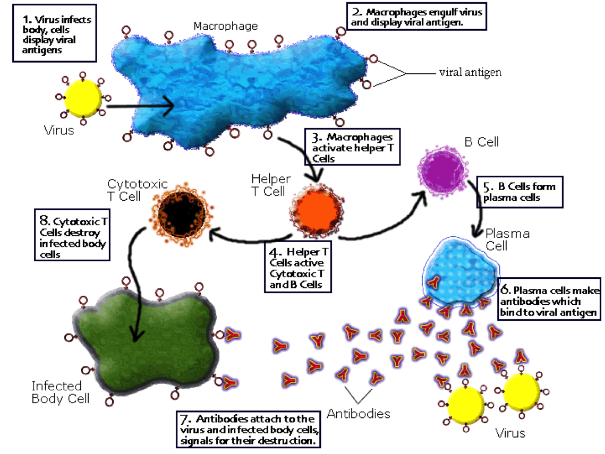

Slide 30
Lecture 5
Describe the process by which antibodies are produce
  B cells act as antigen presenting cells and interact with the foreign body directly
  They then present the antigen on the class 2 MHC displaying it for activated t helper cells to connect with
  T helper cells then release cytokines that cause b cells to mature to plasma cells which produce the antibodies specific to the pathogen
What is the function of CD cluster diffenrentiations
  Regular cell development and function
  Facilitate communication with the extracellualer environment
B cell differentiate from ___ and developing in ____ ___
  Lymphoblasts ,, bone marrow
What do B cells express that allows them to recognize specific antigenic epitopes
  Call surface immunoglobulin receptors or B cell receptors
What are plasma cells?
  Terminally differentiated B cells that provide protective immunity through continuous secretion of antibodies, resdie in lymph tissue
What is a common characteristic of the plasma cells?
  A lot of golgi apparatus because this is the factory for the antibodies

Slide 31
Do plasma cells have MHC receptors? Why or why not
  No, they are differentiated and already know what they have to target
What are the 5 classes of antibodies and what do they do ?
  M: pentamer or monomer(receptors for b cells), large antibody clusters, fungi and large antigens triggers completment, tags and prevents function
  G: small, principle type that responds, only one to cross placenta, coats org. to signla phagocytosis
  A: monomer or dimers in secretions, resp and gi tracts, forms antibody complexes thAT cannot be absorbed
  D: on cell membrane of b cells, small quantities in blood
  E : parasite disease, high in allergic people, causes basophil and mast cell degranulaton -> releases histamines
What are the 2 major regions of the antibodies
  Variable
    Uniquely shaped: specific to the antigen
    Combines with the antigen
  Constant
    Identical to all of the same class
    Binds to cell membrane and can activate completement cascade
What is the antibody structure
  Antigen binding region: Fab
  And Fc region

Slide 32
How do b cells injest the foreign body?
  Receptor mediated endocytosis
Where does the proliferation and differentiation of b cells occur?
  Germinal centers of the lymphatic tissue
If b cell don’t differentiate properly how are they gotten rid of?
  Apoptosis
What are the 9 ways antobodies act
  Agglutination: sticking antigens together (IgM)
  Precipitation: anitbody binfing to soluble antigens, The virus/toxin can no longer easily transport itself through the blood stream – it may precipitate out of solution and sink to the bottom of the vessel where it can be phagocytosed
  Opsonization: coating the bacteria with antibodies (tagging)
  Neutralizing: big antibodies block toxins from entering cells
  Immobilization: block normal cilliae of flagella
  Mucosal protect: IgA and IgG, blocks pathogens from gaining access
  Expulsion of parasites: IgE -> degranulation of some cells = contraction of smooth muslces i.e diarhhea
  Passive immunity: IgG into placenta
  Activation of completment: hole punching of the pathogens leading to death by osmosis

Slide 33
Describe the elisa testing method
  The wells are lined with the antigen in question
  A solution of the patients fluid is put in the well. If they have the corresponding antibodies they will bind
  The wells are washed out and then filled with an animal antibody that binds to the human antibodies tagged with something that will florense when triggered
  The trigger is then added to the well and if the patient had the antibodies to the chosen pathogen the well will glow

Slide 34
Lecture 6
What is a hypersensitivity reaction?
  Altered reactivity to bacterial products or foreign material during acquired immune response, undersirable impact, tissue damage
What are the 4 types of hypersensitivity under what 2 classifications
  Antibody mediate
    Immediate hypersensitivity
    Cytotoxic hypS
    Immune complex disease
  Cell-mediated
    Delayed hypS
What is immediat hypS?
  Allergy: localized hypS
  Anaphylaxis: widespread hypS
What is an atopic person
  a person prone to allergies
What are the 4 ways you can come into contact with an allergen?
  Skin contact, injection, ingestion, inhalation

Slide 35
Describe the relationship of IgE and allergies
  IgE like to bind to basophils and mast cells via the Fc constant region
  It then combs through for antigens and causes degranulation of these cells with contain histamines and prostaglandins
  These then find their home on their complementary receptors causing varying reactions
What type of receptors are histamine receptors?
  G-protein coupled
What 2 histamine receptors are involved with allergies?
  H1 and H4
Binding of histamine cuases?
  triggers inflammation, vasodilation, increased vascular permeability, bronchoconstriction, sensations of itching
How do antihistamines work?
  Block histamine receptors on target cells
Asthmas can have an __ basis
  Alllergic
What is allergen immunotherapy?
  Repeated subcutaneous injections of the antigen
  Induces the formation of IgA and IgG , IgE doesn’t have a chance to work

Slide 36
What are anaphalactoid reactions?
  a hypersensitivity reaction resembling anaphylaxis but not involving IgE
  Occurs after the 1st contact with the allergen
  Possibly by stimulating mast cells directly or by activating complement
What is cytotoxic hypS?
  the antibodies produced by the immune response bind to antigens on the patient's own cell surfaces.
  Igm and IgG and antigen complexes-> trigger complement
Give and example of cytotoxic hypS reaction
  Incorrect blood tansfusions
What 2 ways can this be activated?
  Triggered by antigen –antibody interactions
  Complement activated by bacterail cell wall material or by products generated during inflam process
What is immune complex disease?
  Antigen-antibody clumps within the circulation (physical obstruction)

Slide 37
What is delayed hypS?
  T-lymphocytes resp.
  initial antigenic contact sensitizes affected individual, generating T4 (CD4+) lymphocytes
  sensitized T4 cells accumulate at site of antigenic material, secrete a variety of cytokines which attract macrophages and activate T8 cells
  Tissue damage via inflammation, cytotoxic T8 cell destruction of target cell (apoptosis
What is an example of this type of hypS?
  Tuberle bacillus -> the site in the lungs dies where it was infected
What are 9 feautures of autoimmune diseases?
  Multiple cells, cytokines and mediators working togther
  Spontaneuous remmission and induced remission possible
  Relapses are common
  Combinations of AD are common
  Fluctuates between worsening and improvement
  Clinical and immunological features vary even for the same disease
  No single autoantibody or clone expains all clinical manifestations
  No single defect has been demonstrated to be resp. for driving AD

Slide 38
What is a mechanism of prevention of autoimmunity?
  Negative selection in the thymus, bone marrow, and germinal centers -> apop
How do MHC effect autoimmunity?
  AD requires that an MHC presents a self antigen to T-cells
  HLA alleles genes on chromosome 6
What is antigen mimicry?
  Regions of homology
  Cross reaction of pathogen generated antibodies with host antigens
What are 3 examples of altered proteins that effect autoimmunity?
  Autoimmune regulatory gene (AIRE) regulate negative selection
  Glycosylation of lysine
  Protein misfolding
What is Rheumatic Fever?
  develops several weeks post- infection with group A beta hemolytic streptococcus bacteria (such as strep throat or scarlet fever)
  Anti-strept antibodies cross-react with antigens in heart muscle, heart valves and other tissues.
  clinical symptoms include acute arthritis affecting multiple joints, inflammation of the heart.

Slide 39
What is rhuematoid arthritis?
  chronic, inflammatory autoimmune disorder
  affects the joints as well as other organ systems
  Formation of cross-reacting antibodies subsequent to primary infection
What is Systemic Lupus Erythematosus (sle)?
  connective tissue disease
  Mild episodic illness → severe fatal disease
  Widespread damage to fibrous connective tissue in skin, heart, serous membranes (pleura, pericardium),
  mechanism: autoantibodies.
How does SLE work?
  Damadge leukocytes
  Causes swelling and loss of structural detail of the nuclei, these convert into large spherical blobs and migrate to the edge of the cell
    LE cell
What is a common sypmtom of SLE
  Butterfly rash
What is vitiligo
  Complete loss of melanin

Slide 40
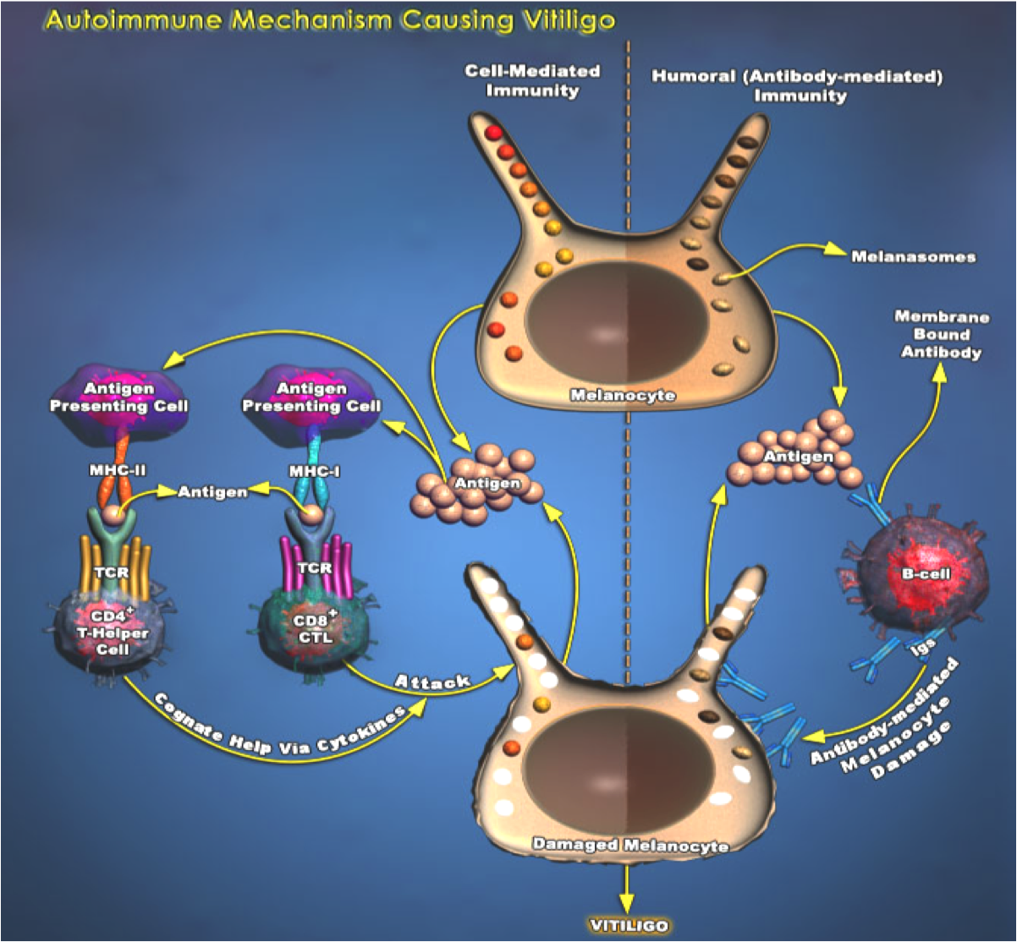

Slide 41
Lecture 7
Describe how the flu works in 3 steps
  Virus enters resp. tract
  Resplicates causing swelling
  Enters blood stream causing symptoms
Define epidemic
  An increase, often sudden, in the number of cases of a disease above what is normally expected in that population in that area
Define outbreak
  Same as epidemic but to a more limited area
Define cluster
  Aggregation of cases grouped in place and time that are suspected to be greater than the number expected
Define pandemic
  An epidemic occuring world-wide, or over a very wide area
What is a common feature of all of the above definitions?
  No indication of severity of the disease

Slide 42
What is the WHO 3 criteria for pandemics
  Able to infect humans
  Able to cause disease in humans
  Able to spread from human to human quite easily
About how many people died during the 1918 influenza “the spanish flu”
  40-50 million
Describe the types of victims the spanish flu took
  Healthy young adults
  99% of death were in ppl under 65
  More than 50% were 20-40 yo
What was the mortality rate of the spanish flu?
  2-20%
What is the basic way the 1918 virus killed?
  Inflammation of the lower resp. tract -> people suffocated to death
What does the H and N stand for in influenzas?
  H: hemaglutinin -> gene that allows entry into the host
  N: Neuraminidase -> allows exit of host cells to spread to others

Slide 43
What is antigenic drift? Example of importance
  A shift in the antigen provoking a different reaction in our bodies
  is the process of random accumulation of mutations in viral genes recognized by the immune system
  The reaason we need seasonal influenza vaccines
What is antigenic shit?
  Genetic mutation allowing the virus to jump species
  is the process of random accumulation of mutations in viral genes, may allow virus to jump host
What is saras-cov
  Severe acute respiratory syndrome
  Coronavirus
  Outbreak in 2003
What are the phases of SARS
  Persistnet fever, myalgia, chills, dry cough, dizziness, and headahces
  Oxygen desaturation, reccurrence of fever, progression of acute pneumonia
  Acute respiratory distress syndrom requiring mechanical ventilation
How many people progressed to the 3rd stage?
  20%

Slide 44
What are the basic steps to the SARS infection?
  Binds, brought in, high jacks replication, replictes, leaves cell
Who had the highest number of sars cases and how many people did canda have and how many died?
  China 2674, 349 deaths
  Canada:151 with 43 deaths
What happens when sars virus leaves the cell?
  It induces apoptosis and the inflammatory response issues
what is the recpetor sars targets?
  ACE-2 cell surface receptor that is interacts with
What protein induces apoptosis in sars?
  SARS-CoV U122 protein
What are 2 other sars proteins that regulate apoptosis indirectly?
  Sars-cov S and 3, N
What is H5N1 avian flu?
  Very deadly, couldn’t pass human to human, passed from bird to humans, crosses placenta
What area of the body does it affect
  Lungs, Gi, brain, liver, blood cells

Slide 45
Why is it thought that H5N1 is so deadly?
  Cytokine production is 10 times higher then other flus
  release of pro-inflammatory cytokines, upregulation of apoptosis and resistance to interferon
When did H1N1 hit where, how many died?
  2010, world wide, 18398 deaths
What is the MERS-Cov ?
  Middle east respiratory syndrome coronavirus
  Saudi arabia 2012
  Zoonotic = camels
What are the symptoms of MERS?
  Fever, cough, shortness of breath
  Possibly pneumonia, GI symptoms, including diarrhea
What is the mortality rate of MERS?
  ~36%
What is Avian Influenza A H7N9 and when did it occur?
  2013
  No sustained human-human
  135 lab confirmed human cases, 44 deaths

Slide 46
What is the increased risk for pregnant women with influenza?
  Increased oxygen consumption (~20%)
  Untested anti-viral
  Transmission to fetus
  Stress to the baby = preterm labor complication
List 2 anti-viral meds and relate them to pregnancy
  Ribavirin
    broad spectrum nucleoside analogue used against RNA viruses and coronaviruses
  recommended for patients treated with ribavirin in early pregnancy to be given the option for termination of pregnancy
Oseltamivir/Zanamivir
  neuraminidase inhibitors recommended for use against H5N1 and H1N1 influenza
  “Pregnancy Category C” agents as there have been no clinical studies to assess safety during pregnancy
What is a cytokine storm?
  Cytokines are signalling molecules which activate lymphocytes and other immune cells towards inflammation, infection and trauma
  cytokine storm is an inappropriate (exaggerated) immune response that is caused by rapidly proliferating and highly activated T-cells or natural killer cells
What is acute lung injury?
  Acute inflammatory response -> chronic fibroproliferative phase-> progressive collagen deposition in lungs

Slide 47
Relate cytokine storms to the younger pop that dies during the 1918 influenza
  Cytokine storms are a result of a healthy immune system so the healthy people would have had worse reactions and had more damage

Slide 48
Lecture 8
What does aids do?
  Attacks and destroy helper T cells, weakening the immune system
What are the 2 types of HIV virus? Where do they occur?
  HIV-1: pandemic
  HIV-2; mainly west africa
What are the further classifications of HIV-1?
  M : major or main
  O: outlier
  N: new or non-m, non-o
What was the first repot of AIDS?
  June 5 1981
When was HIV id? When was the first blood test available?
  1983 , 85
What is the structure of HIV?
  RNA virus
  Core: rna and reverse transcriptase
  Core is surrounded by an envelope = double lipid bilayer

Slide 49
What are the 2 proteins on the viral envelope of HIV?
  Gp 41 (stem) and pg 120 (cap)
What are the 3 viral enzymes?
  Reverse transcriptase
  Integrase
  Protease
What is the target of the HIV virus?
  CD4 proteins act as receptors for the virus
What does the CD4 protein attach to on the virus? What does this cause
  Gp 120, causes structural changes of gp 41 -> unfolds and penetrates the cell
Once HIV is bound what happens?
  Envelope fuses, virus enters cells, reverse transcriptase makes a DNA copy of the viral RNA, HIV integrase inserts the viral DNA into infected cell genome, the viral dna is replicated, HIV protease then cleaves into little packages to release from the host cell
How do helper t cells and monocytes react to being invaded by HIV?
  Helper t cells damaged and die -> disruption of cell memebrane, and not doing normal functions anymore
  monocytes resistant and act as vehicles

Slide 50
What is the effect of HIV on bystander cells
  Immune cells target HIV particles bound to cells, cell death
  Immune cells target uninfected cells that have phagocytosed HIV, displaying antigens on cell surface
  Immune cell cross-reactivity with HIV-like antigens on healthy cells
  Apoptosis of uninfected cells
What 3 ways does HIV upregulate apoptosis?
  Upregulations of Fas-L (extrinsic pathwary of apop)
  Inhibition of Bcl-2 (anti apop proteins) -> it inhibits the off switch
  Activates pro-apoptotic procaspase 8 -> increases this = more likely to be cleaved and activated = increase apop
Virus particles are produced ____, there is not ___ phase
  Continuously, dormant
What is the body’s response to the destruction of t cells and what is the result
  Ramps up production -> destruction rate is faster then production and the battle is eventually lost

Slide 51
What are 3 late manifestations of HIV?
  Opportunistic infections
  Neoplasms
  Central nervous system damage
What are 2 factors that affect the disease progression?
  Genetics
  HAART therapy
    Highly active antiretroviral therapy
What are some common infections with AIDS patients?
  Viruses: Herpes
  Fungi: Candida infections
  Protozoa: Pneumocystis carinii pneumonia
  Myco: TB
What is the most common malignant tumor with AIDS patients?
  Kaposi’s sarcoma: tumor of the CT,
  caused by an interaction between HIV, immune system suppression, and human herpesvirus-8 (HHV-8
Overall the number of Aids cases has ___?
  Plateaued

Slide 52
HIV/latent TB infected people are at much higher risk for?
  progressing to active TB disease than people with latent TB infection alone.
How is HIV transmitted?
  Unprotected sex
  Sharing needles
  Blood products
  Congenitally
What are some causes for disparity in women’s health ?
  limited access to education/employment
  high illiteracy rates
  anatomical/sociological vulnerability to HIV/AIDS and other STIs
As of December 2003, women accounted for nearly ___% of all people living with HIV worldwide and for ___% in sub-Saharan Africa.
  50, 57
AIDS has killed one or both parents of an estimated ___million children in sub-Saharan Africa
  12

Slide 53
Africa has ____ million cassses of HIV-Aids
  24.5 million
What are some things that happen associated with stigma and Aids
  Ostracism
  Rejection
  discrimination and avoidance of HIV infected people
  compulsory HIV testing without prior consent or protection of confidentiality; violence against HIV infected individuals or people who are perceived to be infected with HIV
  quarantine of HIV infected individuals.
What is the view of someone with aids today
  Relatively normal lifespand = normal issues associated with ageing

Slide 54
Lecture 9
What are 4 categories of congenital and hereditary diseases?
  Genetic abnormalities
  Chromosomal abnormalities
  Disruptions in development
  Intrauterine injury
what is somatic genetic variability?
  Occur after fertilization
What is germline genetic variability
  Originally present in the sperm or egg
Which of the above can be transmitted to offspring?
  Somact can or cant -> if repro cells not affected = no
  Germ = yes
What are de novo variation
  Variation that neither parent possessed
What is point letter mutation?
  Single letter is change
What is a nonsense mutation?
  Causes Transcription to arrest early

Slide 55
What is missense mutation
  Encodes abnormal amino acid
What are the 4 types of genetic diseases?
  Monogenic (single gene)
  Complex (multifactorial)
  Chromosomal aberrations
  Mitochondrial disease
What are the 5 inheritance patterns of monogenic disorders?
  Autosomal dominant
  Autosomal recessive
  X-linked
  Y-linked
  Mitochondrial
List 3 examples of autosomal dominant traits
  Freckles
  Cleft chin
  Achondroplasia (growth of long bones and cartilage is retarded)
What does it mean to be a dominant allele?
  Express their phenotype even when heterozygous pair
  Phenotype appears the same in both heterozygous and homozygous pairing

Slide 56
What does it mean to be a recessiv allele?
  Phenotype only express when homozygous pairing
  Heterozygous pairing -> person is a carrier
What are some examples of recessive disorders?
  CF, sickle cell anemia, Tay-sachs, Phenylketonuria PKU
What is the CF gene?
  Cystic Fibrosis Transmembrane Regulator gene (CFTR)
More than ____ mutation of the CF gene have been ID
  900
What is a common deletion that occurs in many CF patients?
  Phenylalanin 508 deleted
What are the 5 types of mutation that occur to produce CF?
  Deletions
  Nonsense
  Splicing error
  Missese
  Frameshift

Slide 57
What is an x- linked mutation
  Both men and women can have them because both inherit x chromosome
What is a y linkined mutation
  Men only -> theyre the only ones that inherit y chromosomes
List 3 x-linked mutations
  Hemophilia, re-green color blindness, congenital night blindness
What is a complex disorder?
  Each mutation is insufficient to cause the disease phenotype by itself
What are the 2 types of chromosomal abnormalities?
  Numerical
  Structural
When can chromosomal abnormalites occur and what importance does this have
  Occur as an accident in the egg or sperm = present in every cell
  Happen after conception in early embryp= mosiaicim = not in every cell

Slide 58
What is down sydrome? Sypmtoms
  Numerical chromosome abnormality
  Trisomy 21
  Impairment of cognitive abilit, physical growth, distinctive facial appearance, decelopmental diabilities
People with trisomy 21 are at high risk for
  Congenital heart defects,
  gastroesophageal reflux disease
  recurrent ear infections
  obstructive sleep apnea
  thyroid dysfunctions
At what maternal age does the risk for trisomy 21 significantly increase?
  35 yo
As age ____, rate of aneuploidy ___
  Increases, increases
As ago ___, rate of implantation___
  Increases, decreases

Slide 59
What is Edwards syndrome?
  Numerical chromosomal abnormality
  Trisomy 18
  Impairment of cognitive ability, facial and physical deformities
  Poor prognosis, 50% die in utero, 50% live to 2 monts, 5-10% will survive first year of life
What is Turners syndrome?
  Numerical sex linked chromosomal abnormality
  (x)
  Signs of turners syndrome include
    Short stature
    Broad chest
    Widely spcae nipples
    low hairline
    Low-set ears
    Steril
    Amenorrhea or absence of menstral period
    Increased weight and obesity

Slide 60
What is Klinefelter syndrome
  Numerical sex linked chromosomal abnormality
  (xxy)
  Signs:
  principal effect is small testes development
  reduced fertility
  a thin build or a rounded body type with some degree of gynecomastia (increased breast tissue)
  decreased testicular hormone/endocrine function
What is fragile X syndrome?
  Structureal sex linked chromosomal abnormality
Signs for boys
  Boys with the syndrome may have large testicles
  low muscle tone
  autism
  Speech disorders
  characteristic but variable face with large ears, long face, high-arched palate
  Gynecomastia
Females with fragile x?
  Range from normal to mild manifestations

Slide 61
What is crytorchidism?
  Undescended testicles one or both
What are men with crytorchidism at greater risk of/
  Cancer
If one or more fails to descende what is the risk?
  Risk of hernia and lower fertility
What is hypospadias? Prevalance?
  Opening for the urethra is on the underside instead of the end of the penis
  3 in 1000
What is fetal alcohol syndrome?
  growth, mental, and physical birth defects associated with the mother's high levels of alcohol use during pregnancy
Associate timing of alcohol consumption with severity of FAS
  1st > 2nd>3rd
What is autism?
  Neurological spectrum disorder
  Communication/social disabilities
  Restricted/repetitive ‘patterned’ behaviors
___ age, __ and older, is associated with an increase risk of autism
  Paternal , 40 yo

Slide 62
every additional ___ of paternal age results in an average of ___ extra mutations in offspring.
  Year, 2
What are the 3 possible outcomes of congenital. Heritable diseases?
  Live birth
    Disability or dysfunction
    Increased risk of adult onset diseae
  Miscarriage (before 20 weeks)
  Stillbirth (after 20 weeks)
Miscarriage is classified as as ___ delivery
  Preterm
What characteristic increase your chances for spontaneous abortion?
  Over age 35
  Systemic diseases i.e diabetes
  History of 3 or more spontaneous abortions
List 6 causes of spontaneous abortion
  defective embryo implantation.infection,
  , hormonal factors,
  immune responses, and
  serious systemic diseases of the mother

Slide 63
What trisomy is most commonly associate with spontaneous abortion?
  Trisomy 16
  Triploidy (everything is in 3)
In Ivf what measures are taken to prevent and reduce the occurrence of congenital/ hereditary issues?
  Embryos that will be implanted are screened -> only those without abnormalities are implanted
What is an amniocentesis
  Small amount of fluid withdrawn from amniotic sac
women with no history of spontaneous abortion risk of fetal loss with amniocentesis is ___%.
  1.3%
women with history of spontaneous abortions, risk of fetal loss rises to
  5%
Genetic testing can test for risk of disease, give 2 examples
  Breast/ovarian cancer BRCA 1and 2 gene
  Huntington’s disease

Slide 64
If it is found that there is a mutation in the BRCA ½ gene what does this mean?
  You are at increased risk for breast and ovarian cancer
  It doesn’t mean you will for sure get it
What is prophylactic surgery?
  removal of healthy breasts/ovaries BEFORE cancer
What are 4 limitations to genetic tests?
  Severity of disease
  Time of onset
  Progression of disease
  Lack of treatment strategies
what are the 4 major duties of a clinical medical geneticist?
Provides genetics consultations and genetic counselling
Provides supervision for and collaborates with genetic counsellors in the provision of genetic counselling for cases seen by genetic counsellors.
Participates in the education of medical students, residents and fellows.
Provides supervision of genetic counsellors.

Slide 65
Lecture 10
Gastric acid is secreted by what type of cells?
  Parietal cells
What is GERD?
  Loweresophageal sphincter issue
  Gastrointestinal reflux disease
What are 2 ways to prevent GERD?
  Don’t eat before bed
  Don’t eat fatty foods
What are the 3 triggers for gastric acid production?
  Histamine
  Acetylcholine
  Gastrin
What is the pump that secretes the HCl in gastric acid?
  H+/K+ ATPase
What is the pH of the stomach ?
  ~2
Why doesn’t gastric acid damage the stomach?
  Mucosal epithelium produce NaHCO3 and mucus = protect and buffer

Slide 66
What is Gastritis? What causes it
  Inflammation associate with mucosal injury
  Multiple causes: alcohol, H.pylori
What are 8 symptoms of gastritis ?
  Indigestion
  Heartburn
  Abdominal pain
  Hiccups
  Loss of appetite
  Nausea
  Vomitting
  Dark stool
What is the association of chronic gastritis and gastric cancer?
  Cells that are damaged have to undergo repair
  Wound repair means cell proliferation
  More cell proliferation= increased replication of DNA; more chance of mutation; more chance of cancer
What are peptic ulcers?
  Area of the GI tract that is usually acidic and thus extremely painful

Slide 67
What causes peptic ulcers?
  Helicobacter pylori (80%)
  Hyperacidiity
  Excessive pepsin acitivity
What is the function of:
  Small intestine:
    Absoprtion or water and nutrients
  Large intestine
    Dehydration of stool
    Addition of mucus bacteria
    Storing waste
    Maintaining water balance
    Absorbing some vitamins
      K
  Rectum
    Storage of stool
What are 2 things that help increase the surface are of the SI?
  Invaginations
  Intestinal villi
The intestines are consider the ____ ____ because of the nerve plexus
  Second brain
In the LI what does it have instead of villi?
  Intestinal crypts

Slide 68
What is peristalsis
  Coordniated effort to move bolus of food through the intestines
What is the rate of peristalsis related to ?
  To allow from proper absorption of nutrients and water
How can you tell if a bolus is a partial or complete blockage?
  Part: gas is able to pass
  Complete: no bowel sounds = emergency
What is the prevalence of true food allergies in adults and kids
  1% adults, 5% kids
What is a true food allergy
  An adverse reaction to foods that is triggered by the immune system
What are the signs of a food allergy
  Hives, itching or eczema
  Swelling of the lips, face, tongue and throat, or other parts of the body
  Wheezing, nasal congestion or trouble breathing
  Abdominal pain, diarrhea, nausea or vomiting
  Dizziness, lightheadedness or fainting
What is food intolerance?
  Irritation of GI tract, may be related to digestive enzymes

Slide 69
What are 5 symptoms of foodborne illness
  Biarrhea
  Abdominal pain
  Bloating
  Nausea/vomitting
  Gastroenteritis
What is gastroenteritis?
  inflammation of the gastrointestinal tract, primarily the stomach and intestines
What is E coli O157:H7? What does it cause?
  Gram negative, rod shaped bacteria
  Severe, bloody diarrhea, abdominal cramps
  Hemolytic uremic syndrome
What is Hemolytic uremic syndrome
  Anemia cause by destruction of RBC and acute kidney failure
What is campylobacter? What does it cause? Where is it present?
  Gram negative bacteria
  Fever, diarrhea, abdominal cramps
  Present in intestines of healthy birds

Slide 70
What is Salmonella? What does it cause?
  Gram negative rod shaped bacteria
  Fever, diarrhea, abdominal cramps
Where does salmonella come from?
  Intestines of birds, reptiles, and mammals
What is cyclosporiasis?
  Caused by the parasite Cyclospora cayetanensis
What are the sypmtoms of cyclosporiasis?
  Watery diarrhea
  Loss of apetite
  Weight loss
  Cramping
  Bloating
  Increased gas
  Nausea
  Fatigue
Where did the 2015 outbreak of cyclosporiasis happen, how many infected, what was it linked to ?
  USA: 476
  Canada: 87
  Restaurants , fresh produce , cilantro

Slide 71
What are norwalk of noroviruses? Symptoms, exposire, mode of trans?
  Family if viruses
  Vomitting, some diarrhea
  Exposure from food of bodily fluids
  Ppl-ppl trans.
  Rna virus
What is cholera?
  Infection of the small intesting caused by : Vibrio cholerae
What does the toxin the bacteria produce cause?
  increased secretion of water and chloride ions in the intestine, which can produce massive diarrhea.
How does death occur with cholera?
  Severe dehydration due to diarrhea
What conditions create epideics of cholera?
  Poor sanitation
  Crowding
  War
  Famine
Describe the mechanism of the cholera toxin
  Enters epithelial cell-> permanently activats cl channels ->Cl is set to lumen-> Na and H2O increase transport to lumen -> massive diarrhea

Slide 72
What type of receptor does the cholera toxi act on?
  G-coupled protein receptor -> activated subunit alpha
What is botulism?
  Gram +ve bacteria Clostridium botulinum
  Caused by the toxin the bac produces
What type of toxin is produce with C. botulinum?
  Neuroparalytic toxin
What are the symptoms of C. botulinum?
  double vision,
  blurred vision,
  drooping eyelids,
  slurred speech,
  difficulty swallowing,
  dry mouth
  muscle weakness.
What is the result of the block of neurotrasmitter ?
  Permanent contraction
What is a gut microbiome? What is it’s function?
  Internal microbial communities
  Metabolic, immune, protect against pathogens

Slide 73
Babies are born with ___ GI tract
  Sterile
Microbiome is accumulated in ___ months
  3
Adult gut microbiome colony reached by age __?
  3
What is inflammatory bowel disease?
  Inflammatory condition of colon, small intestine
What are the 2 major types of chronic inflammatory bowel disease?
  Crohn’s disease
  Ulcerative colitis
What are 3 symptoms associated with crohn’s disease
  Pain
  Diarrhea
  Vomiting
The exact cause of crohn’s disease is unknown but what are 3 things appear to conribute?
  Autoimmune cell meditated response
  Genetics: CARD15 and XBP1 gene mutation
  Envrionment: smoking, diet

Slide 74
What is celiac disease.
  Gluten intolerance causing = inflamm response
  Atrophy of intestinal villi
  Scar tissue fromation
  Loss of architecture of villi
What are the symptoms of celiac disease?
  Weight loss
  Pale stool
  Abdominal pain
  Diarrhea
What is the impact of celiac disease?
  Malabsorption of nutrients and ADEL vitamiines
What are the 3 causes of celiac disease?
  Autoimmine
  Genetic
  Diet

