Slide 1
The following are the slides presented at the midterm tutorial
There are several sample MCQs at the end. The answers are included but added as animations. Run the slides in presentation mode if you do not want to see the answers
In the event any content contradicts Dr. Carnegie’s lectures, please note that the midterm will reflect her material.
Enjoy!
David Cook (dcook082@uottawa.ca)

Slide 2
ANP1106
The tale of the midterm tutorial

Slide 3


So our story begins…
Hi! I’m David

Slide 4
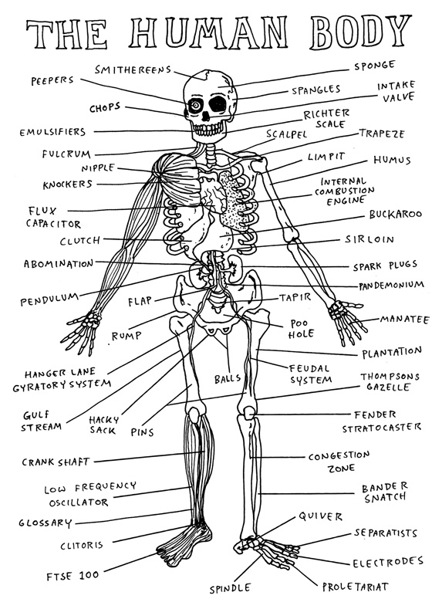
Today’s Objectives
Get pumped for anatomy!
How can I study for this!?!?!?
Overview: Muscle anatomy
Overview: Neuroanatomy
Questions???

Slide 5
Chapter 1
Getting Pumped for Anatomy

Slide 6

Get pumped!

Slide 7
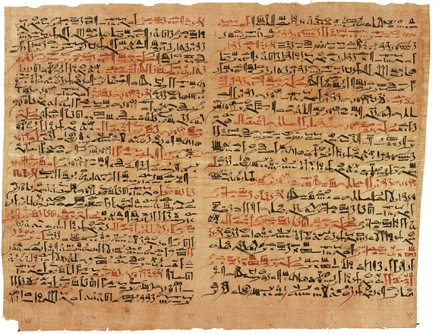
Egyptian study of anatomy (1500BCE)
Edwin Smith Papyrus

Slide 8
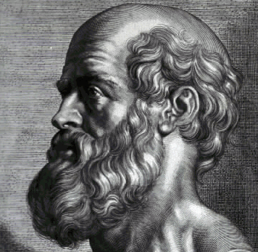
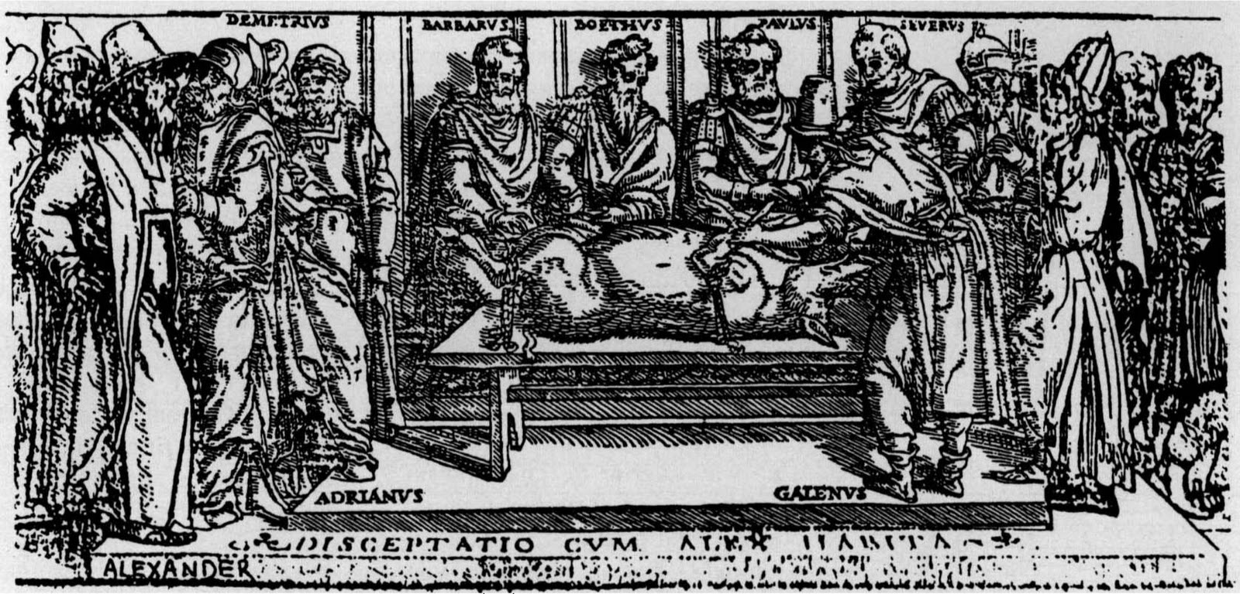
Greece
(400BC)
(150AD)

Slide 9
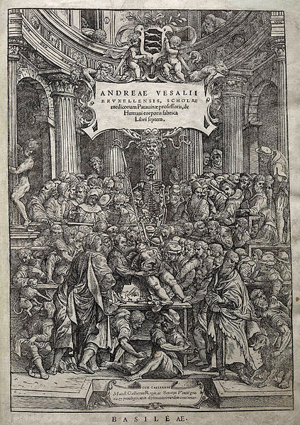
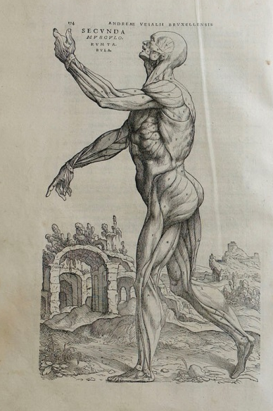
Andreas Vesalius
De Humani Corporis Fabrica (1543)

Slide 10
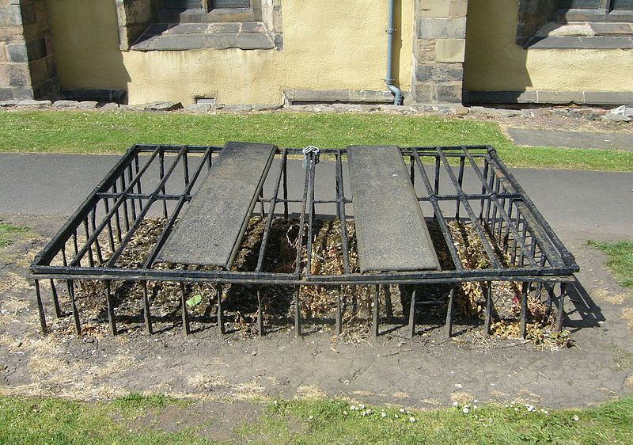
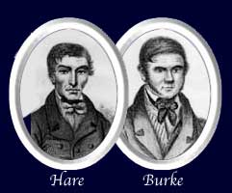
1800s
Grave robbing
Anatomy murder

Slide 11

1800s cont’d
Anatomy Act of 1832
Gray’s Anatomy

Slide 12
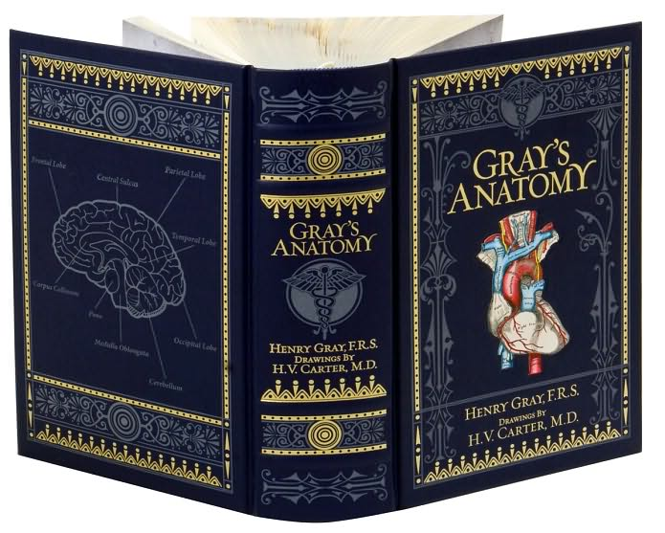
Gray’s Anatomy

Slide 13
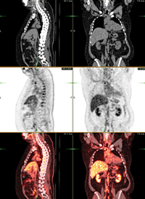
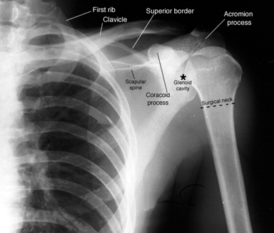
Modern
Nuclear Imaging
X-ray technology

Slide 14
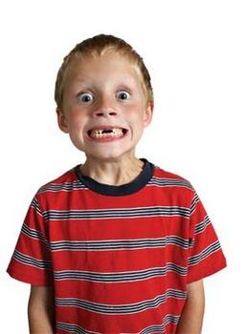
EXCITED!?!?!?

Slide 15
Chapter 2
How can I study for this?!?!?!

Slide 16
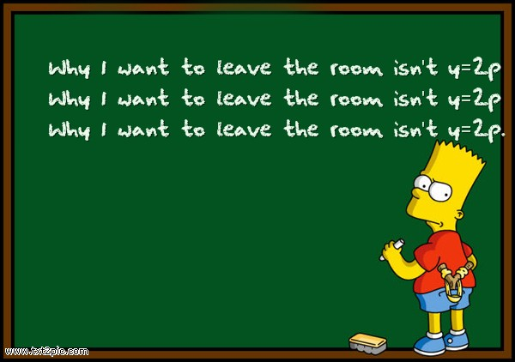
REPETITION!

Slide 17

Think Critically!!!
Always challenge your own knowledge
Ask yourself questions and try to solve them
Make connections and draw conclusions
Most importantly, think!

Slide 18
Chapter 3
Overview: Muscle Anatomy

Slide 19
Muscle Overview Part 1:
Gross Anatomy and Function
Be very comfortable with the different movements
    Flexion and extension
    Pronation and supination
    Inversion and eversion
    Adduction and abduction
    Dorsiflexion and plantar flexion
Be very comfortable with muscle interactions
      Prime mover
      Antagonist
      Synergist
      Fixators

Slide 20
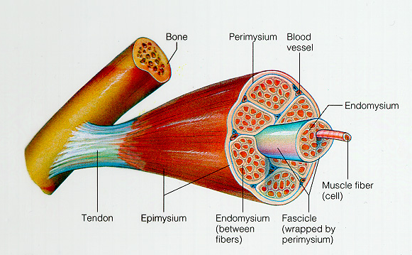
Muscle Overview Part 1:
Gross Anatomy and Function
Be fairly comfortable with CT wrappings
      What are they???
Muscle Group > Muscle > Fascicle > Muscle fiber
Deep fascia > Epimysium > Perimysium > Endomysium

Slide 21

Muscle Overview Part 2:
The Dreaded Names

Slide 22
Muscle Overview Part 2:
The Dreaded Names
Review them all as many times as possible
Remember that the name of a muscle may contain information about the function or attachments of the muscle
Don’t be afraid to feel your own muscles!
Make a list, categorizing each muscle according to location
If you MUST prioritize, focus on the major muscles of each location and their functions

Slide 23
Chapter 4
Overview: Neuroanatomy

Slide 24
Neuroanatomy Overview
Nervous System
Central Nervous System
-Brain
-Spinal Cord
Peripheral Nervous System
Motor Division
Sensory Division
-Somatic and visceral
Somatic Motor
Autonomic Nervous System
Sympathetic
-Fight or flight response
Parasympathetic
-Rest and digestion

Slide 25
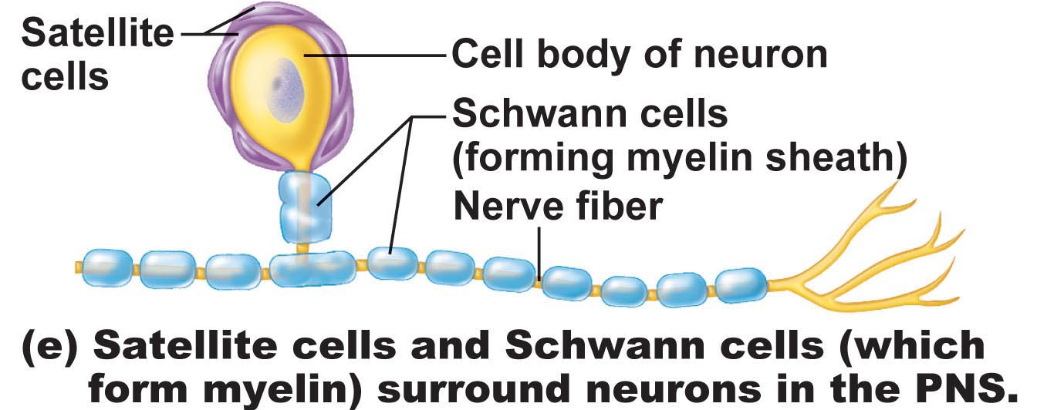
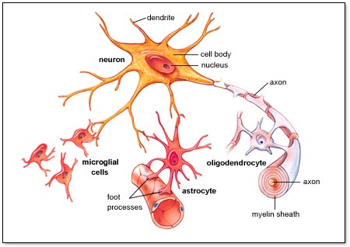
Neuroanatomy Overview
Supporting Cells of the Nervous System (6 types):
Peripheral Nervous System:
Satellite cells
Schwann cells
Central Nervous System:
Astrocytes
Microglia
Ependymal cells
Oligodendrocytes

Slide 26
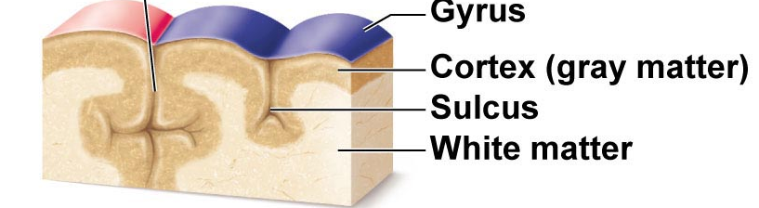
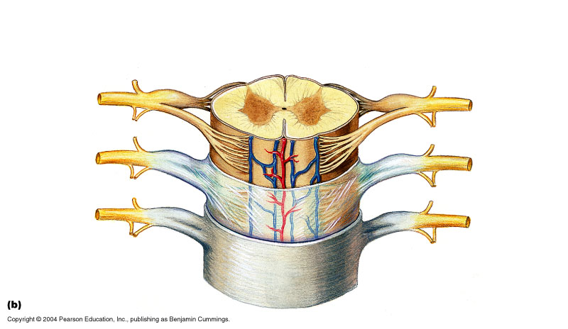
Neuroanatomy Overview
White matter vs. Grey matter?
White Matter: Myelinated axons
Grey Matter: Cell Bodies
Cerebral cortex is made up of?
Grey matter
Cerebral white matter can run in several different directions.
What do you call fibers that run:
a) vertically to the thalamus or brain stem?
-Projection Fibers
b) Form connections between the two hemispheres?
How about in the spinal cord? What makes up the outer layer?
-Commissural Fibers
White matter!
c) Form connections within a hemisphere?
-Association Fibers

Slide 27
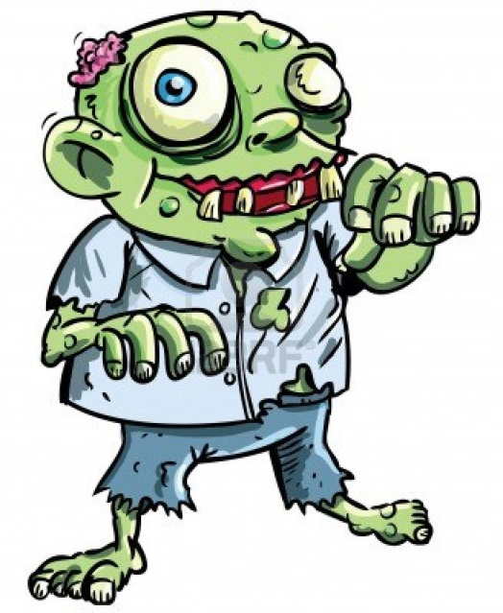
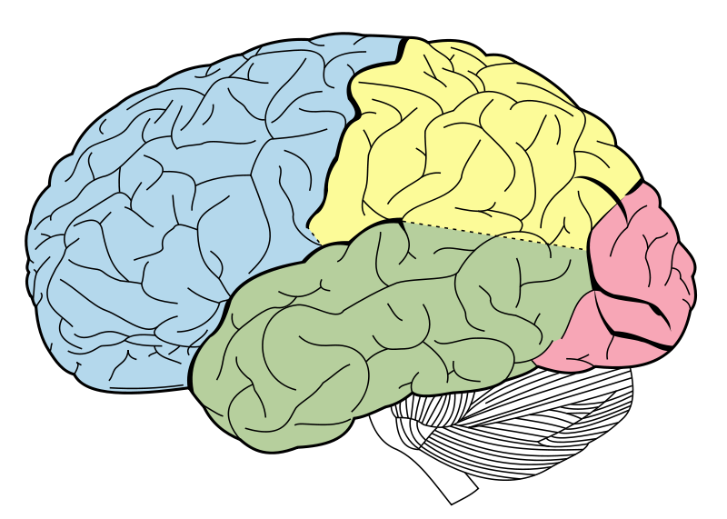
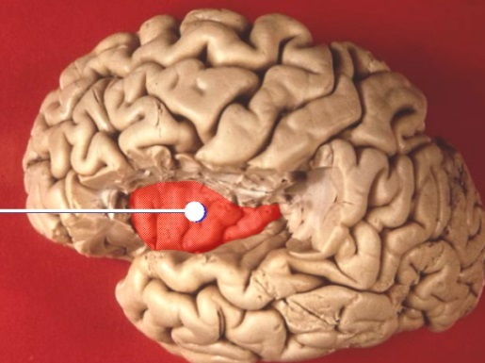
Neuroanatomy Overview
Braaaaains!
Know the five cerebral lobes:
  Frontal – Conscious thought, mood
  Parietal – Integrates sensory information
  Occipital – Sense of sight
  Temporal – Auditory and smell
  Insular - Pain

Slide 28
Neuroanatomy Overview
Should be able to describe the three types of functional areas of the cerebral cortex
Motor Areas
Sensory Areas
Primary Motor Cortex
Premotor Cortex
Broca’s area
Frontal eye field
Primary somatosensory
Somatosensory association area
Visual areas
Auditory areas
Vestibular cortex
Olfactory cortex
Gustatory cortex
Visceral sensory area
Multimodal Association Areas
Anterior association area (prefrontal cortex)
Posterior association area (part of posterior lobes)
Limbic association area
Notes:
MAAs are regions that receive sensory input from multiple sensory modalities in order to make associations
Posterior AA is where visual, auditory, and somatosensory association areas converge. Gives spatial awareness of our body
Anterior AA receives input from Posterior AA, integrates it with past experiences from limbic AA, and decides what to do. Has a lot to do with how we think and behave.
Limbic AA receives input and helps generate memories.

Slide 29
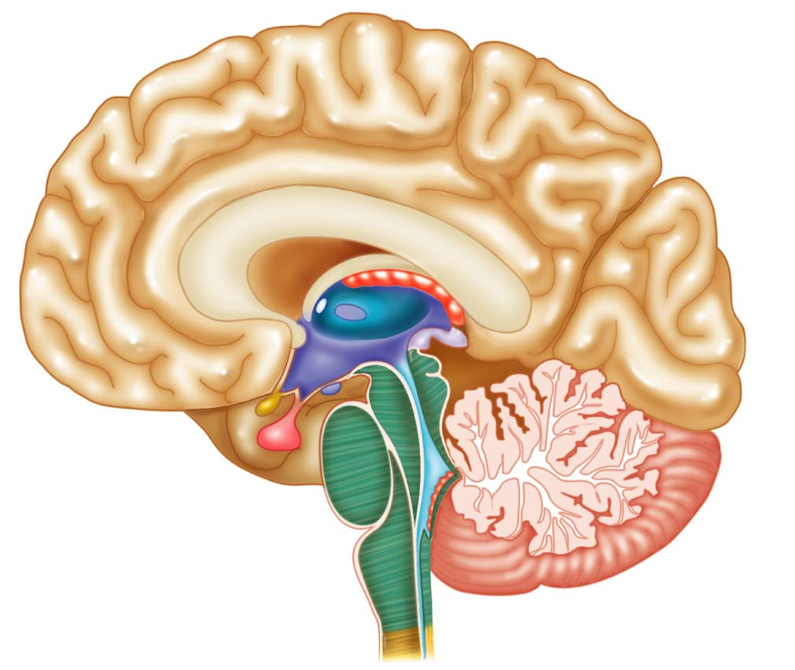
Neuroanatomy Overview
The Diencephalon
The three -thalamuses
Thalamus
-Very important
-Gateway to cerebral cortex
-Sensory sorting and modification
Epithalamus
-Contains choroid plexus which forms CSF
- Contains pineal gland which produces melatonin (sleep-wake cycle)
Hypothalamus
-Master of endocrine system and many homeostatic variables

Slide 30
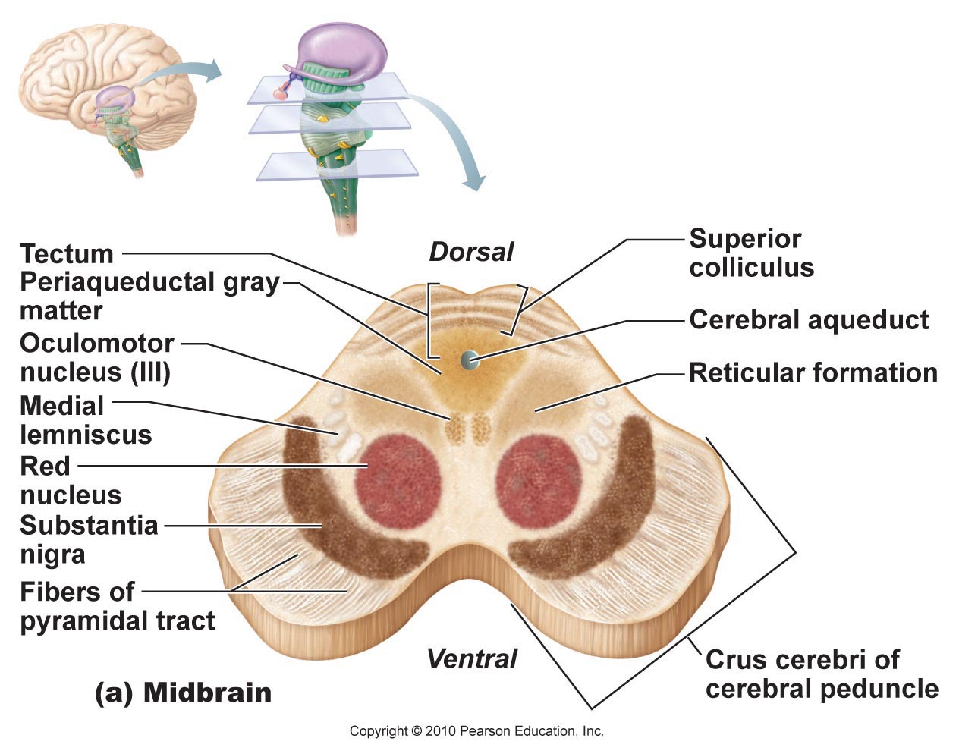
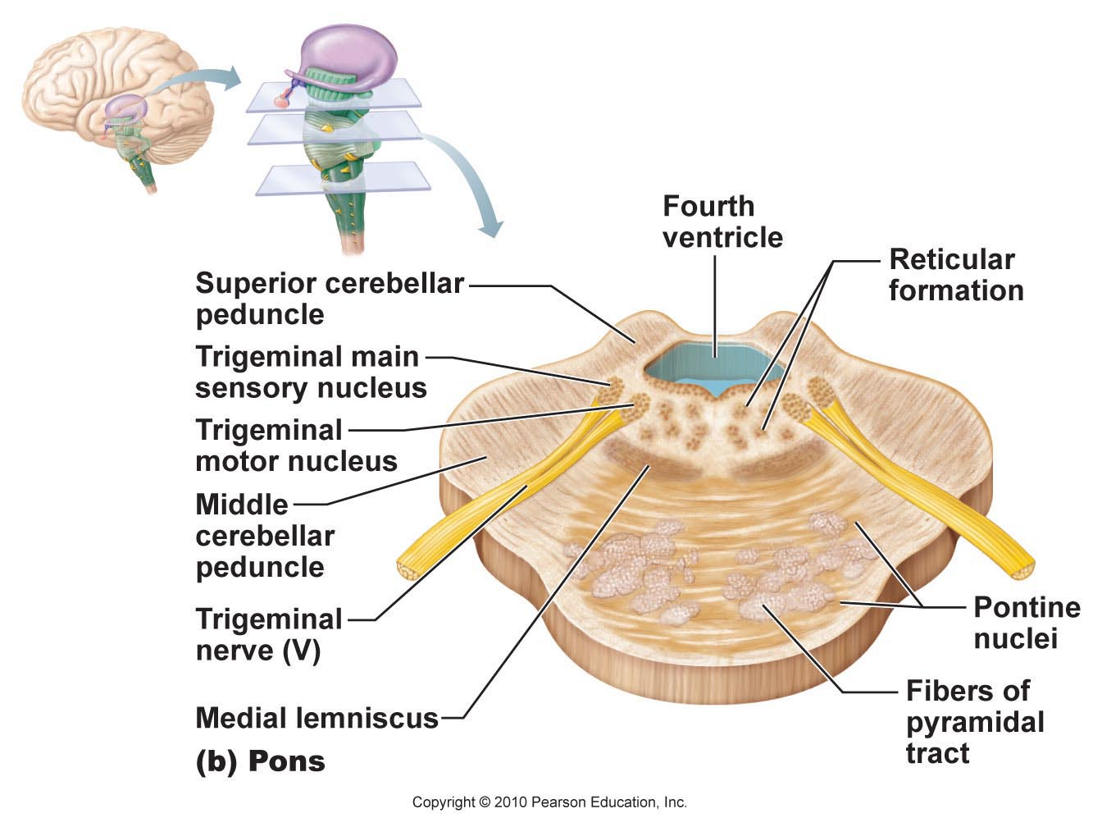
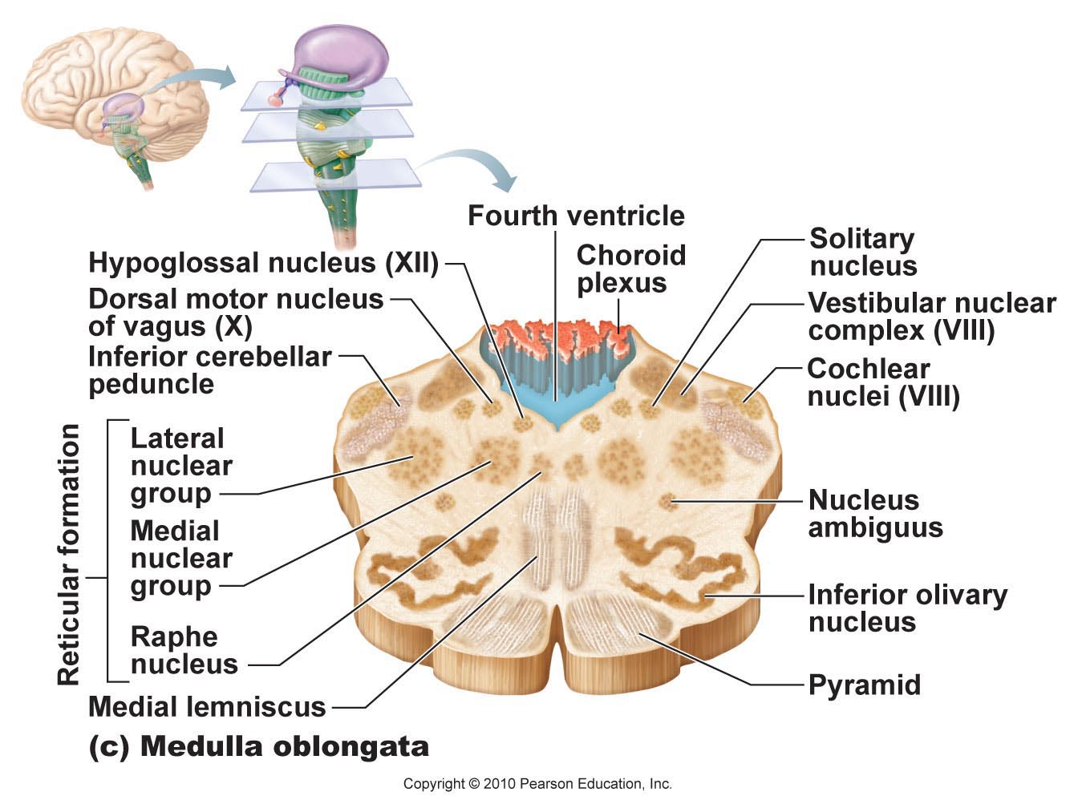
Neuroanatomy Overview
The Brainstem
Midbrain
-Substantia nigra
-Red nucleus
Pons
-”Pons are pudgey”
(pyramidal tracts)
Medulla Oblongata
-Pyramids
-Motor fibers decussate after pyramids
-Life-supporting reflexes:
Respiratory, cardiovascular, vomiting

Slide 31
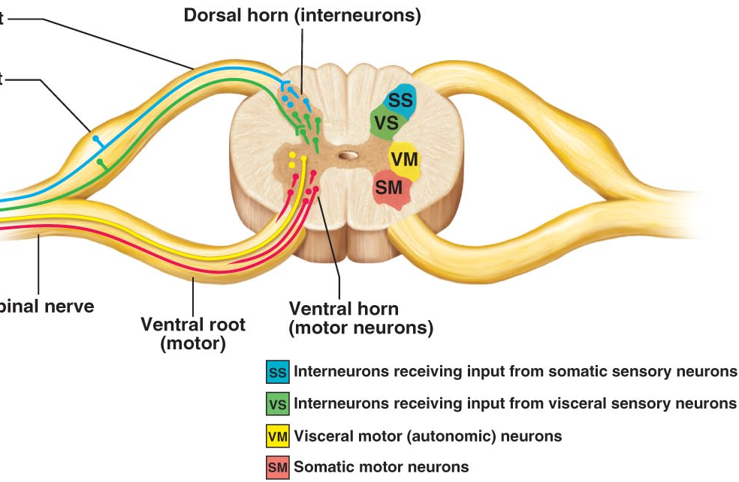
Neuroanatomy Overview
Horns of the spinal cord
What makes up these horns? (hint: grey matter)
Cell bodies!
What neurons make up the:
Ventral/anterior horn?
Somatic motor neurons
Dorsal/posterior horn?
Sensory INTERNEURONS
Lateral horn?
Autonomic motor neurons

Slide 32
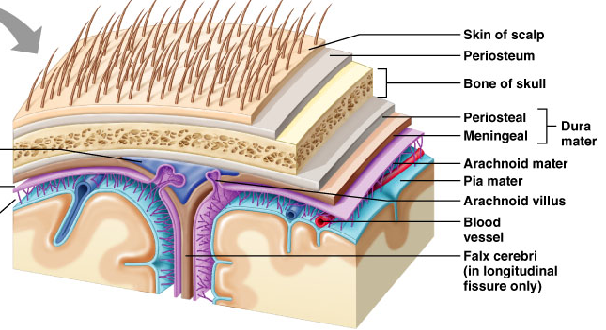
Neuroanatomy Overview
Meninges (sing: meninx)
Dura mater
-Two layers: periosteal, meningeal
Arachnoid mater
-Subarachnoid space (sub = below) filled with CSF and large blood vessels!
Pia mater
-Small blood vessels

Slide 33
Neuroanatomy Overview
Cranial Nerves
-12 pairs!
-Mnemonic to remember order:
”On Occasion, Our Trust Truck Acts Funny. Very Good Vehicle AnyHow”
-Mnemonic to remember sensory/motor/both
“Some Say Marry Money But My Brother Says (its) Bad Business (to) Marry Money”
-Vagus Nerve: ONLY cranial nerve to extend beyond head-neck
-Very important parasympathetic motor signals

Slide 34
Chapter 5
Any Questions???

Slide 35
Chapter 6
Midterm-style Questions

Slide 36
Midterm Style Questions
1. 99% of the neurons in the body are what type of neuron?
a) Astrocytes
b) Sensory neurons
c) Interneurons
d) Peripheral nervous system neurons
2. A patient is brought into the hospital. He has no paralysis, but lacks coordination of fine movements and balance. What is wrong with him?
a) He has a lesion in his spinal cord
b) His motor cortex is damaged
c) He has frontal lobe damage
d) Dysfunction of his cerebellum
3. Reticular formation is responsible for:
a) Controlling heart rate
b) Arousal of the brain
c) Produces melatonin as part of sleep-wake cycle
d) Filters sensory information
e) B and D
(C)
(D)
(E)

Slide 37
Midterm Style Questions
4. A mixed nerve:
a) Contains both nerves and tracts
b) Contains both grey matter and white matter
c) Contains both afferent and efferent nerves
d) Can release different types of neurotransmitters
5. Prime mover(s) of forearm flexion at the elbow is/are:
a) Brachialis
b) Triceps brachii
c) Biceps brachii
d) Flexor digitorum longus
e) a and c
6. Neurons that send impulses from Wernicke’s area to neurons in Broca’s area are:
a) Commissural fibers
b) Projection fibers
c) Association fibers
d) Corpus callosum
(C)
(E)
(C)

Slide 38
Midterm Style Questions
7. Which of the following is NOT part of the brainstem
a) Medulla
b) Cerebellum
c) Pons
d) Midbrain
8. Cell bodies of first order sensory neurons are:
a) At the site of sensation (eg. Fingertips)
b) Dorsal root ganglion
c) Dorsal horn of spinal cord
d) Somatosensory cortex
9. Primary motor cortex is in the:
Precentral gyrus
Postcentral gyrus
Parietal lobe
Precentral sulcus
a and c
(B)
(B)
(A)

Slide 39
Midterm Style Questions
10. Vastus medialis and vastus lateralis are antagonists for which movement:
a) Forearm extension
b) Knee extension
c) Hip flexion
d) Knee flexion
e) C and D
11. The cell type responsible for formation of cerebrospinal fluid
a) Astrocytes
b) Oligodendrocytes
c) Arachnoid villi
d) Ependymal calls
12. Broca’s Area:
a) Is found in the occipital lobe
b) Is usually found in the right hemisphere
c) Is considered a motor speech area
d) Is involved in the understanding of written and spoken language
(D)
(D)
(C)

Slide 40
THANK YOU!!!

