Slide 1
Discourse Memory and Memory Training (Chapter 7)
PS277 – Lecture 8

Slide 2
Discourse Memory and Production
Models of Text Recall
Story Retellings – Some Problems in Older Adults?
Multi-Directionality: Strengths in Adult Discourse Memory
Notes:
Several different models for how ppl remember text or discourse

Slide 3
Text-Based Models
Texts are connected sets of sentences that make sense together…”The baby cried. The mommy picked it up.”
Propositions in a story or text are more or less central to the story line
Healthy adults remember the central propositions (the gist) better than other propositions, older adults remember the details less well than do younger adults
Older adults may be more likely to be confused by a lot of lower level detail, don’t attend to key propositions as effectively
Notes:
Older adults usually can remember the gist, but may have problems remembering a lot of lower level detail

Slide 4
Situation-Based Models
Higher level cognitive representations of text’s meaning
We create mental pictures, models of a story (baby in crib, mother bending over it with outstretched arms)
Age differences in the accuracy of these are modest, but older adults are slower at producing them
Notes:
Possible explanations for why older ppl could have problems, but generally they don’t in these situations

Slide 5
Aging and Narrative Retellings – An Example of Gain/Loss Balance?
Referential errors in story retellings increase with age and smaller working memory spans (Pratt et al., 1989)
High level structures of personal story tellings show some gains into later life – Labov’s evaluative high-point model of narrative (Pratt & Robins, 1991)
Notes:
High level structures- Older ppl can do better than younger ppl in some cases. –older ppl are better with ‘the big picture’

Slide 6
Older Adult’s Story Retelling (Pratt et al., 1989)
“Two girls were visiting the zoo. And they met the friends. Mary and Susan met Betty. And one of them had a broken foot. So they had to go slowly so she could keep up with her. And they met the girl that was the zookeeper, and they watched her feed the lion…And the lion got out. Two of the girls ran away, but Susan was slow because of the cast. So one of the girls came back and took the crutch and fended her off…”
Notes:
Confusing because some of the pronouns are ambiguous (ex: “..fended her off”) who’s her?
Ambiguous pronouns or nouns like “her” and “the friends” = errors/confusion

Slide 7
Average Working Memory Span Performance Across Age Groups
Notes:
Memory span was lower on average for older ppl

Slide 8
Referential Errors in Story Retellings
Notes:
Stories were scored for referential errors –did they retell the story clearly?
Older ppl had a much higher rate of error when retelling the story –more likely to make referential errors in story retellings
-older ppl who had a good working memory span made fewer of these referential errors

Slide 9
Social Context and Purpose: The Role of the Listener (Adams et al., 2002)
Older adults may be “specialized” towards sharing information in a meaningful and engaging way with listeners rather than remembering details (Mergler, 1983) – oral storytelling cultures
Older vs. younger women in study (68 vs. 21 yrs)
Told two stories to either adult experimenter or to child (age 5-6)
Tested for total number of story propositions recalled and for extent to which complexity of the story telling was simplified for child listener vs. experimenter
Notes:
Younger ppl were socialized to listen to older ppl –they learned through the stories told to them
Measured how complex the language was –language was simplified for younger children

Slide 10
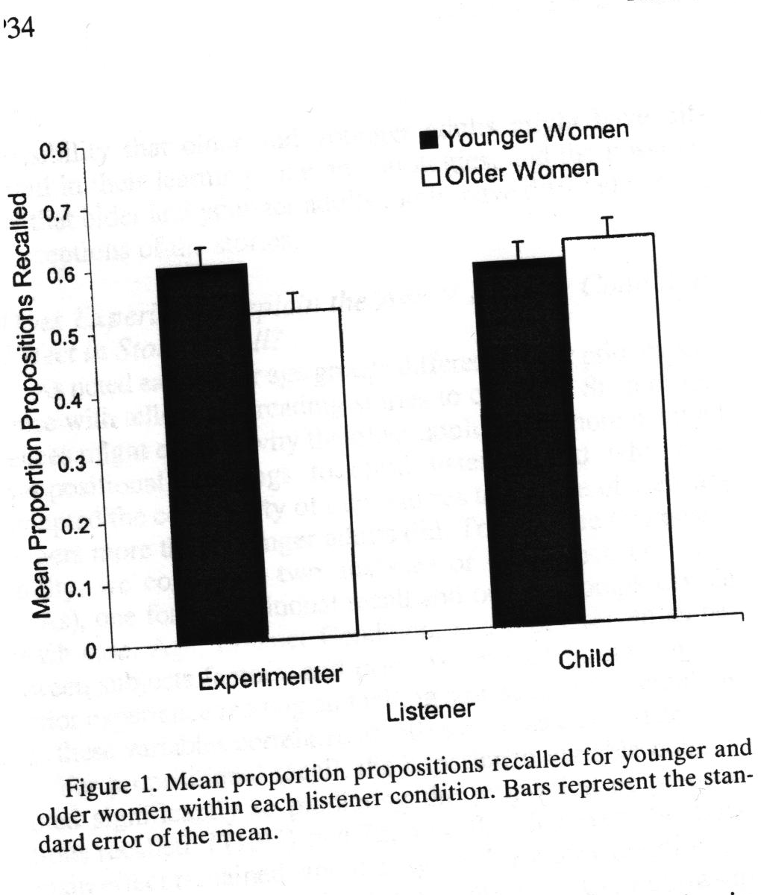

Results for Adams et al. (2002)
Notes:
younger women didn’t make very much difference in terms of how simply they told the story to the experimenter vs. the child
Older women told a much more complex story to the experimenters and a simplified version to the child
-suggests that older adults are better at presenting stories appropriately depending on the age group of listeners

Slide 11
High Point Personal Story Structure (Labov) and Age (Pratt & Robins, 1991)
Orientation: One summer at the cottage I was walking with Nancy, my grandchild.
Complicating Action: Finally the sun sank into the water, and I said it was time to go to bed. But Nancy didn’t want to go.
High Point: She said ”I’m just waiting to see the steam come from the lake.”
Resolution: From where the sun had gone in, I guess. So I finally made her understand the sun was far away, and there would not be steam. And then she came up to the cottage and happily went to bed.”
Notes:
Percentage of high point stories was significantly higher for older ppl –their stories were in good/proper form (according to Labov)

Slide 12
Story Ratings of Uninstructed Raters by Age Group of Teller (Pratt & Robins, 1991)
Controlled for WAIS vocabulary scores
Notes:
Young ppl got the lowest ratings on their stories, older ppl got the highest.

Slide 13
Predicting Story Telling Ratings
Classic high point stories = 72% above median on ratings of quality
Deviant stories (40%) = only 17% above median on ratings
Unrelated to memory span measure
Predicted by WAIS Vocabulary (r = .43)
Several studies show that older adults’ narratives are preferred, people have a stereotype that older adults are better storytellers (Ryan)
Notes:
High point stories were the ones that were judged as very good
If the story doesn’t have the proper high point form suggested by Labov, then it doesn’t get a good rating –better quality
-

Slide 14
Training and Enhancing Memory Skills
E-I-E-I-O Framework
Some General Points about Training
Additional Factors in Enhancing Memory
Notes:
-in the textbook (chapter 7)

Slide 15
The E-I-E-I-O Framework
External vs. Internal Memory Aids
Explicit vs. Implicit Memory Tasks
Some example external aids that adults might use? Assistive Cognitive Technology (ACTs), etc.
Some example internal aids that might be trained?
Notes:
Internal aids: mnemonics or songs

Slide 16
Explicit vs. Implicit Memory
Most studies have examined explicit memory training (like use of imagery, method of loci, etc.)
What would implicit memory aids look like (external ones could be special place for putting car keys, pill boxes, colour coding)?
How about implicit memory training? (not strategies, but some sort of unconscious conditioning)
Notes:
Implicit memory aid: something we don’t don’t do directly as a memory aid –always putting your keys in a certain place
Implicit memory tasks that are internal: not training strategies, but some kind of unconscious conditioning (unconsciously encouraging ppl)

Slide 17
Some Issues Regarding Training Research in General
Ease with which skill can be learned
Level of retention over time
Extent to which learned skill is generalized
What kind of research designs needed to test these questions?
Notes:
Mid term: 36 multiple choice (1/4 point each, 9 points total)
Fill-ins (9 of 10 items at 1/3 of a point each, 3 points total)
Essay: Why is the extreme age group design used so frequently in adult development and aging research? What are the limitations of this design? (choose 1 of 2 items at 3 points total)
-things talked about in lecture
-use lecture material as a guide for the chapters

Slide 18
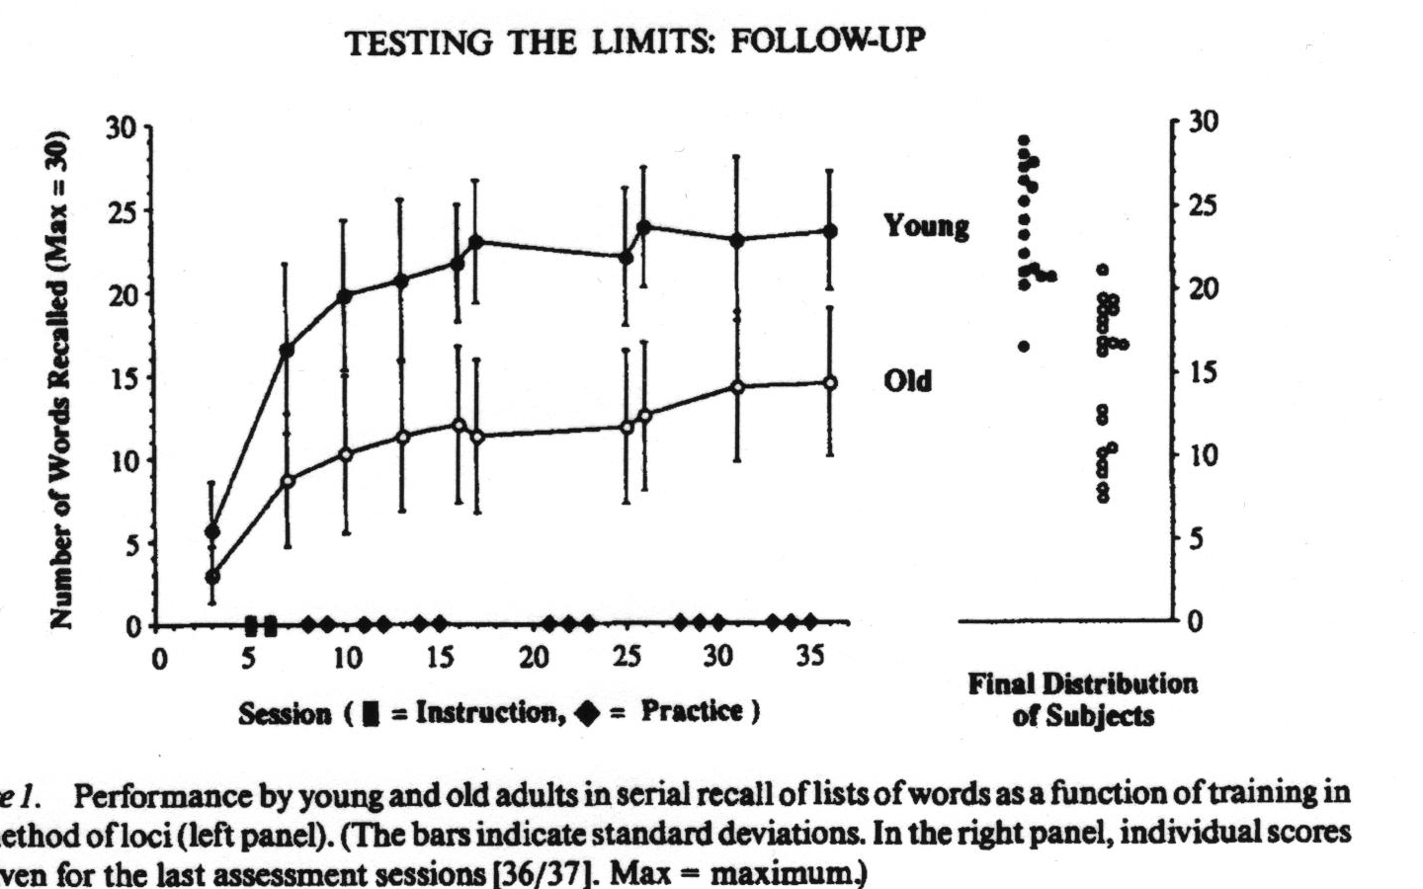
General Pattern of Results for Aging and Training Effects – Baltes and Kliegl (1992)
Notes:
Older ppl start out a little bit worse than younger ppl
-if you train older ppl they show a lot of plasticity (they learn) –shows that they have potential to improve their performance
-if you train younger ppl they learn better
This pattern of findings is quite typical

Slide 19
Engaged Lifestyle as a Buffer of Cognitive Decline in Aging (Hultsch et al., 1999) – Use It or Lose It?
Victoria Longitudinal Study
Adults (55 – 86) tested over 6 years
Tested for cognitive functions, mainly memory measures, at each time point
Measured active lifestyle (hobbies, social relations), reported health, novel cognitive processing (e.g., playing bridge, learning a language) and change in these over time
Which do you think will predict best?
Notes:
Conducted at University of Victoria
Wanted to look at what helped ppl not decline so quickly –the more you use a skill the more you retain it
Novel cognitive processing makes the biggest difference

Slide 20
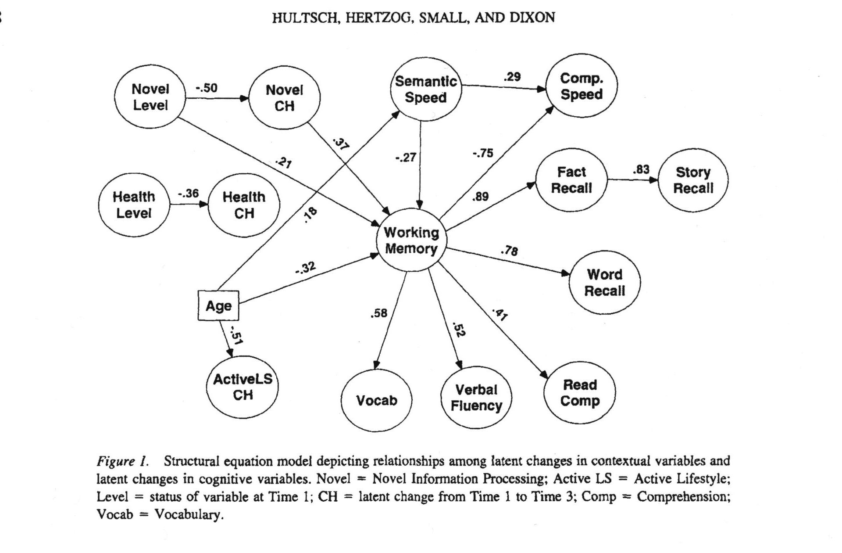
Model of Change in Cognitive Variables and Context Variables – Hultsch et al.
Notes:
In this study health and active lifestyle didn’t show any direct impact on memory performance
Novel cognitive processing showed the largest impact

Slide 21
Other Types of Interventions for Memory (despite Hultsch)
Physical Exercise – evidence of some improvement of frontal lobe functioning in older adults on tasks after fitness (brisk walking) training – fMRI studies
Brain Nutrients – gingko-ginseng vs. placebo – can buy this as a nutritional supplement at drug store – why might this work – protection from oxidation, changes in brain chemistry, etc. (but no evidence it works!)
Alzheimer’s Drug Interventions – Aricept and several other drugs on market, mostly useful at early stages…slow the progression of disease by preventing breakdown of neurotransmitter acetylcholine in cells, improving cell communication
Notes:
Early steps that have been of some help in regards to memory performance

