Slide 1
Week 10
New Technologies
Week 10

Slide 2
G20 update
http://conspiretoresist.wordpress.com/

Slide 3
Digital Nation
http://www.pbs.org/wgbh/pages/frontline/digitalnation/view/

Slide 4
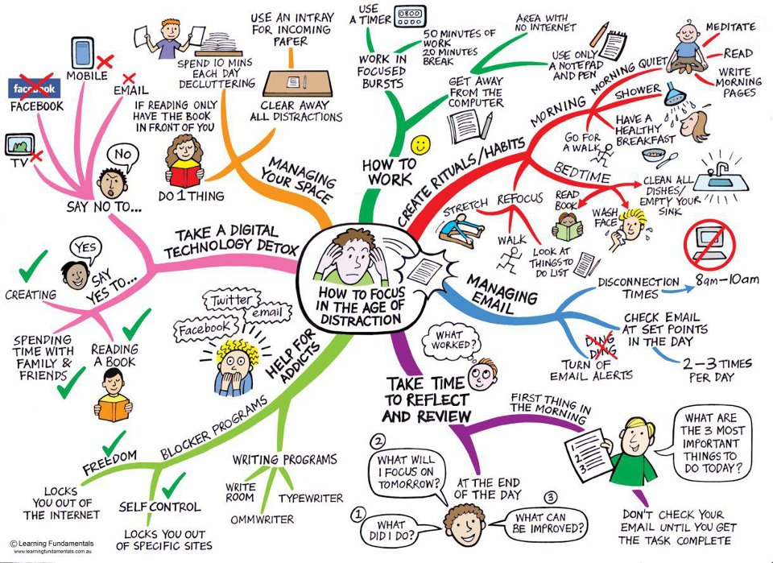

Slide 5
Ways of understanding the technology
Technological Determinism
“The medium is the message” McLuhan
assume that technology causes social change
technology = motivator for social change

Slide 6
The problem with Tech D.
No human agency
Choice of how to use
Choice in design, organization and development
Institutions have influenced
what tech is designed
how designed
how used
how understood
(military, family, religion, education, corporations)

Slide 7
Remember technology operates within specific social contexts
It’s not what technology does, but what do people do with technology
media technology and social forces that shape evolution and use - “dynamic tension

Slide 8
Technologies have own sets of limitations
both inherent in the technology itself
but also in how is it designed to be used, social decisions on applications

Slide 9
But technological a critical piece of the puzzle
but not the only piece
But use it to see organization and structure of technology – set limitations and open up possibilities

Slide 10
New media also reshape how old media is used
- Example radio reshaped in TV age

Slide 11
Brief history
- Pentagon ARPANet
(Advanced Research Project Agency Networks)
1984 William Gibson name cyberspace
1991 Tim Berners Lee develop WWW
“interactive sea of shared knowledge”
And many other innovations described in your text
(fibre optical cable, compression, wi-fi, bandwidth)

Slide 12
Internet is not broadcasting
1999: CRTC not regulate the internet
B/C 1. the internet is not broadcasting
2. it doesn’t regulate content
But regulates carriage (delivery)

Slide 13
A. More Democracy
Internet
– originally celebrated as site of democracy
– free from corporate control, from governmental control

Slide 14
New media and the news
Citizen journalism: eyewitness accounts
Citizens opinions – blogging
Democratic news? Democracy now

Slide 15
B. Less Democracy
It is becoming increasingly corporate
1. Top news stories by mainstream sources
- little recognition of alternative sites
- pressure on news outlets (speed over content)
2. Websites “own” your information and “own” your content
- your labour = information
- monetize your content
i.e turnitin.com
http://www.youtube.com/watch?v=n7U1e4B_iI8

Slide 16
B. Less Democracy cont’d
3. Corporations own / control content
i.e. The Google book project
Corporations power internet
http://www.youtube.com/watchv=R7yfV6RzE30

Slide 17
New problems with the news
“Unpublishing” news and altering online content
- longevity of information
- easy access to information
Canadian journalism project
http://www.journalismproject.ca/en/attachments/Long%20Tail%20report_Kathy_English.pdf

Slide 18
But before we celebrate - we must remember
Digital divide- technology access not equal

Slide 19
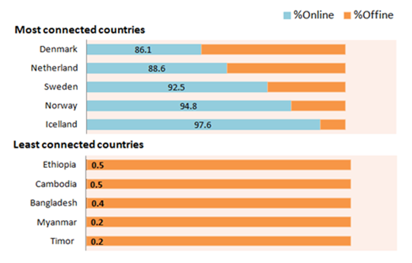
Notes:
2010

Slide 20
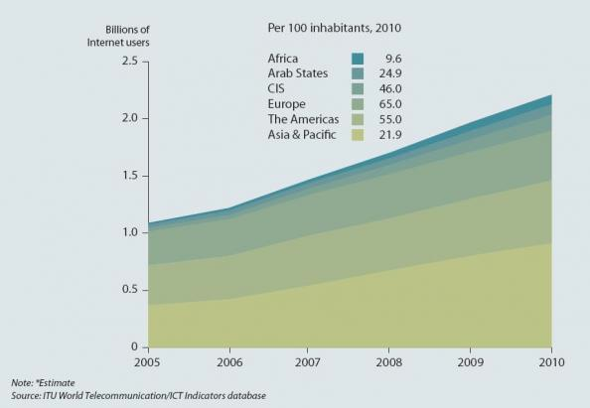

Slide 21
What is the impact of the digital divide?
Information haves and information have nots.

Slide 22
Part B: Media Effects
Debate in communication studies
Impact of media on audiences

Slide 23
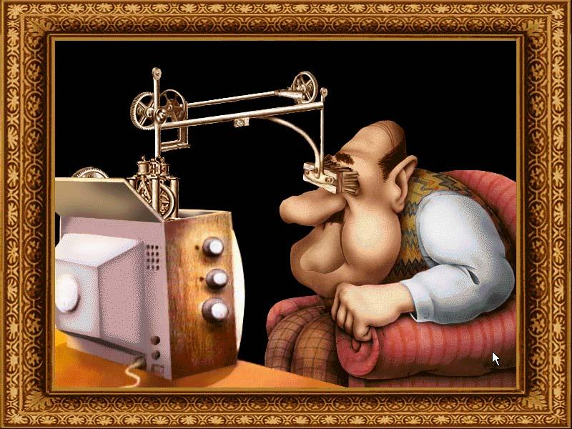
1. Media Effects

Slide 24
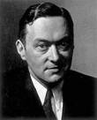
Walter Lippmann
Public Opinion (1922)
"the mass of the reading public is not interested in learning and assimilating the results of accurate investigation."
“The bewildered herd”
"the manufacture of consent"

Slide 25
Hypodermic needle
Passive audience, monolithic audience
Democratic
The media “does” something to us.

Slide 26
Minimal effects models
Two-step flow model –opinion leaders

Slide 27
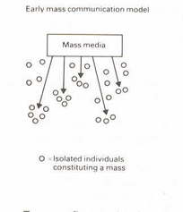
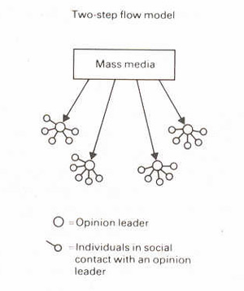
Two-Step Flow

Slide 28
Minimal effects models
Two-step flow model
Status conferral/Agenda setting
Narcoticizing dysfunction

Slide 29
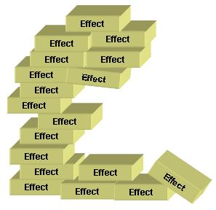
Cumulative Effects Theory

Slide 30

2. Uses and Gratifications Theory

Slide 31
Basic Functions
Surveillance
Socialization
Diversion

Slide 32
3. Socialization
teach children who to be members of society
role models
stereotyping

Slide 33
Overview
The impact (effect) of the media is not clear or straightforward.
The audience is not passive
And the impact can’t be separated from other social/cultural contexts

